Slide 1

Jeopardy
Welcome to the Bohs Jeopardy
John Steinbeck’s
Of Mice and Men.
Click to begin.

Slide 2
Choose a category!.
Take notes for review.
Click here for Final Jeopardy

Slide 3
Characters
Contents of
Plot
Themes
Figurative
Language
More Plot
Idioms
and Jobs
10 Point
10 Point
10 Point
10 Point
10 Point
10 Point
20 Points
20 Points
20 Points
20 Points
20 Points
20 Points
30 Points
30 Points
30 Points
30 Points
30 Points
30 Points
40 Points
40 Points
40 Points
40 Points
40 Points
40 Points
50 Points
50 Points
50 Points
50 Points
50 Points
50 Points

Slide 4
Who is the stable buck?

Slide 5
Who is Crooks

Slide 6
Who is the Prince of the Ranch?

Slide 7
Who is Slim, the foreman

Slide 8
Who won the Golden Glove Award?

Slide 9
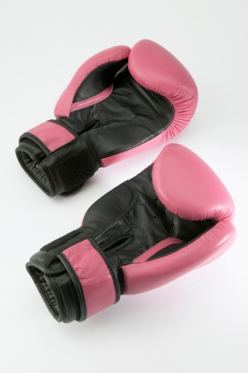
Who is Curley, the boss’ son

Slide 10
What are the characteristics of a person in authority?

Slide 11
What is :
Stetson hat
Boots with spurs

Slide 12
Who shoots Candy’s old dog and give
two characteristics of his personality?

Slide 13
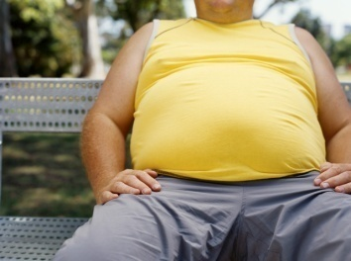
Carlson:
a big fat stomached man, a bindle bum, owns a Luger

Slide 14
Who or what is Murry and Ready and what did George and Lennie get there?

Slide 15
What is the employment agency and work tickets.

Slide 16
What is a bindle bun and who qualifies for this term?

Slide 17
An iterant farm worker and all the work hands except George and Lennie.

Slide 18
Name three symbols.

Slide 19
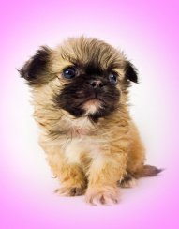
What are:
Mice and puppy
The Brush
Candy’s dog

Slide 20
What is the term for “mercy killing” and give two examples

Slide 21
What is called euthanasia:
Carlson kills Candy’s dog
George kills Lennie

Slide 22
What is the term for “deadly woman?”

Slide 23
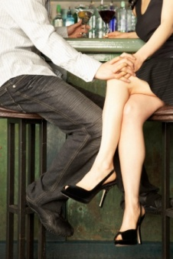
What is femme fatal

Slide 24
Name two themes and explain.

Slide 25
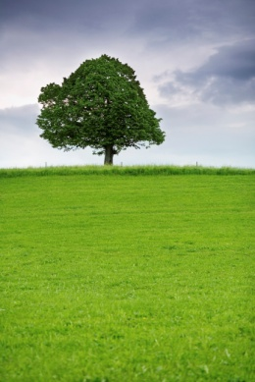
Friendship
Euthanasia
American Dream
Loneliness

Slide 26
What is the American Dream?

Slide 27
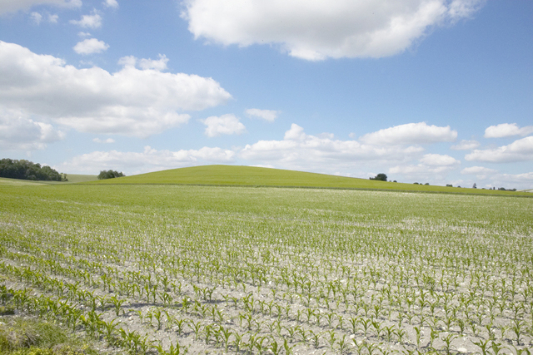
To own land, home and earn a decent living.
“live off the fatta the ‘lan”

Slide 28
Characteristics of a bindle bum?

Slide 29
One who is a transient farm worker who has no ties and no one to care for or about

Slide 30
What is the role that George assumes for Lennie?

Slide 31

What is
a surrogate mother

Slide 32
What is the climax of the novel?

Slide 33

When Lennie kills Curley’s wife

Slide 34
Name two forshadowing events

Slide 35
George tells Lennie to go to brush if he gets in trouble
Lennie says “I don’t like it here”
Lennie kills the mouse
Lennie kills the puppy
Lennie touches the girl’s red dress
Curley hates big guys

Slide 36
What is ironic about George at the end of the novel?

Slide 37
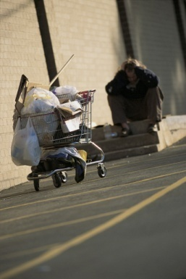
He becomes a bindle bum

Slide 38
Name an allusion.

Slide 39
The brush appears to be like the Garden of Eden
Milton’s Paradise Lost
San Quentin- high security prison (Andy Cushman)

Slide 40
What do these names mean?
George
Milton
Small
Crooks
Candy
Lennie

Slide 41
George- Tiller of the soil
Lennie- Lion- hearted
Small- Lennie is large
Milton- Paradise lost
Crooks-Crooked back
Candy – Sweet old man

Slide 42
What is ironic about the characters who did not go into town, name them, and give disability.

Slide 43
Who are:
Lennie- M, S
Crooks- P, S
Candy- P, S
Curley’s wife- S

Slide 44
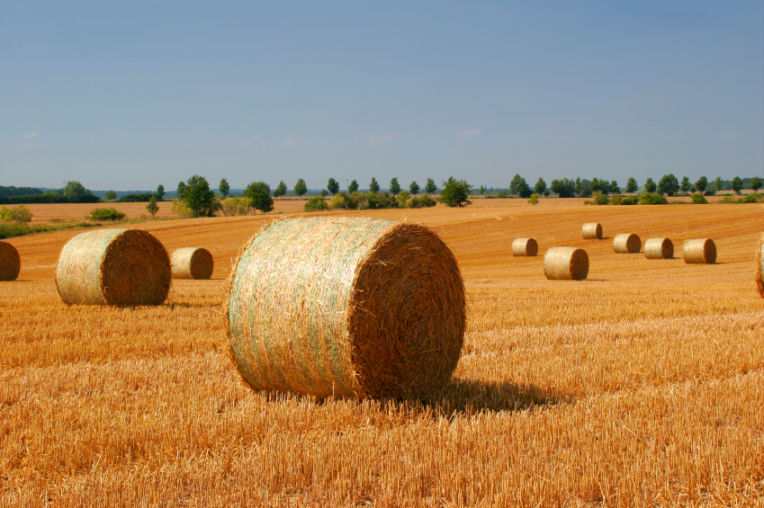
Who serves as the anomaly on the Tyler Ranch and why?

Slide 45
Who are George and Lennie because they have each other to care for, unlike the other bindle bums

Slide 46
For what two things is John Steinbeck known, regarding our novel?

Slide 47
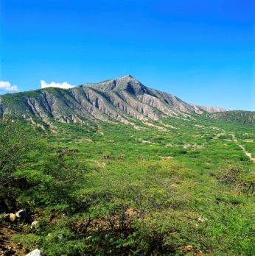
What is:
Born Salinas Valley, CA
Received Noble Prize for literature
Wrote about the underdogs or the downtrodden

Slide 48
From where does the title of the novel come?
Poet
Title
lines

Slide 49
Robert Burns
“To a Mouse”
The best laid plans of mice and men
Often go astray

Slide 50

Give two characteristics of Steinbeck’s novel.

Slide 51

1.Animal imagery
2. Symbolism of names
3. Excellent use of descriptive scenery.
4. Easily adapted to the genre of a play
5. Circular – starts and ends at the brush

Slide 52
Describe a “small-man complex” and who displays this on the ranch?

Slide 53
If Curley beats up a big guy, everyone will be impressed with him
If Curley gets beat up by a big guy, everyone will feel sorry for him
Win-win situation

Slide 54
Who and what is a Jerkline Skinnner?

Slide 55
Slim is a mule skinner who runs the grain teams

Slide 56
Who and what is a Swamper?

Slide 57
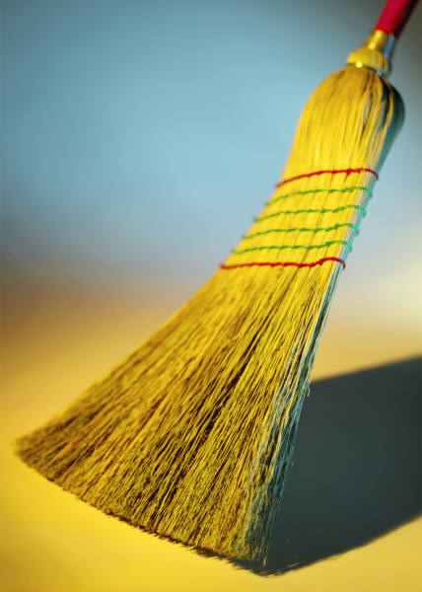
Candy is the swamper who sweeps up around the farm

Slide 58
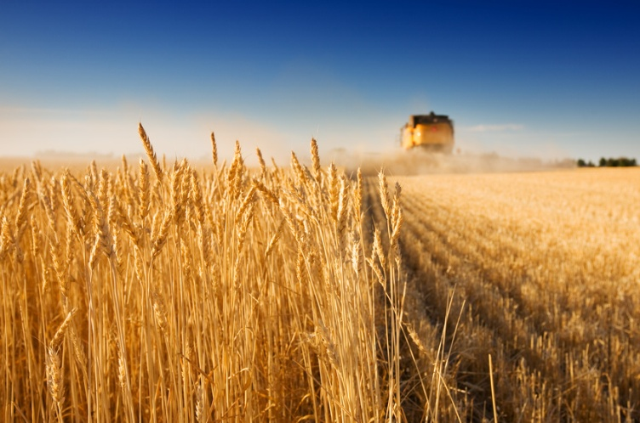
Who and what is a barley bucker?

Slide 59
All the men who harvest the barley are buckers.

Slide 60
Who and what is a stable buck?

Slide 61
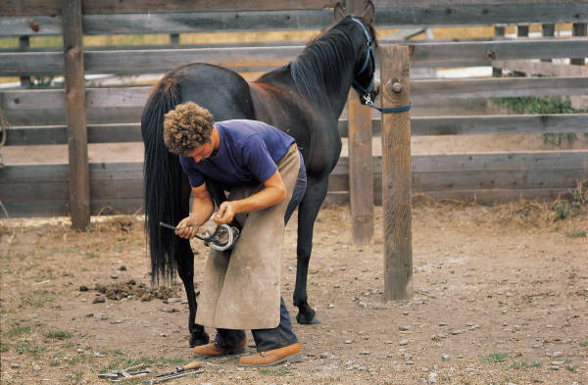
Crooks is the stable buck who lives in the barn and takes care of the horses.

Slide 62
What scene proves that the boss can be nice sometimes?

Slide 63
The boss gave the bindle bums whiskey and Smitty and Crooks fought.
Smitty had his legs tied up so that it would be a fair fight.
Crooks won.

Slide 64
Final Jeopardy
Make your wager

Slide 65
Who is Andy Cushman and what story does George tell us about him. Name the allusion used in the story.

Slide 66
He married a tart and ended up
in San Quentin, a famous prison.
George reminds Lennie to stay
away
from Culey’s wife.

