Slide 1


Macbeth
By William Shakespeare

Slide 2
Ye Olde Permission Forme for Studying Shakespeare
As we explore the play, please remember that Shakespeare wrote Macbeth to be performed; he wrote each of his plays with the expectation that it would be brought to life on stage, to be enjoyed by an audience watching the performance. With this in mind, we will be reading the play (as a play) and concurrently watching the movie. And, most importantly, don’t worry if you don’t understand every single word (neither do I)!
Here's the plan for this unit...
You will be reading Macbeth, doing plenty of thinking and talking about the play,
and completing the following assignments:
Symbolism & Imagery Poster (15%)
Character Analysis (15%)
Thematic Writing Assignment (25%)
Writing/Discussion/Quizzes (20%)

Slide 3

Quick Write: Guilt & Greed
This introductory activity to allow you to explore themes and ideas in Macbeth before we read the text. By having you think about your own situations where you have faced guilt, perhaps you will be able to relate to the play once you have read it...

Slide 4
Quick Write: Guilt & Greed
Write about whether or not you have ever gotten away with doing something wrong. Did you feel guilty about it? Would you rather have been caught?
Elaborate on your response by thinking about how you felt, what you would do if you were in that situation again and whether or not you had any outside influences other than their own intuition.

Slide 5
Hail, thou wanton, shag-eared scullions! Thine eyes have not yet drunk a thousand words and yet thou knowest that thou art about to embark on a study of Macbeth!
But Seriously...
Why is it that you’ve heard many of the play’s more familiar lines?
or example: “Out damned spot…” “Double, double, toil and trouble” “Fair is foul and foul is fair”
Why is it that the name Shakespeare strikes fear into the hearts of so many students? And why do so many other students love his plays? And (really this is the big question) why are we still studying Shakespeare more than 400 years after his death?
Please write your musings to these questions on your worksheet

Slide 6
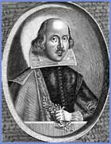
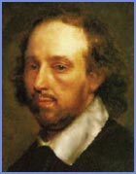
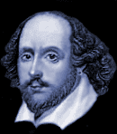
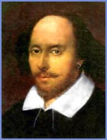
Act One: Shakespeare’s Life
For somebody so famous, we know relatively little about Shakespeare’s life. We do, however, know a great deal about Shakespeare's work and the times in which he lived.
Let’s watch short video about Shakespeare's life.

Slide 7
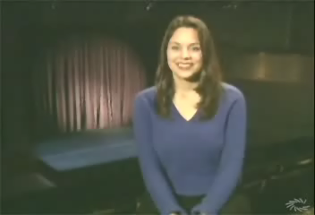

Slide 8
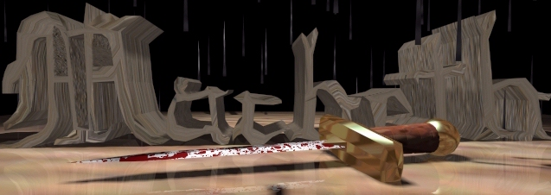
“By the pricking of my thumbs,
Something wicked this way comes.” IV,i,44-45

Slide 9
Scene Summary
Before each scene, I will give you a quick introduction to what will happen as well as one or two guiding questions. Use these questions to focus your reading. Sometimes, I will direct you to participate in some discussion about the scene. After each scene, you will take a quick quiz to check your understanding. If you want to, you can also check the more detailed scene summary (in book or on the handout)

Slide 10
An Introduction
In 1606 William Shakespeare, the Bard of Avon, wrote a play which would go down in history as the cursed Scottish play after numerous mishaps during production. It was written for his new patron, James I (James VI of Scotland), following the death of Queen Elizabeth. James was interested in witchcraft and Scotland, and hence the themes in the play. Banquo is James's ancestor. The play itself tells the story of a man, urged by his wife and foretold by prophecy, who commits regicide in order to gain power.

Slide 11
Was there really a Macbeth?
Yes!
King Duncan and Macbeth interacted with each other in August 1040
Macbeth was a real king of eleventh-century Scotland, whose history Shakespeare had read in several sources, principally the Chronicles of Holinshed, to which he referred for many of his other historical dramas.
As for the personalities of the two main characters, Duncan and Macbeth, -Shakespeare's portrayal is not historically correct.
However, it has to be asked - who would have heard of these two Scottish kings had it not been for Shakespeare and the 'Scottish Play'?

Slide 12
Refer to the play only as
“The Scottish Play”
Macbeth is surrounded with “bad luck”
Many actors have been injured while playing Macbeth
Could it be the witches? That’s what some believe!
Just to be safe, refer to Macbeth only as “The Scottish Play”!

Slide 13
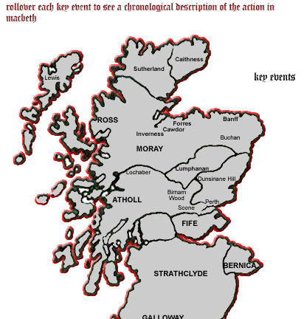
The Setting
The general setting of Macbeth is tenth and eleventh century Scotland.
Since the play was performed long ago in a simple open theater, backdrops were not used and there were only a few props. Most of the scenery had to be imagined by the audience. Since backdrops could not be used to create mood and atmosphere, the atmosphere had to be created by the few props they used and by the acting of the actors. For example, a cauldron would have been used in the first scene with the witches, and it would have served to create a mood of evil foreboding.

Slide 14
The Characters
As we learn about the characters from the play, you will be expected to complete a character profile on one of the characters from the play. I will provide you with a character analysis for each scene of the play…you may find this useful for your characterization.
By using direct and indirect characterization methods, describe characters traits using specific examples from the play. Remember to use quotations when taking lines from the play.
Note what type of character he/she is (ie, flat, round, stock…) and why.
Note the function of the character in the play (minor character, protagonist, antagonist, major)

Slide 15
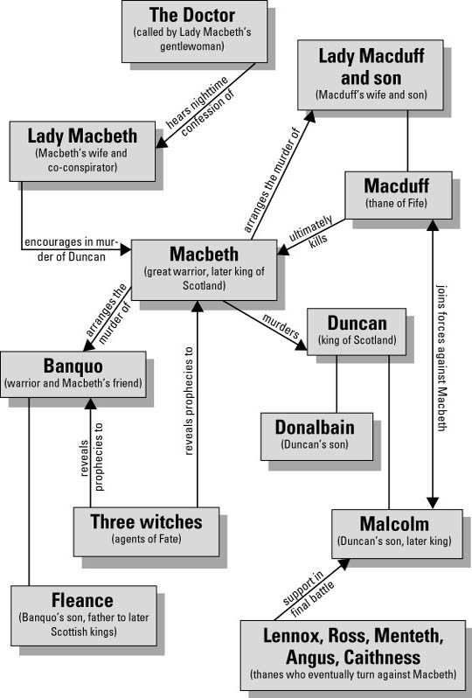
Character Map: Macbeth

Slide 16
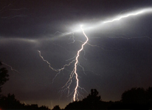
Act One Scene One:
Setting the Stage
This opening scene not only quickly captures our attention, but also sets the atmosphere of the play. The scene opens on a barren, deserted, and unspecified place. Amidst thunder, lightning, and fog, we are introduced to three supernatural creatures. They are referred to as Witches. The Witches plan to meet Macbeth when the “hurlyburly’s done,” but their purpose remains unspoken, creating a sense of mystery and suspense.
The last two lines of the scene, “Fair is foul, and foul is fair. Hover through the fog and filthy air,” introduce a principal theme of the play: the discrepancy between appearance and reality.

Slide 17
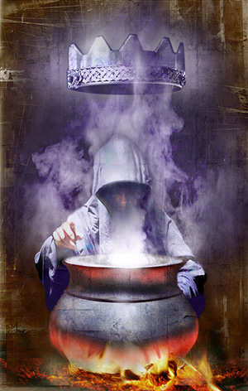
Act One Scene One
Guiding Question: What might the last two lines of this scene foreshadow?
A barren, misty heath in Scotland
Thunder and lightning
Enter Three Witches…Lets read the scene

Slide 18
Note of Interest
Note that the last two lines are a rhyming couplet. Most scenes in Shakespeare’s plays end this way.
This serves a twofold purpose: first it acts as a signal that the scene is ending, and secondly, because the end rhymes are emphatic, it enables the scene to end on a climatic note.

Slide 19
Purposes of Act I, Scene I
1. The presence of the supernatural—as symbolized by the witches—would prove a thrilling interest to a Shakespearean audience. The scene serves to attract and hold the attention of the audience
2. It mentions Macbeth and begins the dramatic build-up which prepares us for his arrival on the stage
3. It foretells the mood and strikes the keynote of the play: human struggle against the forces of evil

Slide 20
Character Analysis Act I, Scene I
The witches are introduced associated with unwholesome objects…the familiar or attendant spirit of the first witch is a cat, of the second a toad, of the third an unknown—possibly Hecate
The number three plays an important part in the play. Its association with the three witches gives the number 3 a supernatural significance

Slide 21
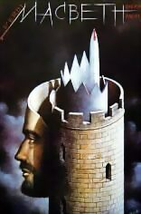
Act One Scene Two:
Setting the Stage
This scene gives a strong impression of Macbeth’s character. We learn, through reports of two different battles, that Macbeth is a bold and valiant general, relentless and ruthless in combat, and valued highly by his king and country. Macbeth obviously has the potential for greatness. It is essential in a tragedy to establish the protagonist as a worthy hero. Otherwise, the death of the protagonist will not seem like a tragic loss.
This scene also shows us Duncan, a king who has proven himself to be a poor judge of character—he trusted Cawdor and was betrayed by him. However, Duncan is also a gracious king who gives Cawdor’s forefeited title to Macbeth as a reward for his efforts during the war.

Slide 22
Act One Scene Two: Purposes
1. It continues the dramatic build-up for Macbeth before he makes his appearance on stage
2. In showing the unsettled and rebellious conditions in Scotland, it reveals Duncan as a mild and benevolent man, but a weak and unfit king.
3. It reveals the ability and the power of Macbeth and prepares us for his royal aspirations.
4. It reveals the association between Macbeth and Banquo
5. The gift of the Cawdor title serves as an impulse to encourage Macbeth’s criminal ambitions
6. The audience is introduced to characters of secondary importance: Duncan, his sons Malcolm and Donalbain, Lennox, and Ross (who is to be the carrier of messages throughout the play).

Slide 23
Act One Scene Two: Character Analysis
Duncan: A weak king; a mild and benevolent man; his generals make peace terms without consulting him
Malcolm: Older son of the king; too young to fight, but had been in a position of some danger, “fought ‘gainst my captivity.”
Macbeth: Mentioned but does not appear in the scene(1) is brave (2) strong physically (3) inspiring leader and brilliant general (4) accustomed to assume authority since he has already made terms with Sweno, King of Norway.
Ross: Makes his first appearance as news carrier of the play; he is a nobleman and speaks in picturesque poetic language.

Slide 24
Act One, Scene Two
Guiding Question:
This play has many words and phrases that echo throughout the various scenes. Look at the last line of this scene and find what it echoes in the first scene of this play.

Slide 25
Note of Interest
Line 41: cannons
In Macbeth’s day, cannons had not yet been invented. Shakespeare often includes details in his plays which are outside of their proper time period. For example, we have references to clocks in the Roman world of Julius Caesar. These errors in chronology are called anachronisms. (see your list of terminology)
Shakespeare’s inclusion in such details made the plays more topical and accessible to the audiences of his time.

Slide 26
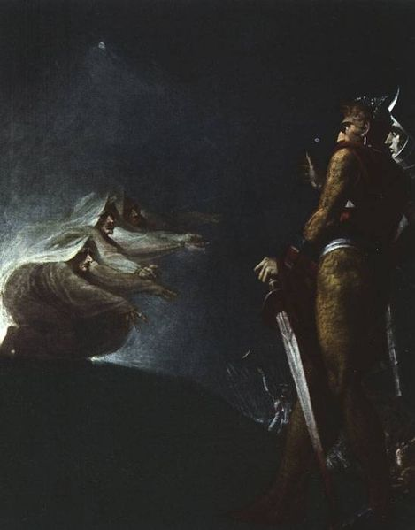
Act One, Scene Three:
Setting the Stage

Slide 27
Act One, Scene Three:
Setting the Stage
The Weird Sisters open this scene by recounting what they have been doing since their meeting in scene one. It is obvious from their activities that they should not be trusted.
Macbeth’s very first words in the play recall the Weird sisters’ closing lines in scene one. He receives fair prophecies from them, but responds with fear rather than joy. This might suggest that Macbeth had been plotting the assassination of Duncan well before the announcement of the Weird Sisters.
Macbeth puts aside the thought of murder. He hopes to become king without having to kill Duncan. Again, it is important for Shakespeare to establish that Macbeth has elements of goodness. At this moment, he is not a ruthless traitor.

Slide 28
Act One, Scene Three
Guiding Questions:
What supernatural powers do the Witches seem to have?
What evidence is there in Macbeth’s speech (lines 139-154) that he has entertained the thought of murder before the predictions of the Witches?

Slide 29
Note of Interest
Line 6, Aroint thee, witch—this scene contains the only reference in the text to a “witch.” Nowhere else are the three women referred to as witches except in the stage directions and the may not have been written by Shakespeare. Holingshed makes it clear that they are Fates or goddesses of destiny. In the play, they are referred to as the Weird Sisters.

Slide 30
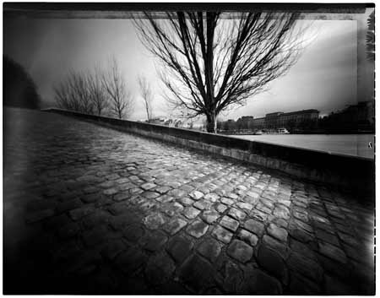
Dramatic Irony
Dramatic irony is created when the audience or the readers have knowledge of a character’s present (or sometimes future) circumstances that the character does not.
Throughout the play Macbeth, we in the audience are privy to information the characters in the play do not know. Take note of the examples of dramatic irony you find in the play.

Slide 31
Purposes of Act 1, Scene 3
1. The greetings of the witches to Macbeth furnish a motivating force to the drama and mark the beginning of the complication of the play.
2. It introduces two of the major characters in the presence of Macbeth and Banquo
3. It reveals the connection between Macbeth and the witches
4. Macbeth, by his being startled, reveals that the witches had read his thoughts and that he already possessed ambitions to be king.
5. It contrasts the characters of Macbeth and Banquo, and reveals that Banquo, although loyal to King Duncan, is also loyal in some degree to Macbeth. This scene can be called temptation scene since both Macbeth and Banquo are being tempted by the lure of the prophecies.

Slide 32
Characterization
Macbeth: Ambition is the first quality revealed; he reveals the idea of the murder of Duncan has already occurred to him—“My mind whose murder is but fantastical.”; the witches are an embodiment of his own evil ambitions…they startle him because they read his mind; He makes an effort to fight his ambitions by trying to keep from believing the witches.
Banquo: Has some justification for being ambitious also, for this reason, he too sees the witches; his ambition is not as strong as Macbeth’s and he is content that kingship should fall on his decendends.
Ross: appears once more bringing Duncan’s message to Macbeth.

Slide 33
Act One, Scene 4:
Setting the Stage
Upon hearing of the noble manner in which the traitor Cawdor faced his death, Duncan echoes the main theme of the play when he declares that “There’s no art/To find the mind’s construction in the face.” This emphasizes Duncan’s greatest weakness—his inability to judge character. Duncan then shows the generous side of his nature when he praises and rewards Macbeth and Banquo for their loyalty.
Macbeth’s resolution to wait till chance crowns him king is tested when Duncan announces that Malcolm is heir to the throne. This is the first of many scenes that depends on dramatic irony for effect.

Slide 34
Act 1, Scene 4
Guiding Questions:
Point out two examples of dramatic irony in this scene.
. Give examples to show Duncan’s weakness and unfitness to be king.

Slide 35
Note of Interest
Line 46: Prince Cumberland—the rule of succession had not yet been established by Macbeth’s time. Kings were elected in Scotland, and only the most powerful of persons could attain the throne. If a king felt that his will would be executed event after death, he could do so as Duncan does—name his heir by declaring him Prince of Cumberland.

Slide 36
Act 1, Scene 4: Purposes
1. In Duncan’s nomination of Malcolm as heir to the throne we have a way prepared for a line of action by Macbeth. That line, of course will lead Macbeth to murder.
2. We are preparing for the introduction of Lady Macbeth
3. It reveals further Duncan’s unsuitability for the kingship, and makes Macbeth stand out favourably in contrast.
4. It reveals court life and Macbeth’s ease in courtly procedures.
5. There is dramatic irony in Duncan’s comment upon the impossibility of judging a man’s character from his appearance being followed by the immediate arrival of Macbeth

Slide 37
Act 1, Scene 4: Characters
Duncan: Poor judge of character; over-emotional and too weak to be a capable king
Malcolm: Seems to be well-informed about what is going on; makes an intelligent and clear report of Cawdor’s death
Macbeth: Is revealed here as the polished nobleman, skilled in the art of courtly talk; his elaborate language lacks the forthright sincerity of Banquo’s short remark; plays part of humble and loyal servant of king while confident in his mind that fate will give him the throne; quickly changes his plan to murder and hastens to his home when Duncan announces his successor is to be Malcolm.
Banquo: His one short speech is straightforward and sincere; he is not jealous of Macbeth.

Slide 38
Act One, Scene Five: Setting the Stage
Scenes one and three involve the Witches, while Scenes two and four feature Duncan and Macbeth. If the pattern is to continue, this scene should involve the Witches again—and in a way it does. Lady Macbeth’s vocabulary and resolve (manner) clearly remind us of the Witches.
Lady Macbeth fears that Macbeth is “too full of the milk of human kindness” to take the quickest route to acquiring the throne. This serves once again to reinforce that Macbeth is not yet a ruthless murderer. His wife takes it upon herself to persuade Macbeth to go through with the assassination of Duncan.
Macbeth arrives and his wife assures him that “This night’s great business” shall result in attaining “sovereign sway and masterdom.”
This scene also contains at least two pieces of evidence that suggest Lady Macbeth intends to kill Duncan herself.

Slide 39
Act One Scene Five
Guiding Question
1. What characteristics are revealed about Macbeth and Lady Macbeth?

Slide 40
Act One, Scene Five:
Portraying Lady Macbeth
There are different ways of interpreting Lady Macbeth’s character, but two portrayals have predominated. One view holds that she is like a fourth Witch, utterly evil and ruthless. She bullies and intimidates Macbeth until she gets what she wants. The other view holds that she is able to influence Macbeth because of her beauty and seductive charm.
While we read this scene, note what Lady Macbeth’s chief motivations seem to be.

Slide 41
Act One, Scene Five:
Note of Interest
Line 56, blanket—perhaps a reference to a stage convention of the Elizabethan period. According to Clarendon, “When tragedies were represented, the stage was hung with black…on the same occasion, the Heavens, or the Roof of the stage underwent likewise some gloomy transformation.”

Slide 42
Act One, Scene Five:
Purposes
1. Introduces Lady Macbeth and indicates at once her strength of character.
2. She reveals Macbeth’s basic weakness of character, and that is his inability to pursue a course of action if he allows his mind to concern itself too much with the thought of that action
3. In Lady Macbeth’s soliloquy, Shakespeare permits a passage of time to enable Macbeth to travel from the king to his castle…this is for dramatic credibility.
4. It reveals the bonds of affection existing between husband and wife…In that way the two are made plausibly human, and their crime becomes all the more dreadful because of that. These people are not monsters, they are human beings.
5. The plot of the play leading to the death of Duncan advances rapidly

Slide 43
Act One, Scene Five:
Character Analysis
Lady Macbeth: Strong will and character; ambitious—but for her husband, not for herself; knows her husband’s character and is capable of dominating him; shows a hardness and cruelty; loves her husband and greets him proudly
Macbeth: Loves his wife; his character is revealed in Lady Macbeth’s soliloquy; he has aspects of nobility but is capable of crime for gain but does not want to be discovered; he is ambitious, but would like to achieve his ambition without evil; he is hesitant and shows a basic weakness of character in seeking to put off the murder of Duncan---once again his “function Is smother’d in surmise.”

Slide 44
Act One, Scene Six:
Setting the Stage
This is one of the few daylight scenes in the play. The day is fair, and Duncan expresses how much he likes the look of Dunsinane and its surroundings. Lady Macbeth plays the role of gracious host, and Duncan responds with additional warm words. But we see the irony of the fair weather, the fair prospect, and the fair words, because we know that the Macbeths are planning a foul murder and that Duncan is approaching the place of his death.

Slide 45
Act One, Scene Six:
Setting the Stage
Guiding Question:
Point out two instances of dramatic irony in this scene
What qualities of character are revealed in this scene by Lady Macbeth and King Duncan?

Slide 46
Act One, Scene Six:
Purposes
1. In the calmness of this scene we have a release from the nervous tension of the preceding scene and a slight pause before the tension of the scene which are to follow
2. Duncan is brought into the power of Macbeth and his wife.
3. It reveals a courtliness and graciousness of manner in Lady Macbeth that prepares us for her fine regal bearing when once she has become queen
4. It heightens the dramatic interest by its dramatic irony and the irony of the situation.

Slide 47
Act One, Scene Six:
Character Analysis
Duncan: Once more reveals his weakness or unfitness to be king in his complete inability to suspect what is going on; for purposes of dramatic effectiveness his character must gain the sympathy of the audience so that the crime of his murder will seem greater; by the same token, Macbeth must begin to lose sympathy of the audience.
Lady Macbeth: A polished and gracious host; possesses charm, dignity and potential human warmness…Shakespeare has 2 reasons for showing this aspect of her character (a) by contrast it makes her guilt in the murder more brutal and inhuman (b) is in keeping with her regal bearing when she is keen.

Slide 48
Act One, Scene Seven:
Setting the Stage
In Macbeth’s first true soliloquy, he talks himself out of killing Duncan. He is not afraid of being damned, but he does worry that he will suffer the same fate as Duncan. He also admits that he is driven by ambition. This his tragic flaw. When he informs his wife of his decision, she shames him into renewing his resolve to kill Duncan. She also reveals more details of her plot.
This scene serves to emphasize once again that Macbeth is not unremittingly evil. He does not rush headlong into murder. He has scruples and a conscience.
Decide for yourself who or what is most responsible for the bloodshed that occurs in the play. Is it Macbeth himself? Is it Lady Macbeth? Or is the influence of the “instruments of darkness”?

Slide 49
Macbeth’s Soliloquy
Soliloquy: A soliloquy is a speech made by a single character alone on stage. The character reveals his or her thoughts, feelings and motivations in such a speech.

Slide 50
Act One Scene Seven
Guiding Question
What reasons does Macbeth give for not continuing with the crime?
Analyze Lady Macbeth’s method of winning back Macbeth to proceeding with the murder.

Slide 51
Act One, Scene Seven:
Purposes
It reveals once more the weakness in Macbeth’s character that renders him incapable of action when his mind is preoccupied with thoughts of that action.
It shows again Lady Macbeth’s strength of character and her understanding of her husband’s weaknesses.
Macbeth’s indecision adds an element of dramatic suspense.
It wins even more of the sympathy of the audience for Duncan when it repeats his good qualities, and in that way heightens the cruelty of the crime of his murder
It shows that Macbeth’s indecision is set aside and prepares the audience for the murder in the next act.

Slide 52
Act One, Scene Seven: Media Connection
Roman Polanski’s version of Macbeth:
In Polanski’ view, Lady Macbeth uses her femininity to convince Macbeth to go through with the plot. However, this is not the decisive influence. In the movie, Malcolm gestures to Macbeth to pour wine for him. This indicates the role that Macbeth will have to play if he does not kill Duncan—he will be Malcolm’s subject and servant.
Be prepared to take a quiz on Act I next class.

Slide 53

Macbeth: A Tragic Hero
A tragic hero suffers his downfall as a result of “hamartia” or a tragic flaw. This is a flaw in his personality, some quality that in excess (too much pride, too much ambition, for example) leads to his own death and probably the deaths of many others. What do you think Macbeth’s
tragic flaw might be?

Slide 54
Act Two: Tragedy, Comedy & Historical Plays
Shakespeare’s plays fall into a number of categories, including tragedy, comedy and history, as well as “the problem plays” (considered problems because they don’t fit into one of the first three categories!). Many of Shakespeare’s best known plays, including Hamlet, King Lear, Macbeth and Romeo and Juliet, are tragedies. In a tragedy, the main character undergoes a reversal of fortune due in large part to his “tragic flaw”, a flaw in his character that leads him into misery. Shakespearean tragedies tend to end with a great number of dead bodies on the stage.
Shakespearean comedy, on the other hand, is characterized by a humourous mix ups and mistaken identity, and ends happily, with weddings instead of dead bodies. A Midsummer Night’s Dream and Much Ado About Nothing are good examples of Shakespearean comedies.
The history plays are based on the lives of English kings.
Let’s watch a short clip about tragedy.

Slide 55
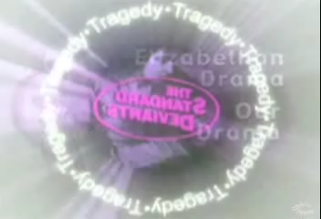

Slide 56
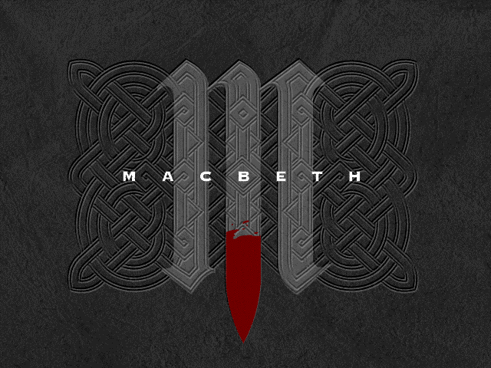
Act Two

Slide 57
Act Two : Scene One

Slide 58
Act Two, Scene One: Setting the Stage
Macbeth, still playing the part of the gracious host, speaks with Banquo before bidding him goodnight, mentioning that he would like Banquo to join him in some exploit. Banquo replies that he will consier it as long as he can retain a clear conscience. It is interesting that in Holinshed’s Chronicles, Banquo does indeed help Macbeth murder Duncan.
Macbeth hears the all-clear signal and proceeds towards Duncan’s chamber. One of Macbeth’s greatest weaknesses is his vivid imagination. His vision of a dagger floating in the air raises a difficult question: is it a “dagger of the mind, a false creation” or is it real, perhaps sent by the Witches to spur him on to his deed? The last 14 lines of his soliloquy include numerous references to and images associated with witchcraft.

Slide 59
Act Two, Scene One:
Temporary Insanity?
Some murderers talk to themselves about the crime they are planning to commit or claim to hear voices or see visions spurring them on. Do you think Macbeth might have been temporarily insane when he murdered Duncan?

Slide 60
Poetry inspired by Macbeth, page 150
Questions to consider:
1.What metaphor does Newall develop in her poem?
Metaphor: A direct comparison between two unlike things. An
extended metaphor is a comparison which is drawn out or is central to a poem. Simile and personification are types of metaphors.
2.Does the shape of Newall’s poem relate to its content in any way?
3.Read the two poems again, as well as the limerick on page 151. How do the three poems portray Macbeth? Lady Macbeth?

Slide 61
Act Two, Scene Two: Setting the Stage
The king’s guards are stupefied with drink, but Lady Macbeth claims that the liquor has only made her bolder. Her bravado is immediately shown to be hollow, however, when the shrieking of an owl deeply startles her. This reaction foreshadows her breakdown later in the play. She reiterates that she would have killed Duncan herself if he had not looked so much like her father.
Macbeth appears and is even more shaken that his wife. He is convinced that he has “murdered sleep” (his peace of mind) by stabbing Duncan. His confusion and remorse remind us that he is not utterly ruthless.

Slide 62
Act Two, Scene Two: Setting the Stage
Lady Macbeth berates her husband for not leaving the daggers at the scene of the murder. Because Macbeth is unwilling and unable to return the daggers, Lady Macbeth herself takes them to Duncan’s chambers, at the same time smearing the faces of the guards with Duncan’s blood. Macbeth hyperbolically claims that his bloody hands could turn all the seas read. Lady Macbeth, using understatement that will prove to be ironic, maintains that a little water will be sufficient to was away the deed.
The sound of knocking at the gate reminds them that they should return to their beds to make it appear that they have been sleeping. As they exit, Macbeth wishes that he could undo the murder.

Slide 63
Act Two, Scene Two: Prediction
Question:
How does Macbeth and Lady Macbeth feel about Duncan’s murder immediately after it has been committed?
Predict how these characters might behave, what attitudes they might have, and what choices they might face throughout the play, based on their guilt or lack of guilt.

Slide 64
Act Two, Scene Three: Setting the Stage
The knocking heard in the previous scene continues into this scene as the Porter makes his way towards the gate of Macbeth’s castle. During the Elizabethan period, the Porter would have been played by the clown in the acting company. In a tragedy such as Macbeth, the clown’s role was to provide comic relief, but the clown’s speeches would usually contribute to the theme of the play as well. In this case the Porter focuses on equivocation—saying one thing and meaning another—which is tied into the theme of discrepancy between appearance and reality.

Slide 65
Act Two, Scene Three: Setting the Stage
Macduff and Lennox enter and are soon joined by Macbeth. Their conversation about Duncan’s intention to depart and the “unruly night” is evidence that Shakespeare was a master of understatement and dramatic irony.
Duncan’s body is discovered by Macduff. The alarm is sounded, and the news of Duncan’s murder is made public. Macbeth visits the scene of the crime. When he returns, he tells Macduff an the others that, overcome with rage, he has killed Duncan’s guards. It is notable

Slide 66
Act Two, Scene Four: Setting the Stage
Several days have passed since the murder of Duncan. Ross converses with an old man about the unnatural events that occurred on the same night that Duncan was assassinated. The Elizabethans believed that any serious disruption of the natural order of the universe would lead to an outbreak of disturbing and unnatural occurrences, such as those described by Ross and the Old Man.
Macduff appears and he mentions that Malcolm and Donalbain have been accused of hiring the guards to murder the king. Macduff also reports that Macbeth has been named the new king. Ross decides to go to the coronation, but Macduff declines the opportunity and returns home to Fife. We see that Macduff is already distancing himself from Macbeth, though no reason for his attitude is given

Slide 67
The Imagery of Macbeth
Imagery: Vivid descriptions that appeal to the senses—sensory or image-rich language. “The yellow moon hung in the black sky” is an example of visual imagery.
Read : “The Imagery of Macbeth”
Complete the review questions (Imagery & Macbeth) & activity

Slide 68
Act One: The Language of Shakespeare
The hardest thing about reading Shakespeare is the language. In the more than 400 years since Macbeth was written, the English language has evolved, so that many words used in Elizabethan time have fallen out of usage and are now unfamiliar to us. In addition, much of Shakespeare’s work is written in blank or rhymed verse, adding an extra level of difficulty. Just remember that you want to get a good sense of what is happening and if you don’t understand every word, it’s okay! And, if it’s any consolation, it does get easier
Lets watch a short video about The Language of Shakespeare.

Slide 69
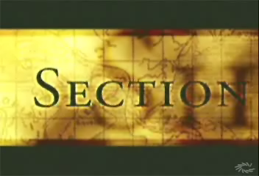

Slide 70
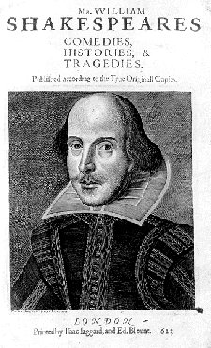
Act Three
Quotable Quote:
“Avaunt, and quit my sight! Let the earth hide thee? Thy bones are marrowless, thy blood is cold; Thou has no speculation in those eyes
Which thou dost glare with.”

Slide 71
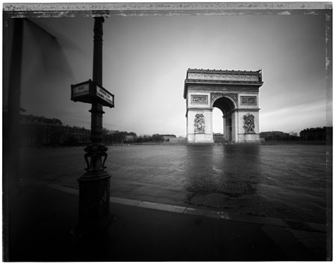
Act Three, Scene One
If your remember, at the end of Act II, Banquo vowed that he would fight against “treasonous malice.” That fact that the had done nothing since then does not speak well for his character. In this scene, Banquo, in his only soliloquy, expresses his suspicions about Macbeth, but remembers that the Witches prophesized that he, not Macbeth, would father a line of kings. It now seems that he is more concerned with what the Witches promised him than he is abou the possibility of Macbeth’s wrongdoings.

Slide 72
Act Three, Scene One
Macbeth appears and reminds Banquo not to miss that evening’s banquet. Through a series of not-so-subtle questions, Macbeth learns what Banquo plans to do during the day.
When he is finally alone, Macbeth reveals in another soliloquy that he has not gained anything by killing Duncan. Macbeth feas Banquo and believes that he has destroyed his own peace of mind for the sake of Banquo’s children. To remedy the situation, he has convinced two Murderers to kill Banquo and Banquo’s son, Fleance. This shows a development in Macbeth’s degeneration. He is willing to kill his friend because of the potential threat Banquo poses to his position.

Slide 73
Act Three, Scene Two
Lady Macbeth’s boast that “ A little water clears us of this deed” takes on ironic overtones in her “Naught’s had, all’s spent” soliloquy. Her eventual demise is foreshadowed in this scene; she says that death would be better than a life plagued by “doubtful joy.”
Macbeth appears and hints of a dreadful deed that is to be done. It is obvious that she has had nothing to do with the planning of Banquo’s murder. From here on in the play, Macbeth will act alone. He no longer needs to be prodded by his wife.
The scene ends with Macbeth once again using imagery that reminds us of the Witches.

Slide 74
Act Three, Scene Three
A third Murderer joins the other two and they all wait for Banquo. When Banquo and Fleance arrive, the Murderers attack, succeeding in killing Banquo, Fleance flees unharmed.
This scene is a turning point for Macbeth. We know that he will not take well the news of Fleance’s escape.

Slide 75
Act Three, Scene Three
Macbeth as the Third Murderer.
Who was the third murderer? Read Harold C. Goddard’s literary conjecture on page 136 of the text.

Slide 76
Act Three, Scene Four
The joviality of the beginning of this banquet scene serves as a strong contrast to the violence and bloodshed of the previous scene. Macbeth leaves the festivities and learns from the Murderer that Banquo is dead but Fleance has escaped. This marks the beginning of Macbeth’s downfall. He is now aware that he has not been able to thwart the prophecies of the Witches concerning Banquo. It is at this point that Macbeth loses his composure and control.
Banquo’s ghost appears—is it a true ghost or a false creation of Macbeth’s vivid imagination?

Slide 77
Act Three, Scene Four
Once the guests leave, the Macbeths discuss Macduff’s refusal to attend the banquet. It is significant that Macduff is mentioned in this crucial scene because he will eventually be Macbeth’s nemesis. Macbeth announces a the end of the scene that he intends to seek out the Weird Sisters to get more information from them, another indication of his continuing degeneration. At the beginning of the play, the Witches sought him out. Now he has reached the point where he is seeking them out.

Slide 78
Act Three, Scene Five
This scene adds little to the plot development of the play. Its sole purpose is to give Hecate, the queen of the Witches, the opportunity of foreshadowing how the “instruments of darkness” will destroy Macbeth by filling him with over-confidence. In Hecate’s words, “security/Is mortals chiefest enemy.”
Most scholars agree that this scene was likely not written by Shakespeare. Its author might have been Thomas Middleton; the song that the Witches sing as they exit is found in his play The Witch

Slide 79
Act Three, Scene Six
Act III ends with a short scene that summarizes much of the action that has occurred in the play. Lennox, in his conversation with an unnamed Lord, gives us a sense of how Macbeth is now regarded by his subjects. Lennox’s speech is characterized by unrestrained sarcasm.
We also learn that Macduff is in disgrace and has taken refuge in England. There he hopes to help Malcolm raise an army and return to free Scotland from Macbeth’s tyranny.

Slide 80
Act Three, Scene Six
To Note:
In this scene it is not clear that Macbeth knows that Macduff has fled to England. Why then is Macbeth surprised a the end of the next scene when he is informed that Macduff has gone? This inconsistency may be evidence that the play was hastily and carelessly edited before it was printed in 1623

Slide 81
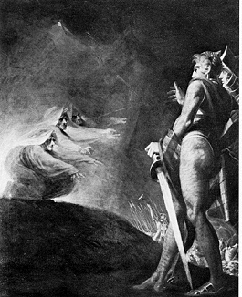
Act Four
“Something wicked this way comes”

Slide 82
Act Four, Scene One
This scene opens with the Witches performing a ritual around a boiling cauldron. “Something wicked this way comes,” they say when Macbeth approaches, a further indication of his corruption.
Macbeth demands to know the answers to his questions, and the Witches summon their masters to respond. First Macbeth is warned to beware Macduff. But then he is informed that no one born of a woman can harm him. Finally he is told that he will never be vanquished tll Birnam Wood comes to Dunsinane.

Slide 83
Act Four, Scene One
The last two predictions fill him with confidence and hope. Macbeth is still anxious to know if Banquo’s children will become kings. A line of eight kings appears, with Banquo at the rear of the procession. The Witches disappear after performing a dance, leaving the dismayed Macbeth alone.
Lennox appears and announces that Macduff has fled to England. This surprises Macbeth, and he vows to have everyone at Macduff’s castle—wife, children, and servants—killed.

Slide 84
Act Four, Scene One: Double Meanings
Earlier in the play, Banquo warned Macbeth that the “instruments of darkness…Win us with honest trifles, to betray us/In deepest consequence.” This suggest that we should not take at face value anything that the Witches say. On the surface, the two prophecies offer Macbeth assurance of invulnerability. How else might have the prophecies be interpreted? What other meanings could the words have had?

Slide 85
Act Four, Scene Two
Ross attempts to comfort Lady Macduff, whose husband has fled to England, in effect abandoning his family. When Ross leaves, we are treated to a tender family scene involving Lady Macduff and her young son. But this brief moment of humour is followed by shocking brutality. A Messenger arrives to warn Lady Macduff of approaching danger. The warning comes too late. Several Murderers enter and begin the slaughter of everyone within the castle.

Slide 86
Act Four, Scene Two: Prose vs. Poetry
The dialogue between Lady Macduff and her son is written in prose vs. blank verse. Why might have Shakespeare opted for prose? What effect has it created?

Slide 87
Act Four, Scene Two: The Role of Ross
The Role of Ross: Moments after Ross leaves, the Murderers arrive. In Polanski’s film version of this scene, Ross is shown letting the Murderers in. Polanski also has Ross appear as the Third Murderer (Act III).
Is there anything in the text that supports this treatment of Ross?

Slide 88
Act Four, Scene Three
In this, the longest scene of the play, several very important purposes are accomplished. First, Malcolm is established as worthy of being King of Scotland. By testing Macduff’s loyalty, Malcolm proves that he will not be deceived by appearances as his father was. Shrewdly, Malcolm withholds his military plans until he is sure he can trust Macduff.

Slide 89
Act Four, Scene Three
The ever-present Ross once again appears and informs Macduff that his family has been slaughtered. Malcolm encourages Macduff to seek revenge against Macbeth. Macduff’s vow of vengeance makes it clear that he has become Macbeth’s nemesis.
Why would Shakespeare have Macduff appear in a scene immediately after his wife and children have been killed. What effect is thereby created?

Slide 90
Act Four, Scene Three: Memory Challenge
Can your remember who has spoken the following lines from the play?
Who is being spoken about?
By the pricking of my thumbs
Something wicked this way comes.
What haste looks through his eyes!
So should he look that seems to speak things strange.

Slide 91
Act Four, Scene Three: Memory Challenge
Nothing in his life became him
Like the leaving it. He died
As one that had been studied in his death
Had he not resembled
My father as he slept, I had done it.
There is none but he
Whose being I do fear

Slide 92
Act Four, Scene Three: Memory Challenge
6. He needs not our mistrust, since he delivers
Our offices and what we have to do
To the direction just
The worm that’s fled
  Hath nature that in time will venom breed,
  No teeth for the present.

Slide 93
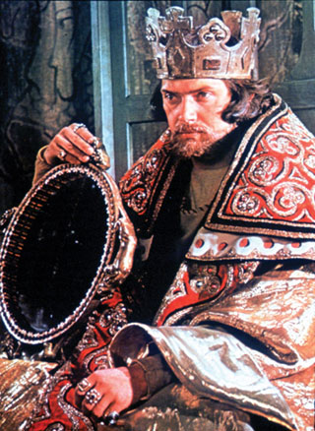
Macbeth: Act Five

Slide 94
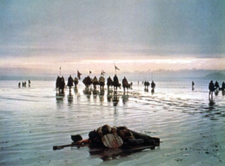
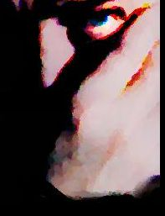
Act Five, Scene One
Guiding Question for Act V:
Sleepwalking-
What experiences have you had with sleepwalking, if any…? Is it best to wake a sleepwalker or to escort the person gently back to bed?

Slide 95
Act Five, Scene One
Setting the Stage
Immediately after the murder of Duncan, Lady Macbeth seemed to believe she would be impervious (resistant/not influenced) to remorse, but this scene shows that she is racked with guilt and can get no rest. Sound familiar…Macbeth too is unable to sleep…
The Doctor and the Gentlewoman (Lady Macbeth’s attendant) observe Lady Macbeth as she walks and talks in her sleep. It is obvious to the Doctor that she needs spiritual counsel, not a medical doctor. He advises the Gentlewoman to keep a close watch on Lady Macbeth, foreshadowing Lady Macbeth’s eventual demise (suicide).

Slide 96
Act Five, Scene Two
Setting the Stage
This scene tells us that forces (military) are rallying against Macbeth. An English army, led by Malcolm and Old Siward, has arrived in Scotland and is near.
The four lords in this scene will join their troops with Malcolm’s . The meeting place is close to Birnam Wood—the very place mentioned to Macbeth in one of the prophecies.
The next four short scenes give us the impression that events are moving swiftly and that Macbeth’s end is in sight.

Slide 97
Act Five, Scene Three
Setting the Stage
This scene marks Macbeth’s first appearance since Act 4, scene 1, when he visited the Witches. Previous to that scene Macbeth was uncertain and distracted, but the prophecies gave him a sense of security that is most evident in this scene. He scoffs at reports that the thanes are deserting him. He does not feel threatened when he hears that ten thousand English soldiers are approaching. He believes the prophecies implicitly (completely); he cannot be harmed by anyone of woman born, nor can he be defeated till Birnam Wood comes to Dunsinane.

Slide 98
Act Five, Scene Three
Setting the Stage continued…
Beneath his confidence there is another element to his character—an ennui, a heart sickness. He realizes that he can never be happy and have all those things that usually are associated with old age, “honour, love, obedience, troops of friends.” Instead he is cursed and given only token respect.
Macbeth tells the Doctor to cure his wife’s malady( illness). The Doctor replies that she is beyond his help and must minister to herself. With these words, the Doctor joins the growing exodus from Macbeth’s ranks.

Slide 99
Act Five, Scene Three
Shakespeare’s Insults
This scene features quite a number of insults. Using the handout, compose your own invective (abuse/attack/criticism). You should have a specific target, either a character from the play or some well known celebrity. When completed, you will hurl your insult, with the rest of the class guessing who is the target.

Slide 100
Act Five, Scene Four
Setting the Stage
The English forces have arrived near Birnam Wood. Malcolm orders that each soldier should cut down a bough from a tree and carry it as camouflage. We now see that what seemed a fair prophecy for Macbeth is in fact not so fair. What’s fair is foul and what’s foul is fair…
Birnan Wood is indeed coming to Dunisinane. Macbeth now has only one prophecy to depend on.

Slide 101
Act Five, Scene Five
Setting the Stage
Macbeth is filled with bravado (boldness, daring). He knows that his well-fortified castle can survive a long siege. In no time at all, however, his world begins to crumble. He learns that his wife is dead. He responds with one of the more memorable speeches in the Shakespeare canon (tenet, principles), a speech that eloquently captures Macbeth’s terrible sense of life’s meaninglessness: “It is a tale/Told by an idiot, full of sound and fury, /Signifying nothing.”

Slide 102
Act Five, Scene Five
Setting the Stage-continued…
He then hears that Birnam Wood is coming to Dunsinane. He abandons his plan of remaining safe behind the castle walls and chooses instead to face his enemies in open battle.

Slide 103
Act Five, Scene Five
Note of Interest:
Line 25. It is not unlikely that Macbeth’s “Tomorrow and tomorrow” speech has as one of its sources a Biblical reference (allusion). In Proverbs xxiv, 20, we find the following: “the candles of the wicked shall be put out.”
Line 26, shadow—actors were frequently referred to as “shadows”. Here, shadows is a clear reference to the cast of the play.

Slide 104
Act Five, Scene Six
Setting the Stage
Malcolm’s army arrives at Macbeth’s castle. The soldiers are told to throw down their camouflage (the branches) and show their strength. Malcolm then orders Siward and his son to lead the attack, with Malcolm and Macduff directing the forces in the rear.

Slide 105
Act Five, Scene Seven
Setting the Stage
Macbeth feels concerned. He cannot escape, but he remains confident because of the second prophecy—no one born of a woman can harm him. Young Siward challenges him and is killed. Macbeth takes this as a confirmation of the prophecy. He exits.

Slide 106
Act Five, Scene Seven
Setting the Stage, continued…
Macduff appears, frantically searching for Macbeth. Siward tells Macduff that the castle has been taken with minimal resistance and that the battle will soon be over.

Slide 107
Act Five, Scene Eight
Setting the Stage
Macbeth, refusing to give up while ther are lieves athat he can take, finally faces Macduff. They fight and Macduff appears to be losing. Macbeth brags that he cannot be vanquished by one of woman born and offers to let Macduff go unharmed. It is at this point that Macduff announces that he was “untimely ripped” from his mother’s womb. A caesarian birth was not considered natural, and therefore Macduff technically was not born of a woman.

Slide 108
Act Five, Scene Eight
Setting the Stage, continued…
When Macbeth hears this, he refuses to resume the fight with Macduff. He soon changes his mind when he realizes what his fate will be if he were to be taken alive. Macduff kills Macbeth and drags his body off stage.
Malcolm and Siward appear and the latter learns that his son has been killed. Macduff then enters with Macbeth’s severed head. Malcolm is declared the new King of Scotland. He quickly deals with the matters at hand and the play ends with the natural order of the universe being restored.

