Slide 1
Industrialization
1700-1900
Mr. Deger
Ch 25 Sec 1-2

Slide 2
So what are we talking about?
Definition for Industrial Revolution?
  Greatly increased output of machine-made goods that began in England around the mid-18th century.

Slide 3
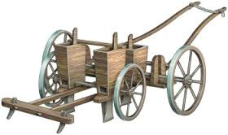
Agricultural Revolution -1750’s
Experimentation and improvements in agriculture causes larger, more nutritious, stable, less work intensive crops & tenant farmers.
  Enclosure- no common land
  Crop Rotation- no fallow land
  Seed Drill →
  Selective Breeding of Livestock

Slide 4
Examples of Agricultural Innovation
Seed Drill
Crop Rotation
Selective Breeding of Livestock
All of these innovations consequently __________ the food supply, which in turn __________ the _________________.

Slide 5
Why Britain?
Labor Supply (large population)
Natural Resources (coal& water to power machines +raw materials)
Investment Capital (econ. & banking)
Entrepreneurs
Transportation
Markets (Forced)
Government Support

Slide 6


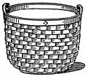
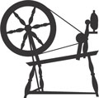


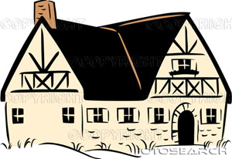






Cottage Industry
Notes:
Problems-
Not primary job but night time and seasonal work as supplementary income
worker owner relations
Quality control
Backlogs
Very expensive

Slide 7
Inventions Spur Industrialization
Improvements occur in textiles first
(wool linen cotton) profits increase by speeding up production
1733- John Kay Flying Shuttle- doubles output
1764- James Hargreaves- Spinning Jenny- eight threads at once
1769 Richard Arkwright- Water Frame- water powered spinning
1779- Samuel Crompton- Spinning Mule- stronger thread
1787- Edmond Cartwright- Water Powered Loom
1793- Eli Whitney- Cotton Gin, invention to remove seeds from cotton, increases American cotton crop
*All bulky and expensive machines- took Cottage Industry out of Houses and put it in Factories
All stages of production under one roof

Slide 8
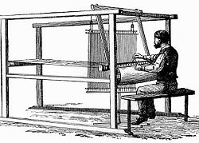
Flying Shuttle- John Kay 1733
Increased output by 4- 10 times

Slide 9
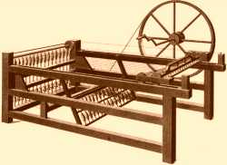
Spinning Jenny-
James Hargreave1764
Initially- By hand
1000 hours=22# yarn
After
400 hours= 22 # Yarn
Eventually-Spinning Jenny allows workers to work eight times faster in textile mills

Slide 10
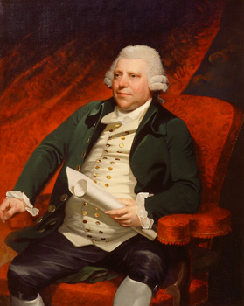
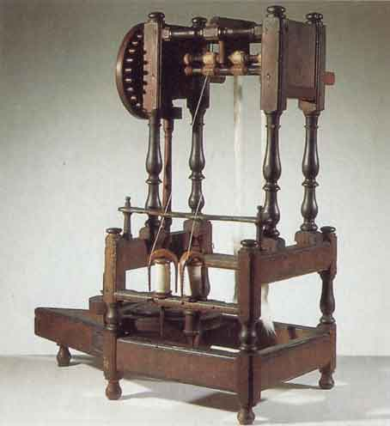
Richard Arkwright:
“Pioneer of the Factory System”
The “Water Frame” 1769
=stronger thread

Slide 11
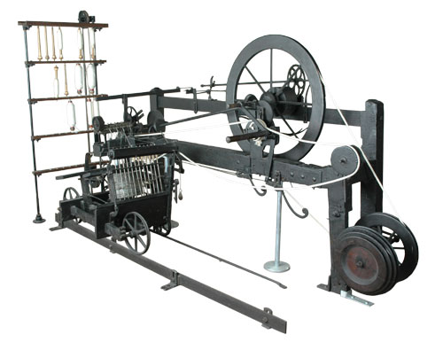
The Spinning Mule
1779 Samuel Crompton
Combined a Spinning Jenny and water frame

Slide 12
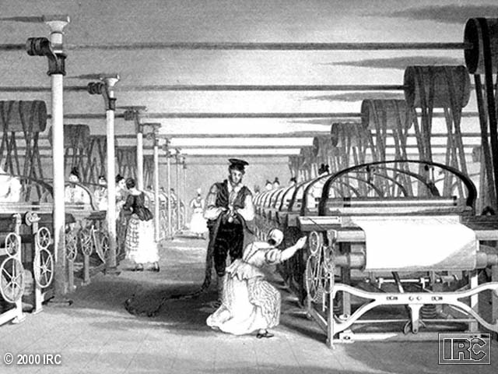
1789-The Water Power Loom
Edmund Cartwright

Slide 13
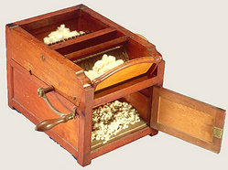
Cotton Gin
1792- Eli Whitney
A machine that automated the separation of cottonseed from the short-staple cotton fiber.

Slide 14
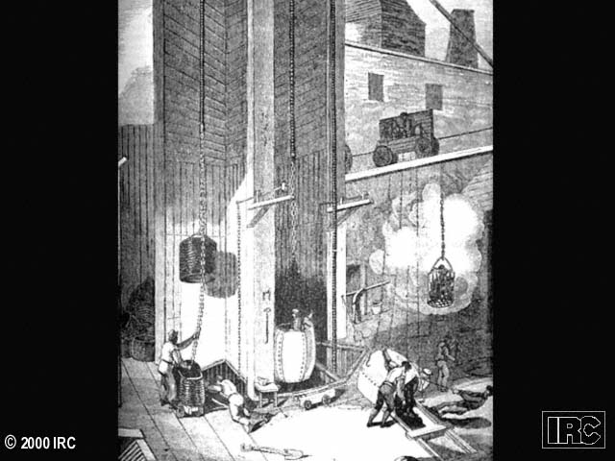
1765-James Watt’s Steam Engine
Watt joined businessman and entrepreneur Matthew Bolton

Slide 15
Power Sources
Initially used water power
Then steam- using wood, deforestation occurs (1765- Watt)
Coal power: labor intensive to get, but more reliable energy source
Pollution occurs

Slide 16
Transportation
Roads—John McAdam
Canals
Railways—George Stephenson

Slide 17
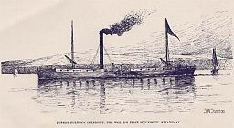
Water Transportation
Robert Fulton ordered a steam engine from Boulton/Watt
1807 Steam boat the Clermont* North River Steamboat
Ferried passengers up and down the Hudson in New York
Slashed cost of transporting raw materials

Slide 18
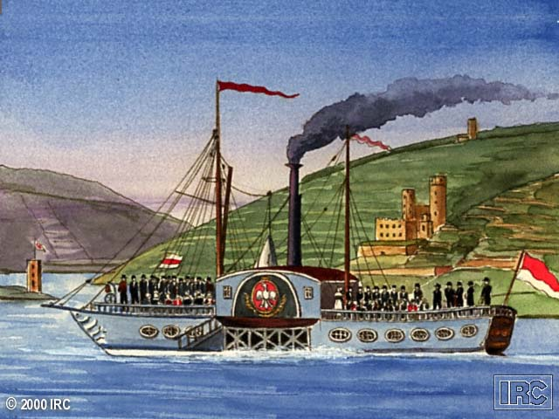
Steam Ship

Slide 19
Railroads
Steam engines power locomotives
  Trevithick (1804)
Railroad allows quicker transportation & greater accessibility
Impact of railroad:
  Growth of industry
  New jobs created
  Growth of agriculture
  People can work further from home

Slide 20
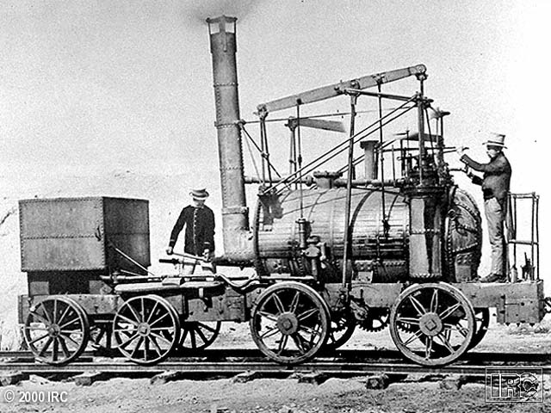
An Early Steam Locomotive
Notes:
Railways developed quickly following the early successes of the Stephenson's and other pioneers. This new technology was the result of the invention and subsequent development of the steam engine. Steam could be used to power motors and had been used in mines to help bring coal and tin to the surface quicker. This idea was transferred to the notion of pulling wagons along rails and eventually Stephenson took the idea one stage further and built the steam engine into a wagon.
This first 'train' was very slow and initially scared a lot of people but soon the early railway lines between Liverpool and Manchester and Stockton and Darlington were accepted and people began to realise that Rail had a lot to offer industry and society in general.
The railways spread across the country at an amazing rate as companies were established to build and run the new lines. Many were financed by industry, eager to have quicker delivery of goods and a wider sales reach.
The impact of the railways was great. Industry benefited as goods could now be transported faster and in even greater quantities than before, reducing costs and creating bigger markets. The construction of the railway network also fueled demand for coal and steel. Ordinary people saw the benefits too. They could now get around the country much quicker and for the first time holidays out of the city were a possibility (Thomas Cook organising the first 'package' holiday from Leicester Station to the seaside). Communications in general improved as well. Newspapers could now be sent from London and Manchester, where most of the national dailies are printed, to towns across the country, the postage system became much quicker and movement of workers became a more realistic prospect.
One of the most noticeable consequences of the growth of the Railways was the rapid development of a number of towns. Crewe and Peterborough are both examples of towns that grew quickly due to their location on the railway network.
There were however several negative consequences of the growth of the Railways. Many people lost money from previous investments in canals, people who worked on the canals found themselves out of work.
The railways were built by workers called Navvies. These men had incredibly difficult jobs to do. A Navvy would need to dig the foundations, lay the stones that the tracks were placed upon, move and fix the tracks and dig tunnels. The picture above is a contemporary image of a Navvy. Much of the work was done by hand, using a pick axe as building machines such as mechanical diggers did not exist at the time.
Many of the men employed as Navvies originated from Ireland and came to Britain looking for work during the Irish Famines of the 18th and 19th centuries.

Slide 21
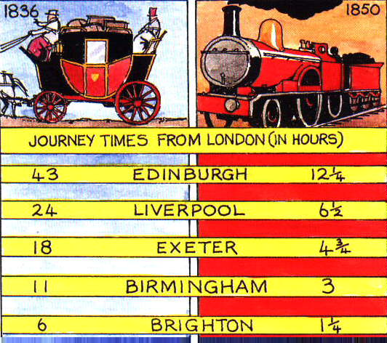
The Impact of the Railroad

Slide 22
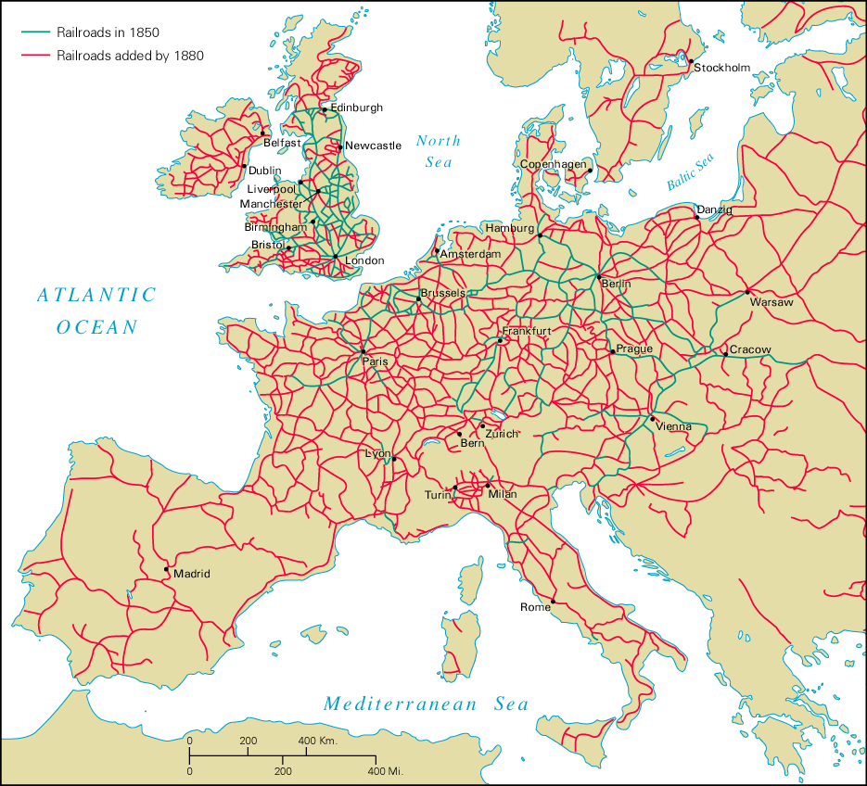
Railroads on the Continent

Slide 23
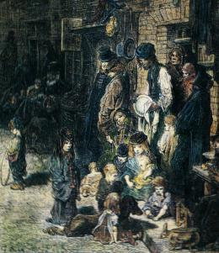

Slide 24
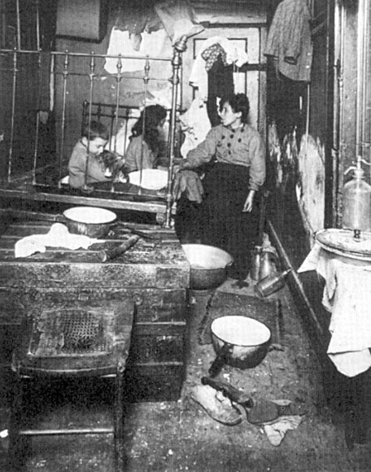

Slide 25
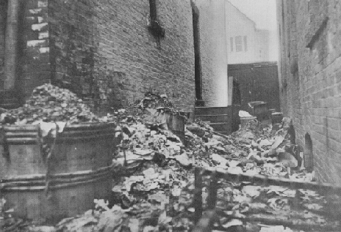
No sanitation meant the streets were filled with trash

Slide 26
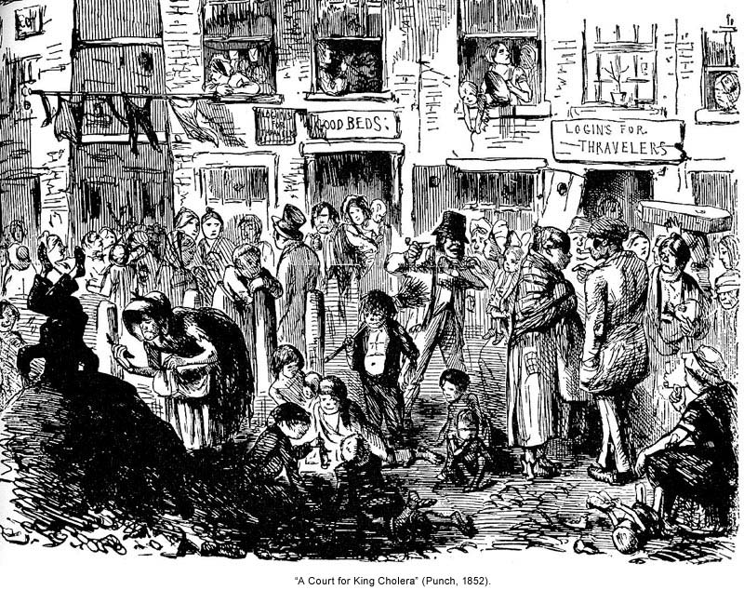
The crowded, filthy slums were a breeding ground for diseases such as cholera

Slide 27
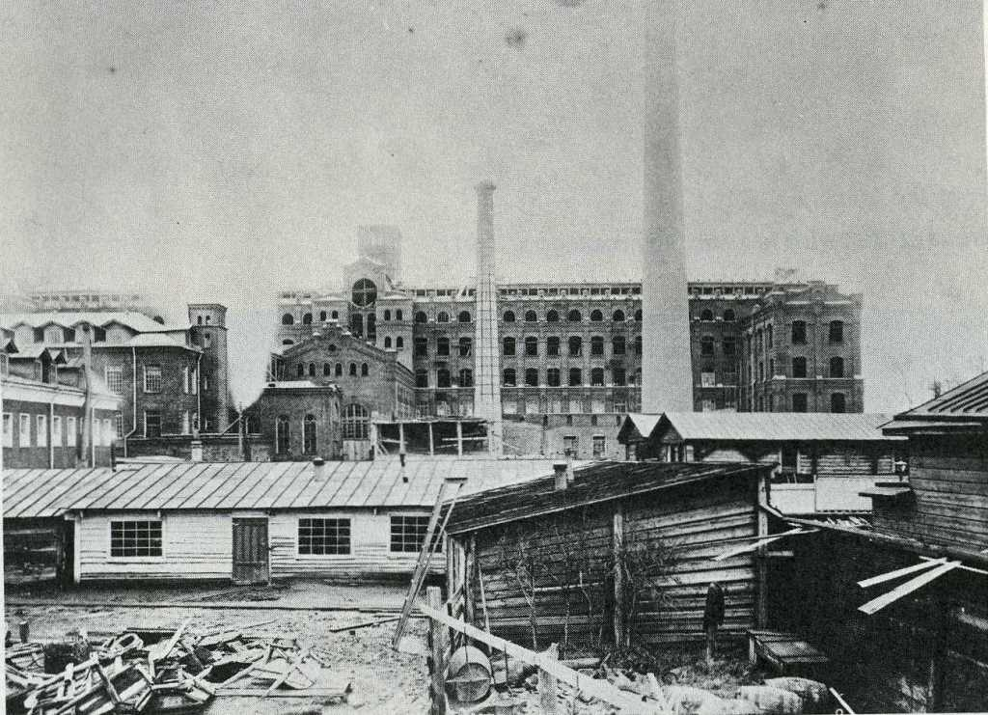
1742 First Cotton Mills Opened in England

Slide 28
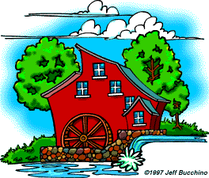


Factory
System
Water powered Factory
Farm
Factory Workers
Factory owner
Notes:
Hydropower from rivers used to power machines
Factories built near rivers to power production

Slide 29
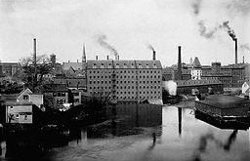
Working Conditions
Rigid schedule.
Children as young as 5
6 days a week
12-16 hour day (few breaks)
Dangerous conditions.
Mind-numbing monotony.
Notes:
Poorly lit factories lead to many accidents
Child labor widespread
No health insurance
Machines often replaced people in jobs
Causes
Increased opportunity for owner profit
Supply of laborers exceeds demand for labor
Effects
Increased # of accidents
Depression causes rise in alcoholism and accidents
Decline in health of workers due to poor air quality, temperature, and fatigue
Factory work was difficult and dangerous
If you complained, you were fired.
If you got sick, you were fired.
If you got hurt and could no longer work, you were fired.
Families needed the income working children could provide.
Children could be hired at very low wages
Children worked in the same dangerous factories, for the same long hours

Slide 30
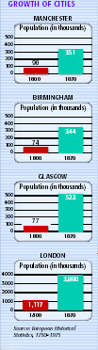
Urbanization
Increased economic opportunity leads to urbanization – migration from farms to cities
People earned higher wages in factories than farms – leads to better quality of life

Slide 31
Living Conditions
Exponential city growth leads to problems
Lack of city codes means no laws for building construction or sewage removal
Lack of police protection
Streets lack drainage
Families cramped in small living spaces
Disease spreads, housing fires common
Notes:
Cities grew around factories
These cities grew rapidly, without planning
Working people lived in tenements in hellish slums
The lack of planning meant that there was no sewage, running water, or sanitation system

Slide 32
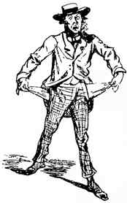

Social Class
The Haves
The Have-Nots
The entrepreneurs (Individuals who start a new business) who opened factories and shipping companies became very rich during the early industrial revolution.
The people who worked in the factories for the entrepreneurs (the working class), were soul-crushingly poor
Notes:
New Social classes develop
Growing middle class
Upper middle – lawyers, doctors, managers, merchant
Lower middle – tool makers, factory supervisors
Urban Poor = Factory laborers, unemployed

Slide 33
Positives and Negatives of Industrialization
Negative
Initially-
Decreased living conditions
Decreased and dangerous working conditions
Pollution
Sanitation problems
Adulteration of food
Small merchants/cottagers lose business
Positive for the average participant are 50-75 years into industrialization
  Increased quality and decreased prices of goods
  New jobs created requiring less skills
  Eventual rise in the standard of living (50-75 years)
  Wealth of nation
  Diets
  Housing
  Clothes
  Education
  Social mobility
  Improved working conditions (eventually)
Notes:
Jobs created
Technological progress and invention
Standard of living increases
Education expands
Need for city planning realized
Healthier diets
Higher wages, better conditions, shorter hours (long term benefit)
Hope that life can improve

Slide 34
