Slide 1
Analyzing Political Cartoons

Slide 2
Political Cartoons
Also known as editorial cartoons are defined as illustrations or comic strips containing a political or social message that usually relates to current events or personalities.
They are pictorial editorials.
These often use symbols and labels to get the message across.

Slide 3
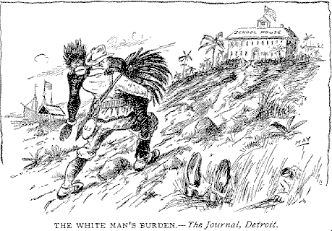
What event or issue is this cartoon about?
Notes:
Look at title and symbols

Slide 4
How do you know? What do you see in the cartoon that tells you this?

Slide 5
What opinion does the artist have on this issue? How do you know?

Slide 6
What is your opinion on this issue? Why?

Slide 7
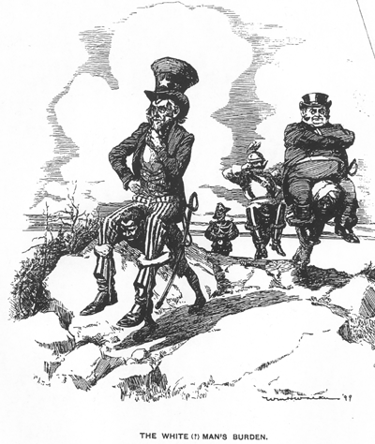
What event or issue is this cartoon about?
How do you know? What do you see in the cartoon that tells you this?

Slide 8
What opinion does the artist have on this issue? How do you know?
What is your opinion on this issue? Why?

Slide 9

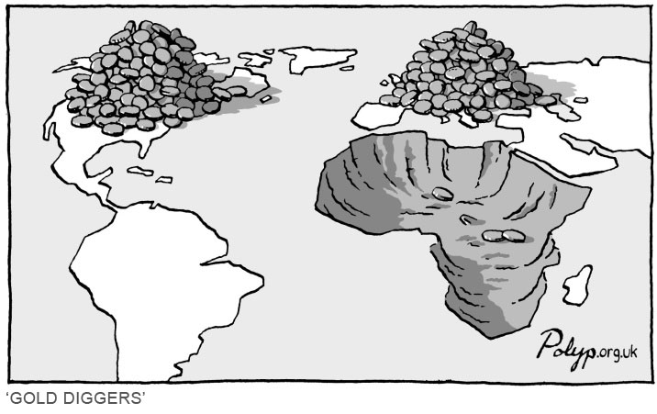

Slide 10


Slide 11


Slide 12


Slide 13
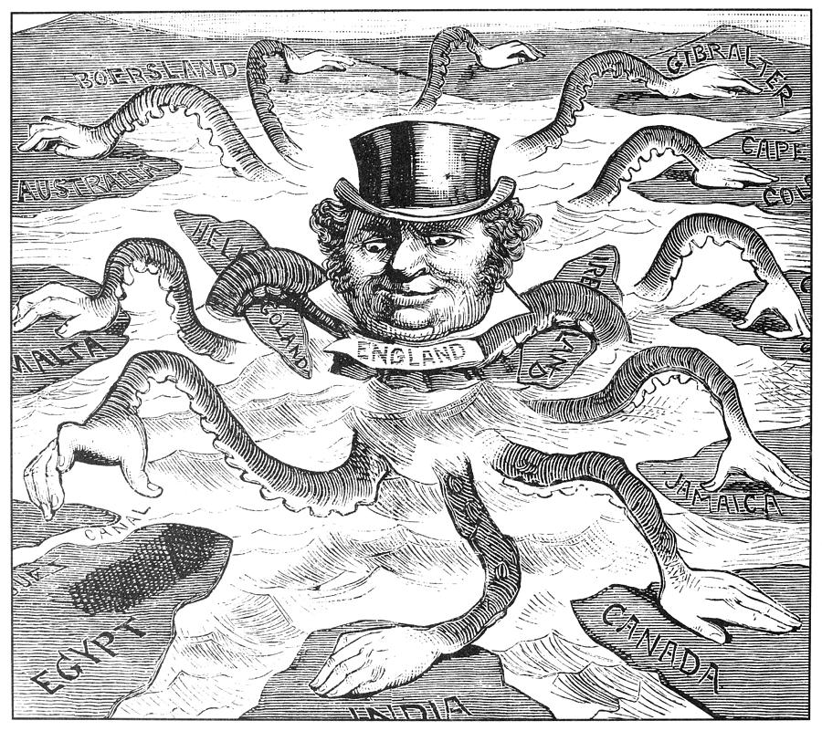
What event or issue is this cartoon about?
Notes:
0056521
IMPERIALISM CARTOON, 1882. 'The Devilfish in Egyptian Waters.' An American cartoon from 1882 depicting John Bull (England) as the octopus of imperialism grabbing land on every continent.

Slide 14
How do you know? What do you see in the cartoon that tells you this?

Slide 15
What opinion does the artist have on this issue? How do you know?

Slide 16
What is your opinion on this issue? Why?

