Slide 1
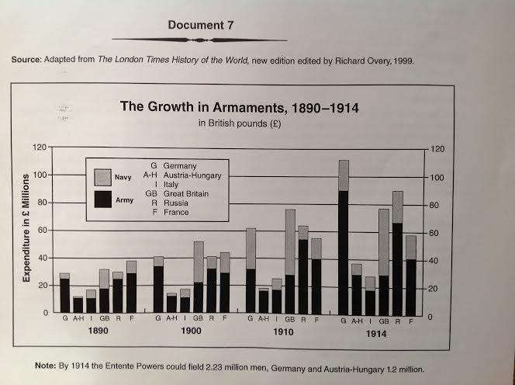

Slide 2
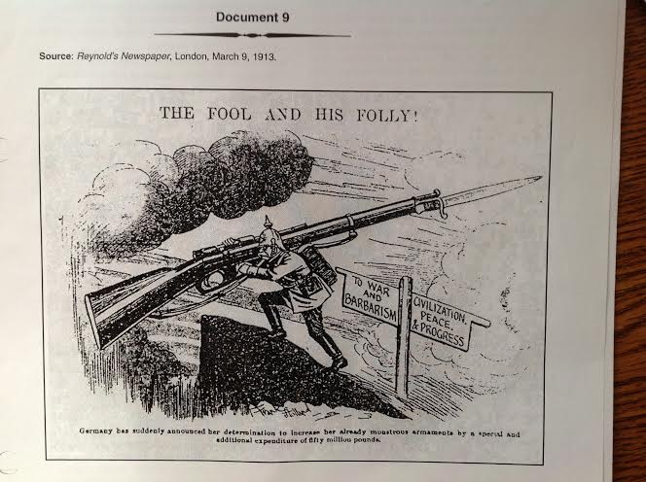

Slide 3
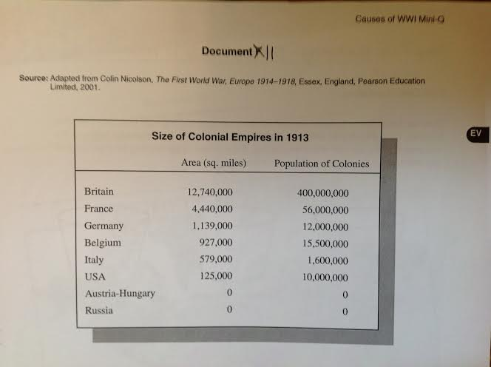

Slide 4
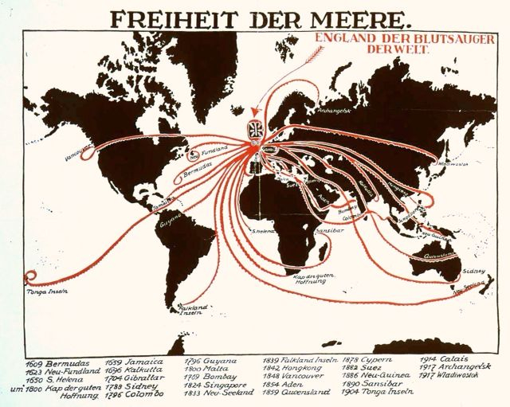

Slide 5
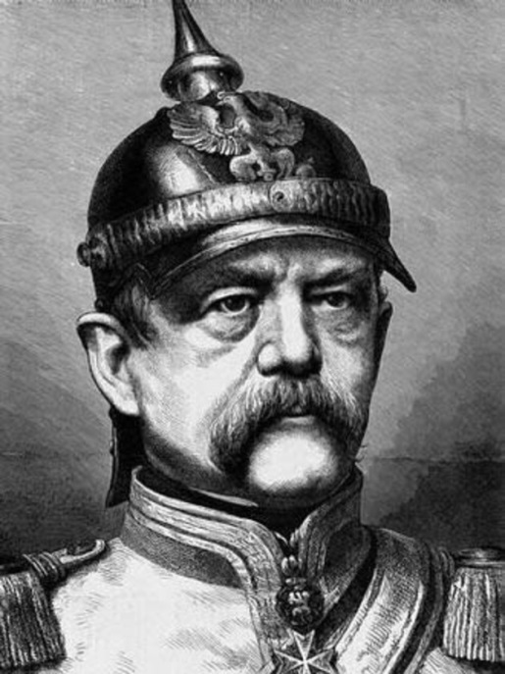
Germany under Bismarck
Goal: isolate France
Form Dual Alliance with Austria-Hungary (1879)
Form Triple Alliance with A-H, and Italy (1882)
Treaty with Russia (1881)

Slide 6
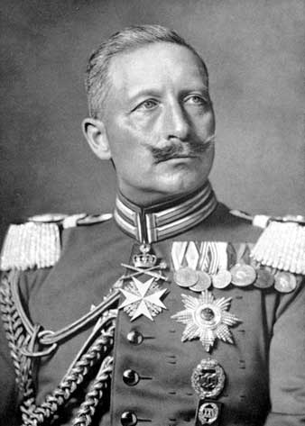
Kaiser Wilhelm II
Forces Bismarck to resign
--Wilhelm pretends to be upset (sly)
Primary Source (1683)—What can you tell me about Wilhelm’s personality?

Slide 7
Wilhelm’s Actions
Russia:
Wilhelm lets treaty lapse in 1890 with Russia.
  Russia responds by forming an alliance w/ France
Britain:
Germany increases its shipbuilding (navy).
  Forces Britain to ally with Russia and France.

Slide 8
Alliances form by 1907
Triple Alliance
Triple Entente
Germany
Austria-Hungary
Italy
France
Russia
Britain

Slide 9
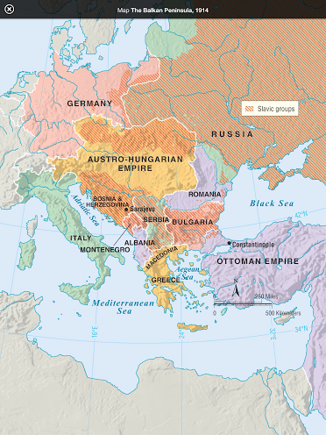

Slide 10
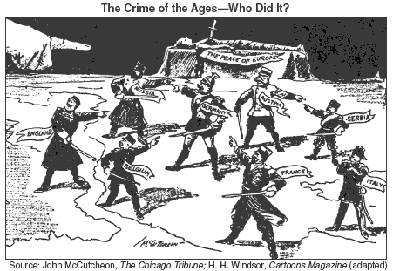

Slide 11
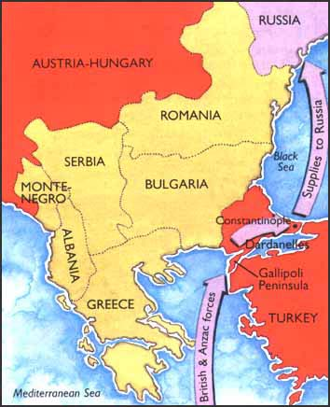
Gallipoli Campaign

Slide 12
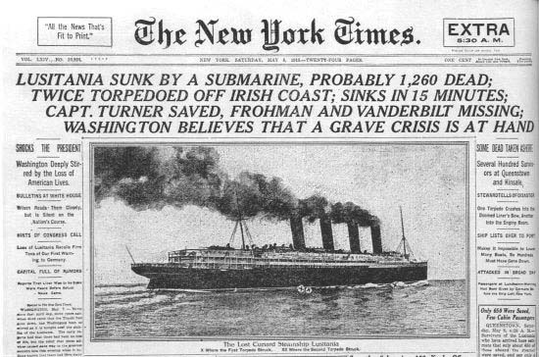
Why does the US get involved?
Unrestricted Submarine Warfare
  Lusitania (05/07/1915)
  Sinking of 3 US ships in 1917
Zimmerman Note
  Final straw
  Congress declares
  war on Germany
  (1917)

Slide 13

WWI Propaganda

Slide 14
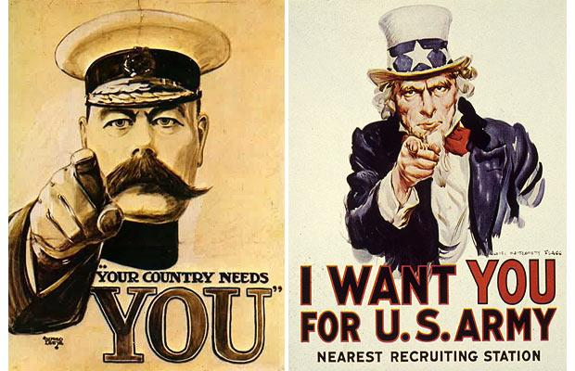
WWI Propaganda

Slide 15
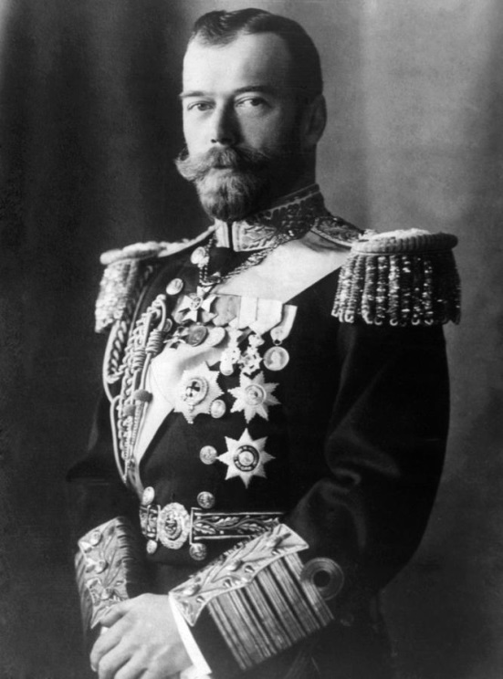
Russia Withdraws
Czar Nicholas II steps down in 1917
5.5 million casualties by 1917
Army is tired
Revolution occurs
Treaty of Brest-Litovsk (March 1918)
  Ends fighting between Russia and Germany

Slide 16
Legacy of WWI
An entire generation of Europeans wiped out
  Approximately 8.5 million soldiers dead
  Another 21 million wounded
  Civilian deaths from starvation, disease, slaughter
WWI costs $338 billion—drained treasuries of Europe
Destroys landscape in Europe—homes, villages, farms
Treaty of Versailles

Slide 17
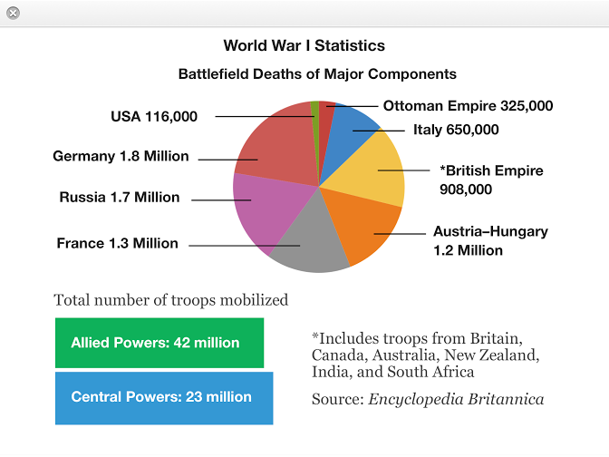

Slide 18
Fourteen Points
1 - 4: An end to secret treaties, freedom of the seas, free trade, and reduced national armies and navies (Demilitarization)
5: Adjustment of colonial claims with fairness towards colonial peoples.
6-13: Specific suggestions for changing borders and creating new nations (Self-Determination).
14: a “General Association of Nations” that could peacefully negotiate solutions to world conflicts (League of Nations)

Slide 19
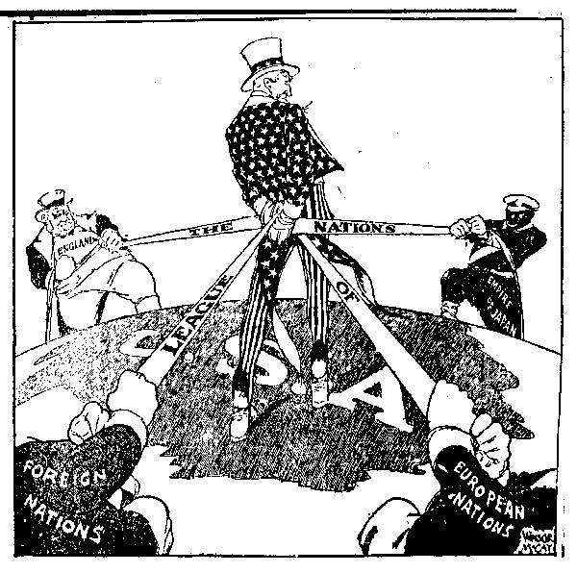

Slide 20
