Slide 1

World Geography
Map Skills

Slide 2

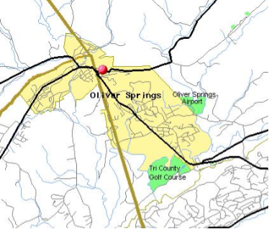
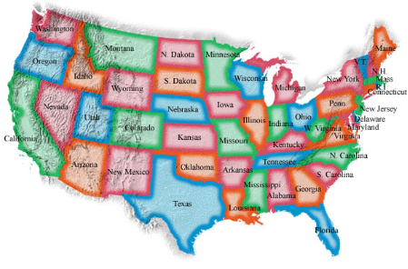
Maps
A map is a flat diagram of all or parts of Earth’s surface.

Slide 3
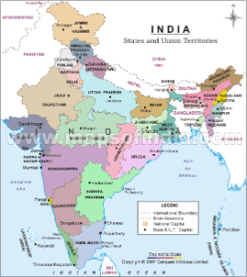
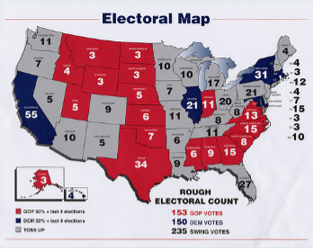
Map Essentials
A map’s title show what the subject of the map is. The map title is usually the first thing you should look at when studying a map, because it tells you what the map is trying to show.

Slide 4
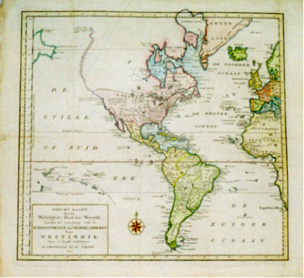
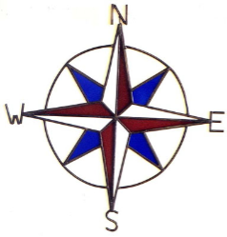
A compass rose has arrows that point to all four principal directions (North, South, East, and West)

Slide 5
Mapmakers use scales to represent the distances between points on a map. Scales give the distance in miles and kilometers.
  To find the distance between two points on the map, place a piece of paper so that the edge connects the two points. Mark the location of each point on the paper with a line or dot. Then compare the distance between the two dots with the map’s scale.

Slide 6
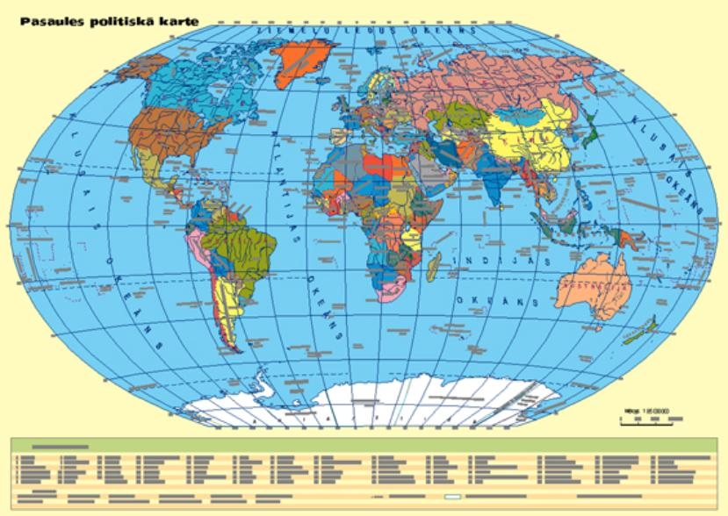

Slide 7
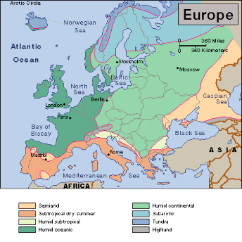
The legend, or key, explains what the symbols on the map represent. Legends may use specific symbols or colors to represent information on maps.

Slide 8
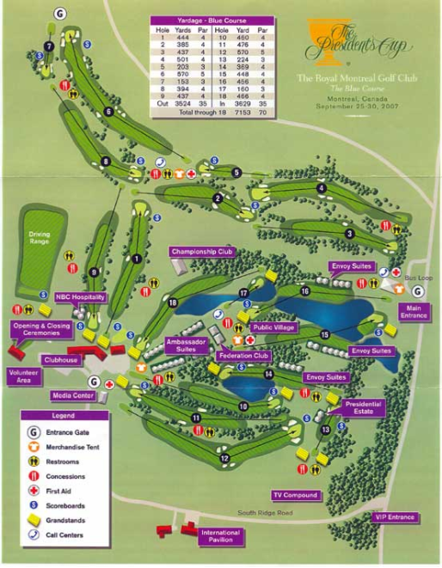

Slide 9
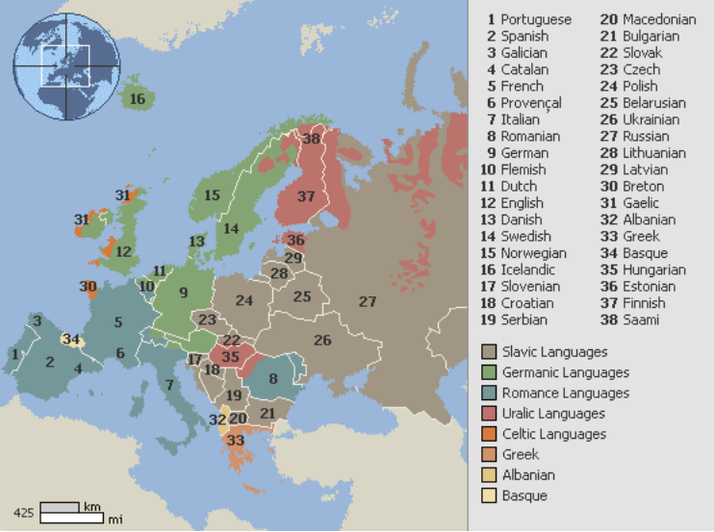

Slide 10
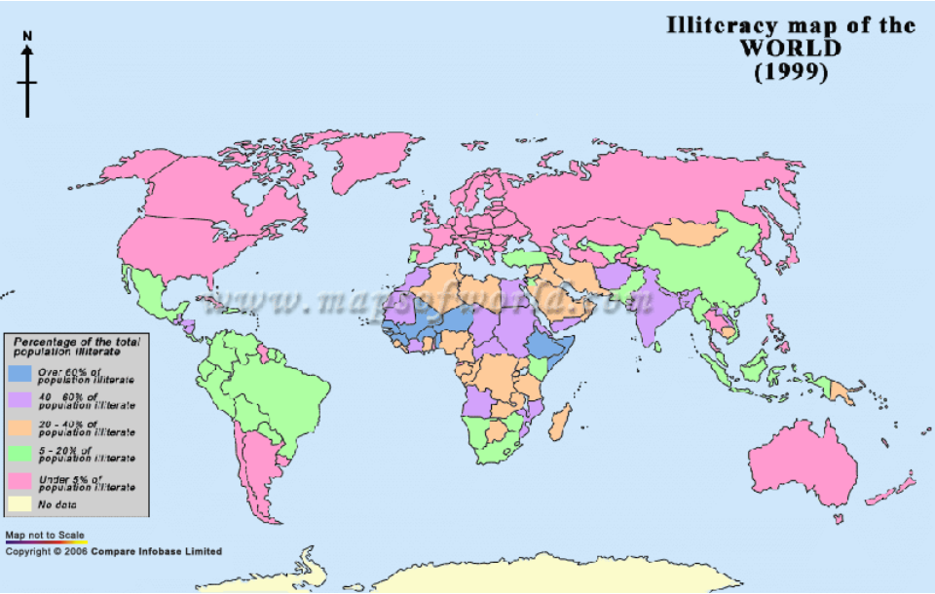

Slide 11
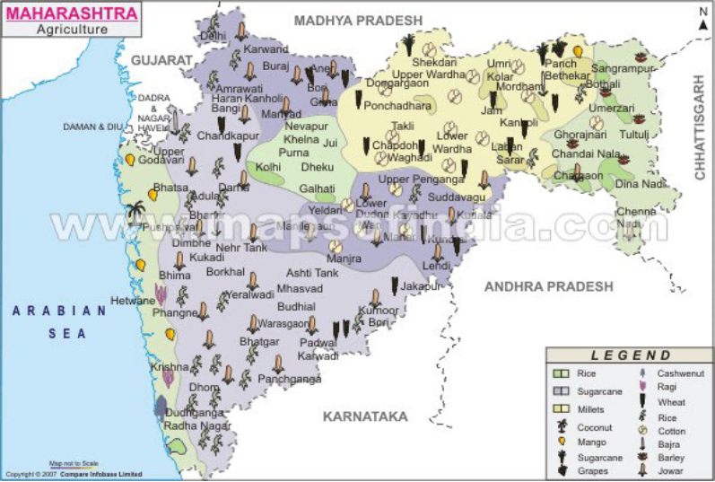

Slide 12
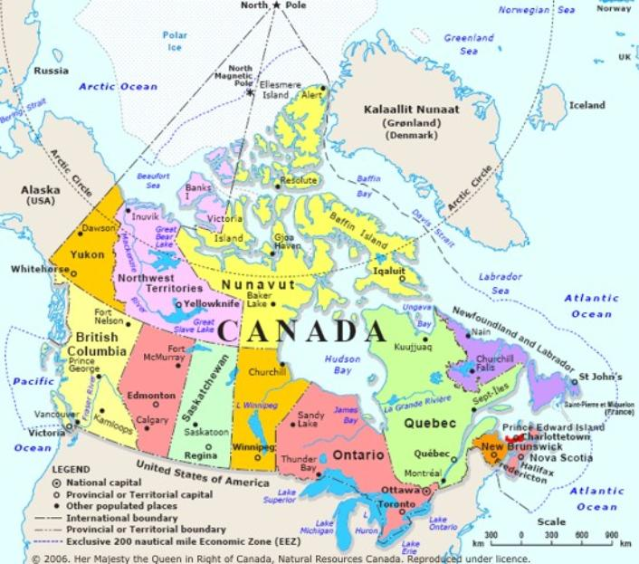

Slide 13
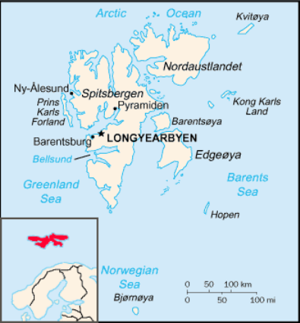
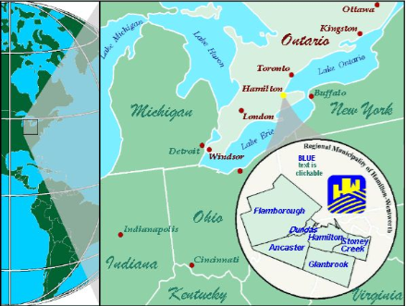
A locator map shows where in the world the area on the map is located.

Slide 14
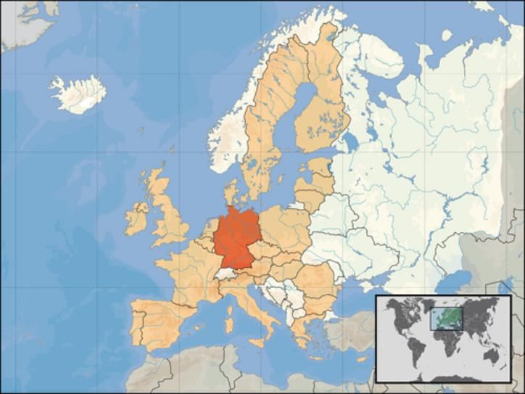

Slide 15
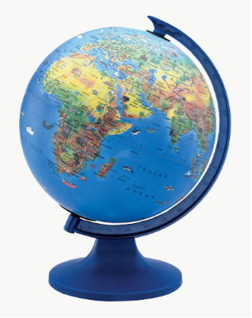
Globe
A globe is a scale model of the Earth. It is useful for showing the entire Earth or studying large areas of Earth’s surface.

Slide 16

Lines of Latitude and Longitude
To study the world, geographers use a pattern of imaginary lines that circles the globe in east-west and north-south directions. It is called a grid. The intersection of these imaginary lines helps us find places on Earth.

Slide 17
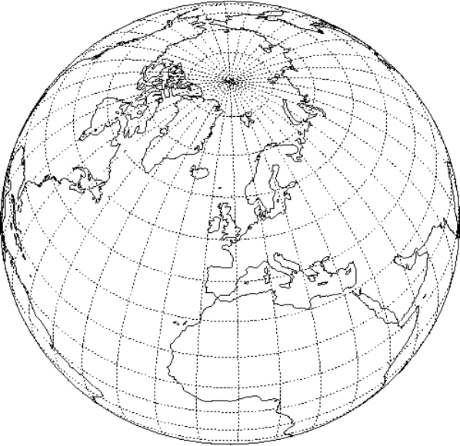

Slide 18
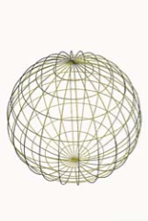
The east-west lines in the grid are lines of latitude. They measure distance north and south of the equator.
Lines of latitudes are called parallels.
Parallels north of the equator are labeled with an N
Parallels south of the equator are
labeled with an S

Slide 19
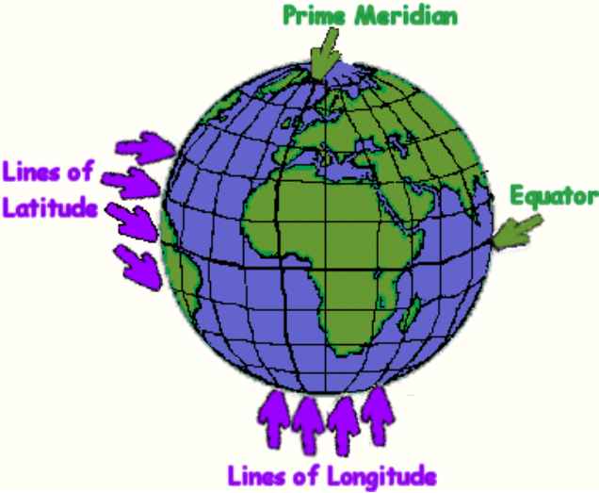

Slide 20
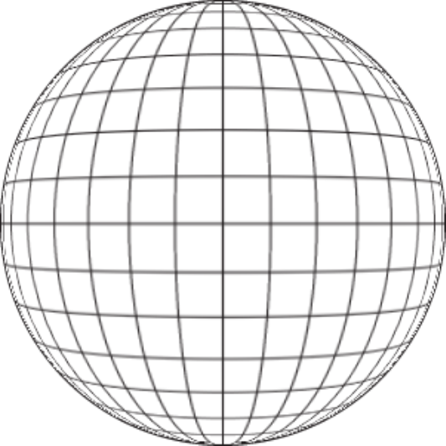

Slide 21
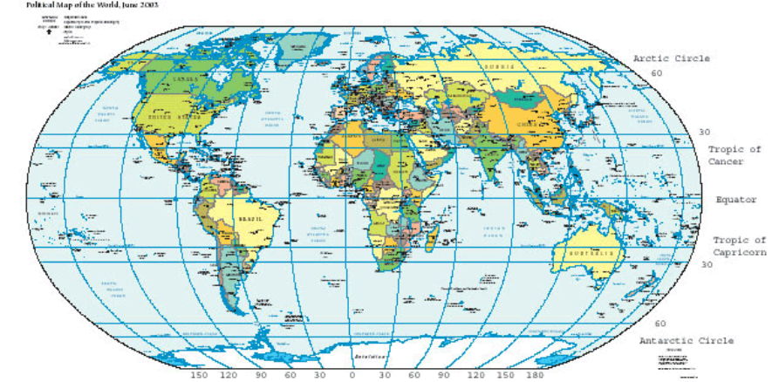

Slide 22
The equator in an imaginary lines that circles the globe halfway between the North and South Poles.
Parallels measure distance from the equator in degrees. The symbol for degree is °
Degrees are further divided into minutes. There are 60 minutes in a degree. The symbol for minute is ´

Slide 23
The north-south imaginary lines are lines of longitude.
Lines of longitude are called meridians. These imaginary lines pass through the poles. The measure distance east and west of the prime meridian.
The prime meridian is an imaginary line that runs through Greenwich, England. It represents 0° longitude.

Slide 24
Lines of latitude range from 0°, for locations on the equator, to 90°N or 90°S, for locations at the poles.

Slide 25
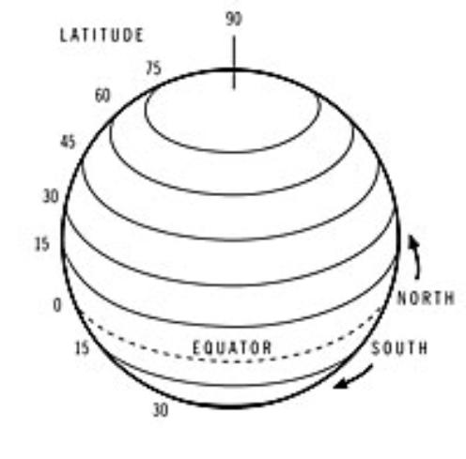

Slide 26
Lines of longitude range from 0° on the prime meridian to 180° on a meridian in the mid-Pacific Ocean.
Meridians west of the prime meridian to 180° are labeled with a W.
Those eat of the prime meridian to 180° are labeled with an E.

Slide 27
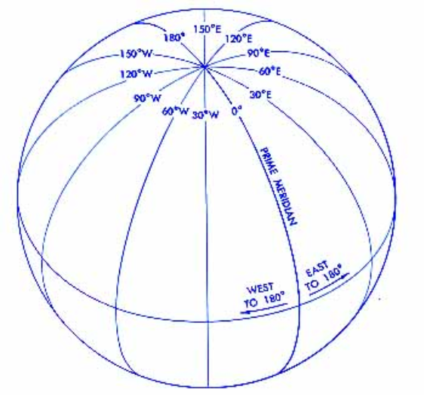

Slide 28
Why do we use grids?
To identify the exact location of any place on Earth.
  O.S.E.S is located at
  36°02´31.9 "N 84°20´42.10 "W

Slide 29
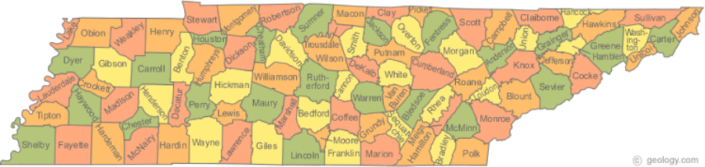
Types of Maps
Political Maps show the major political features of a region. These features include country borders, capital cities, and other places.

Slide 30
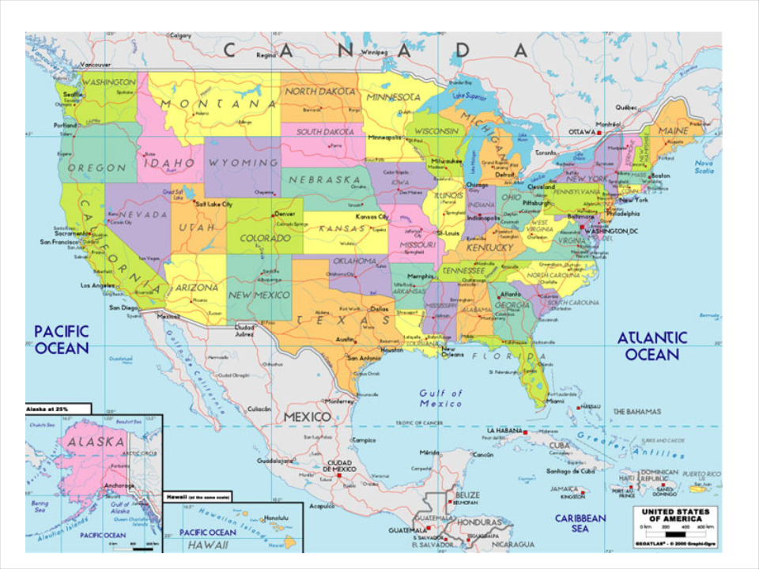

Slide 31
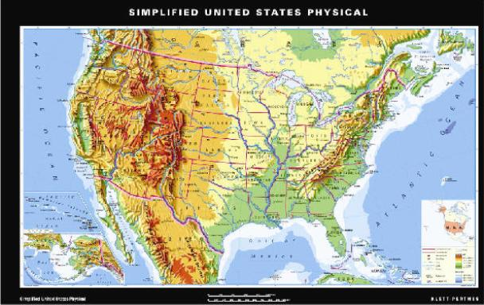
Physical maps show the major physical features of a region. These features may include mountain ranges, rivers, oceans, islands, deserts, and plains.

Slide 32
Special-Purpose maps focus on one special topic such as resources, population, or time zone. These maps present information on the topic as it relates to a region.

Slide 33
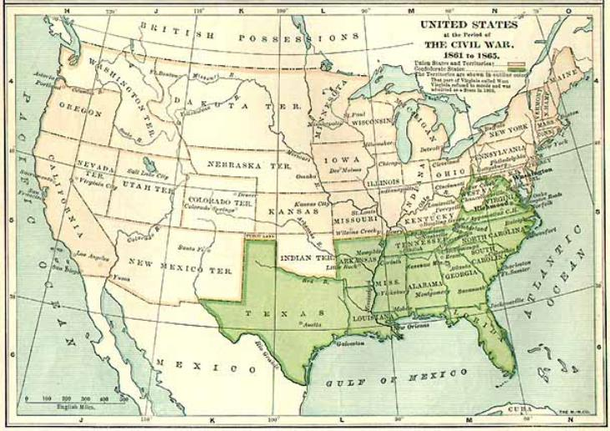
Historical maps show a variety of information of past events.

Slide 34
Contour Map
Shows elevation more exactly using lines on the map that join all the places that have the same elevation. (looks like a finger-print)

