Slide 1

World Geography
Map Skills

Slide 2

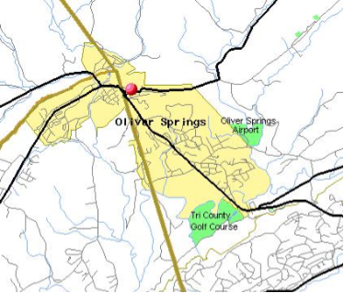
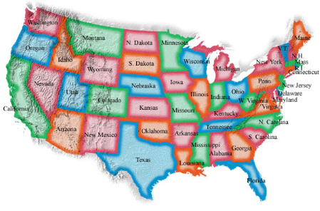
Maps
A map is a flat diagram of all or parts of Earth’s surface.

Slide 3
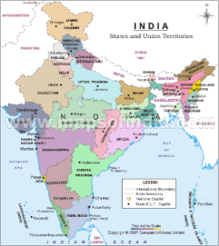
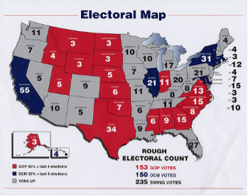
Map Essentials
A map’s title show what the subject of the map is. The map title is usually the first thing you should look at when studying a map, because it tells you what the map is trying to show.

Slide 4
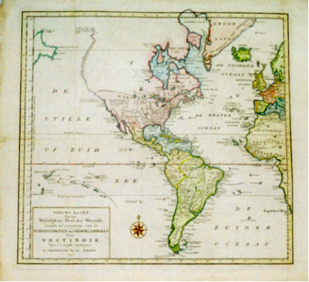

A compass rose has arrows that point to all four principal directions (North, South, East, and West)

Slide 5
Mapmakers use scales to represent the distances between points on a map. Scales give the distance in miles and kilometers.
To find the distance between two points on the map, place a piece of paper so that the edge connects the two points. Mark the location of each point on the paper with a line or dot. Then compare the distance between the two dots with the map’s scale.

Slide 6
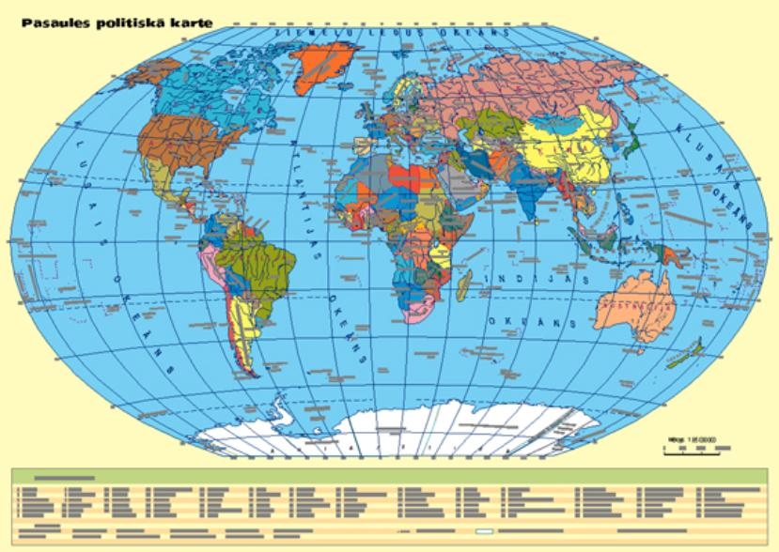

Slide 7
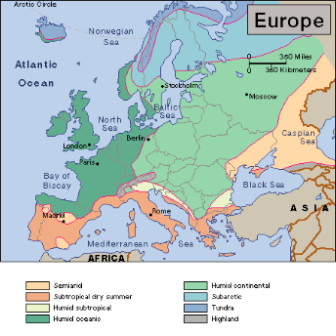
The legend, or key, explains what the symbols on the map represent. Legends may use specific symbols or colors to represent information on maps.

Slide 8
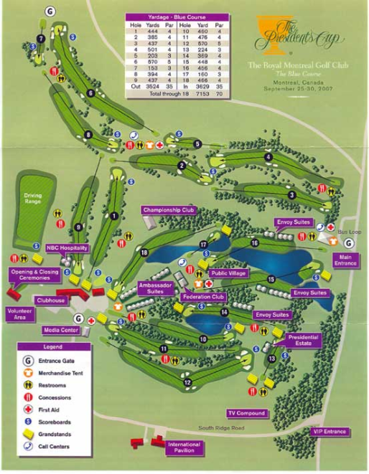

Slide 9
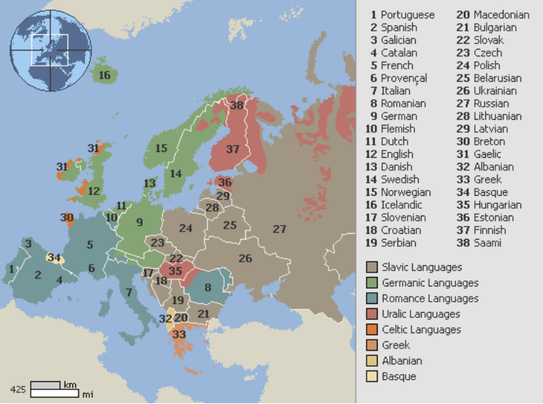

Slide 10
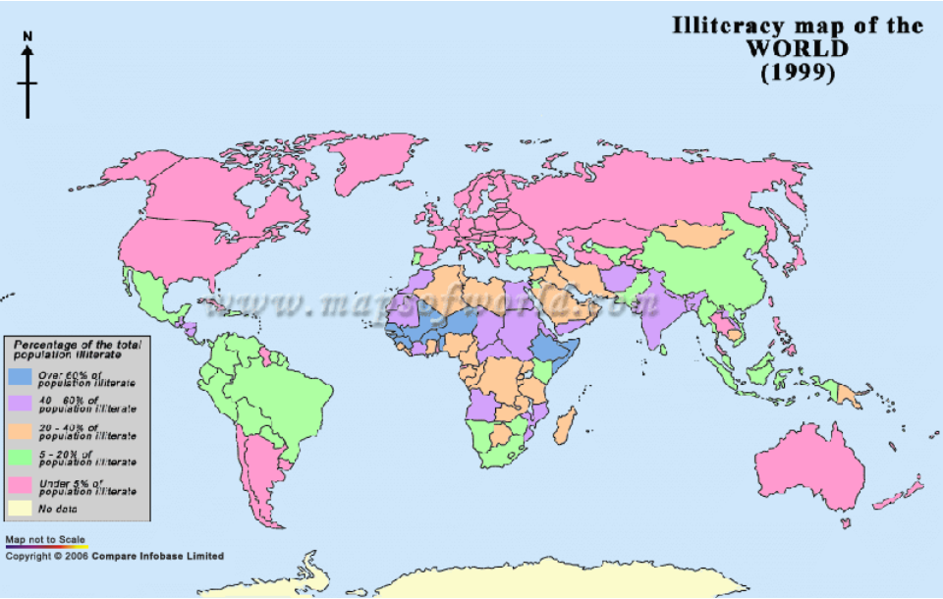

Slide 11
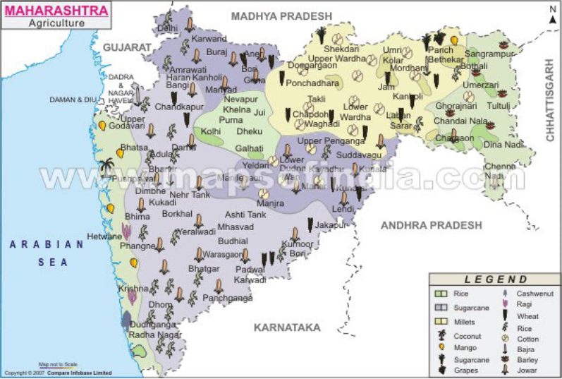

Slide 12
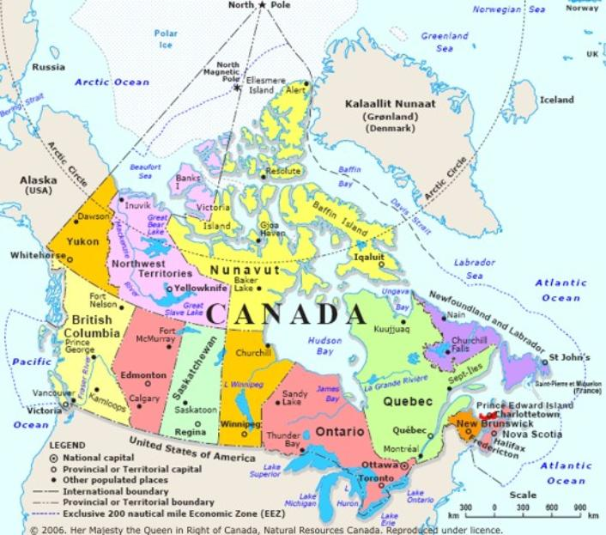

Slide 13
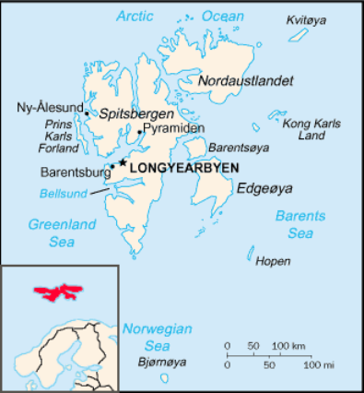
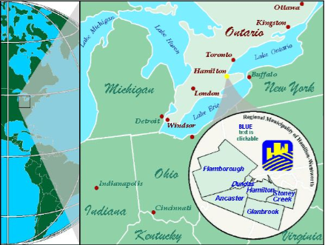
A locator map shows where in the world the area on the map is located.

Slide 14
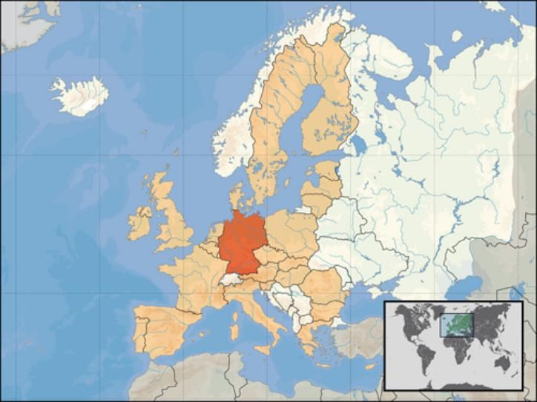

Slide 15

Globe
A globe is a scale model of the Earth. It is useful for showing the entire Earth or studying large areas of Earth’s surface.

Slide 16

Lines of Latitude and Longitude
To study the world, geographers use a pattern of imaginary lines that circles the globe in east-west and north-south directions. It is called a grid. The intersection of these imaginary lines helps us find places on Earth.

Slide 17
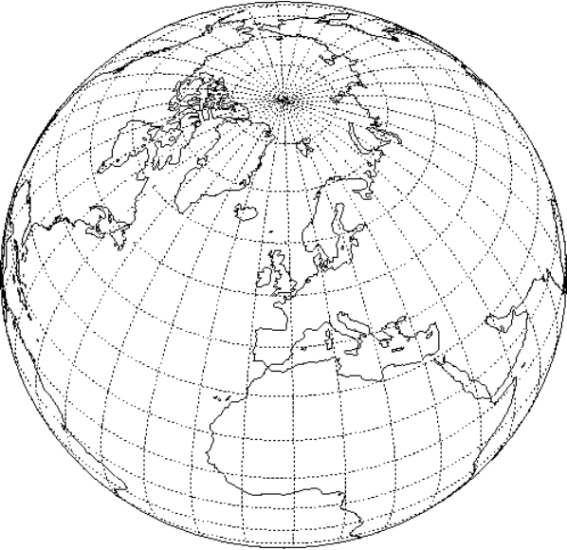

Slide 18

The east-west lines in the grid are lines of latitude. They measure distance north and south of the equator.
Lines of latitudes are called parallels.
Parallels north of the equator are labeled with an N
Parallels south of the equator are
labeled with an S

Slide 19
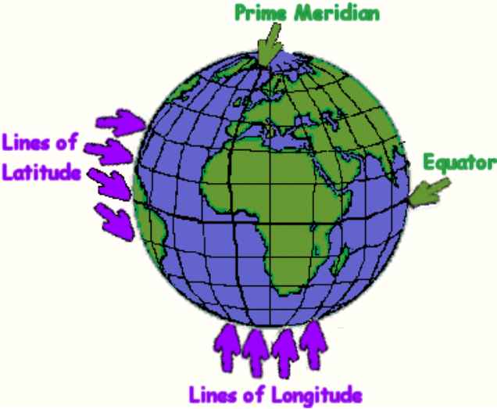

Slide 20


Slide 21
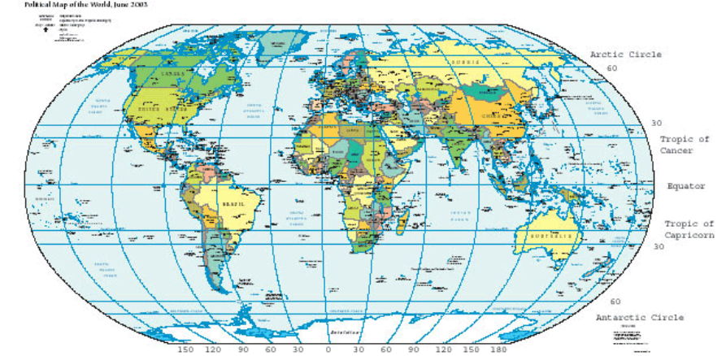

Slide 22
The equator in an imaginary lines that circles the globe halfway between the North and South Poles.
Parallels measure distance from the equator in degrees. The symbol for degree is °
Degrees are further divided into minutes. There are 60 minutes in a degree. The symbol for minute is ´

Slide 23
The north-south imaginary lines are lines of longitude.
Lines of longitude are called meridians. These imaginary lines pass through the poles. The measure distance east and west of the prime meridian.
The prime meridian is an imaginary line that runs through Greenwich, England. It represents 0° longitude.

Slide 24
Lines of latitude range from 0°, for locations on the equator, to 90°N or 90°S, for locations at the poles.

Slide 25
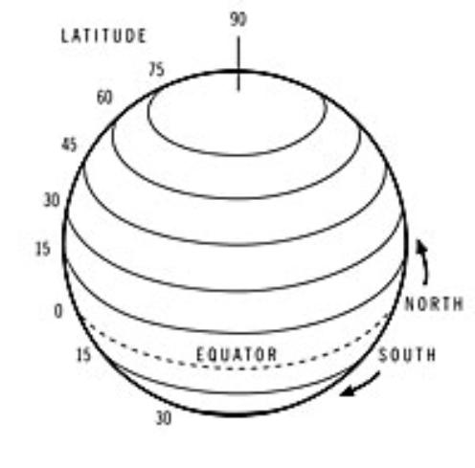

Slide 26
Lines of longitude range from 0° on the prime meridian to 180° on a meridian in the mid-Pacific Ocean.
Meridians west of the prime meridian to 180° are labeled with a W.
Those eat of the prime meridian to 180° are labeled with an E.

Slide 27
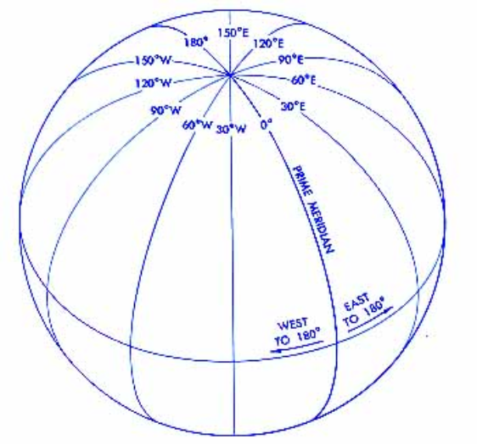

Slide 28
Why do we use grids?
To identify the exact location of any place on Earth.
O.S.E.S is located at
36°02´31.9 "N 84°20´42.10 "W

Slide 29
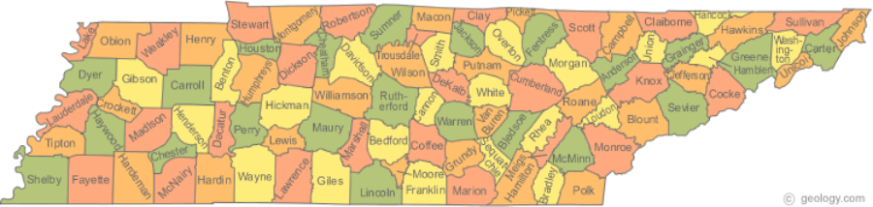
Types of Maps
Political Maps show the major political features of a region. These features include country borders, capital cities, and other places.

Slide 30
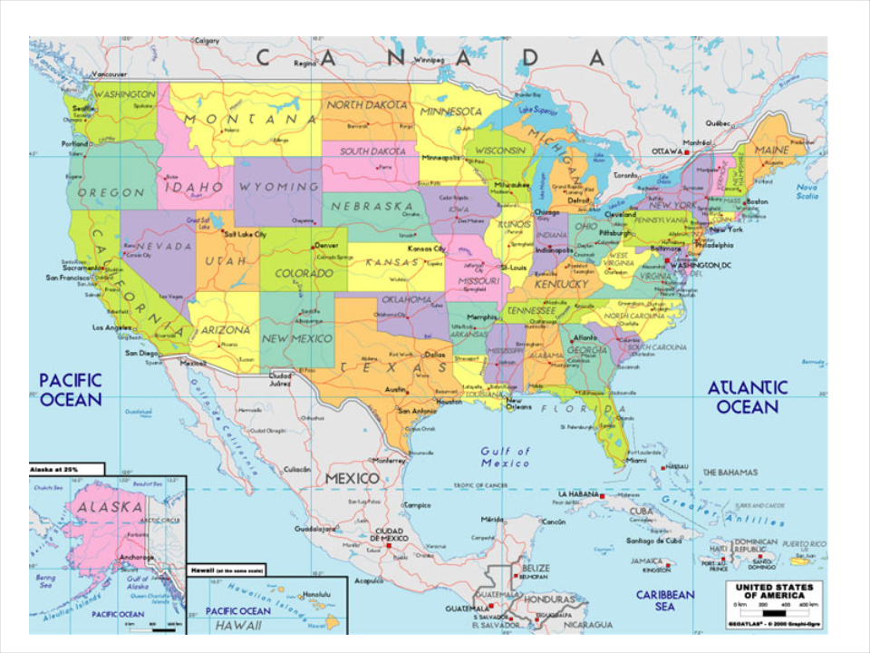

Slide 31
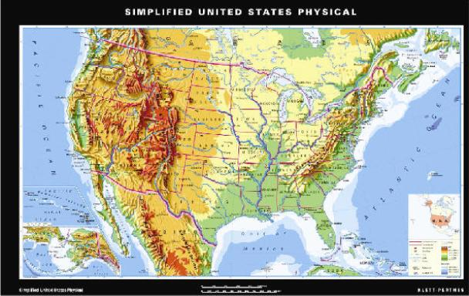
Physical maps show the major physical features of a region. These features may include mountain ranges, rivers, oceans, islands, deserts, and plains.

Slide 32
Special-Purpose maps focus on one special topic such as resources, population, or time zone. These maps present information on the topic as it relates to a region.

Slide 33
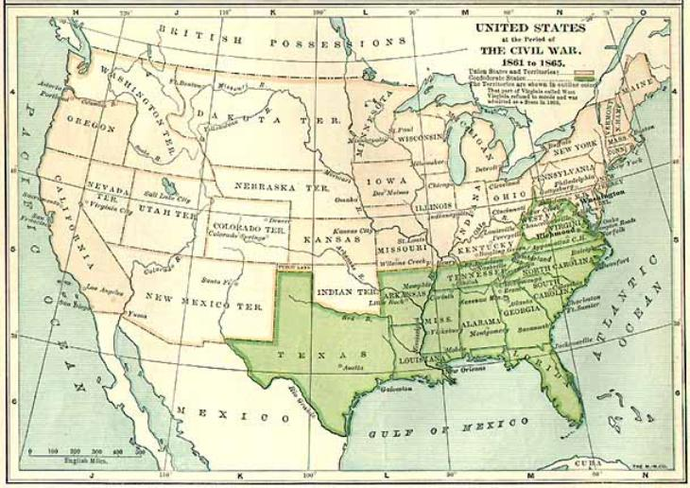
Historical maps show a variety of information of past events.

Slide 34
Contour Map
Shows elevation more exactly using lines on the map that join all the places that have the same elevation. (looks like a finger-print)

Slide 35
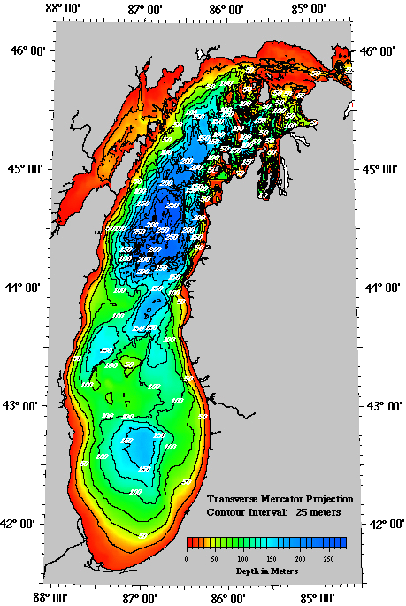
Contour Map

Slide 36
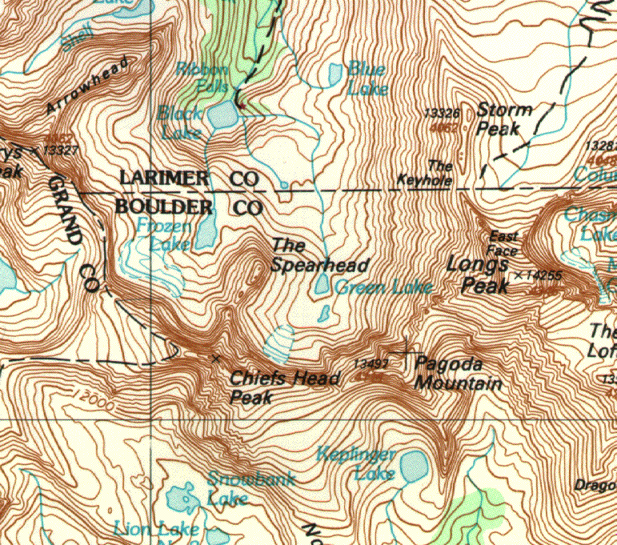

Slide 37
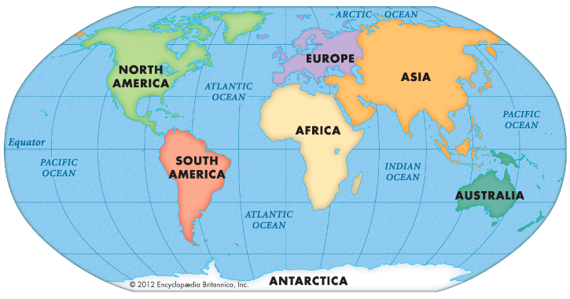
Continents
The world is divided into 7 continents. You will need to be able to locate and label them on a map along with geographic characteristics; Africa, Antarctica, Asia, Australia, Europe, North America, South America

Slide 38
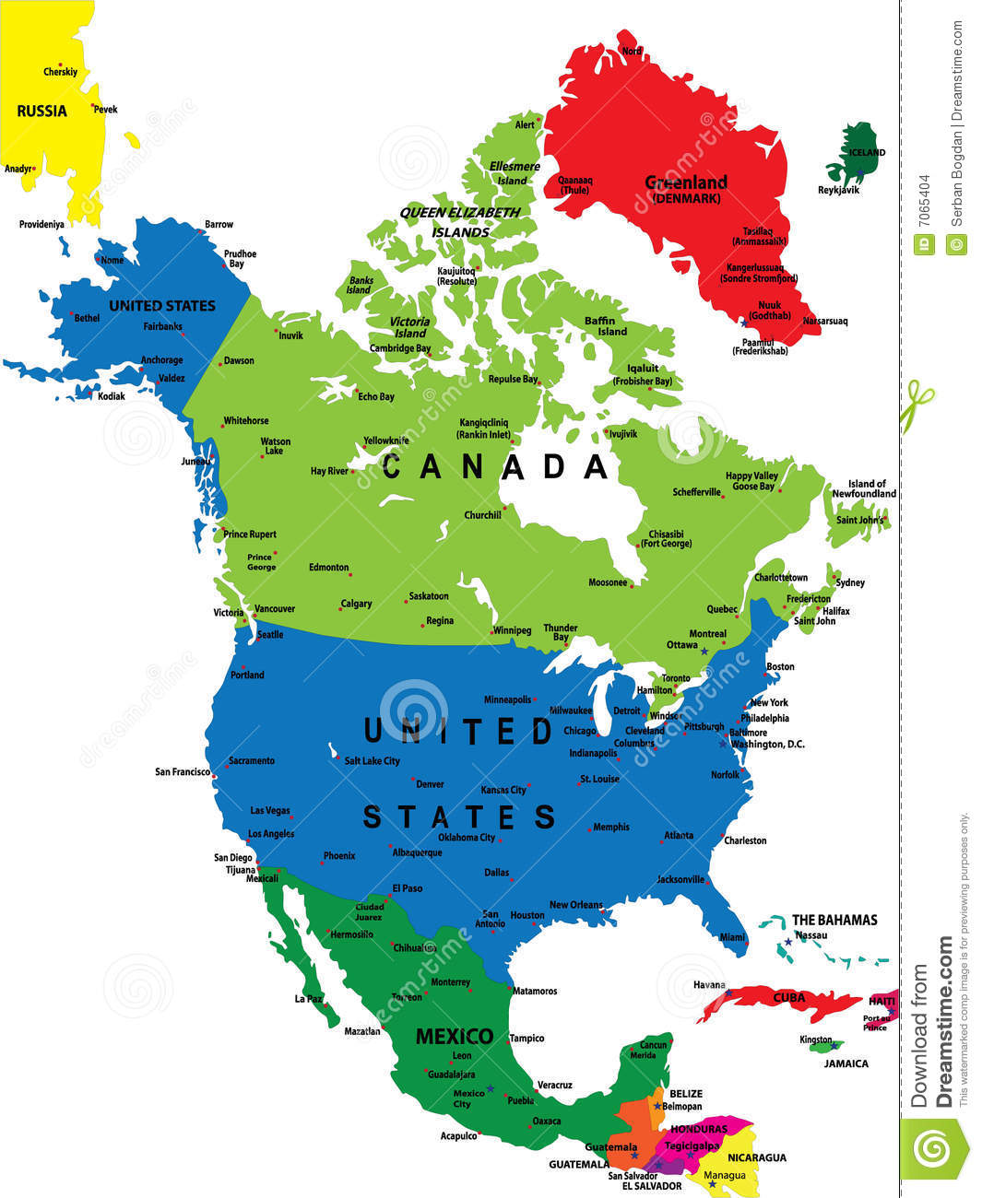
North America
Canada, United States, Mexico

Slide 39
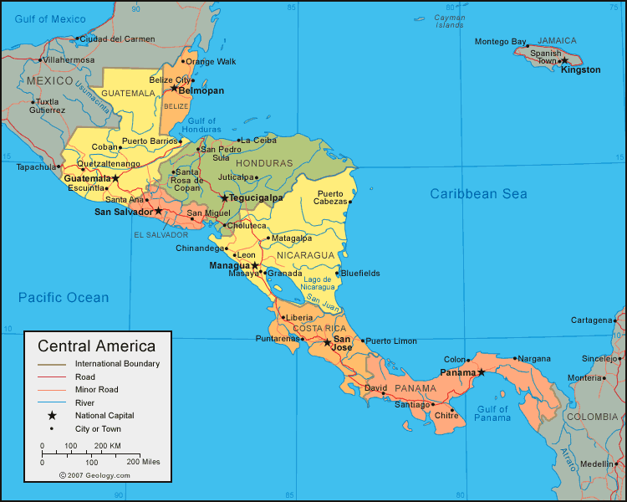
North America
Central America (still part of North America): Guatemala, Belize, El Salvador, Honduras, Nicaragua, Costa Rica, Panama

Slide 40
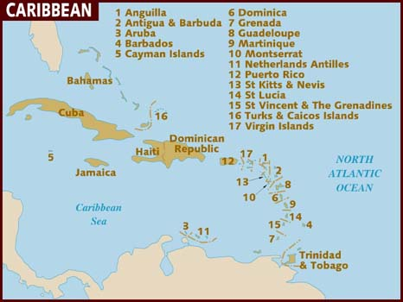
North America
Caribbean (still part of North America): Anguilla, Antigua, Aruba, Barbados, Cayman Islands, Dominica, Grenada, Guadalupe, Martinique, Montserrat, Netherlands Antilles, Puerto Rico?, St. Kitts & Nevis, St. Lucia, St. Vincent & Grenadines, Turks & Caicos, Virgin Islands, Cuba, Bahamas, Dominican Republic, Haiti, Jamaica, Trinidad & Tobago

Slide 41
Country Project:
Country Project:
You will be randomly given a country. Once the state is selected you will research characteristics of that country.
Example Characteristics:
What is the history of the country?
How has this evolved?
What is the standard of living?
How do people earn a living/what is the economy based on?
What are the important geographic considerations in your country?
Who are notable residents of the country?
What is the current political climate? (how stable is the country? When did they have a revolution etc?)

Slide 42
Countries:
Country Project:
You will turn in a written report on your country (1-2 pages). You will also make your state presentations on September 22th. The project will have 2 separate grades – one for the written portion – one for the presentation
Today we will be assigned our countries and work on initial research. – you will be given some class time each day for the next two weeks

Slide 43
Countries Project:
Timeline:
September 3 – pick country and get as much initial information as possible
September 5th – continue with research/begin organization of material
September 8th – turn in outline of both written report and oral presentation

Slide 44

REGIONS OF THE UNITED STATES:
Timeline:
September 11th (rough draft of report is due)
September 15th (rough drafts will be returned with feedback)
September 21st country report is due along with presentation
Go to www.quia.com/pages/jchristman38/page28
click on the geolocator
The first location that you are given a picture of is the location that you will do your report on.

Slide 45
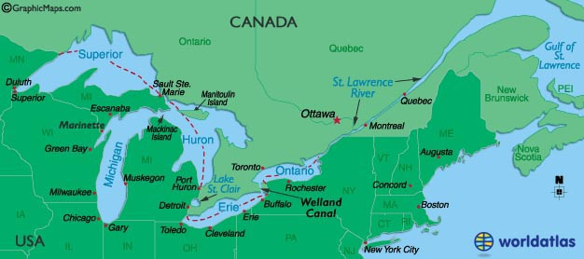
REGIONS OF THE UNITED STATES:
Midwest Geography:
The Great Lakes are vitally important to the Midwest: (ocean access)

Slide 46
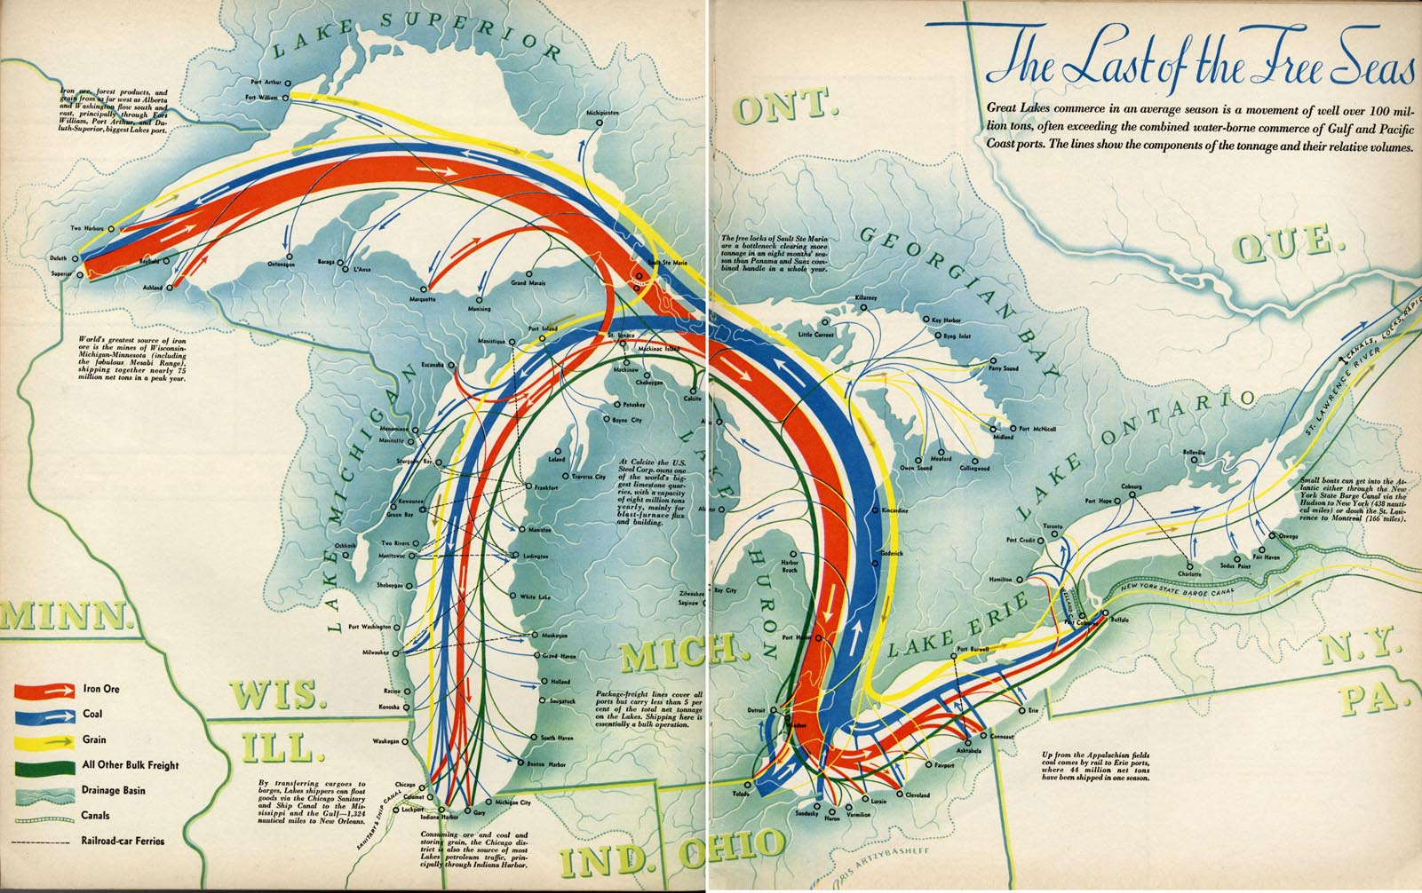
REGIONS OF THE UNITED STATES:
Influence of the Great Lakes: iron ore mining (from Northern Minnesota – was shipped to southern Lake Michigan (to be turned into steel) and Michigan/Ohio (to be turned into automobiles)

Slide 47
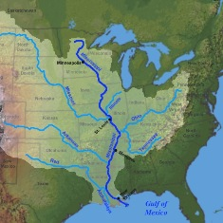
REGIONS OF THE UNITED STATES:
Mississippi River:
Has provided access and exchange for cultural ideas of the Midwest to flow down river as well as the influence of the South to flow up river (think Jazz/Blues which both have roots in the Lower Mississippi River Delta

Slide 48
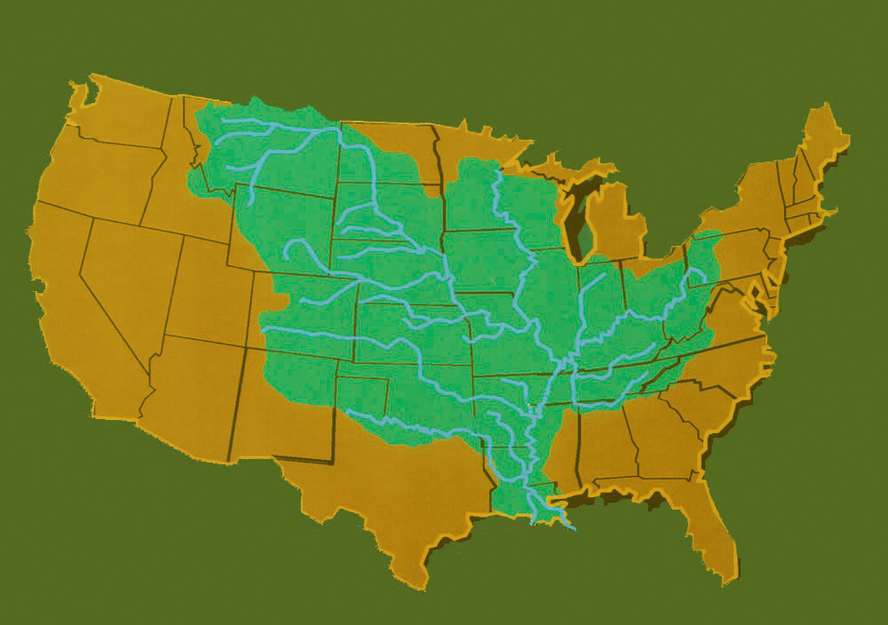
REGIONS OF THE UNITED STATES:
Mississippi River: the most important river in the United States as it provides port (access to the oceans) for the region from the Rocky Mountains to the Appalachian Mountains
The Mississippi River has very strongly influenced cultural exchange up and down the River – think the influence of the Blues and of Jazz (both from the southern Mississippi River Delta

Slide 49
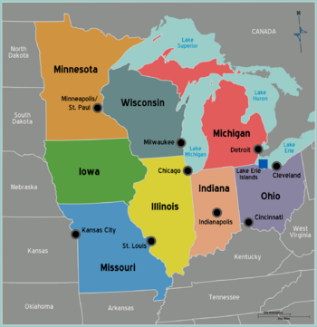
REGIONS OF THE UNITED STATES:
Major Midwestern Cities: Chicago, Detroit, Cleveland, Minneapolis/St. Paul, Kansas City, St. Louis,
Indianapolis, Cincinnati

Slide 50
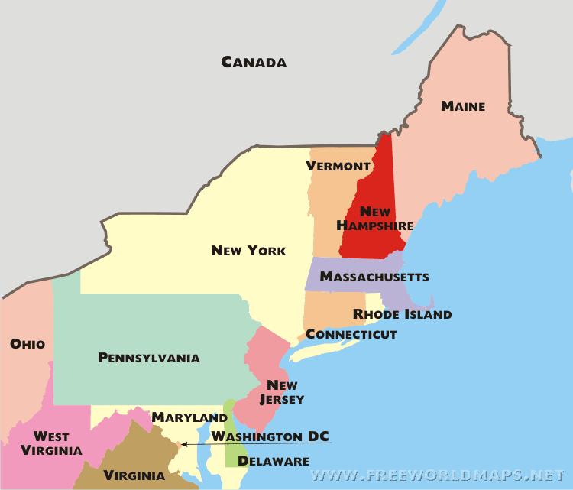
REGIONS OF THE UNITED STATES:
Northeast: the most populous region of the United States – also the wealthiest region of the United States
Includes the states of: Maine, New Hampshire, Vermont, Massachusetts, New York, Rhode Island, Connecticut, Pennsylvania, New Jersey, Delaware, Maryland

Slide 51
REGIONS OF THE UNITED STATES:
Northeast: the economic activity of the region is comprised of mainly trade with Europe and the financial services sector (banks, brokerage houses, stock market, etc.)
New York City is the major city in the region (we will look at others also but NYC deserves special mention) It is the financial services headquarters of the world

Slide 52
Outline
7th grade outlines are due at the end of class – eighth grade outlines are due at the beginning of class on Tuesday ! ! !
Format:
The title of your project (this could be as simple as the name of the place you are researching or feel free to get much more creative:
Introduction: How are you going to introduce your project? What are strategies that good writers use to introduce material? (you do not need to write the introduction here but you should include the idea of what the introduction will consist of

Slide 53
Outline
Format
Body paragraph 1:
What is the first topic that you are going to write about? It should be one of the more interesting things you found – this along with the introduction capture the readers/listeners interest
Body paragraph 2:
This will be where you include some of the more factual but perhaps less interesting elements of the research – a lot of young writers struggle here as the information still needs to flow

Slide 54
Outline
Format
Body paragraph 3 (might not actually be the 3rd paragraph) this is a great time to transition away from historical information to more contemporary (present day) information
Conclusion:
This will be the lasting impression that you leave on the reader – this along with the introduction need to be the strongest pieces of writing/the best part of the presentation

Slide 55
Outline
Appearance:
Introduction
Main idea or more interesting information
a. A story about an important event or person
b. Transition sentence to the most information dense portion of the paper
Informational piece (organization of this section is vital)
a. Piece of information 1
b. Piece of information 2
c. Piece of information 3 etc
Modern information (move away from the historical into the present (follow format from step III
Conclusion

