Slide 1

Learning Objectives
LO1 Journalize and post closing entries for a service business organized as a proprietorship.
© 2014 Cengage Learning. All Rights Reserved.

Slide 2
Need for Permanent and Temporary Accounts
Lesson 8-1
LO1
Accounts used to accumulate information from one fiscal period to the next are called permanent accounts.
Permanent accounts are also referred to as real accounts.
Accounts used to accumulate information until it is transferred to the owner’s capital account are called temporary accounts.
Temporary accounts are also referred to as nominal accounts.

Slide 3
Need for Closing Temporary Accounts
Lesson 8-1
LO1
Journal entries used to prepare temporary accounts for a new fiscal period are called closing entries.
The temporary account balances must be reduced to zero at the end of each fiscal period.

Slide 4
Need for the Income Summary Account
Lesson 8-1
LO1
When revenue is greater than total expenses, resulting in a net income, the Income Summary account has a credit balance, as shown in the T account.
Income Summary
Debit
Total expenses
Credit
Revenue (greater than expenses)
(Credit balance is the net income.)
When total expenses are greater than revenue, resulting in a net loss, the Income Summary account has a debit balance, as shown in the T account.
Income Summary
Debit
Total expenses (greater than revenue)
(Debit balance is the net loss.)
Credit
Revenue

Slide 5
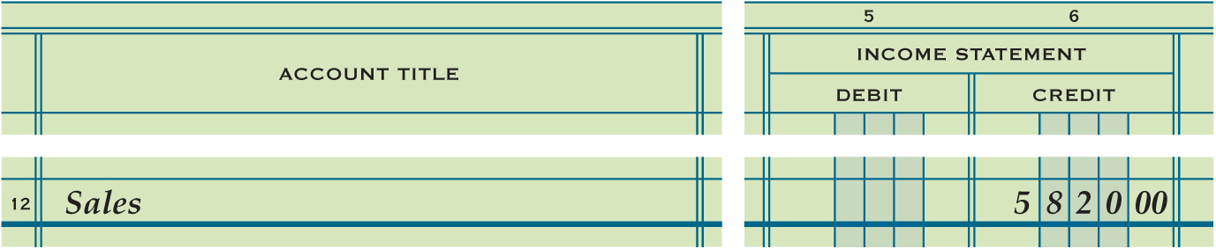
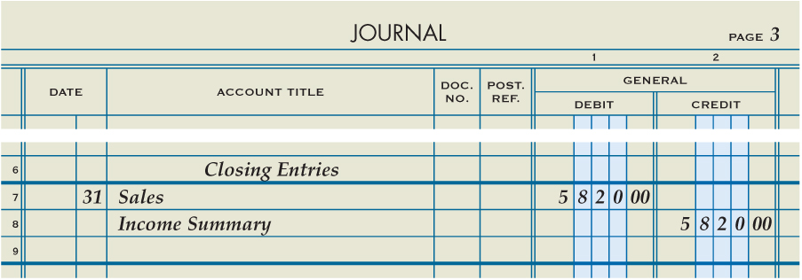
Closing Entry for an Income Statement Account with a Credit Balance
Lesson 8-1
LO1
Sales
Closing 5,820.00
Bal. 5,820.00
(New Bal. 0.00)
Income Summary
Closing (revenue) 5,820.00
(Debit to close)
3
Debit
Heading
1
Date
2
4
Credit

Slide 6
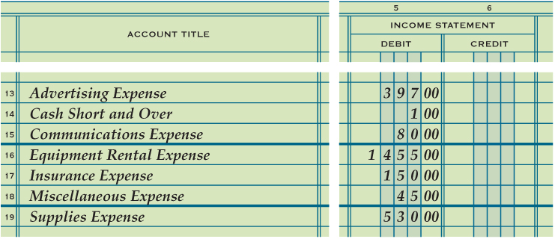
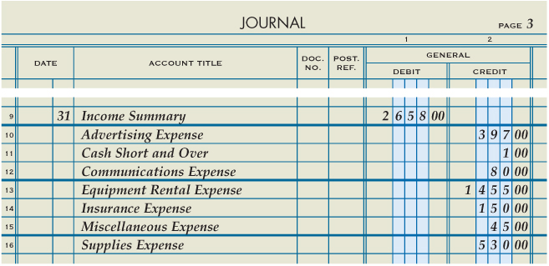
Closing Entry for Income Statement Accounts with Debit Balances
Lesson 8-1
LO1
(Credit to close)
Debit Amount
Income Summary
Date
Credit

Slide 7
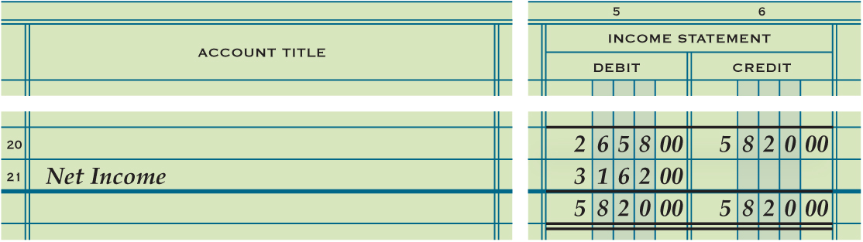
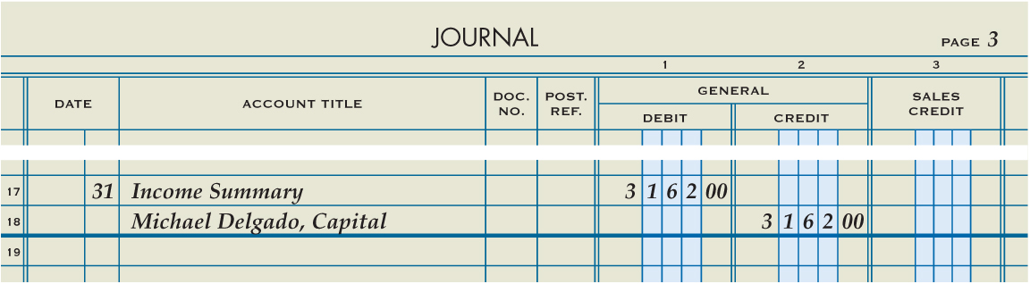
Closing Entry to Record Net Income or Loss and Close the Income Summary Account
Lesson 8-1
LO1
(Capital: credit to record net income)
(Income Summary: debit to close)
2
Debit
Date
1
3
Credit

Slide 8
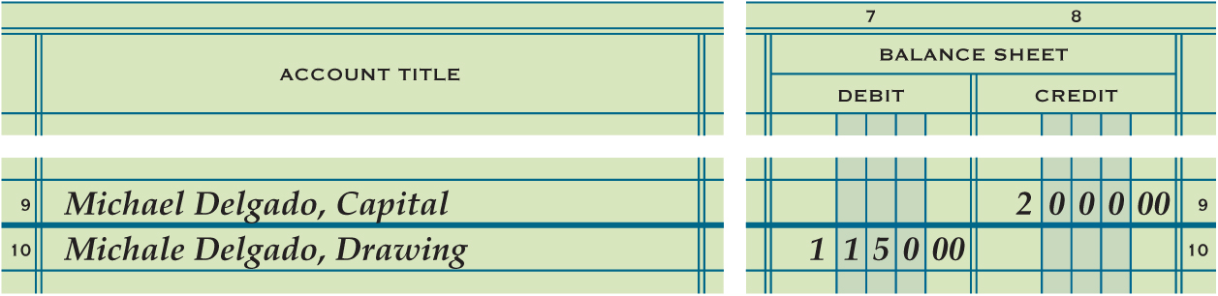
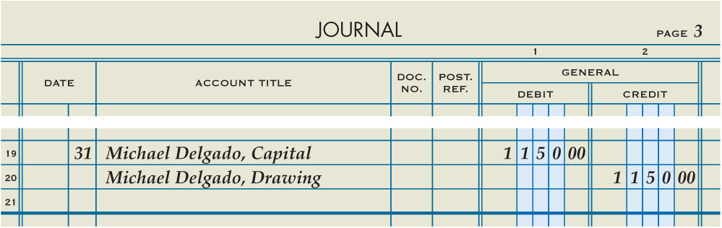
Closing Entry for the Owner’s Drawing Account
Lesson 8-1
LO1
(Credit to close)
Date
1
2
Debit
3
Credit

Slide 9

Lesson 8-1 Audit Your Understanding
Lesson 8-1
1. What do the ending balances of permanent accounts for one fiscal period represent at the beginning of the next fiscal period?
ANSWER
Beginning balances

Slide 10
Lesson 8-1 Audit Your Understanding
Lesson 8-1
2. What do the balances of temporary accounts show?
ANSWER
Changes in the owner’s capital account for a single fiscal period.

Slide 11
Lesson 8-1 Audit Your Understanding
Lesson 8-1
3. List the four closing entries.
ANSWER
1. An entry to close income statement accounts with credit balances.
2. An entry to close income statement accounts with debit balances.
3. An entry to record net income or net loss and close the Income Summary account.
4. An entry to close the owner’s drawing account.

