Slide 1

Learning Objectives
LO2 Prepare a post-closing trial balance.
© 2014 Cengage Learning. All Rights Reserved.

Slide 2
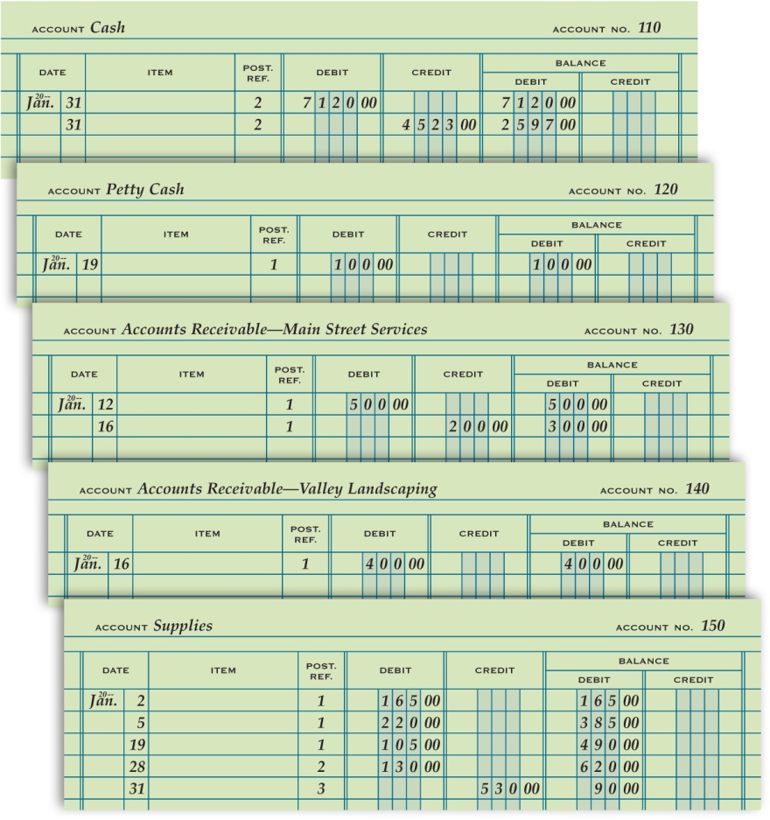
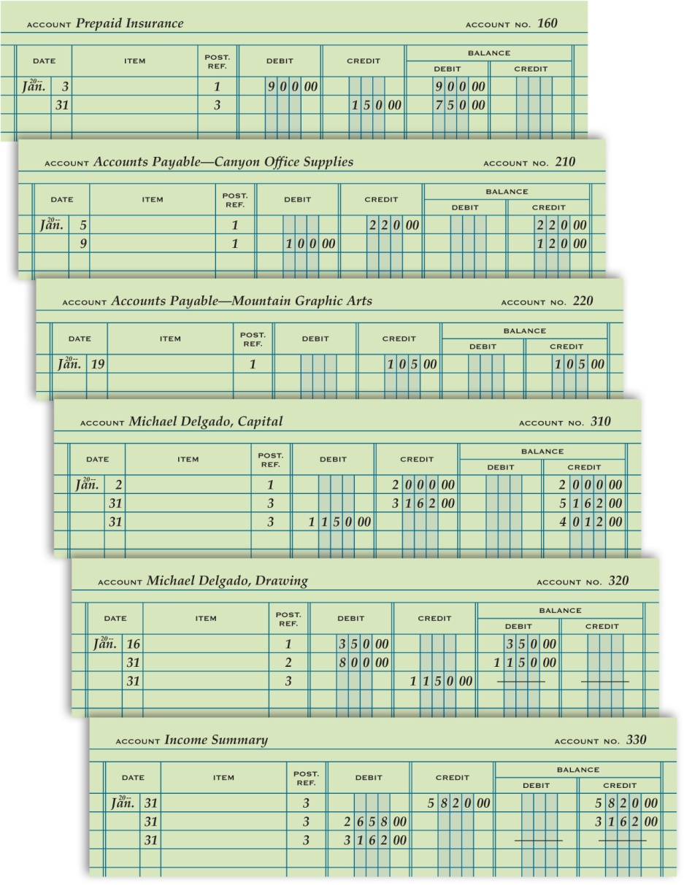
General Ledger Accounts after Closing Entries Are Posted
Lesson 8-2
LO2

Slide 3
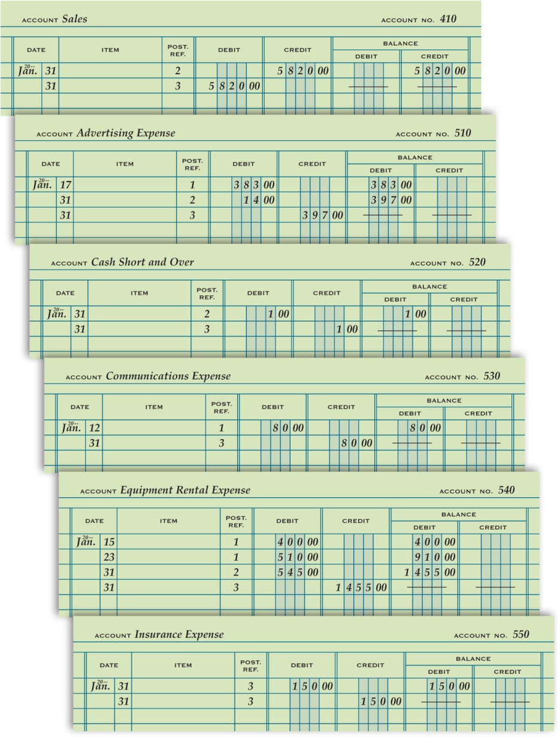
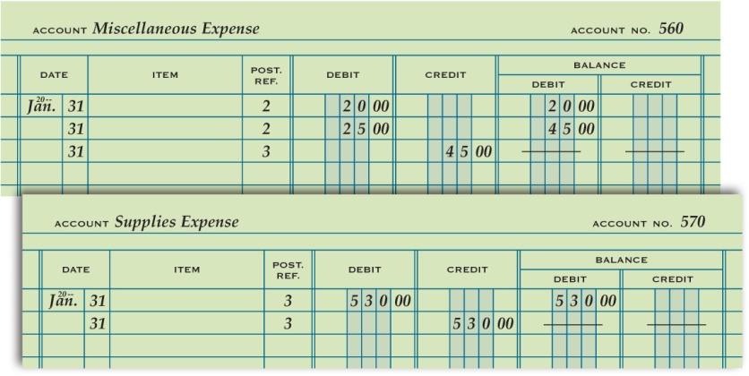
General Ledger Accounts after Closing Entries Are Posted
Lesson 8-2
LO2

Slide 4
Post-Closing Trial Balance
Lesson 8-2
LO2
A trial balance prepared after the closing entries are posted is called a post-closing trial balance.

Slide 5
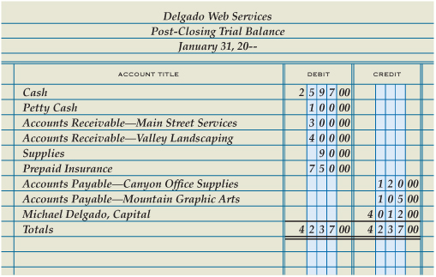
Post-Closing Trial Balance
Lesson 8-2
LO2
Heading
1
Account
Titles
Account
Balances
2
3
4
Single
Rule
Totals
6
Compare Totals
5
Double Rule
8
7
Record Totals

Slide 6
Accounting Cycle for a Service Business
Lesson 8-2
LO2
The series of accounting activities included in recording financial information for a fiscal period is called an accounting cycle.

Slide 7
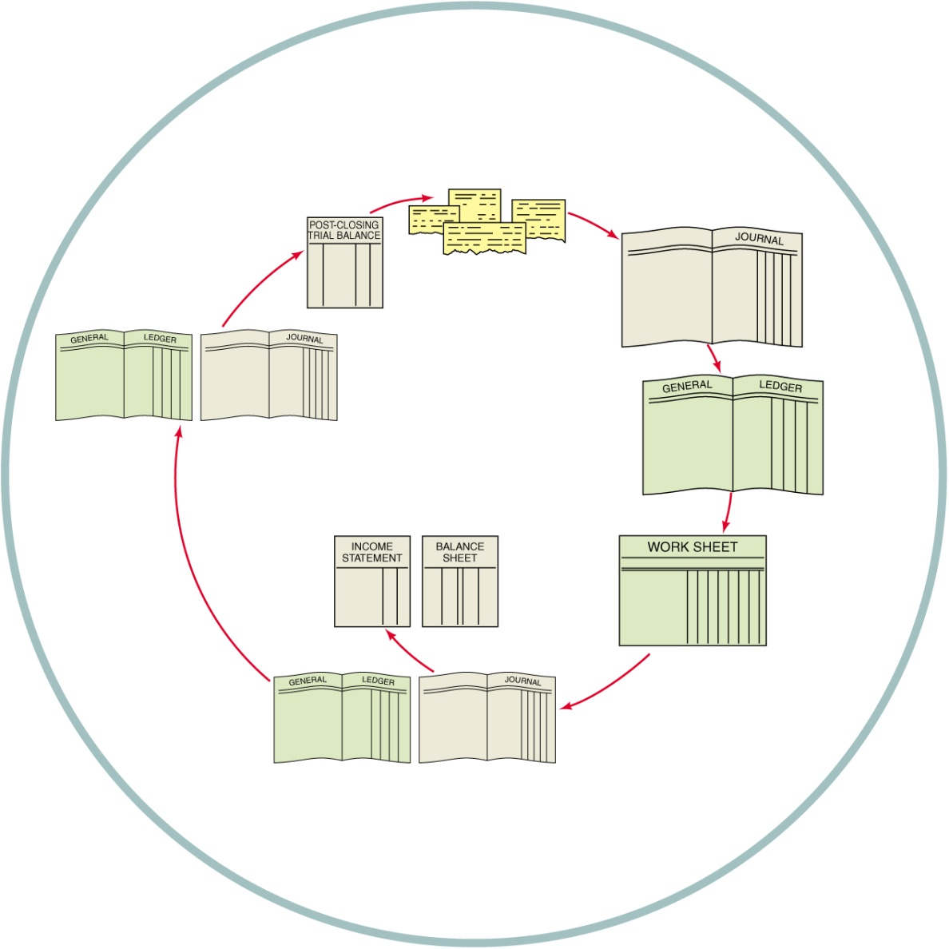
Accounting Cycle for a Service Business
Lesson 8-2
LO2
1. Analyze transactions
1
2. Journalize
2
8
3. Post
4. Prepare work sheet
5. Journalize and post adjusting entries
3
7
6. Prepare financial statements
6
4
7. Journalize and post closing entries
5
8. Prepare post-closing trial balance

Slide 8

Lesson 8-2 Audit Your Understanding
Lesson 8-2
1. Why are lines drawn in both the Balance Debit and Balance Credit columns when an account has a zero balance?
ANSWER
To assure a reader that a balance has not been omitted

Slide 9
Lesson 8-2 Audit Your Understanding
Lesson 8-2
2. Which accounts go on the post-closing trial balance?
ANSWER
Only those with balances (permanent accounts)

Slide 10
Lesson 8-2 Audit Your Understanding
Lesson 8-2
3. Why are temporary accounts omitted from a post-closing trial balance?
ANSWER
Because they are closed and have zero balances

Slide 11
Lesson 8-2 Audit Your Understanding
Lesson 8-2
4. What are the steps in the accounting cycle?
ANSWER
1. Analyze transactions.
2. Journalize.
3. Post.
4. Prepare work sheet.
5. Journalize and post adjusting entries.
6. Prepare financial statements.
7. Journalize and post closing entries.
8. Prepare post-closing trial balance.

