Slide 1

Learning Objectives
LO6 Prepare a payroll register.
LO7 Prepare employee earnings records.
© 2014 Cengage Learning. All Rights Reserved.

Slide 2
Payroll Register
Lesson 12-3
LO6
A payroll register summarizes the earnings, deductions, and net pay of all employees for one pay period.

Slide 3
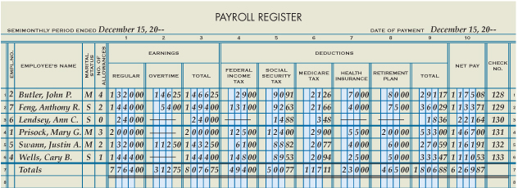
Payroll Register
Lesson 12-3
LO6
Pay Period
Date
Social
Security Tax
Medicare
Tax
Health
Insurance
Retirement
Plan
Payment
Date
Earnings
1
4
6
7
8
9
2
3
5
12
10
11
13
Employee
Personal Data
Federal
Income Tax
Total, Prove,
and Rule
Total
Deductions
Net Pay
Check
Number

Slide 4
Employee Earnings Records
Lesson 12-3
LO7
A business form used to record details of an employee’s earnings and deductions is called an employee earnings record.

Slide 5
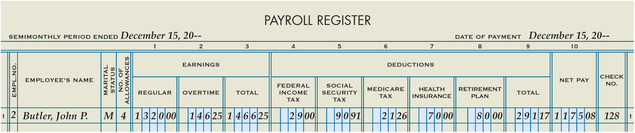
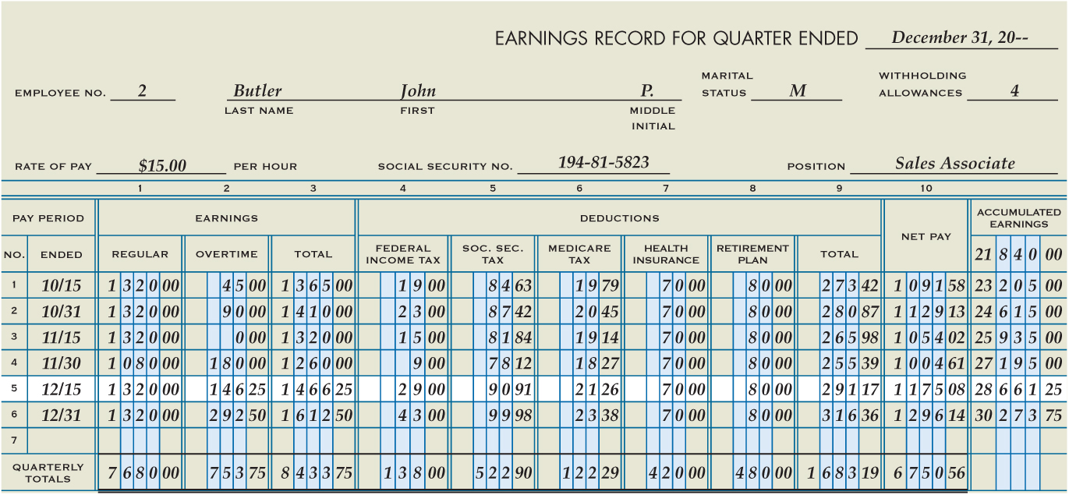
Employee Earnings Records
Lesson 12-3
LO7
2
Employee
Personal Data
4
Pay
Period
5
Earnings, Deductions,
Net Pay
1
Last Day of Quarter
3
Beginning
Accumulated
Earnings
Updated Accumulated Earnings
6
7
Total and Prove

Slide 6

Lesson 12-3 Audit Your Understanding
Lesson 12-3
1. What does the payroll register summarize?
ANSWER
The payroll register summarizes the payroll for one pay period and shows total earnings, payroll withholdings, and net pay for all employees.

Slide 7
Lesson 12-3 Audit Your Understanding
Lesson 12-3
2. How is net pay calculated?
ANSWER
By subtracting total deductions from total earnings

Slide 8
Lesson 12-3 Audit Your Understanding
Lesson 12-3
3. Why do companies complete employee earnings records?
ANSWER
Because a business must send quarterly and annual reports to federal and state governments showing employee taxable earnings and taxes withheld from employee earnings

