Slide 1
Chapter 2
Biochemistry
Notes:
Photo Credit: © John Conrad/CORBIS

Slide 2
Organization of matter
(simplest to most complex)
Atom
Molecule
Organelle
Cell
Tissue
Organ
Organ system
Multicellular organism
Species
Population
Community
Ecosystem
Biosphere

Slide 3
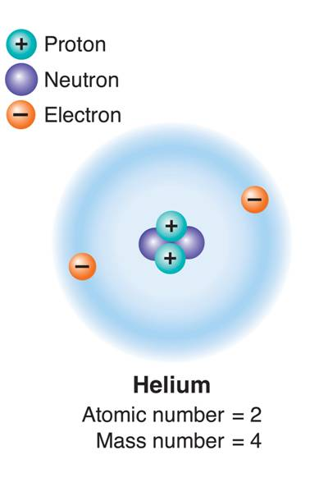
Atoms
Atoms
  The study of chemistry begins
  with the basic unit of matter, the
  atom.
  The subatomic particles that
  make up atoms are
    Protons (+)
    Neutrons (0)
    Electrons (-)
Notes:
The Greek philosopher Democritus called the smallest fragment of matter the atom, from the Greek word atomos.
Placed side by side, 100 million atoms would make a row only about 1 centimeter long.
Atoms contain subatomic particles that are even smaller.

Slide 4
Atoms
Atoms
  Atoms always have a neutral charge.
  How can that be?
  They have the same number of protons (+) as electrons (-), the charges cancel.
Notes:
The Greek philosopher Democritus called the smallest fragment of matter the atom, from the Greek word atomos.
Placed side by side, 100 million atoms would make a row only about 1 centimeter long.
Atoms contain subatomic particles that are even smaller.

Slide 5
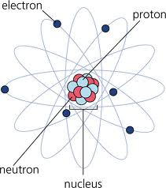
Atoms
Protons: positively charged particles (+)
Neutrons: no charge
Nucleus: center of the atom; contains protons and neutrons
Notes:
Strong forces bind protons and neutrons together to form the nucleus, which is at the center of the atom.
What would the charge on the nucleus be?

Slide 6
Atoms
Electron: a negatively charged particle (−)
  1/1840 the mass of a proton.
Orbitals: space surrounding nucleus where the electrons are found
Notes:
Electrons are attracted to the positively charged
nucleus but remain outside the nucleus because
of the energy of their motion.
Electrons are in constant motion.
Valence shell: the last orbital

Slide 7
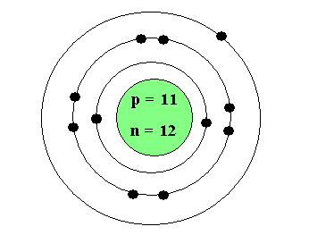
Atomic Model
Bohr Model
Orbital # of e- required to fill
1st (closest to nucleus) 2
2nd 8
3rd 8
Notes:
Electrons are attracted to the positively charged
nucleus but remain outside the nucleus because
of the energy of their motion.
Electrons are in constant motion.
Valence shell: the last orbital

Slide 8
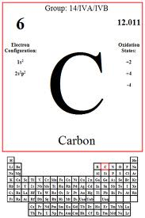
Elements
Element: a pure substance that consists entirely of one type of atom.
    Elements are represented by a one- or two-letter symbol.
      C stands for carbon.
      Na stands for sodium.
Notes:
More than 100 elements are known, but only about two dozen are commonly found in living organisms.

Slide 9
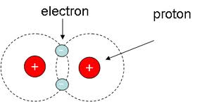
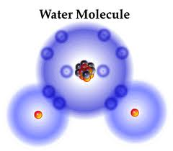
Chemical Bonds
Molecule – a combination of 2 or more atoms. Example H₂ (2 H atoms)
Compound – a combination of 2 or more different atoms in definite proportions. Example H₂0 (2 H atoms; 1 Oxygen atom)
Notes:
Sharing electrons means that the moving electrons actually travel in the orbitals of both atoms

Slide 10
Chemical Compounds
Chemical formula: shorthand to show the composition of compounds
  Water, H₂O
1 Oxygen
2 Hydrogen

Slide 11
Element Info

Slide 12
How can you determine how many p+, e-, n⁰ an atom has?
Atomic Number:
represents the number of protons
(and therefore the number of electrons)
Atomic Mass Number:
the weight of the atom;
represents the number of neutrons + protons
How would you find the number of neutrons?
Atomic Mass # - Atomic # = # of nuetrons
Notes:
(the weight of the e- is so small it is not counted when we consider atomic mass

Slide 13
How do elements combine?
Chemical bonding – the attraction, sharing, or transfer of electrons between atoms.
How elements combine to form compounds and molecules
Chemical Reactions – the forming and breaking of bonds
The rearrangement of elements to form new chemicals
It’s all about the electrons!!
The goal of bonding is to achieve a stable structure (a full outer shell).
Full outer shell ☺
Not full outer shell ☹

Slide 14
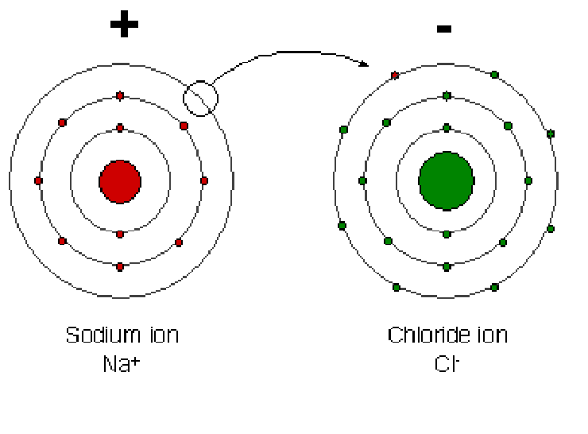
How do elements combine?
Ionic Bonding – when 1 or more electrons are transferred from one atom to another
Forms ions (atoms with a positive or negative charge)

Slide 15
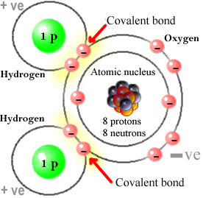
How do elements combine?
Covalent Bonding – formed when electrons are shared between atoms.
Forms compounds or molecules
Example Water H₂O

Slide 16
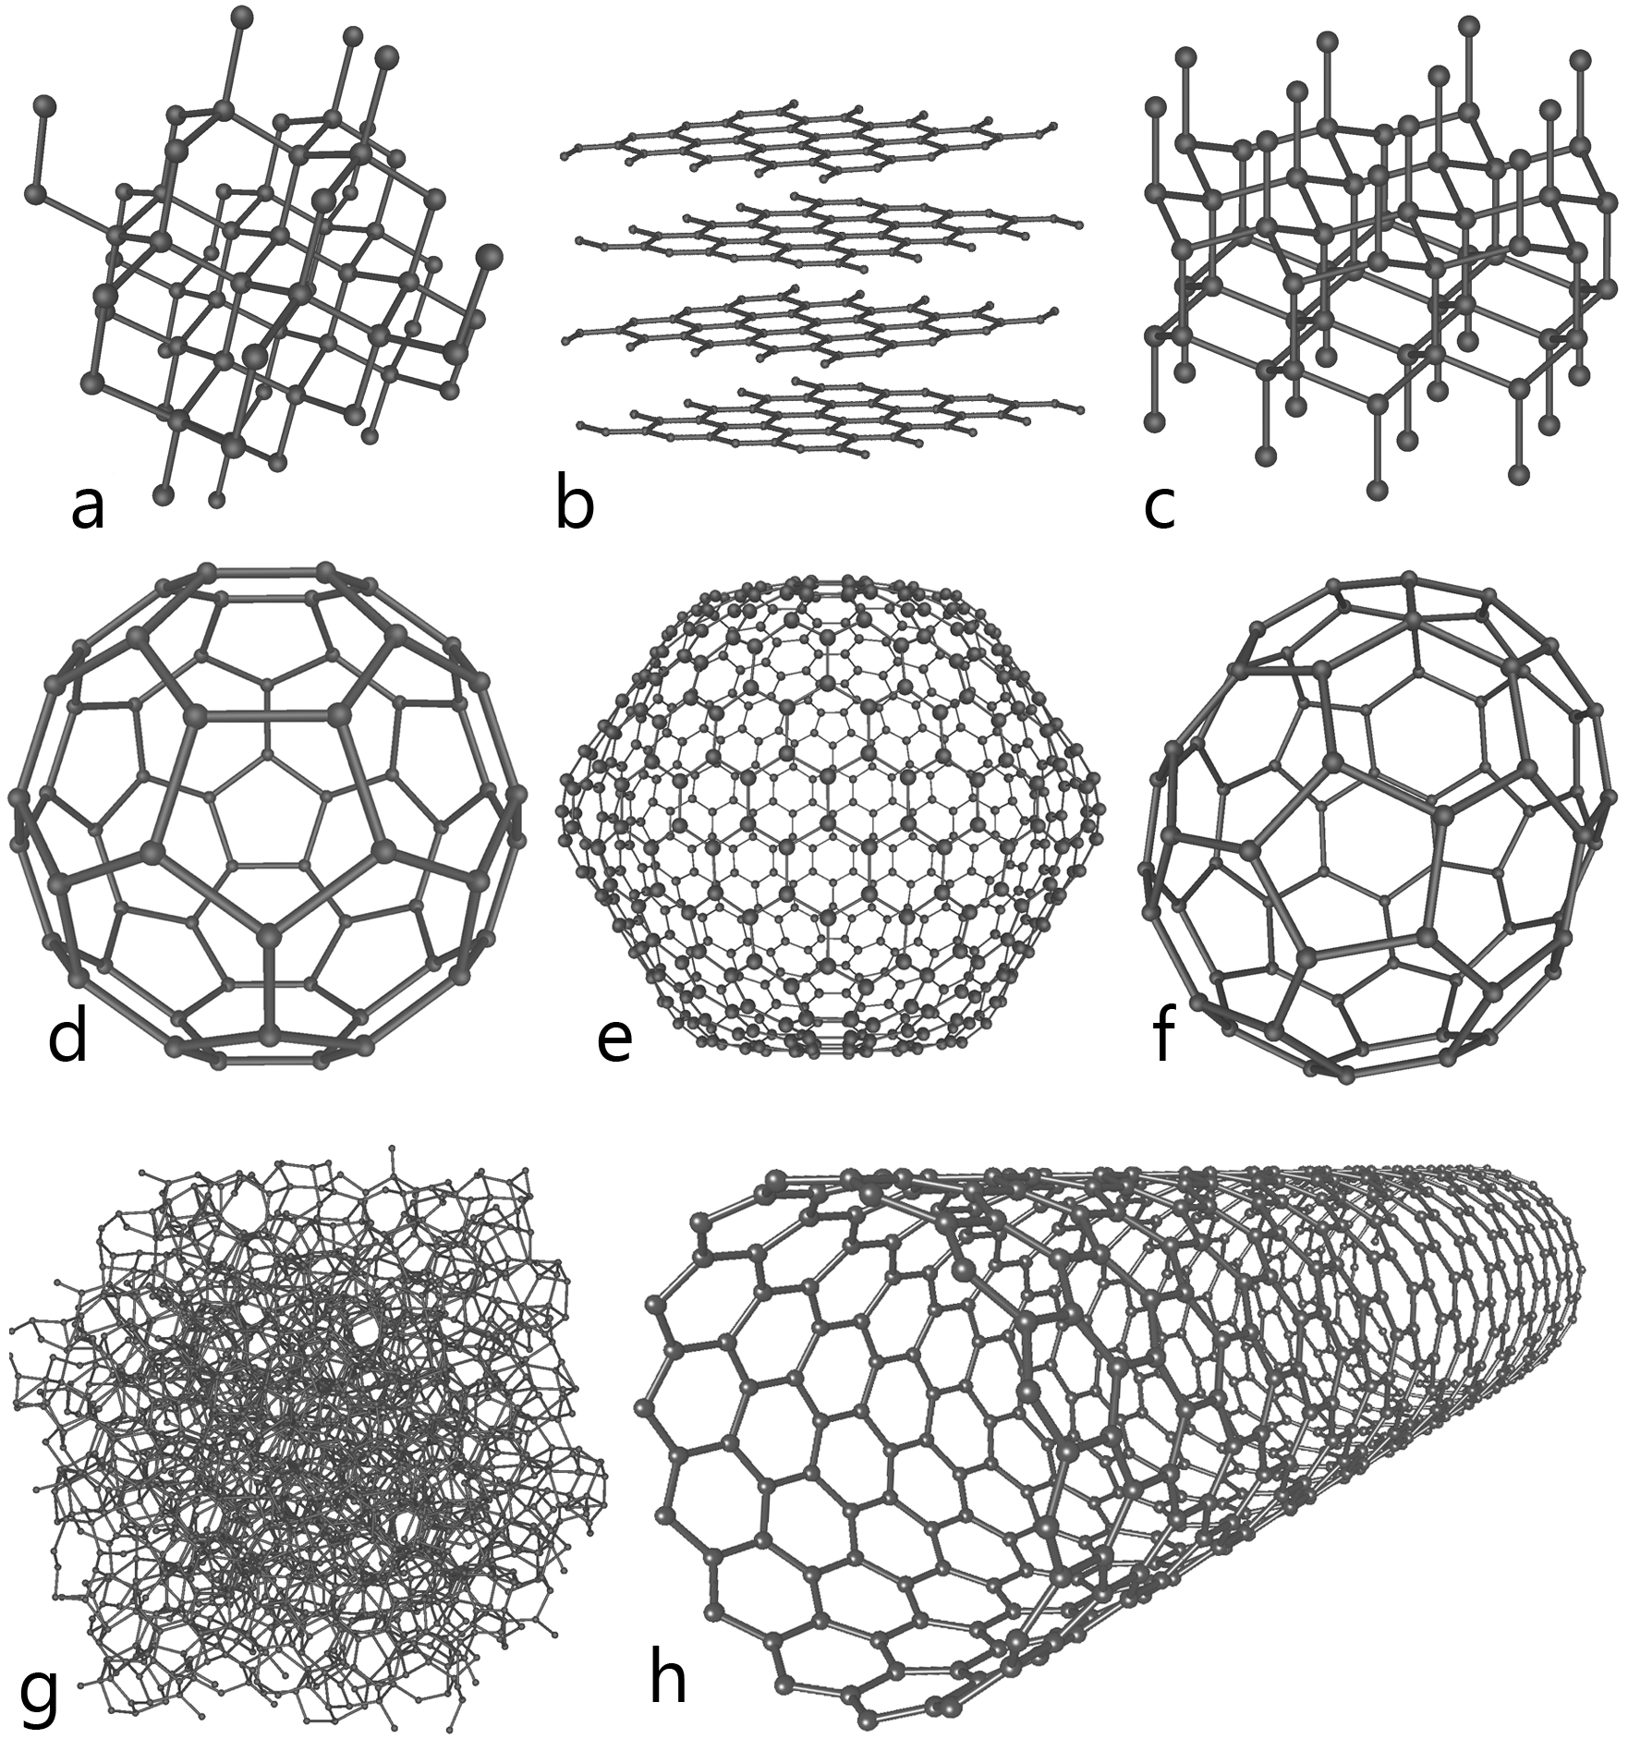
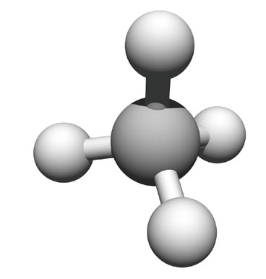
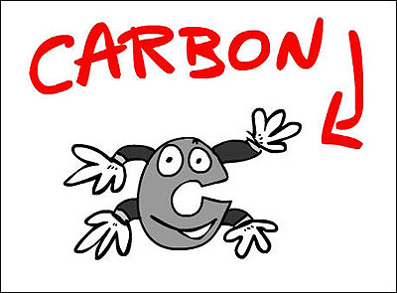
2–3 Carbon Compounds
Notes:
Photo Credit: © John Conrad/CORBIS

Slide 17
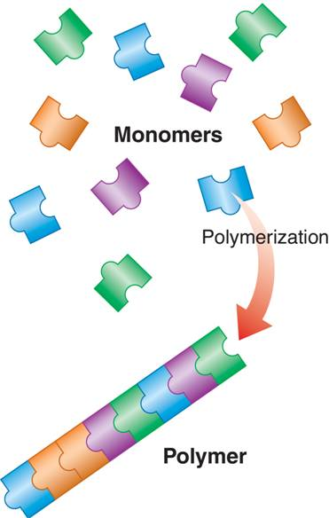
Biomolecules
Biomolecules are made up of polymers.
Polymers are long Carbon chains made up of repeated linked units called monomers.
=polymer
Monomers are small building blocks made up mostly of carbon and hydrogen atoms
        = Monomer
Notes:
When small molecules called monomers join together, they form polymers, or large molecules.
Monomers in a polymer may be identical, or the monomers may be different.

Slide 18
Dehydration synthesis
Dehydration synthesis (aka polymerization): the process by which polymers are formed
+ + H₂O
Monomer + Monomer Polymer + water

Slide 19
Hydrolysis
Hydrolysis: the process by which polymers are broken down into monomers
+ H₂O +
Polymer + water Monomer + Monomer

Slide 20
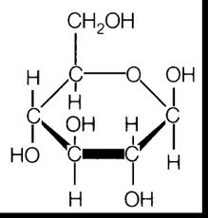
The Chemistry of Carbon
Organic Chemistry – reactions between molecules containing carbon-carbon bonds
Organic Molecules contain C and H
  Plus other elements
  also called biomolecules or macromolecules

Slide 21
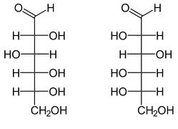
Organic molecules
The basic structure for an organic molecule is a C-H chain.
How many bonds can a carbon atom make?
  4
Notes:
Because carbon can form 4 different bonds it leads to a great variety of molecules

Slide 22
Organic Molecules
Four groups of organic compounds found in living things are:
    carbohydrates
    lipids
    nucleic acids
    Proteins
These are called biomolecules

Slide 23
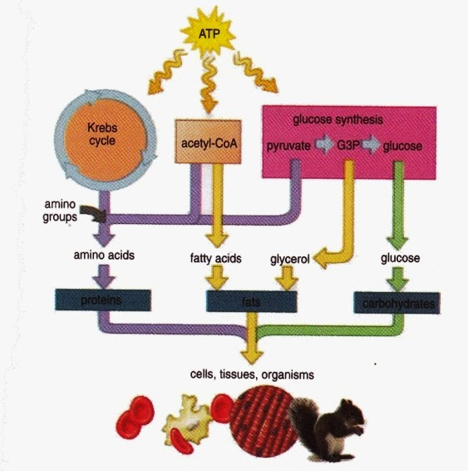
Biomolecules
Most organisms get the basic structure for all four biomolecules by eating sugar.
The carbon, hydrogen, and oxygen in the sugar is then rearranged and combined with other elements to form proteins, nucleic acids, lipids, and other carbohydrates.

Slide 24
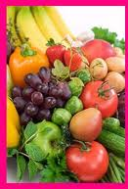
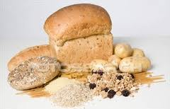
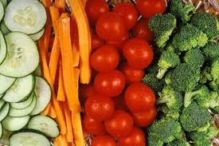
Carbohydrates
Carbohydrates: compounds made up of carbon, hydrogen, and oxygen atoms
    usually in a ratio of 1 : 2 : 1 (CH₂O)

Slide 25
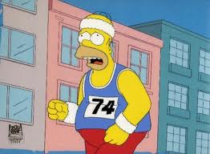
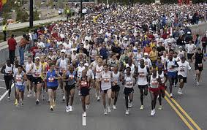
Carbohydrates
Function:
  Supply energy that cells require
  Supply materials to build certain cell structures
  Stored as reserve energy supplies
Notes:
The breakdown of sugars, such as glucose, supplies immediate energy for all cell activities.
Living things store extra sugar as complex carbohydrates known as starches.

Slide 26
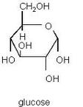
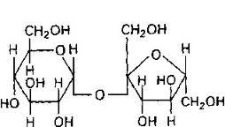
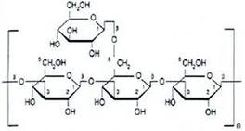
Carbohydrates
Monomer: monosaccharides (simple sugars)
  i.e. glucose, fructose
Disaccharides:
2 monosaccharides
  i.e. sucrose and lactose
Polysaccharides: 3 or more monosaccharides

Slide 27
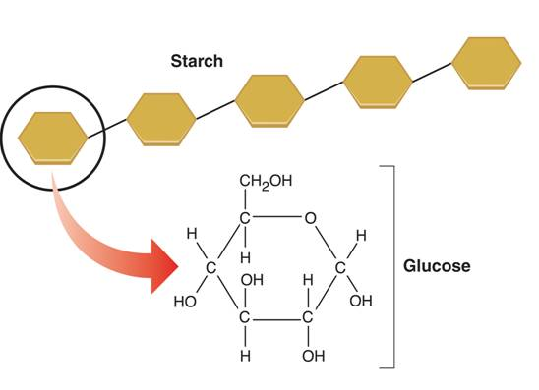
Carbohydrates
  Starches and sugars are examples of carbohydrates that are used by living things as a source of energy.
Glucose
Notes:
Starches and sugars are examples of carbohydrates that are used by living things as a source of energy. Starches form when sugars join together in a long chain.

Slide 28
Examples and their function
Sugar: simple carb; short-term energy storage
Starch: human complex carb; medium-term energy storage
Glycogen: Animal complex carb; medium-term energy storage
Cellulose: Plants complex carb; structural support (cell wall)

Slide 29
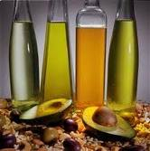
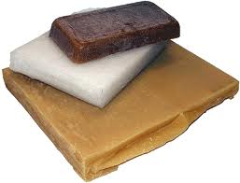
Lipids
Lipids: compounds made up of mostly carbon and hydrogen, but do have a little oxygen
    generally not soluble in water.
Common categories of lipids are:
  fats
  oils
  waxes
  steroids
Notes:
have more C-H bonds than carbs)
Fats are a more efficient form of energy storage than carbs because of this.

Slide 30
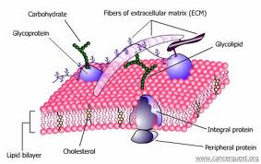
Lipids
Function:
  Long-term energy storage
  important parts of biological membranes and waterproof coverings

Slide 31
Lipids
Monomer: Fatty acids and glycerol
Polymer:
  Triglyceride: 3 fatty acids combine with each glycerol;
  Phosopholipid: 2 fatty acids and a phosphate group combine with each glycerol
  Examples: Steroids, Waxes

Slide 32
Two types of fatty acids:
Saturated – each C atom is bound to as many H atoms as possible
  saturated with H
  solids at room temp (ie butter)
Unsaturated –not bound to max # of H
  liquid at room temp (ie olive oil)
Notes:
If there is at least one carbon-carbon double bond in a fatty acid, it is unsaturated.
Lipids whose fatty acids contain more than one double bond are polyunsaturated.
Lipids that contain unsaturated fatty acids tend to be liquid at room temperature.

Slide 33
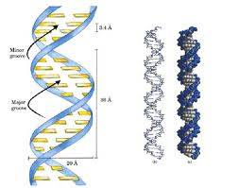
Nucleic Acids
Nucleic Acids: macromolecules containing hydrogen, oxygen, nitrogen, carbon, and phosphorus

Slide 34
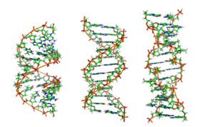
Nucleic Acid
Function:
  Store and transmit genetic information.
  Form genes
  Instructions for making proteins

Slide 35
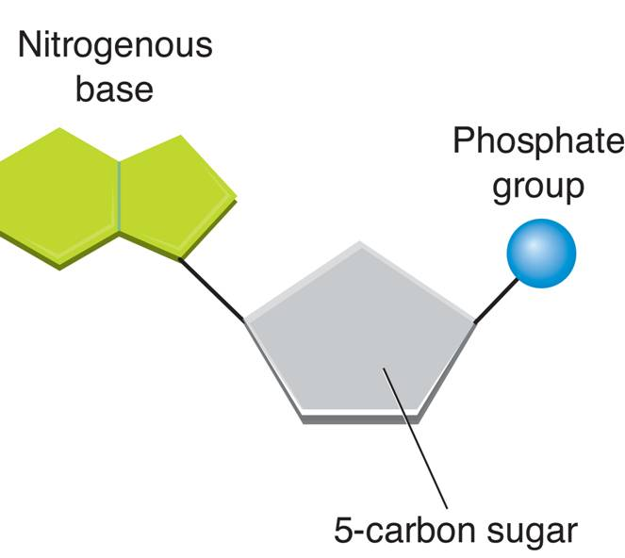
Nucleic Acids
Monomer: nucleotide
  Nucleotides consist of three parts:
      a 5-carbon sugar (ribose or deoxyribose)
      a phosphate group
      a nitrogenous base
Polymer: polynucleotide or nucleic acid
  Examples: ribonucleic acid (RNA) and deoxyribonucleic acid (DNA)

Slide 36
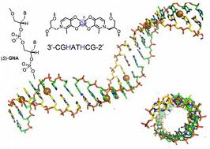
DNA
contains deoxyribose
coil-shaped, double helix strands
encodes info on how an organism will grow and develop
encodes sequences of all the cell’s proteins

Slide 37
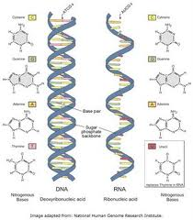
RNA
contains ribose
single stranded
involved in making working copies of genes
carries DNA’s message from one
part of the cell to another

Slide 38
Proteins
Proteins: macromolecules that contain nitrogen, carbon, hydrogen, and oxygen.
  Has amino group (NH₂)
  Carboxyl group (COOH)

Slide 39
Proteins
Function
  control the rate of reactions and regulate cell processes
  used to form bones and muscles
  transport substances into or out of cells or help to fight disease

Slide 40
Proteins
Monomer: Amino Acids
Polymer: Polypeptides
  2 or more amino acids held together by a peptide bond

Slide 41
Proteins
Examples and Functions:
Antibodies: Defend the body
Collagen: makes up cartilage; gives strength to skin and bones
Enzymes: Increase rates of rxns
Notes:
Some chemical reactions that make life possible are too slow or have activation energies that are too high to make them practical for living tissue.
These chemical reactions are made possible by catalysts.

Slide 42
Enzymes
A catalyst is a substance that speeds up the rate of a chemical reaction.
  work by lowering the energy required to start a reaction – called activation energy
Catalysts that are also proteins are called enzymes
  Each enzyme has a particular target molecule called the substrate
Notes:
Enzymes are proteins that act as biological catalysts.
Enzymes speed up chemical reactions that take place in cells.
Enzymes act by lowering the activation energy.
Enzymes are very specific, generally catalyzing only one chemical reaction.

Slide 43
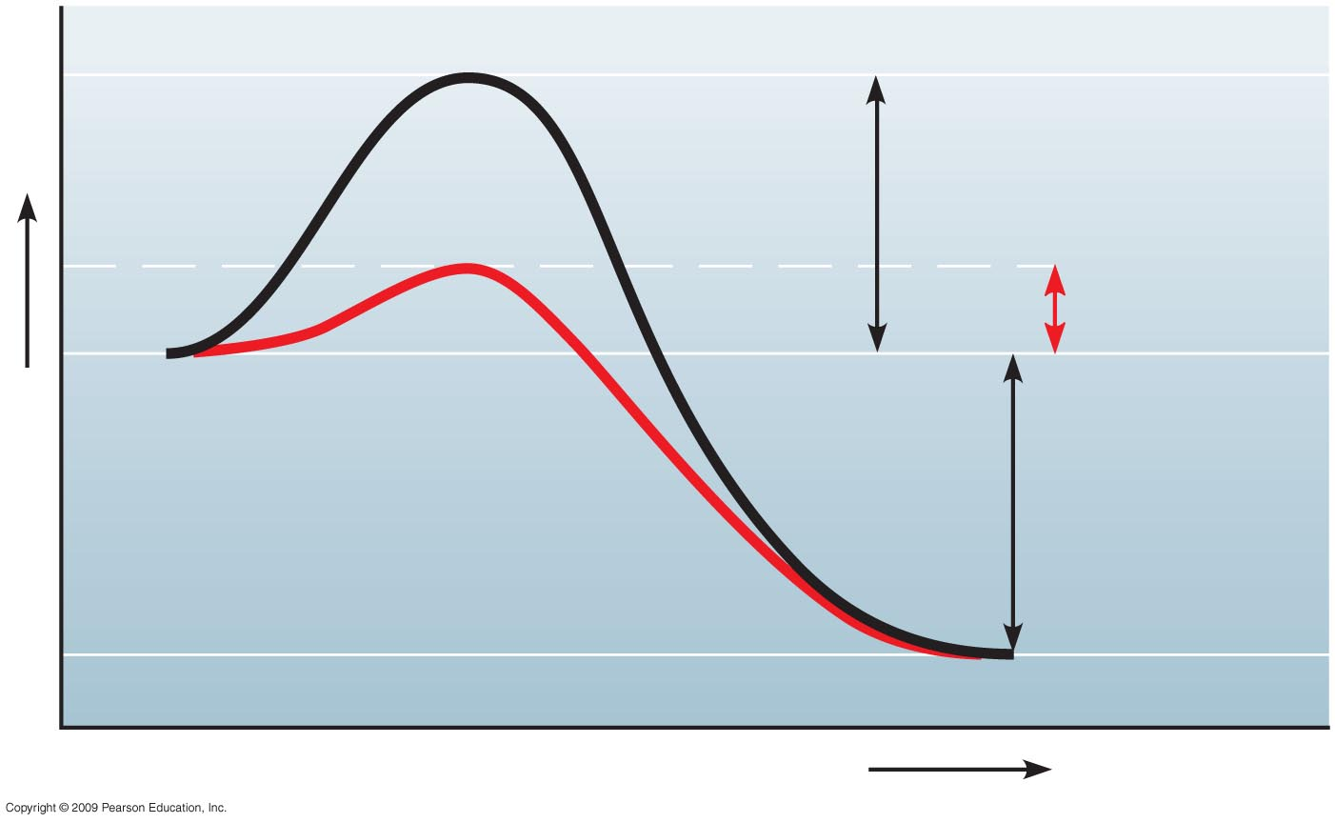
Reaction
without
enzyme
E_{A} without
enzyme
E_{A} with
enzyme
Reactants
Energy
Net
change
in energy
(the same)
Reaction with
enzyme
Products
Progress of the reaction
Notes:
Figure 5.14 The effect of an enzyme is to lower E_{A}.

Slide 44
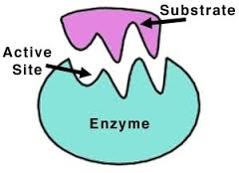
5.15 A specific enzyme catalyzes each cellular reaction
Enzymes have unique three-dimensional shapes
  The shape is critical to their role as biological catalysts
  active site: where the enzyme interacts with the enzyme’s substrate
    Each active site only fits one specific substrate
Copyright © 2009 Pearson Education, Inc.
Notes:
Student Misconceptions and Concerns
1. The specific interactions of enzymes and substrates can be illustrated with simple physical models. Many students new to these concepts will benefit from several forms of explanation, including diagrams such as those in the textbook, physical models, and the opportunity to manipulate or create their own examples. Just like pitching a tent, new concepts are best constructed with many lines of support.
Teaching Tips
1. The information in DNA is used to direct the production of RNA, which in turn directs the production of proteins. However, in Chapter 3, four different types of biological molecules were noted as significant components of life. Students who think this through might wonder, and you could point out that DNA does not directly control the production of carbohydrates and lipids. So how does DNA exert its influence over the synthesis of these two chemical groups? The answer is largely by way of enzymes, proteins with the ability to promote the production of carbohydrates and lipids.
2. The text notes that the relationship between an enzyme and its substrate is like a handshake, with each hand generally conforming to the shape of the other. This induced fit is also like the change in shape of a glove when a hand is inserted. The glove’s general shape matches the hand, but the final “fit” requires some additional adjustments.

Slide 45
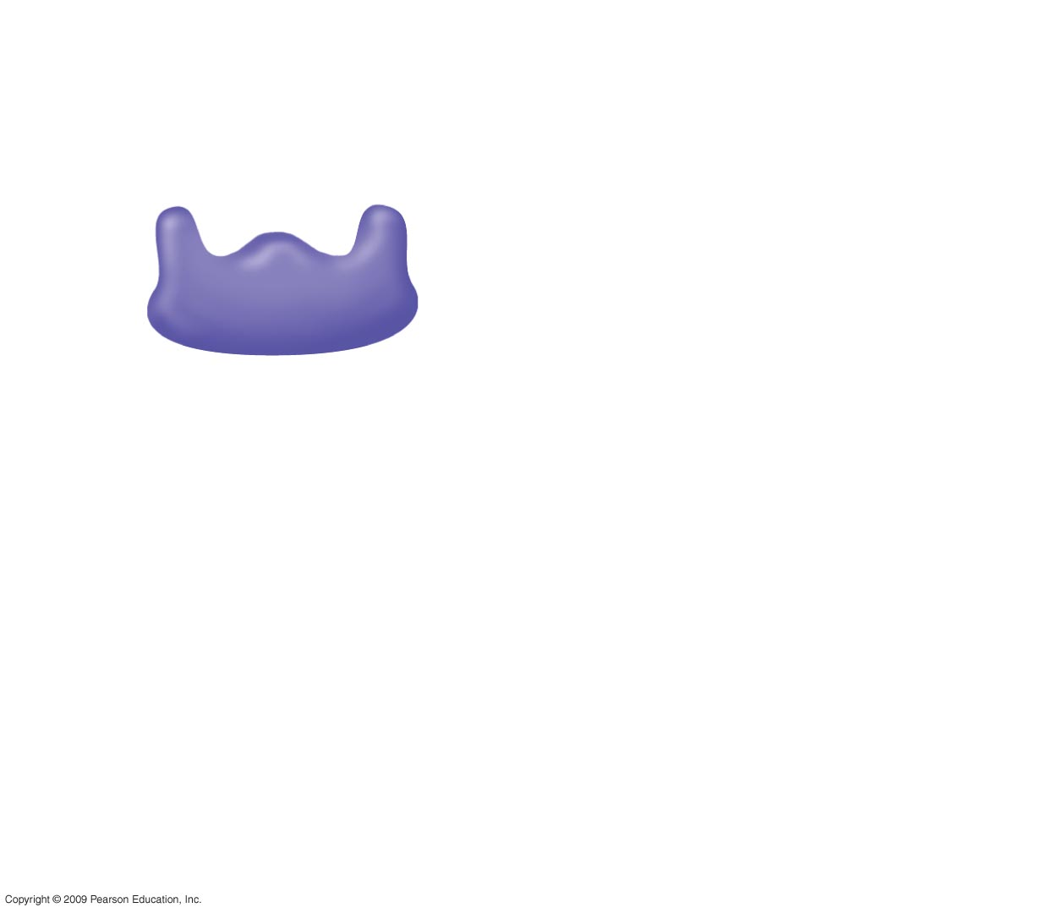
1
Enzyme available
with empty active
site
Active site
Enzyme
(sucrase)
Notes:
Figure 5.15 The catalytic cycle of an enzyme.

Slide 46
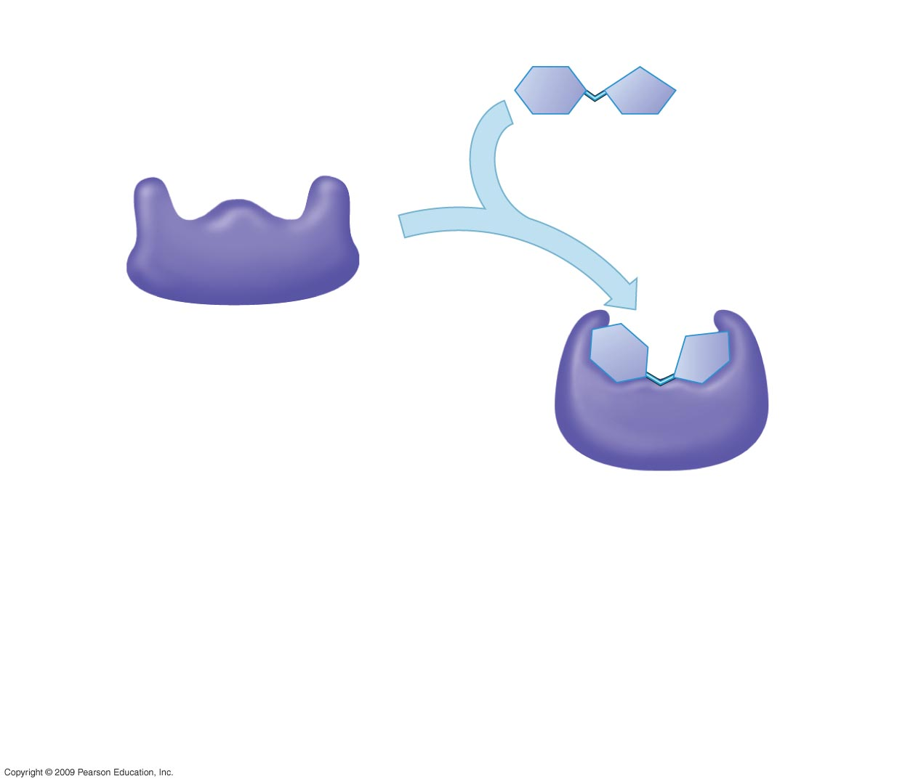
1
Enzyme available
with empty active
site
Active site
Substrate
(sucrose)
2
Substrate binds
to enzyme with
induced fit
Enzyme
(sucrase)
Notes:
Figure 5.15 The catalytic cycle of an enzyme.

Slide 47
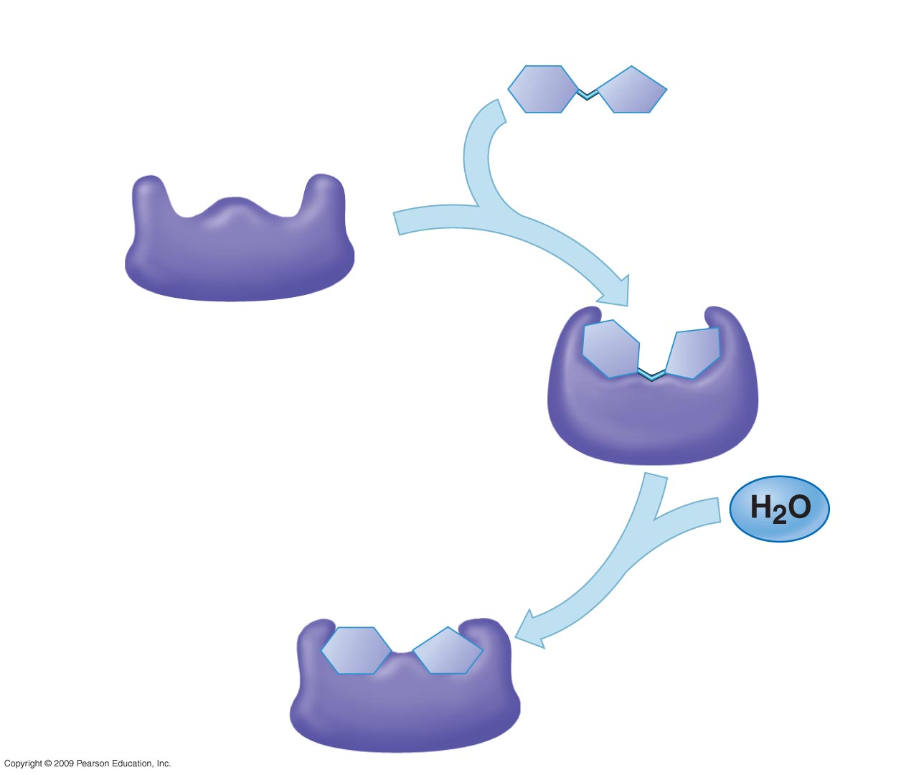
1
Enzyme available
with empty active
site
Active site
Substrate
(sucrose)
2
Substrate binds
to enzyme with
induced fit
Enzyme
(sucrase)
3
Substrate is
converted to
products
Notes:
Figure 5.15 The catalytic cycle of an enzyme.

Slide 48
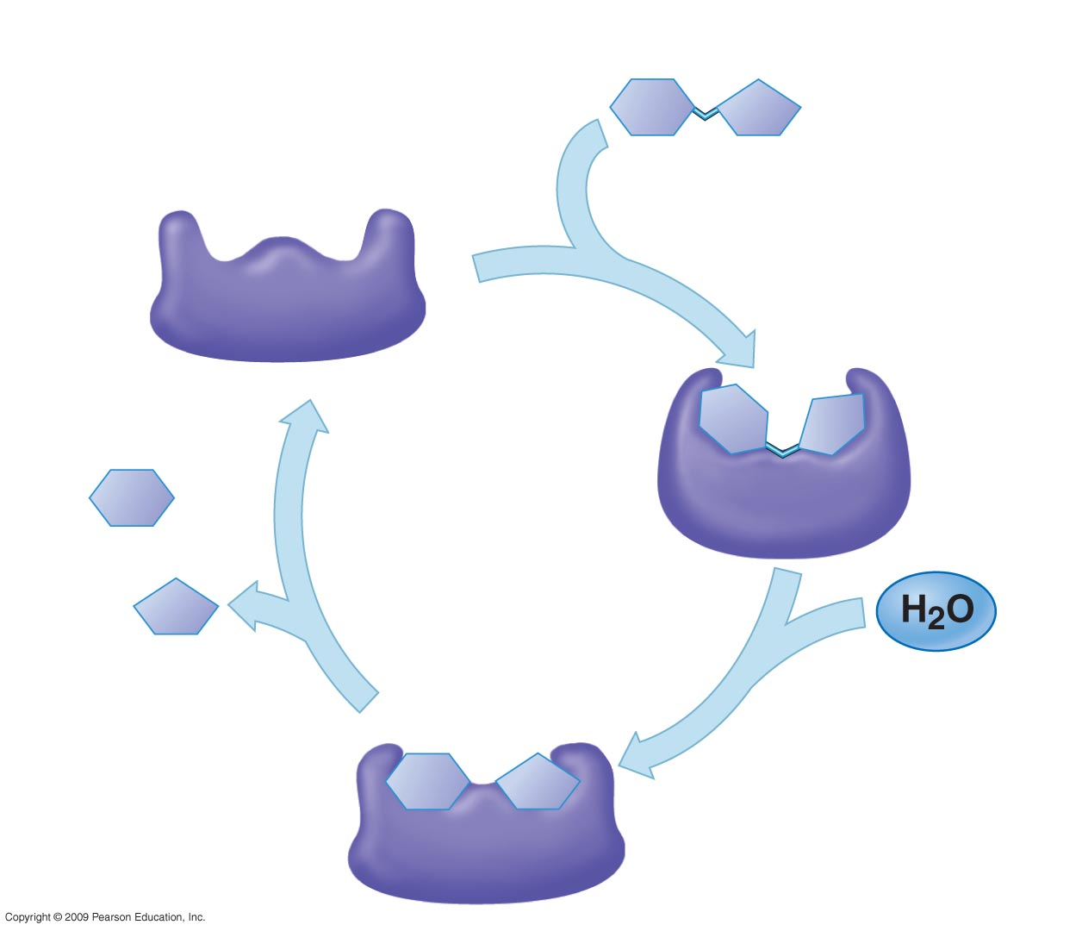
1
Enzyme available
with empty active
site
Active site
Substrate
(sucrose)
2
Substrate binds
to enzyme with
induced fit
Enzyme
(sucrase)
Glucose
Fructose
4
Products are
released
3
Substrate is
converted to
products
Notes:
Figure 5.15 The catalytic cycle of an enzyme.

Slide 49
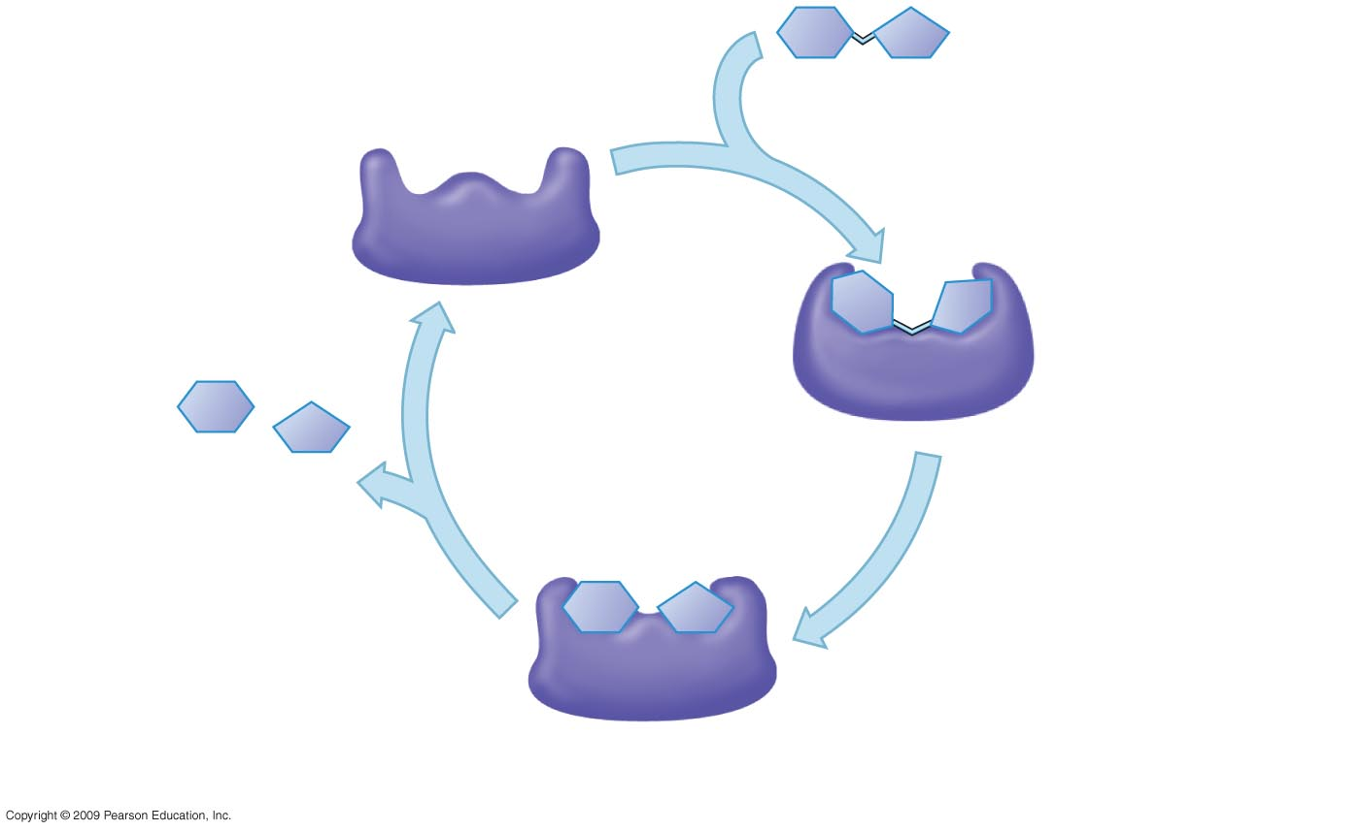
c.
b.
a.
d.
f.
e.

