Slide 1
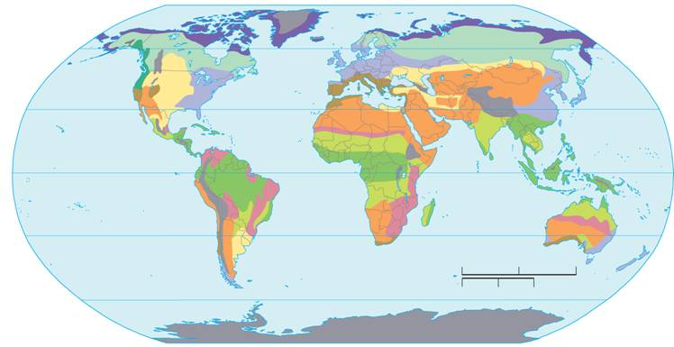
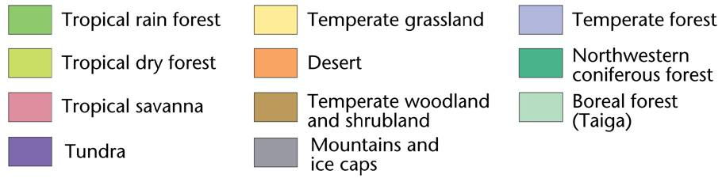
4-3 Biomes
A physical environment that contains a specific collection of plants and animals.
60°N
30°N
0° Equator
30°S
60°S
Tropical rain forest
Temperate grassland
Temperate forest
Tropical dry forest
Desert
Northwestern
coniferous forest
Tropical savanna
Temperate woodland
and shrubland
Boreal forest
(Taiga)
Tundra

Slide 2
Land Biomes
Ecologist use the concept of biomes to classify different types of large ecosystems.
classified by their characteristics:
  Climate
  Terrain
  Vegetation
  Inhabitants
Notes:
Ecologist use the concept of biomes to classify the many different types of ecosystems within our Biosphere.
Ecologist recognize at least 10 different biomes
Their names give clues to their environment and location
Example: Northwestern coniferous forest
Location: Northwestern North America
Type of environment? forest
Types of trees? coniferous

Slide 3
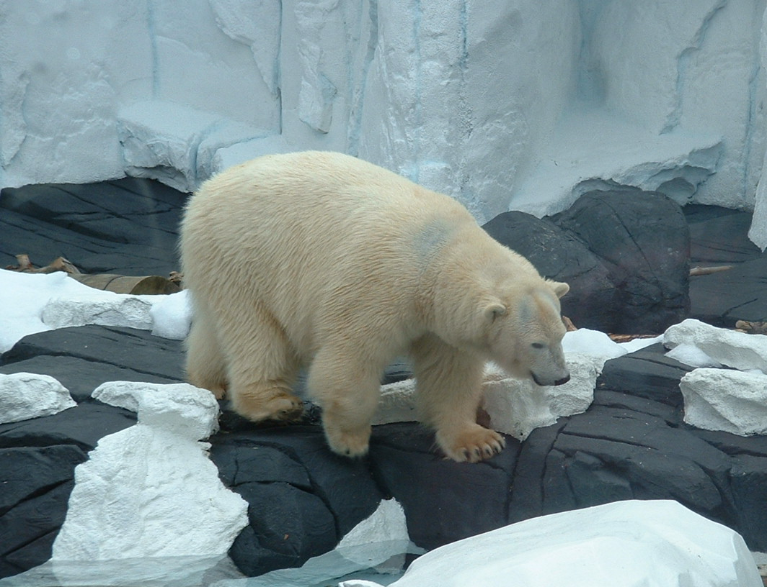
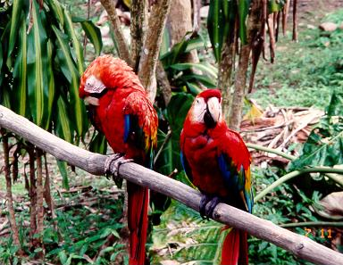
Population Range
Geographical limitations
  abiotic & biotic factors
    temperature, rainfall, food, predators, etc.
  habitat
adaptations to
polar biome
adaptations to
rainforest biome

Slide 4
Classifying a Land Biome
Abiotic factors
Climate
  Average yearly temperature and precipitation
Terrain
    describes the overall biome landscape
      Mountains, hills, rocky soil, flat land, occasional fires etc.
Latitude
    areas found at same latitudes on the earth tend to have the same climates, due to the amount of sunlight received.
Notes:
Weather
day-to-day condition of Earth's atmosphere at a particular time and place.
Climate
average year-after-year conditions of temperature and precipitation in a particular region.

Slide 5
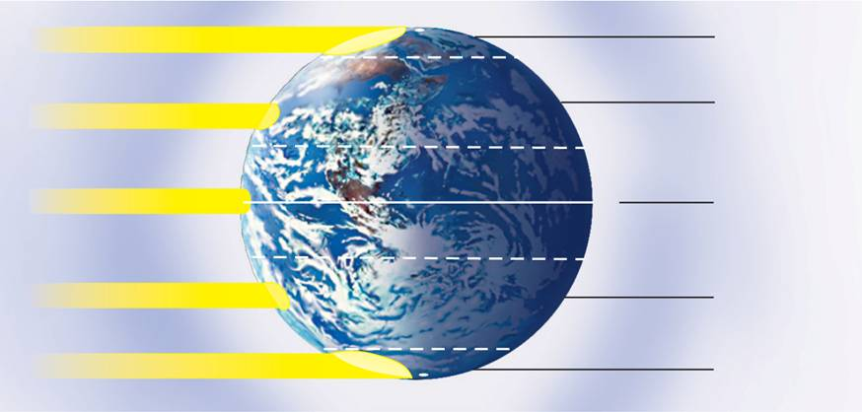
Main Climate Zones
  Earth has three main climate zones:
    Polar – cold areas
    Temperate – ranges from hot to cold, depending on the season.
    Tropical – almost always warm
90°N North Pole
Sunlight
Polar
Arctic Circle
66.5°N
Temperate
Sunlight
Tropic of Cancer
23.5°N
Equator
Most direct sunlight
0°
Tropical
Tropic of Capricorn
23.5°S
Sunlight
Temperate
Antarctic Circle
Sunlight
66.5°S
Polar
90°S South Pole
Notes:
Earth has three main climate zones. These climate zones are caused by the unequal heating of Earth's surface. Near the equator, energy from the sun strikes Earth almost directly. Near the poles, the sun's rays strike Earth's surface at a lower angle. The same amount of solar energy is spread out over a larger area, heating the surface less than at the equator.
Polar zones are located in the areas around the North and South poles, between 66.5° and 90° North and South latitudes. sun's rays strike Earth at a very low angle.
The temperate zones sit between the polar zones and the tropics. Affected by the changing angle of the sun over the course of a year.
Tropical zones: near the equator; receive direct or nearly direct sunlight year-round, making the climate almost always warm.

Slide 6

Climate

Slide 7
The Major Land Biomes
Tropical Biomes
Are located close to the earths equator
generally have a very warm climate
Three types
Tropical rain forest
Tropical dry forest/deciduous forest
Tropical savanna

Slide 8
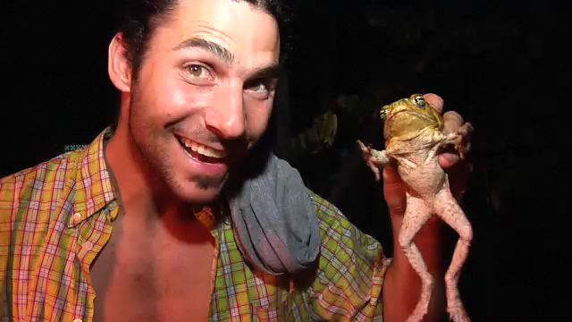
Tropical rain forest

Slide 9
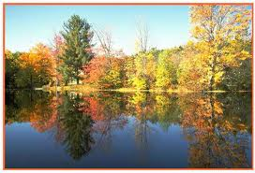
Temperate Biomes
Located out side of the tropic regions
Not as consistently hot as tropical Biomes
Seasons are defined
  warm to hot summers
  cool to cold winters
Notes:
Located out side of the tropic regions
Between 30°N and 60°N and 30°S and 60°S

Slide 10

Temperate Grasslands

Slide 11
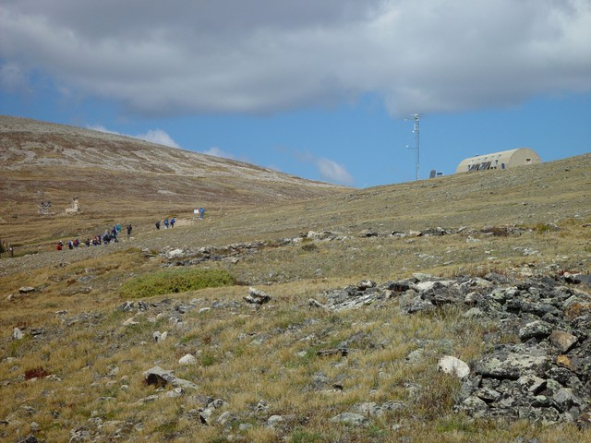
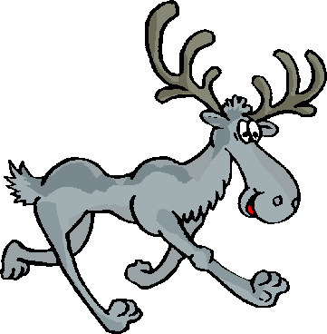
Northern Biomes
Located north of ≈50°N latitude
Short Mild summers
  That means short growing season
    Can be as short as one month
Cold to severely cold winters

Slide 12
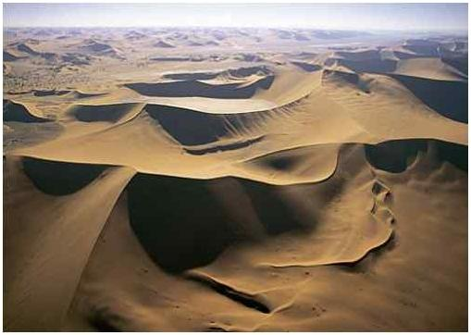
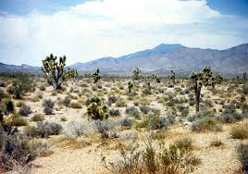
Deserts
Precipitation determines a desert biome NOT temperature
  All Deserts are dry!!!!!!
  Not all are hot
Many undergo extreme
temperature changes each day.
  Alternating between hot days and cold nights.
Notes:
Deserts are Defined as having less then 10 in. of rain/yr
Deserts Cover about 1/5 of the Earth's land surface

Slide 13
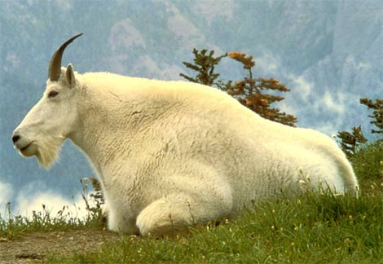
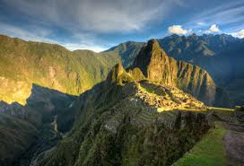
Mountain Ranges
Found on every continent
Abiotic and Biotic conditions vary with elevation
  Temperature decreases with elevation increase
  Precipitation increases with elevation increase
Changing abiotic factors causes vegetation and wildlife to change with elevation
Mountain ranges may exhibit characteristics of many different biomes within a small geographic area.
Dominate wildlife
  Mountain goats, big horn sheep, mountain lions, Snow Leopard, yak

Slide 14
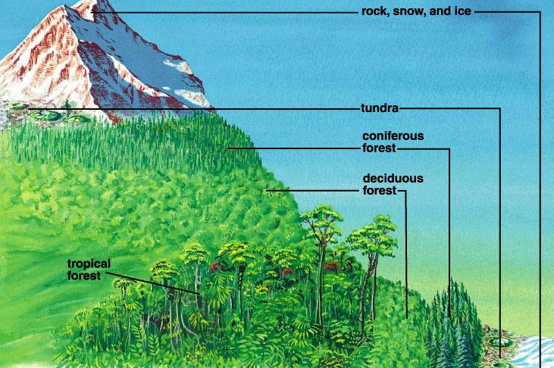
Mountain Ranges
Effects of Elevation
Low (Altitude) High

Slide 15
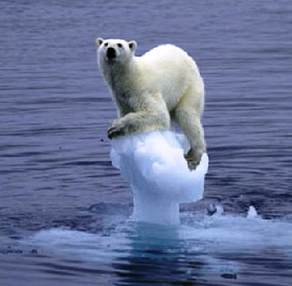
Polar Ice Caps
Ice caps exist in the regions of both the N and S poles
During winter months, region may go months without true day light.
North Polar Region (Arctic)
  Arctic Ocean is covered with sea ice
  Thick ice cap also covers Greenland
  Dominate wildlife
    Polar bears, seals
South Polar Region (Antarctica )
  Landmass covered by ice nearly 3 miles (5 km) thick
  Dominate Wildlife
    Penguins, and Marine Mammals

Slide 16
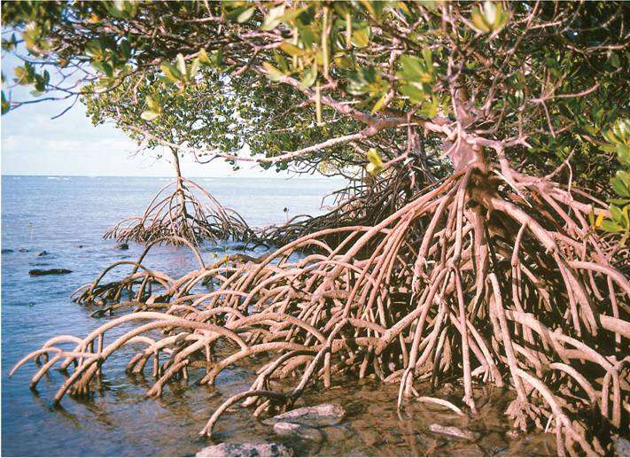
4-4 Aquatic Ecosystems
Notes:
Photo Credit: © Belinda Wright/DRK Photo

Slide 17
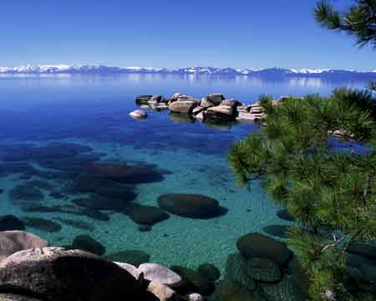

Aquatic Ecosystems
¾ of the earths surface is covered with water.
Three main types
  Freshwater Ecosystems
  Estuaries
  Marine Ecosystems
Like terrestrial ecosystems they are still determined by their abiotic and biotic factors
However the abiotic factors differ
  Water temperature, flow rate, depth, distance from shore
  Water chemistry: amount of salts, nutrients, & oxygen dissolved water.
Terrestrial Biomes often contain several types of fresh water ecosystems
Notes:
----- Meeting Notes (1/12/15 14:04) -----
hi

Slide 18
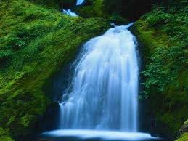
Freshwater Ecosystems
Only makes up 3% of Earth’s surface water
Different types
  Standing-water ecosystems
  Flowing-water ecosystems
  Wetland ecosystems
Circulation of water helps to
  Regulate water temperate
  Distribute oxygen
  Distribute nutrients
Notes:
Standing water Most common
Lakes
Ponds
Water is relatively still but does circulate
Phytoplankton, and aquatic plants form food web base
Phytoplankton are single celled aquatic organisms
Other wildlife: various fish, freshwater clams and mussels, turtles, ducks, beavers, and aquatic snakes.
Flowing water ecosystem
Consist of Rivers, streams, creeks, and brooks
Major characterizing factors
Volume of water
Rate of flow
Fast moving water
Plenty of oxygen
little sediment for plant growth
Slower moving water
More sediment for plants
Usually wide river, and low volume creeks.
Wetlands
Characterized by Large amounts of shallow water covering the surface or Water is at or near the surface but does not cover It
Water may be flowing or standing
Serves as breeding grounds for insects, fish, amphibians, and migratory birds
Three main types: Bogs, Marshes, Swamps

Slide 19
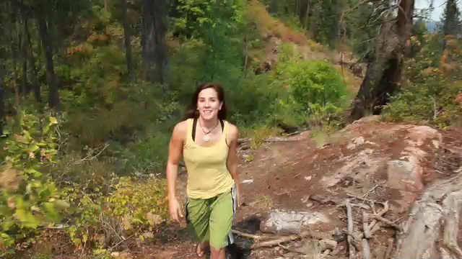
Lakes & Ponds
(click video to begin)

Slide 20

Streams & Rivers

Slide 21

Wetands Video

Slide 22
Estuaries
Form where rivers meet the sea
Contain a mixture of fresh water and salt water
  called Brackish water
Are affected by ocean tides
  Tides: the rise and fall of sea levels caused by the gravitational forces of the moon and sun
Usually contain fewer species then fresh water or marine ecosystems.
  low biodiversity
However, they do support a large amount of biomass

Slide 23

Estuaries Video

Slide 24
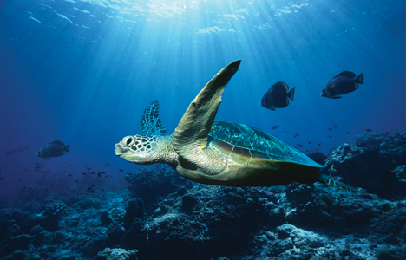
Marine Biomes

Slide 25
Marine Ecosystems (Oceans)
Divided into “zones” based on light, depth & distance from the shore
  Light:
    Photic zone
      Well-lit upper layer of the ocean
      Algae and other producers can grow only in this thin surface layer.
    Aphotic zone
      permanently dark
  Depth & distance
    Intertidal
    Coastal
    Open Ocean

Slide 26
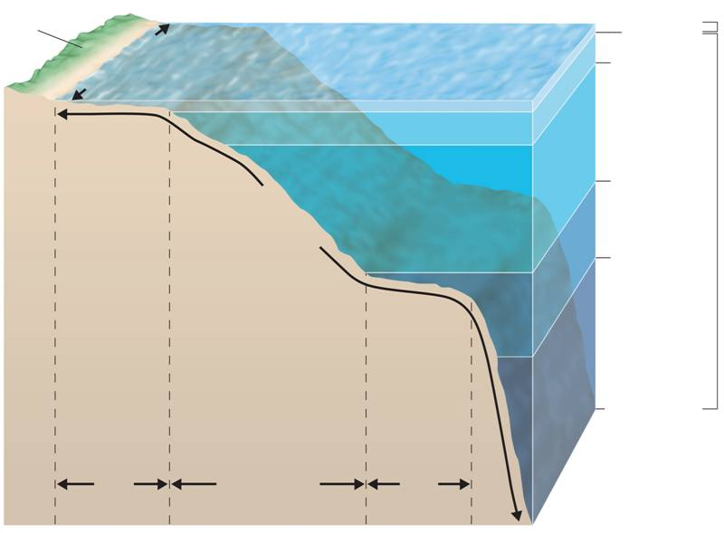
Photic
zone
Land
Intertidal
zone
200 m
1,000 m
Coastal
ocean
Open
ocean
4,000 m
Benthic
zone
Aphotic
zone
6,000 m
Ocean
trench
Continental slope
and continental rise
10,000 m
Continental
shelf
Abyssal
plain
Notes:
The ocean can be divided into zones based on light penetration and into zones based on depth and the distance from shore. Each zone contains a characteristic assemblage of organisms.
Light:
Photic zone
Well-lit upper layer of the ocean
Algae and other producers can grow only in this thin surface layer.
Aphotic zone
permanently dark

Slide 27

Intertidal Zone

Slide 28
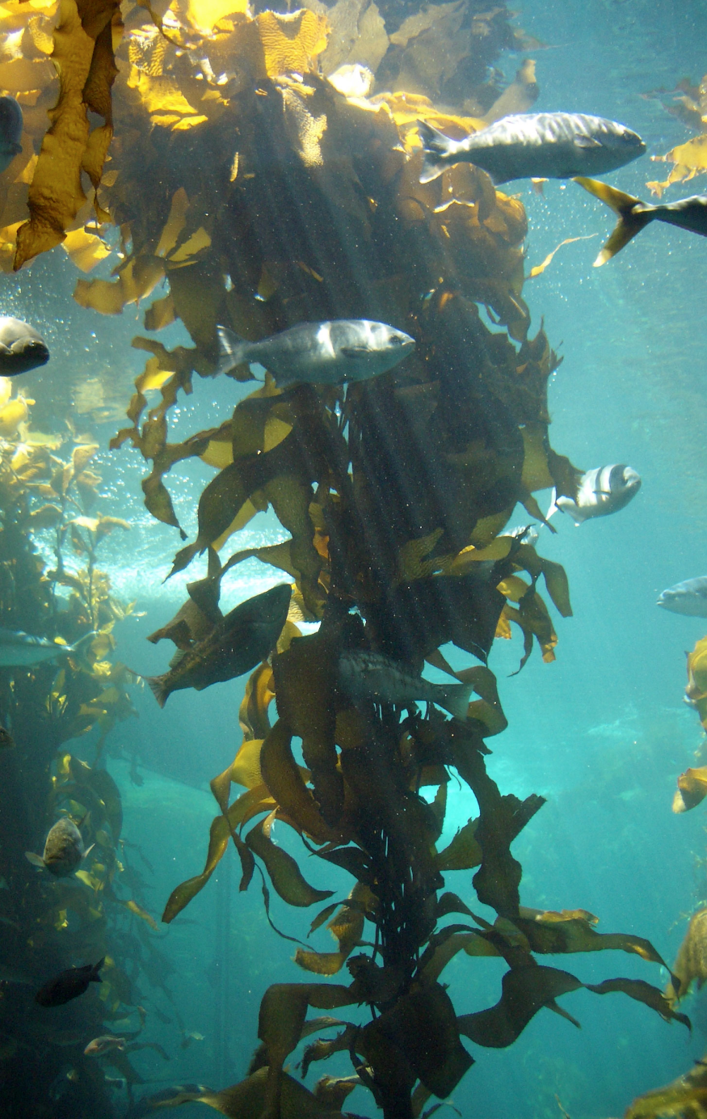
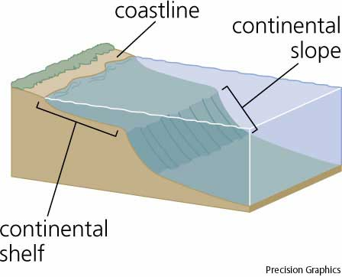
Coastal Ocean
  Located between the low-tide mark to the outer edge of the continental shelf.
  Rich in plankton and many other organisms
Notes:
Kelp Forests:
Dominated by giant brown alga.
One of the most productive coastal ocean communities.
Support a complex food web.
Coral reefs
found in tropical coastal waters
Extremely diverse organisms flourish among coral reefs

Slide 29
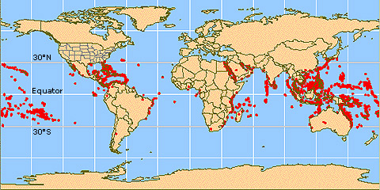
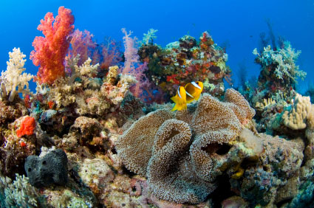
Coastal Ocean
Coral reefs
    found in tropical coastal waters
    Extremely diverse organisms flourish among coral reefs
Notes:
Coral reefs
found in tropical coastal waters
Extremely diverse organisms flourish among coral reefs

Slide 30

Coral Reefs

Slide 31
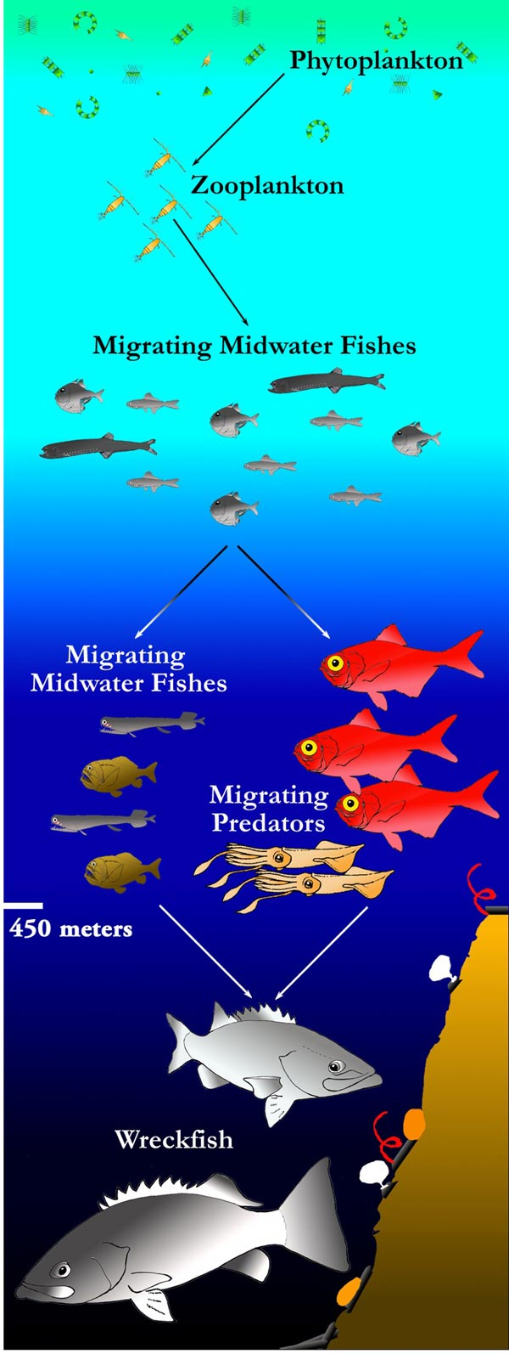
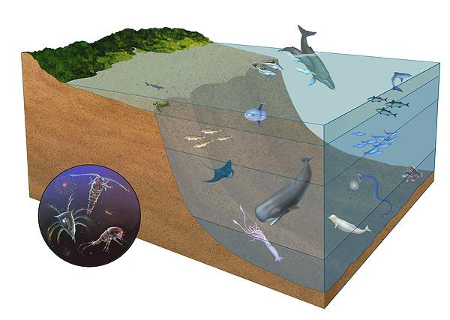
Open ocean (oceanic zone)
  Located from the edge of the continental shelf outward.
    largest marine zone.
    has fish of all shapes and sizes
    Marine mammals live there but must stay close to the surface to breathe.

Slide 32
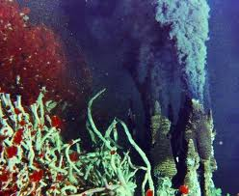
Deep Ocean
Hydrothermal vent communities
Found where sea floor is spreading
Vents spew superheated, nutrient-rich water
Chemosynthetic bacteria primary producers
Notes:
First discovered in 1977

Slide 33
Deep Sea

Slide 34
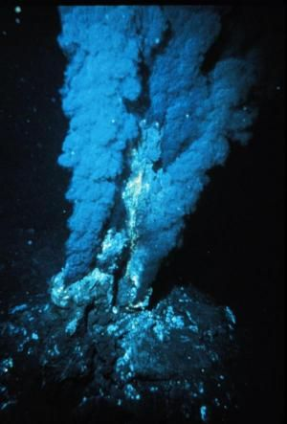
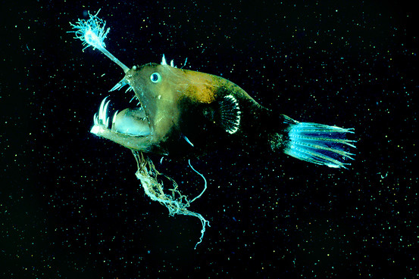
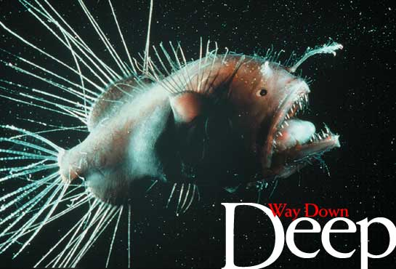
The End

