Slide 1
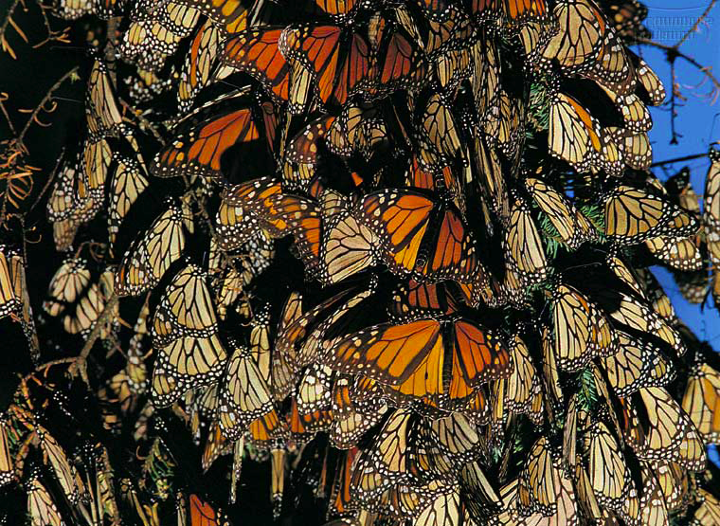
organism
population
community
ecosystem
biosphere
Ch 5 Population Ecology

Slide 2
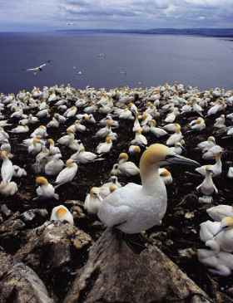
Life takes place in populations
Population
  group of individuals of same species
  in same area at same time
rely on same resources
interact
interbreed
  Three important characteristics of a population are its:
    geographic distribution
    density
    growth rate
Population Ecology: What factors affect a population?
Notes:
Population ecology is the study of populations in relation to environment, including environmental influences on density and distribution, age structure, and population size
Scientific goal
understanding the factors that influence the size of populations
general principles
specific cases
Practical goal
management of populations
increase population size
endangered species
decrease population size
pests
maintain population size
fisheries management
maintain & maximize sustained yield

Slide 3
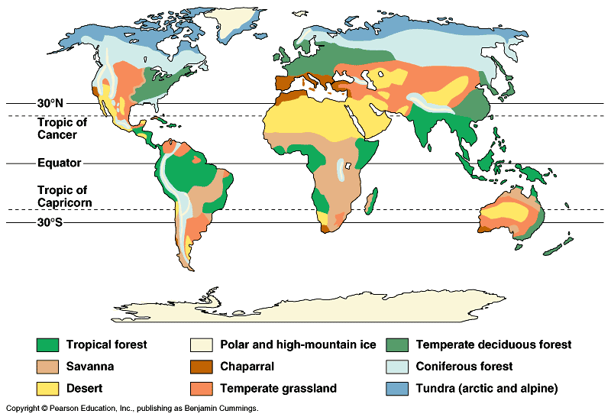
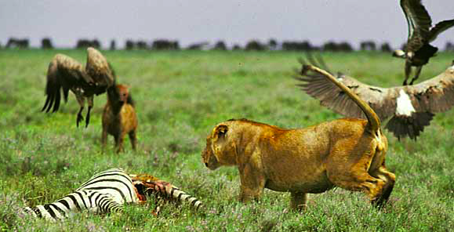
Factors that affect Population Size
Abiotic factors
  sunlight & temperature
  precipitation / water
  soil / nutrients
Biotic factors
  other living organisms
    prey (food)
    competitors
    predators, parasites,
    disease

Slide 4
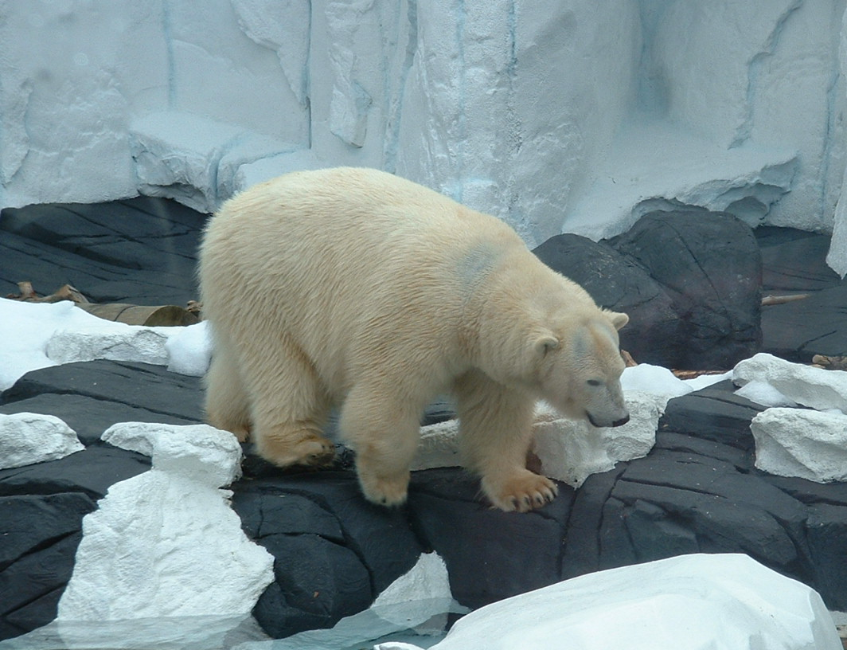
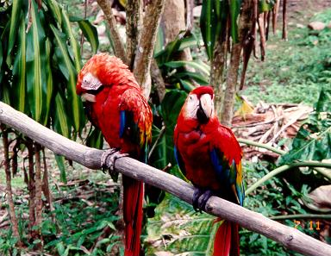
Population Range
Geographical limitations
  abiotic & biotic factors
    temperature, rainfall, food, predators, etc.
  habitat
adaptations to
polar biome
adaptations to
rainforest biome

Slide 5
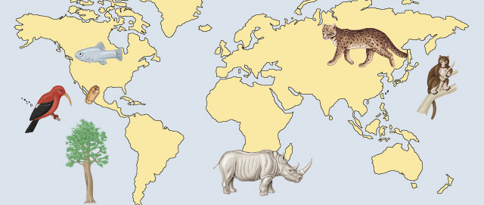
At risk populations
Endangered species
  limitations to range / habitat
    places species at risk
Devil’s hole
pupfish
Iiwi
Hawaiian
bird
Socorro
isopod
Iriomote cat
New Guinea
tree
kangaroo
Catalina
Island
mahogany
tree
Northern white rhinoceros

Slide 6
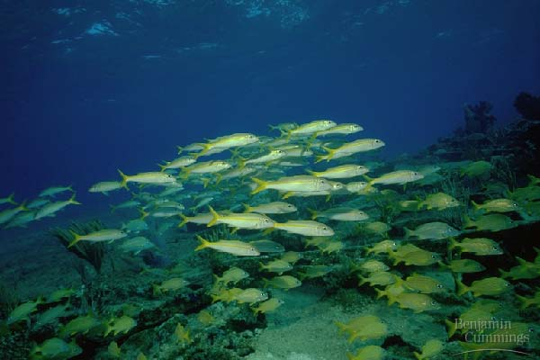

Measuring population density
Population density: the number of individuals in an area
How do we measure how many individuals in a population?
  mark & recapture methods
Difficult to count a moving target
sampling populations
Notes:
Assumptions
: The accuracy of this mark-recapture method re
sts on a number of assumptions being met.
Assumption 1
. During the interval between the preliminary
marking period and the subsequent recapture
period, nothing has happened to upset the proportions
of marked to unmarked animals (that is, no new
individuals were born or immigrated
into the population, and none
died or emigrated). Another way to state
this assumption is that th
e population is assumed to be "closed".
An exception is when there are equal
proportions of deaths or emigrants
for marked and unmarked individu
als during the sampling period. If
deaths occur in this manner the proportions of marked to unmarked will not change and thus we can still
estimate the population. Notice the same cannot hold
true for births since
a proportionate number of
individuals will not be born with marks on them. Births
can still occur and an accurate estimate can still be
made only if an equal number of unmarked individua
ls leave (or die) and are
born. This means that no
marked individuals can leave,
which would be highly unlikely.
Notice that inherent in this assumption is that the mark
ing of the individuals has no
effect on their survival.
This is often the most difficult assumption to meet si
nce the mark may make the individual more noticeable
to predators or may slow them dow
n, such that more marked individuals die than unmarked between the
sampling periods.
You should also be aware that the length of the samp
ling period is very importa
nt. The shorter the time
interval between marking
and recapturing individuals reduces the li
kelihood that this assumption will be
violated. The longer the time interv
al the greater the chance that some
individuals will die, emigrate,
immigrate or even be born and
hence become an "open" population.
Assumption 2
. The chance for each individual in the population to
be caught are equal and constant for both the
initial marking period and the recapture
period. That is, marked individu
als must not become either easier
or more difficult to catch. Marking an
individual does not make them more
or less likely to be recaptured
relative to unmarked individuals.
Furthermore, there cannot be someth
ing unique about those animals that
were initially marked that
make them more conspicuous. If only
males are captured in the traps because
females are busy incubating eggs or
feeding, then males may be more lik
ely to be recaptured. Hence the
population estimate would only be appropriate for those an
imals with that unique be
havior that make them
easier to capture (i.e. males).
Another problem deals with 'trap shy' or 'trap ha
ppy' individuals. Some techniques for capturing and
marking animals can have a dramatic effect on the anim
al. ‘Trap shy’ animals quickly learn to avoid those
traps or that area where the capture occurred making
them less like to be recaptu
red. The opposite can also
occur, especially if the trapping method uses bait. A ‘t
rap happy’ individual is lu
red into a trap with food
and is then marked. Later during the recapture peri
od the animal may recall that
these traps had rewards
(food) and that other than a little decoration (the ma
rk) it made out pretty good.
Therefore it becomes ‘trap
happy’ and is more likely to be captured in the tr
ap compared to unmarked individuals who have not
experienced the rewards.
Also notice that there cannot be any changes in be
havior among individuals that may affect capture
probabilities. For example, in some
species there are different times of pe
ak activity for different classes in
the population. Adult males may be most active in the
morning. Juvenile males and females may be most
active midday, and adult female may be most active
in the afternoon. If you ma
rk individuals in the
morning you will capture and mark mostly males. But
if you perform your recapture sample at midday or
the afternoon, you will capture mostly unmarked j
uveniles or females, respectively. Again, you should
realize that the length of time betw
een the sampling periods plays an
important role in whether this
assumption is violated.
Assumption 3
. Sufficient time must be allowed between the in
itial marking period and the recapture period for
all marked individuals to be randomly dispersed
throughout the population (so that assumption 2 above
holds). However, the time period must not be so l
ong that Assumption 1 breaks down. If marked animals
failed to disperse from the sampling area, or if they
tend to aggregate in groups,
there is a higher probability
that they will be recaptured relativ
e to unmarked individuals (or not de
pending on where they aggregate).
Assumption 4.
Animals do not lose their marks. This is an im
portant factor for animals that shed or molt as
they grow or as they respond to seasonal factors.
All these assumptions must be considered very carefully
and play a strong role in
the techniques used to
perform the study. A certain method of trapping may vi
olate one assumption while another trapping method
may violate another assumption. Ha
ving too short of a time interval between sampling may lead to the
violations of one assumption (which one(s)?) while an
interval that is too long will violate others (which
one(s)?).

Slide 7
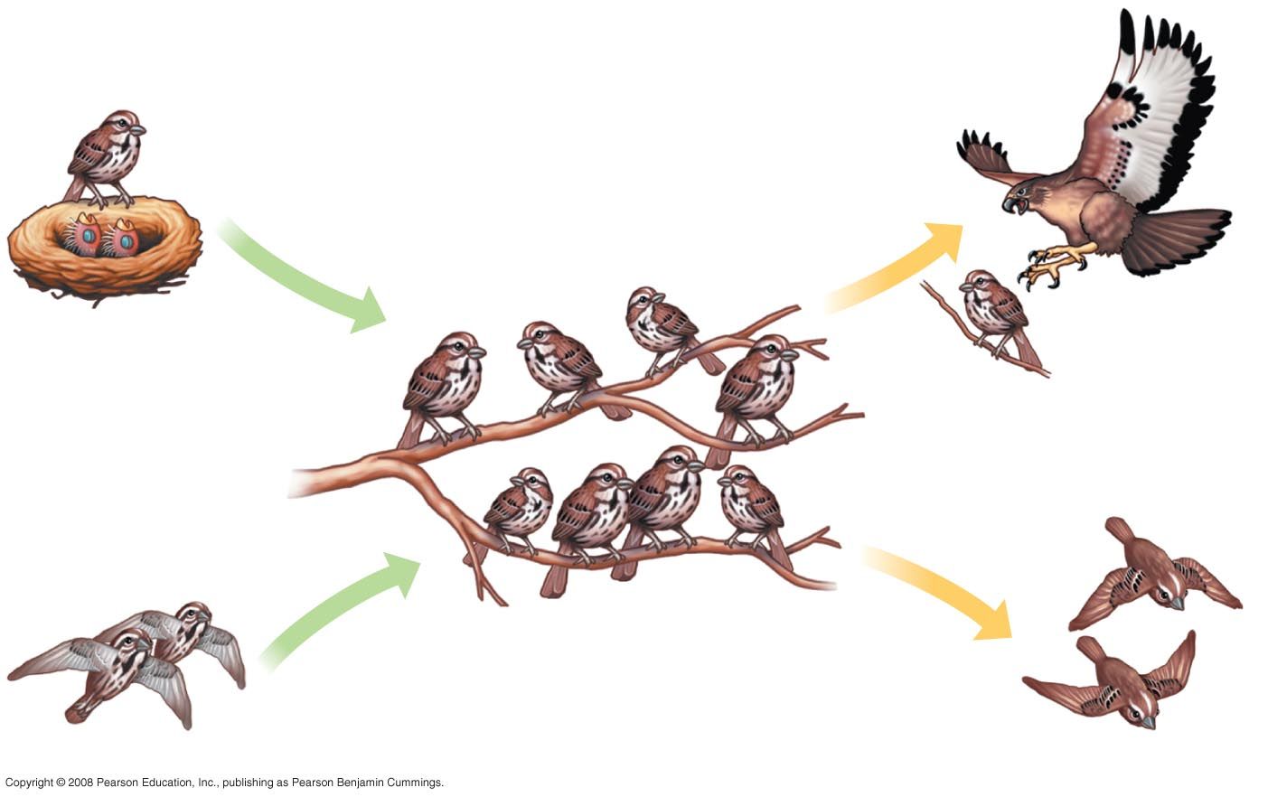
Growth Rate of a Population
  adding & removing individuals from a population
    birth
    death
    immigration
    emigration
Births
Deaths
Births and immigration
add individuals to
a population.
Deaths and emigration
remove individuals
from a population.
Immigration
Emigration
Notes:
Density is the result of an interplay between processes that add individuals to a population and those that remove individuals
Immigration is the influx of new individuals from other areas
Emigration is the movement of individuals out of a population

Slide 8
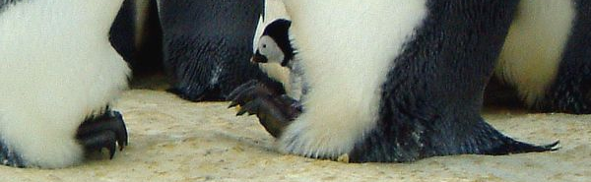
Population growth rates
Factors affecting population growth rate
  sex ratio
    how many females vs. males?
  generation time
    at what age do females reproduce?
  age structure
    how many females are at reproductive age?

Slide 9
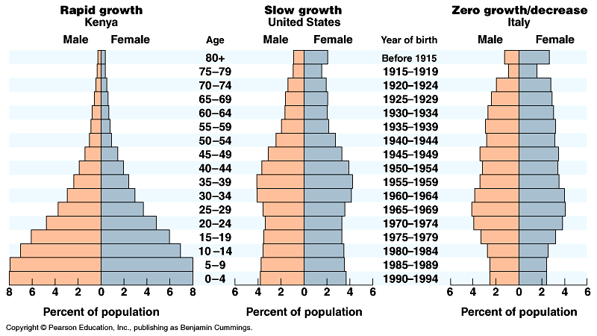
Age structure
Relative number of individuals of each age
What do these data imply about population growth in these countries?
Notes:
One important demographic factor in present and future growth trends is a country’s age structure
Age structure is the relative number of individuals at each age
Age structure diagrams can predict a population’s growth trends
They can illuminate social conditions and help us plan for the future

Slide 10
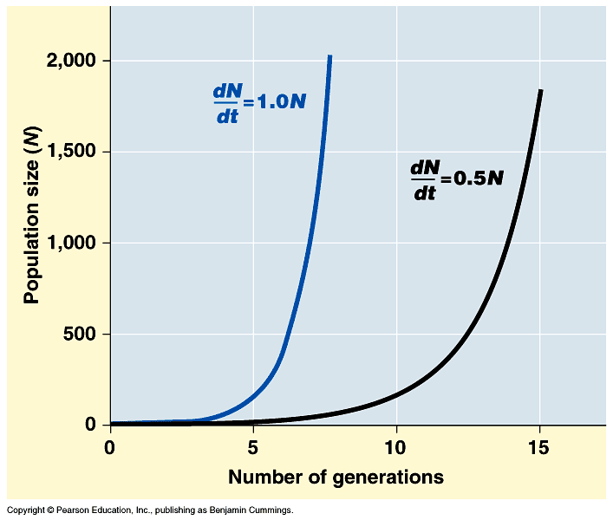
Population growth
change in population = births – deaths
Exponential growth: when the individuals in a population reproduce at a constant rate.
  The population becomes larger and larger until it approaches an infinitely large size.
growth increasing at constant rate
every pair has 4 offspring
every pair has 3 offspring
Notes:
Under ideal conditions with unlimited resources, a population will grow exponentially
It is useful to study population growth in an idealized situation
Idealized situations help us understand the capacity of species to increase and the conditions that may facilitate this growth
If immigration and emigration are ignored, a population’s growth rate (per capita increase) equals birth rate minus death rate
Zero population growth occurs when the birth rate equals the death rate
Most ecologists use differential calculus to express population growth as growth rate at a particular instant in time:
where N = population size, t = time, and r = per capita rate of increase = birth – death
Exponential population growth is population increase under idealized conditions
Under these conditions, the rate of reproduction is at its maximum, called the intrinsic rate of increase
Exponential population growth results in a J-shaped curve
The J-shaped curve of exponential growth characterizes some rebounding populations

Slide 11
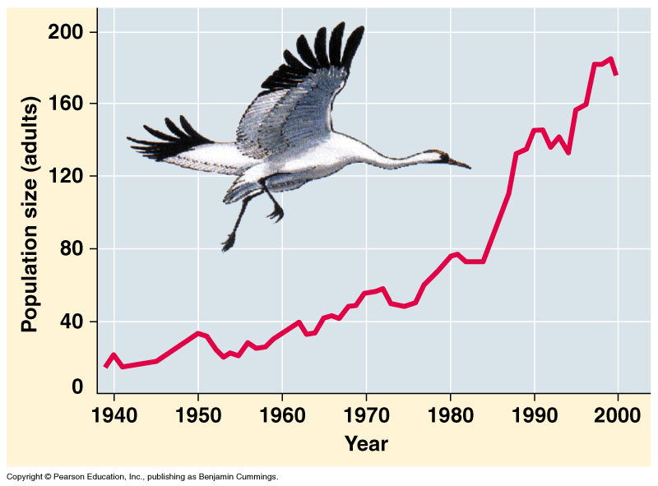
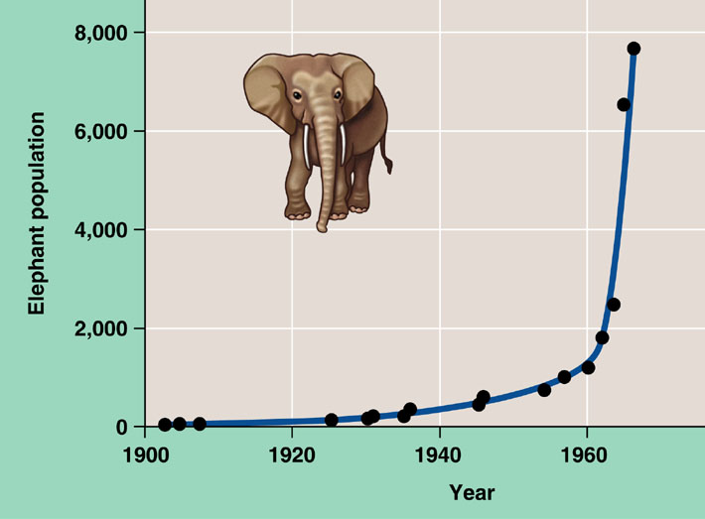
Exponential growth rate
Characteristic of populations without
limiting factors
  introduced to a new environment or rebounding from a catastrophe
Whooping crane
coming back from near extinction
African elephant
protected from hunting
Notes:
The J–shaped curve of exponential growth is characteristic of some populations that are introduced into a new or unfilled environment or whose numbers have been drastically reduced by a catastrophic event and are rebounding. The graph illustrates the exponential population growth that occurred in the population of elephants in Kruger National Park, South Africa, after they were protected from hunting. After approximately 60 years of exponential growth, the large number of elephants had caused enough damage to the park vegetation that a collapse in the elephant food supply was likely, leading to an end to population growth through starvation. To protect other species and the park ecosystem before that happened, park managers began limiting the elephant population by using birth control and exporting elephants to other countries.

Slide 12
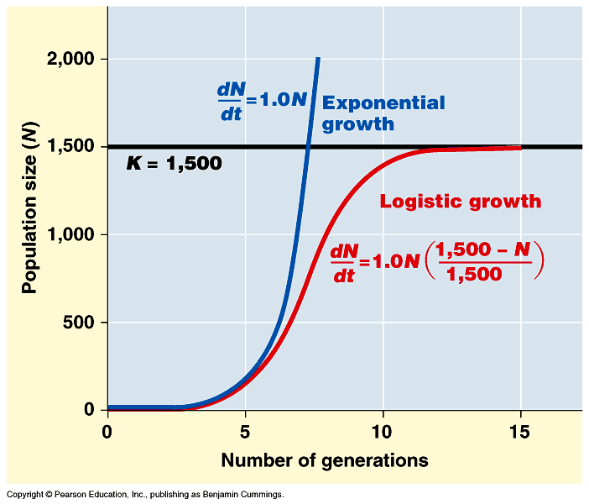
Logistic rate of growth
Can populations continue to grow exponentially?
Of course not!
no natural controls
K =
carrying
capacity
What happens as
population size
approaches K?
effect of
natural controls
Notes:
Decrease rate of growth as N reaches K
A more realistic population model limits growth by incorporating carrying capacity
Carrying capacity (K) is the maximum population size the environment can support
In the logistic population growth model, the per capita rate of increase declines as carrying capacity is reached
We construct the logistic model by starting with the exponential model and adding an expression that reduces per capita rate of increase as N approaches K
The logistic model of population growth produces a sigmoid (S-shaped) curve

Slide 13
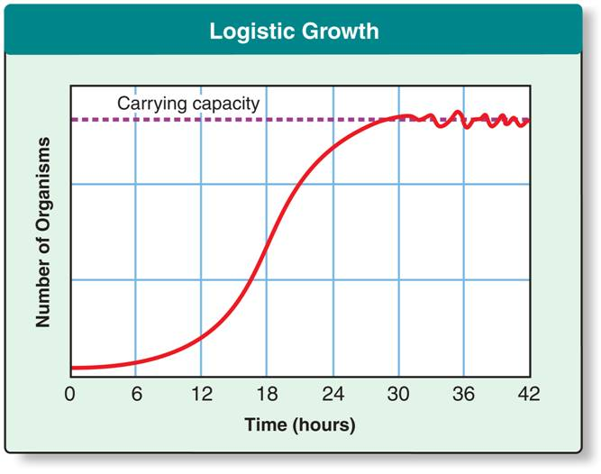
Logistic rate of growth
  As resources become less available, the growth of a population slows or stops.
  Logistic growth occurs when a population's growth slows or stops following a period of exponential growth.
    S-shaped curve
Notes:
Logistic growth is characterized by an S-shaped curve.

Slide 14
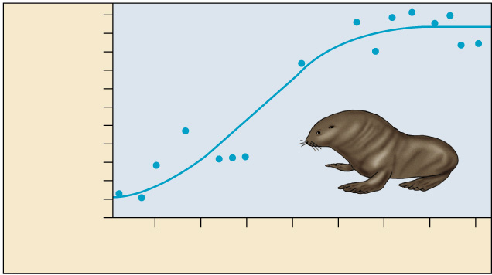
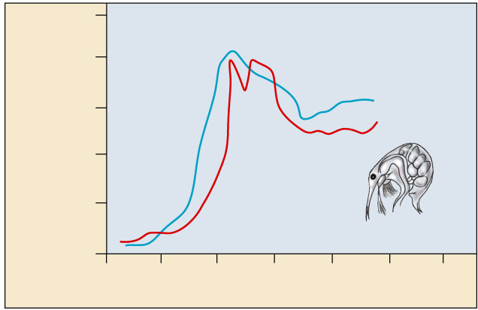
Carrying capacity
Maximum population size that environment can support with no degradation of habitat
  varies with changes in resources
10
8
Number of breeding male
fur seals (thousands)
6
4
2
0
1915
1925
1935
1945
Time (years)
500
400
Number of cladocerans
(per 200 ml)
300
What’s going
on with the
plankton?
200
100
0
0
10
20
30
40
50
60
Time (days)
Notes:
The largest number of individuals of a population that a given environment can support is called its carrying capacity.
When a population reaches the carrying capacity of its environment, its growth levels off. The average growth rate is zero.
Some populations fluctuate greatly and make it difficult to define K
Some populations show an Allee effect, in which individuals have a more difficult time surviving or reproducing if the population size is too small
The logistic model fits few real populations but is useful for estimating possible growth
Some populations, like the plankton, overshoot K before settling down to a relatively stable density. There is a rapid decline (deaths) after they went passed carrying capacity because they ran out of resources and died off until they hit carrying capacity.

Slide 15
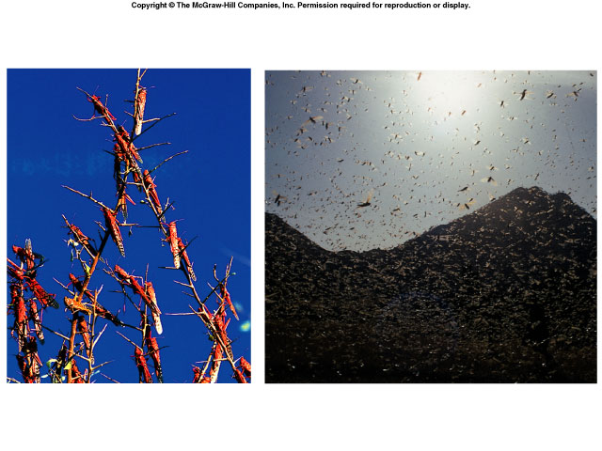


5-2 Regulation of population size
Limiting factors
  density dependent: depends on population size
    competition: food, mates, nesting sites
    predators, parasites, disease
  density independent: same effect regardless of population size
    abiotic factors
      sunlight (energy)
      temperature
      Rainfall
      Natural disasters
      Human activity
Notes:
In the context of populations, a limiting factor is a factor that causes population growth to decrease.
Exponential growth cannot be sustained for long in any population
Density-dependent factors operate only when the population density reaches a certain level. These factors operate most strongly when a population is large and dense.
They do not affect small, scattered populations as greatly.
They are affected by many factors, such as competition for resources, territoriality, disease, predation, toxic wastes, and intrinsic factors
Competition: Occurs when organisms of the same or different species attempt to use an ecological resource at the same place and time.
In crowded populations, increasing population density intensifies competition for resources and results in a lower birth rate
Predation: An interaction when one organism captures, kills, and feeds on another.
As a prey population builds up, predators may feed preferentially on that species
Population density can influence the health and survival of organisms
In dense populations, pathogens can spread more rapidly
Accumulation of toxic wastes can contribute to density-dependent regulation of population size
Density-independent limiting factors affect all populations in similar ways, regardless of the population size.

Slide 16
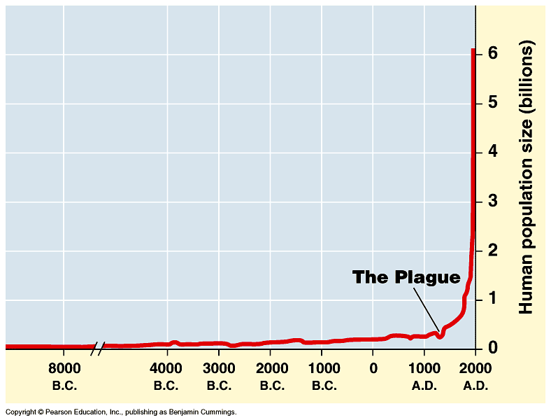
Human population growth
Population of…
China: 1.3 billion
India: 1.1 billion
Doubling times
250m → 500m = y ()
500m → 1b = y ()
1b → 2b = 80y (1850–1930)
2b → 4b = 75y (1930–1975)
adding 82 million/year
~ 200,000 per day!
2005→6 billion
Significant advances
in medicine through
science and technology
What factors have contributed to this exponential growth pattern?
Industrial Revolution
Is the human
population reaching
carrying capacity?
Bubonic plague "Black Death"
1650→500 million
Notes:
No population can grow indefinitely, and humans are no exception
The population doubled to 1 billion within the next two centuries, doubled again to 2 billion between 1850 and 1930, and doubled still again by 1975 to more than 4 billion. The global population now numbers over 6 billion people and is increasing by about 73 million each year. The population grows by approximately 201,000 people each day, the equivalent of adding a city the size of Amarillo, Texas, or Madison, Wisconsin. Every week the population increases by the size of San Antonio, Milwaukee, or Indianapolis. It takes only four years for world population growth to add the equivalent of another United States. Population ecologists predict a population of 7.3–8.4 billion people on Earth by the year 2025.
To maintain population stability, a regional human population can exist in one of two configurations:
Zero population growth =
High birth rate – High death rate
Zero population growth =
Low birth rate – Low death rate
The demographic transition is the move from the first state toward the second state
The demographic transition is associated with an increase in the quality of health care and improved access to education, especially for women
Most of the current global population growth is concentrated in developing countries
The carrying capacity of Earth for humans is uncertain
The average estimate is 10–15 billion

Slide 17
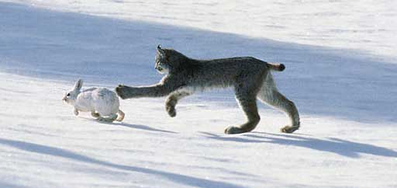
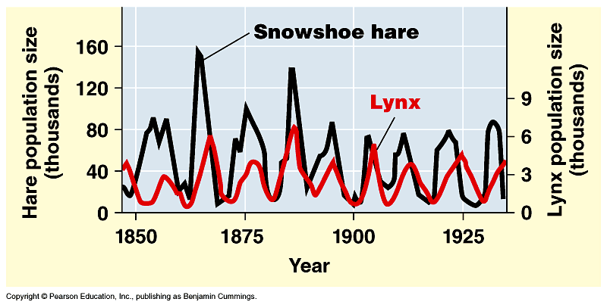
Changes in Carrying Capacity
Population cycles
  predator – prey interactions
At what
population level is the
carrying capacity?
K
K
Notes:
Some populations undergo regular boom-and-bust cycles
Lynx populations follow the 10 year boom-and-bust cycle of hare populations
Three hypotheses have been proposed to explain the hare’s 10-year interval
Hypothesis: The hare’s population cycle follows a cycle of winter food supply
If this hypothesis is correct, then the cycles should stop if the food supply is increased
Additional food was provided experimentally to a hare population, and the whole population increased in size but continued to cycle
No hares appeared to have died of starvation
Hypothesis: The hare’s population cycle is driven by pressure from other predators
In a study conducted by field ecologists, 90% of the hares were killed by predators
These data support this second hypothesis
Hypothesis: The hare’s population cycle is linked to sunspot cycles
Sunspot activity affects light quality, which in turn affects the quality of the hares’ food
There is good correlation between sunspot activity and hare population size
The results of all these experiments suggest that both predation and sunspot activity regulate hare numbers and that food availability plays a less important role

