Slide 1

Chapter 1
What is Science?

Slide 2
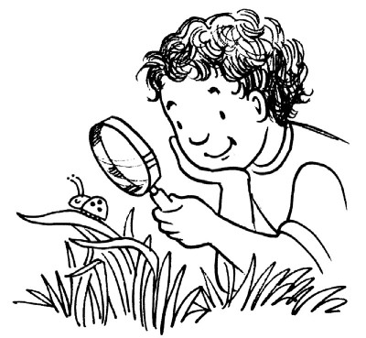

What is Science?
Science: a way of using evidence to learn about the natural world
The goals of science are to:
  investigate and understand the natural world
  explain events in the nature
  make useful predictions
Notes:
use those explanations to make useful predictions.
Scientific information aides in decision making.
Advancement in science and technology provide new products, procedures, or treatments.
Understanding the limits of science is critical in positive decision/policy making.

Slide 3
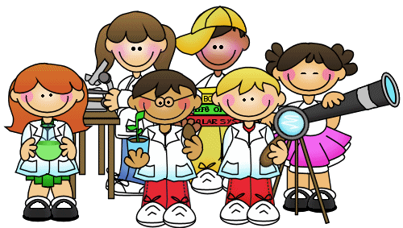

What makes science different?
Deals only with the natural world.
Scientists collect and organize information in a orderly way, looking for connections & patterns between events.

Slide 4

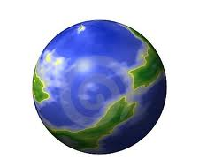

What makes science different?
Scientists propose explanations that can be tested by examining evidence.
Science is repeatable.
Science is ever-changing
Notes:
Science is ever-changing—as new evidence unfolds, our understanding of how the world works changes.
Good scientists possess these traits:
Curiosity
Honesty
Open-mindedness
Skepticism
Recognition that science has limits

Slide 5
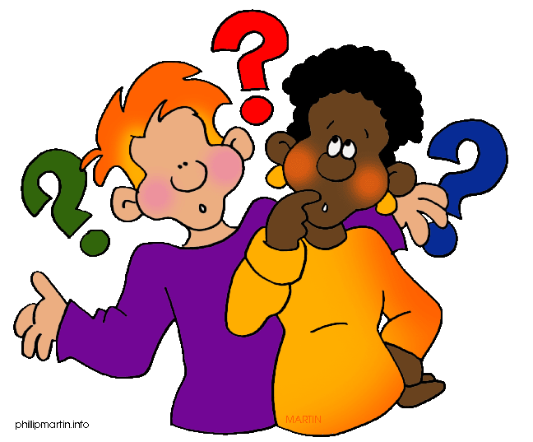
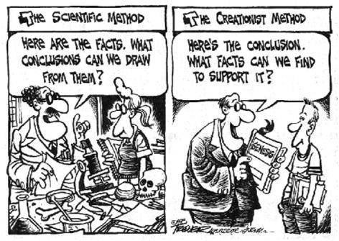
Science is NOT…
able to solve all types of questions or problems
  i.e. ethical or moral dilemmas; opinion questions
a process that tries to prove things
  science tries to disprove things

Slide 6

Science is NOT…
a process that produces certainties, or absolute facts
always done properly or without mistakes
a process that is free from values, opinions or bias
  Nobody is perfect ☹

Slide 7
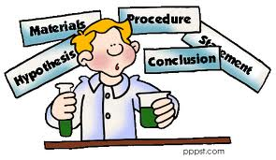
Thinking Like a Scientist
  Science is an ongoing process that involves:
    asking questions
    observing
    making inferences
    testing hypotheses
Scientific Method
Notes:
Science is not just a list of “facts.”
The job of science is to use observations, questions, and experiments to explain the natural world.

Slide 8
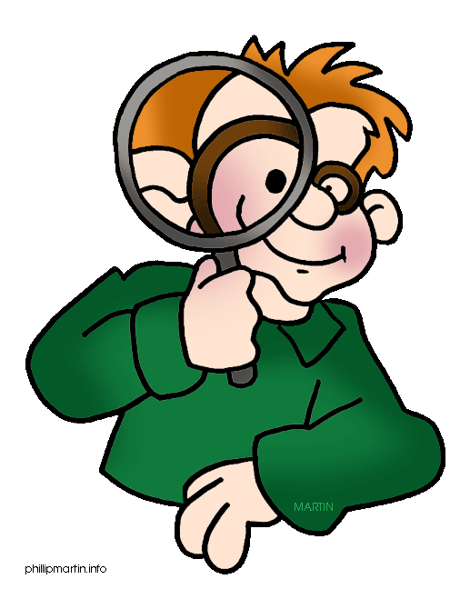
Evidence Based on Observation
Science starts with an observation.
  Made by one or more senses
Information gathered is called evidence or data.
Notes:
Observation is the process of gathering information about events or processes in a careful, orderly way.
Senses: sight, touch, hearing, smell, and taste

Slide 9
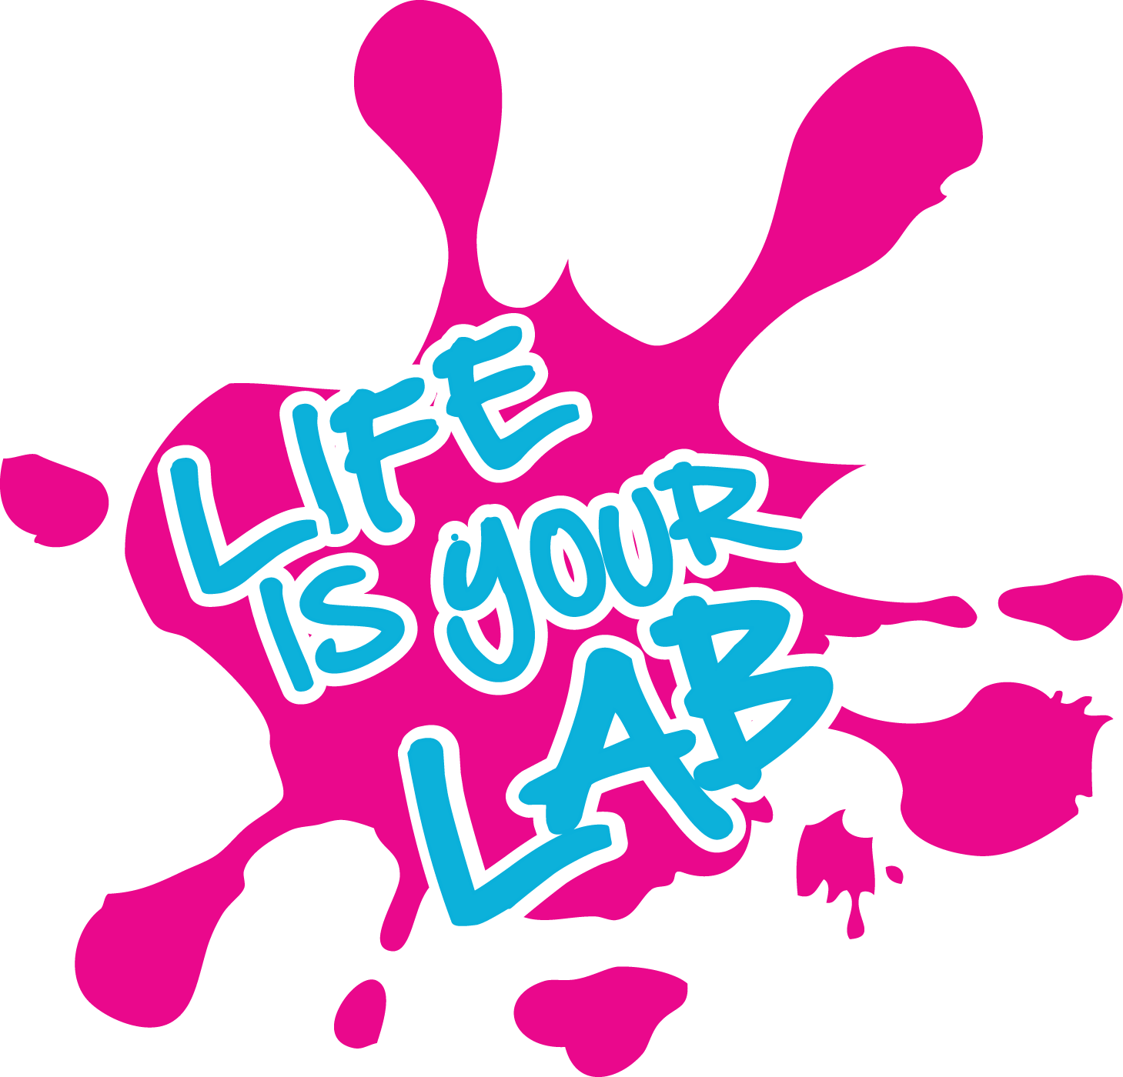
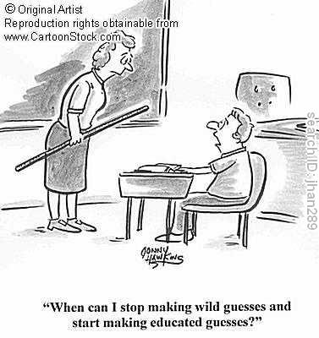
Scientists use data to make inferences
Inference: a logical interpretation based on prior knowledge or experience.
Hypothesis: a proposed scientific explanation for a set of observations – an educated guess
  attempts to answer the question/problem
  may be ruled out or confirmed
  must be testable

Slide 10
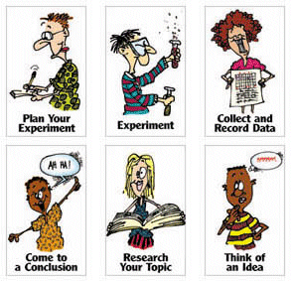
Scientific Method
State the problem/ Ask a question
Research the problem
Form a hypothesis
Test the hypothesis (experiment)
Record Data/ Analyze Data
Form a conclusion
Repeat experiment.
Notes:
Scientific thinking begins with observation – finding a problem or asking a question.
A scientist might then research this question/problem.
Once a problem has been determined or a question asked a hypothesis must be made.
Some people may revise hypothesis if it was shown to be incorrect and then repeat experiment.

Slide 11
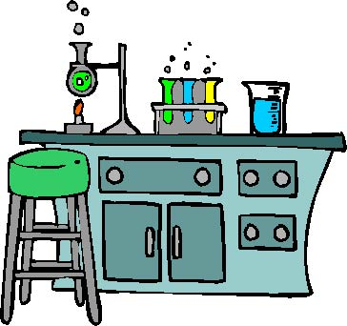
Testing a hypothesis
Controlled Experiment: an experiment that tests only one variable
  Variable: something that can change
  changes only one variable
A good experiment must have a detailed procedure.
Notes:
Whenever possible, a hypothesis should be tested by an experiment in which only one variable is changed at a time. All other variables should be kept unchanged, or controlled

Slide 12
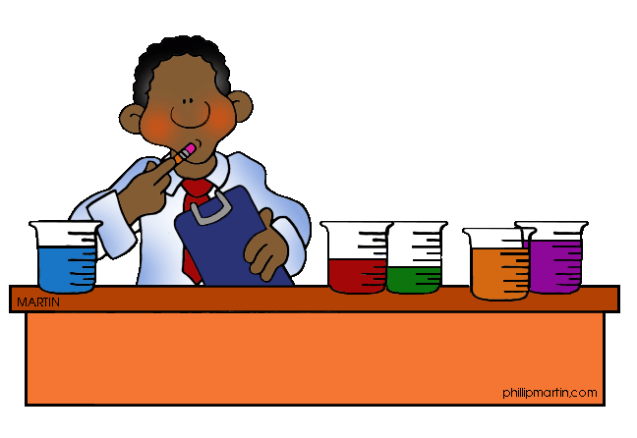
Setting Up a Controlled Experiment
Independent variable: variable that is deliberately changed
Dependent variable: variable that is observed and that changes in response to the manipulated variable
Constant: remains the same; is not changed
Notes:
Manipulated or independent variable
Responding or dependent variable
Constant or Controlled variable
Can also think of it as cause and effect

Slide 13
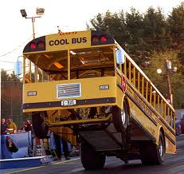

Situation 1
When the bell rings at school, you leave the classroom.

Slide 14

What is the Manipulated Variable?
The bell ringing

Slide 15
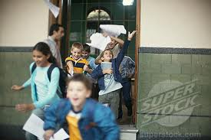
What is the Responding Variable?
You leave the class

Slide 16
Therefore…
When the bell rings (MV), you to leave the class (RV)
The bell ringing (MV), causes you to leave the classroom (RV)

Slide 17
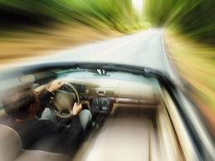
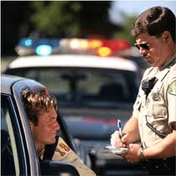
Situation 2
You were speeding, and got a ticket.

Slide 18
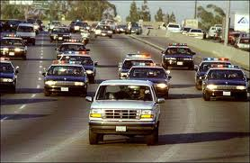
Manipulated Variable ?
You were speeding

Slide 19

Responding Variable ?
You got a ticket

Slide 20
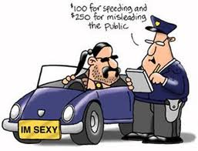
Therefore…
You were speeding (MV), and got a ticket (RV)
The speeding (MV) caused you to get a ticket (RV)

Slide 21
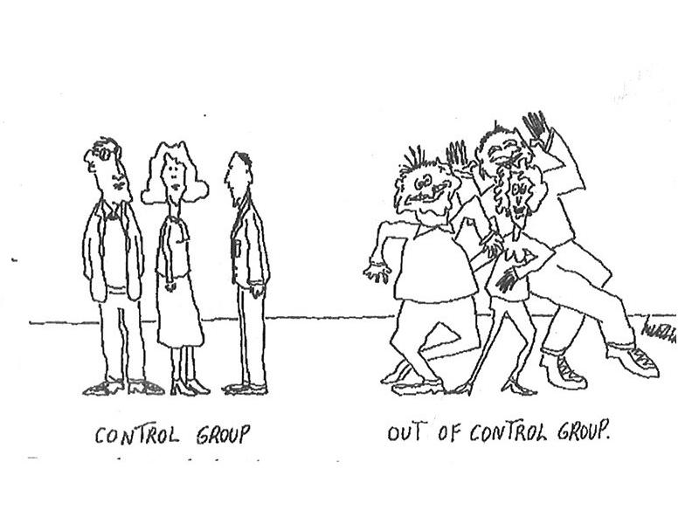
Experimental Groups
Control group: group that is not experimented on
    comparison group: to see what would have happened had you not done anything
Variable group (experimental group/ test group): group that is experimented on

Slide 22
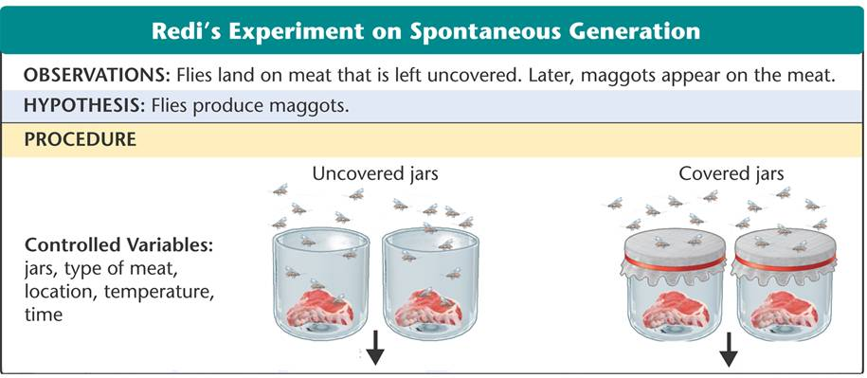
Redi’s Experiment

Slide 23
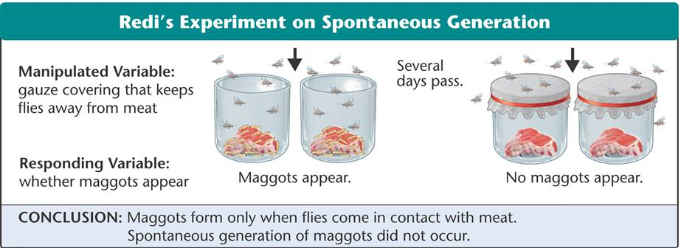

Slide 24
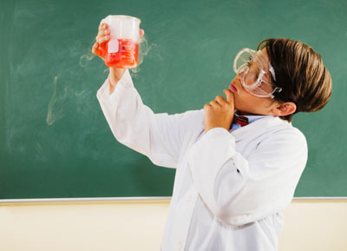
Results
Types of data
  Quantitative data:
    expressed as numbers
    obtained by counting or measuring
  Qualitative data:
    descriptive
    involve characteristics that
    can’t easily be measured
Notes:
Ways to record data
Paragraph
Drawings
Table
Graph
Chart

Slide 25
Recording Quantitative Data: Graphs
Pie
Bar or Line
  Independent variable is on the x axis (example: time)
  Dependent variable is on the y axis (example: the thing you are measuring)
How does gauze affect the # of maggots that appear?
Time (days)
Notes:
Amounts need to be evenly spaced and go up by the same amount every time
Can graph different groups using different colored lines or bars.

Slide 26
Drawing a Conclusion
Scientists use the data from an experiment to
  evaluate their hypothesis
  draw a valid conclusion
Notes:
Scientists may use computers to help them analyze a large quantity of data
Analyses of data can be used to make predictions
Today, researchers use computers to record their work.
Online storage makes it easier for researchers to review the data.
Computers help scientists to gather, analyze, and present large quantities of data.
Analyses of data are used to make predictions about complex phenomena.
Redi’s results supported the hypothesis that maggots were produced by flies, not spontaneous generation.

Slide 27
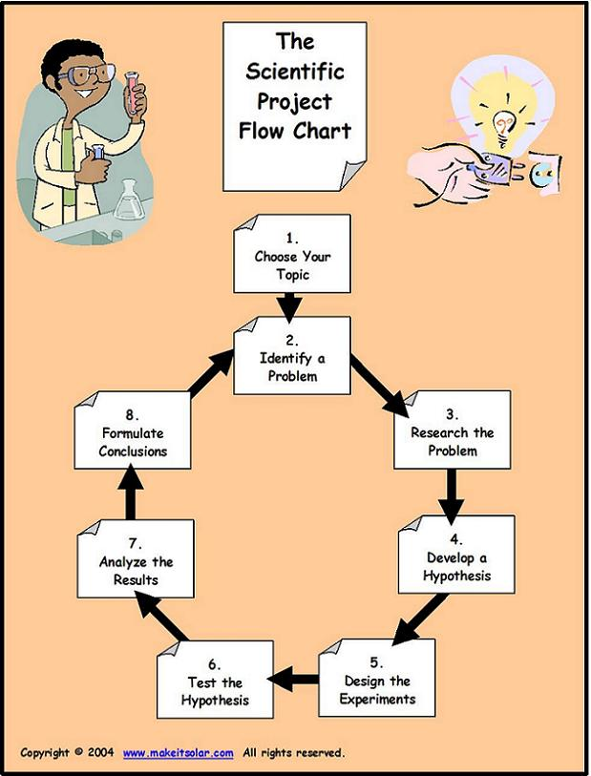
Repeating Investigations
Scientists repeat experiments to be sure that the results match those already obtained.
  If similar results are not obtained
    may have a flaw in your experiment
    conclusion may be invalid.
Notes:
Researchers often work in teams to analyze, review, and critique each other’s data and hypotheses. A review process helps ensure conclusions are valid.

Slide 28
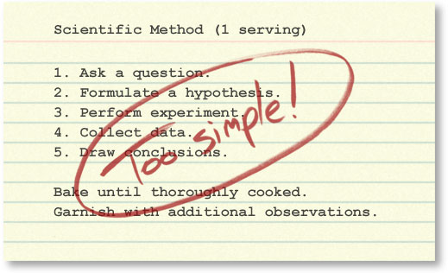
Scientific Method
State the problem/ Ask a question
Research the problem
Form a hypothesis
Test the hypothesis (experiment)
Record Data/ Analyze Data
Form a conclusion
Repeat experiment.
Notes:
http://undsci.berkeley.edu/article/howscienceworks_01
The Scientific Method is traditionally presented in the first chapter of science textbooks as a simple recipe for performing scientific investigations. Though many useful points are embodied in this method, it can easily be misinterpreted as linear and "cookbook": pull a problem off the shelf, throw in an observation, mix in a few questions, sprinkle on a hypothesis, put the whole mixture into a 350° experiment — and voila, 50 minutes later you'll be pulling a conclusion out of the oven! That might work if science were like Hamburger Helper®, but science is complex and cannot be reduced to a single, prepackaged recipe.
The linear, stepwise representation of the process of science is simplified, but it does get at least one thing right. It captures the core logic of science: testing ideas with evidence. However, this version of the scientific method is so simplified and rigid that it fails to accurately portray how real science works. It more accurately describes how science is summarized after the fact — in textbooks and journal articles — than how science is actually done.
The simplified, linear scientific method implies that scientific studies follow an unvarying, linear recipe.
But in reality, in their work, scientists engage in many different activities in many different sequences. Scientific investigations often involve repeating the same steps many times to account for new information and ideas.
The simplified, linear scientific method implies that science is done by individual scientists working through these steps in isolation.
But in reality, science depends on interactions within the scientific community. Different parts of the process of science may be carried out by different people at different times.
The simplified, linear scientific method implies that science has little room for creativity.
But in reality, the process of science is exciting, dynamic, and unpredictable. Science relies on creative people thinking outside the box!
The simplified, linear scientific method implies that science concludes.
But in reality, scientific conclusions are always revisable if warranted by the evidence. Scientific investigations are often ongoing, raising new questions even as old ones are answered.

Slide 29
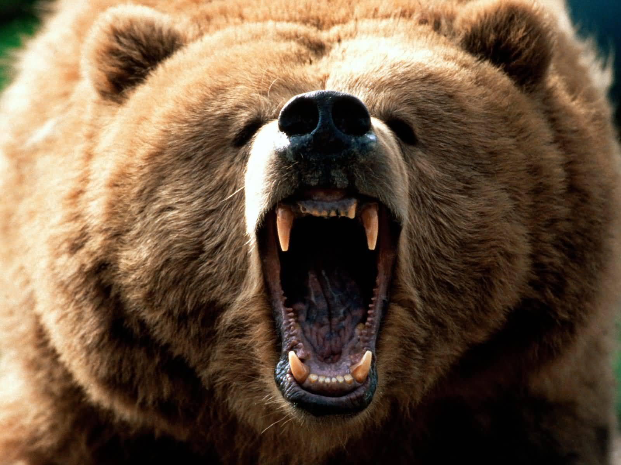
When Experiments Are Not Possible
It is not always possible to do an experiment to test a hypothesis..
  carefully plan alternative investigations
Notes:
For example:
Wild animals must be observed without disturbing them.
Ethical considerations prevent some experiments
Example: smoking mothers and the effect is has on the baby
rely on mothers memory

Slide 30
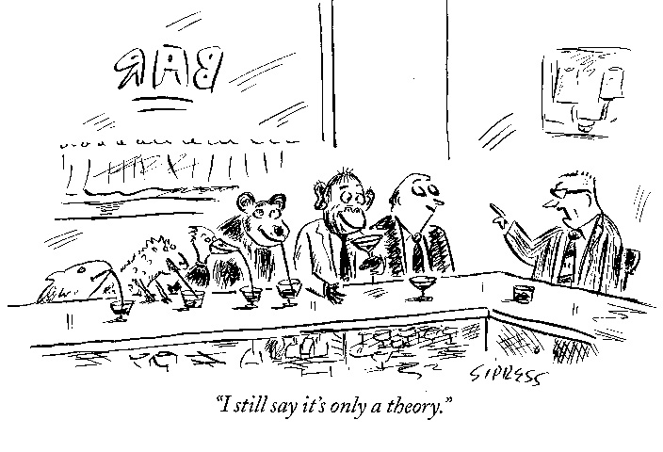
How a Theory Develops
Theory: (scientific definition) a well-tested explanation for a wide range of observations
  A hypothesis that has been supported by numerous investigations

Slide 31
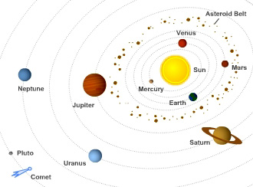
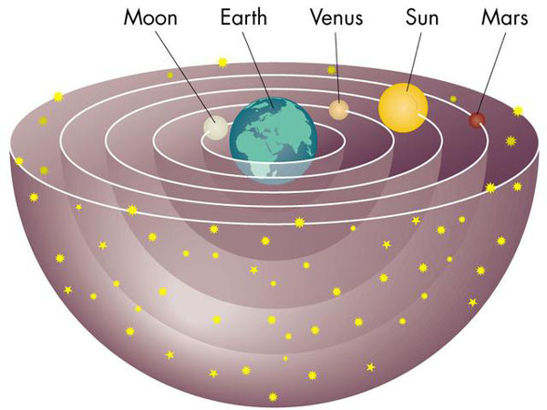
No theory is considered absolute truth. Scientific understanding is always changing.
  New evidence
  New technology
Notes:
As new evidence is uncovered, a theory may be revised or replaced by a more useful explanation.
Sun revolves around the Earth
World is flat

Slide 32
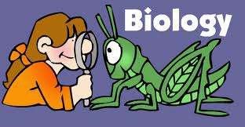
What is Biology??
Biology is the study of life
Biology in Everyday Life
  food supplies
  health
  environmental factors
  quality of life
  future
Notes:
1. Biology provides information about the food you need and the methods for sustaining the world’s food supplies.
2. Biology describes the conditions of good health and the behaviors and diseases that can harm you; used to diagnose and treat medical problems; identifies environmental factors that might threaten you.
3. Biology helps you understand what affects the quality of your life.
4. Biology provides decision makers with useful information and analytical skills needed to predict and affect the future of the planet.

Slide 33
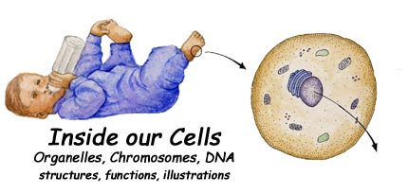
Characteristics of Life
  1. Living things are made up of units called cells
  Cell: smallest unit of life
Notes:
Cellular Basis of Life
Organisms are composed of one or more cells, which are the smallest units that can be considered fully alive.

Slide 34
  1. Living things are made up of units called cells
Can be made of one cell – unicellular
Or many cells – multicellular
All cells have
  A cell membrane – a surrounding barrier
  Ribosomes – small factories for making proteins
  Genetic information – instructions for making proteins
    DNA
    RNA

Slide 35
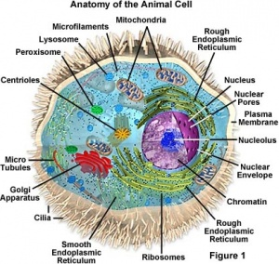
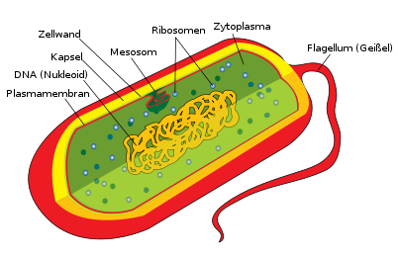
  1. Living things are made up of units called cells
Two types of cells
  Eukaryote – store DNA in a nucleus
    Examples: animals, plants, fungus, protists
  Prokaryote – no nucleus; DNA floats freely
    Examples: bacteria

Slide 36
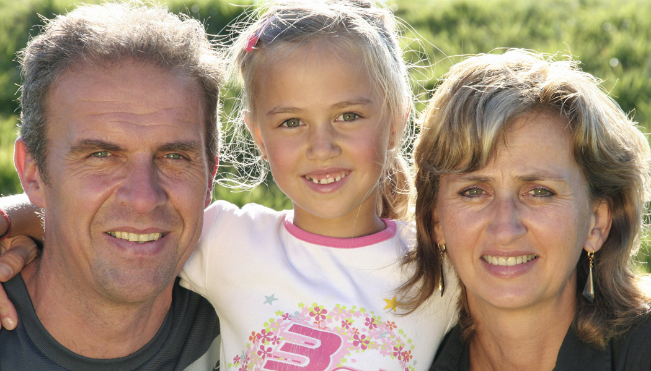
Characteristics of Life
  2. Living things reproduce
  Sexual reproduction
    Two different parents
    Forms new organism
    Needs sex cells
      Sperm (Male)
      Egg (Female)
      Formed by Meiosis - Nuclear division that divides the amount genetic information in half
    Fertilization – joining of the two sex cells to produce a new organism with half the DNA from the sperm and half from the egg

Slide 37
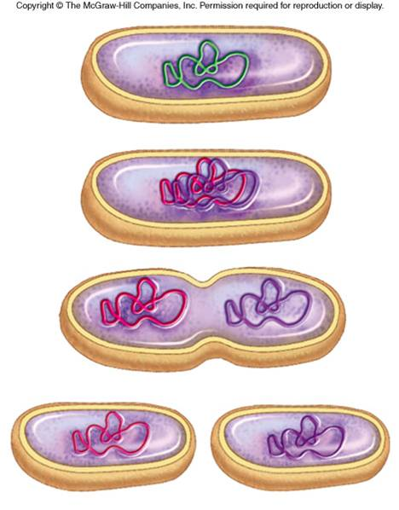
2. Living things reproduce
  Asexual reproduction
    A single parent
    Forms a clone
    Genetic information is copied and the cell splits in half producing two genetically identical organisms
    Examples: binary fission and budding

Slide 38
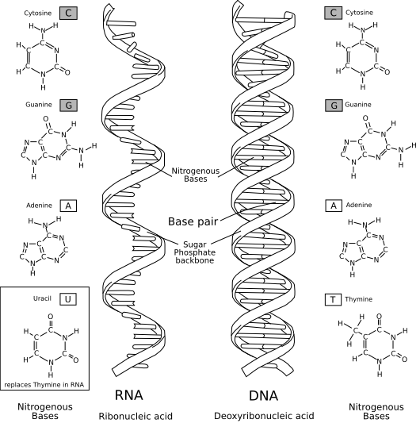
Characteristics of Life
  3. Living things are based on a universal genetic code
  Instructions for making proteins
  Nucleic Acid
  Passed down from parents
  Examples: DNA, RNA
Notes:
Organisms store the information they need to live, grow, and reproduce in a genetic code in a molecule called DNA.
Life’s processes are directed by information carried in a genetic code that is common, with minor variations, to every organism on Earth.
That information, carried in DNA, is copied and passed from parents to offspring.

Slide 39
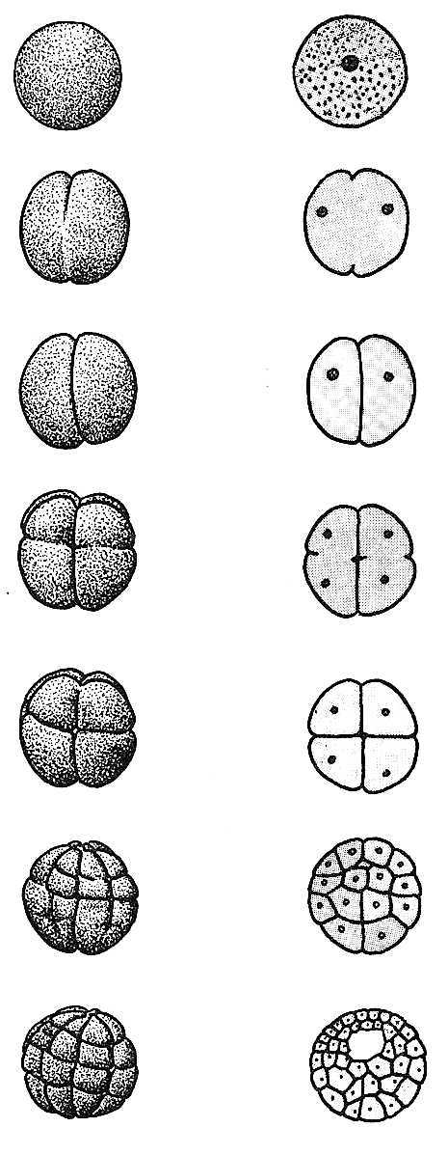
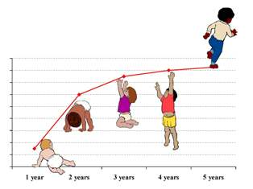
Characteristics of Life
  4. Living things grow and develop
  Multicellular organisms grow by making more cells
    Mitosis – Division of the nucleus
    Cytokinesis – Division of the cytoplasm
Notes:
Growth and puberty

Slide 40
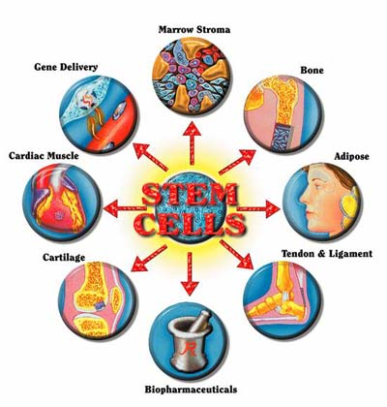
4. Living things grow and develop
  Organisms can develop two ways
  cell differentiation: cells look different from one another and perform different functions
  Puberty
Notes:
Growth and puberty

Slide 41
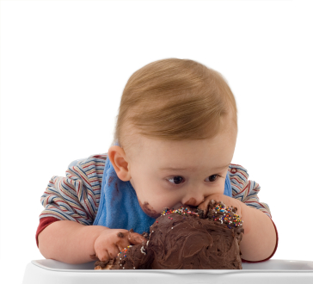
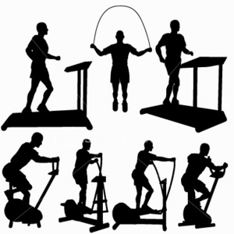
Characteristics of Life
  5. Living things obtain and use materials and energy
  Metabolism: chemical reactions through which an organism builds up or breaks down materials
  *Cellular Respiration: Breaking down sugar into energy molecules the body can use
Notes:
Life’s most basic requirements are matter that serves as nutrients to build body structure and energy to fuel the processes of life.

Slide 42
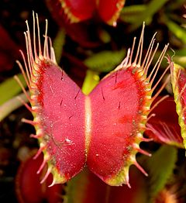
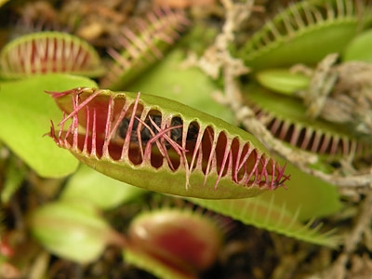
Characteristics of Life
  6. Living things respond to their environment
  stimulus is a signal to which an organism responds.
Notes:
Plant growing toward sunlight.

Slide 43

Characteristics of Life
  7. Living things maintain a stable internal environment
Homeostasis: An organism’s ability to maintain a relatively stable internal environment
Notes:
Although conditions outside an organism may change, conditions inside an organism tend to remain constant.
This process is called homeostasis.
Homeostasis is in the face of changing external conditions is vital to an organisms survival.

Slide 44
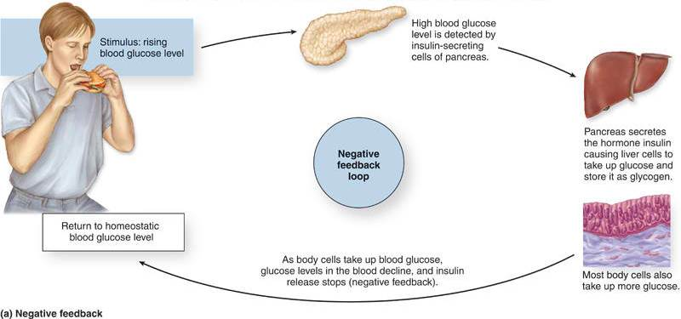
7. Living things maintain a stable internal environment
Organisms often maintain homeostasis through feedback mechanism.
Negative feedback: a loop system in which the response brings the stimulus back to the norm
Example: When there is too much sugar in your blood, your body secretes insulin that causes your cells to absorb the sugar and lower your blood sugar level.
Notes:
Although conditions outside an organism may change, conditions inside an organism tend to remain constant.
This process is called homeostasis.
Homeostasis is in the face of changing external conditions is vital to an organisms survival.

Slide 45
7. Living things maintain a stable internal environment
Positive feedback: a loop system in which the response brings the stimulus further from the norm
Not used for homeostasis
Example: Child birth: when the female has contractions, the body releases oxytocin that causes more contractions
Notes:
Although conditions outside an organism may change, conditions inside an organism tend to remain constant.
This process is called homeostasis.
Homeostasis is in the face of changing external conditions is vital to an organisms survival.

Slide 46
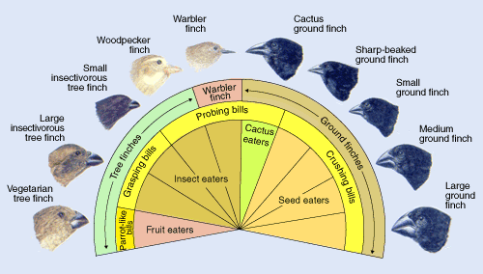
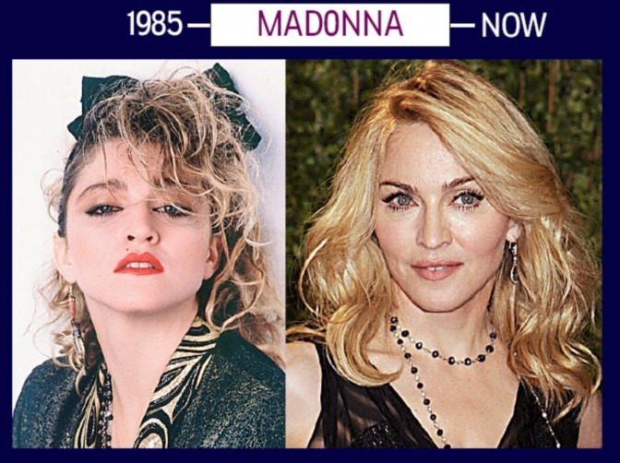
Characteristics of Life
  8. Living things change over time
  Evolution: changes in the frequency of traits in a population of organisms
  Some living things are better adapted to their environment. These organisms survive and reproduce passing their traits on to their offspring.
  Populations evolve in order to survive.
Notes:
“if you don’t use it you lose it”

Slide 47
Characteristics of Life
1. Made of cells
2. Reproduces
3. Grows and Develops
4. Changes over time
5. Obtains and uses energy
6. Maintains a stable internal environment
7. Responds to stimuli
8. Based on universal genetic code
Notes:
No single characteristic is enough to describe a living thing.
Some nonliving things share one or more traits with living things.

Slide 48
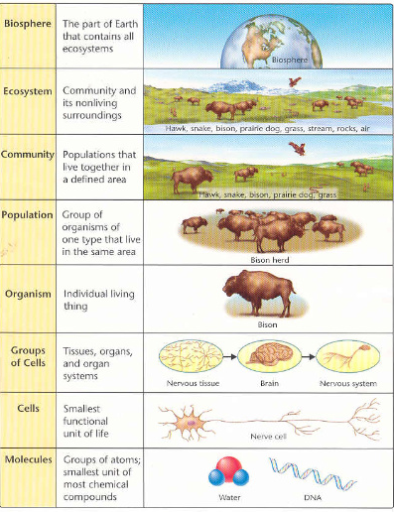
Some of the levels at which life can be studied include:
    molecules
    cells
    organisms
    populations
    communities
    the biosphere
Notes:
All forms of life on Earth are connected together into a biosphere, which literally means “living planet.”
The relationship between organisms and their environment depends on both the flow of energy and the cycling of matter.
All living things are fundamentally alike at the molecular level, even though life takes an almost unbelievable variety of forms.

