Slide 1
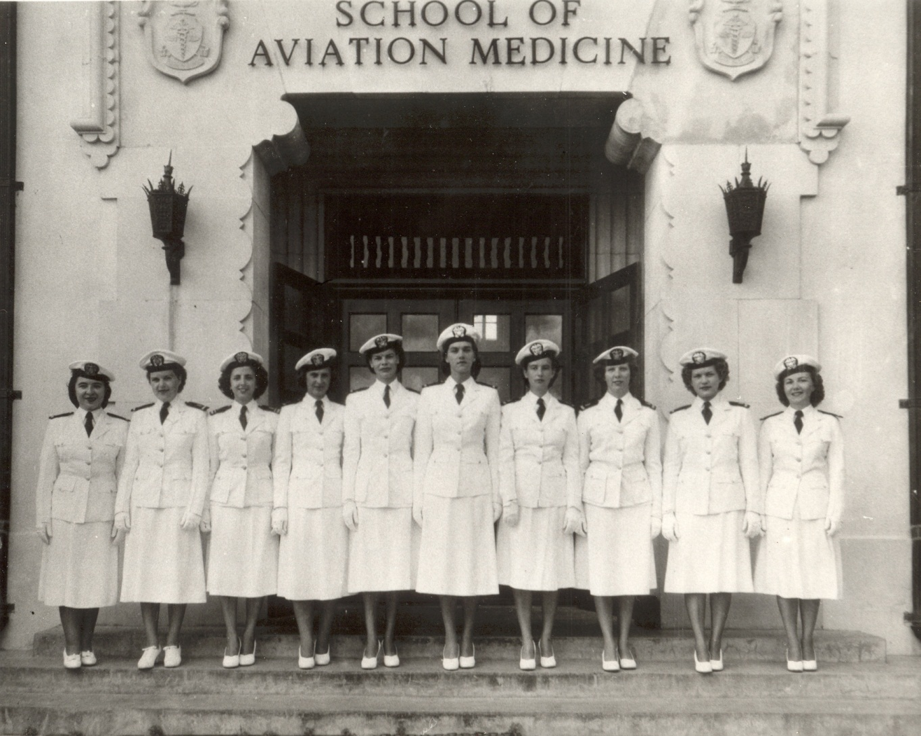
What are your memories of healthcare?

Slide 2

What is bad about our healthcare?

Slide 3
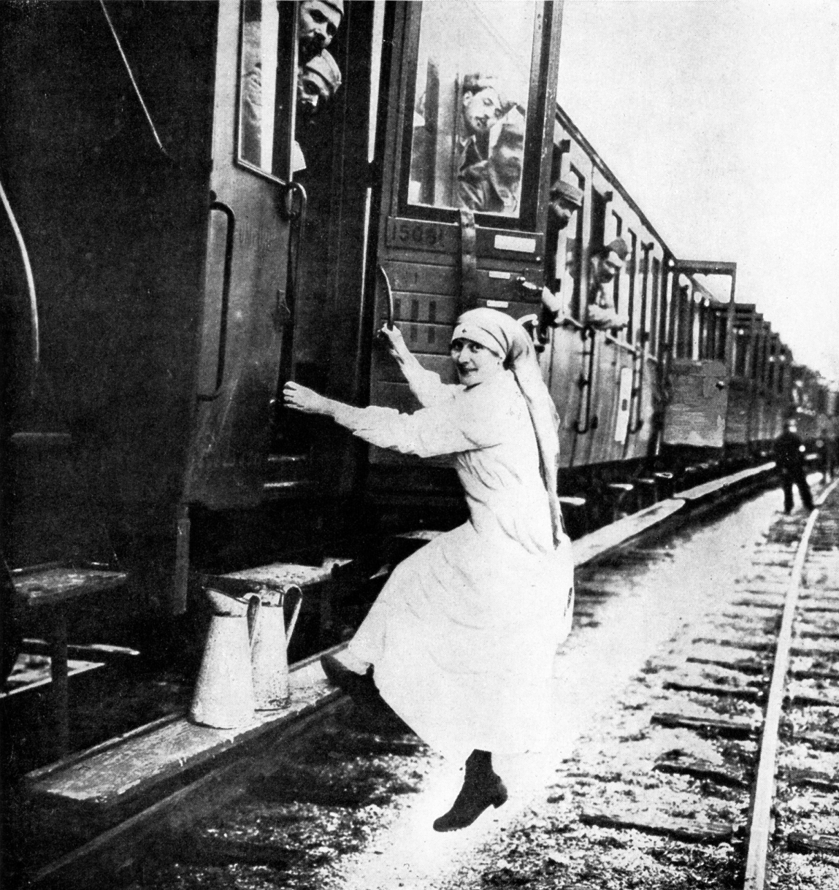
What is good about our healthcare?

Slide 4
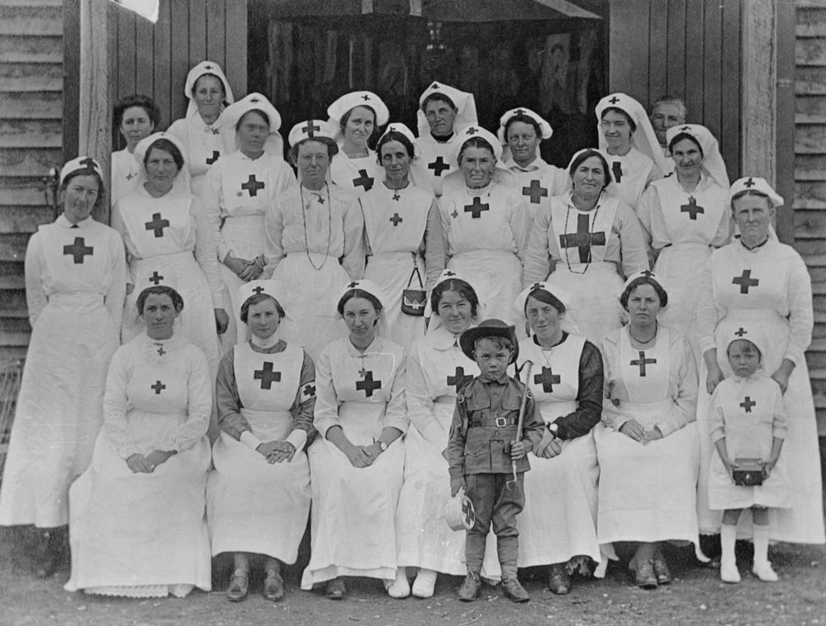
Is Healthcare a Right or a Privilege?
What if there were no insurance, no Medicare, no Medicaid?

Slide 5
Homework
Talk to various people about their perceptions of healthcare (right versus privilege)
  Someone in college
  Someone working with a young family
  Someone working with teenagers/college-age children
  Someone not working but not retired

