Slide 1

Healthcare through the Ages
Sheryl Buckner PhD, RN, ANEF
University of Oklahoma
College of Nursing

Slide 2
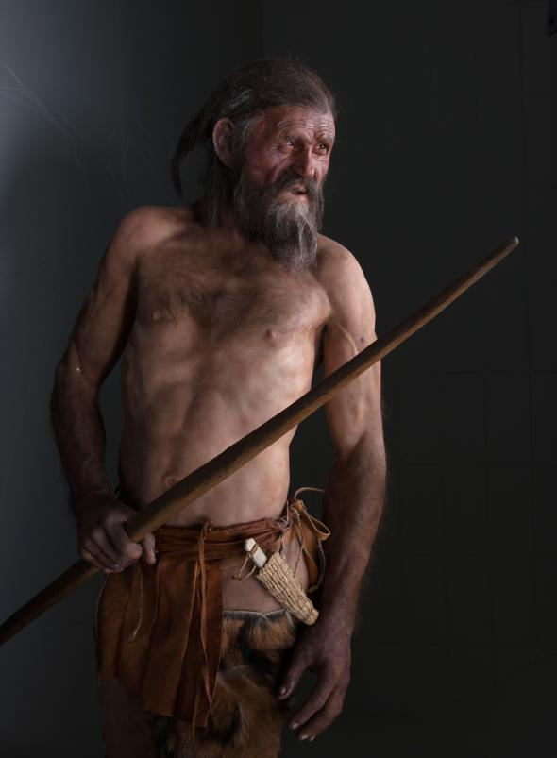
"Those who cannot remember the past are condemned to repeat it“ George Santayana
Ötzi the Iceman
Notes:
A report that Ötzi the Iceman has 19 genetic relatives living in Austria is the latest in a string of surprising discoveries surrounding the famed ice mummy. Ötzi's 5,300-year-old corpse turned up on the mountain border between Austria and Italy in 1991. Here is a rundown of the latest on the world's oldest Alpine celebrity, and some of the other remarkable things we've learned about Ötzi.
(Read "Unfrozen" from the November 2011 issue of National Geographic magazine.)
1. The Iceman has living relatives.
Living links to the Iceman have now been revealed by a new DNA study. Gene researchers looking at unusual markers on the Iceman's male sex chromosome report that they have uncovered at least 19 genetic relatives of Ötzi in Austria's Tyrol region.
The match was made from samples of 3,700 anonymous blood donors in a study led by Walther Parson at Innsbruck Medical University. Sharing a rare mutation known as G-L91, "the Iceman and those 19 share a common ancestor, who may have lived 10,000 to 12,000 years ago," Parson said.
The finding supports previous research suggesting that Ötzi and his ancestors were of farming stock. The study used Y-chromosome markers that are passed from father to son to trace the Neolithic migrations that brought farming to Europe via the Alps. Ötzi belonged to a Y-chromosome group called haplogroup G, which is rooted, like farming, in the Middle East.
The study's overall results fit the idea that the changes of the Neolithic Revolution spurred people westward into the Tyrol region, Parson said.
He is nevertheless wary of any suggestion that Ötzi's distant relatives might be a chip off the old block, either physically or in their liking for simple grain porridge.
2. He had several health issues.
Since Ötzi's discovery in an alpine glacier more than two decades ago, scientists have subjected his mummy to a full-body health check. The findings don't make pretty reading. The 40-something's list of complaints include worn joints, hardened arteries, gallstones, and a nasty growth on his little toe (perhaps caused by frostbite).
Furthermore, the Iceman's gut contained the eggs of parasitic worms, he likely had Lyme disease, and he had alarming levels of arsenic in his system (probably due to working with metal ores and copper extraction). Ötzi was also in need of a dentist—an in-depth dental examination found evidence of advanced gum disease and tooth decay. (See video: "Iceman Autopsy.")
Despite all this, and a fresh arrow wound to his shoulder, it was a sudden blow to the head that proved fatal to Ötzi.
3. He also had anatomical abnormalities.
Besides his physical ailments, the Iceman had several anatomical abnormalities. He lacked both wisdom teeth and a 12th pair of ribs. The mountain man also sported a caddish gap between his two front teeth, known as a diastema. Whether this impressed the ladies is a moot point—some researchers suspect Ötzi might have been infertile.
4. The Iceman was inked.
Ötzi's frozen mummy preserves a fine collection of Copper Age tattoos. Numbering over 50 in total, they cover him from head to foot. These weren't produced using a needle, but by making fine cuts in the skin and then rubbing in charcoal. The result was a series of lines and crosses mostly located on parts of the body that are prone to injury or pain, such as the joints and along the back. This has led some researchers to believe that the tattoos marked acupuncture points.
If so, Ötzi must have needed a lot of treatment, which, given his age and ailments, isn't so surprising. The oldest evidence for acupuncture, Ötzi's tattoos suggest that the practice was around at least 2,000 years earlier than previously thought.
5. He consumed pollen and goats.
The Iceman's final meals have served up a feast of information to scholars. His stomach contained 30 different types of pollen. Analysis of that pollen shows that Ötzi died in spring or early summer, and it has even enabled researchers to trace his movements through different mountain elevations just before he died. His partially digested last meal suggests he ate two hours before his grisly end. It included grains and meat from an ibex, a species of nimble-footed wild goat.
A traveler out of the past, the Iceman, whose mummified body was discovered in the Tyrolean Alps in Northern Italy in 1991, has given archeologists and other scientists a lifelike picture of what people wore and ate and carried with them on treks into the Alps 5,300 years ago, at the end of the Stone Age and beginning of the Copper Age in Europe. An anthropologist reported last week that the Iceman was also providing a rare glimpse of prehistoric medicine, including his apparent use of a natural laxative and antibiotic.
Among the Iceman's possessions were two walnut-size lumps with a consistency somewhere between cork and leather. Each lump was pierced and tied to a leather thong, perhaps so it could be fastened to some part of his clothing or belt. At first, the material was mistakenly described as tinder for starting fires.
But Austrian microbiologists have identified the lumps as the fruit of the birch fungus, Piptoporus betulinus, which is common in alpine and other cold environments. If the fungus is ingested, it can bring on short bouts of diarrhea. It also contains oils that are toxic to certain parasitic bacteria, thus acting as a form of nature's own antibiotics.
Scientists have not yet been able to determine the cause of the Iceman's death, but studies of his body have yielded a picture of a man stiff with arthritis who had not eaten in his last eight hours and may have died of exhaustion in a sudden snowstorm.
An autopsy of the well-preserved body has at least revealed the apparent reason the fungus was among the Iceman's remedies of the road. British scientists found in the man's colon the eggs of a parasitic whipworm, Trichuris trichiura. This infestation causes diarrhea and acute stomach pains. It can also bring on anemia, which might explain the evidence of low iron content in some of the mummy's muscles.
In the current issue of the British medical journal Lancet, Dr. Luigi Capasso, an anthropologist at the National Archeological Museum in Chieti, Italy, reviewed the evidence and concluded, ''The discovery of the fungus suggests that the Iceman was aware of his intestinal parasites and fought them with measured doses of Piptoporus betulinus.''
As Dr. Capasso pointed out, the birch fungus contains toxic resins that attack parasites like whipworm and another compound, agaric acid, which is a powerful laxative. The combined properties of the fungus could have brought at least temporary relief by purging the Iceman's intestines of nearly all of the worms and their eggs.
The birch fungus, Dr. Capasso wrote, was probably the only such remedy available in Europe before introduction of the far more toxic chenopod oil from the Americas. The chenopod is a low shrub found in arid environments of South America. The efficacy of chenopod oil as a medicine was increased by adding a strong laxative that expelled the worms and their eggs.
In ''The Man in the Ice,'' published in 1994 (Harmony Books, $25), Dr. Konrad Spindler, an archeologist at the University of Innsbruck in Austria who led the early investigation of the mummy, noted the first evidence suggesting that the Iceman might have been carrying some natural medicines.
''All folk medicine has its origins in prehistory,'' Dr. Spindler wrote. ''Over hundreds and thousands of years remedies were passed on from generation to generation. The modern pharmaceutical industry has frequently analyzed the active constituents of traditional medicines and makes use of them to this day, where synthetic forms cannot be produced. Seen in this light, the Iceman with his modest but no doubt effective traveling medicine kit, is not all that remote from ourselves.''
Dr. John F. Leslie, a fungal geneticist at Kansas State University who is editor of the journal Applied and Environmental Microbiology, called the reported link between the fungus and the Iceman's intestinal parasites ''an interesting and exciting finding.'' He said the toxins effective as medicine were produced by the fungi to protect themselves and their food source in the tree.
Dr. Michael G. Rinaldi, a clinical mycologist at the University of Texas Health Science Center in San Antonio, said he would like to see more evidence supporting the inference that the Iceman was consciously treating the parasites with the fungus.
If that proves to be the case, he said, ''It just shows that from earliest time, people when they were sick would try whatever they could to make it go away, even if they never had a clue as to why it made them feel better.''

Slide 3
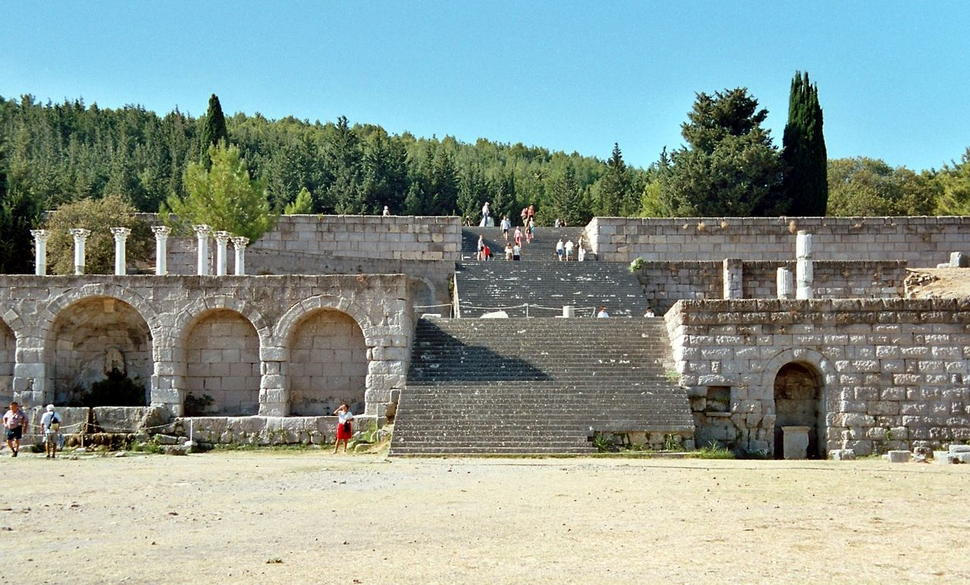
350 BC—Healthcare through the Gods
View of the Askleipion of Kos, the best preserved
instance of a Greek Asklepieion.
Notes:
In ancient cultures, religion and medicine were linked. The earliest documented institutions aiming to provide cures were ancient Egyptian temples. In ancient Greece, temples dedicated to the healer-god Asclepius, known as Asclepieia (Ancient Greek: Ἀσκληπιεῖα, sing. Asclepieion, Ἀσκληπιεῖον), functioned as centres of medical advice, prognosis, and healing.^{[1]} At these shrines, patients would enter a dream-like state of induced sleep known as enkoimesis (ἐγκοίμησις) not unlike anesthesia, in which they either received guidance from the deity in a dream or were cured by surgery.^{[2]} Asclepeia provided carefully controlled spaces conducive to healing and fulfilled several of the requirements of institutions created for healing.^{[3]} In the Asclepieion of Epidaurus, three large marble boards dated to 350 BC preserve the names, case histories, complaints, and cures of about 70 patients who came to the temple with a problem and shed it there. Some of the surgical cures listed, such as the opening of an abdominal abscess or the removal of traumatic foreign material, are realistic enough to have taken place, but with the patient in a state of enkoimesis induced with the help of soporific substances such as opium.^{[2]} The worship of Asclepius was adopted by the Romans. Under his Roman name Æsculapius, he was provided with a temple (291 BC) on an island in the Tiber in Rome, where similar rites were performed.^{[4]}
Institutions created specifically to care for the ill also appeared early in India. Fa Xian, a Chinese Buddhist monk who travelled across India ca. 400 CE, recorded in his travelogue ^{[5]} that
"The heads of the Vaisya [merchant] families in them [all the kingdoms of north India] establish in the cities houses for dispensing charity and medicine. All the poor and destitute in the country, orphans, widowers, and childless men, maimed people and cripples, and all who are diseased, go to those houses, and are provided with every kind of help, and doctors examine their diseases. They get the food and medicines which their cases require, and are made to feel at ease; and when they are better, they go away of themselves."
The earliest surviving encyclopaedia of medicine in Sanskrit is the Carakasamhita (Compendium of Caraka). This text, which describes the building of a hospital is dated by Dominik Wujastyk of the University College London from the period between 100 BCE and CE150.^{[6]} The description by Fa Xian is one of the earliest accounts of a civic hospital system anywhere in the world and, coupled with Caraka’s description of how a clinic should be equipped, suggests that India may have been the first part of the world to have evolved an organized cosmopolitan system of institutionally-based medical provision.^{[6]}
King Ashoka is wrongly said by many secondary sources to have founded at hospitals in ca. 230 B.C.^{[7]}
According to the Mahavamsa, the ancient chronicle of Sinhalese royalty, written in the sixth century A.D., King Pandukabhaya of Sri Lanka (reigned 437 BC to 367 BC) had lying-in-homes and hospitals (Sivikasotthi-Sala) built in various parts of the country. This is the earliest documentary evidence we have of institutions specifically dedicated to the care of the sick anywhere in the world.^{[8][9]} Mihintale Hospital is the oldest in the world.^{[10]}

Slide 4
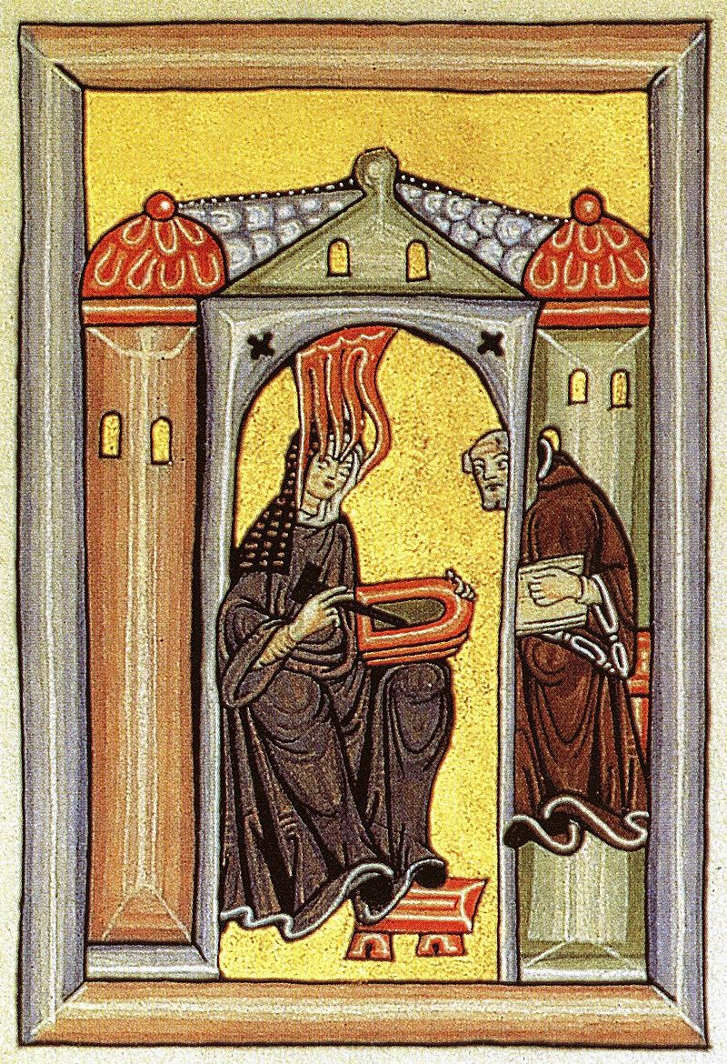
Middle Ages—Healthcare through the Church
St. Hildegard of Bingen
Doctor of the Church
Patron of Artists, Musicians, Gardeners
Notes:
Roman Empire
The Black Death led to cynicism toward religious officials who could not keep their promises of curing plague victims and banishing the disease. No one, the Church included, was able to cure or accurately explain the reasons for the plague outbreaks. One theory of transmission was that it spread through air, and was referred to as miasma, or 'bad air'. This increased doubt in the clergy's abilities. Extreme alienation with the Church culminated in either support for different religious groups such as the flagellants, which from their late 13th century beginnings grew tremendously during the opening years of the Black Death, and later to a pursuit of pleasure and hedonism. It was a common belief at the time that the plague was due to God's wrath, caused by the sins of mankind; In response, the flagellants travelled from town to town, whipping themselves in an effort to mimic the sufferings of Jesus prior to his crucifixion. Originating in Germany, several miraculous tales emerged from their efforts, such as a child being revived from the dead, and a talking cow. These stories further fuelled the belief that the flagellants were more effective than church leaders. It may have been that the flagellant's later involvement in hedonism was an effort to accelerate or absorb God's wrath, to shorten the time with which others suffered. More likely, the focus of attention and popularity of their cause contributed to a sense that the world itself was ending, and that their individual actions were of no consequence.
Sadly, the flagellants may have more likely contributed to the actual spreading of the disease, rather than its cure. Presumably, there were towns that the flagellants visited or passed through which were largely unaffected by the plague until that point, only to be infected by fleas carried either by the flagellant's followers, or the flagellants themselves. This is a common ironic theme in how individuals at the time dealt with the plague—that in nearly all cases, the methods employed to defend against the plague encouraged its spread.
The Black Death hit the monasteries very hard because of their proximity with the sick, who sought refuge there, so that there was a severe shortage of clergy after the epidemic cycle. This resulted in a mass influx of hastily-trained and inexperienced clergy members, many of whom knew little of the discipline and rigor of the veterans they replaced. This led to abuses by the clergy in years afterwards and a further deterioration of the position of the Church in the eyes of the people.
Further information: Byzantine medicine
The Romans constructed buildings called valetudinaria for the care of sick slaves, gladiators, and soldiers around 100 B.C., and many were identified by later archeology. While their existence is considered proven, there is some doubt as to whether they were as widespread as was once thought, as many were identified only according to the layout of building remains, and not by means of surviving records or finds of medical tools.^{[11]}
Saint Sampson the Hospitable built some of the earliest hospitals in the Roman Empire.
The declaration of Christianity as an accepted religion in the Roman Empire drove an expansion of the provision of care. Following First Council of Nicaea in 325 A.D. construction of a hospital in every cathedral town was begun. Among the earliest were those built by the physician Saint Sampson in Constantinople and by Basil, bishop of Caesarea in modern-day Turkey. Called the "Basilias", the latter resembled a city and included housing for doctors and nurses and separate buildings for various classes of patients.^{[12]} There was a separate section for lepers.^{[13]} Some hospitals maintained libraries and training programs, and doctors compiled their medical and pharmacological studies in manuscripts. Thus in-patient medical care in the sense of what we today consider a hospital, was an invention driven by Christian mercy and Byzantine innovation.^{[14]} Byzantine hospital staff included the Chief Physician (archiatroi), professional nurses (hypourgoi) and the orderlies (hyperetai). By the twelfth century, Constantinople had two well-organized hospitals, staffed by doctors who were both male and female. Facilities included systematic treatment procedures and specialized wards for various diseases.^{[15]}
Hildegard (1098-1179) was a Benedictine abbess and visionary. Through much of her life, she experienced powerful visions, some of which she dictated and which are contained in three volumes. She illustrated these texts herself, in works of unique power and originality. She also wrote poems, plays, hymns (many of which today can be found in recordings), and works on medicine and natural history. She advised popes, kings, and bishops. Hildegard was widely known for her knowledge of the curative powers of natural objects, especially herbs, and is sometimes regarded as one of the sources of modern medicine. She did all this during a time in which women were accorded little respect as artists and intellectuals, yet the effects Hildegard’s experiments and advancements in music, art, and healing continue to this day. On 7 October 2012, Pope Benedict XVI named her a Doctor of the Church

Slide 5
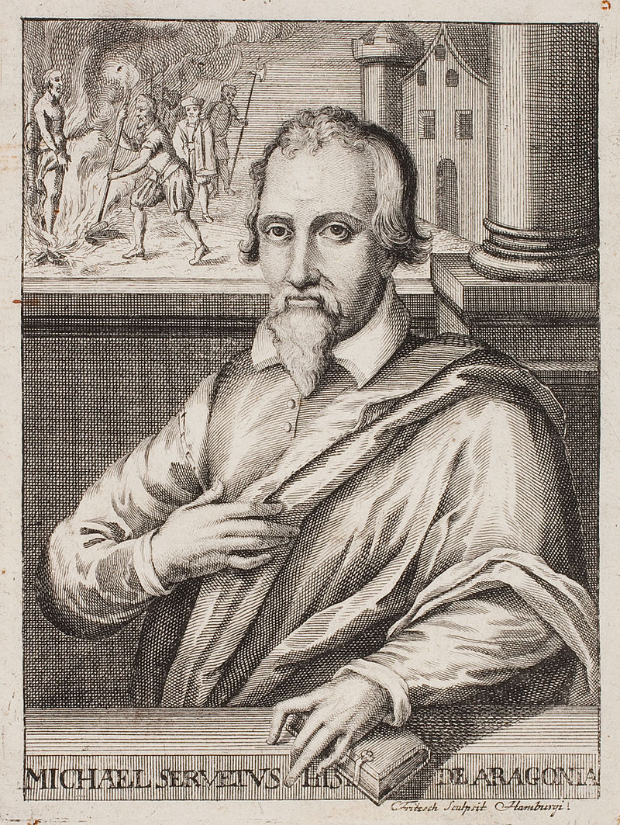
Renaissance—questioning the Church
Michael Servetus aka Miguel Serveto
Notes:
Spanish theologian, physician, cartographer, and Renaissance humanist. He was the first European to correctly describe the function of pulmonary circulation, as discussed in Christianismi Restitutio (1553). He was a polymath versed in many sciences: mathematics, astronomy and meteorology, geography, human anatomy, medicine and pharmacology, as well as jurisprudence, translation, poetry and the scholarly study of the Bible in its original languages. He is renowned in the history of several of these fields, particularly medicine and theology. He participated in the Protestant Reformation, and later developed a nontrinitarian Christology. Condemned by Catholics and Protestants alike, he was arrested in Geneva and in 1553 burnt at the stake as a heretic by order of the city's Protestant governing council.
From 1500-1800, you start seeing a turn from health as punishment to something more physiological. Royal College of Physicians in England established in 1518.

Slide 6
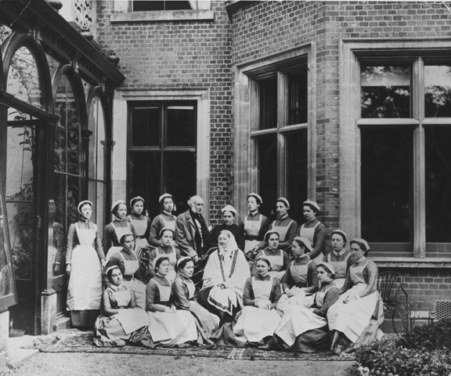
Florence Nightingale
Notes:
Nightingale was a pioneer in the visual presentation of information. In 1857, she invented the pie chart, which helped her disprove the medical assumptions of her day. Using fatality counts from the Crimean War, Nightingale develops a progressive series of statistical diagrams that reveal startling information: most soldiers did not die of their wounds, as reported, but in army hospitals, from diseases related to poor hygiene. When further data showed army death rates twice that of the civilian population, Nightingale traces the cause to overcrowded, disease-ridden barracks. She used in her report to the royal commission to force the British army to maintain nursing and medical care to soldiers in the field.

Slide 7
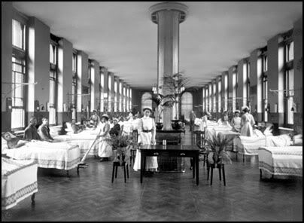
A Whole New World
St. Thomas Hospital, London
Notes:
St. Thomas's Hospital was described as ancient in 1215. It was a mixed order of Augustinian monks and nuns, dedicated to Thomas Becket which provided shelter and treatment for the poor, sick, and homeless. The hospital was located in Southwark, just south of London Bridge.
In the fifteenth century Richard Whitington endowed a laying-in ward for unmarried mothers. St Thomas Church
St Thomas in the 18th Century (engraving)
The First English Bible
It was in the grounds of the Hospital in Southwark that the first complete translation of the bible into English was made. In 1533, Thomas Cromwell and Sir Thomas More suggested that the Scriptures should be translated into `the vulgar tongue'. Miles Coverdale made the translation and James Nicholson printed the Bible from premises in St Thomas's. The grounds also housed one of England's most famous stained glass window manufacturers.
The Reformation
The Hospital was dissolved by Henry VIII in 1540, despite pleas from the City to allow it to take over control. It was described as a 'bawdy' house, possibly because the Master was accused of immorality, or because it treated many of the prostitutes and their clients of their venereal diseases. Southwark was the red-light district of London. The hospital was reopened as a hospital by Edward VI in 1552, since when it has continued to serve the public, although it moved from its ancient site to its present location in Lambeth in 1862. The monastery was dissolved in the Reformation, but reopened in 1551 and rededicated to Thomas the Apostle, as Becket had been decanonised.
Rebuilding
At the end of the 17th century, the hospital and church were largely rebuilt by Thomas Cartwright (Master Mason to Christopher Wren at St Mary-le-Bow). In 1822, part of the Herb Garret was converted into a purpose built Operating Theatre. This strange situation resulted from the fact that the female surgical ward abutted the garret. Previously operations took place on the ward.
To see a plan of the hospital click here.
Florence Nightingale and the Hospital.
In 1859, Florence Nightingale became involved with St Thomas's, setting up on this site her famous nursing school. It was on her advice that the Hospital agreed to move to a new site when the Charing Cross Railway Company offered to buy the hospital's land. More information about Florence Nightingale can be found at the Florence Nightingale Museum .
In 1862 the Hospital began the move to its present site at Lambeth. The operating theatre in Southwark was closed and lay abandoned until rediscovered in 1956.
Who were the patients?
The patients were mainly poor people who were expected to contribute to their care if they could afford it. Rich patients were treated and operated on at home rather than in hospital. The patients at the Old Operating Theatre were all women. Those who visit the Museum will be relieved to know that the patients did not have to climb the spiral staircase that is the current entrance. They came in from the women's ward through what is now the fire escape.
For further information on the patients click here.
The Old Operating Theatre Museum on line exhibitions explain the detailed history of the Museum and its context in the history of medicine in general and the history of Guys and St Thomas Hospital in particular.

Slide 8
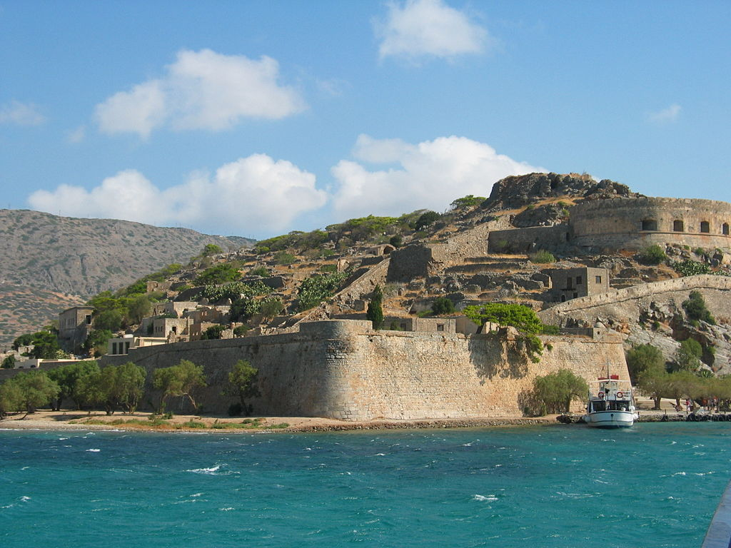
Middle Ages to 1900’s—old ideas still linger
Spinalonga on Crete, Greece, one of the last
leper colonies in Europe, closed in 1957.
Notes:
Beliefs that sickness came from being a “bad person” to sickness related to something happening within the body.
Those with TB were in sanatoriums
Mentally Ill: 1700-1800 were kept at home, mid 1900's admitted to asylums or imprisoned - some were never released, little community support

Slide 9
Turn of the Century
  Poor
  No health care
  Family Provided
  Received health care in crowded hospitals
  Wealthy
  Avoided hospitals
  Hired Dr's privately
  HC provided by nurses in the home
Notes:
https://quizlet.com/65515965/history-of-canadas-health-care-system-flash-cards/

Slide 10
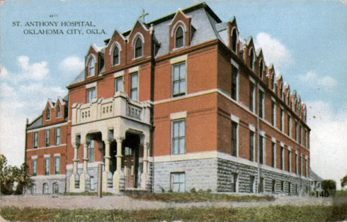
St. Anthony
Notes:
At the turn of the century, either governments or religious orders began making healthcare a right for all. Before 1900, the UK started assisting with healthcare for their citizens . Around 1900 in Canada, money was put from the government to support healthcare, other countries followed (Norway, Sweden, UK)
In America, religious orders took on the burden of healthcare (Sisters of Mercy, Sisters of St. Francis, Baptist, Presbyterian Religions). Modest Beginnings. How did it get started? A pair of Roman Catholic Franciscan nuns (Sisters Beata Vinson and Clara Schaff) traveled to Oklahoma City from Missouri in the spring of 1898. They were looking to raise funds here for a hospital there (in Maryville, Missouri), apparently thinking that 9 years after the Land Run they'ed find some benefactors here, and they sought permission from the local priest, Rev. D.I. Landslots, to solicit funds for that purpose. Whether he gave permission or not I don't know, but, at the least, he requested and charged the Sisters to go back to Maryville and carry a request that the Order to establish a permanent hospital here ... none existed at the time in the city or even in Oklahoma Territory, according to an April 26, 1998, Oklahoman article.
It worked. In July 1898, 4 Sisters returned and rented a pair of houses on NW 4th (one a residence, the other a temporary hospital ... which would later become the location of the Murrah Building ... so the ties between the Order and the later Murrah Building were/are longstanding).
When the initial hospital opened, it had no electricity, sewage, running water (water had to be hauled by the nuns from 4 blocks away) or natural gas. In fact, it had to close in November 1898 because of those problems.
The Sisters had been instructed by their Mother Superior Augustine in her August 1, 1898 mandate, "Turn no one away." In the aftermath of the Murrah Building bombing, much beyond the death of Sister Augustine, 300 of the people injured in the 1995 Murrah bombing were brought to Saint Anthony's, the hospital nearest to the Murrah Building, and many were treated without charge. During the Great Depression, hospital Sisters served more than 2,000,000 free meals to the hungry. The hospital's bank balance was $19.07 on January 1, 1931 ... four years later, it was in debt by $331,060.

Slide 11
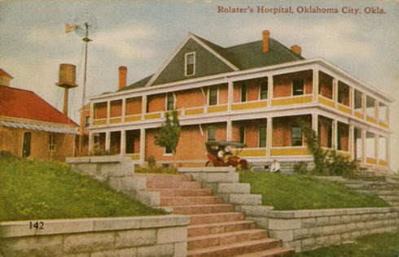
Rolater Hospital, later University

Slide 12
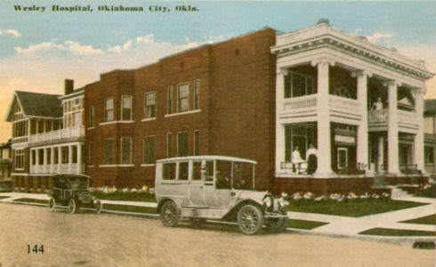
Wesley Hospital, later Presbyterian, then OU Medical Center

Slide 13
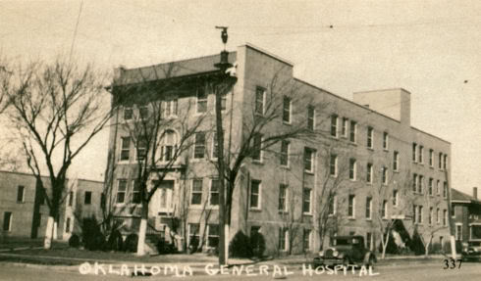
Baptist Hospital, then Oklahoma General then Mercy
Notes:
State Baptist Hospital (1916), it
became Oklahoma General Hospital in 1922, Mercy
Hospital in 1947. Before Mercy moved in 1974, it
occupied the block between Dewey & Walker, NW 13 & NW 12

Slide 14
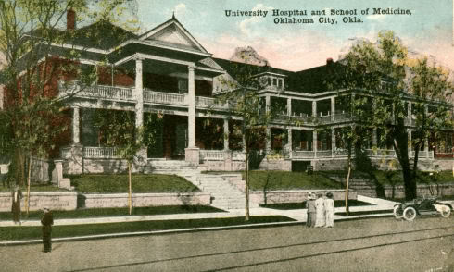
University Hospital

Slide 15
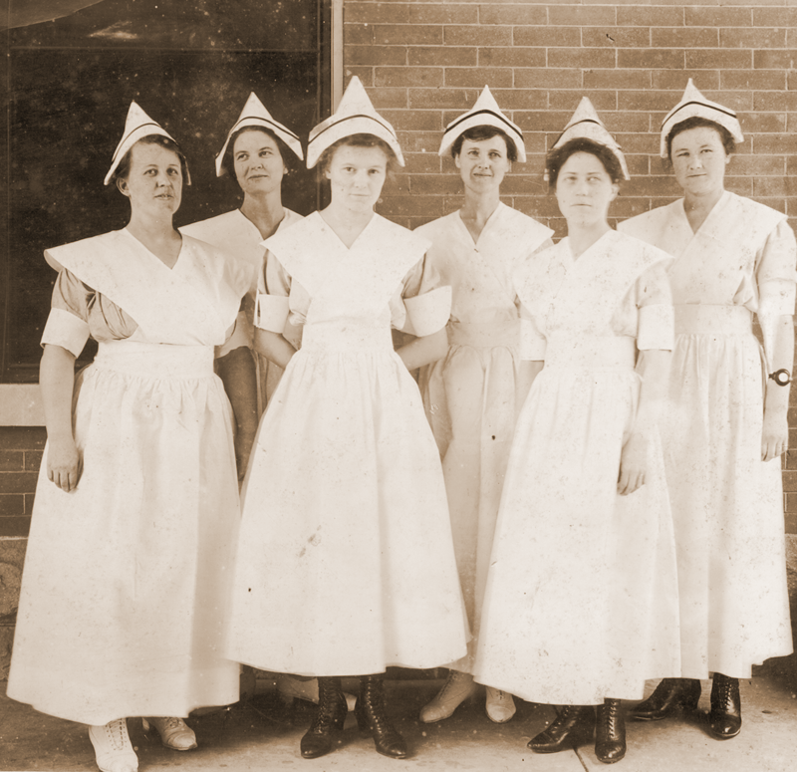
Educated Healthcare Workers

Slide 16
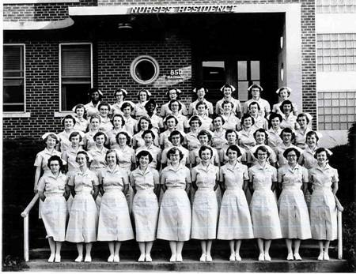
Increasing numbers over the years

Slide 17
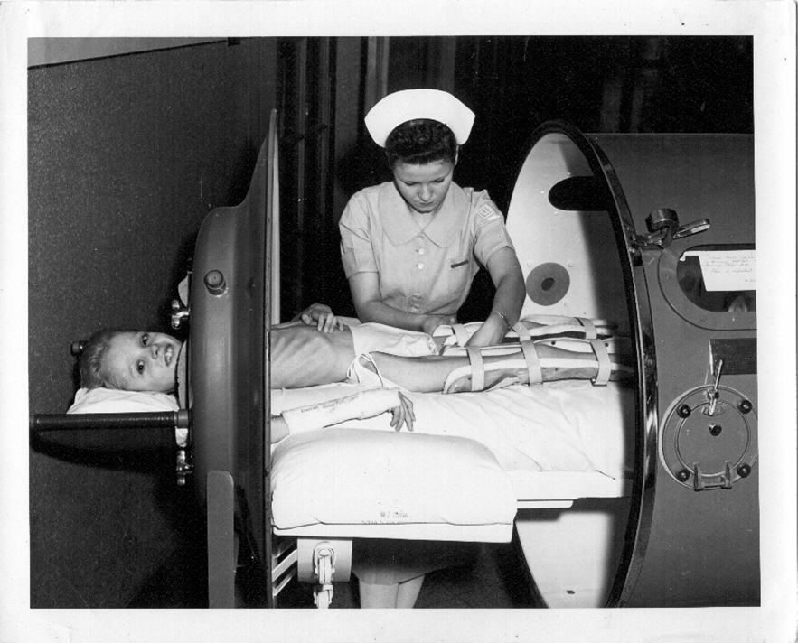
Technology Use Increased

Slide 18
What changed our attitudes about healthcare in a hospital?
We understood the body better (more research)
We had better technology (electricity vs. gas)
We had better anesthesia
We had antibiotics
We could create sterile environments
Medicare and private insurance coverage

Slide 19
As time went by, problems occurred

Slide 20
As time went by, problems occurred
Cost
Abuses of the system
Result of the abuses: too much oversight
Prevention not covered by insurance
Health outcomes worse than in countries where government supported healthcare

Slide 21
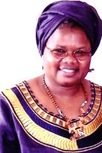
Old ideas still hang on in some places in the world
Florence Mubichi, RN, MS
Notes:
As most of you know Florence returned to her home in Kaaga, Meru, Kenya, a few weeks ago seriously ill. After about 3 weeks of a remarkable time in which she rallied to walk in her gardens, watch the sunset from her veranda with her husband, share her life story on tape with her daughters and be her 2 year old grand-daughter's favorite 'patient', she declined rapidly over the last 3 days. She had her final home going about 1:30pm, Kenya time (6:30 am in Oklahoma). She leaves behind a family grateful for that last time of closeness and love, who miss her more than words can say, and a multitude of friends across the world. All of us who knew her will remember a woman whose Christian focus and commitment to mission never faltered. To most of you at some point she has said, "God is good all the time, all the time God is good",and "Come and visit me in Kenya and see what wonderful work God is doing in my country". A memorial for Florence is being planned at Nichols Hills UMC, OKC, on Thurs, March 25, 2010 at 1:00 p.m. Florence’s funeral in Kenya will be March 23rd.
I was on Skype continuously with the family during Flo's last hours. The girls said they needed their "other mother" (me) so just we just kept the computer internet line open and I kept the computer on mylap. They would come back and forth from her room and talk to me until the doctor finally came. I got off the line then but just a few minutes later I got the message, "we just lost mum." Of course I opened up Skype again and talked to all 3 of the family. Things went as they should have. She was in her own bed, the family all there, the doctor and a senior nurse she worked with for years there, a close personal friend of Stephens' from CA (who was there with a work team) was there, and the head of the extended family, the retired Bishop Lawi Imathiu was there. it could not have been more of exactly what Florence would want except I was not there...however, I was there in spirit and on Skype. (Something in favor of technology.

Slide 22
References
http://news.nationalgeographic.com/news/2013/10/131016-otzi-ice-man-mummy-five-facts/
http://www.nytimes.com/1998/12/08/science/lessons-in-iceman-s-prehistoric-medicine-kit.html
http://uudb.org/articles/michaelservetus.html
http://www.thegarret.org.uk/stthomas.htm
http://www.kdnuggets.com/news/2008/n07/22i.html
http://dougdawg.blogspot.com/2007/07/saint-anthonys-hospital.html

