Slide 1
About Me
Sheryl Buckner PhD, RN, ANEF
Fellow, Academy of Nursing Education

Slide 2
But first—about YOU!
Answer the following questions on the paper:
What made you want to take this class?
What questions do you have about the healthcare system?

Slide 3
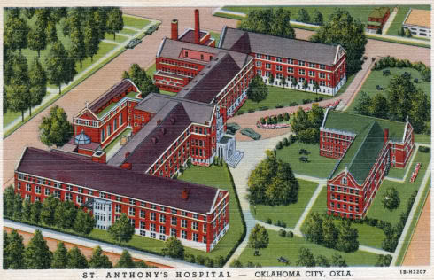
Born and Raised in OKC

Slide 4
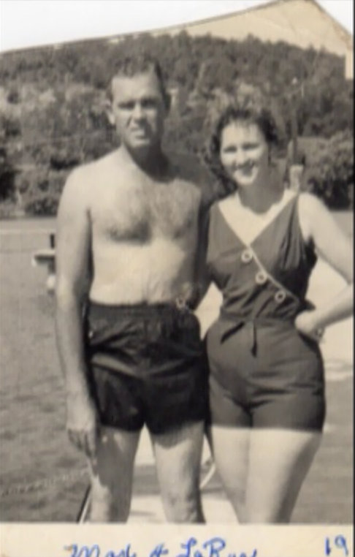
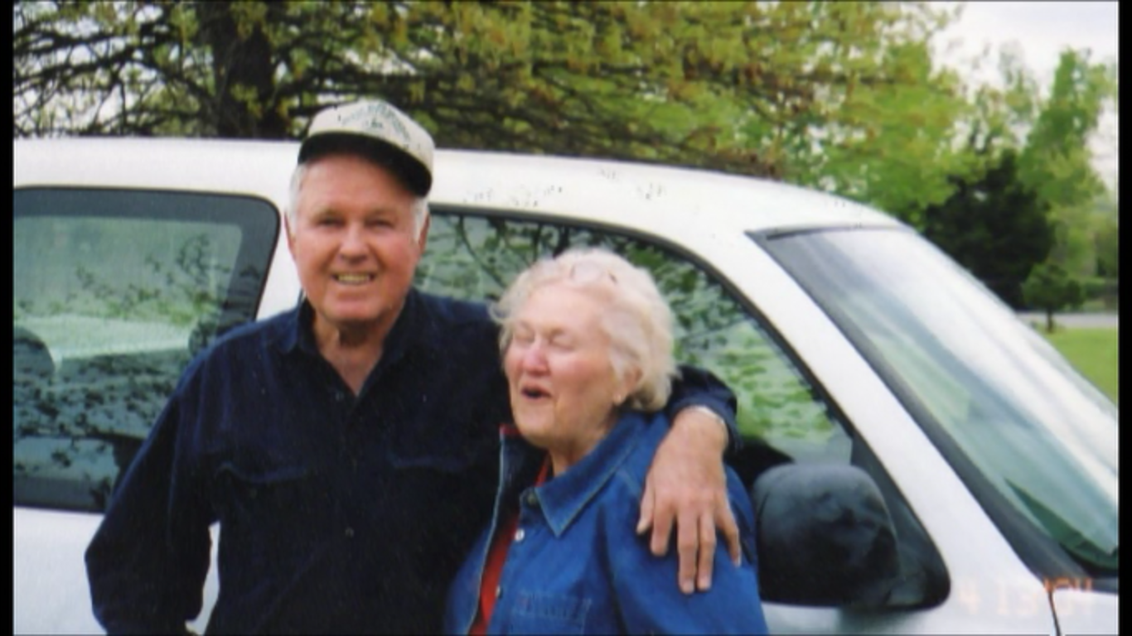
My parents—Max and Myrel

Slide 5
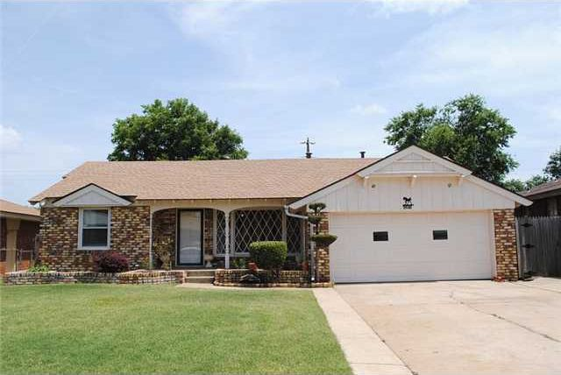
Where I grew up

Slide 6
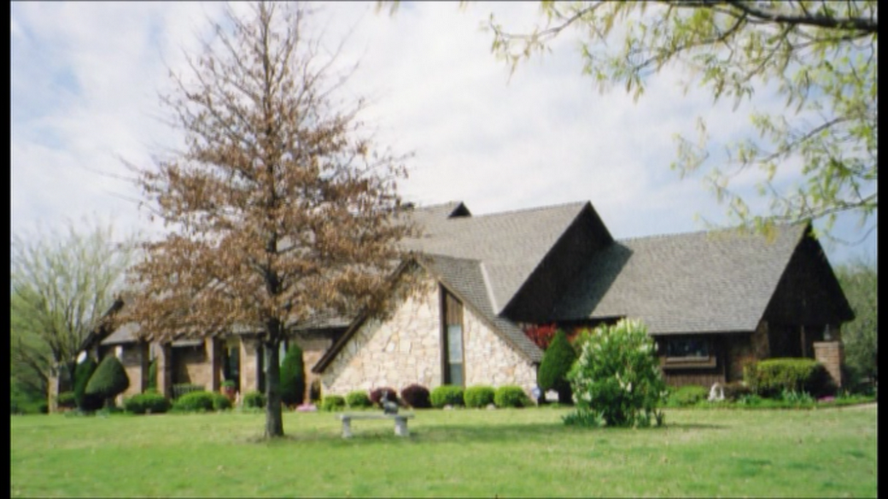
Where I ended up

Slide 7
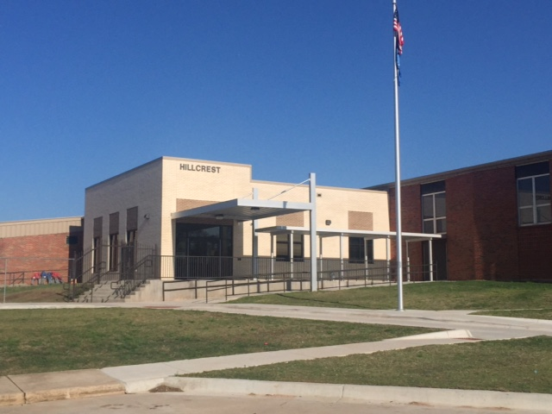

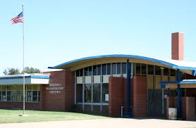
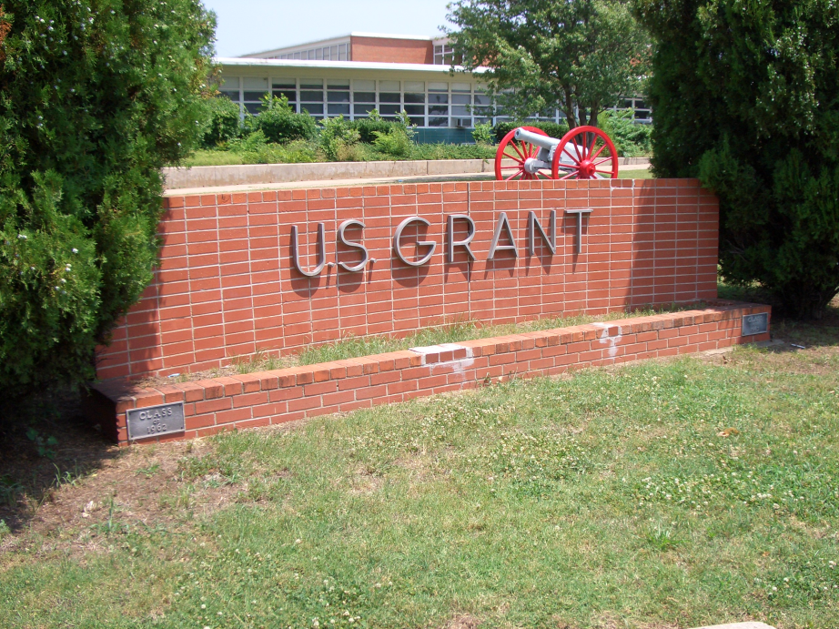
Schools
Oklahoma City Public Schools
Hillcrest Elementary
Grace Christian Academy
Jefferson Middle School
U.S. Grant High School

Slide 8
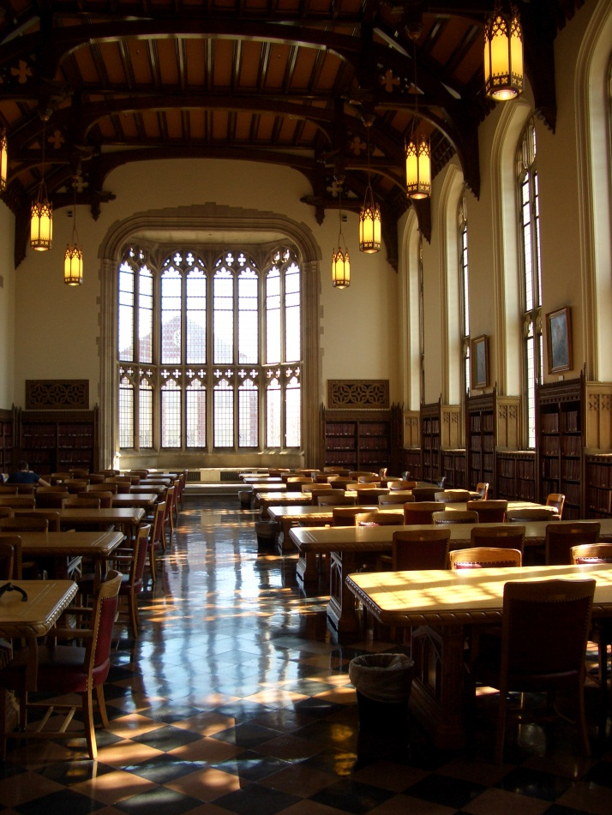

Colleges
Oklahoma State University
B.S. Secondary Biology Education, English Minor
University of Oklahoma
B.S. Nursing, Cum Laude, M.S. Nursing

Slide 9
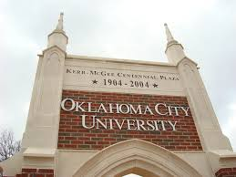
Colleges
Oklahoma City University
PhD in Nursing, Highest Honors

Slide 10

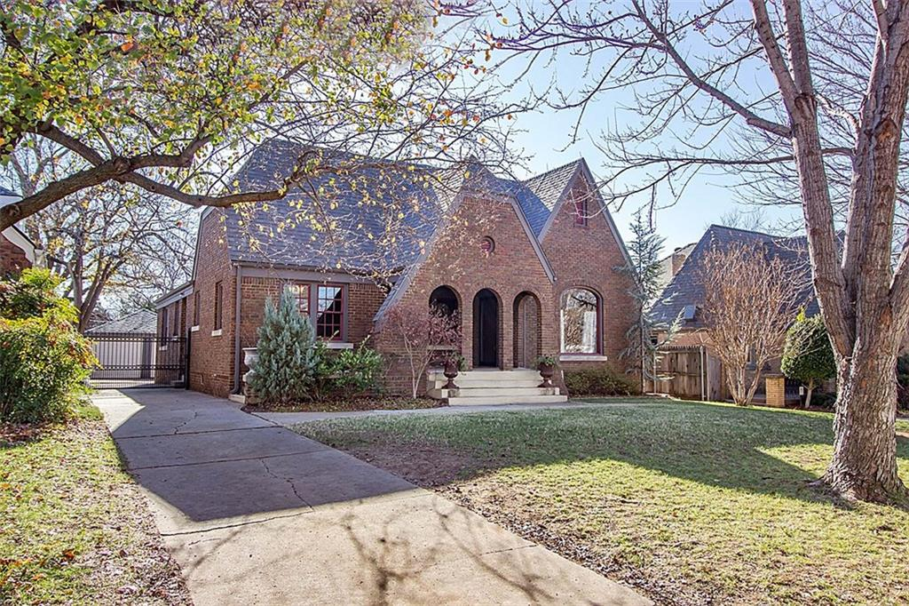


I initially didn’t plan to be a nurse

Slide 11
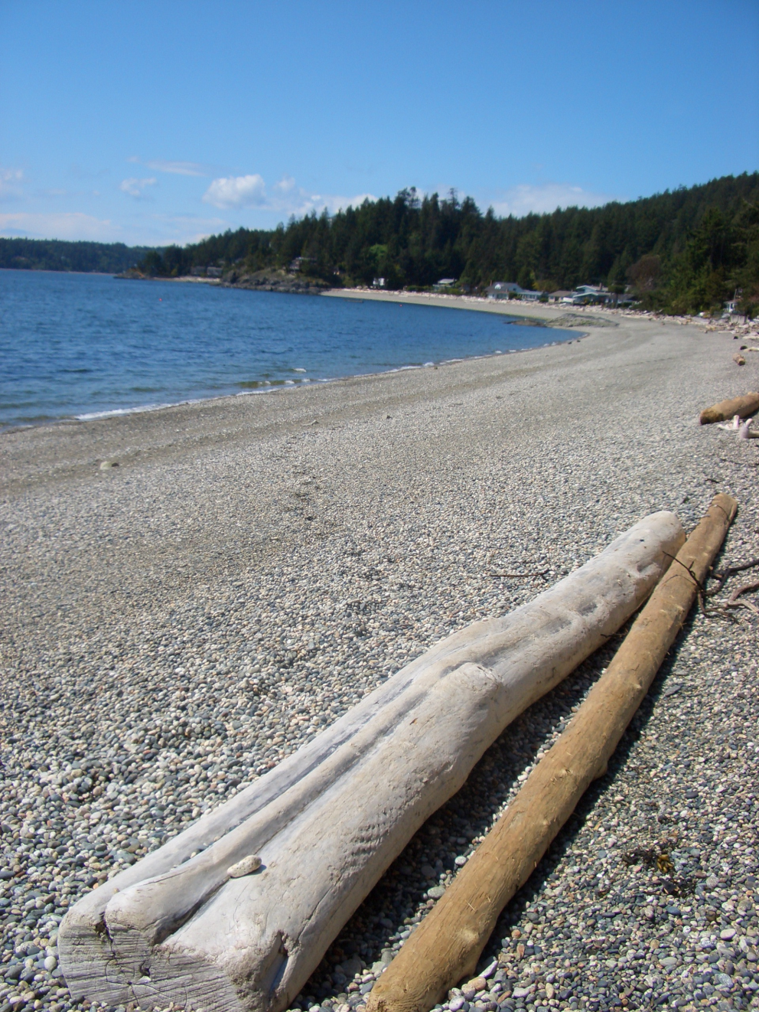

but then

Slide 12
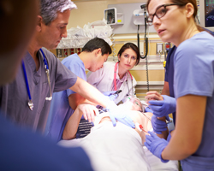
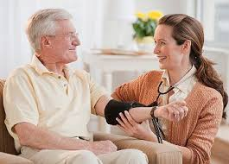
Work History
Home Health & Case Management
CICU

Slide 13
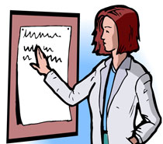
And now

Slide 14
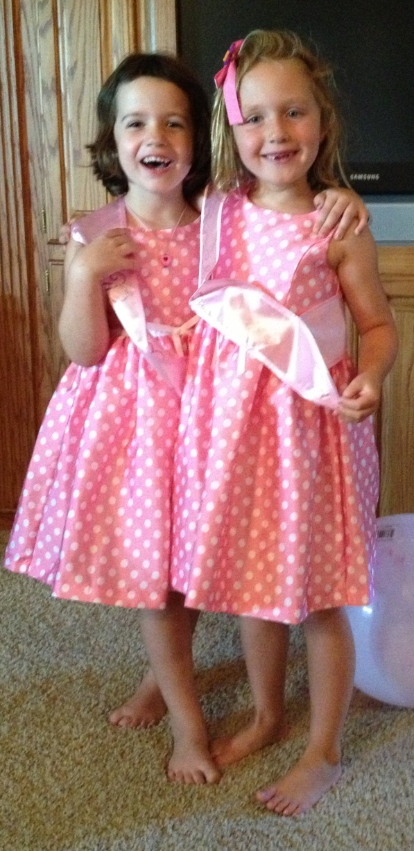
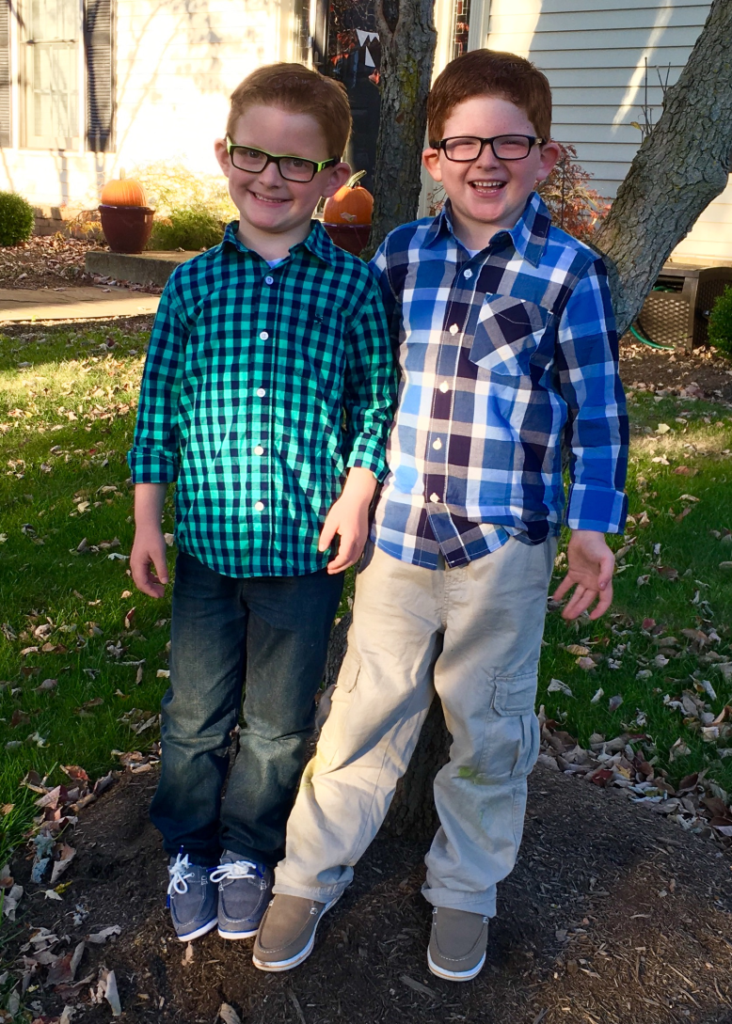
My family

Slide 15
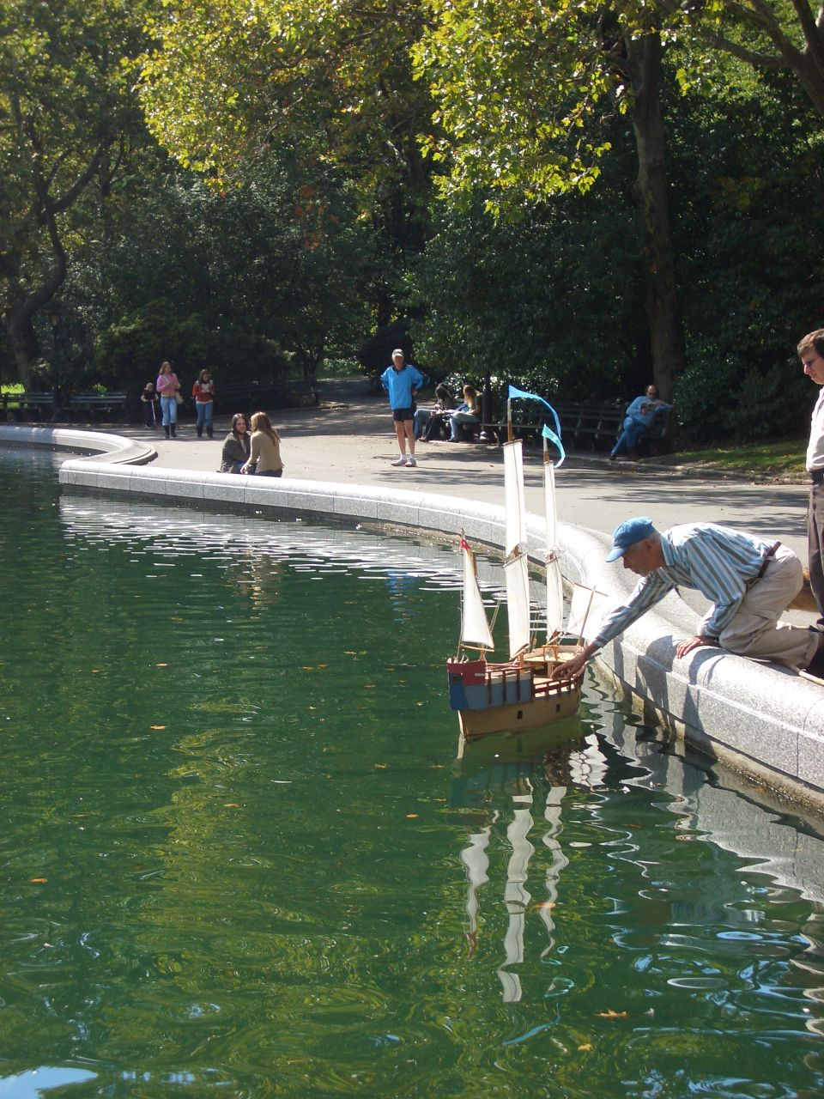
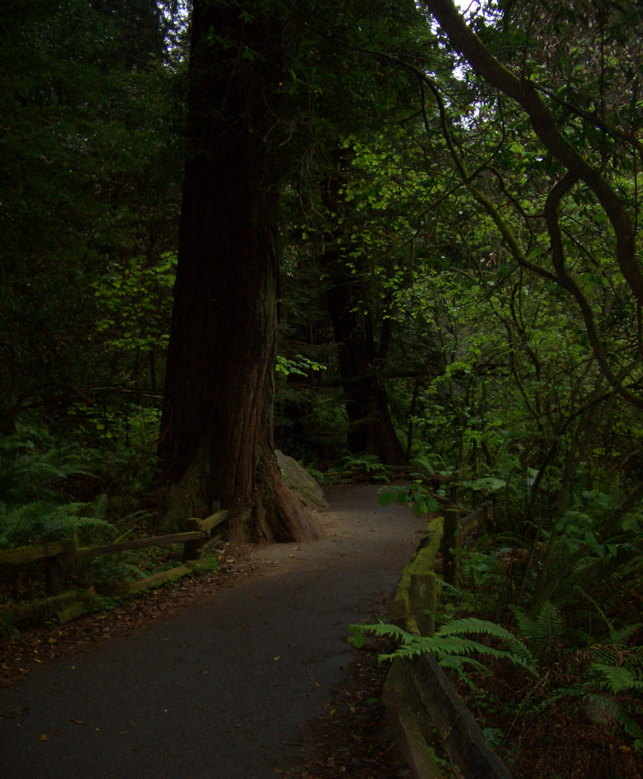
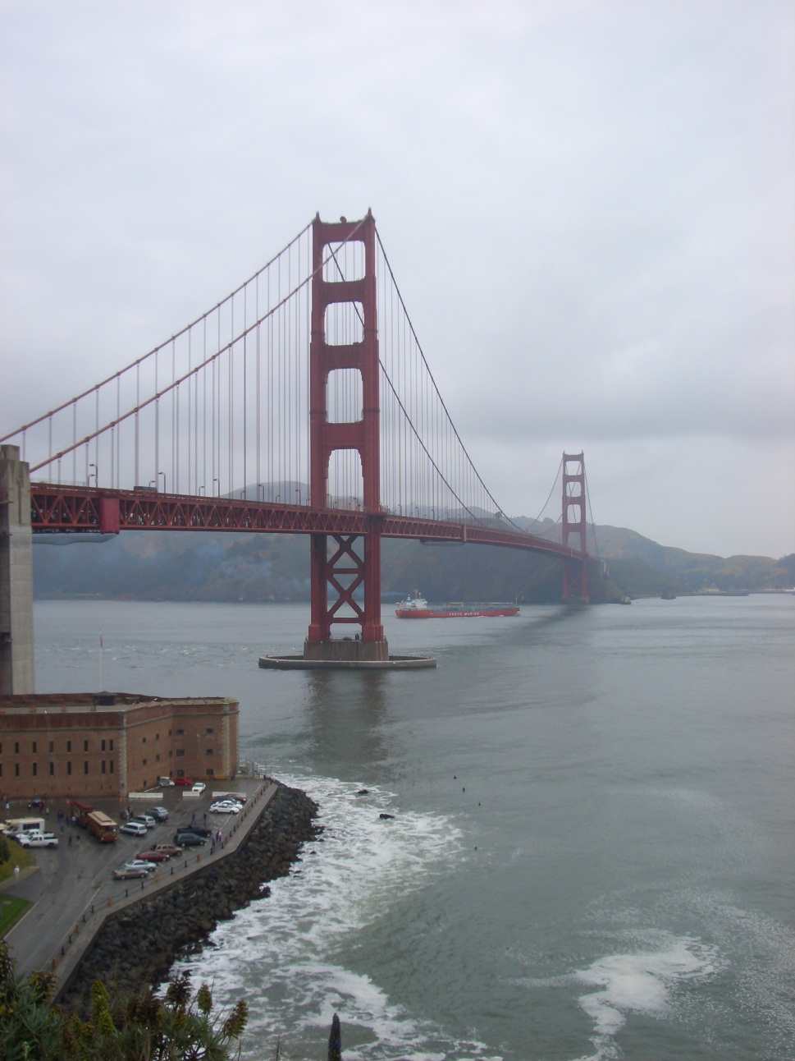
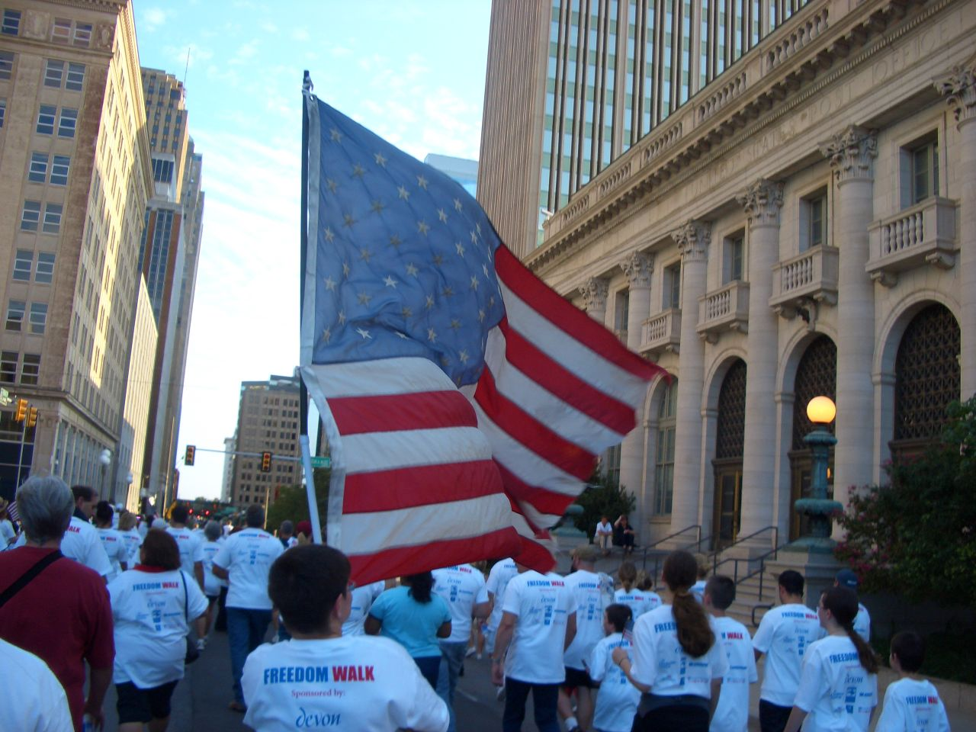
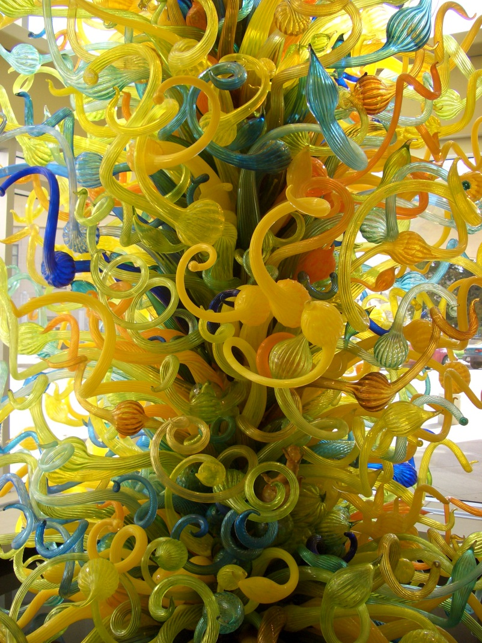
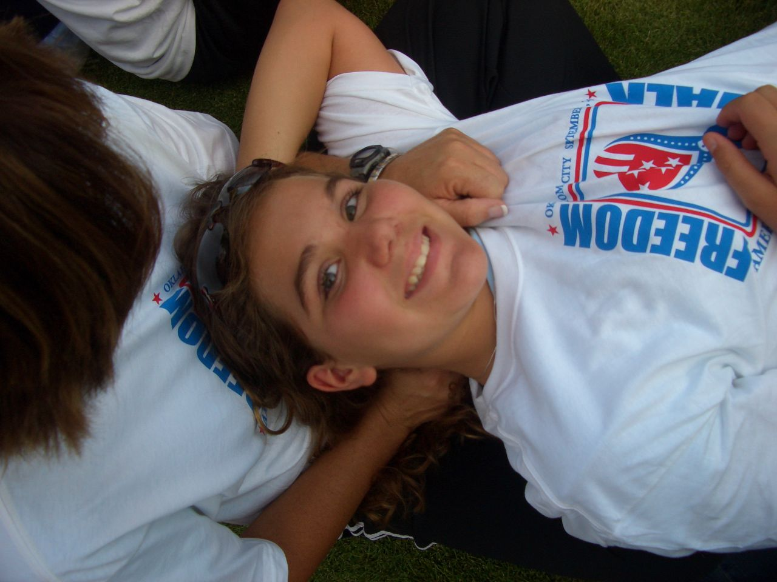
My hobby

Slide 16
Tell each other
Your name
Your background
Your hobbies
Introduce the person

