Slide 1
Art Interventions for Palliative Care Symptom Management in Comanche Cancer Survivors
Partners in Quality Conference
April 17, 2015

Slide 2
Interdisciplinary Research
Valerie Eschiti, PhD, RN, AHN-BC, CHTP, CTN-A^{1,2}
Names of Other Presenters: Doris Benbrook,^{1,2} Stacey Sanford,³ Dorothy Rhoades,^{1,2} Mark Doescher,^{1,2} Elizabeth Warson,¹ Jana Lauderdale,⁴ Marianne Matzo,^{1,2}
Agency Affiliation: 1. University of Oklahoma Health Sciences Center, 2. Stephenson Cancer Center, 3. Comanche Nation, 4. Vanderbilt University

Slide 3




Project funded by Stephenson Cancer Center
Partnership with Comanche Nation
Community-engaged approach

Slide 4
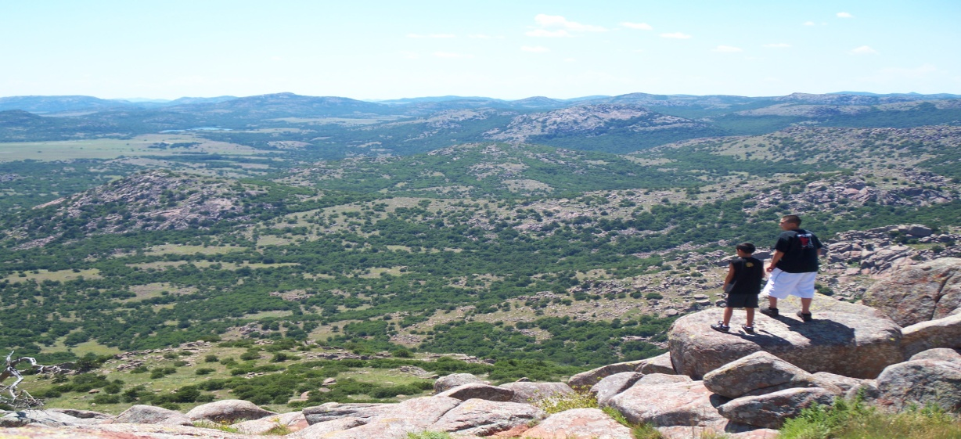
Background
American Indian (AI) cancer mortality rates in Southern Plains
  Leading cause of death in women; 2nd for men
  In 2007-09 (most recent data available) in the 8-county jurisdiction of Comanche Nation, the age-adjusted cancer incidence rates (per 100,000) were Whites 474.2 vs AIs 483.7 (no tribe-specific data available) and a large racial disparity in mortality rates (Whites 196.9 vs AIs 262.6)
  Data indicate a need for culturally appropriate interventions to improve AI cancer survivorship
  Need for palliative care

Slide 5
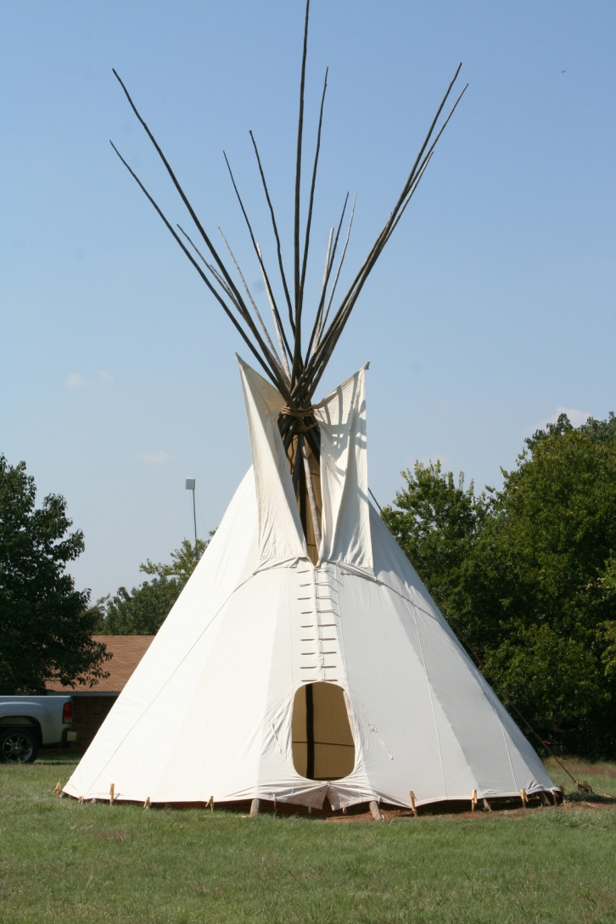
Palliative Care
The World Health Organization (2003) defines palliative care as “…an approach which improves the quality of life of patients and their families facing life-threatening illness, through the prevention, assessment, and treatment of pain and other physical, psychosocial, and spiritual problems.”
Interdisciplinary care that aims to relieve suffering and improve quality of life for patients with advanced illness and their families.

Slide 6
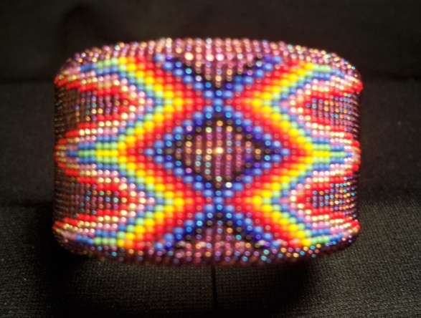
Art as Therapy
Cultural and expressive framework for health promotion and prevention centered in the arts
Art can be used as a medium to promote experiences of “flow”: focused application of one’s strengths into mastering challenges; provides a sense of freedom that comes when one is lost in an activity regardless of time, duty, or worry
Allows participants to experience a self-induced state of relaxation
Culturally relevant healing practice

Slide 7
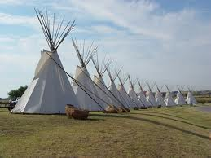
Cultural Considerations
Discussions with Comanche cultural consultant
Feedback from Comanche community outreach worker
Comanche Nation approval process
Ongoing maintenance of positive academic-tribal partnership
Sensitivity to collection of biospecimens

Slide 8
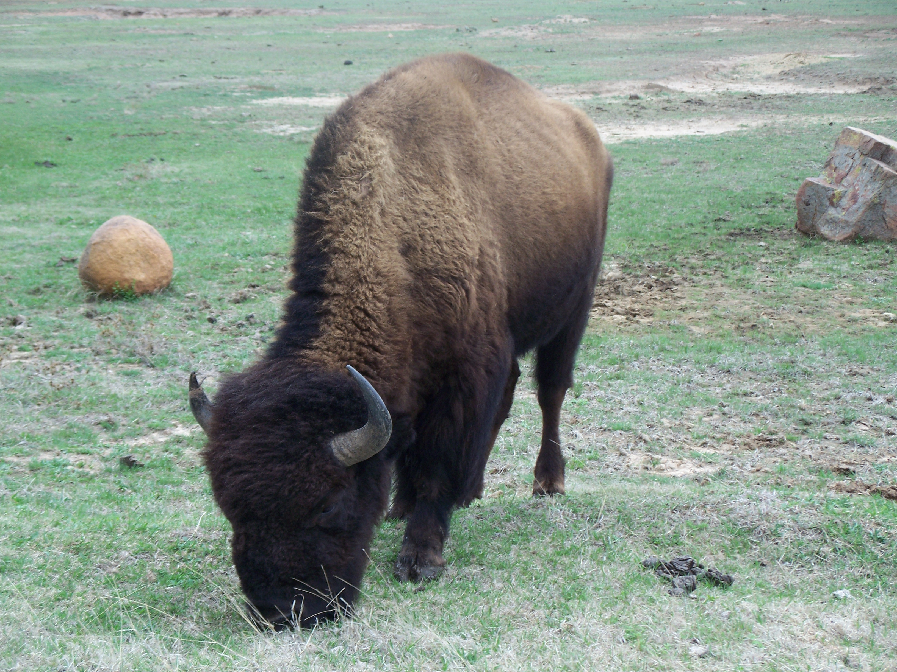
Aims
Determine culturally appropriate art interventions that incorporate Comanche peoples’ strengths
Pilot test pre- and post-test assessment tools measuring anxiety, depression, fatigue, and quality of life for cultural applicability and usefulness
Evaluate the feasibility of collecting and analyzing salivary fluid for measuring effects of an art activity on levels of cortisol and immune cytokines

Slide 9
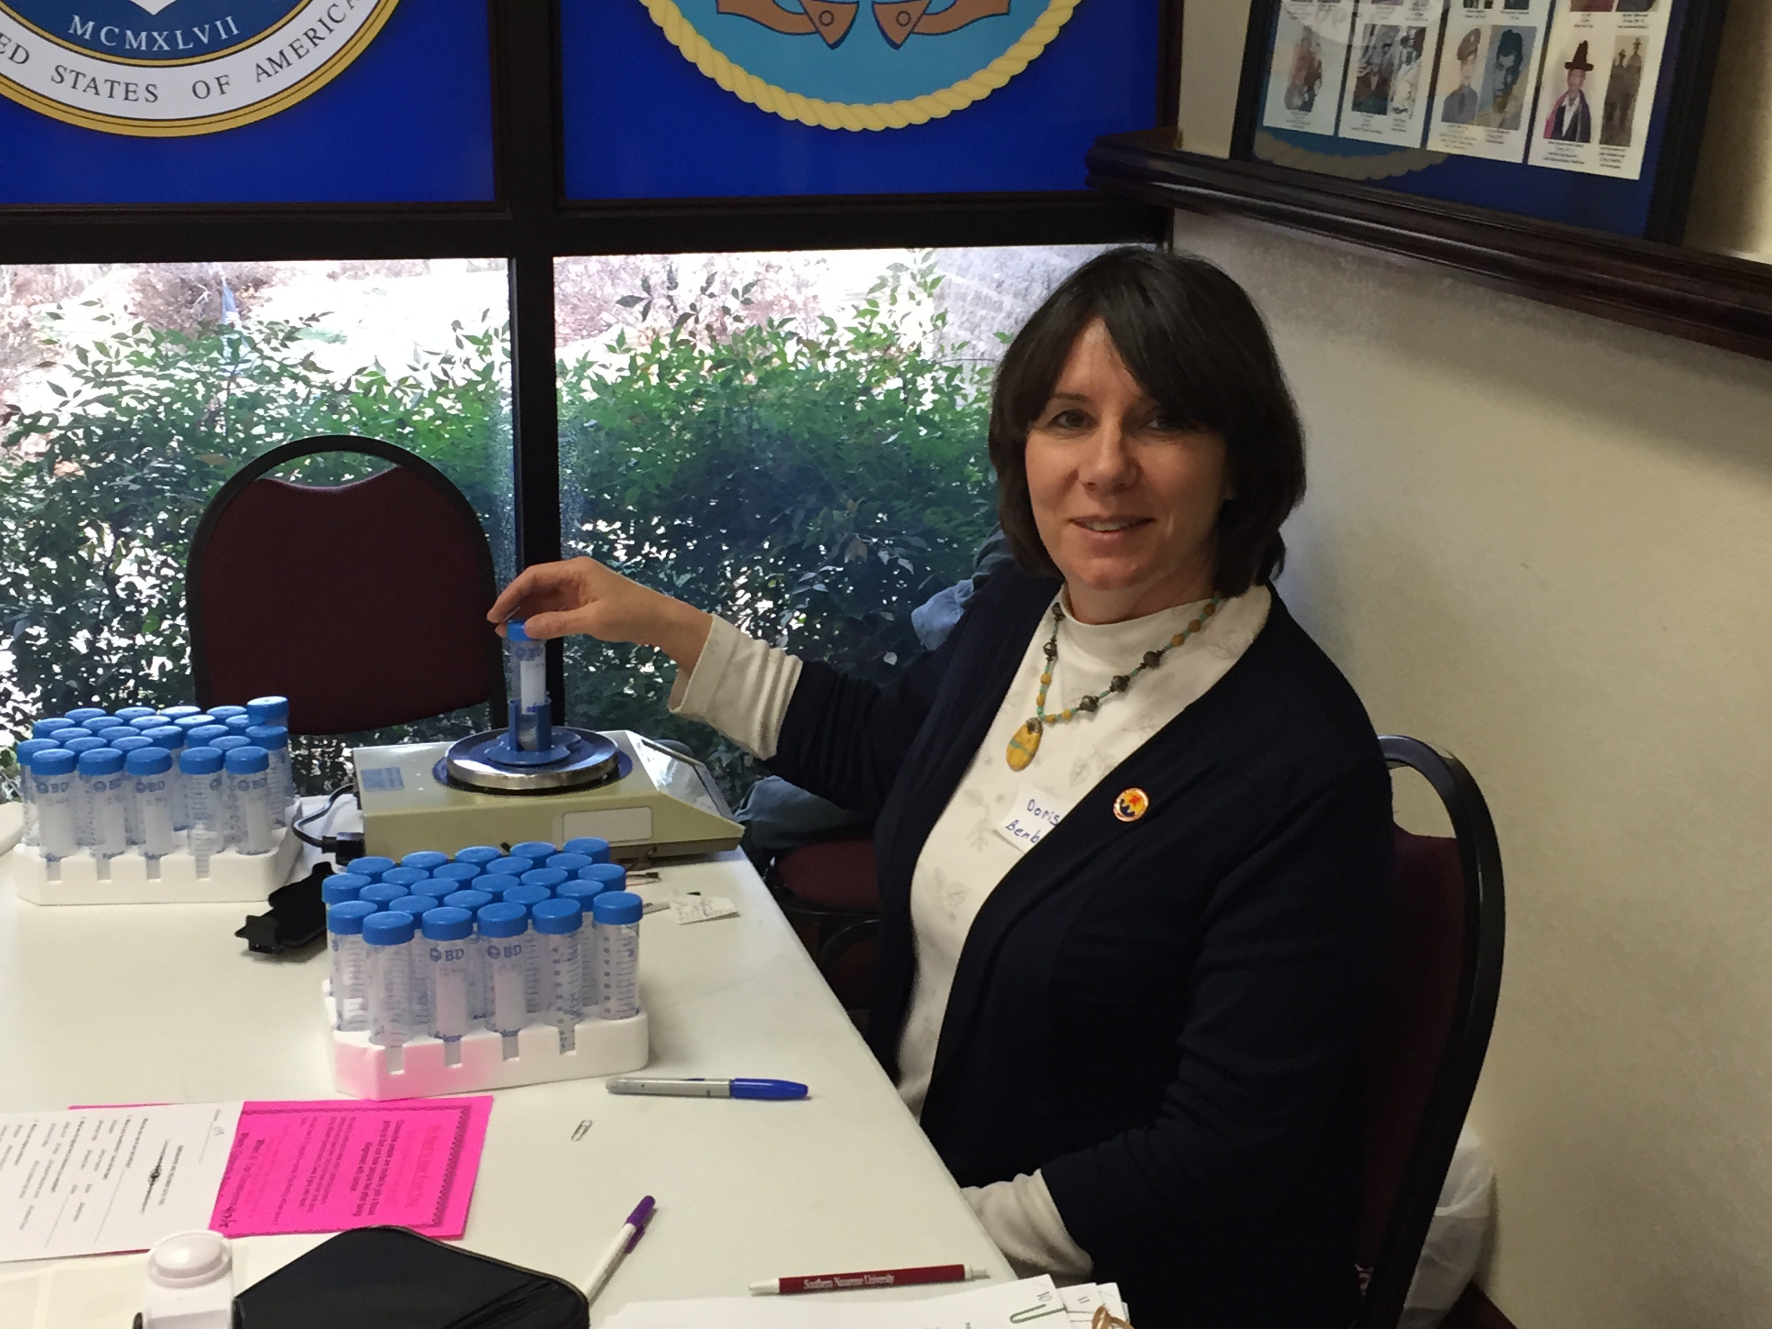
Salivary Fluid Collection
Cortisol: inflammatory biomarker
Immune cytokines: identified associations with sickness behavior and anxiety
Collected before and after intervention

Slide 10
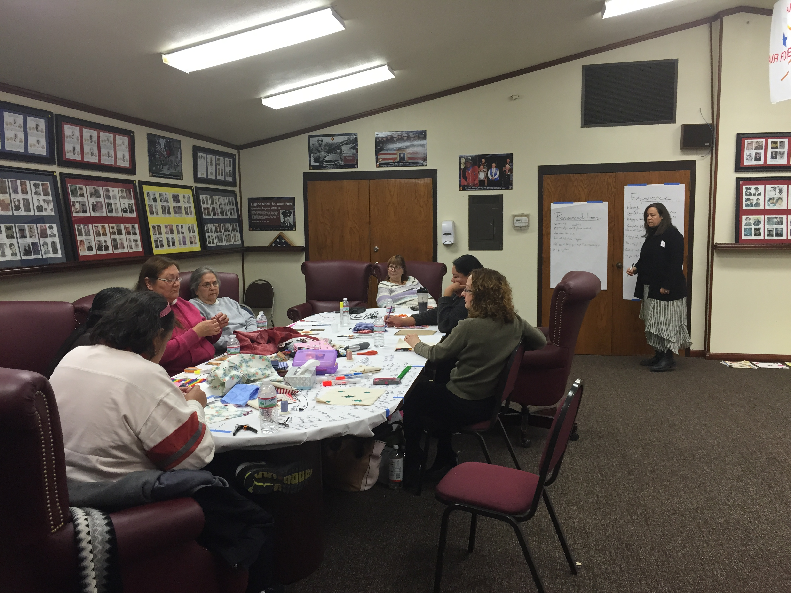
Methodology
Mixed methods
2 focus groups (n = 6): tested six art-making interventions
1 focus group (n = 13): reviewed survey tools
At each of the groups, feasibility of collecting salivary fluid assessed

Slide 11
Preliminary Findings
N = 19 for all 3 group meetings
Quilting and painting preferred arts
Painting elicited flow state
No refusals for salivary fluid collection; feasible
Preferred brief surveys; no changes needed for readability or cultural appropriateness

Slide 12
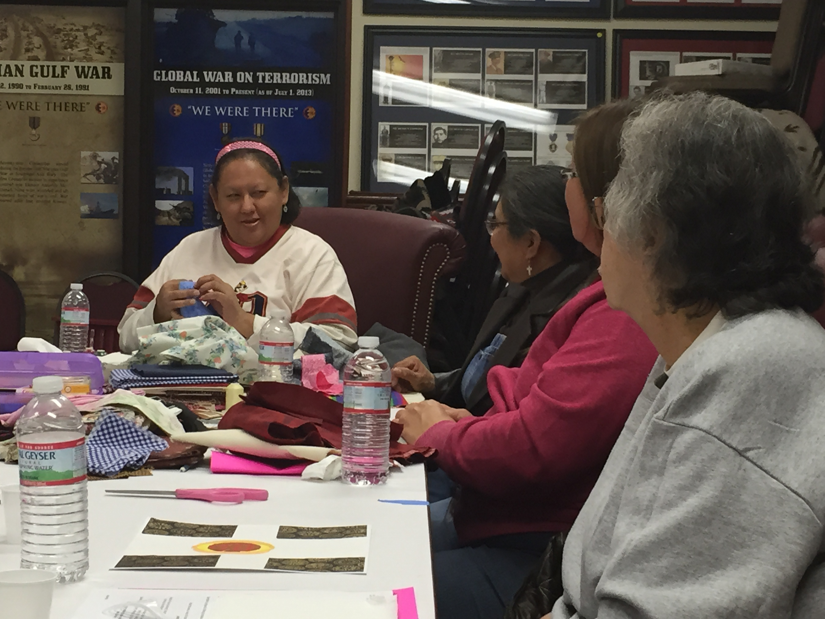
Implications
In future study, we will use salivary samples and brief assessment tools to study the impact of a painting arts-making intervention in Comanche cancer survivors
Grant application submitted

Slide 13
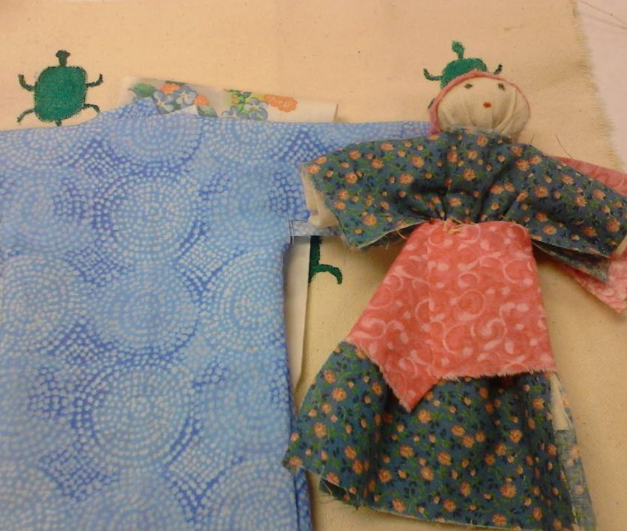
Questions?

Slide 14

Contact Information
valerie.eschiti@ouhsc.edu
580-512-7280

