Slide 1

Use of Lean Methodology to Improve Services in a School of Nursing
Sara Manning, MSN, RN, CNE, FCN
Carol Mannahan, EdD, RN, CNE, NEA-BC

Slide 2



Once upon a time…
Eli Whitney - cotton gin
Henry Ford - assembly line & mass production
Japan – rebuilding manufacturing
Supermarkets - “just in time”
Cost of living in U.S.

Slide 3

To make things worse…
Health care costs were soaring
Government was imposing controls on payment for health care services
Consumers were complaining
Universal health care legislation failed
People feared:
What will happen to
health care??

Slide 4


Then, an amazing thing happened…
Health care leaders began
  looking around for ideas
  reading journals & books about business & manufacturing
  Studying the success of other industries – automotive, airlines

Slide 5

Is it possible? Can it be?
“Lean” coined to describe Toyota’s business (late 1980s); entire company transformation!
Purpose - solve customer problems
Process - look at value, waste, & flow
People – engagement & responsibility
Lean: A thought process

Slide 6
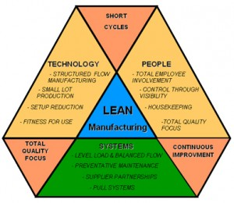
Lean means…
Customer-centric
Continuous process improvement
Waste elimination
Shifting focus

Slide 7
Definition of Lean
End
“The endless transformation of waste into value from the customer’s perspective.”
(Womak, J. & Jones, D. 1996. Lean Thinking.
Simon & Schuster.)

Slide 8

Eliminating waste means…
LESS
Human effort
Space
Capital
Time
Cost
Defects

Slide 9
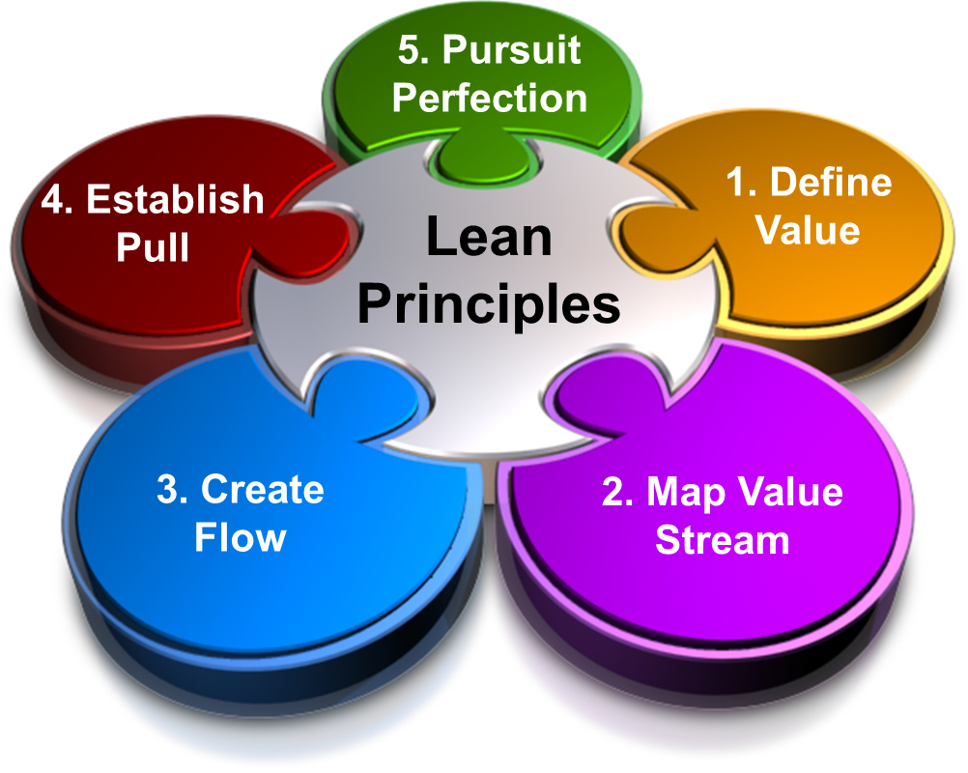
Basic Lean Principles

Slide 10
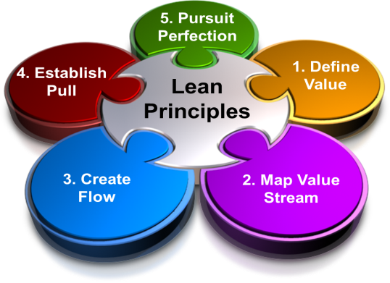
Adapting to KSN
Identify a key process that supports a core product; define value (unanimous!)
Involve participants (Lean Team = 7 + coach & students)
Map current process (UGH!)
Identify areas for impact (2)
Be creative; figure it out! (gets interesting)
Implement; map future state (within 12 weeks)
Keep working to improve the process (continuous)

Slide 11
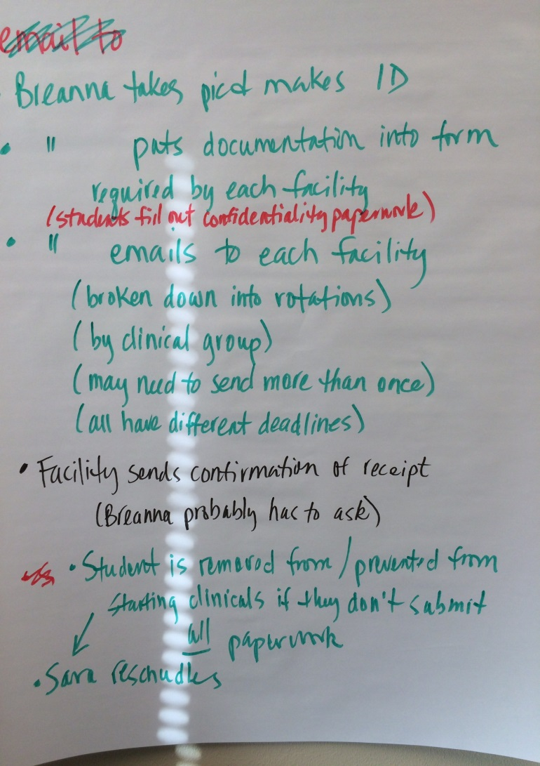
Starting the Process
The committee met to identify the MANY steps of the current process for collecting the required documents. Three giant Post-It note pages later, the complicated process was in front of everyone.

Slide 12

Problems Identified
:
.
Time Waster:
Flurries of repeated emails to and from students felt similar to being tossed around in the wind – like one of Winnie the Pooh’s blustery days
Notes:
There are 8 possible Time Wasters; we identified 6 in our problem

Slide 13
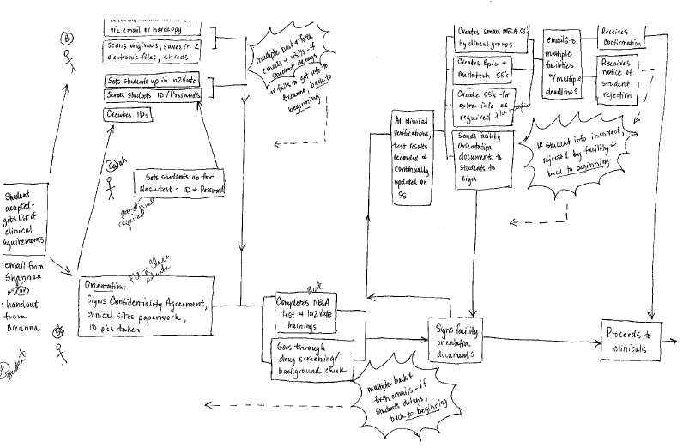
Visual Representation
Next in the Lean process is development of a concept map to depict what has been discovered.

Slide 14
The concept map helped us identify that there are 3 major groups involved in the process:
KSN policies, procedures, & personnel
Clinical facilities
Students

Slide 15
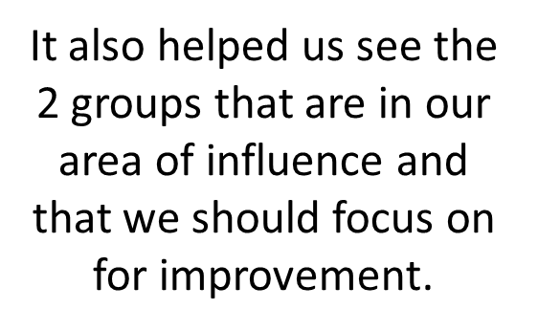
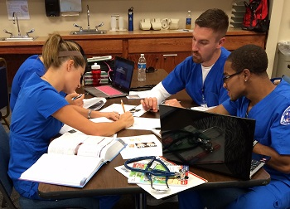


Slide 16
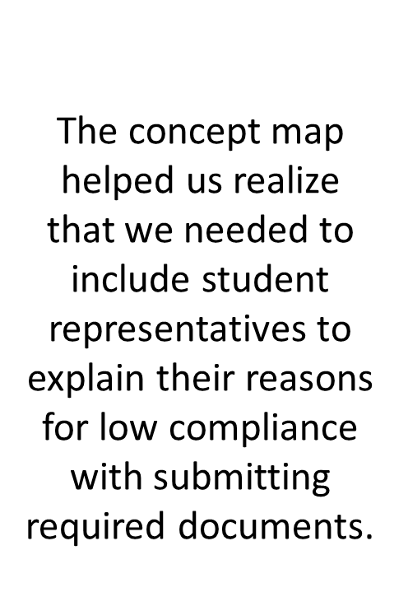


Did not understand need/importance
“Just Procrastinated”
Unclear about deadlines
Did not know who to give documents to

Slide 17
Requirement Confusion
Notes:
As you can see, there are a number of clinical requirements and many of them have several variables. For example the TB; if the student has a positive skin test then they must see a provider for a chest x-ray plus have a Release for Public Contact AND a TB screening – and that is just for one year of the program. We tried to make it clear by putting in colors, but it still was causing confusion.

Slide 18
To Address the Confusion . . .
Developed a checklist
Evaluated and updated website
Identified an improved plan to inform students
Established firm deadlines with consequences

Slide 19
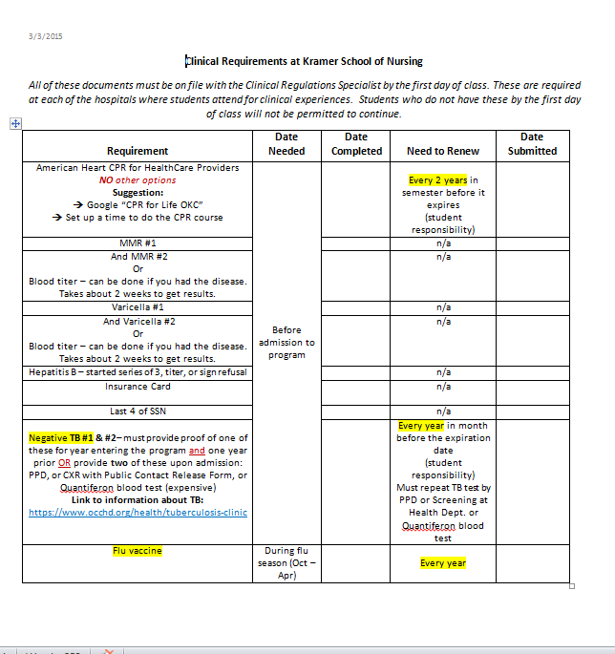

Slide 20
Other Strategies . . .
Work with the Campus Health Center to establish an “Immunization Blitz”
Arrange for all students to do CPR training within the first week of the semester (fall or spring)
Consider altering fee structure to include cost of immunizations
Notes:
Implementation of these strategies will be dependent upon a variety of factors – but we are in the process of exploring all options.

Slide 21
The End . . .
. . . is yet to be written. The remaining changes will be fully implemented in Fall 2015.
Notes:
And, as in our nursing practice, evaluation is an ongoing process – we will evaluate, make adjustments, re-implement, and re-evaluate.

Slide 22

But the sense of whirlwind has settled into a hopeful confidence of a process that will work smoothly.

Slide 23
Many Thanks To
Staci Swim – slide design
Team Members:
Staci Swim
Breanna Perry
Lauren Riney
Gina Crawford
Dianna Blackmon
Lisa Rother, advisor
KSN Students

