Slide 1

Massive Transfusion Protocol
(MTP)
A journey to safer patient care
Sandra Terry, Director of Quality, ISMC
Shirlin Ashby, Clinical Education Consultant-IBMC
Notes:
Review of patient event reports indicated opportunities
Reviewed data 2012-2013 Emergency events greater than 6 units in 24 hours
Time from request of product to arrival to patient was not tracked
Process of review for MTP events
Communication challenges
Guidance for product selection
Product delay

Slide 2
MTP Elements
BLOOD BANK POLICY
NURSING POLICY
EMR ELEMENTS-POWER PLAN, NURSING DOCUMENTATION FORM
EDUCATION SPECIFIC TOOLS-LMS MODULE, CHECKLIST, PROCESS CHART

Slide 3

DEVELOPMENTAL ELEMENTS
ID STAKEHOLDERS, CREATE THE CLINICAL WORK TEAM
DIAGNOSTIC LABORATORY OF OKLA. – MED TECHS, BLOOD BANK MANAGER AND PHYSICIANS
QUALITY AND SPECIAL PROJECTS
EMERGENCY DEPARTMENT
NURSING EDUCATION
LABOR AND DELIVERY
SURGERY
CATH LAB
HEMATOLOGIST

Slide 4

UNDERSTANDING KEY CRITICAL POINTS
DLO PROCESSES
REGULATORY LIMITATIONS
TIME REQUIREMENTS
BLOOD PRODUCT AVAILABILITY
NURSING UNIT LIMITATIONS:
  STAFFING
  AM, PM, WEEKEND
  RESOURCES
  MTP INITIATION BY VERBAL ORDER FROM PHYSICAN
  A PHONE CALL TO BLOOD BANK STARTS IT
  EMR ORDER ENTRY OCCURS LATER AND ASAP WHEN:
    PATIENT &/OR SITUATION MORE STABLE
    ENOUGH STAFF AVAILABLE

Slide 5

COMMUNICATION,
A HUGE PART OF THE PROCESS
MEETINGS, FOLLOWUP MEETINGS AND LOTS OF EMAIL
NURSING POLICY EXPERTS WITH CLINICAL WORK TEAM DEVELOPED BODY OF THE POLICY DEFINING:
  PURPOSE
  RESPONSIBILITY
  POLICY SECTION TO DEFINE:
    INITIATION OF MTP
    DOCUMENTATION OF MTP
  PROCEDURE
    INITIATION OF MTP
    DISCONTINUATION OF MTP
FINAL POLICY DRAFT APPROVED

Slide 6
IDENTIFIED ROLES
CLINICAL UNIT ROLES:
BEDSIDE RN
IDENTIFY FROM UNIT, A PRIMARY CONTACT PERSON
  TASK: COMMUNICATING WITH LAB CONTACT PERSON
RUNNER
  TASK: PICK UP BLOOD PRODUCTS
  IF UNCROSSMATCHED PRODUCTS, MUST BE RN OR LIP
LABORATORY TECHS ROLE:
IDENTIFY FROM DLO, A PRIMARY CONTACT PERSON
  TASK: TO COMMMUNICATE WITH CONTACT PERSON FROM CLINICAL DEPARTMENT

Slide 7
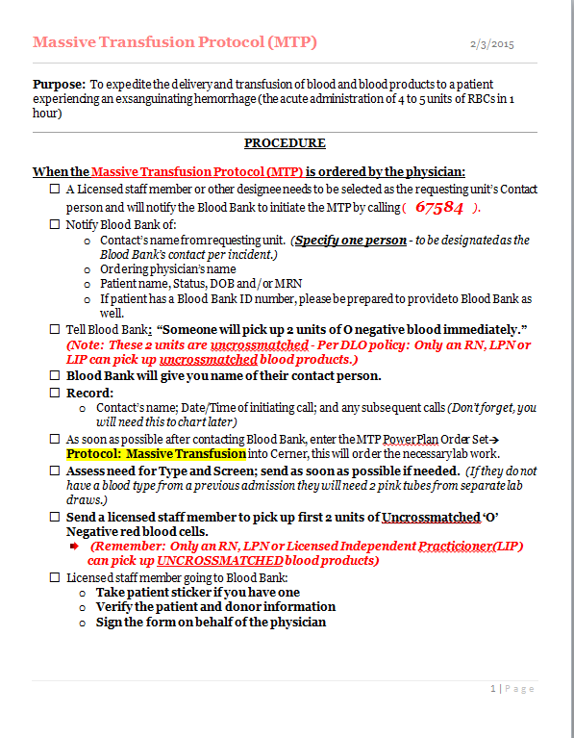
EDUCATION DEVELOPMENT nursing
MTP CHECKLIST-
RN QUICK REF. SHEET
SIDE 1

Slide 8
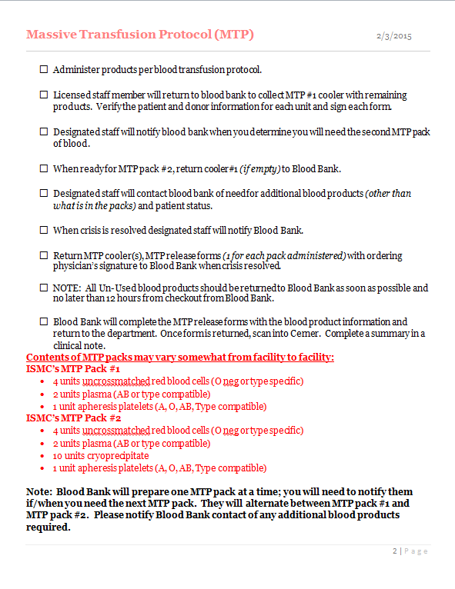
EDUCATION DEVELOPMENT nursing
MTP CHECKLIST-
RN QUICK REF. SHEET
SIDE 2

Slide 9
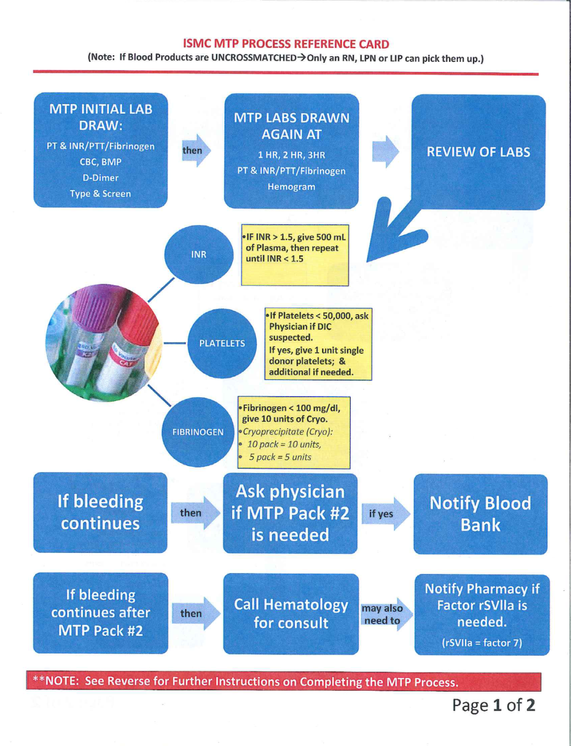
MTP Process chart
Side 1
EDUCATION
DEVELOPMENT
NURSING

Slide 10
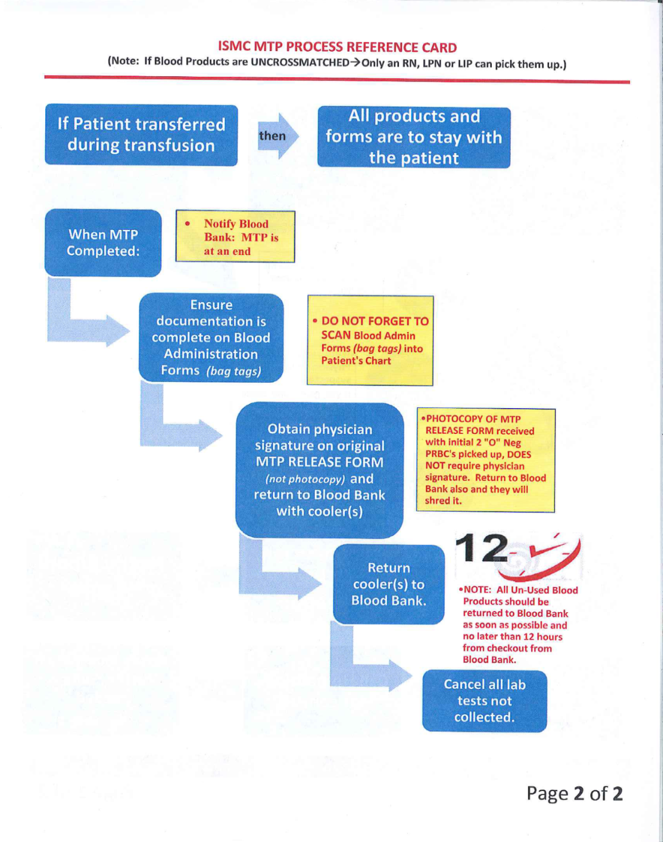
MTP Process chart
Side 2
EDUCATION
DEVELOPMENT
NURSING

Slide 11
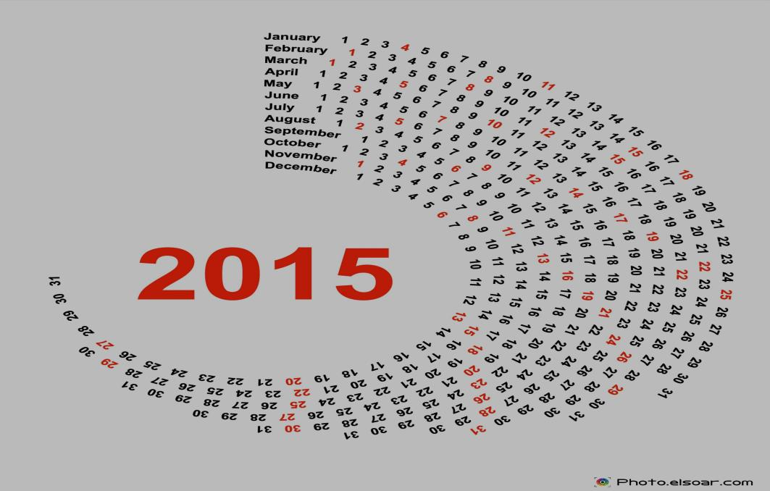
SET DATES
FINAL WALK-THROUGH DISCUSSION OF IMPLEMENTATION
INSERVICE EDUCATION FOLLOWED BY DRILLS
GO LIVE
PLAN
  QUARTERLY OR
  BI-ANNUAL DRILLS

Slide 12
Education implementation
UNIT DRILLS (ED, OR, CATH LAB, L&D, ICUs, DLO, HOUSE SUPERVISORS)
IDENTIFICATION OF LAB LABEL PRINTERS FOR AREAS PRIOR TO DRILL
DLO AND INTEGRIS IT RESPONSIBLE FOR SIMULATED PATIENT CREATION IN EMR ALLOWING:
  PATIENT IDENTIFICATION, LABELS, HX, LABS, PLACEMENT OF ORDERS

Slide 13
Education implementation
PATIENT SCENARIOS
PATIENT NOT TYPED AND CROSSED
DLO CREATED SIMULATED BLOOD PRODUCTS
MTP PACK #1 PLACED IN AN IGLOO COOLER WITH UNCROSSMATCHED PRBCS, FFP, PLATELETS (SEPERATED)
MTP PACK #2 ADDITION OF CRYO

Slide 14
In Process
EPIC INTEGRATION
AUDITING PROCESS
SYSTEMIZATION OF THE PROGRAM

Slide 15
Lessons learned
START WITH ALL THE RIGHTS PLAYERS
ORGANIZE YOUR RESEARCH AND HAVE GOOD DATA
KEEP MOMENTUM
SHARE THE JOURNEY

Slide 16

Questions?
Contact:
Sandra Terry, ISMC 405-644-6280
Sandra.terry@integrisok.com
Shirlin Ashby, IBMC 405-552-0434
Shirlin.Ashby@Integrisok.com
Special thanks to Norman Regional Health System for sharing best practice ideas.

