Slide 1
Cleaning and Re-use of Self-Catheters: Current Practice and Best Evidence
By: Ashley Arenas, Shane Cooper, and Elizabeth Tran

Slide 2
Prevalence of Problem & Cost
In the United States, spinal cord injuries accounts for more than 10,000 cases per year requiring intermittent catheterization (Newman & Willson, 2011).
In a study of 44 participants, 56% reuse their catheter with a median of 20 times each (Hakansson, 2014).
80% of all individuals who re-use their catheters do not disinfect between uses (Newman & Willson, 2011).
Annual per person cost of sterile self catheters can be approximately $1,467(At Home Medical, 2015).
Notes:
http://www.athomemedical.com/Intermittent-Catheters-s/1823.htm
Find how many people self cath;
LIZ
How much medical cost for intermittent catherization
We can not find the number of health

Slide 3
The Current Problem
Identified in community clinical setting.
Recommendations from Medicare DO NOT EXIST(Newman & Willson, 2011).
There is not a consensus of one best way to clean intermittent catheters for reuse.
Notes:
Medicare avoids this issue by issuing 200 intermittent catheters without medical documentation
Mediaid avoids this issue by issuing 120 intermittent catheters without medical documentation
shane

Slide 4
P
I
O
Reduction in UTI rates
C
Alcohol based and water-based cleaning methods
Adults with spinal cord injuries who reuse intermittent catheterization
Microwave sterilization
In adults with spinal cord injuries who reuse intermittent catheters, does cleaning with microwave sterilization decrease UTI rates when compared to alcohol-based or water-based cleaning methods?
Notes:
Utlize summary of the PICO
Ashley
Here you see the PICO broken down, but ultimately in adults with spinal cord injuries who reuse intermittent cathereter, does cleaning with microwave sterizaltion decrease UTIs rates when compared to alcohol based or water based cleaning methods

Slide 5
Review of Literature
Cleaning intermittent catheters for reuse is rarely the sole focus of the study. It has been looked at through general studies of intermittent catheters.
The research of intermittent catheter cleaning methods is old, outdated, and frequently recycled in current studies.
Minimal current research has been conducted to find the best way to clean intermittent catheters for reuse.
Notes:
Elizabeth
When we look back at the literture,

Slide 6
Method of Cleaning:
Water-based
From multiple reviews of literature, the Joanna Briggs Institute recommends that best practice is to have patients wash the reusable catheter with soap and water (Wimpenny, 2013).
In laboratory study involving 312 catheters, rinsing and drying without soap has shown to significantly reduce bacteria content by 5 folds (p. <001) (Lavellee et al., 1995).
Drying was the most effective component(p. <001) (Lavellee et al., 1995).
Notes:
Shane

Slide 7
Method of Cleaning:
Alcohol-based
After immersion of alcohol in 5 minutes, the catheters show these results below (Bogaert, et al., 2004).
If catheter remains in alcohol solution for more than 45 minutes, it will jeopardize qualities of catheter (Bogaert, et al., 2004).
Non-research articles endorses the use of alcohol for catheter cleaning methods (Granger, 2009; Karr, 2009; Larson, 2009).
Bacteria | E.coli | P. aeruginosa | S. aureus
Control group | 6.67 | 6.81 | 7.05
Immersion in alcohol | less than 0.3 | Less than 0.3 | Less than 0.3
Notes:
CITE NON RESEARCH ARTICLES
elizabeth

Slide 8
Method of Cleaning: Microwave Sterilization
After microwaving red rubber catheters for 12 minutes at full power, the catheters had zero viable organisms. (Douglas et al., 1990).
After microwaving the three catheters for 12 minutes, there are changes in physical qualities and an antimicrobial effect was present in E. coli. Bacterial results are shown below (Bogaert, et al., 2004).
Consideration: the study was conducted in a lab with the use of Ziploc bag/heat sinks to hold in moisture.
Current evidence of microwave sterilization yields the risk of disturbing the integrity of the catheter for reuse (Chan, Cooney, & Schober, 2009; Bogaert, et al., 2004; Mervine & Temple, 1997).
Bacteria | E.coli | P. aeruginosa | S. aureus
Control group | 6.67 | 6.81 | 7.05
Microwave sterilization | 1.57 | 5.81 | 5.12
Notes:
MAKE SURE AND INCLUDE OTHER STUDIES/CITE THEM
Heat sink serves to absorb excess heat which otherwise would melt the catheters and plastic bag and possibly cause fire.
Ashley
Our biggest problem

Slide 9
Summary of Cleaning Methods
More studies have evaluated microwave sterilization.
Alcohol cleaning is popular in non-research resources available to the community.
Water based methods are easy, convenient and cost effective.
All methods have shown some level of effectiveness.
Notes:
Ashley
Lets look at see the pros and cons if these
We got more evidence looking at mircowave steriation. There is more formalc
However we
We have old method
In the end all of our methods to shown effective in cleaning intermittent catheteres

Slide 10
Recommendation
There is insufficient evidence to recommend a certain method of cleaning out the three methods evaluated: microwave sterilization, alcohol-based, and water-based cleaning (Prieto, Murphy, Moore, & Fader, 2014; Baker, 2014; Hooten et al., 2010).
We believe the prudent nurse should focus on the basic principles of cleanliness when educating patients on intermittent catheterization.
Notes:
Elizabeths
Afer looking at a cochrane reivew and joanna briggs, it is apparanty that there is insufficient evidences when looking at the methods of cleaning. So instead as a group, the

Slide 11
Facilitators:
Patient
Barriers:
Patient Resources
Desire, knowledge
Nurse
Education, availability
Biomedical Supply Companies
Catheter design that best allows for reuse
Supplemental equipment that assists in cleaning
Possibly other disciplines such as Social Work, Medicine, etc.
Finances, running water, microwave, clean environment
Patient Ability to Maintain
satisfaction with method, cognitive ability, knowledge
Insurance Companies
paying for fewer catheters, remain in denial that reuse is occurring
No federal insurance recommendations
Notes:
Supplemental equipment that assists in cleaning: microwaveable container for sterilizing medical objects
Elizabeth

Slide 12
Intervention
At this time, nurses who work with patients with spinal cord injuries should be educated not only on the different methods of cleaning, but how to utilize nursing judgement to help their patients identify which cleaning method will lead to highest satisfaction and maintenance.
Notes:
Ashley

Slide 13
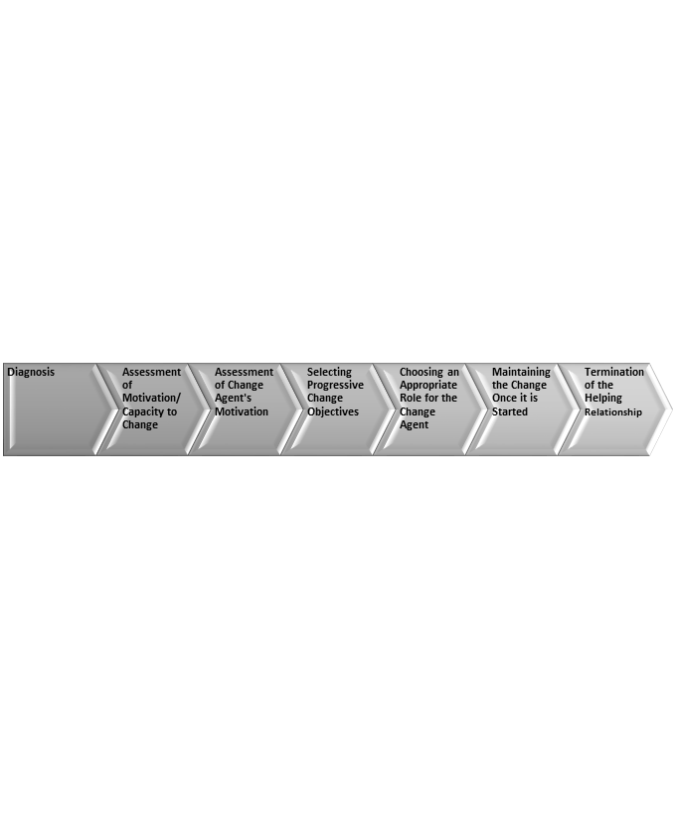
Lippitt Change Theory
Diagnosis of the problem: Reusing catheters
Assessment of motivation and capacity to change: Patient Centered
Assessment of the change agent’s motivation and resources: Nurse Focus
Selecting progressive change objectives: Cleaning Method
Choosing an appropriate role for the change agent: Nurse as Educator
Maintaining the change once it is started: Remaining a Resource
Termination of the helping relationship with the change agent: Evaluation
Notes:
The Change Theory is at the patient level.
Shane

Slide 14
Evaluation
If this educational change was going to be applied in the primary care setting, this change can be evaluated by:
    Rates of symptomatic UTIs
    Patient satisfaction reports
    Patient’s ability to safely resuse, clean, and maintain
UTI rates can be difficult to evaluate because many patients are on prophylactic antibiotics.
Best evaluation criteria would be patient satisfaction reports and ability to maintain one cleaning method. This data could be generated through verbal reports or surveys.
Notes:
Ashley
We found that majority of the studies have been done in the lab and if it was to be implemented in a primary care setting the change can be evaluated by the following: rates of symptomatic UTIs, patient satisfaction, and patients ability to safely reuse, clean, and maintain
However, there is a setback with uti rates is if the patient is on prophylactic antibiotics
Our best
we want to know: Is our patient happy with their cleaning method and are they using regularly.

Slide 15
Other Approaches & Suggestions
Consider:
  Intervening at the level of the nurse educating patients who are new to self-catheterization.
  Have one nurse teach alcohol-based/water-based cleaning and another nurse teach microwave sterilization and compare the two studies.
We suggest:
  Randomized controlled trials with people in the community setting who require reuse of intermittent catheters.
  Cleaning methods may be equal in effectiveness, but each method requires more realistic research.
Notes:
Elizabeth

Slide 16
Lessons Learned
The answer to an EBP question will still require critical thinking and nursing judgment.
Available evidence may not answer all questions.
New studies can recycle old literature which only perpetuates gaps in practice.
Notes:
Shane

Slide 17
References
At Home Medical. (2015). Intermittent catheters. Retrieved from http://www.athomemedical.com/Intermittent-Catheters-s/1823.htm
Baker, S. (2014). Clean intermittent catheterization [Evidence summary]. Retrieved from Joanna Briggs Institute EBP Resources website: http://joannabriggslibrary.org/
Bogaert, G. A., Goeman, L., Ridder, D.D., Wevers, J.I., & Schuermans, A. (2004). The physical and antimicrobial effects of microwave heating and alcohol immersion on catheters that are reused for clean intermittent catheterisation. European Urology, 46, 641-646.
Bolinger, R., & Engberg, S. (2013). Barriers, complications, adherence, and self-reported quality of life for people using clean intermittent catheterization. Journal of Wound, Ostomy, and Continence Nursing, 40, 83-89.
Chan, J. L., Cooney, T. E., & Schober, J. M. (2009). Adequacy of sanitization and storage of catheters for intermittent use after washing and microwave sterilization. The Journal of Urology, 182, 2085-2089.
Douglas, C., Burke, B., Kessler, D. L., Cicmanec, J. F., & Bracken, R. B. (1990). Microwave: Practical cost-effective method for sterilizing urinary catheters in the home. Urology, 35, 219-222.
Garon, M. (2014). Change and innovation. In D. L. Huber (Ed.), Leadership & Nursing Care Management (pp. 37-54). St. Louis, MO: Elsevier Saunders.
Granger, B. (2009, October 31). How to Clean the Urinary Catheter. Retrieved March 6, 2015, from http://www.ehow.com/how_5595676_clean-urinary-catheter.html
Hakansson, M. (2014). Reuse versus single-use catheters for intermittent catheterization: What is safe and preferred? review of current status. Spinal Cord, 52, 511-516.
Hooton, T. M., Bradley, S. F., Cardenas, D. D., Colgan, R., Geerlings, S. E., Rice, J. C., Nicolle, L. E. (2010). Diagnosis, prevention, and treatment of catheter-associated urinary tract Infection in adults: 2009 international clinical practice guidelines from the infectious diseases society of america. Clinical Infectious Diseases, 50(5), 625-663. doi:10.1086/650482
Karr, R. (2009, November 07). How to reuse catheters. Retrieved March 6, 2015, from http://www.ehow.com/how_5619094_reuse-catheters.html
Lavallee, D. J., Lapierre, N. M., Henwood, P. K., Pivik, J. R., Best, M., Springthorpe, V. S., & Sattar, S. A. (1995). Catheter cleaning for re-use in intermittent catheterization: New light on an old problem. SCI Nursing: A Publication of the American Association of Spinal Cord Injury Nurses, 12, 10-12.
Larson, C. (2009, November 06). How to sterilize catheters. Retrieved March 6, 2015, from http://www.ehow.com/how_5614604_sterilize-catheters.html
Lewis, S. L., Dirksen, S. R., Heitkemper, M. M., Bucher, L., & Camera, I. M. (2011). Medical-surgical nursing: Assessment and management of clinical problems (8th ed.) (p. 1122). St. Louis, MO: Elsevier Mosby.
Mervine, J., & Temple, R. (1997). Using a microwave oven to disinfect intermittent-use catheters. Rehabilitation Nursing, 22, 318-320.
Newman, D. K., & Willson, M. M. (2011). Review of intermittent catheterization and current best practices. Urologic Nursing, 31, 12-29.
Prieto, J., Murphy C. L., Moore K. N., Fader M. (2014) Intermittent catheterisation for long-term bladder management. Cochrane Database of Systematic Reviews 2014, Issue 9. Art. No.: CD006008. DOI: 10.1002/14651858.CD006008.pub3.
Wimpenny, P. (2013). Clean intermittent self catheterisation [Evidence Summary]. Retrieved from Joanna Briggs Institute EBP Resources website: http://joannabriggslibrary.org/
Notes:
cite non-research X4 and cite joanna briggs and cochrane review
Author, A. A. (Year). Title of article [Evidence summary]. Retrieved from http://xxxxxxxxxxxxxxxxxxxx
Read, S. (2013). Home-based versus centre-based cardiac rehabilitation [Evidence summary]. Retrieved from Joanna Briggs Institute EBP Resources website: http://joannabriggslibrary.org/

