Slide 1
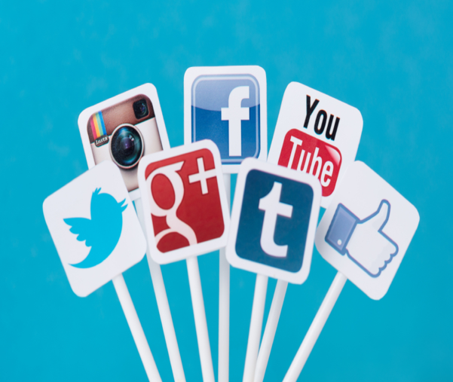
Evidence Supporting the Use of Social Media in Nursing Education & Practice
Cathrin Carithers, DNP, APRN, FNP-C
University of Arkansas for Medical Sciences
Renee Leasure, PhD, RN; Barbara Miller, MS, RN University of Oklahoma Health Sciences Center; Angela Gore, MS, RN, Oklahoma City VA Medical Center

Slide 2
Social Media
Forms of electronic communication (as Web sites for social networking & microblogging) through which users create online communities to share information, ideas, personal messages, & other content (as videos)
                Merriam -Webster

Slide 3
Social Media Facts…
Developed in 2005-06; 2011 became public entity
#1 activity on the Web
Americans own average of 4 digital devices
Average 60 hrs/week consuming content across devices; > 6 hrs/day on social media sites
In 2013, > 1 Billion people were on Facebook; in 2014 > 1.28 billion monthly active users
Facebook - world’s 3rd largest country after China & India

Slide 4

Social Media
Usage now standard practice
  Nearly ¾ of Americans use social media
  Almost half of smartphone owners visit social networks daily
1 in 5 couples meet online
1 in 5 divorces blames on Facebook
Hispanics are ahead of the curve –
  Latinos adopt smartphones at a higher rate than any other demographic group
  Watch more hours of videos online &on mobile phones than the average American

Slide 5
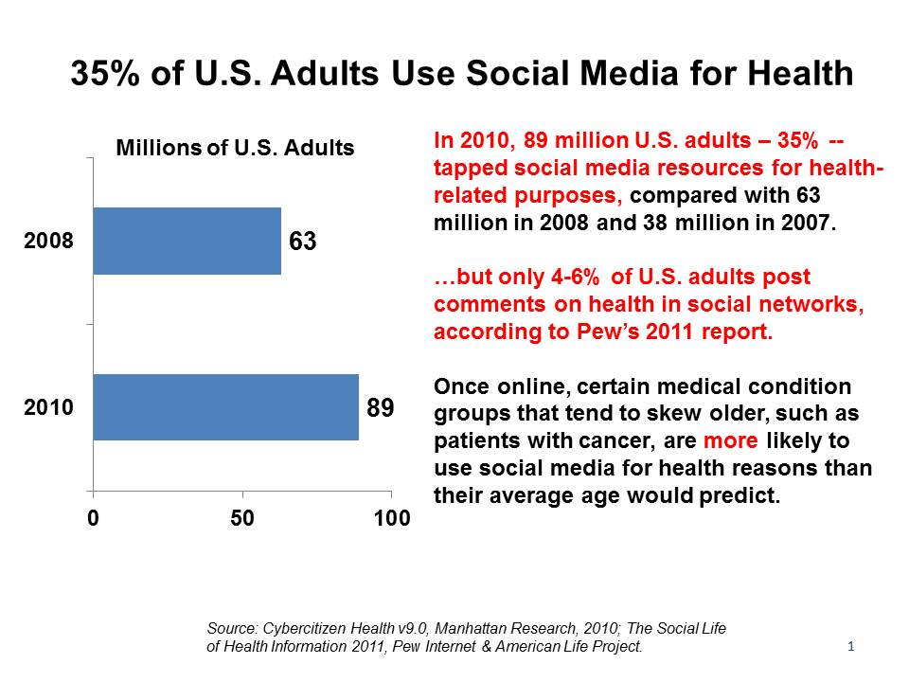

Slide 6
Social Media in Education: An Evidence-Based Practice
The IOM Future of Nursing (2010) asserted need for health information technology competencies be included in nursing education
Social media platforms augment student learning & prepare them for use in clinical practice (George & Dellasega, 2011)
Twitter reliable/valid tool when used for formative course evaluations (Stieger & Berger, 2009) & effective for class discussions (Mistry, 2011)

Slide 7

Baby Boomer
Largest generational group
Two parent families
Reliable
Family oriented
Believed they could change the world
Hard working
Work no longer necessity, it was the focus of life

Slide 8

Gen X
Can multitask
Flexible
Independent
Intolerant of busy work
Pessimistic
Prefer to work alone
Self-reliant
Used to change
Want to get the job done

Slide 9
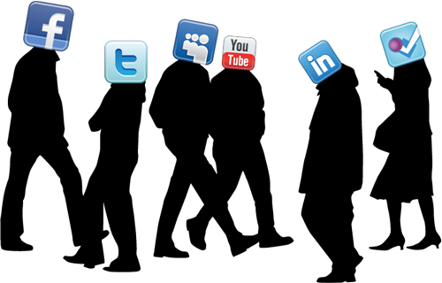
Millennials
Accept authority
Balance work & personal life
Direct, Optimistic
Rule follower
Self-confident, narcissistic
Socially aware & involved
Team player
Vocal
Most educated generation Technologically savvy

Slide 10

You Tube …
Generation Y & Z e-mail is passé
YouTube - world’s second largest search engine
Every minute 72 hrs of Video is uploaded to YouTube

Slide 11
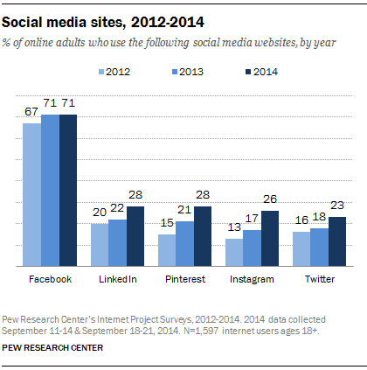

Slide 12
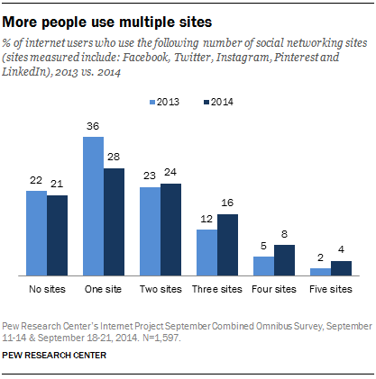

Slide 13

SOCIAL MEDIA

Slide 14
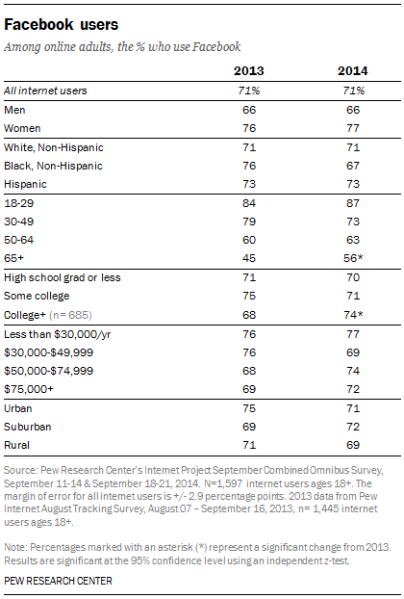

Slide 15
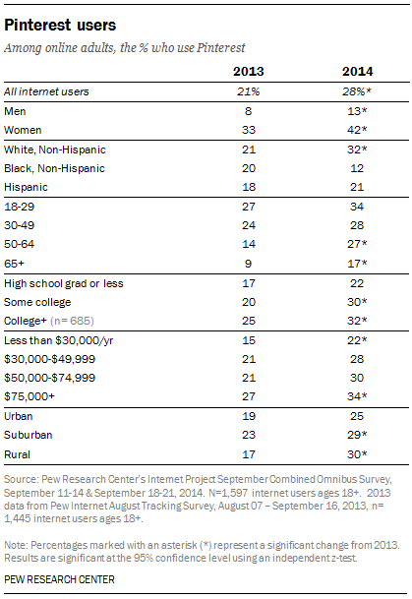

Slide 16
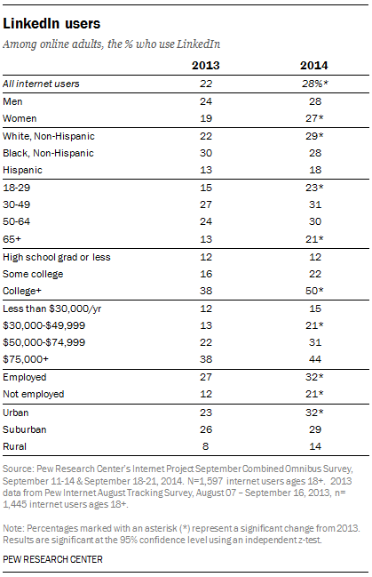

Slide 17
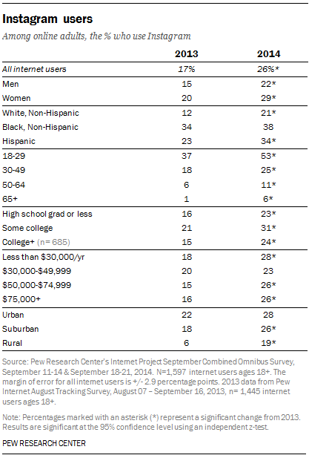

Slide 18
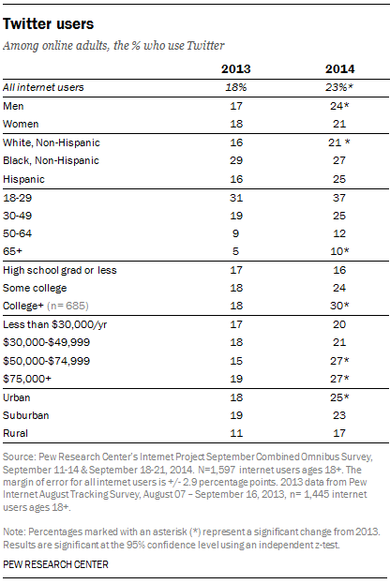

Slide 19

Social Media In Education: VA Mentoring Program
Utilized Facebook to facilitate communication, socialization, & engagement
Closed Facebook page
Nursing students & mentors informed regarding
  Type of information to share
  HIPAA - Information not allowed on social network site
Mentors discussed availability, accessibility, & expectations
Allowed a safe forum for on-line posting
Kept communication open, constant & informational

Slide 20

Tweet of the Week…
Sign up for free Twitter account (www.twitter.com) & Twitter management software (Hootsuite, Tweetdeck)
  Username is key; used in all Twitter communication
Review National Councils of State Board’s of Nursing & ANA’s Social Media Policy & ANA Social Networking Tips
  Must maintain professional standards.
Review HIPPA Guidelines
Join course/group & complete first Twitter discussion of student/faculty Introductions
Limited to 140 characters per Tweet;
  Be succinct;
  Remember netiquette/tweetiquette rules

Slide 21

Tweet - scussions
Make class tweets private or use disclaimer that users accept full responsibility for Tweets
Hashtags are words prefixed with the “#” symbol that identify topics or groups within social media sites
  Course number can be used as hashtag
Students participate by tweeting (sending) messages to ask & answer questions or expand on thoughts
Discussion grading rubric used to grade tweet content

Slide 22
Tweet-scussion Topics
Clinical Case Study (HIPPA)
Clinical PEARLS
Medical Spanish phrases
Health Advocacy/Policy
Ethical Issues (HIPPA)
Theme of the Week
Quiz Review/Tips

Slide 23

Social Media In Healthcare
Patients
  Education
  Obtaining Information
  Networking
  Performing research
  Receiving support
  Goal setting
  Tracking personal progress
Provider
  Read news articles
  Listen to experts
  Research medical developments
  Network
  Communicate with colleagues
Healthcare Organizations
  Community Engagement
  Fundraising
  Customer Service & Support
  Provision of News & Information
  Patient Education
  Advertisement

Slide 24

Pinterest
Health Care Organizations Turn to Pinterest To Connect With Community, Boost Brand

Slide 25


Teal Toes
Raising Ovarian Cancer Awareness
Teal Toes
  http://www.tealtoes.org/spreadtheword

Slide 26


Twitter
Linkedin
@RNchat

Slide 27

Social Media Toolkit For Nurse Educators

Slide 28

ANA’s Social Networking Tips
Standards of professionalism same on-line as any other circumstances
Do not share or post information or photos gained through provider-patient relationship
Maintain professional boundaries – Online patient contact blurs this boundary
Take advantage of privacy settings & separate personal & professional information online

Slide 29

ANA’s Social Networking Tips
Refrain from making disparaging remarks about patients, employers, or colleagues even if they are not identified
Do not take patient photos on personal devices including cell phones
Promptly report a breach of confidentiality or privacy
Patients, colleagues institutions, &
employers may view posts

Slide 30
ANA’s Social Networking Principles Toolkit - www.nursingworld.org/socialnetworkingtoolkit
Canadian Association of Schools of Nursing’s publication on educating for effective clinical use of information and communication - www.casn.ca/en/Whats_new_at_CASN_108/items/ 104.html
CDC’s Health Communicator’s Social Media Toolkit - www.cdc.gov/socialmedia/Tools/guidelines/pdf/ SocialMediaToolkit_BM.pdf
The Chronicle of Higher Education: Various online resources and articles about online learning and technology integration - http://chronicle.com/section/Home/5

Slide 31
College of Registered Nurses of British Columbia statement on social media - https://www.crnbc.ca/Standards/Confidentiality/ Pages/SocialMedia.aspx
Pew Research Center American Life Project, Pew Internet: Health - http://pewinternet.org/Commentary/2011/November/ Pew-Internet-Health.aspx
Registered Nurses’ Association of Ontario Faculty eHealth Resource for the Integration of eHealth into Undergraduate Nursing Curricula- http://rnao.ca/ehealth/facultyresource

Slide 32
The Sloan Consortium: An organization focused on online educational excellence - http://sloanconsortium.org/
The Tiger Initiative Informatics Agenda - http://tigersummit.com/Education_New.html
The Tiger Initiative Informatics competencies for every practicing nurse - http://tigersummit.com/Competencies_New_B949.html
(Schmidt, Simms-Giddens, & Booth, 2012)

Slide 33
To Friend or Not to Friend…
Use should be intentional
  Think about how you are going to use social media
  Drinking & blogging can be a problem
There is no private vs. professional sphere
There is no plausible deniability
  Picture or video is difficult to deny
Lots of behavior is unprofessional &/or uncollegial
Your behavior is recordable like never before

Slide 34
Web IQ Quiz
Take the Web IQ Quiz from the Pew Research Center at
http://www.pewinternet.org/quiz/web-iq-quiz/

Slide 35
References
American Nurses Association, Fact Sheet. (2011). Navigating the world of social media. Retrieved from www.Nursing World.org
Borges, N.J., Manuel, R.S., Elam, C.L., & Jones, B.J. (2010). Differences in motives between Millennial and Generation X medical students. Medical Education, 44, 570-576.
Duggan, M., Ellison, N. B., Lampe, C., Lenhart, A., & Madden, M. (2015) Social Media Update 2014. Pew Research Center Retrieved from http://www.pewinternet.org/2015/01/09/social-media-update-2014/
Nielson ratings (2011). http://marketresearch.about.com/od/market.research.social.media/u/social-media-research.htm
Richter, J.P., Muhlestein, D.B., & Wilks, C.E. (2014). Social media: How hospitals use it, and opportunities for future use. Journal of Healthcare Management, 59(6), 447-460.
Schmitt, T. L., Simms-Giddens, S. S., & Booth, R. G. (2012). Social media in nursing education. OJHIN: The Online Journal of Issues in Nursing, 17(3), Manuscript 2.
Smith, S. & Clark, A.P. (2009). Millennials and their value cohort: How to educate them. Clinical Nurse Specialist, 23 (6), 289-292.
Stewart, D.W. (2006). Generational mentoring. The Journal of Continuing Education in Nursing, 37(3), 114-120.
Venne, V.L., & Coleman, D. (2010). Training the Millennial learner through experiential evolutionary scaffolding: Implications for clinical supervision in graduate education programs. J. Genet Counsel, 19, 554-569. doi: 10.1007/s10897-010-9319-8

