Slide 1
An Innovative Educational Program to Teach VA Nurses about EBP
Beverly Bowers, PhD, APRN-CNS, ANEF
Judy Ogans, MS, RN, CNE

Slide 2

History

Slide 3
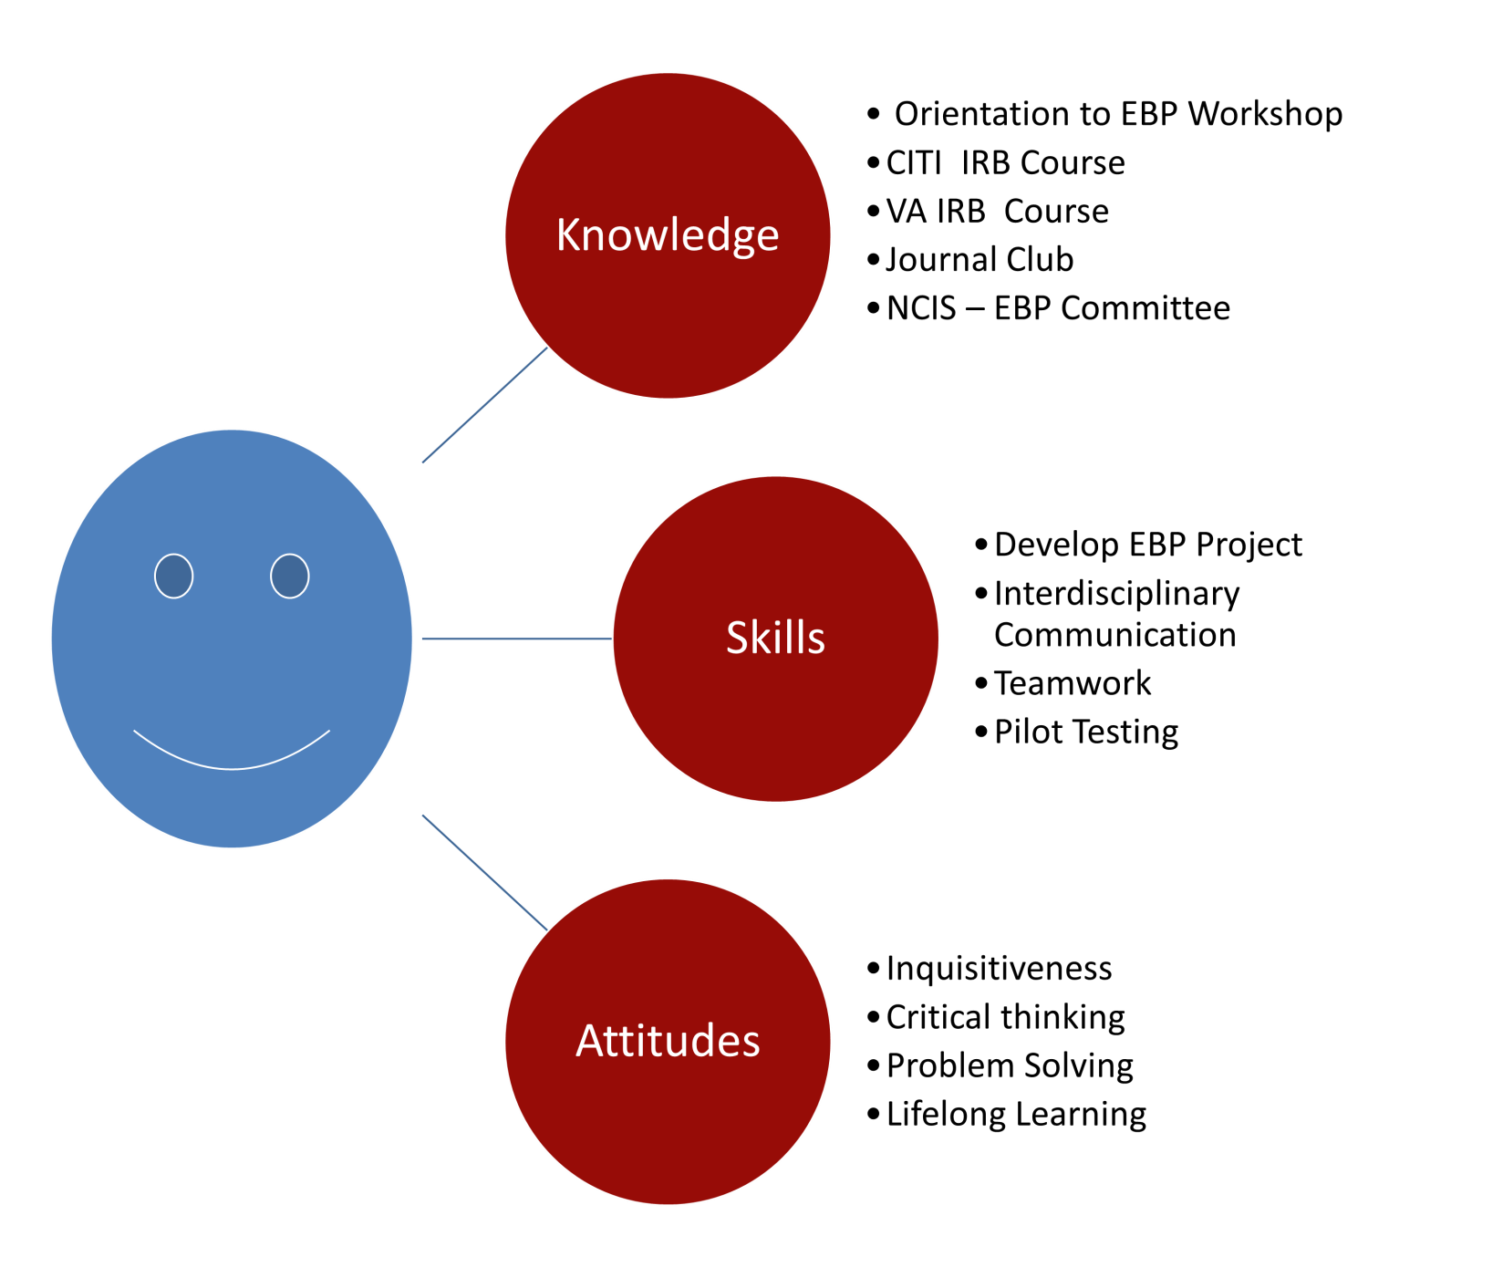
KSAs for EBP
Trainee

Slide 4


Johns Hopkins PET Model
PRACTICE
QUESTION
EVIDENCE
TRANSLATION

Slide 5
Course Components
Overview of EBP-Johns Hopkins Model
Developing the PICO question
Journal Club
Searching the Literature
Summarize and Synthesize Literature
Translation
Make recommendations for practice change

Slide 6
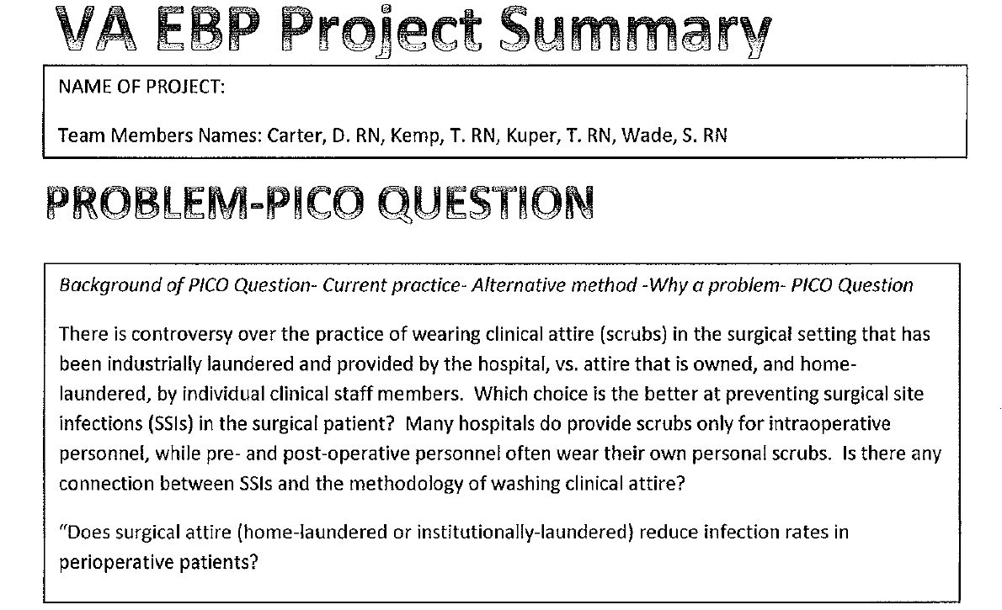
Home Laundered versus Institutional Laundered Scrub Attire

Slide 7
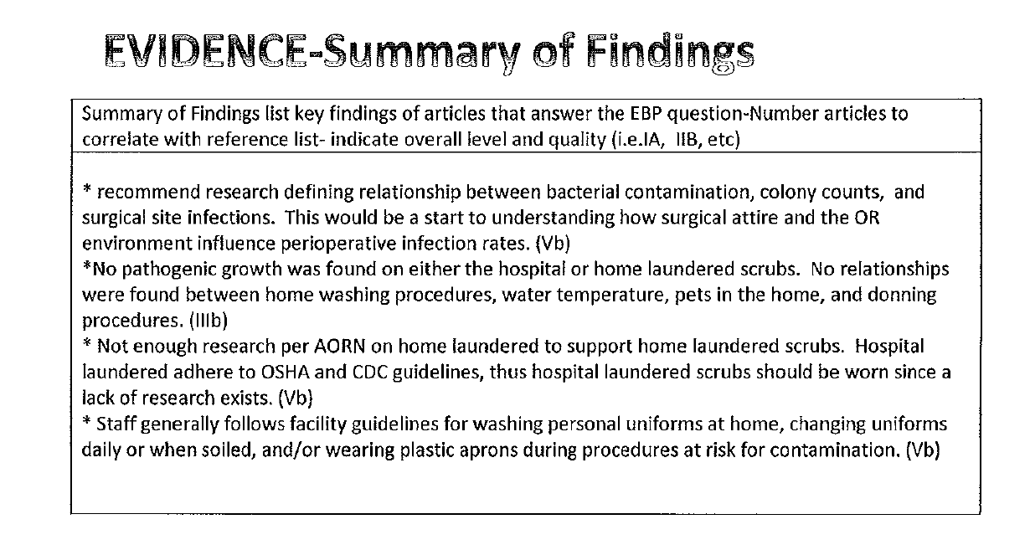

Slide 8
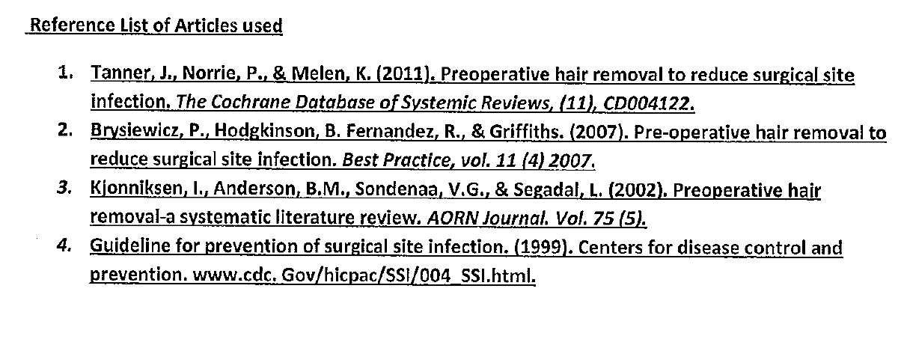

Slide 9
Outcomes of the Course
Students apply aspects of the EBP process from beginning to end
Identify issues important to their unit
Learn sources of evidence and how to systematically search the evidence-
  CINAHL, Medline, Pub Med, AHRQ Guidelines, Joanna Briggs, Cochrane Data Base
How to locate research vs non-research
Learn how to appraise evidence

Slide 10
Outcomes
Learn how to rate level and quality of evidence
How to synthesize literature
Difference between EBP, Research and QI
How to translate evidence in to practice if a practice change is needed
EBP can be done in a short time span with a dedicated effort
EBP is FUN!

Slide 11
What is one thing you learned today that you will implement into your practice ?
This class was a really good refresher course
How to put together a PICO question
How to effectively conduct EBP
How to use the Boolean process
All was valuable information
I would like to follow up on my research on ear plugs on the ICU and advocate to implement at the VA. I learned that earplugs reduce delirium and confusion and increase rest and sleep in ICU pts. I was also reminded how to develop a PICO question

