Slide 1
CARING FOR THE HEART FAILURE PATIENT
Angie Matthews, APRN,CNP

Slide 2
Objectives
Participants will:
Understand the stages of the heart failure and the care of HF patients through each stage
Have increased knowledge guideline directed medical therapy for HF in each stage
Understand importance of self care

Slide 3
Heart Failure Stats
Leading cause of hospitalizations among adults > 65 years of age
> 1 million patients are hospitalized with primary diagnosis of HF at a cost of 17 billion
>650,000 new cases a year
5.1 million persons in US clinically affected
56,000 will die each year
1 in 9 deaths is US – HF on death certificate
2013 > $32 billion-services, meds, and
lost productivity
Notes:
Heart Failure in the United States
About half of people who develop heart failure die within 5 years of diagnosis.¹
Heart failure costs the nation an estimated $32 billion each year.³ This total includes the cost of health care services, medications to treat heart failure, and missed days of work

Slide 4
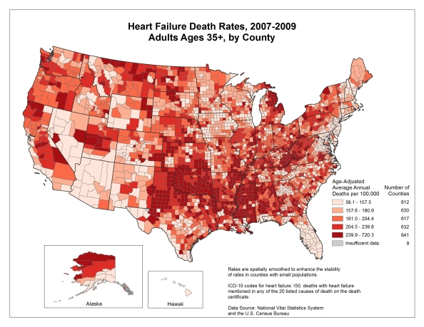
Notes:
About 5.1 million people in the United States have heart failure.¹
One in 9 deaths in 2009 included heart failure as contributing cause.¹

Slide 5
Heart Failure Definition
Complex clinical syndrome
Results from structural or functional impairment of ventricular filling
Ejection of blood from ventricles impaired
Manifested by dyspnea and fatigue
Heart failure with reduced EF (HFrEF) EF < 40%
Heart failure with preserved EF (HFpEF)
“Heart Failure” preferred over
“Congested heart failure”
Notes:
In most patients abnormalities of systolic and diastolic can coexist despite EF.

Slide 6
Complex Clinical Syndrome
Impaired Ventricular Filling or Ejection
Dyspnea and Fatigue
Limited Exercise Tolerance
Fluid Retention
Pulmonary and Congestion
Peripheral Edema
Orthopnea
Structural or Functional Disorder

Slide 7
Risk Factors For HF
HYPERTENSION- single most important
modifiable risk factor
HTN
Older Age
Over Time
↑HF
LONG TERM TX OF BP↓
↓HF 50%

Slide 8
Risk Factors
Diabetes
Obesity and insulin resistance ↑ incidence
Metabolic Syndrome
abdominal adiposity, dyslipidemia, fasting hyperglycemia
Atherosclerotic Diseases

Slide 9
Precipitating Factors
Myocardial ischemia/infarction
Hypertension
Atrial fibrillation or other arrhythmias
Thyroid diseases
Anemia
Pulmonary congestion
Drug interactions
Non-adherence
Sleep apnea

Slide 10
Structural Abnormalities
Dilated Cardiomyopathies (DCM)
Characterized by ventricular dilatation and decreased contractility
Ischemic and Non-ischemic
Idiopathic DCM
Toxic exposures- chronic alcoholism
Long term use of cocaine
Cardiotoxicity of cancer therapies
Myocarditis due to inflammation
Peripartum –last trimester
Rheumatological/Connective tissue disorders

Slide 11
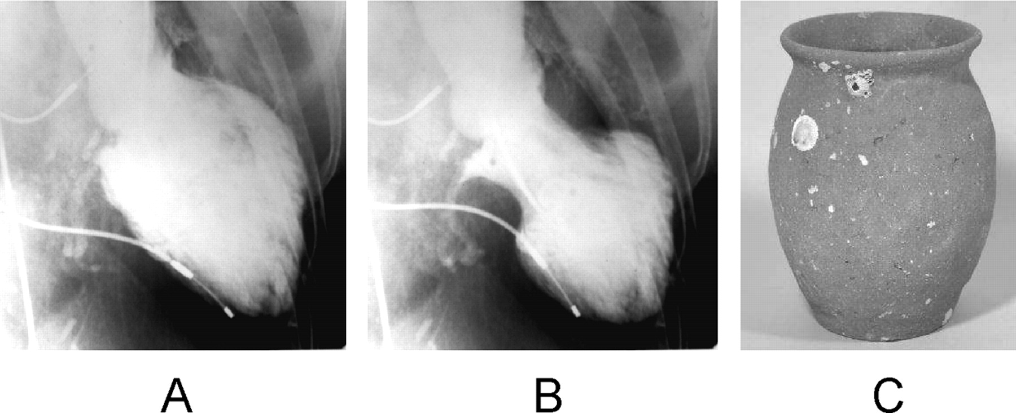

Takotsubo Cardiomyopathy
Broken Heart Syndrome
Chest pain, SOB after severe emotional or physical stress
Mimics MI
(A, end-diastolic phase; B, end-systolic phase) in the right anterior oblique projection.
Akashi Y J et al. Circulation. 2008;118:2754-2762
Copyright © American Heart Association, Inc. All rights reserved.
Notes:
Figure 1. Left ventriculogram (A, end-diastolic phase; B, end-systolic phase) in the right anterior oblique projection. The extensive area around the apex shows akinesis, and the basal segments display hypercontraction, especially in the end-diastolic phase. C, A picture of a real takotsubo, which has a round bottom and narrow neck to capture octopuses and has been used for a long time in Japan.
Broken Heart Syndrome
Features of takotsubo cardiomyopathy
Chest pain and shortness of breath after severe stress (emotional or physical)
Electrocardiogram abnormalities that mimic those of a heart attack
No evidence of coronary artery obstruction
Movement abnormalities in the left ventricle
Ballooning of the left ventricle
Recovery within a month

Slide 12
HF Care-History
Clues suggesting etiology
Duration of illness
Severity and triggers of dyspnea and fatigue
Presence of chest pain
Exercise capacity
Anorexia, weight loss, weight gain
Palpitations, pre(syncope), ICD shocks
Recent hopitalization
Discontinuation of medications for HF
Medications that exacerbate HF

Slide 13
HF Care- Physical Exam
HR, B/P standing and sitting, Weight, Height, BMI
JVD at rest and following abdominal compression
Rales, dullness at lung bases due to pleural effusions
Tachycardia, afib-rvr
Displaced apical impulse
Heart murmurs, S3
Hepatomegaly, (venous congestion), ascites
Peripheral edema
Determine functional capacity; document each visit

Slide 14
Diagnostic Testing
EKG- ischemia, previous MI, LVH, arrhythmias
CXR- evidence for chamber enlargement, pleural effusions, COPD
Non-invasive imaging, Echo
Brain natriuretic peptide levels (BNP)
Metabolic panel
Non-invasive imaging to detect ischemia
Heart cath

Slide 15
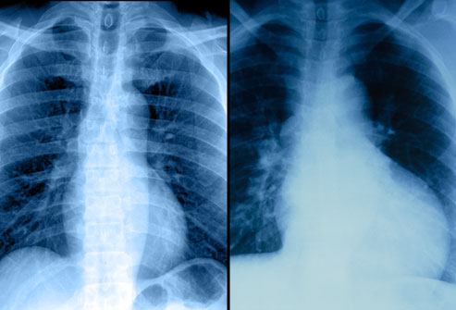
Cardiomegaly

Slide 16
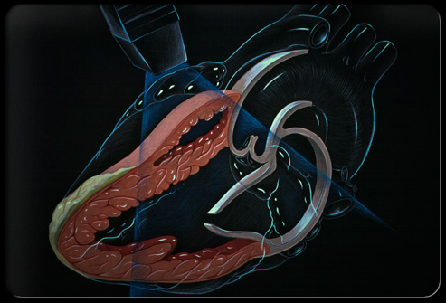
Echo
Most useful
Distinguishes between systolic and diastolic
Shows wall motion abnormalities
Hypertrophy
Chamber sizes
Valvular abnormalities

Slide 17
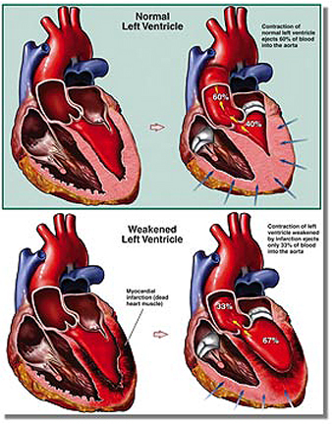
Change in chamber size and wall motion

Slide 18
Brain Natriuretic Peptide
Guides Treatment
Results
Secreted from ventricles with stretch
Correlates with severity of HF
Decreases with compensation
Distinguishes HF from pulmonary disease
Increases with age especially in women
< 100 | No HF
100-300 pg/ml | HF presence
>300 pg/ml | Mild HF
>600 pg/ml | Moderate HF
>900 pg/ml | Severe HF

Slide 19
New York Heart Association
Functional Level of Impairment
I. No symptom limitation with ordinary physical activity
II. Ordinary physical activity limited by dyspnea; walking long distance or climbing two flights of stairs
III. Exercise limited by dyspnea; walking short distance or climbing one flight of stairs
IV. Dyspnea at rest with very little exertion

Slide 20
Stages in the development of HF and recommended therapy by stage
2013 ACCF/AHA HF Guidelines: Executive Summary

Slide 21
Stages of Heart Failure
ACCF-AHA Stages
A.
High risk for HF
No structural HD
B.
Structural HD
No signs or symptom of HF
Structural HD
Hx of or current symptoms of HF
No symptoms of HF
C.
Refractory HF
D.
High risk for HF
HF

Slide 22
Stages, Phenotypes and Treatment of HF
2013 ACCF/AHA Guideline for the Management of Heart Failure. E-Published on June 5, 2013, available at: [http://content.onlinejacc.org/article.aspx?doi=10.1016/j.jacc.2013.05.019 and http://circ.ahajournals.org/lookup/doi/10.1161/CIR.0b013e31829e8776]

Slide 23
Stage A
At risk; no symptoms
Patients with:
Htn- ID and Treat! Major risk factor
Atherosclerotic disease –Treat dyslipidemia!
Metabolic syndrome
Diabetes
Obesity
Family history of cardiomyopathy
Using cardiotoxins

Slide 24
Stage A Therapy
Goals
Heart healthy lifestyle
Prevent vascular coronary disease
Prevent left ventricular
structural abnormalities
Drugs
ACE or ARB in appropriate patients
for vascular disease or diabetes
Statins as appropriate

Slide 25
Stage B
Structural HD; No symptoms
Patient with:
Previous MI
LV remodeling including LVH and low EF
Asymptomatic valvular disease

Slide 26
Stage B Therapy
Goals
Prevent HF symptoms
Prevent further cardiac remodeling
Drugs
ACE or ARB as appropriate
Evidence based beta blockers as appropriate
In selective patients
ICD
Revasuclarization or valvular surgery

Slide 27
Stage C
HF
Patients with:
Structural HD
Symptoms of HF NYHA II,III,IV
HF with preserved EF (HFpEF)
HF with reduced EF (HFrEF)

Slide 28
Stage C Therapy
HFpEF
Goals
Control Symptoms
Improve HRQOL
(health related quality of life)
Prevent hospitalization
Prevent mortality

Slide 29
Stage C Therapy
HFpEF
Strategies
ID comorbidities
Treatment
Diuresis to relieve symptoms of congestion
Follow guideline driven indications for comorbidities
Treat HTN, Afib, CAD, DM

Slide 30
Stage C Therapy
HFrEF
Goals
Control symptoms
Patient education
Prevent hospitalization
Prevent mortality
Drugs for routine use
Diuretics for fluid retention
ACEI or ARB
Beta Blockers
Aldosterone antagonist

Slide 31
Stage C Therapy
HFrEF
Drugs for use in selective patients:
Hydralazine/Isosorbide dintrate
ACEI and ARB
Digitalis
In select patients:
CRT (Cardiac Resynchronization Therapy)
ICD
Revascularization
Valvular surgery as appropriate

Slide 32
Stage D
Refractory HF
Patients with:
Marked HF symptoms at rest
NYHA IV
Recurrent hospitalizations despite GDMT
(guideline-directed medical therapy)

Slide 33
Stage D Therapy
Refractory HF
Goals
Control symptoms
Improve HRQOL
Reduce hospital readmissions
Establish patient’s end of life goals

Slide 34
Stage D Therapy
Refractory HF
Options of care
Advanced care measures
Heart transplant
Chronic inotropes
Temporary or permanent MCS
(mechanical circulatory support)
Experimental surgery or drugs
Palliative care and hospice
ICD deactivation

Slide 35
Treatment is a step like progression through the stages
HTN,DM,
CAD
Tx with ACE
ACE,
Add BB carvedilol
Symptoms
Ace, BB
Diuretics
Furosemide
Aldosterone
Lanoxin
ICD/CRT
Cardiac Rehab
End stage
Pallative care
Hospice
Heart transplant LVAD
D
C
B
A

Slide 36
Cardiac Rehab
Stable HF
EF < 35%
with symptoms
No recent
< 6 weeks or planned CV procedure
< 6months
Unstable HF
EF < 35%
with symptoms
Recent hospitalization or procedure
Refer to:
Cardiac Rehab Inpatient
Chronic HF Clinic
CHF Home Health
Refer to:
Cardiac Rehab Inpatient
Facilitate to Outpatient

Slide 37
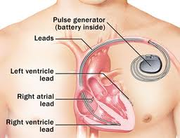
Device Therapy: Biventricular Pacing
Recommendations
Sinus Rhythm
A widened QRS interval (≥ 120 ms)
Severe LV systolic dysfunction (LVEF ≤ 35%)
Persistent, moderate to severe HF (NYHA III-IV) despite optimal therapy
Evidence of dyssynchrony

Slide 38
Implantable devices
Provide meaningful HF monitoring data
Help titrate medications
Alert to change in clinical status
Alert to arrhythmias
Potential to modify outpatient frequency of visits
Measures impedance

Slide 39
Surgical Options
Left Ventricular Assist Devices (LVADs)
Ventricular Reconstruction Surgery
Cardiac Transplantation

Slide 40
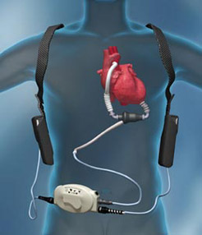
Left Ventricular Assist Device
Heart pump
Assumes pumping functions of left ventricle
Improves quality of life
Bridge to transplant
Destination therapy
Battery life 14 hours
Used since 2005

Slide 41
Ace Inhibitors
Generic | Trade | Initial Daily Dose | Max Dose | Mean Dose in Clinical Trials | Comments
Captopril | Capoten | 6.25mg tid | 50 mg tid | 122.7 mg/day | Short acting
Enalapril | Vasotec | 2.5mg bid | 10mg to 20mg bid | 16.6 mg/day | Low doses
Fosinopril | Monopril | 5-10mg daily | 40 mg daily | n/a
Lisinopril | Zestril, Prinivil | 2.5-5mg daily | 20 to 40 mg daily | 4.5 low; 33.2 high | Once daily Low doses
Quinapril | Accupril | 5mg bid | 20mg bid | n/a
Ramapril | Altace | 1.25 - 2.5mg qd | 10mg daily | n/a
Trandolapril | Mavik | 1mg daily | 4mg daily | n/a

Slide 42
Angiotensin Receptor Blockers
Generic Name | Trade Name | Initial Daily Dose | Target Dose | Mean Dose in Clinical Trials
Candesartan | Atacand | 4-8 mg daily | 32mg q day | 24mg daily
Losartan | Cozaar | 25 to 50mg daily | 50 -150 mg daily | 129 mg daily
Valsartan | Diovan | 20-40mg bid | 160 mg bid | 254 mg daily
Irbasartan | Avapro | Htn, dm nephro | 75mg -300mg
Olmesartan | Benicar | Htn | 10mg-40mg
Telmisartan | Micardis | Htn | 40mg- 80mg

Slide 43
Beta Blockers
Generic | Brand | Initial Daily Dose | Target Dose | Mean Dose in Clinical Trials | Comments
Bisoprolol | Zebeta | 1.25mg qd | 10mg qd | 8.6mg qd
Carvedilol | Coreg | 3.125mg bid | 50 mg bid | 37mg qd | $4.00 WM Postural hypotension Bronchospasms
Carvedilol CR | Coreg CR | 10mg q d | 80mg qd |  | Less fatigue, less ED, $$ Standing b/p
Metoprolol Succinate | Toprol XL | 12.5-25mg qd | 200mg qd | 159 mg qd | Preferred for COPD and asthma
Nebivolol | Bystolic | Htn | 2.5 mg-20mg qd | Studies ongoing | Less fatigue Less ED, $$

Slide 44
Aldosterone Antagonist
↑renin and angiotensin II → aldosterone production
↑NA retention and potassium and magnesium release
Aldosterone upsets autonomic balance
↑sympathetic activation and parasympathetic inhibition
Promotes cardiac and vascular structural remodeling through collagen synthesis
Generic | Trade | Initial Daily Dose | Target Dose | Mean Dose in Trials | Elimination Duration | Comments
Spironolactone | Aldactone | 12.5 mg to 25mg qd | 25 mg qd to bid | 26 mg qd | Metobolic 48-72 hours | Weak diuretic, hyperkalemia, avoid in renal dysf, gynecomastia
Eplerenone | Inspra | 25mg qd | 50 mg qd | 42.6 mg qd | Renal and metabolic Unknown | Hyperkalemia, avoid in renal dysf, no gynecomastia
Notes:
Commonly used for hf reduced ef

Slide 45
Oral Nitrates and Hydralazine Recommendations
African Americans with HFrEF
NYHA III and IV strong recommendation
Can be used in non-African Americans that remain symptomatic
Vasodilators
Generic | Brand | Initial Daily Dose | Target Dose | Mean Dose in Clinical Trails | Comments
Hydralazine | Apresoline | 37.5mg qid | 75mg qid | 270mg q day | 4x’s daily dosing Prevents coronary steal with nitrates; take with meals
Isorsorbide | Isordil | 20mg qid | 40mg qid | 136 mg q day | 4x’s daily dosing Helps angina

Slide 46
Loop Diuretics
Generic | Brand | Initial Daily Dose | Max Total Daily Dose | Elimination: Renal-Met | Duration of Action | Comment
Furosimide | Lasix | 20-40mg qd or bid | 600mg | 65%R 35% M | 6-8 hrs | IV or PO PO = 2x IV
Bumetanide | Bumex | 0.5mg-1.0mg qd or bid | 10mg | 62%R 38%M | 4 to 6 hrs | Good Bio PO or IV
Torsemide | Demadex | 10-20mg qd | 200mg | 20% R 80% M | 12-16hrs | Best availabilty
Ethacrynic Acid | Edicrin | 25-50 mg qd or bid | 200mg | 67% R 33% M | 6 hrs | Can use with sulfa allergy

Slide 47
Thiazide Diuretics
Loop diuretics rather than thiazide-type diuretics are typically necessary to restore normal volume status in patients with HF.
Generic | Brand | Daily Dose | Target Dose | Duration
HCTZ | Esidrix Hydrodiuril | 25mg once or bid | As needed | 6-12 hrs
Metolazone | Zaroxolyn | 2.5mg |  | 12-24 hrs
 |  |  |  | Give ½ hour prior to furosimide

Slide 48
Lanoxin
Neurohormonal modulating agent
Inhibits enzyme Na+/K+ -ATPase in organs
Increases myocardial contractility
Reduces sympathetic outflow
Inhibits renin release
Reduces rate of hospitalization
Does not reduce mortality
Use lowest dose possible

Slide 49
Meds to Avoid
Meds to Avoid
Exceptions
NSAIDS- fluid retention
Antiarrhythmics- prolonged QT,
Multaq can worsen HF; Flecainide and propafenone can induce VT
Cilostazol – used for ASPVD contraindicated when EF ≤ 40%
Calcium channel blockers can worsen symptoms
Tylenol , Glucosomine –ok
Amiodarone, dolfetamide indicated for HF
Dihydroperidine CC – amlodipine is neutral use for chest pain and B/P

Slide 50
Promote Adherence and Self Care
Critical to improving outcomes
Develop a partnership- treatments are explored and agreed upon
Adherence is discussed and follow up planned
When non-adherence is ID’d – reinforce benefits of treatment and resolve barriers
Placing blame should be avoided

Slide 51
Identify Barriers to Adherance
Advanced age
Multiple co-morbidities
Multiple specialist
Dementia/cognitive dysfunction
Financial challenges
Lack of social support
Poor functional capacity
Depression
Cultural barriers

Slide 52
Focused Patient Education
Identify the learner
Focus on key elements of self-care
Address low health literacy issues
Utilize teach back approach
Interdisciplinary approach
Pharmacy, Physical Therapy, Occupational Therapy, Case Management, Chaplain, Nursing, (it takes a hospital)

Slide 53
Prevent Hospital Readmissions
Hospital follow-up within 7 days of discharge
Improved discharge summaries completed prior to the 7 day hospital follow up
Accurate med and up to date med list
Improved education

Slide 54
Tool kits
Hospital to Home – American College of Cardiology : See you in &
Target HF- American Heart Association
Project RED –Boston University
www.bu.edu/fammed/projectred

Slide 55
Resources
American Association of Cardiovascular and Pulmonary Rehabilitation
www.aacvpr.org
American Association of Heart Failure Nurses www.aahfn.org
American Heart Association 800-242-8721 www.heart.org/heartfailure
Heart Failure Society of America www.hfsa.org
NHLBI DASH Eating Plan www.nhlbi.nih/health/healthtopics/topics/dash
American College of Cardiology
www. ACC.org

Slide 56
Thank you !

