Slide 1
ENT Skills
Evaluation of ENT Disorders
Jennifer Bennett, APRN-CNP
Otolaryngology Nurse Practitioner
Oklahoma City VA Medical Center
Oklahoma City, Oklahoma

Slide 2
Objectives
Describe the assessment findings and management principles in ear and nose conditions.
Describe the assessment findings and management principles in throat conditions

Slide 3
Outline
ENT Differential Diagnosis
Ear Disorders
Nose Disorders
Throat Disorders

Slide 4
ENT Differential Diagnosis
Many different Mnemonics
  KITTENS, VITAMIN C, VINDICATE
  Categories are all similar
Can be used in any ENT condition
K = Congenital
I = Infectious, Iatrogenic
T = Hematoma
T = Toxins
E = Endocrine
N = Neoplasm
S = Systemic

Slide 5
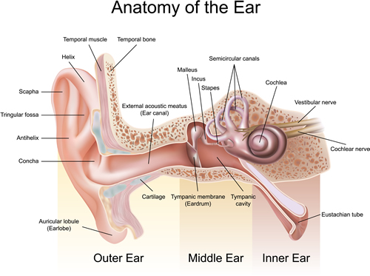
Ear Anatomy

Slide 6
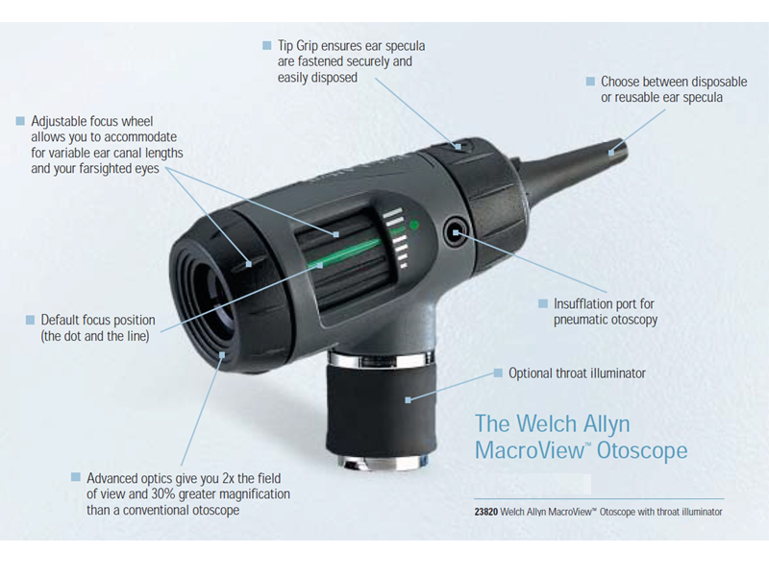
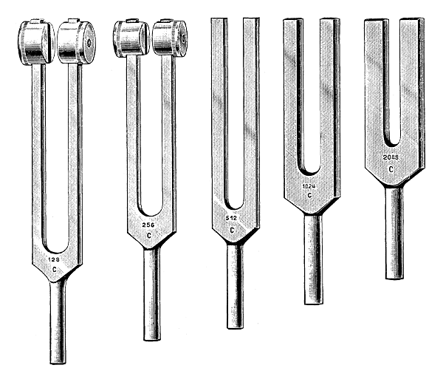
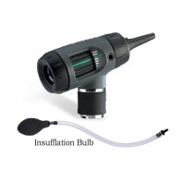
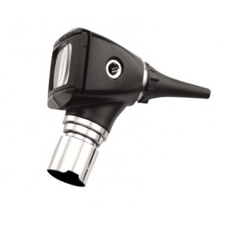
Equipment

Slide 7
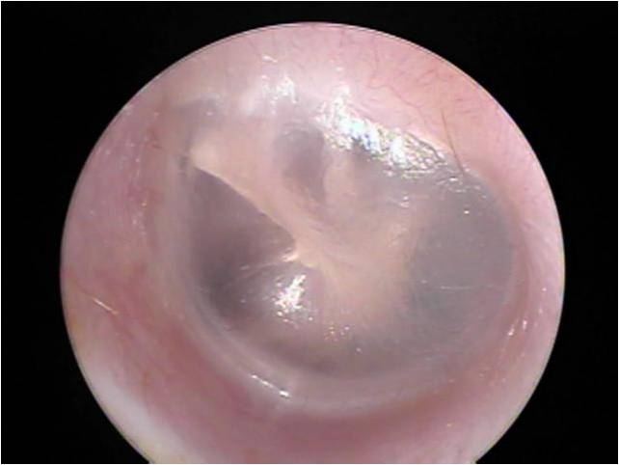
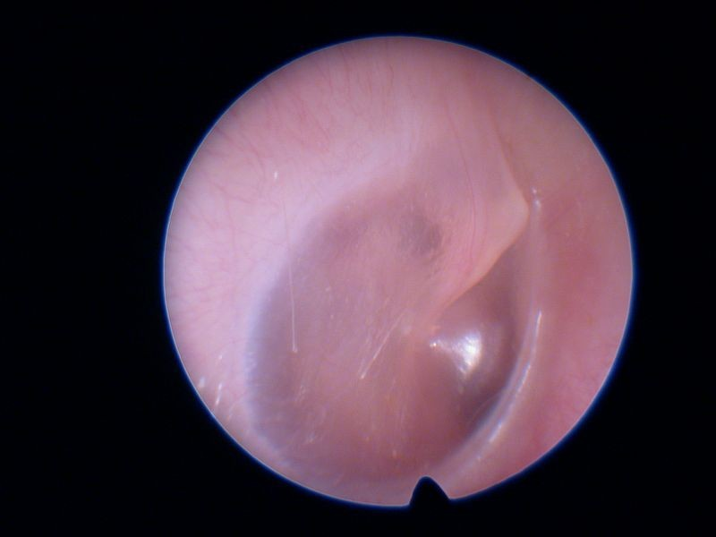
Normal Otoscopy
Opacity
  Translucent OR Transparent
Color
  Gray or Pink
Position
  Neutral
Integrity
  Intact
Mobility
  Full Mobility with Pneumatic

Slide 8

Pneumatic Otoscopy

Slide 9
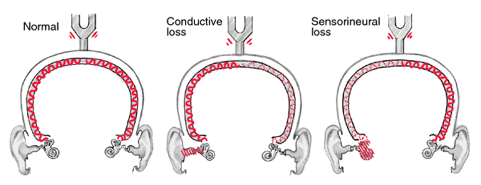
Hearing Assessment
WEBER
Technique
Results
Vibrating Tuning Fork (TF) is placed on the vertex.
Is sound perceived by patient
  If not perceived then change locations
  Alternative locations include bridge of nose, upper incisors, or forehead
Where is the sound the loudest
  Midline = normal
  Lateralization = conductive impairment in the that ear, sensorineural impairment in contralateral ear or both
  Documentation: midline or lateralization location

Slide 10
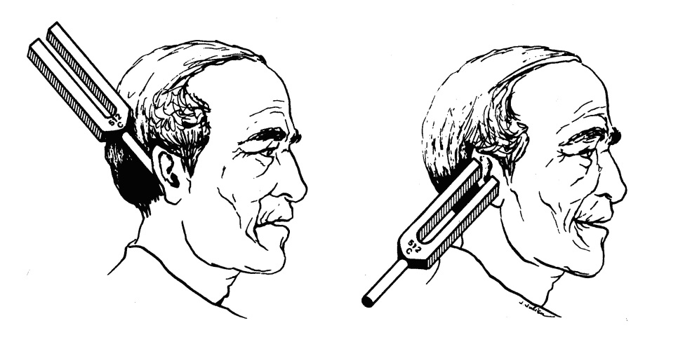
Hearing Assessment
Rinne
Technique
Results
2 Techniques
Loudness Comparison Technique
  Vibrating TF is placed on the mastoid to asses bone conduction THEN
  Vibrating TF is quickly placed close to the ear canal with the “U” of the fork facing forward
  Which sound location is louder
Threshold Technique
  Vibrating TF is placed on the on the mastoid until patient can longer hearing the sound THEN
  Vibrating TF is quickly placed close to the ear canal with the “U” of the fork facing forward
  Can you hear the sound in front of ear
  Normal: air conduction > bone conduction (AC > BC)
  Abnormal: bone conduction > air conduction (BC > AC), consistent with conductive hearing loss

Slide 11
Interpretation
Weber | Rinne (+ or –) | Diagnosis
Lateralization RIGHT EAR | Right Ear: AC > BC (+) Left Ear: AC > BC (+) | LEFT SNHL
Lateralization RIGHT EAR | Right Ear: BC > AC (-) Left Ear: AC > BC (+) | RIGHT CHL
Lateralization LEFT EAR | Right Ear: AC > BC (+) Left Ear: AC > BC (+) | RIGHT SNHL
Lateralization LEFT EAR | Right Ear: AC > BC (+) Left Ear: BC > AC (-) | LEFT CHL
SNHL = Sensorineural Hearing Loss CHL = Conductive Hearing Loss

Slide 12
EAC Foreign Body
History
Findings
History varies according to object and length of time it has been in the ear
Aural Fullness
Hearing Loss
Discomfort
Delayed Presentation
  Otalgia
  Otorrhea
Observe Foreign Body
Insect
  Minimize movement with Viscous Lidocaine or Mineral oil.
Food
  Do not instill water
  Can lead to size increase

Slide 13
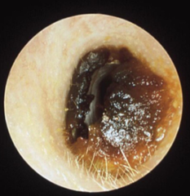
Cerumen Impaction
History
Findings
Aural Fullness
Hearing Loss
Otalgia

Slide 14
Removal
Ceruminolytic Agents
  3% H2O2 Solution
  Debrox® Ear Drops
  Mineral Oil, Baby Oil, Olive Oil
Manual Removal
  Alligator Forceps
  Ear Curette
Suction
  Small catheter held in contact with the object
Irrigation
  Simplest measure but is not without risk.
ENT Consult
  TM Perforation (History or Suspected)
  History Ear Surgery
  Unable to remove
Follow-Up
  None
  Recommend Combo Oto-topical antibiotic & steroid ear drops for infection or abrasion.

Slide 15
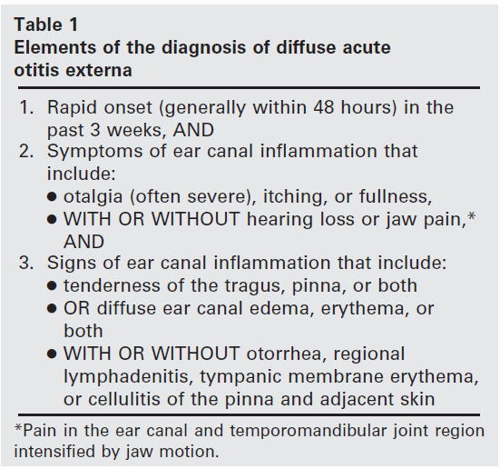
Acute Otitis Externa
***
*** Hallmark Sign

Slide 16
AOE Treatment Principles
Aural Cleaning
Pain Management
Antimicrobial Therapy
Dry Ear Precautions

Slide 17
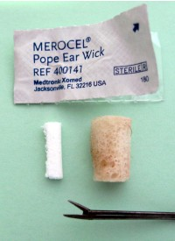
Ear Wick Placement
Facilitates Drug Delivery with severe EAC edema
Hard sponge that expands when saturated with ear drops after placement.
Will cause temporary discomfort with insertion.

Slide 18
Ear Wick Placement
Gently/Firmly place wick into lateral EAC with forceps until external end is at EAC meatus.
Wick may self extrude as edema resolves or provider removes at follow-up visit 5-7 days later.

Slide 19
Otitis Media
Signs & Symptoms
  Fever
  Otalgia
  Irritability, Insomnia
  Otorrhea
  Hearing Loss
  Concurrent or Preceding URI symptoms

Slide 20
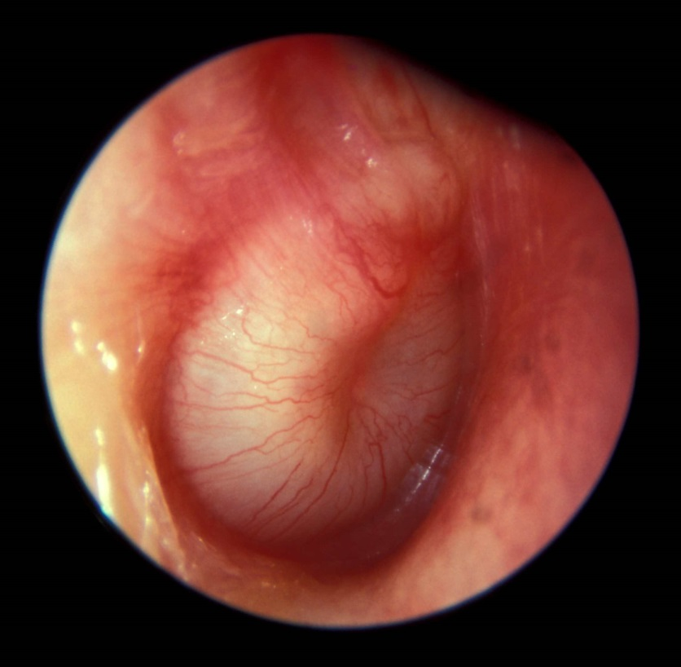
OM Otoscopy Exam
Opacity
  Opaque
Color
  Red, Cloudy
Position
  Bulging/Full
Mobility
  Reduced Mobility
  Effusion Present

Slide 21
OM Treatment Principles
Observation vs. Antibiotics
Pain Management
  Topical
  Systemic
Surgical Management

Slide 22
OM Observation vs. Antibiotics
Age of Child | AOM with Otorrhea |  | AOM without Otorrhea |  | AOM with Severe Symptoms***
 | Unilateral | Bilateral | Unilateral | Bilateral | Unilateral | Bilateral
0-6 mo | Antibiotics | Antibiotics | Antibiotics | Antibiotics | Antibiotics | Antibiotics
6mo-2y | Antibiotics | Antibiotics | Antibiotics or Observation | Antibiotics | Antibiotics | Antibiotics
>2y | Antibiotics | Antibiotics | Antibiotics or Observation | Antibiotics or Observation | Antibiotics | Antibiotics
***Severe Symptoms = toxic appearing child, persistent otalgia > 48 hrs, temperative > 39C in last 48 hrs, or uncertain access to follow-up.

Slide 23
Middle Ear Effusion (OME)
Signs & Symptoms
  No signs or symptoms of active infection
    No otalgia
    No TM color changes
  Aural Fullness
  Hearing Loss
  Concurrent or Preceding URI symptoms
  Recent episode of AOM

Slide 24
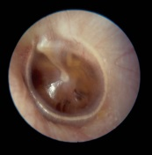
Middle Ear Effusion
Opacity
  Translucent
Color
  Gray or Pink
Position
  Neutral or Retracted Position
Mobility
  Reduced Mobility
  Mobile with Negative Pressure Only
  Effusion Present

Slide 25
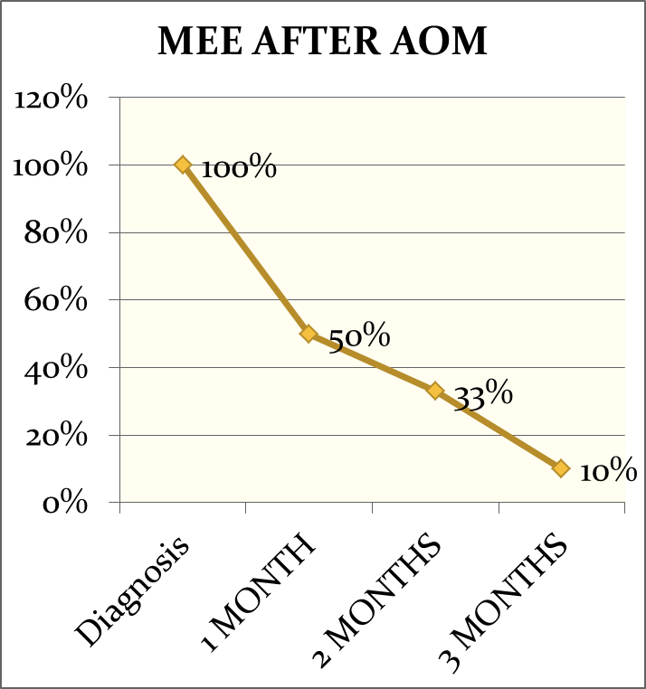
Middle Ear Effusion (OME) Treatment Principles
Watchful Waiting
  No evidence that oral steroids, intranasal steroids, antihistamines, and/or decongestants can be beneficial in resolving fluid or restoring hearing sensitivity.
Surgical Management with Tympanostomy Tubes
  Risk of Language Delay from Impaired Hearing
  Effusion Present > 90 days

Slide 26
Sudden Sensorineural
Hearing Loss
Signs/Symptoms
Exam
Hearing Loss
Tinnitus
Dizziness
Normal Ear Exam
Abnormal Tuning Fork Exam

Slide 27
Sudden Sensorineural
Hearing Loss
Diagnostic
  Audiogram
  MRI
Treatment Principles
  Urgent ENT Consult
  High Dose Oral Steroids

Slide 28
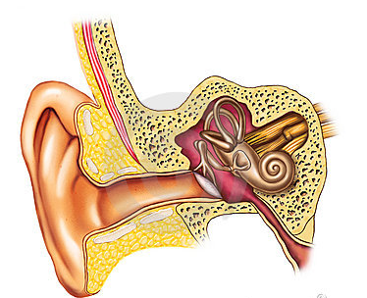
Ear Emergencies
Inner Ear
Sudden SNHL
Middle Ear
TM Trauma
Acute Mastoiditis
Temporal Bone Fracture
Pinna
Auricular Hematoma
EAC
Skull Base Osteomyelitis

Slide 29
Questions

Slide 30

External Nasal Anatomy
External Nose Framework
  Nasal Root
  Nasal Dorsum
  Nasal Tip
  Nasal Ala
Root
Nasal Sidewall
Nasal Dorsum
Ala
Tip
Nasolabial Fold
Nasal Sill
Columella

Slide 31
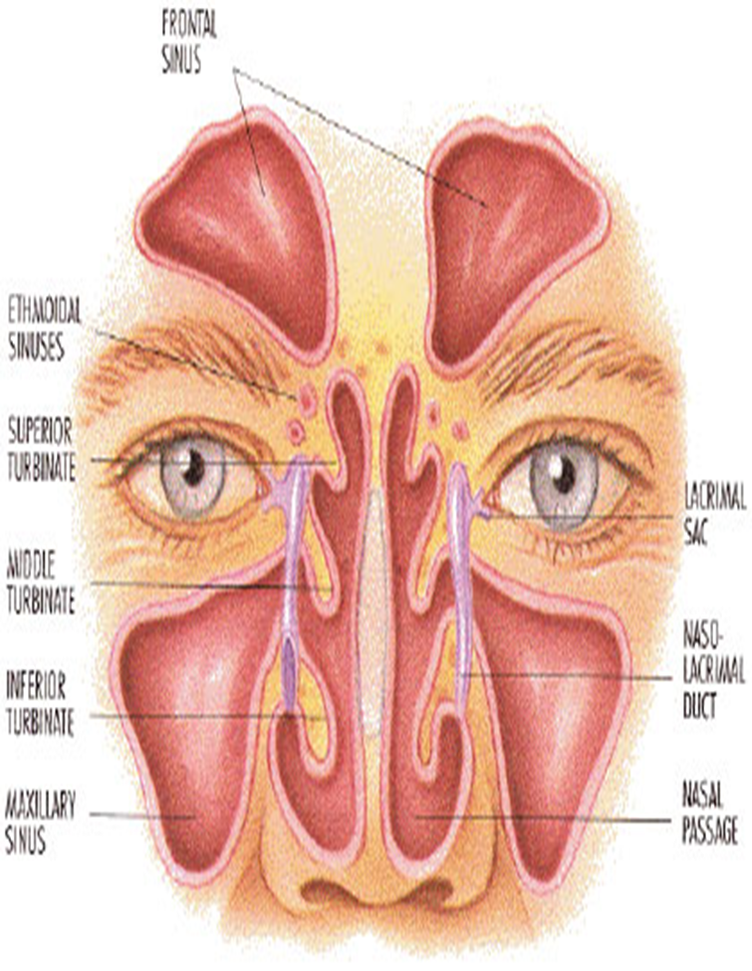
Internal Nasal Anatomy
Internal Nose
  Nasal Septum
  Nasal Turbinates

Slide 32
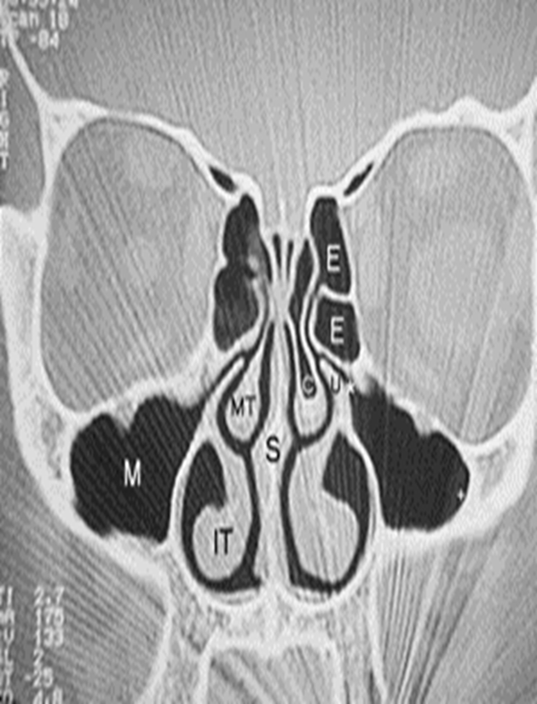
Paranasal Sinuses
4 paired sets
Frontal
Maxillary
Ethmoid
Sphenoid

Slide 33
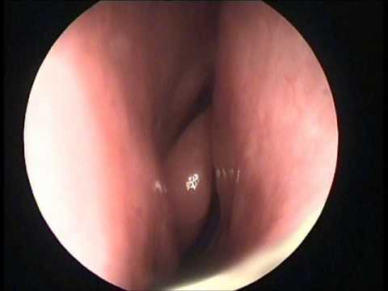
Nasal Exam
Nasal Speculum
Otoscope
Middle Turbinate
Inferior
Turbinate
Septum

Slide 34
Nasal History
Unilateral vs. Bilateral vs. Alternating Symptoms
Duration
    Acute, < 4 weeks
    Sub Acute, 4-12 weeks
    Chronic, > 12 weeks
Seasonal Patterns
Day vs. Nighttime Symptoms
Associated Nasal Symptoms
Nasal Trauma
Nasal Surgery

Slide 35
Common Nasal Symptoms
Nasal Obstruction/Obstruction
Rhinorrhea
Epistaxis
Sneezing

Slide 36
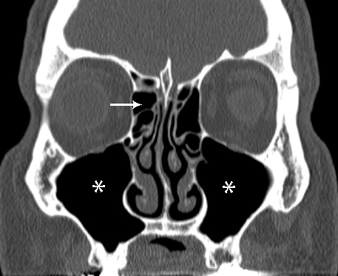
Sinus Symptoms
Maxillary
  Facial Tenderness
  Upper Teeth Ache
  Upper Jaw Ache
Ethmoid
  Pain between Eyes
  Nasal Sidewall Tenderness
  Smell Changes
  Nasal Congestion
  Periocular Tissue Swelling

Slide 37
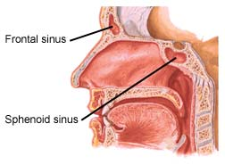
Sinus Symptoms
Sphenoid
  Earache/Otalgia
  Retro Orbital Pain
  Neck Pain
  Vertex Headache
Frontal
  Forehead Pain

Slide 38
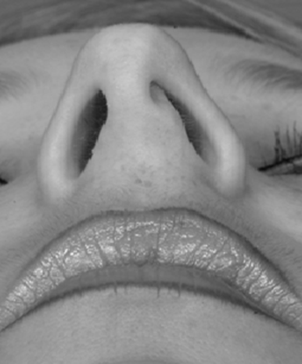
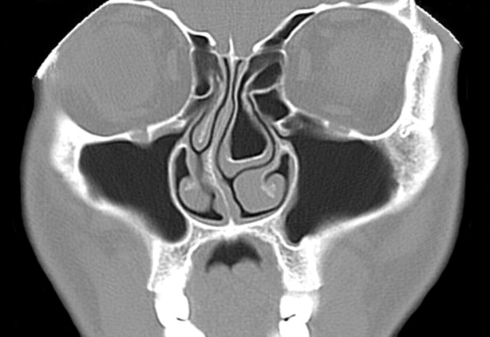
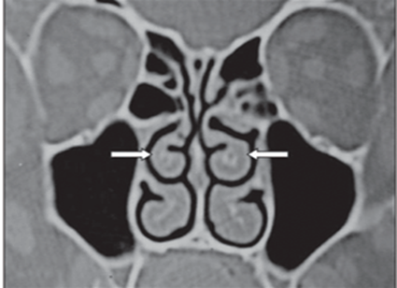
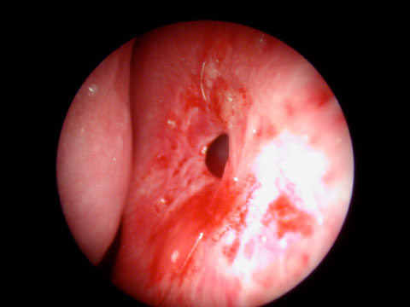
Nasal Airway
Concha Bullosa
Anatomic
  Nasal Valve Collapse
  Nasal Septal Deviation
  Turbinate Hypertrophy
  Concha Bullosa
  Nasal Septal Perforation
Nasal Valve Collapse
Nasal Septal Deviation
Turbinate Hypertrophy
Nasal Septal Perforation

Slide 39
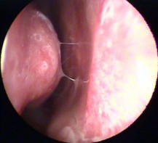
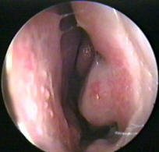
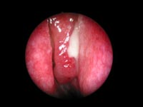
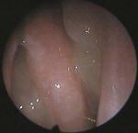
Nasal Airway
Inflammatory/Infectious
    Allergic Rhinitis
    Non Allergic Rhinitis
    Acute Sinusitis
    Chronic Sinusitis
    Nasal Polyps
Chronic Rhinitis
Allergic Rhinitis
Sinusitis
Nasal Polyps

Slide 40
Nasal Obstruction
Treatment Principles
Improve Nasal Airflow
Correct Anatomic Deformity
Treat any underlying infectious and/or inflammatory process
Pain Management

Slide 41
Epistaxis
Incidence
  Children
  Middle Age Adults 45-65 years
Risk Factors
  Hypertension
  Liver Disease
  Blood Disorders
  Anticoagulant or Antiplatelet Use
  ASA, NSAID Use

Slide 42
Epistaxis Etiology
Traumatic
  Nasal Picking
  Facial Trauma
  Nasogastric Tube Placement
Structural
  Nasal Dryness
  Nasal Septal Deviation
  Surgical Procedures
Inflammatory
  Environmental Irritants
  Infections
Drug Induced
  Nasal Sprays
  Substance Inhalation
Hematologic
  Thrombocytopenia
  Hepatic Disease
  Anticoagulant or Antiplatelet Medications
Neoplastic
  Benign
  Malignant

Slide 43
Initial Epistaxis Management
Clear
  Suction or have the patient gently blow the nose to remove any clot THEN
Vasoconstriction
  Flood each nasal cavity with Oxymetazoline nasal spray THEN
Compression
  Manuel Compression along anterior soft part of nose for 10 minutes
Inspection

Slide 44
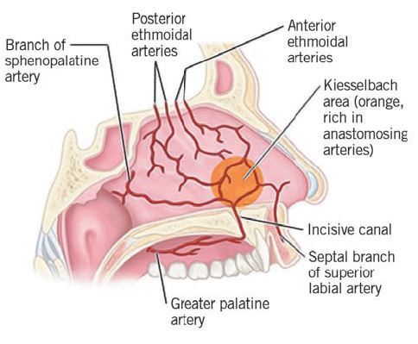
Epistaxis
Location
  Anterior
    Kiesselbach Plexus
  Posterior

Slide 45
Anterior Epistaxis Management
Supplies
  Head Lamp
  Nasal Speculum
  Bayonet Forceps
  Frasier Suction #10
  Suction Set Up
  Non sterile gloves
  Emesis Basin
  Non sterile towels

Slide 46
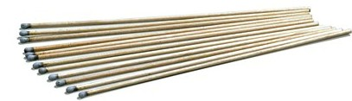
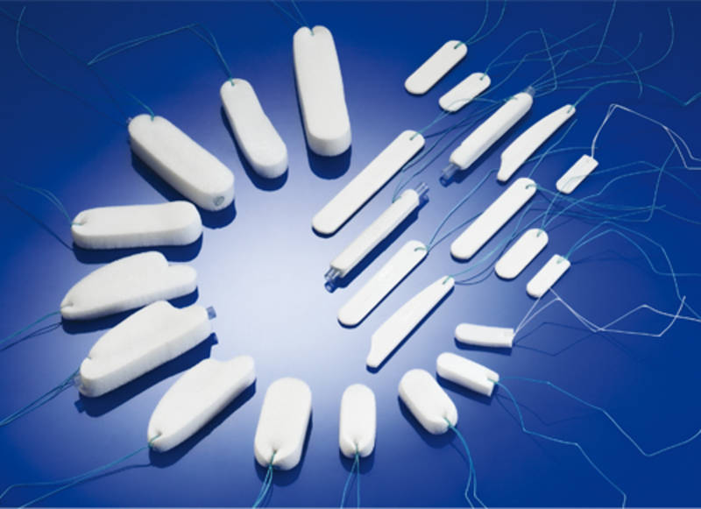
Anterior Epistaxis Management
Chemical Cautery
  Silver Nitrate
Nasal Packing
  Nasal Tampon
  Nasal Balloon Catheter

Slide 47
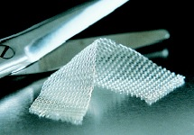
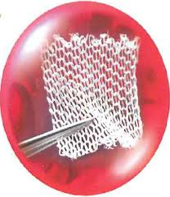
Anterior Epistaxis Management
Thrombogenic Agent
  Surgical Absorbable Gauze
  Topical Thrombin Gel
  Fibrin Glue

Slide 48
Posterior Epistaxis Management
Difficult & challenging to evaluate due to lack of visualization.
Recommend evaluation by Otolaryngology for further management.

Slide 49
Epistaxis Prevention
Aggressive Nasal Moisture Regiment
  Saline Nasal Spray several times daily
  Nasal Ointment BID
Avoid nose blowing for 7-10 days
Home Humidifier Use
Bedside Vaporizer
Open Mouth with Sneezing
Otorhinolaryngology Referral for severe or recurrent epistaxis

Slide 50
Questions

Slide 51
Throat Exam
Oral Cavity
Oropharynx

Slide 52
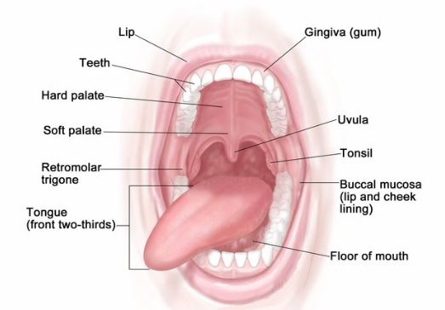
Oral Cavity
Inspect lips, teeth, gums, anterior tongue, floor of mouth

Slide 53
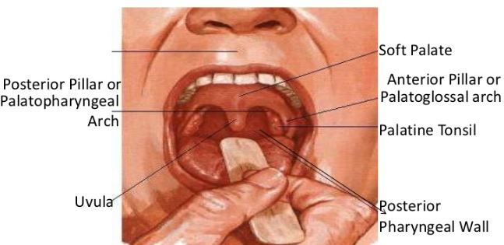
Oropharynx
Area of pharynx posterior to oral cavity
Consists of tonsils, posterior pharyngeal, base of tongue.

Slide 54
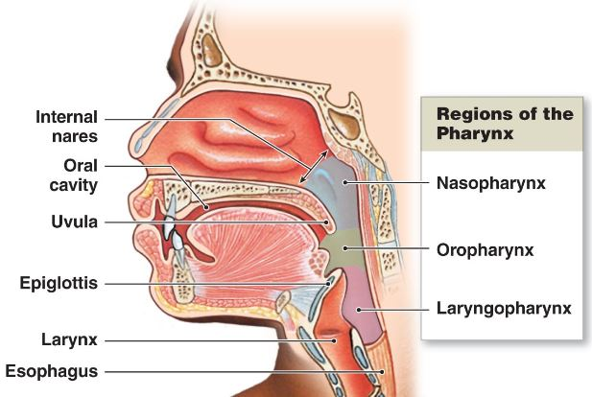
Pharyngeal Anatomy

Slide 55
Throat Symptoms
Sore Throat
Dysphagia
Odynophagia
Hoarseness
Trismus
Neck Mass
Globus Sensation
Drooling
Noisy Breathing

Slide 56
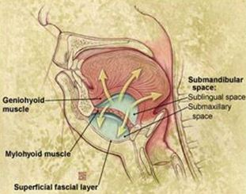
Submandibular Space Infection
Ludwig’s Angina
Aggressive rapidly spreading cellulitis without lymphadenopathy with potential for airway obstruction
Etiology
  Dental
    90% of infections
    2nd & 3rd Molar most commonly involved
  Peritonsillar Abscess
  Suppurative Parotitis

Slide 57
Submandibular Space Infection
Ludwig’s Angina
Symptoms
Exam Findings
Fever
Mouth Pain
Neck Swelling
Stiff Neck
Drooling
Dysphagia
Shortness of Breath
Tender, Symmetric, “Woody” induration of submandibular area.
Floor of Mouth tender with edema & erythema

Slide 58
Submandibular Space Infection
Ludwig’s Angina
Diagnosis
  Clinical Exam
  CT Scan Neck
Treatment Principles
  Surgical Airway Management
  Surgical Drainage
  IV Antibiotics
  Odontogenic Origin Treatment

Slide 59
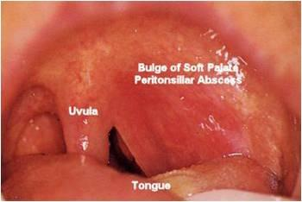
Peritonsillar Abscess
Most common deep space neck infection in children and young adults
Etiology
  Contiguous spread from tonsil parenchyma
  Secondary infection of minor salivary gland

Slide 60
Peritonsillar Abscess
Symptoms
Exam Findings
Prolonged Sore Throat
Hot Potato/Muffled Voice
Fever
Trismus
Dysphagia, Odynophagia
Tender Lymphadenopathy
Unilateral Otalgia
Superior Tonsillar Pole Bulging
Uvula deviation AWAY from abscess formation

Slide 61
Peritonsillar Abscess
Diagnosis
Exam Findings
Clinical Exam
Aspiration
Incision/Drainage
Antibiotics
Hospital Admission for Severe Presentation
Consider Otolaryngology Consult for delayed elective tonsillectomy

Slide 62
Retropharyngeal Space Infection
Most serious deep neck space infection
Infection may reach retropharyngeal space from local or distant sites
  Local Sites
    Pharyngitis
    Penetrating Trauma
    Instrumentation
    Foreign Body Indigestion
  Distant Sites
    Odontogenic Infection
    Peritonsillar Abscess

Slide 63
Retropharyngeal Space Infection
Symptoms
Exam Findings
Fever
Sore Throat
Dysphagia
Odynophagia
Neck Stiffness
Shortness of Breath
Symptoms associated with Ludwig’s Angina or PTA if infection from a distant site.
Posterior Pharyngeal Wall Edema
Cervical Adenopathy
Exam findings associated with Ludwig’s Angina or PTA if abscess from a distant site.

Slide 64
Retropharyngeal Space Infection
Diagnosis
Treatment Principles
Clinical Exam
CT Scan Neck
Hospital Admission
Antibiotics
Surgical Drainage only if localized into a discrete abscess

Slide 65
Questions

