Slide 1
WHAT TO DO
BESIDES STAND THERE AND LOOK

Slide 2
THIS LECTURE
WON’T GET THE JOB DONE
BUT WE HAVE TO START SOMEWHERE
WE CAN GIVE YOU SOME IDEAS OF WHERE TO START
ALMOST NO ONE IN PRIMARY CARE LEARNS DERMATOLOGY

Slide 3
DERM WILL FIND YOU OUT
ALMOST 40% OF PRIMARY CARE PATIENTS HAVE A SKIN COMPLAINT
WHERE TO START?
YOUR COLLEAGUES WILL BE NO HELP
OBFUSCATE OR GET BETTER
WHAT TO DO?

Slide 4
GET SOME DERM BOOKS
FITZPATRICK PAPERBACK
HABIF PAPERBACK OR HARDBACK
PEDS DERM: WEINBERG

Slide 5
HOW NOT TO USE THE BOOKS
DON’T PLAY “MATCH THE RASH TO THE PICTURE”
THIS IGNORES CRUCIAL INFORMATION LIKE CONTEXT, INCIDENCE
READ TABLE OF CONTENTS

Slide 6
READ THE BOOK
IN ADVANCE OF THE SIGHTING
TO SEE WHAT YOU MIGHT SEE AND WHERE IT MIGHT APPEAR
YOU ARE UNLIKELY TO DIAGNOSE CONDITIONS YOU NEVER HEARD OF

Slide 7
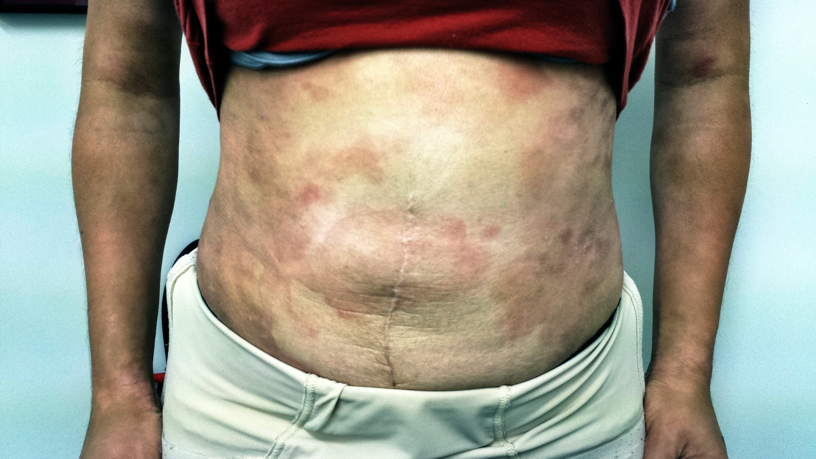

Slide 8
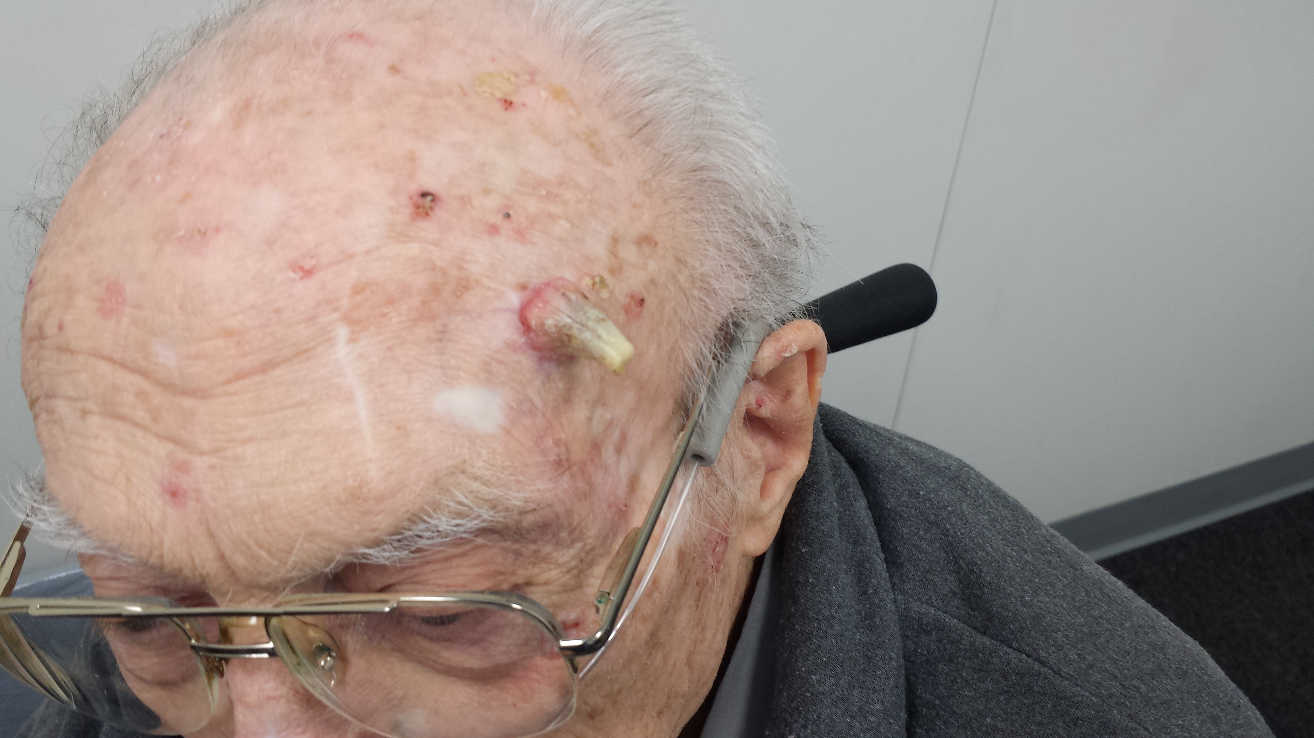

Slide 9
READ JOURNALS
CLINICIAN REVIEWS, CONSULTANT, CUTIS
REPEATED EXPOSURE TO A WIDE VARIETY OF PATHOLOGY = KEY
RELATE SKIN FINDINGS TO INTERNAL PATHOLOGY

Slide 10
ALTERNATIVES
REFER EVERYONE TO DERM?
THEN DEVELOP RELATIONSHIP WITH A PRACTICE OR PROVIDER
TO EXPEDITE TIMELY REFERRAL BY PROVIDER-TO-PROVIDER CALL
READ THEIR CONSULT REPORTS

Slide 11
BIG PEARLS: NMSC
BASAL CELL / SQUAMOUS CELL
MILLIONS EACH YEAR
OLDER PTS = HIGHER RISK
BUMPS GROW OR WON’T HEAL
SUN-EXPOSED AREAS

Slide 12
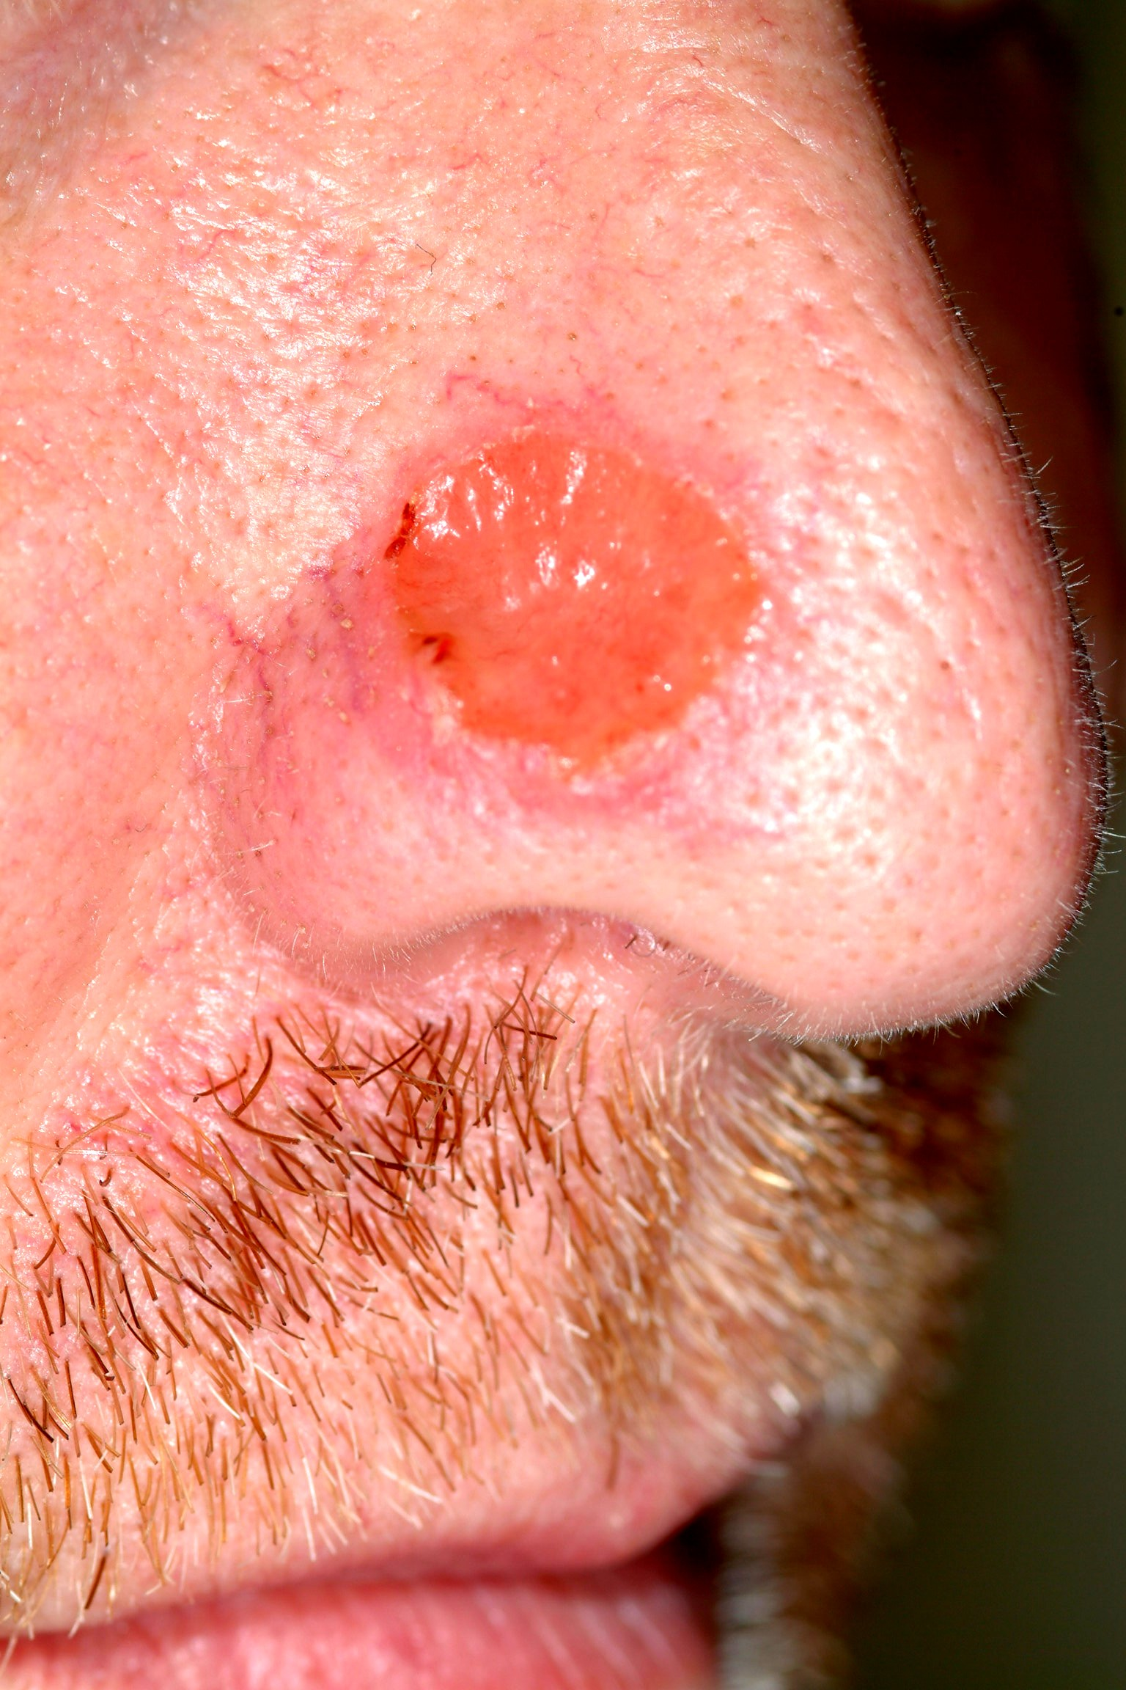

Slide 13
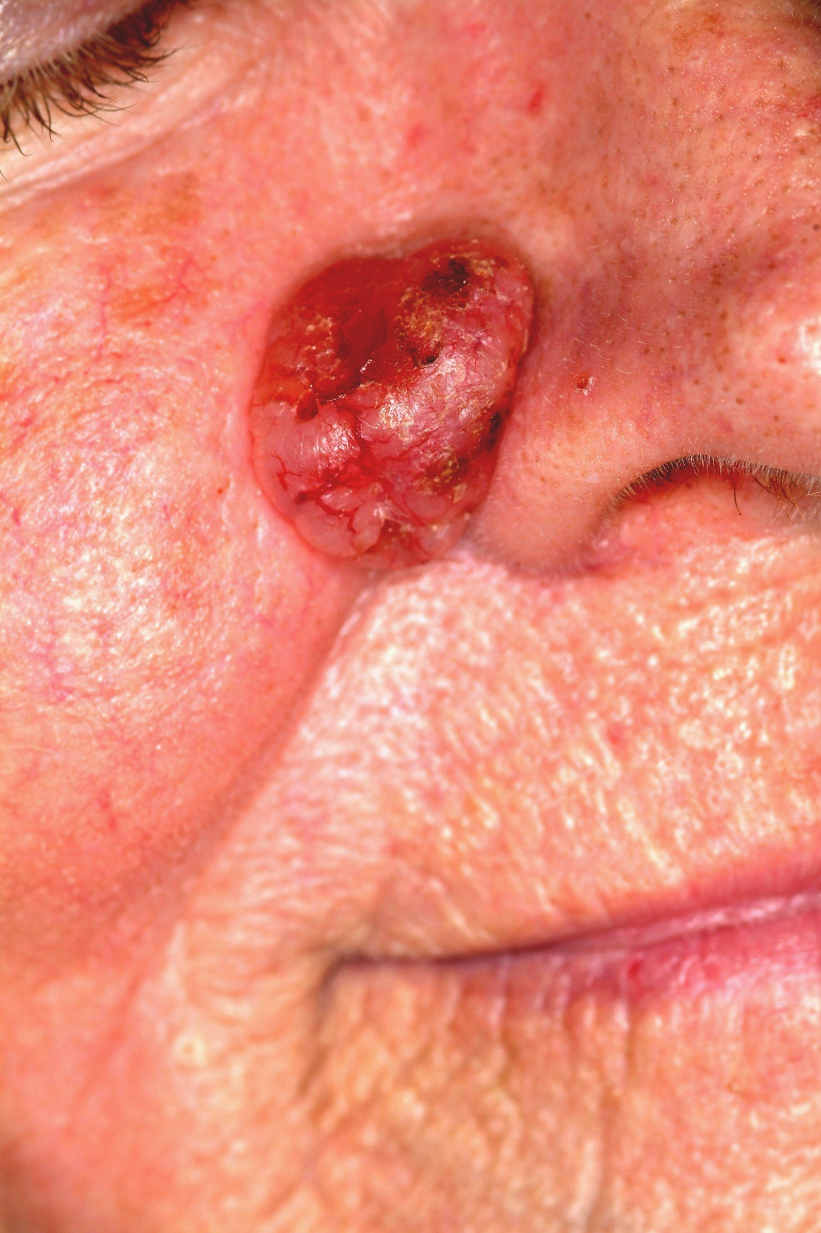

Slide 14
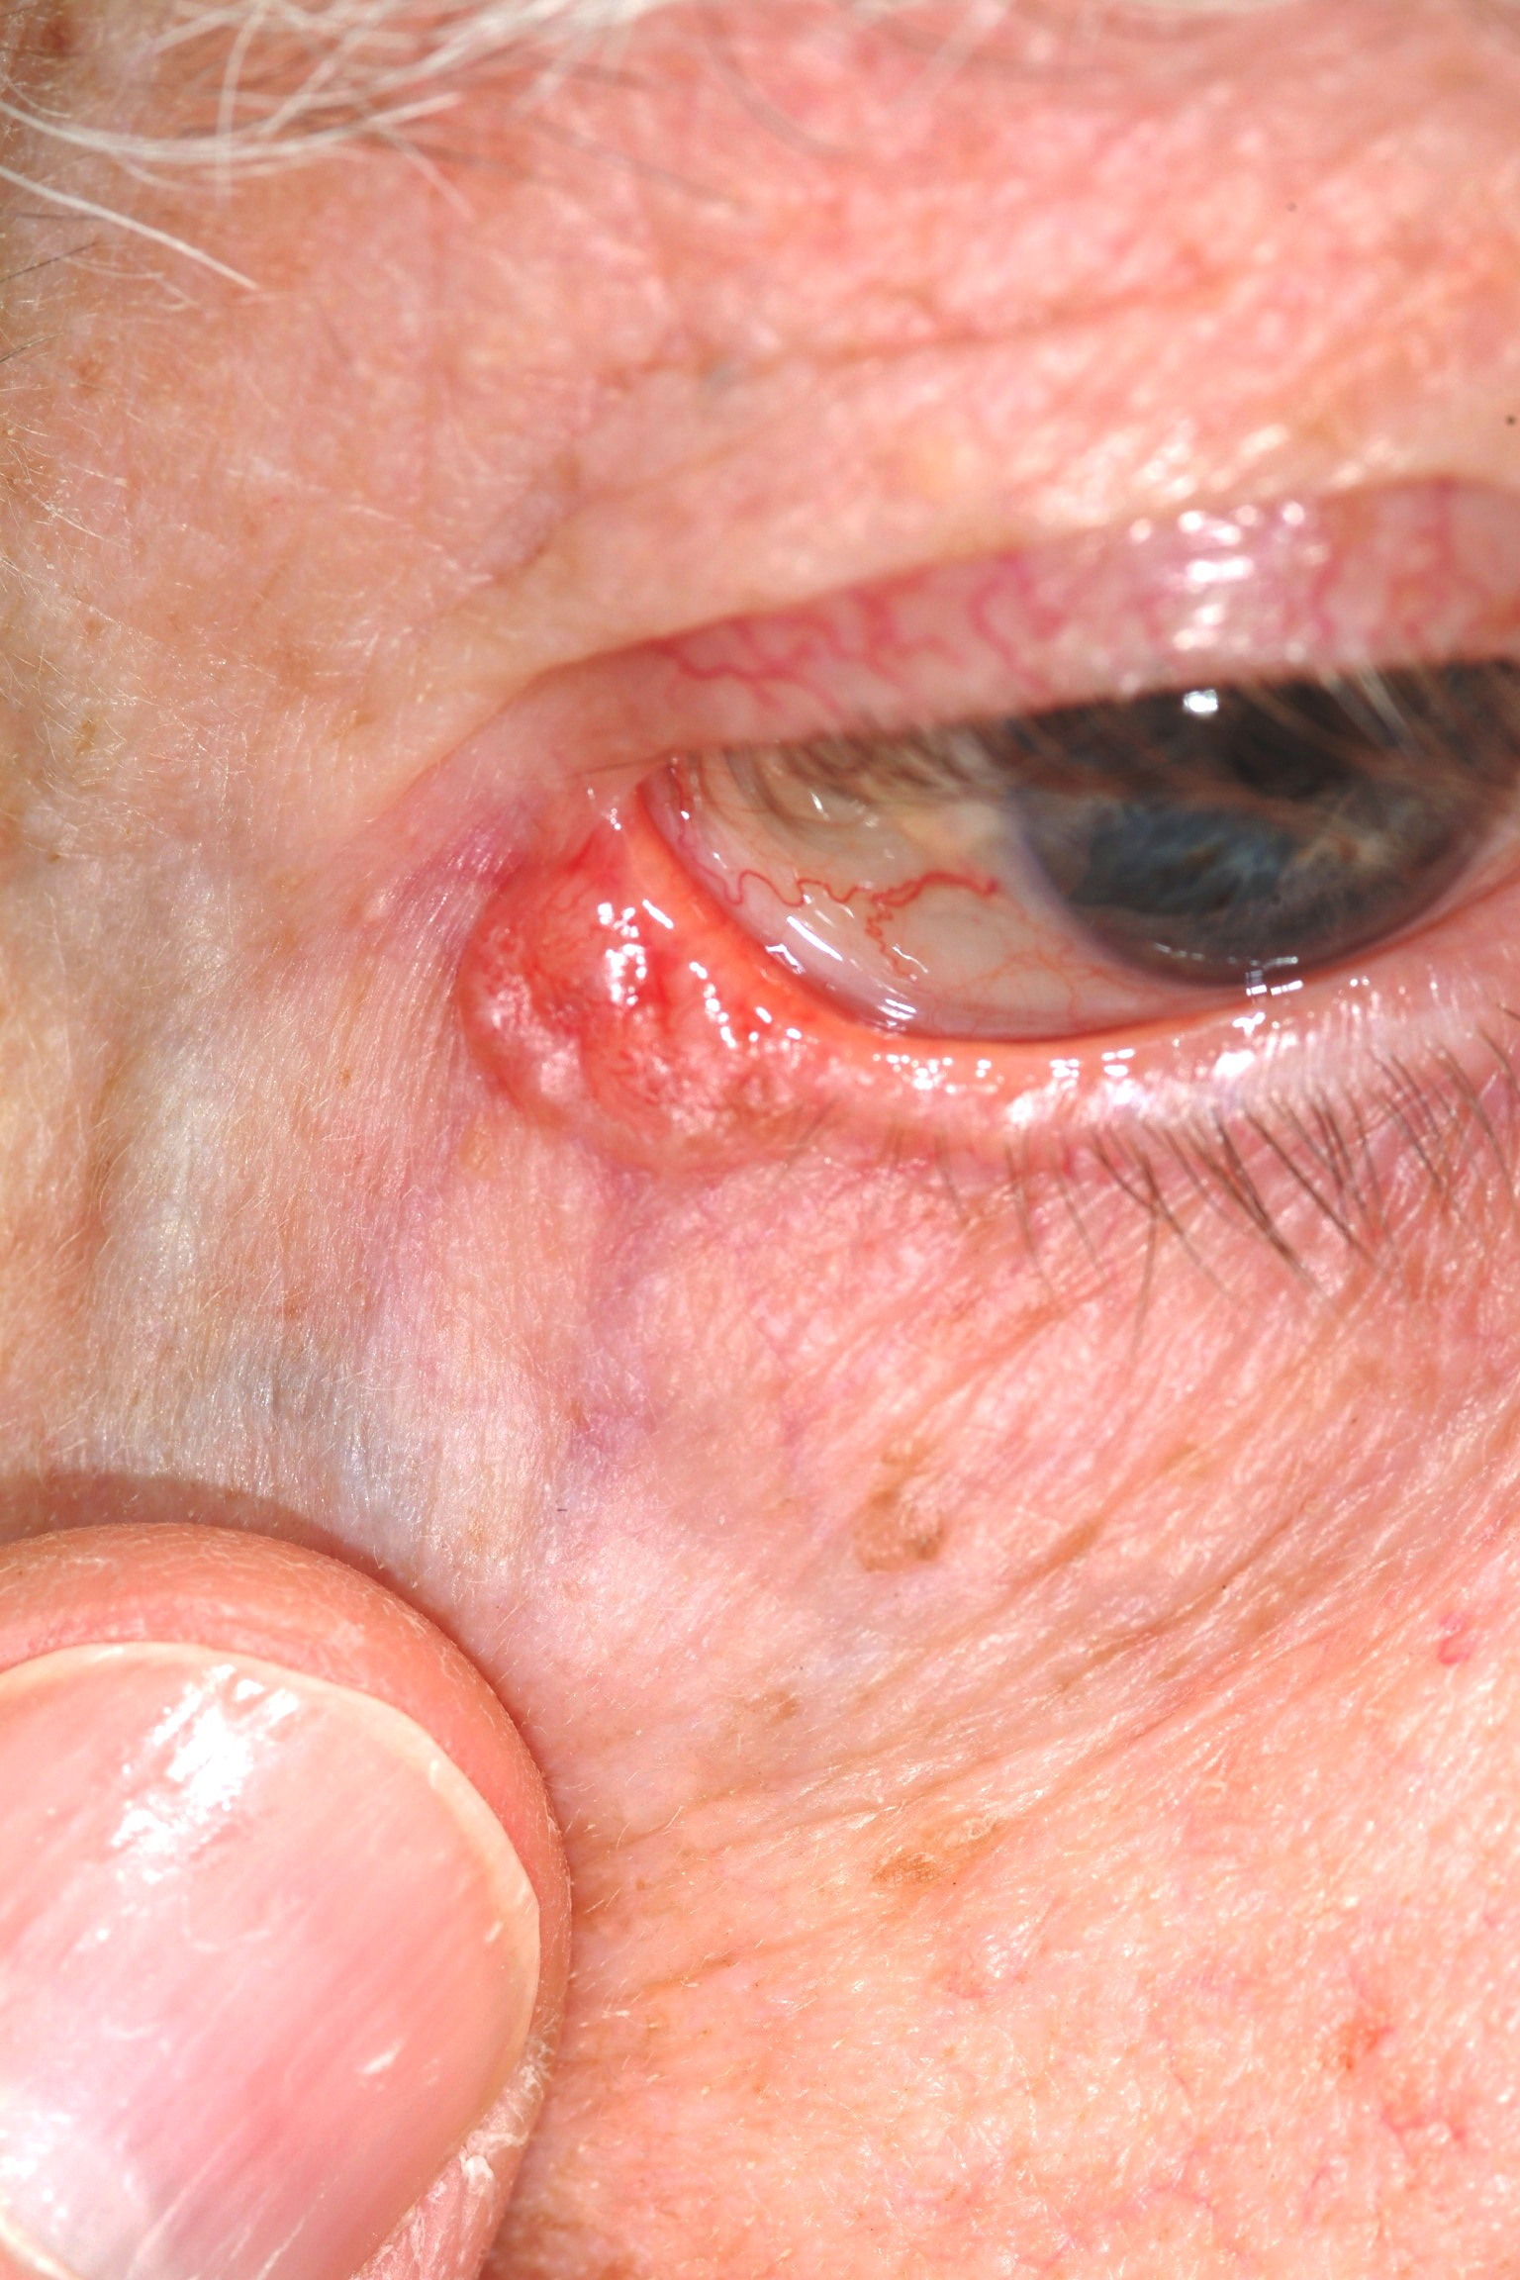

Slide 15
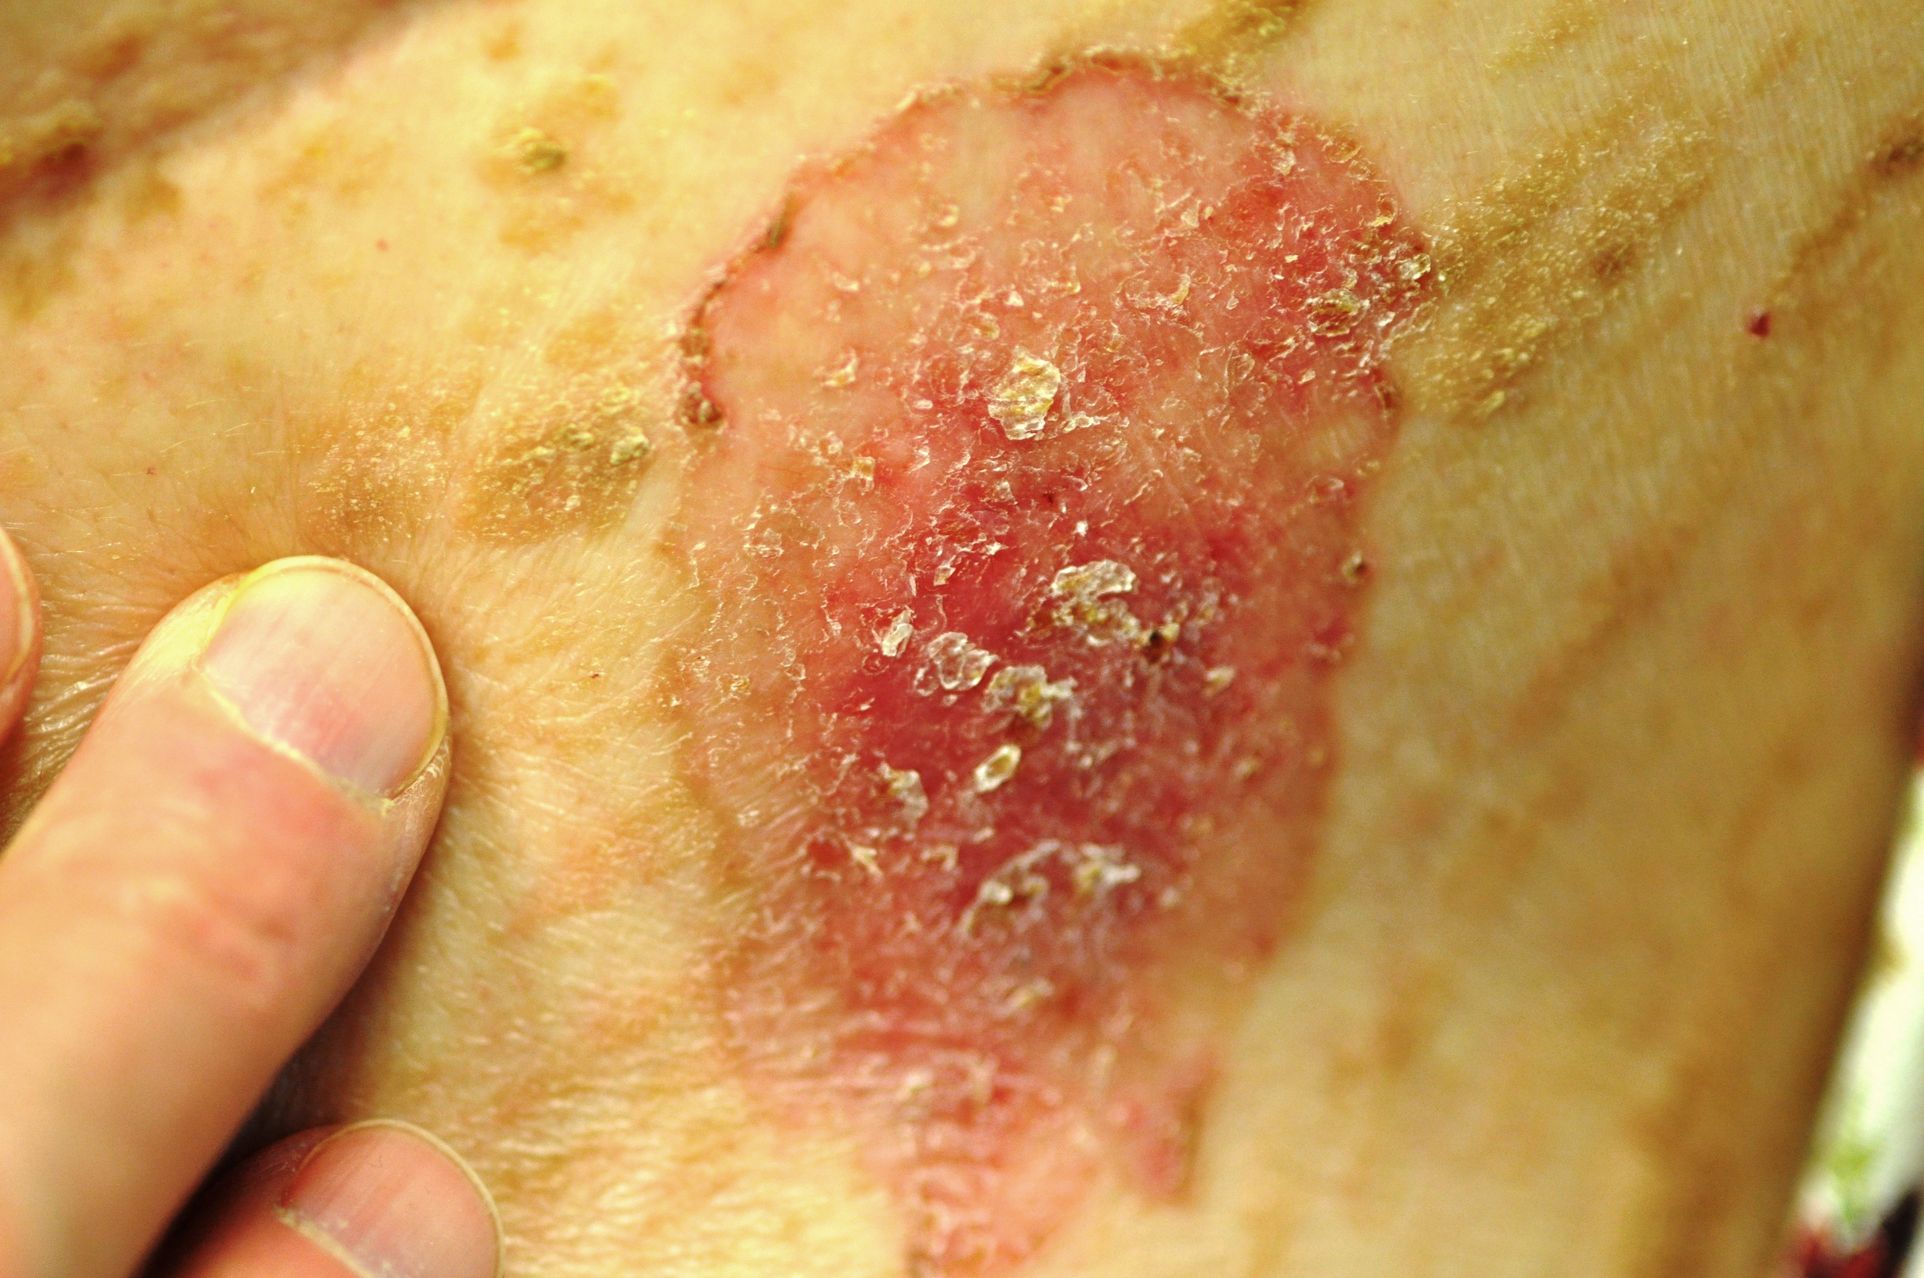

Slide 16
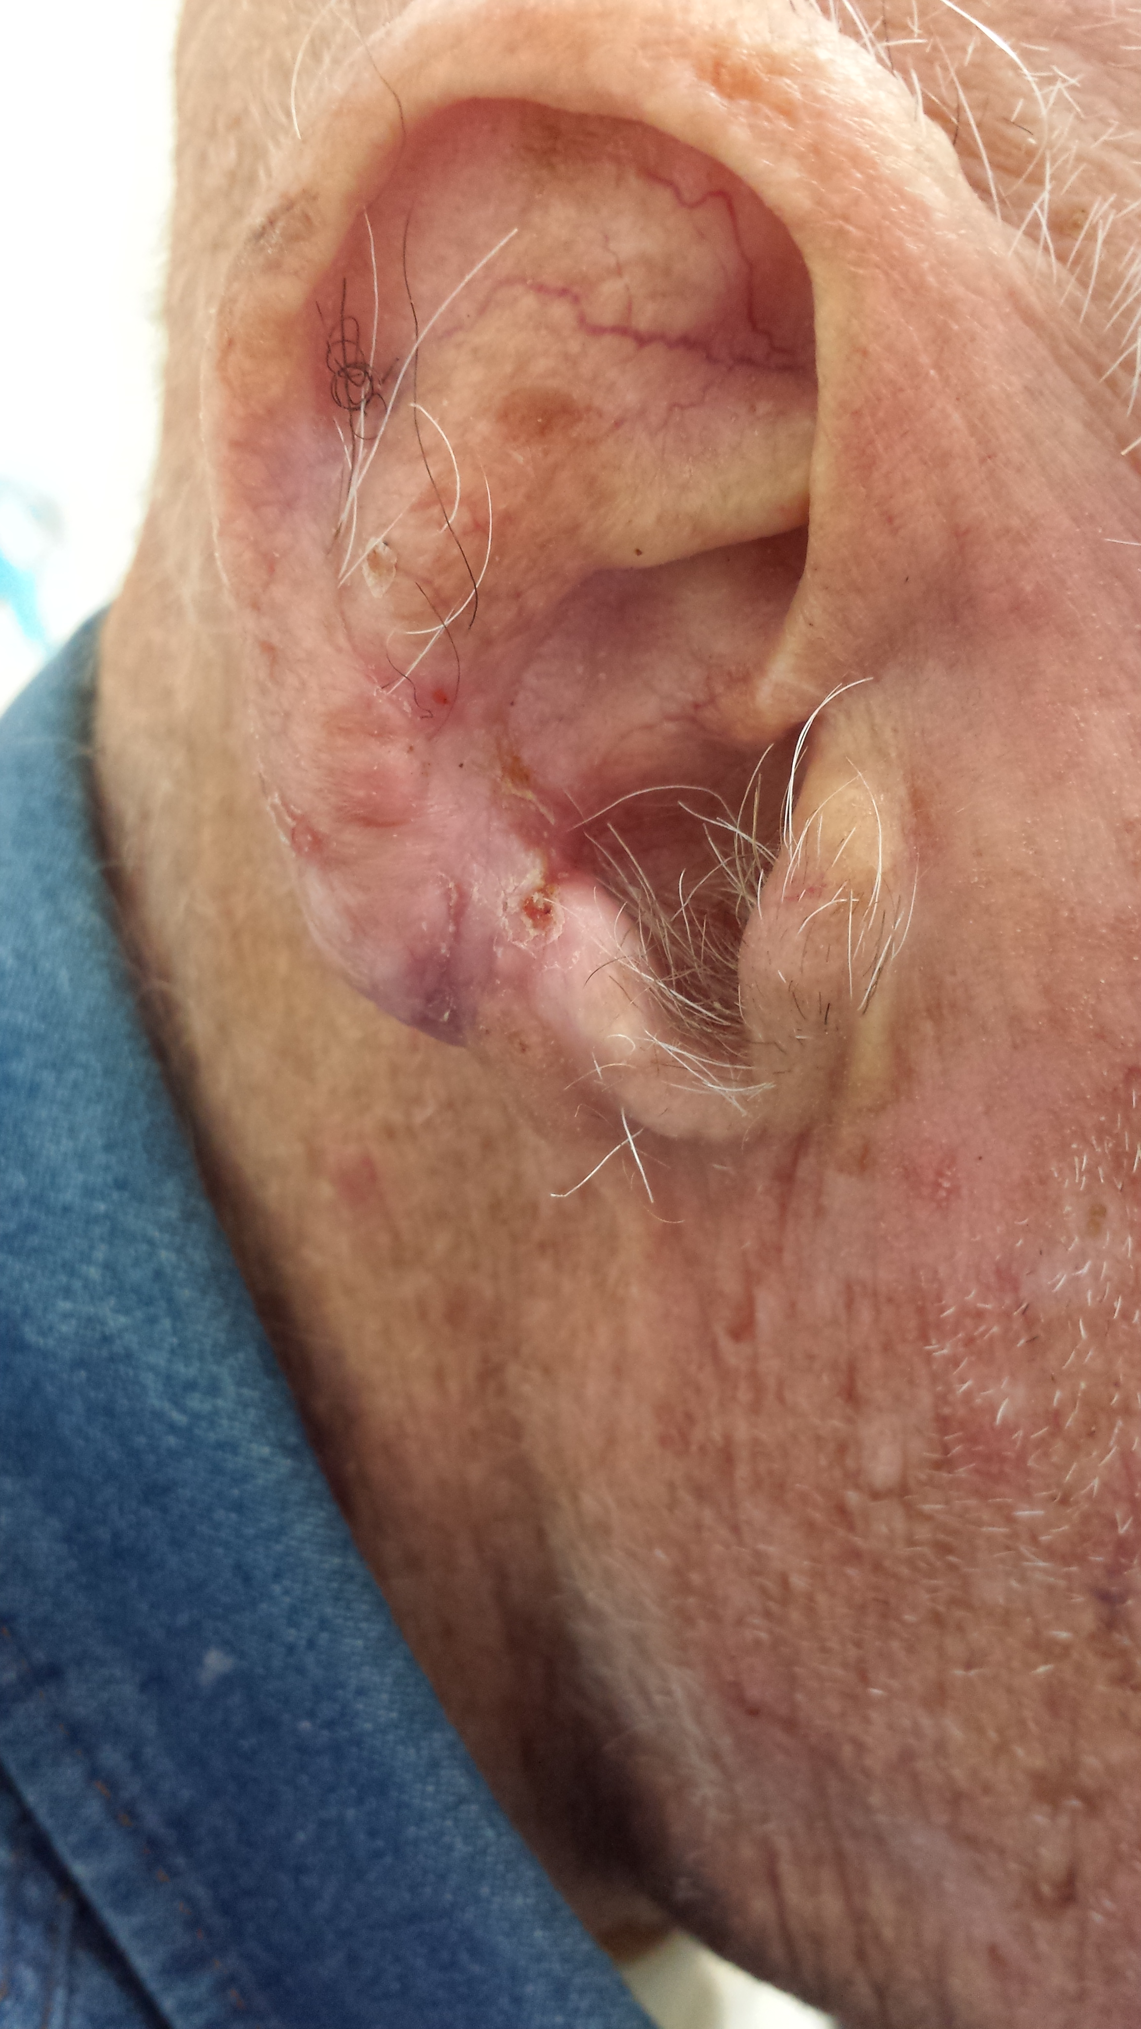

Slide 17
MELANOMA
NOT AS RELATED TO AGE
LEADING CAUSE OF DEATH IN YOUNG WOMEN (LEGS, HIPS)
85% SURVIVE, 15% DON’T
PREFERS THE SAME FAIR, BLUE-EYED, SUN-FRIED FOLKS AS NMSC

Slide 18
MELANOMA FACTS
REDHEADS, BLONDES ESP.
SUN-INTOLERANT
HX OVEREXPOSURE TO UV
INCREASINGLY COMMON

Slide 19
MELANOMA II
USUALLY FLAT, BLACK FRECKLE
ODD BORDERS, COLORS
SLOW GROWTH, SOLITARY
DON’T COME FROM “MOLES” MUCH
UNDER 12, ALMOST UNKNOWN
OVER 15, ALL BETS ARE OFF

Slide 20
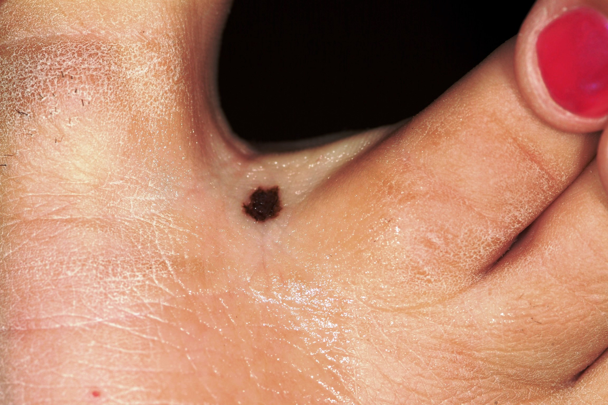

Slide 21
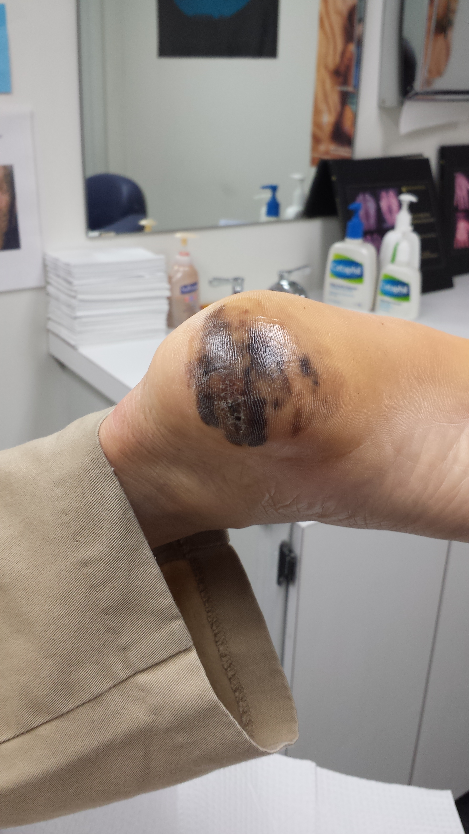

Slide 22
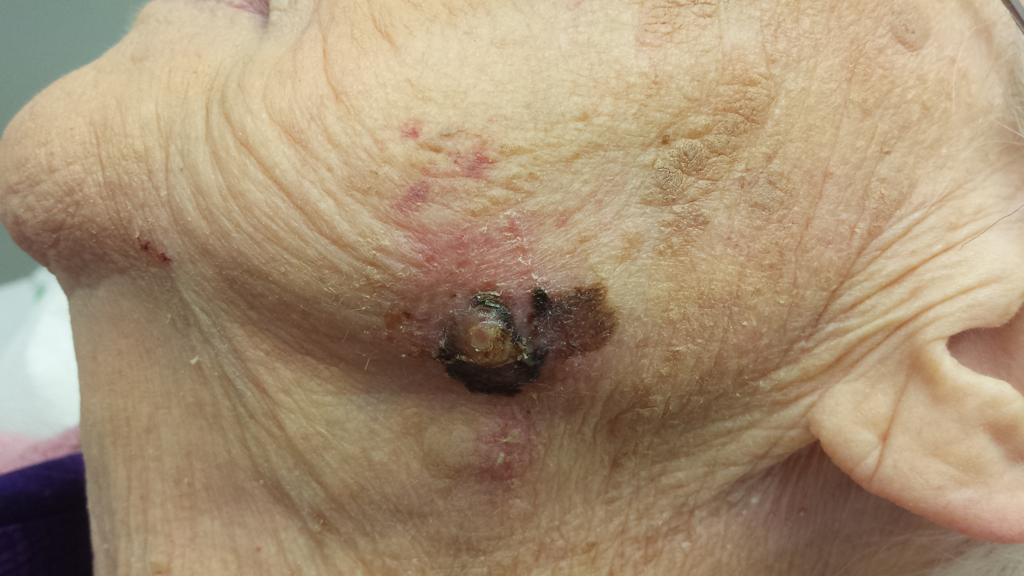

Slide 23
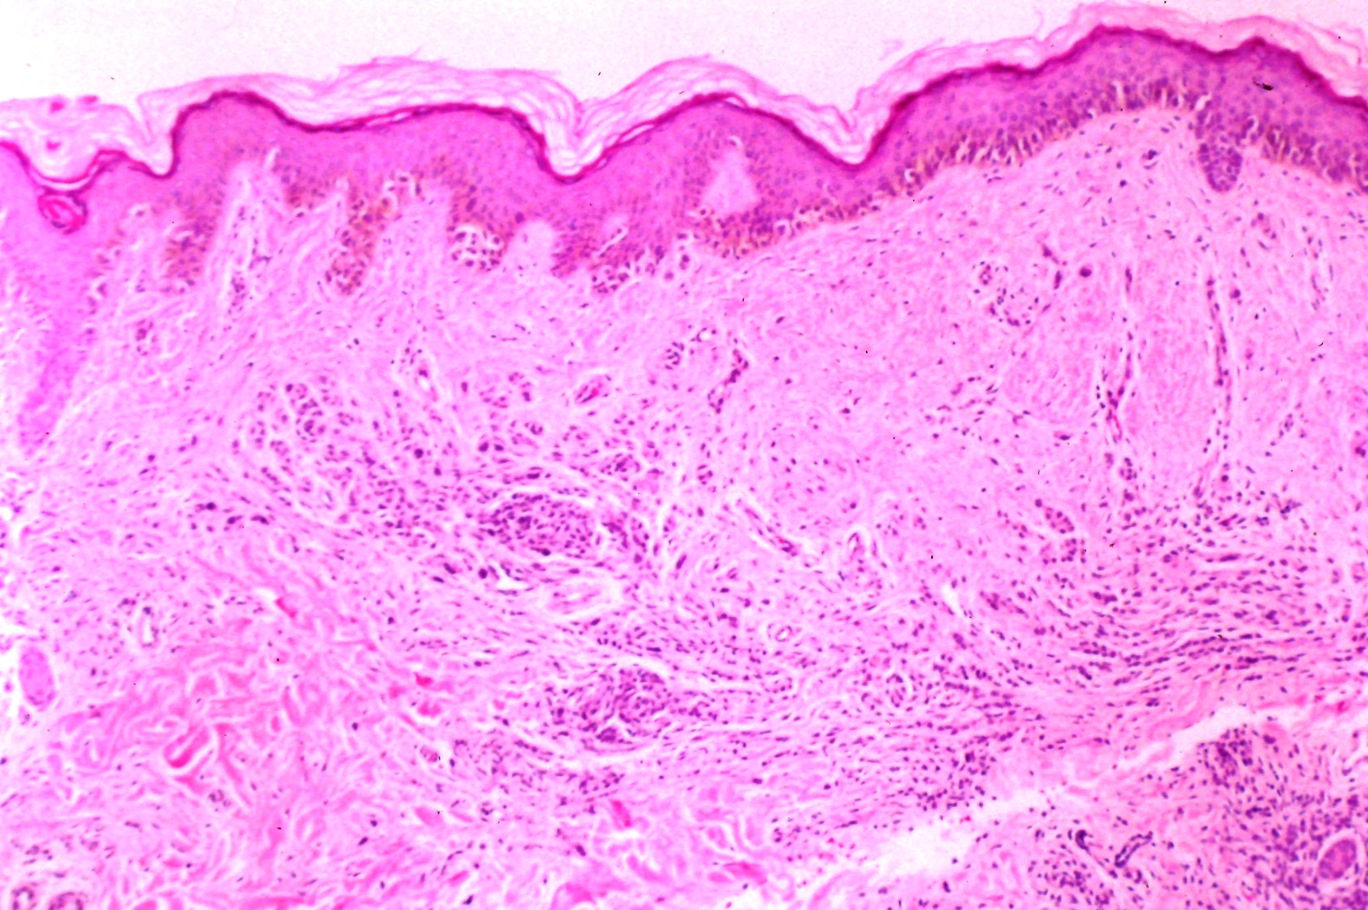

Slide 24
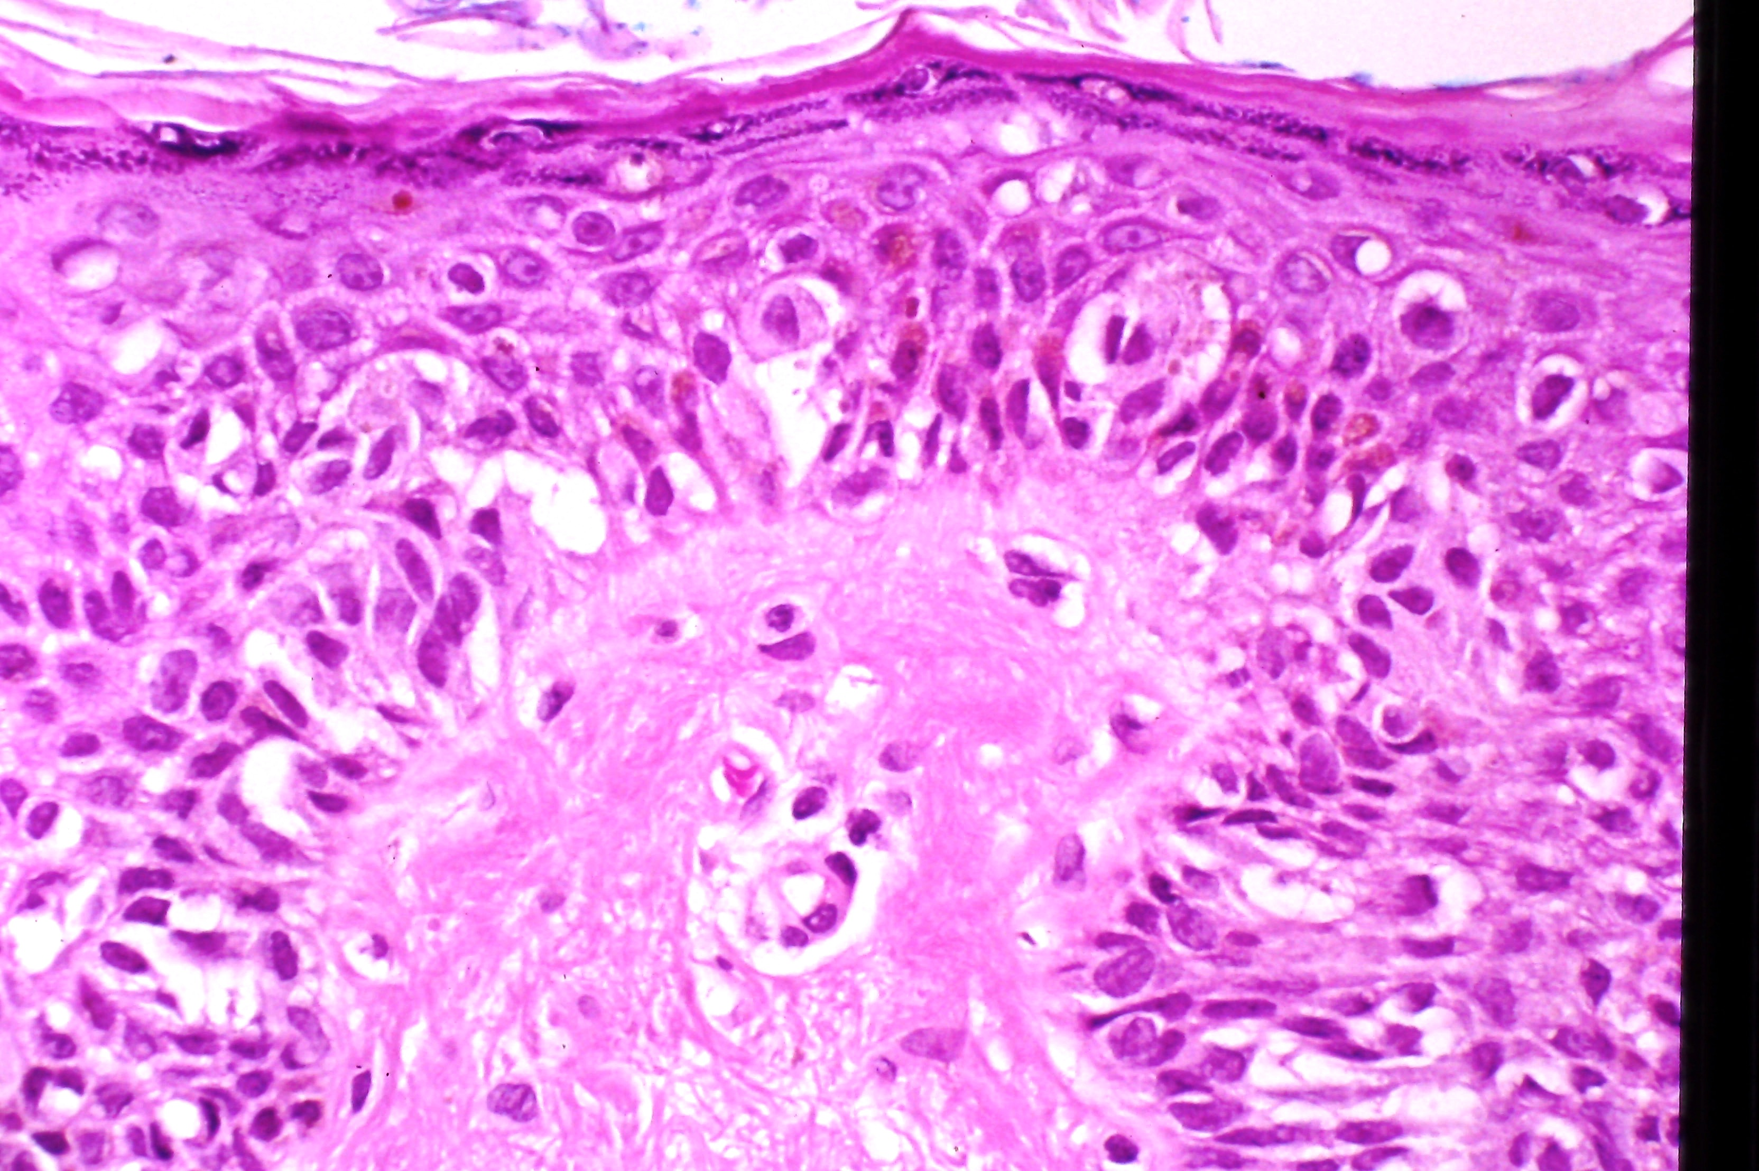

Slide 25
MELANOMA III
PREVENTION: ESPECIALLY FOR THE FAIR: SUNSCREEN, SHADE, HATS
BE A WHITE PERSON!
KEEP YOUR EYES OPEN, ESPECIALLY ON THOSE FAIR SKINNED PATIENTS
TRAGEDY VS TRIUMPH

Slide 26
ATOPIC DERMATITIS
AFFECTS 15 – 20 % OF NEWBORNS
ECZEMA, SEASONAL ALLERGIES, ASTHMA, URTICARIA,DRY SKIN
HEREDITARY BASIS
MOSTLY IN DEVELOPED COUNTRIES
NOT FOOD-RELATED

Slide 27
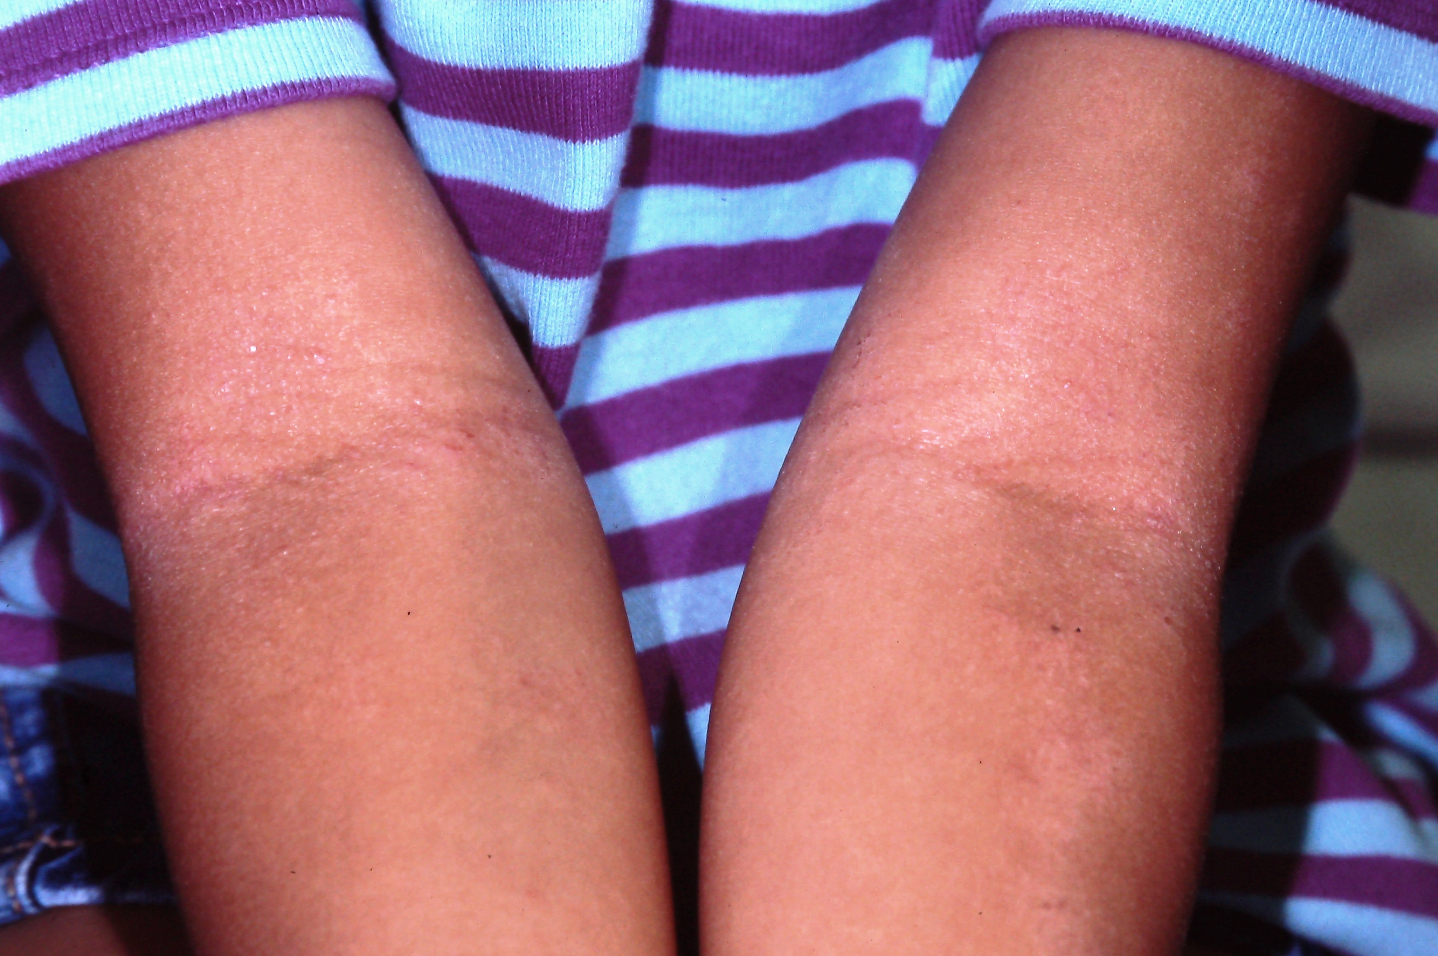

Slide 28
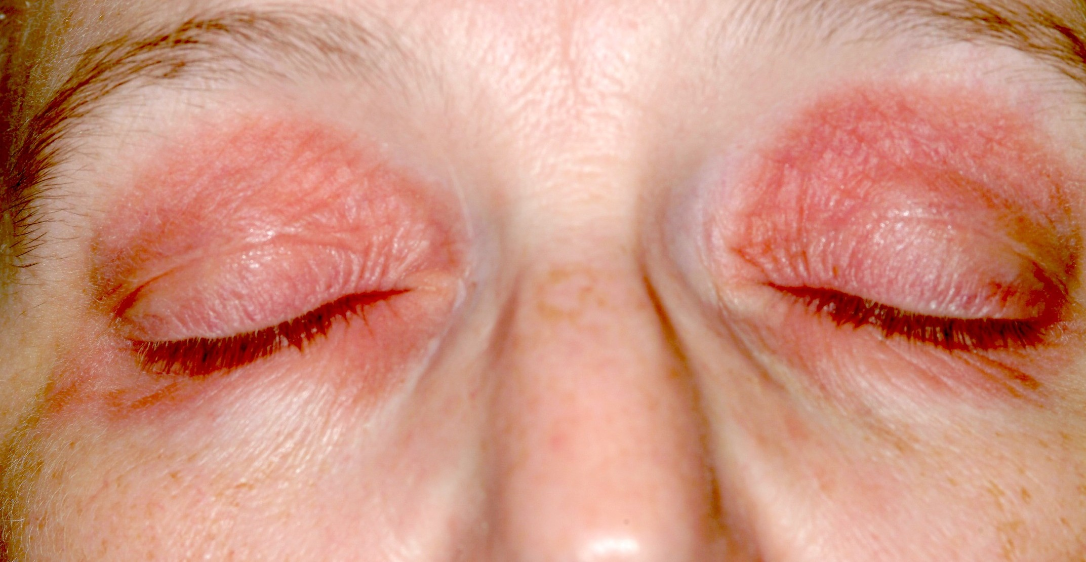

Slide 29
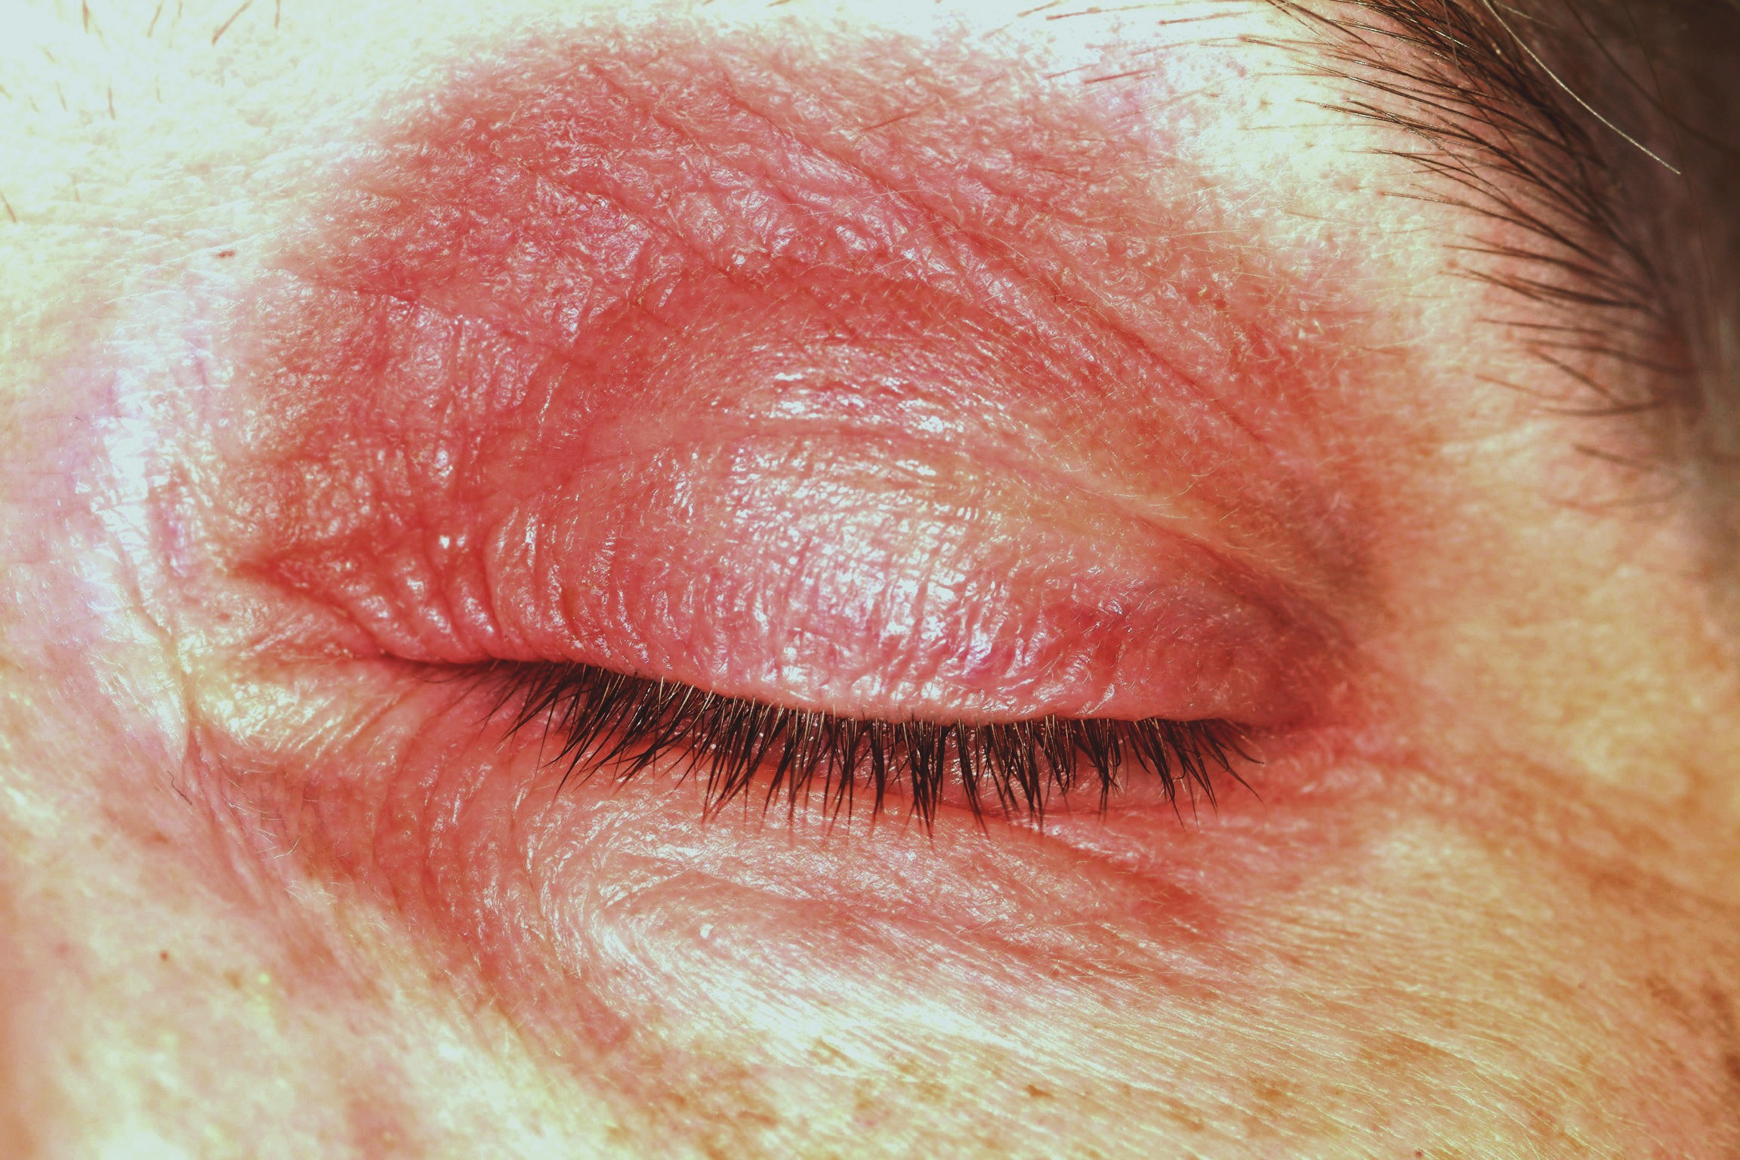

Slide 30
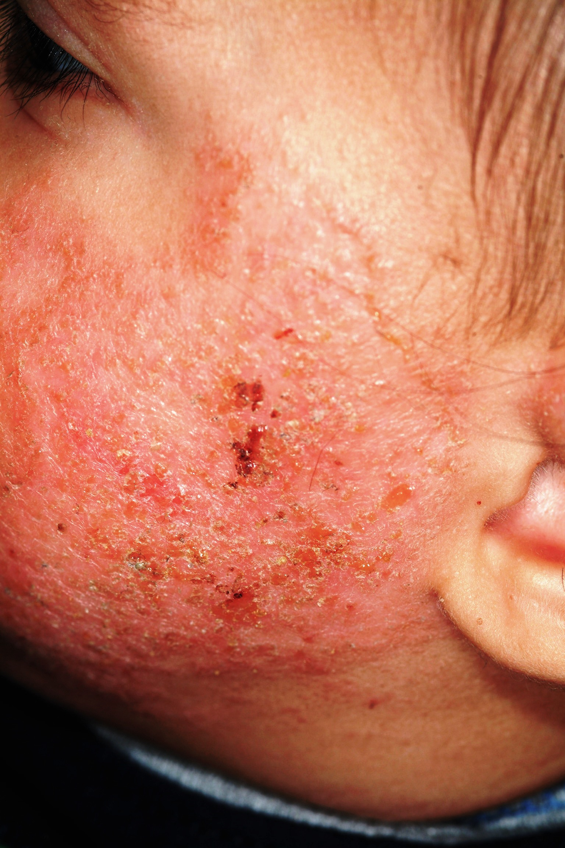

Slide 31
DERMATOLOGY
THE DEEPEST, WIDEST MEDICAL SPECIALTY
= A FILL IN THE BLANK TEST
EITHER STUDY, STUDY, STUDY, OR REFER, REFER, REFER. DON’T OBFUSCATE.
GET BETTER AT DERM, BECOME A REAL RESOURCE IN YOUR PRACTICE
NOT BEYOND ANY MOTIVATED PROVIDER

Slide 32
REFERENCES
ANDREWS DERMATOLOGY, 10TH EDITION
RAPINI, BOLOGNIA ET AL, SKIN DISEASE TEXT, 6TH EDITION
FITPATRICK, ET AL, ATLAS OF SKIN DISEASE, 8TH EDITION

Slide 33
BY JOE MONROE, MPAS, PA
JMONROE9@COX.NET

