Slide 1
Advanced 12 Lead Interpretation
Laura Velez, APRN-CNS

Slide 2
Course Objectives
By the end of the workshop the participant will identify ECG criteria for:
Acute coronary syndrome
For heart block and chamber enlargement.
Pulmonary embolism, pericarditis and pre-excitation syndromes.

Slide 3
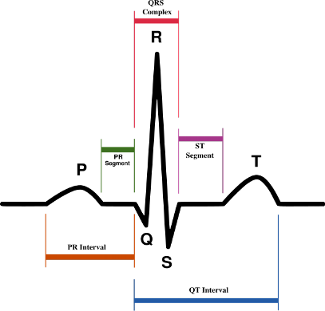
Normal Sinus Rhythm
P wave: atrial activation
PR interval: time between activation of atria and ventricles
QRS: ventricular activation
J point: junction of QRS complex and ST segment
QT interval: onset of QRS to the end of the T wave
ST segment: interval between end of QRS and start of T wave
T wave: ventricular recovery
U wave: source uncertain

Slide 4
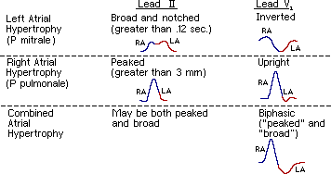
Normal Sinus Rhythm
P wave
Height <2.5 mm
Width < 0.11
Abnormalities: right atrial hypertrophy and left atrial hypertrophy.

Slide 5
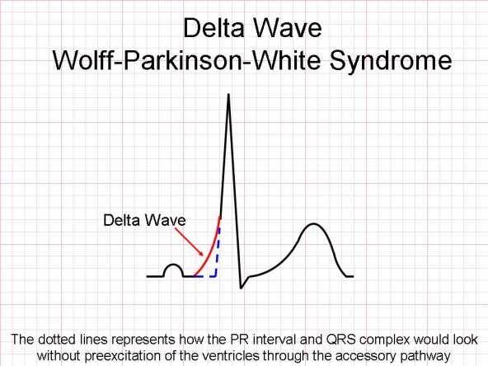
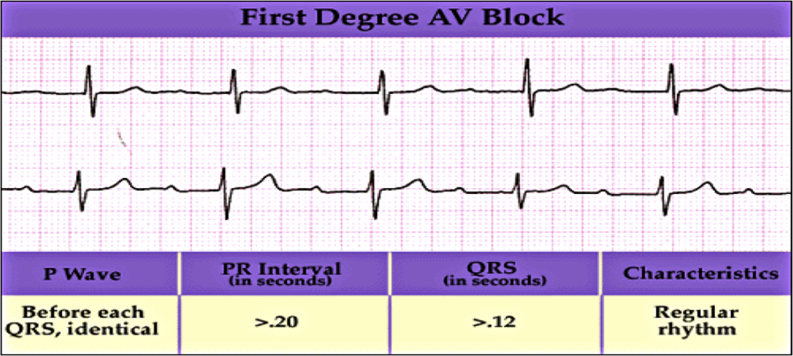
Normal Sinus Rhythm
PR interval
0.12 to 0.20 s duration (3-5 squares)
Short PR interval: Wolff-Parkinson-White syndrome, Duchenne muscular dystrophy, type II glycogen storage, Hypertrophic obstructive cardiomyopathy.
Long PR interval: first degree AVB.

Slide 6
Normal Sinus Rhythm
QRS complex
< 0.12 s duration (3 small squares)
Normal QRS: no pathological Q wave, LVH or RVH
Wide QRS: RBBB, LBBB, paced rhythm, ventricular rhythm, hyperkalemia.

Slide 7
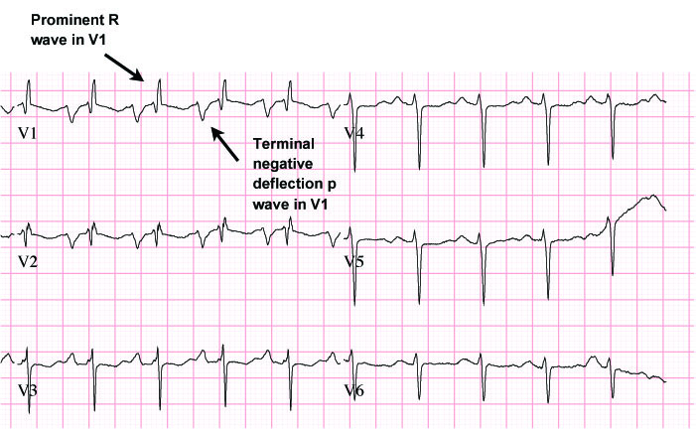
ECG criteria for right ventricular hypertrophy (RVH)

Slide 8
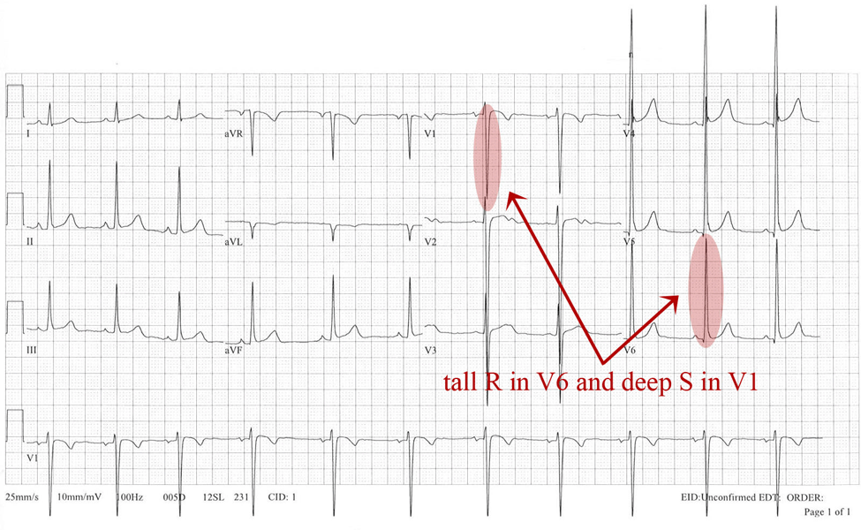
ECG criteria for left ventricular hypertrophy (LVH)

Slide 9
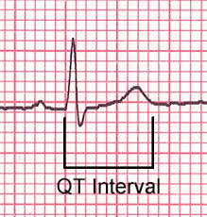
Normal Sinus Rhythm
QT interval
Corrected QTc most accurate: divide QT interval by the square root of the proceeding R-R interval. Normal 0.42 s.
Long QT: MI, myocarditis, hypocalcaemia, hypothyroidism, SAH, antiarrhythmics, heredity.

Slide 10
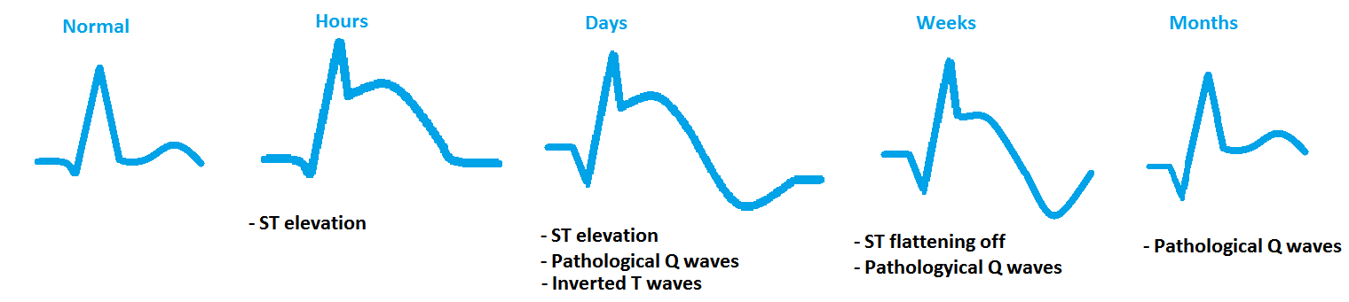
Normal Sinus Rhythm
ST segment
Normal at baseline
Elevation: STEMI, LBBB, athletic heart, acute pericarditis.
Depression: myocardial ischemia, Digoxin, ventricular hypertrophy, pulmonary embolism, LBBB.

Slide 11
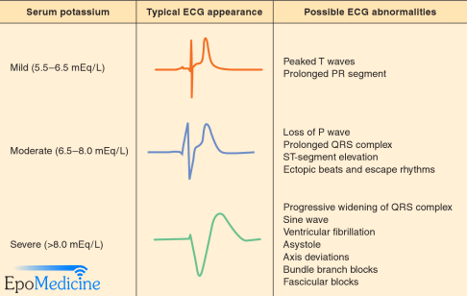
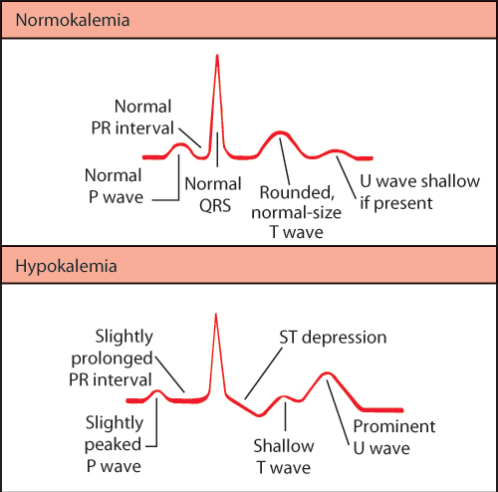
Normal Sinus Rhythm: T Wave
Tall: hyperkalemia, hyperacute MI, LBBB.
Inverted: ischemia, age, race, hyperventilation, LVH, digoxin, pericarditis, pulmonary embolism, IVCD, RBBB, electrolyte disturbance.

Slide 12
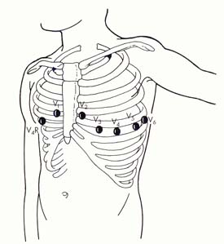
Notes:
Precordial leads picture

Slide 13
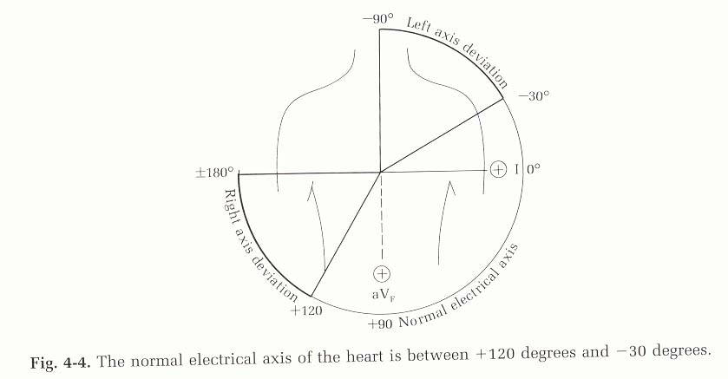
Axis Deviation
Notes:
Normal electrical axis
Fig 4-4 pg 40

Slide 14
Axis Orientation
Normal: 0° to +90° (I+ and aVF +)
Left axis deviation: -90° to 0° (I + and aVF - and II - if II is + it is normal axis)
Right axis deviation: +180° to +90° (I - and aVF +)
No man’s land (NW): +180° to -90° (I- and aVF -)

Slide 15
Right Axis Deviation
Normal in children and thin adults
Causes:
  Left posterior hemiblock
  Right ventricular hypertrophy
  Pulmonary embolism
  COPD (even without pulmonary hypertension
  VSD, ASD
  Anterolateral MI
  WPW with left sided accessory pathway

Slide 16
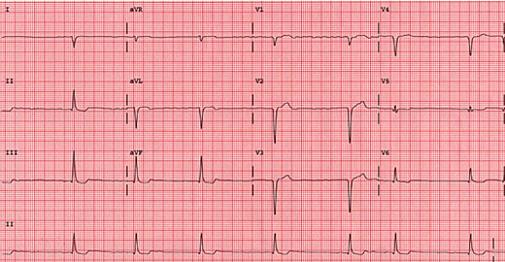
Right Axis Deviation
Right axis deviation: +180° to +90° (I- and aVF+)

Slide 17
Left Axis Deviation
Causes:
  Hyperkalemia
  Left ventricular hypertrophy
  Left anterior hemiblock
  WPW with right sided accessory pathway
  Cardiac pacing
  Injection of contrast into LAD
  COPD
  ASD-ostium primum

Slide 18
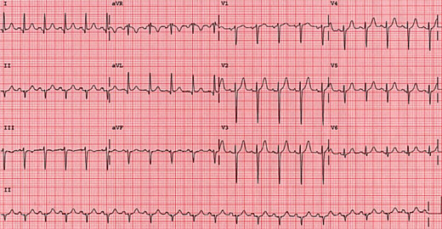
Left Axis Deviation
Left axis deviation: -90° to 0°
(I+ and aVF - and II- if II is +it is normal axis)

Slide 19
Northwest Axis: No Man’s Land or extreme right axis deviation
Causes:
  Hyperkalemia
  Lead transposition
  Cardiac pacing
  Ventricular tachycardia

Slide 20
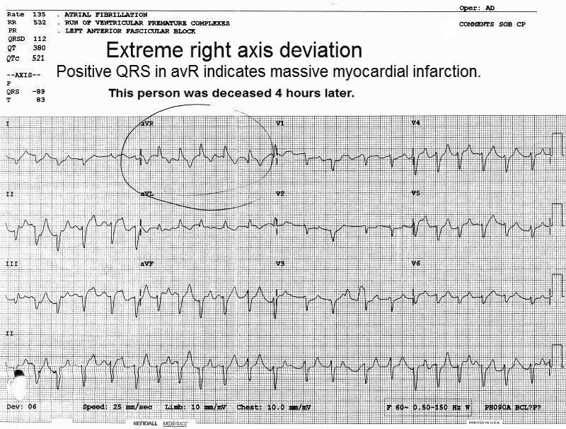
NW axis deviation: No Man’s Land or extreme right axis deviation
No man’s land: (NW): +180° to -90°
(I - and aVF -)

Slide 21
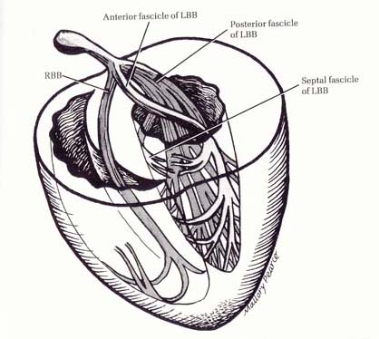
Ventricular Conduction System

Slide 22
Bundle Branch Blocks
Right bundle branch block (RBBB)
Left bundle branch block (LBBB)
Fascicular block
  Anterior
  Posterior
Bifascicular block
Trifascicular block

Slide 23
Reasons for bundle branch block
Coronary artery disease (CAD)
Hypertension
Aortic valve disease
Cardiomyopathy
Degenerative diseases of the conduction system
Damage to conduction system 2° to surgery
Acute myocardial infarction
Rate dependent bundle branch block
Notes:
Review causes of BBB

Slide 24
RBBB: ECG criteria
Complete:
- QRS duration: greater than 0.12 seconds (complete)
- rSR’ complex in V₁
- qRS complex in V₆
Incomplete:
- QRS duration less than 0.12 seconds

Slide 25
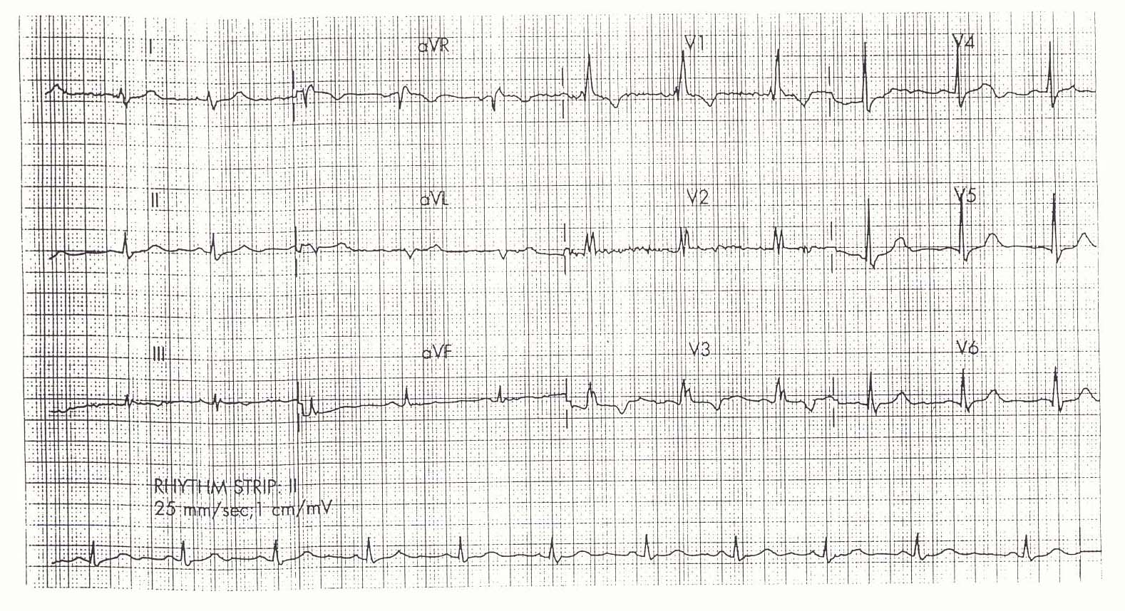
RBBB
Notes:
12-lead of RBBB

Slide 26
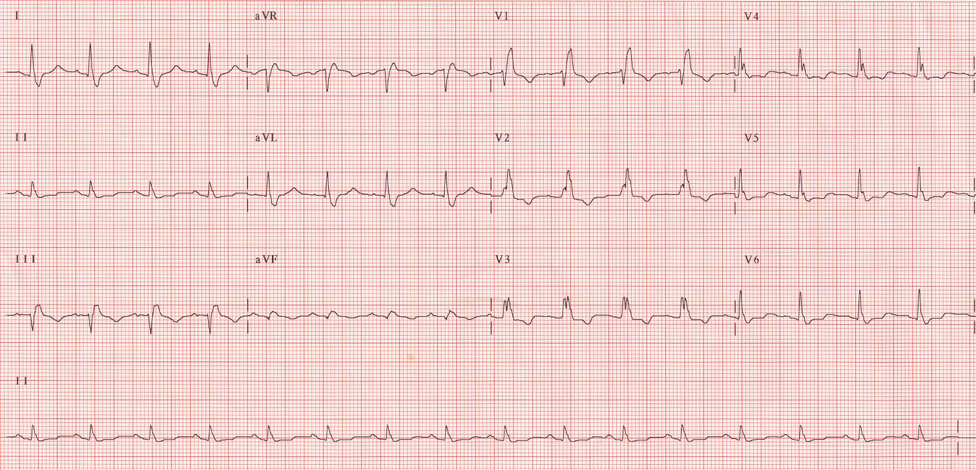
RBBB
Notes:
12-lead of RBBB

Slide 27
LBBB: ECG criteria
QRS greater than 0.12 seconds
V₁ has QS or rS pattern
S wave in V₁ is a swift, clean down stroke
V₆ may have an R wave that is notched
No q wave or S wave in V₆

Slide 28
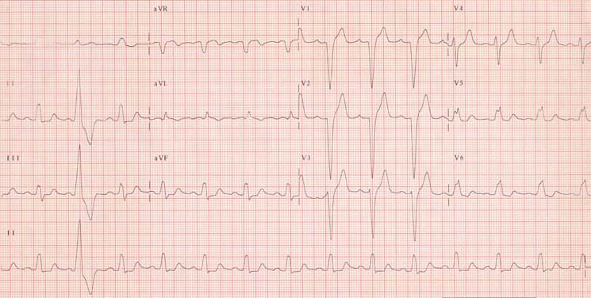
LBBB
Notes:
12-lead of LBBB

Slide 29
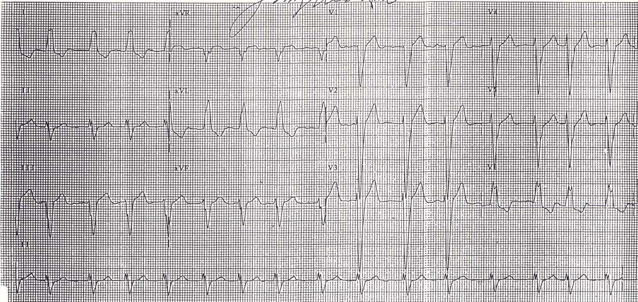
LBBB
Notes:
12-lead of LBBB

Slide 30
Left Anterior Fascicular Block
Anterior fascicle of left bundle is blocked
Conduction must begin in posterior fascicle
Left axis deviation; -40° or greater
QRS width is normal
Morphological appearance:
  Small q waves in I & aVL (both leads are positive)
  Negative terminal deflections in II & III with small initial r waves

Slide 31
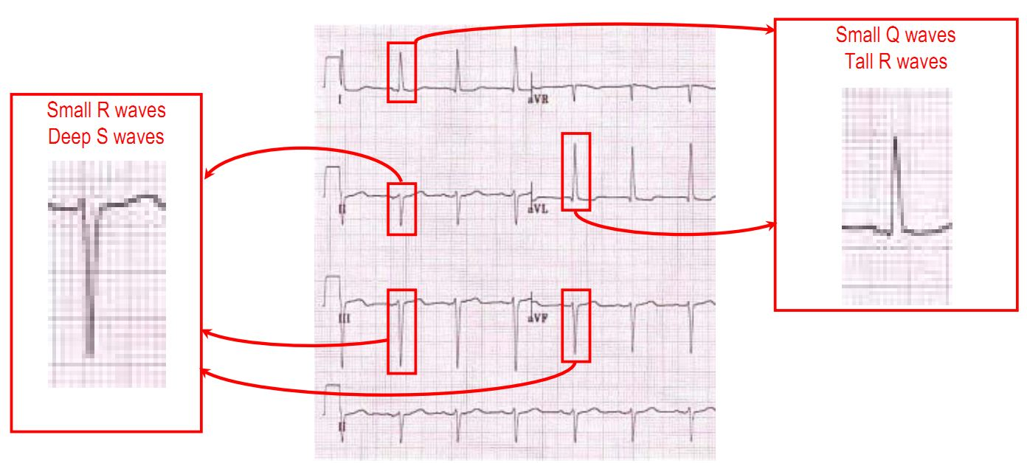
LAFB
Notes:
12-lead of anterior hemiblock

Slide 32
Left Posterior Fascicular Block
Posterior fascicle of left bundle is blocked
Conduction must begin in anterior fascicle
Right axis deviation; about 120°
QRS width is normal
Morphological appearance:
  Leads II, III, and aVF are positive with initial q waves
  Negative terminal deflection in leads I & aVL with initial r waves

Slide 33
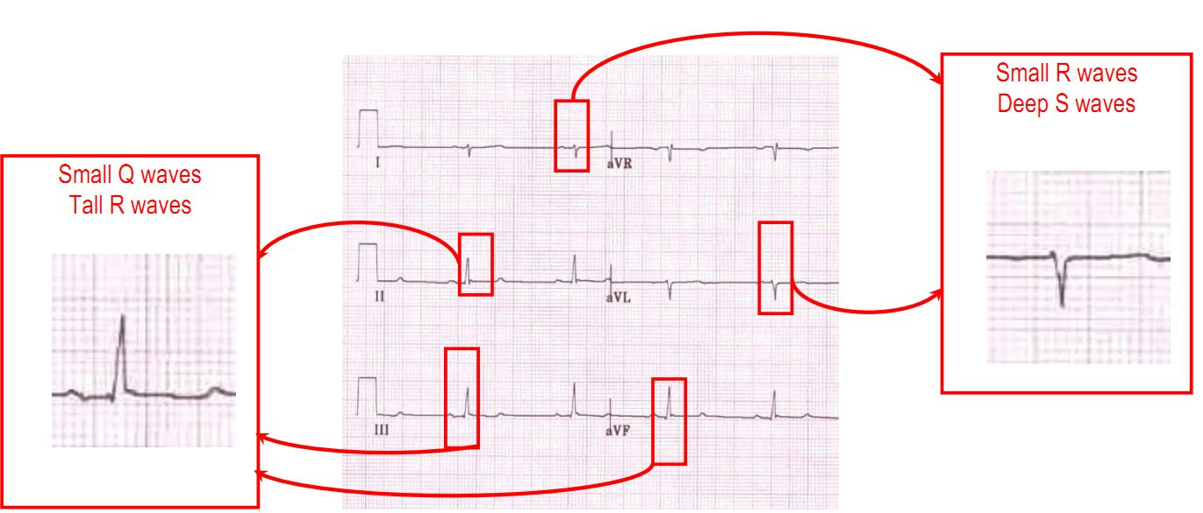
LPFB

Slide 34
Bifascicular Block
RBBB with one fascicle of the left bundle is blocked
Morphological appearance:
  RBBB pattern in V₁ & V₆
  Limb leads reveal fascicular block
  Wide QRS

Slide 35
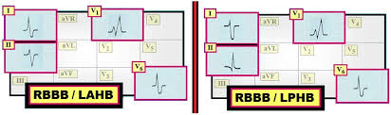
Bifascicular Block
Notes:
12-lead of bifascicular block
Pg 381

Slide 36
Trifascicular Block
RBBB with either LAFB or LPFB and prolonged PR interval
Notes:
12-lead of bifascicular block
Pg 381

Slide 37
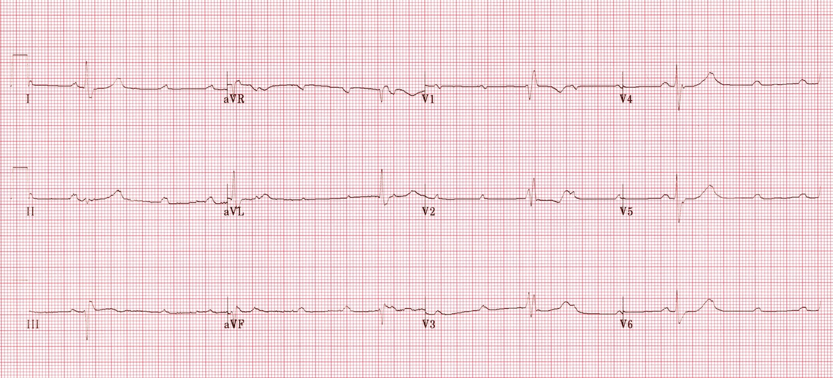
Trifascicular Block
Notes:
12-lead of bifascicular block
Pg 381

Slide 38
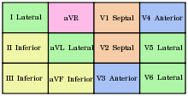
Contiguous ECG leads corresponding with heart muscle involved in acute coronary syndrome
Inferior wall ……………………….. II, III and aVF
Septal wall …………………………. V1 and V2
Anterior wall ………………………. V3 and V4
Lateral wall ………………………… V5 and V6
High lateral wall …………………. I and aVL

Slide 39
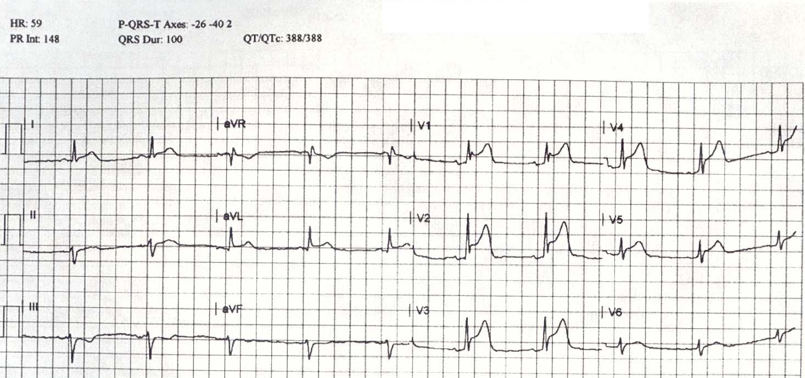
Notes:
Anteroseptal wall MI
Left anterior fascicular block (superior axis)

Slide 40
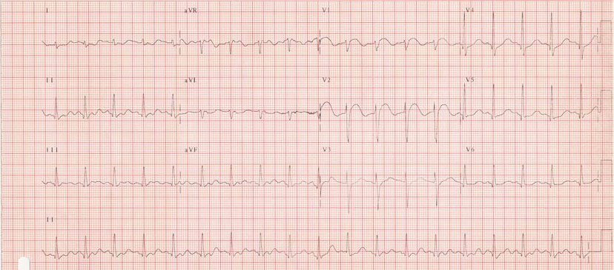
Notes:
Septal wall MI

Slide 41
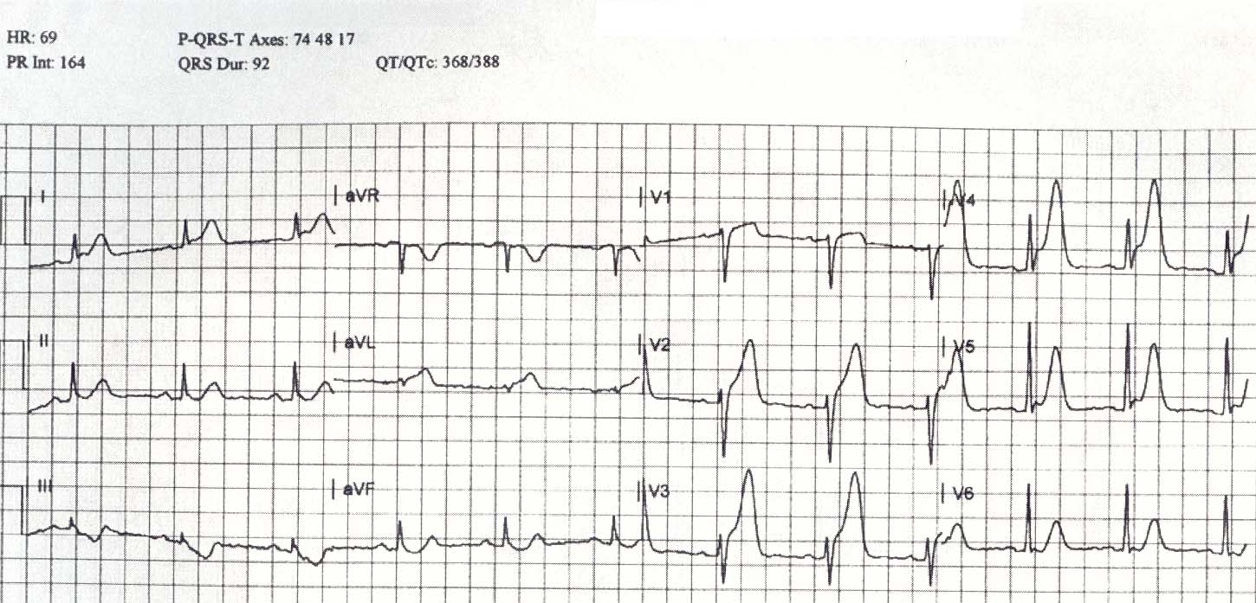
Notes:
Anteroseptal wall MI

Slide 42
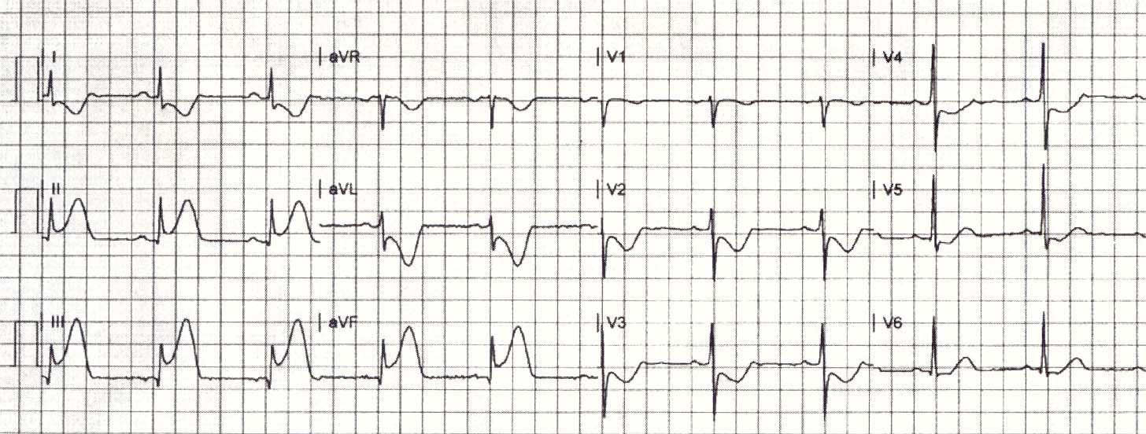
Notes:
Inferior wall MI

Slide 43
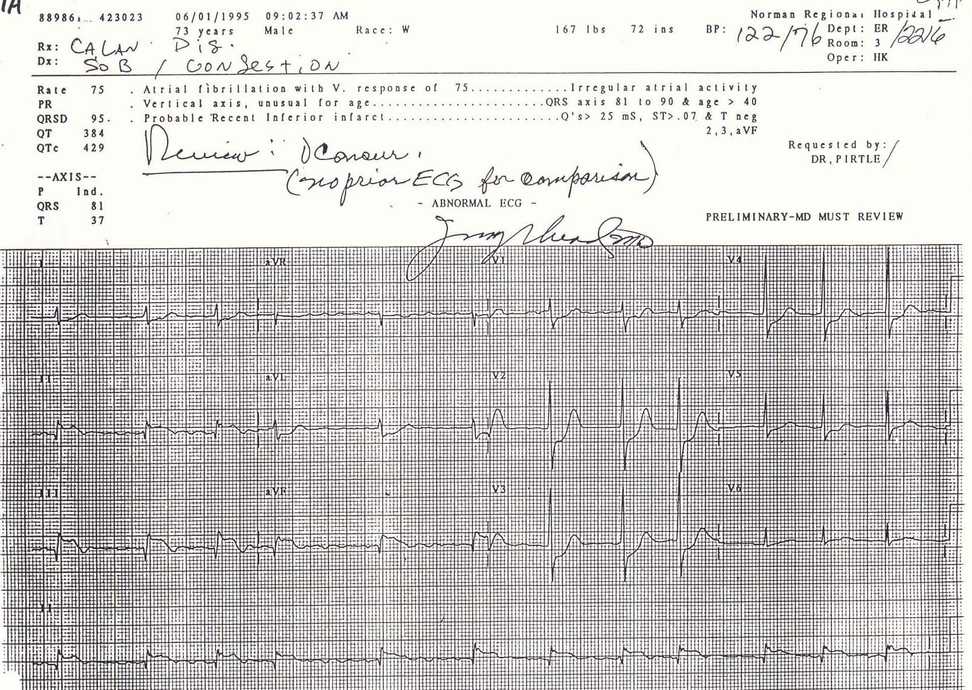
Notes:
Inferior wall MI
Q waves present in inferior leads
A-fib

Slide 44
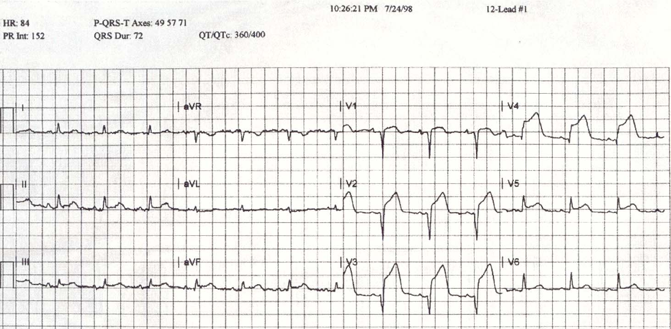
Notes:
Anteroseptal wall MI
Q waves present

Slide 45
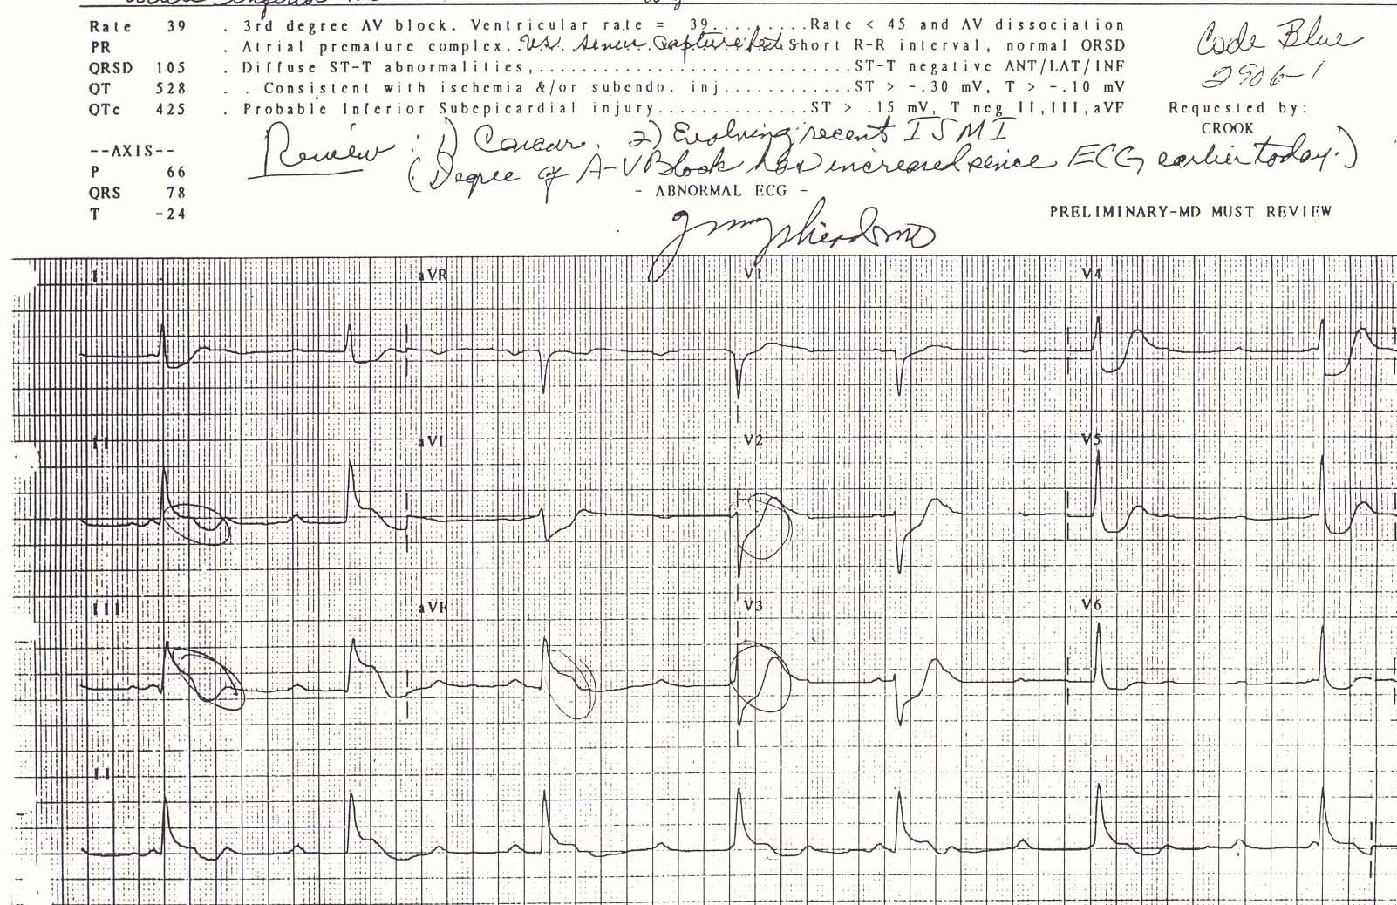
Notes:
Inferior wall MI
3rd degree AV block

Slide 46
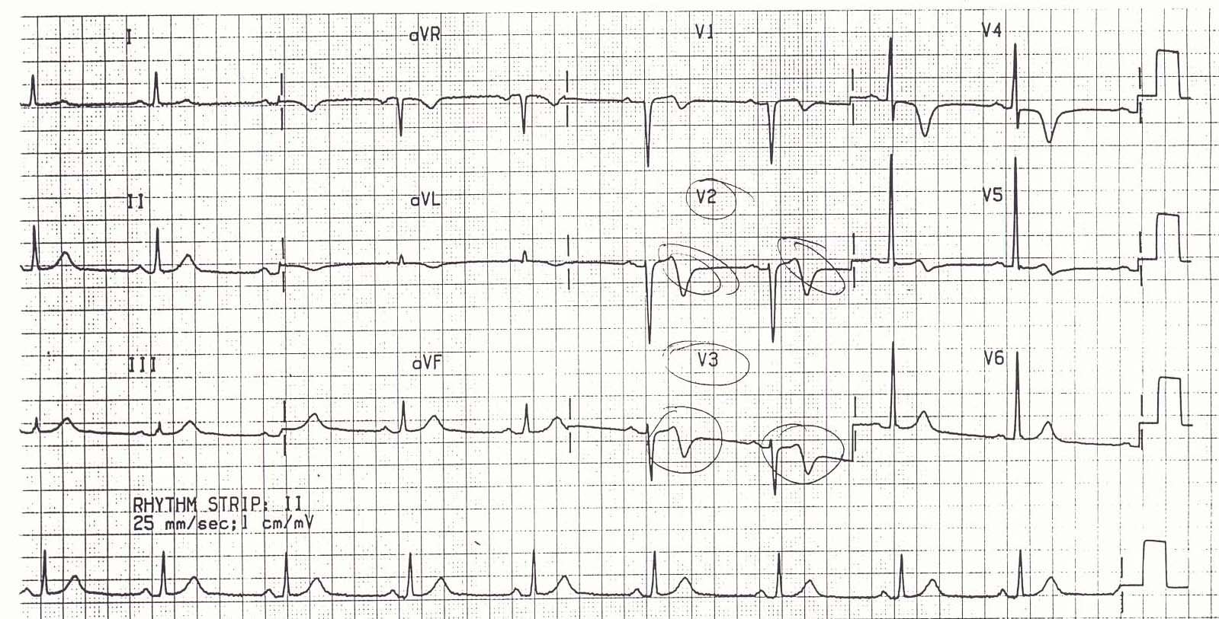
Wellen’s Syndrome
Represents a high grade LAD lesion
Notes:
Fig. 26-1 pg 388

Slide 47
Ventricular Tachycardia
Diagnostic criteria
AV dissociation
Precordial concordance
  Positive
  Negative
  R/O WPW
Axis is in NW quadrant
V₁ is negative with right axis deviation

Slide 48
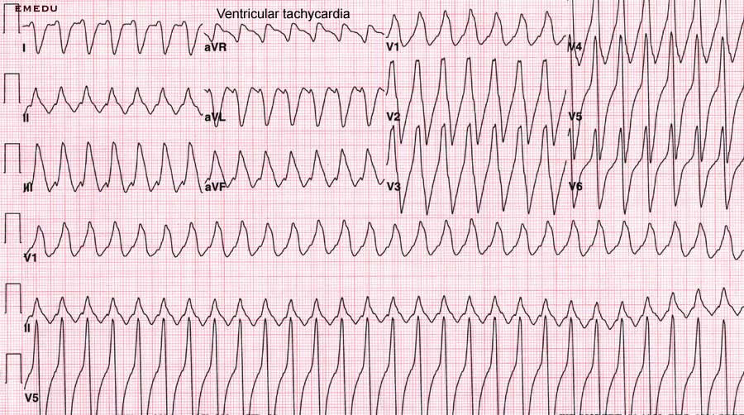
Ventricular Tachycardia
Notes:
VT
First of 5 slides ending in cardio version

Slide 49

Questions

Slide 50
Wolff-Parkinson-White
Statistics
Reasons for why people with WPW seeking treatment do not get diagnosed:
  A 12-lead ECG was not taken during the tachycardia
  A 12-lead ECG taken during the tachycardia was not examined by an informed clinician for its diagnostic clues
  The 12-lead ECG during sinus rhythm is normal
  Delta waves during sinus rhythm are missed because of an uninformed clinician or that they are too small

Slide 51
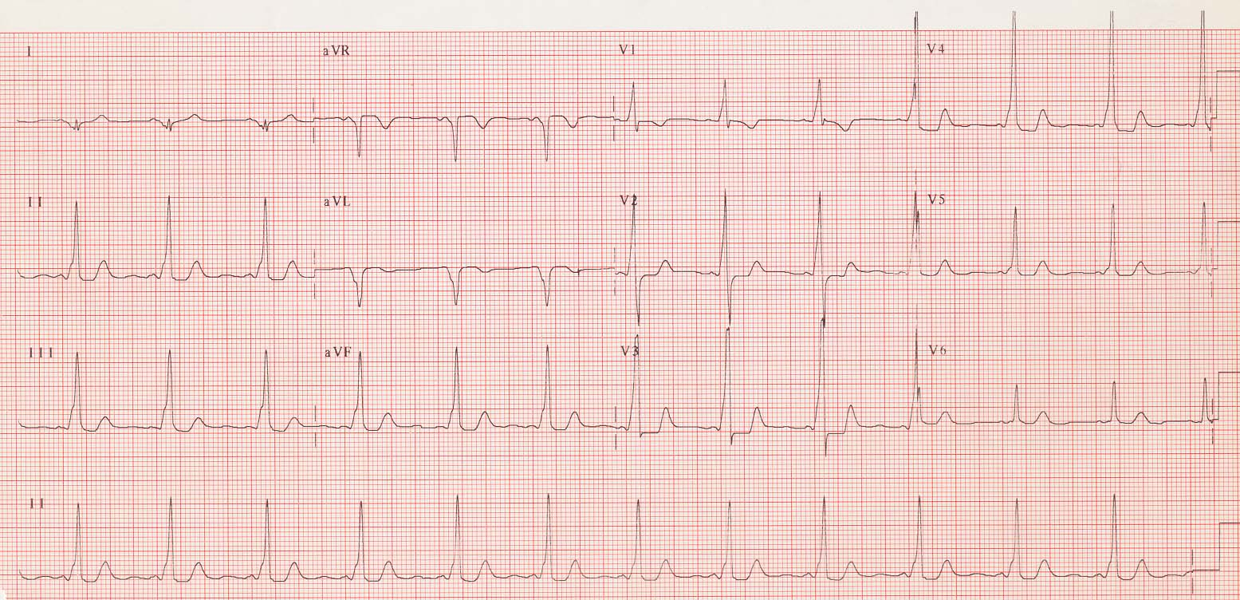
Wolff-Parkinson-White

Slide 52
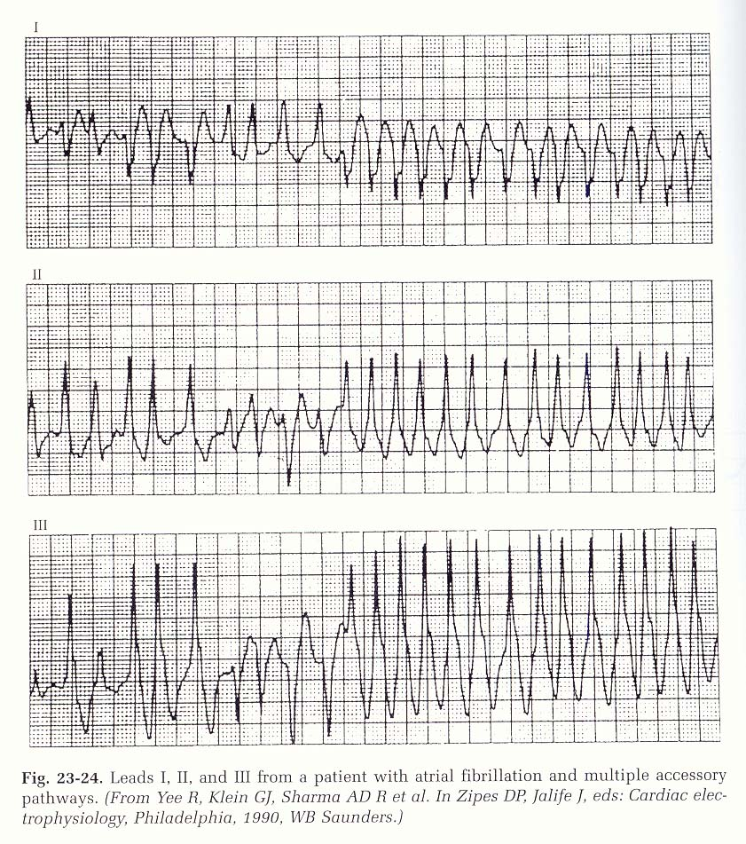

Slide 53
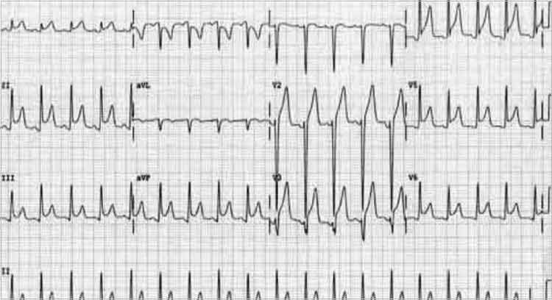
Acute Pericarditis: ECG criteria

Slide 54
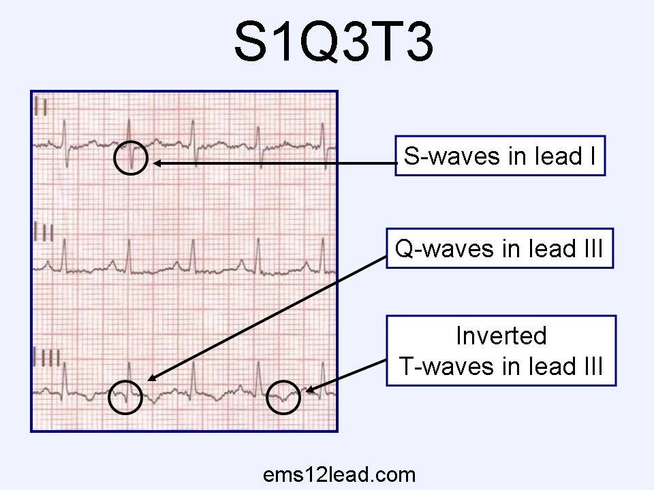
Pulmonary Embolism: ECG criteria

