Slide 1


Cardiovascular Symposium
Venous Disease
Laura Velez, APRN- CNS
Norman Heart and Vascular Associates

Slide 2
Cardiovascular Symposium
Disclosures
    No Disclosures

Slide 3
Cardiovascular Symposium
Prevalence of Venous Insufficiency
    Venous reflux disease is 2x more prevalent than coronary heart disease (CHD) and 5x more prevalent than peripheral arterial disease (PAD)¹
Only 2% treated

Slide 4
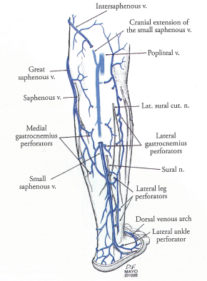
Cardiovascular Symposium
Venous anatomy of the lower extremity:
- Superficial veins
Deep veins
Perforator veins
Accessory veins
Tributary veins

Slide 5
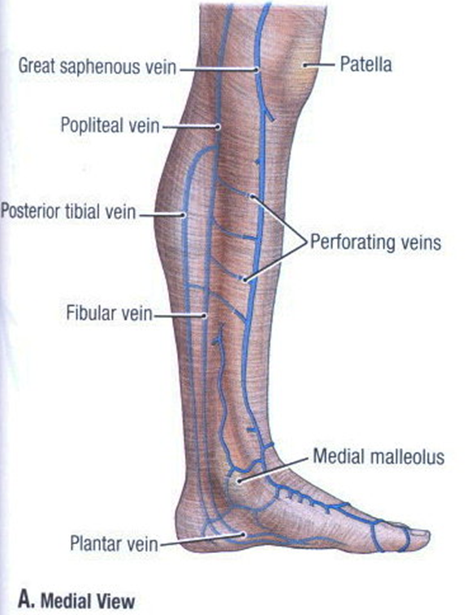
Cardiovascular Symposium
Perforating Veins
Connect the deep venous system to the superficial veins.

Slide 6
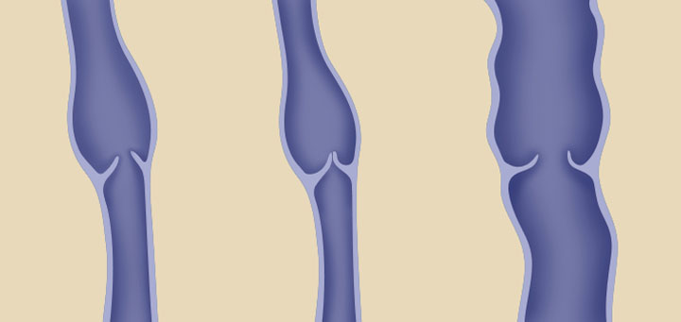
Cardiovascular Symposium
What Is Venous Reflux Disease?
Normal Vein
Dilated Vein
Valve Open
Valve Closed
Leaky Valve
A condition caused by failure of the venous valves leading to back flow of venous blood causing increased venous pressure in the lower leg, ankle and foot. Reflux can be seen in the greater or small saphenous veins, in the perforators, accessory and/or tributary veins.

Slide 7
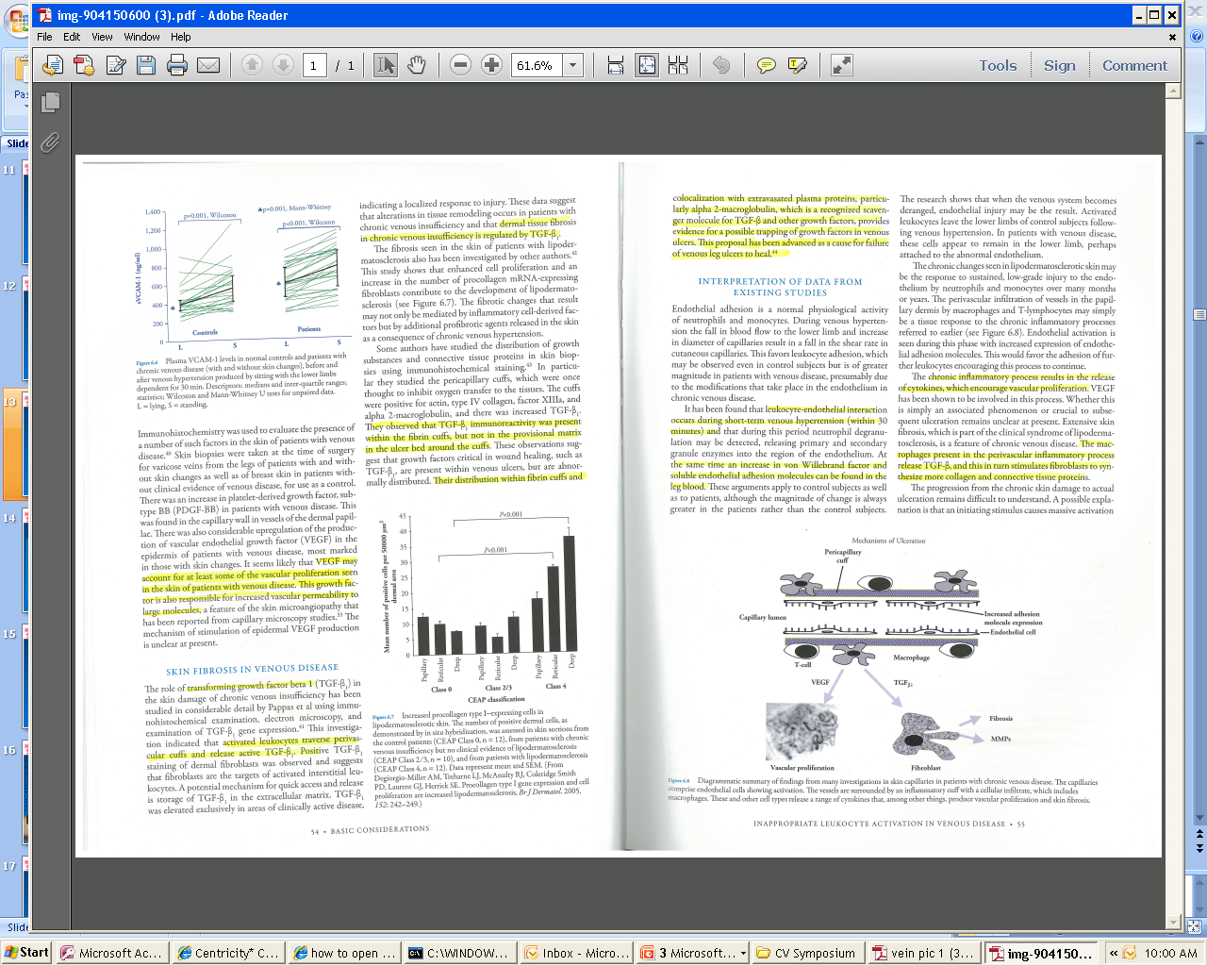
Cardiovascular Symposium
The mechanism regulating varicose vein hypertension and the subsequent skin sequelae are multifactorial and include a genetic component and environmental stimuli where the susceptible patient develops vein wall fibrosis and loss of valvular competence that leads to venous hypertension.
The transmission of high venous pressure to the dermal microcirculation causes extravasation of macromolecules and red blood cells that serve as stimulus for further inflammatory injury which can ultimately lead to poorly healing stasis ulcers.

Slide 8
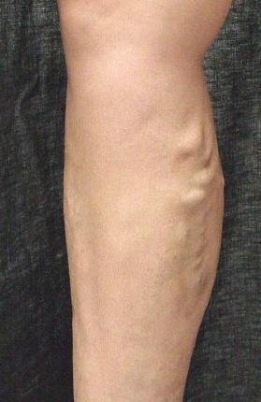
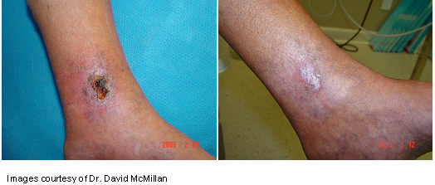
Cardiovascular Symposium
Venous Reflux U.S. Epidemiology
Of the estimated 25 million people with symptomatic superficial venous reflux only 1.7 million seek treatment annually.

Slide 9
Cardiovascular Symposium
Etiology of Venous Insufficiency
Valvular reflux
Venous obstruction
Post-thrombotic syndrome
Muscle pump dysfunction

Slide 10
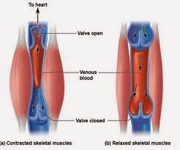
Cardiovascular Symposium
Calf Muscle Pump Mechanism
Flow against gravity is maintained using a system of muscle pumps to eject the blood and internal valves to prevent retrograde flow. In normal individuals the mechanism is remarkable efficient.
The contracting gastrocnemius and soleus muscles expel blood into the large capacity popliteal vein with a normal limb having a calf volume of 1500-3000 mL venous volume of 100-150 mL . The calf pump ejects 60% of the venous volume with a single contraction.

Slide 11
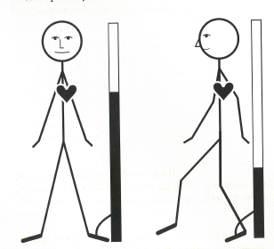
Cardiovascular Symposium

Slide 12
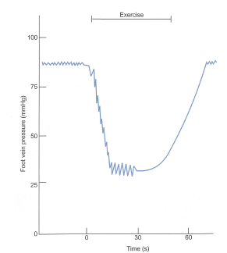
Cardiovascular Symposium

Slide 13
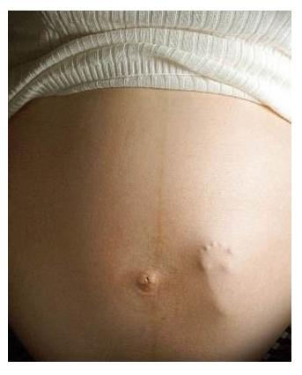
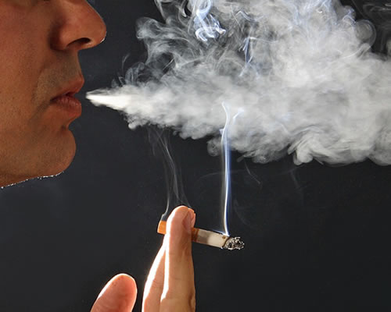


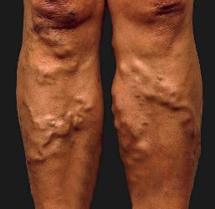


Cardiovascular Symposium
Risk Factors
Age: Aging causes wear and tear. Eventually, that wear causes the valves to malfunction.
Sex: Women > Men. Hormonal changes during pregnancy or menopause. Progesterone relaxes venous walls. HRT / OCP may increase the risk of varicose veins.
Genetics
Obesity: Increases venous HTN.
Standing for long periods of time: Prolonged immobile standing impairs venous return.
Ligamentous Laxity: (hernia, flat fleet)
Pregnancy
Smoking
Prior Venous Thrombosis

Slide 14
Cardiovascular Symposium
Genetic predisposition for development of varicose veins
Not well studied
Twin studies 75% identical, 52% non identical
If both parents VVs - 90% of children VVs
If one parent was affected 25 percent for men and 62 percent for women

Slide 15
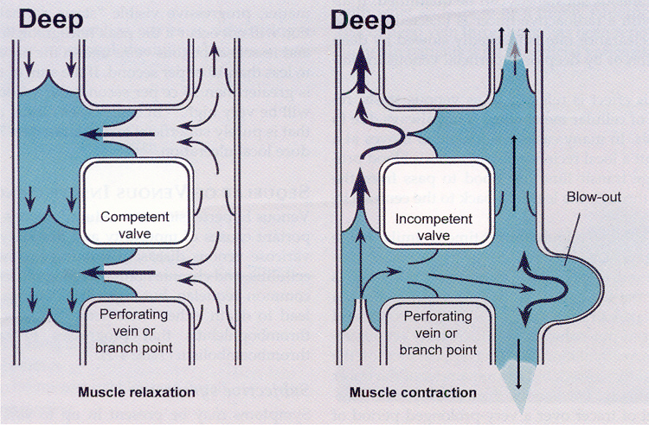
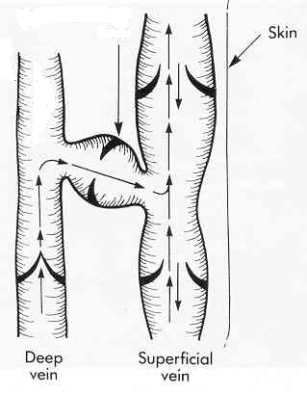
Cardiovascular Symposium
Key Perforator Anatomy
Perforating veins break though the deep fascia to connect the superficial venous system to the deep system
Perforating Vein
Superficial Fascia
Incompetent perforators of the lower limb can transmit extremely high pressure to the skin around the ankle during standing and especially during calf muscle contraction
Deep Fascia

Slide 16
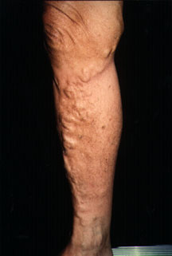
Cardiovascular Symposium
SYMPTOMS: SUPERFICIAL VENOUS REFLUX
Varicose veins
Leg or ankle swelling
Stasis ulcers
Stasis dermatitis/ cellulitis
Heaviness and fatigue
Pain, aching and cramping
Burning or itching of the skin
Restless legs
Discoloration and thickening of the skin
Prolonged sitting or standing intensify symptoms

Slide 17
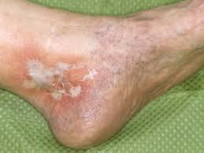
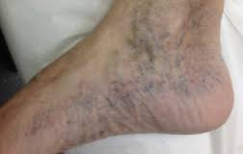
Cardiovascular Symposium
Recognizing Venous Insufficiency
Atrophie blanche: localized circular whitish and atrophic skin surrounded by dilated capillaries and sometimes hyperpigmentation. Sign of severe CVD.
Corona phlebectatica: fan shaped pattern of numerous small intradermal veins on the medial or lateral aspects of the ankle or foot. An early sign of advanced venous disease.

Slide 18
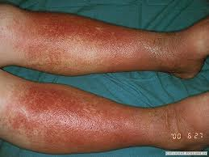
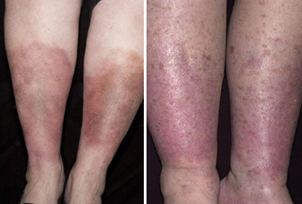
Cardiovascular Symposium
Recognizing Venous Insufficiency
Venous eczema: may progress to blistering, weeping, scaling eruption and if associated with infection and fever cellulitis.
Edema: perceptible increase in volume of fluid in the skin and sub Q tissue, characteristically indented with pressure in the ankle but may extend to leg and foot.

Slide 19
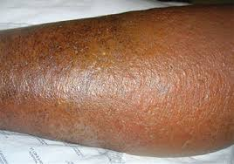
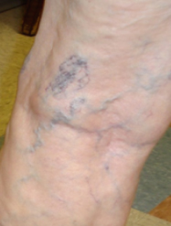
Cardiovascular Symposium
Recognizing Venous Insufficiency
Lipdermatosclerosis: localized chronic inflammation and fibrosis of skin and sub Q tissues of the lower leg. A sign of severe CVD.
Reticular vein: dilated bluish subdermal vein, usually less than 3 mm in diameter, usually tortuous.

Slide 20
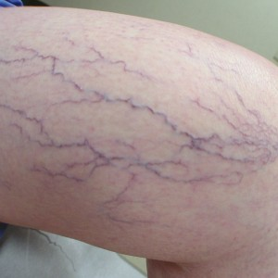
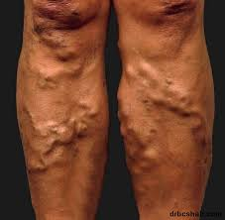
Cardiovascular Symposium
Recognizing Venous Insufficiency
Telangiectasia: spider veins.
Varicose veins: sub Q dilated vein greater than 3 mm in diameter.

Slide 21
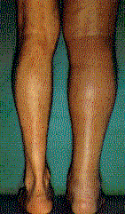
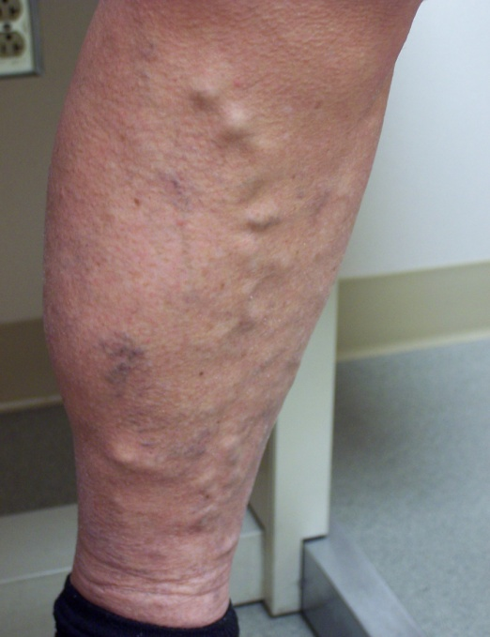
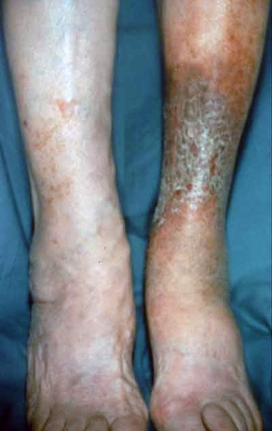
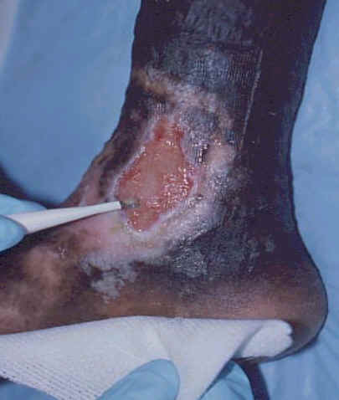
Cardiovascular Symposium
Signs of Advancing Venous Insufficiency
More than “simple or cosmetic” Varicose Veins
Edema¹ Varicose Veins² Skin Changes³ Ulceration⁴
Image sources:
¹ Rajabrata Sarkar, MD
² Paul McNeill, MD
³ missinglink.ucsf.edu/.../stasis_dermatitis.html
⁴ Amor Khachemoune, Catharine Lisa Kauffman: Management Of Leg Ulcers. The Internet Journal of Dermatology. 2002. Volume 1 Number 2.

Slide 22
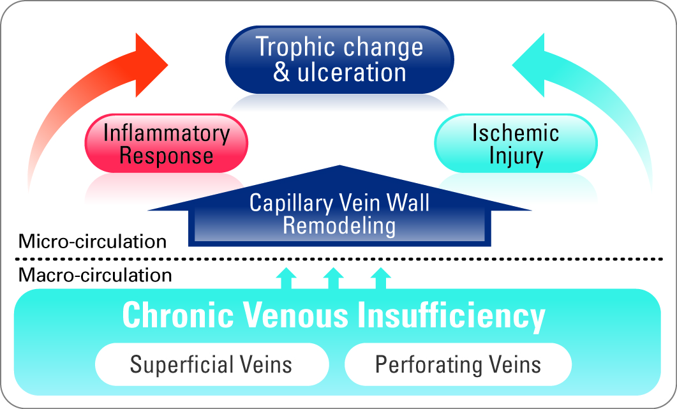
Cardiovascular Symposium
The Reason for the Lesion
Chronic hypertension in the macro-circulation cause micro-circulatory inflammatory and ischemic injury leading to ulcer

Slide 23
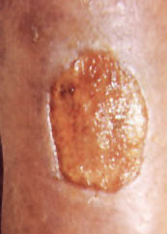
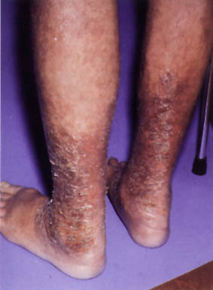

Cardiovascular Symposium
A Serious and Progressive Disease
Skin
Ulcers
Patients with Venous Reflux Disease
U.S. Prevalence
500
Thousand
Skin
Damage
1
Million
Swollen
Leg
6
Million
Increased Pain
and Reduced
Quality of Life
Varicose
Veins
20+
Million

Slide 24
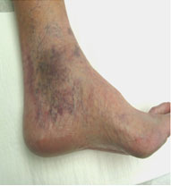

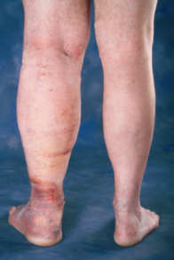


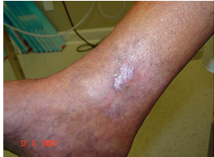
Cardiovascular Symposium
CEAP classification
C = Clinical signs (0 – 6)
E = Etiologic classification (congenital, primary or secondary)
A = Anatomic distribution (superficial, deep, alone, combination)
P = Pathophysiologic dysfunction (alone or in combination)
0 No visible or palpable signs of venous disease
1 Telengectasias (spider veins) reticular veins
2 Varicose veins
3 Edema
4 Skin changes: pigmentation, venous eczema, lipodermatosclerosis
5 Healed venous ulceration
6 Active venous ulceration
20 million
2- 6 million
0
1
2
3
4
5
6

Slide 25
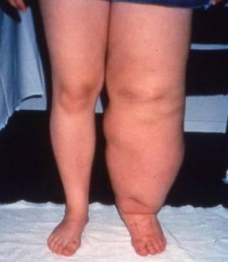
Cardiovascular Symposium
Differential diagnosis for edema
Deep Vein Thrombosis (DVT) needs to be excluded.
Systemic causes of edema: Congestive heart failure, nephrosis, liver disease, endocrine disorders, medication side effect (CCB, NSAIDS, oral hypoglycemic).
Other considerations: ruptured popliteal cyst, soft tissue hematoma or mass, chronic exertional compartment syndrome, gastrocnemius tear or lymphedema.

Slide 26
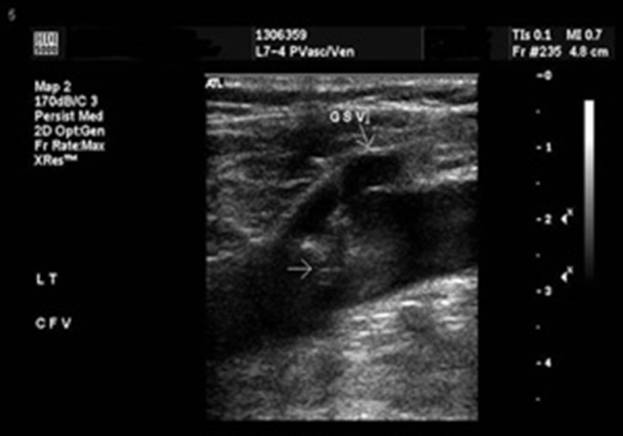
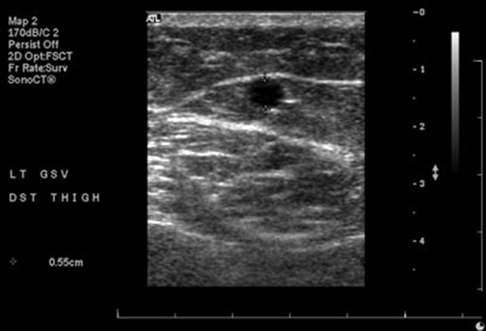
Cardiovascular Symposium
Investigation
All get a Duplex scan
Examines:
– Deep veins
– Superficial veins
– Incompetence and patency
Other Tests Include:
Physiologic testing
Phlebography
Intravascular Ultrasound

Slide 27
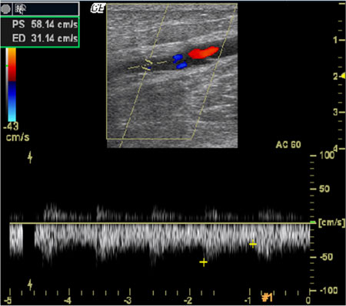
Cardiovascular Symposium
Duplex Scan
Vast majority have superficial incompetence only.
Sensitivity 95 % for identifying the competence of the saphenofemoral and saphenopopliteal junctions.
Less sensitive for identifying incompetent perforators (40 to 60 percent)

Slide 28
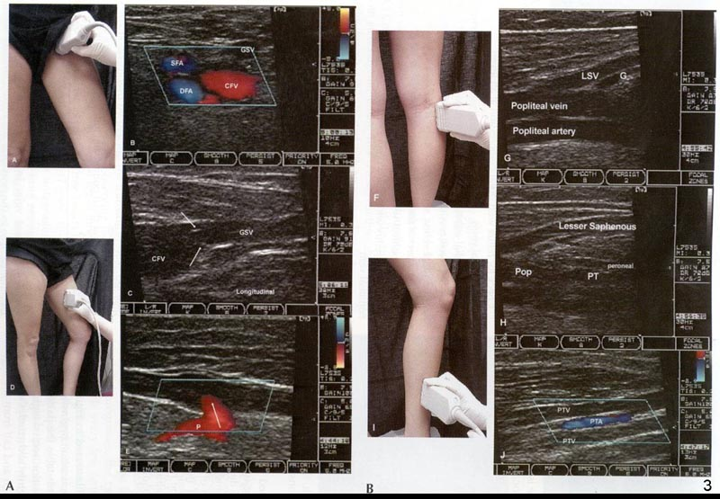
Cardiovascular Symposium
Venous Insufficiency Ultrasound examination - Key to proper diagnosis

Slide 29
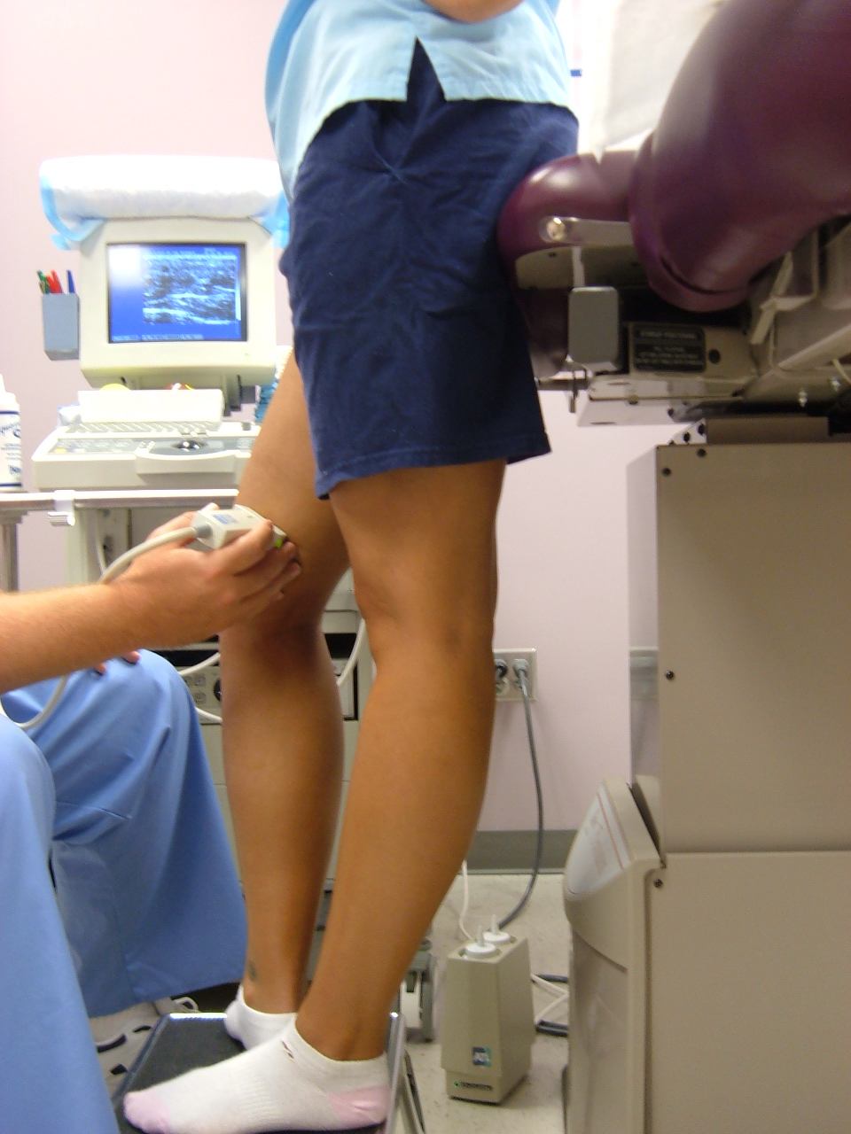
Cardiovascular Symposium
Duplex Ultrasound – Standing Position

Slide 30
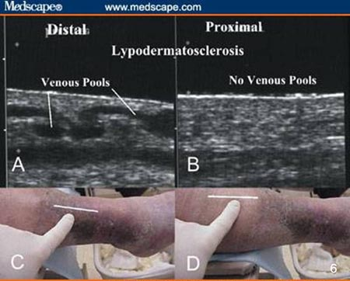
Cardiovascular Symposium
Tissue Changes Beneath Wound
Ultrasound imaging reveals the story
  Pathologic (A, C) vs.
  Non-pathologic (B,D) areas
  Great Saphenous
  reflux

Slide 31
Cardiovascular Symposium
Information gained from venous mapping
Deep vein system evaluation assessing for DVT
Diameter in millimeters and reflux times in milliseconds of the proximal, mid, distal and BTK of the greater saphenous vein and of the small saphenous vein.
Identification of any accessory veins and tributaries.
Identification of perforators and competence of perforator valves.
A NORMAL VALVE SHOULD HAVE NO MORE THAN 500 MS OF REFLUX.

Slide 32
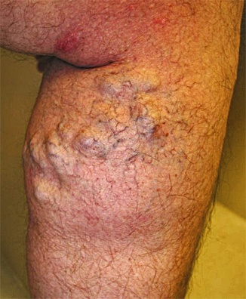
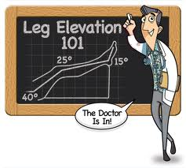
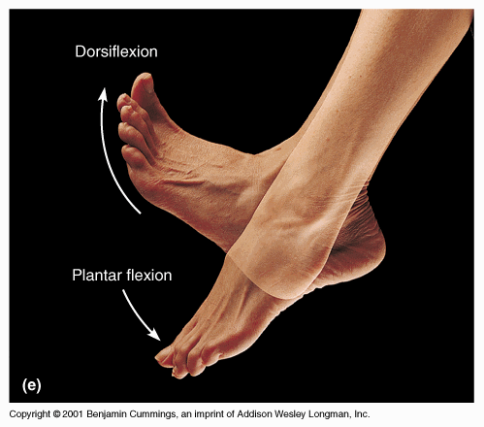
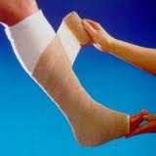
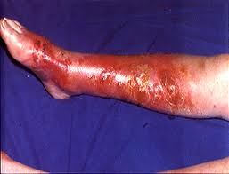
Cardiovascular Symposium
Conservative Management of CVI
Leg elevation- at heart level for 30 minutes, 3-4 times daily improves micro-circulation, reduces edema, and promotes healing of ulcers.
Exercise- daily walking and simple ankle flexion exercises and toe lifts
Compression stockings- elastic or non-elastic with single or multi-layers . Ideally 30-40 mmHg compression.
Treatment of other underlying conditions
Compression therapy- avoid contraindications such as cellulitis or significant arterial occlusive disease.
Weight loss
Diuretics
Low Sodium diet

Slide 33
Cardiovascular Symposium
INSURANCE COVERAGE
Patients with CEAP score 3-4 require 3 months of aggressive conservative management before insurance will consider payment for a venous ablation.
Patients with CEAP scores of 5-6 (healed or active stasis ulcers) no period of conservative management required. Documentation needs to be clear regarding wound as it relates to venous disease.

Slide 34
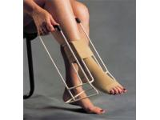
Cardiovascular Symposium
Management of CVI
Compression Stockings
CLASS | PRESSURE | LEVEL OF SUPPORT | INDICATION | CEAP
OTC | <15 mmHg | Minimal | Asymptomatic, comfort only. | 0, 1
I | 15-20 mmHg | Mild | Minor varicosities, tired aching legs, minor swelling. | 1, 2, 3
II | 20-30 mmHg | Moderate | Moderate to severe varicosities, moderate swelling,phlebitis, following ablation. | 3, 4
III | 30-40 mmHg | Firm | Severe varicosities, swelling, management of ulcerations, following DVT, post surgery. | 4, 5, 6
IV | >40 mmHg | Extra firm | Lymphedema. | NA

Slide 35
Cardiovascular Symposium
Benefits of Correcting CVI
Reduce recurrence
  4 year recurrence rate 56% compression group, 31% compression plus surgery (P<0.01)⁶
  3 and 5 year recurrence with perforator surgery 8% and 18% respectively⁷
Faster healing
  Median heal time: 63 day compression group, 31 days surgical group, (P<.005)⁸
Compression, off loading and normal wound bed management is not enough

Slide 36



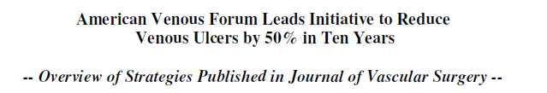
Cardiovascular Symposium
CVI Consensus Guidelines
“Superficial venous ablation … can be useful in decreasing the recurrence of venous leg ulcers”⁹
“We recommend superficial venous surgery to decrease ulcer recurrence in patients with superficial venous reflux”¹⁰
“Endovenous thermal ablation is
the new standard of care”¹¹

Slide 37
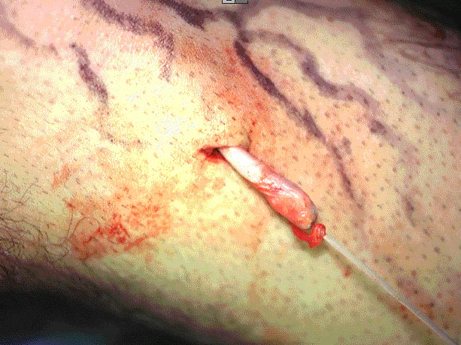
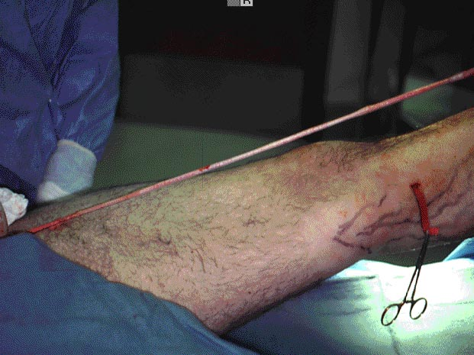
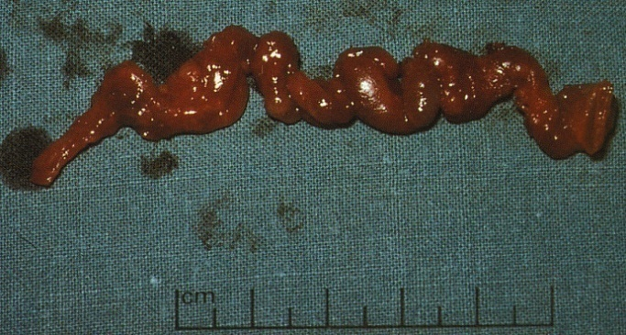
Cardiovascular Symposium
Historic Treatment: vein stripping

Slide 38

Cardiovascular Symposium
Historic treatment: vein stripping

Slide 39


Cardiovascular Symposium
Results

Slide 40
Cardiovascular Symposium
New treatments available for treatment of venous reflux:
Radiofrequency ablation
Endovenous laser ablation
Sclerotherapy
Stab phlebectomy

Slide 41

Cardiovascular Symposium
The Solution you must know about:
The VNUS Closure Procedure
Radio Frequency Ablation
Minimally invasive alternative to traditional surgery
  Faster recovery¹⁻³
  Fewer complications³⁻⁶
  High efficacy^{3,7-9}

Slide 42


Cardiovascular Symposium
Vein Access via VNUS Closure Procedure
Percutaneous vein access
An introducer sheath is placed in vein
Radio Frequency Catheter
Mar 1999
510k clearance of Closure Catheter
1998
First Closure Catheter used

Slide 43

Cardiovascular Symposium
ClosureRFS™ Stylet
for perforating vein reflux
Percutaneous access under ultrasound guidance.
Temperature controlled 90°C heating at or below deep fascia.
Cleared by FDA to treat incompetent perforator veins.

Slide 44
Cardiovascular Symposium
Closure Procedure Efficacy and Complications
ClosureFAST Complications⁷ | All Time N=396
Ecchymosis | 21 (5.3%)
Parasthesia | 16 (4.0%)
Skin Pigmentation | 12 (3.0%)
Erythema | 9 (2.3%)
Thrombus Extension / DVT | 7 (1.8%)
Phlebitis | 6 (1.5%)
Hematoma | 4 (1.0%)
Thermal Skin Injury | 0 (0.0%)
Pulmonary Embolism | 0 (0.0%)
ClosureFAST 92.9% occlusion @ 3 year⁷
^{Kaplan-Meier Analysis}

Slide 45
Cardiovascular Symposium
Before & After RF Ablation
Non-healing ulcer healed 8 weeks after Closure Procedures

Slide 46

Cardiovascular Symposium
SCLEROTHERAPY
Is the use of a chemical foaming agent to provide chemical ablation for relief of significant venous claudications.
The most common agents are polidicanol and sotradecol.
The foaming agent is injected, under ultrasound guidance, into the vein in question while the patient is in a supine position.

Slide 47
Cardiovascular Symposium
AFTER VENOUS ABLATION
Wear compression stockings every day
Elevate the treated leg when seated
Walk every hour for a few minutes. Add a 20-30 minute walk daily if able
Leave the coban dressing on for 48 hours. This will be removed upon return for the follow up ultrasound.
No heaving lifting or straining for 1 weeks post procedure.

Slide 48
Cardiovascular Symposium
POSSIBLE POST ABLATION SYMPTOMS
Pain may be mild to moderate following the procedure. The leg may be tender to the touch. It is normal to experience some tenderness or bruising in the areas where the local anesthesia was administered. The pain should be controlled with Tylenol or Advil.
Transient bruising may occur. This will resolve over time and generally will resolve totally in 2-3 months
Leg/ankle swelling may occur after treatment this generally resolves in a few days but may last a few weeks. Wearing compression stockings and elevation will help lessen the swelling.
There may be a pulling or tight feeling for 5-7 days after the procedure due to the treated area healing.

Slide 49
Cardiovascular Symposium
FREQUENTLY ASKED QUESTIONS
May return to work as soon patient feels able.
Sports/exercise may resume 1 week post procedure.
May resume normal diet with an emphasis on drinking water for several days post procedure.
If there is need to fly be sure to walk hourly and elevate legs as much as possible during the flight.

Slide 50
Cardiovascular Symposium
Patients with Venous Reflux Disease
Estimate: EOY 2007
United States
Vein Stripping
76%
9%
Conservative
or
Endovenous
Ablation
15%
Untreated
95%
Varicose Vein
Treatments
Seek Treatment
5%
2/3
Exhibit Saphenous Reflux
800K
25M
Symptomatic Venous
Reflux Patients
Source: VNUS Commissioned Market Research

Slide 51
Cardiovascular Symposium
Reduce Recurrence,
Improve Quality of Patients Lives
Compress the wound and treat the disease
  High ulcer recurrence rates with compression alone
  Surgical intervention significantly reduces ulcer recurrence^{11,12}
Improve quality of life
  Quality of life significantly improves by treating the venous disease over compression therapy alone¹³

Slide 52

Cardiovascular Symposium
Summary
Be an informed, proactive member of the medical community
Recognize CVI signs & symptoms
Adopt a diagnostic paradigm that includes CVI
Be the tip of the spear

