Slide 1
ICD 10 Introduction: PCP Provider Implications
2015 Spring Workshop
Notes:
----- Meeting Notes (3/2/15 23:57) -----
I want to preface this short presentation with a few introductory comments
1. This is an introductory presentation over ICD 10
2. Not intended to be comprehensive
3. Take home message -- individual comprehensive training is recommended

Slide 2


Susan Quisenberry, DNP, APRN, CNP, NP-C
Assistant Professor
University of Oklahoma Health Science Center
College of Nursing: Nurse Practitioner Program
Clinical Expertise:
    Rheumatology
    Heart Failure
    Cardiology
    Family Practice
Clinical Research: Sub-Investigator @ Health Research of Oklahoma
  Practice Specialty:
    Inflammatory& non-Inflammatory Arthritis
    Autoimmune Disorders
    Degenerative Joint Disease of Spine
    Chronic Pain Management
No Disclosures
Notes:
----- Meeting Notes (3/2/15 23:57) -----
Here is a synopsis about me -- as stated in the introduction
I have nothing to disclose.

Slide 3
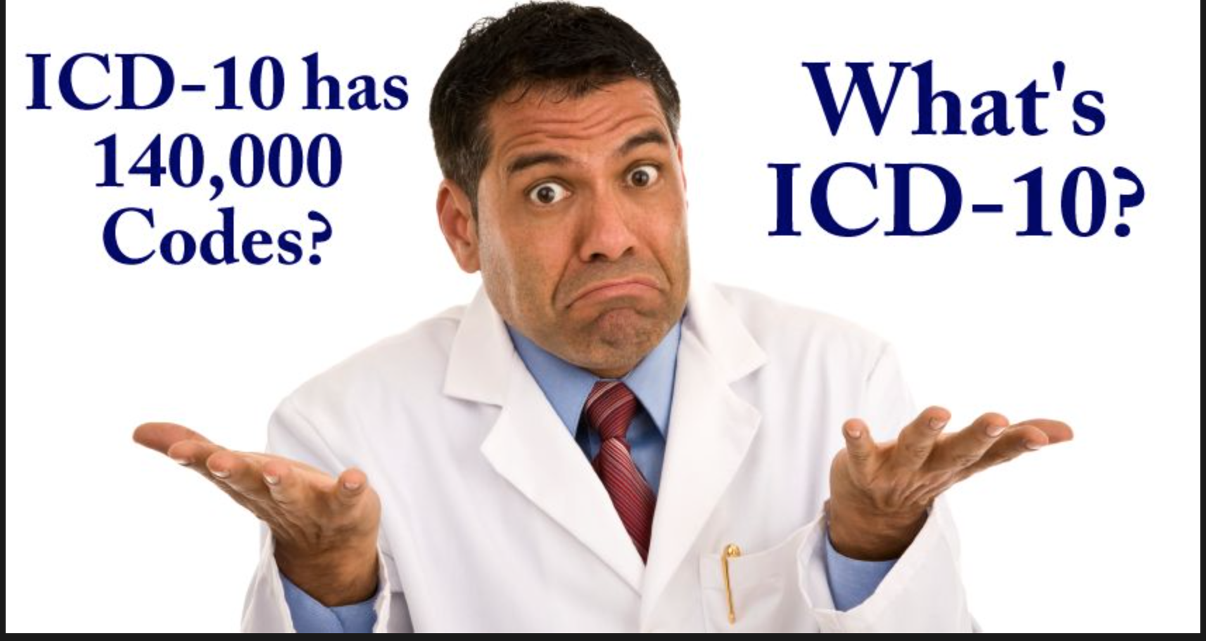
Factoid: ICD-10 Implemented for Mortality reporting in 1999. (CDC, 2015).

Slide 4

Objectives:
ICD 9 Overview & ICD-10 BASICS
  Purpose of Change
  WHO© ICD 10 Overview:
    Disease Grouping by Principles
    Numerical Differences
    Coding Specifics & Conventions
ICD Transition
  Mandatory Changes
  Strategies
  Implications of Practice
    Provider Aspects
    Office Preparation
Notes:
The purpose of this presentation is to provide a generalized, basic overview of the New ICD-10 regulations; Define ICD; Discuss differences between ICD 9 and 10 and rationale for transitioning to this form of coding and documentation

Slide 5
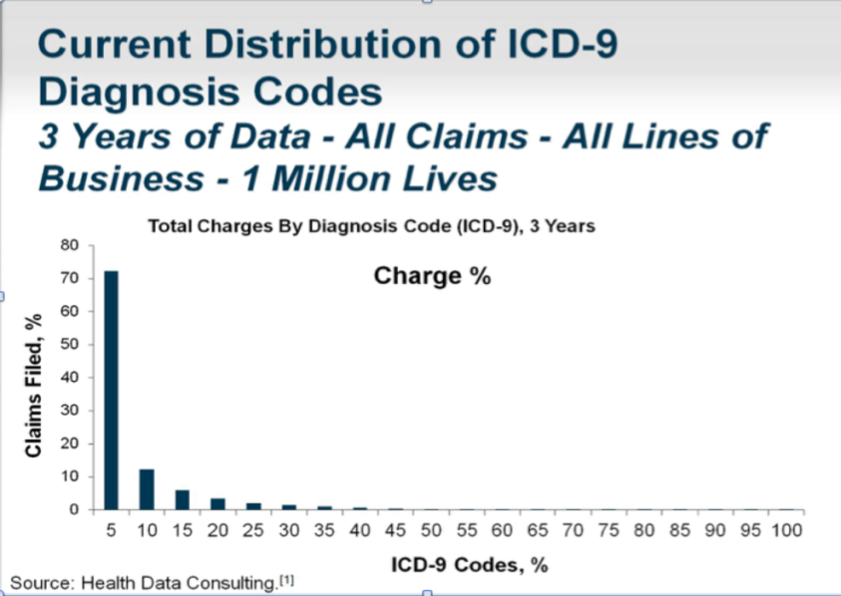
ICD 9 – Last Revision - 1979
What’s Wrong with ICD9?
> 30 years old
Lacks Support HC
Limited data Provision
Lacks comparability to international data
Limits new codes
  Categories - FULL
O U T D A T E D !
  70% of claims filed over 3 years used only 5% of the available ICD 9 Codes
Coding differences:
Example: Fractures
  ICD 9: → 474 Codes
  ICD 10 → 17,000 Codes
Common ICD 9 Codes

Slide 6

COUNTDOWN: 208 Days and counting
Notes:
Interestingly, the ICD 10 Coding transition was planned for 2011 – Technology lagged. – New goal: October 2014 – Pushed back until October 1, 2015. Likely, no further delays.

Slide 7
WHAT’S ALL THE HUB-BUB?
ICD 10 Codes
World Health Organization International Standard
Defines patient’s Health conditions/related conditions
Portrays highly specific picture -every encounter
Continuity of care/Shared Records
Promotes International Comparability
Promotes Quality care
Data Tracking
Populations: Similar/diverse/local/global
Encompasses ~ 140,000 Codes
NEW US Standard - Meets HIPPA requirements
Common Language for reporting illness/disease
  Disease Classification Groups
(WHO, 2015; CMS, 2015; Nichols, 2013)

Slide 8
Understanding Differences
ICD 9
Versus
ICD 10
Alphanumeric Categories
Numeric Categories
3-7 Characters -> ⬆Complexity
3-5 Characters
>68, 000 codes - Dashes
14,000 Codes
Captures Manifestations
Disease Related
SPECIFIC Picture of Encounter
Reflects Medicine/Technology
Generalized Picture
ICD 10
ICD 9
Captures External Factors
Lacks international comparability
Severity
V & E Codes
Comorbidities & Risk
Categories Full
Laterality
Patient’s Health Condition
Unspecified Codes
Dummy Placeholder “x”
(WHO, 2014)
Notes:
----- Meeting Notes (3/2/15 23:57) -----
Total of > 140,000 codes. For purposes of this lecture - we are concentrating only on outpatient ICD-10-CMS codes

Slide 9
Concepts of ICD 10
Documentation
Must
Reflect
Concepts
Co-
morbidity
Manifestations
Causation/Etiology
Complications
Anatomical Location
Functional Impairment
Lateralization
Encounter: Initial, Subsequent, Sequela
Notes:
As you’re accumulating data, this is a logical order in which to think about the complaint: OLDCARTS – Does it affect their daily activity, Any complications associated with complaint/disorder;
Financial professionals should feel free to customize their own hierarchy so that the audience has a clear, visual understanding of how investment “blocks” should build on each other.

Slide 10
Data Tracking
Causality
Prevention
Resource Allocation
Clinical & Research Outcomes
Transparency
Continuity
Population Analysis
Morbidity/Mortality
Other statistics
ICD 10
Universal Health care
Blocks
Building
WHO, 2014; CDC, 2014)
Notes:
ICD 10 classification of diseases are designed to provide the building blocks of global health Identification and Information. ICD 10 coding specifics allows for tracking of injuries, symptoms, causalities by population, geographical location, subpopulations, ethnicities, and more. ICD 10 provides for epidemiologic tracking of disease processes, associated comorbidities. Offers data collections for improved disease prevention. Used for health management and resource allocation. Offers means of monitoring patient treatment and research outcomes. Is designed to promote health car transparency and provider-to-provider continuity of health care.
Data collected provides a methodology of evaluating health care systems throughout the lifespan in various populations, locally and globally.
Improved statistical information regarding morbidity and mortality and Etiologies.

Slide 11
Implications
Expect the Following
What can we do?
EHR→ Required Updates
Software Updates
Training
Superbill – Major Δ
Reimbursement Issues
  Pay for Performance
  Claim Denials
  Audits: Fraud & Abuse
Accurate & Specific Documentation
  Supports payment
  Reduces denials
  Assures transparency & accountability
  Supports evidenced based practices
Billing: Assure accurate codes
  Congruent with documentation

Slide 12
S86.011D
Let’s Dissect it
ICD 10 CM
3-7 Characters
S
8
6
.
0
1
1
D
Category
Etiology, Anatomical Site, Severity, Other Details
Extension
S = Injuries, poisoning, & other consequences
Primarily used to encounter episode with external causes
S86.0 = Injury of Achilles Tendon
S86 = Injury of Muscle, Fascia, or Tendon
S86.01 = Strain of Achilles Tendon
A = Initial
D = Subsequent
S = Sequela
S86.011 = Strain of Right Achilles Tendon
T23.302
S
A
D
Notes:
CODE FIRST: by Manifestation
3-4 characters →RUBRIC – Always strive to at least 4 characters
The fourth character is not always used – but adds specificity when needed to the problem (body part, etc.)

Slide 13
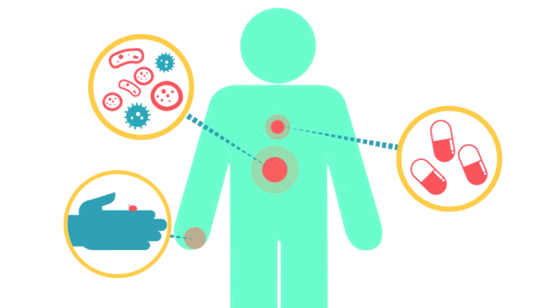
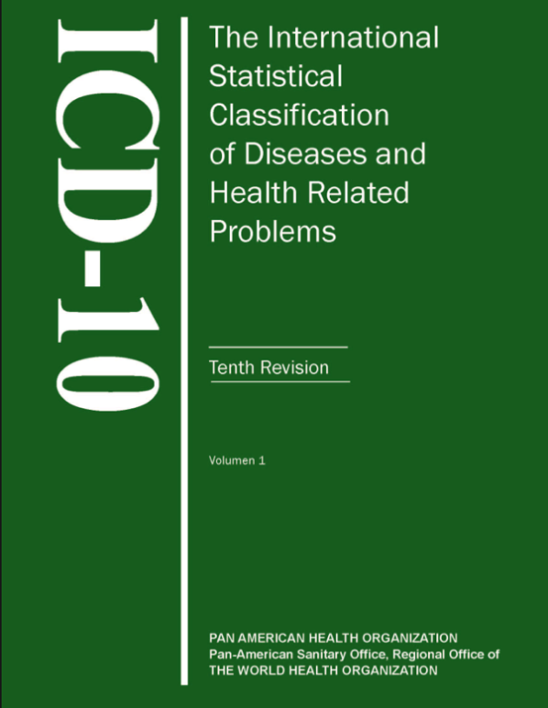
ICD 10 Rules
Are spread between Three (3) Volumes
CODING CORRECTLY
Requires
    Following the rules and coding principles
    Use of all Three volumes
    Follow the CMS ICD 10 Guidelines

Slide 14
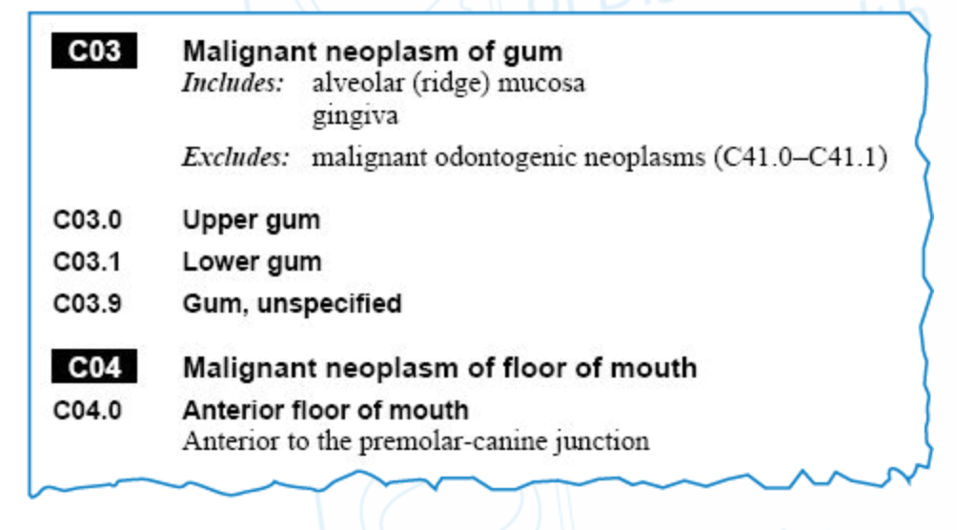
Volume I of III
ICD 10: Volume 1
VOL 1: Tabular List
  Listed by Code –
    C03, C03.0, C03.1
  external causes
  reasons for encounter, and
  other health conditions
CHAPTERS BY:
    Body systems
    Special Diseases
    Pregnancy
    Neoplasms
Note: Most Chapters have a single letter assigned to them: “C0-C91” as above –
Three Chapters Share Letters (Eye/Ear)

Slide 15
Volume II of III
ICD 10
Volume II
Volume II: Instruction Manual
  Introduction to the classification,
  Explains conventions of ICD, and gives
  Instructions regarding coding for
    death certificates,
    hospital medical records and
    other forms of health information.
  Volume 2 also regulates statistical presentation for international comparison.

Slide 16
Volume III of III
ICD 10
Volume III
Volume III: The Alphabetical Index –
  Diseases and conditions which have codes in the Tabular List.
    Diseases [Alphabetical List]
    Table of Neoplasms
    Table of Drugs/Chemicals
    Index for external causes of injury
  Designed to help users identify code(s) for verification in the Tabular List.
    Separate parts for diseases, accidents, and substances.

Slide 17
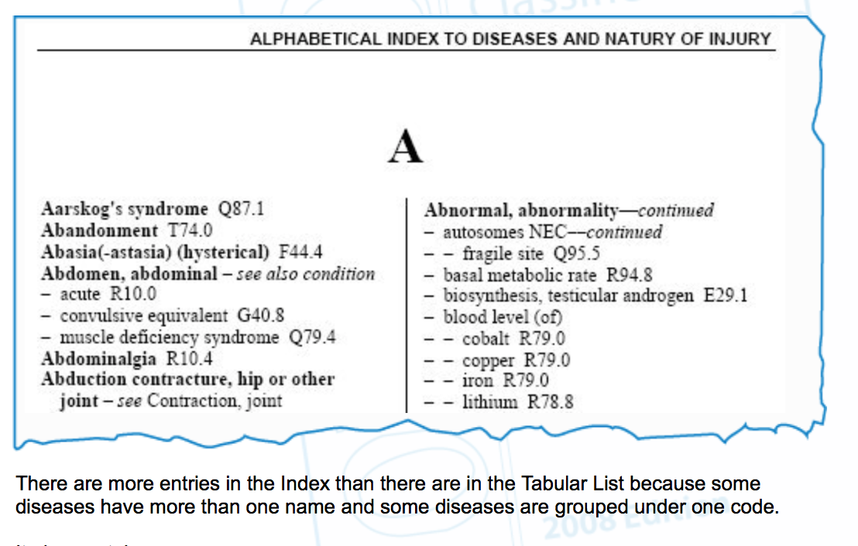
Volume 3 Example
Alphabetical Index

Slide 18
Golden RULES
Volumes I and III --->MARRIED
  Use III to find dx
  Confirm with Vol I (Tabular list)
    Cause of Death and/or Diagnosis
Special Disease Categories – A Priority over body system
    [Neoplasm Lung → trumps Disorders of Respiratory system]
Dagger/Asterisk –
The dagger code (†) is used as the underlying cause of death. Never use the asterisk code (*) alone if the diagnosis being coded uses the dagger and asterisk convention.
Code to the greatest specificity & Always check the inclusion/exclusion notes
Term Encounter –is used for all encounters: Inpatient and Outpatient

Slide 19
Coding Conventions
NEW CONCEPTS
Inclusion terms
Exclusion Terms
NOS “Not otherwise specified”
  NEC “Not elsewhere classified”
Dagger and Asterisks
Dashes
Other coding conventions

Slide 20
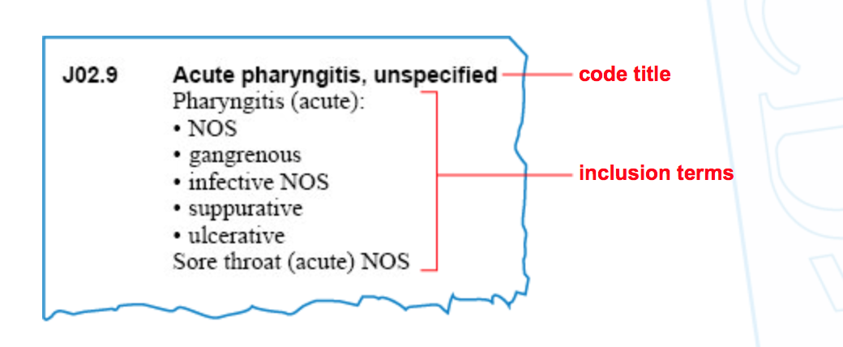
Inclusions
Coding Conventions
Notes:
Within chapters, blocks and three- and four- character rubrics there are usually listed a number of other diagnostic terms in addition to the code title.
examples of diagnostic statements or terms to be classified to that chapter, block or rubric.
NOTE: The Colon after Pharyngitis acute: -- Means there is more that needs to be assigned to this diagnosis: Acute suppurative Pharyngitis

Slide 21
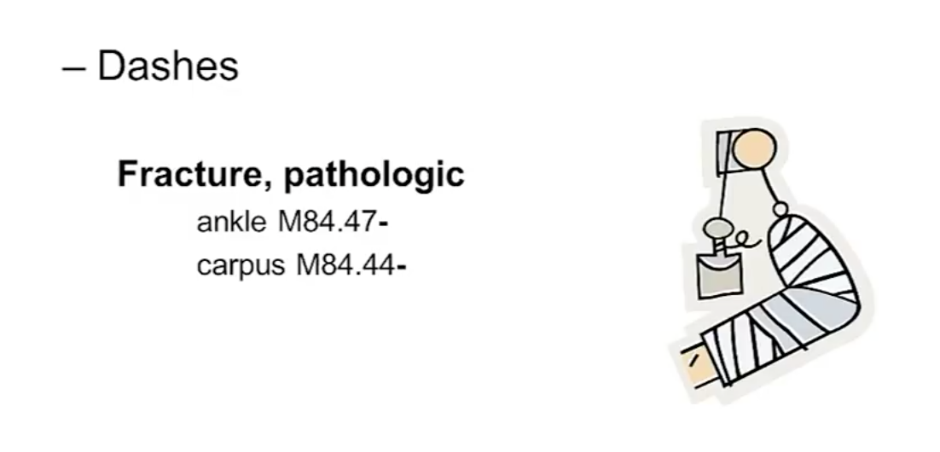
Coding Convention
“the Dash” [M84.47-]
USE of DASHES
Notes:
When a dash is used – this means the Code is incomplete and needs further “defining” characters
Go to Tabular List and look up Pathologic Fracture ankle

Slide 22
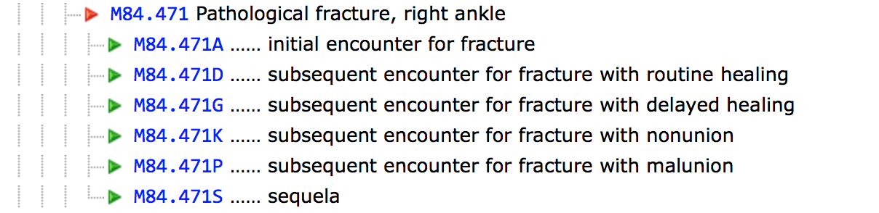
M84.47-
DASH = Further Information is required
Notes:
Exclusion terms
In addition to inclusion terms, certain chapters, blocks, three- and four-character codes contain lists of conditions preceded by the word ‘Excludes’.
These conditions are to be coded elsewhere, not within the chapter, code range or rubric that the title may suggest.

Slide 23
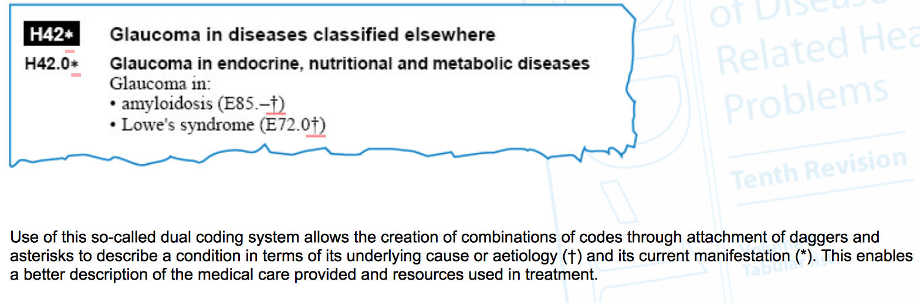
Dagger & Asterisks
Coding Conventions
Notes:
Dual Coding System: Attached daggers and asterisks to describe a condition in terms of UNDERLYING CUASE (DAGGER) AND CURRENT MANIFESTATION (ASTERISK)
The dagger code (†) is used as the underlying cause of death. Never use the asterisk code (*) alone if the diagnosis being coded uses the dagger and asterisk convention.

Slide 24

Mutually Exclusive Grouping
Communicable diseases
General diseases that affect the whole body
Local diseases arranged by site
Developmental diseases
Injuries
External causes

Slide 25
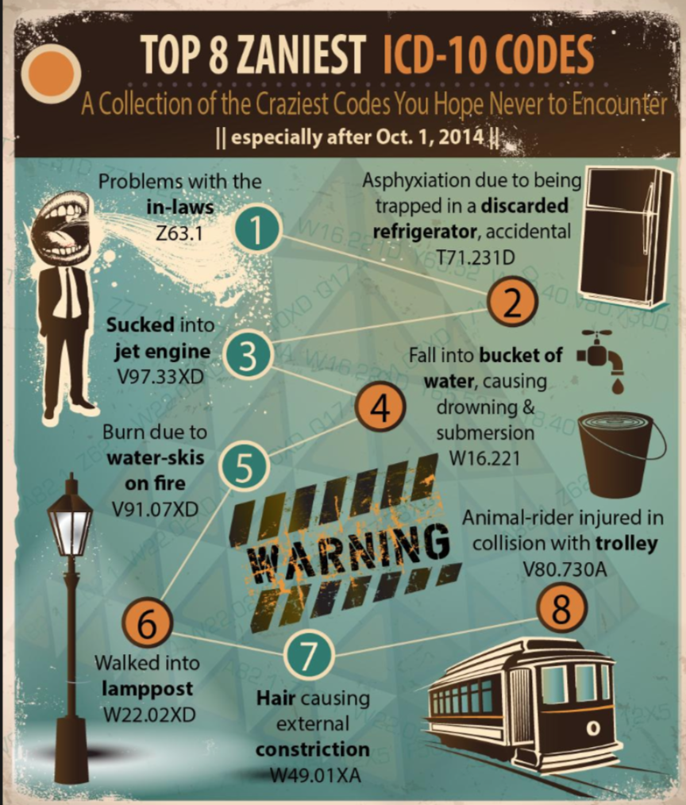

Slide 26


Slide 27

Excludes “NOTES”
Coding Rules
ICD 10 Coding Rules
Excludes1 -- a “pure excludes” note
  Never use excludes1 codes with the code listed above
Excludes2 –
  Excludes the above code; however, may actually occur simultaneously on occasion and may be used together if appropriate

Slide 28
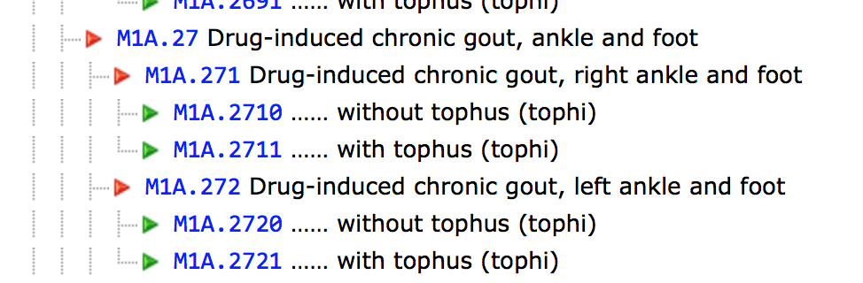
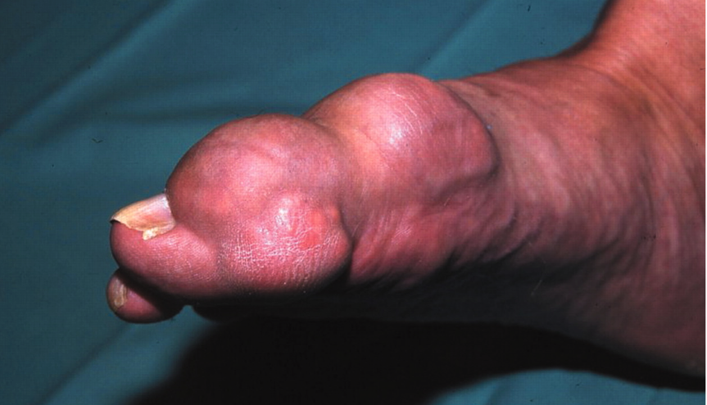
Type 1 Excludes
Means: “not coded here”
  The code excluded can never be used with the code listed
  M1A– Chronic Gout
      Type 1 Excludes: M10.- Acute Gout
                M10.- Gout, NOS

Slide 29
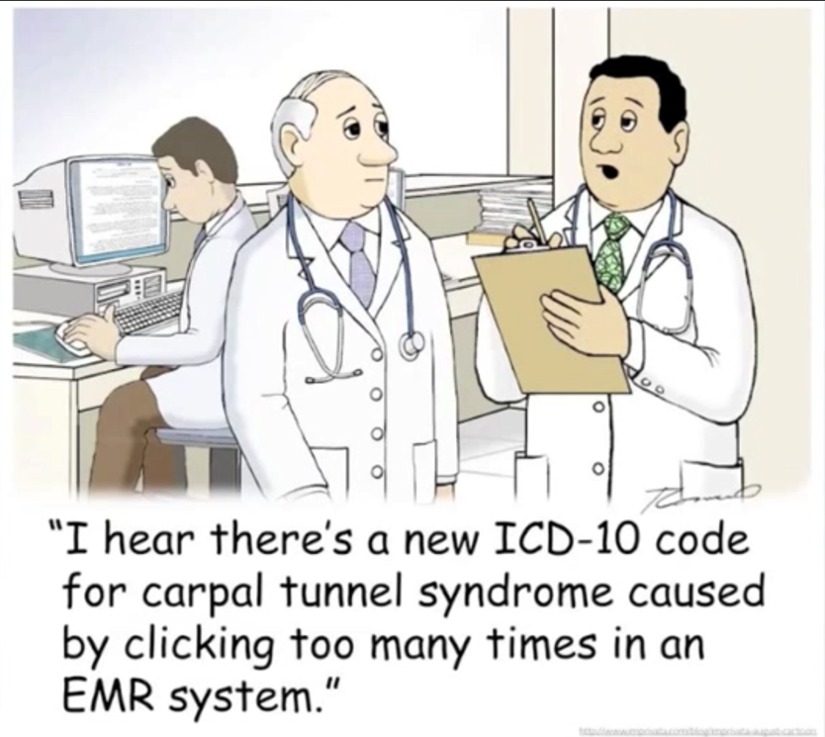

Slide 30
Case Example
35 y/o male, firefighter presents for follow-up r/t Left arm “burn wound” from hot water tank explosion during attempts to extinguish house fire 3 weeks ago.
Initial eval -> ER 2.10.15-> dx: 3rd degree burn →referred ->burn clinic for initial management/tx.
Returns today for scheduled 3 week bandage change. Pain1/10 otherwise denies complaints. ROS neg.
How would you code this?

Slide 31
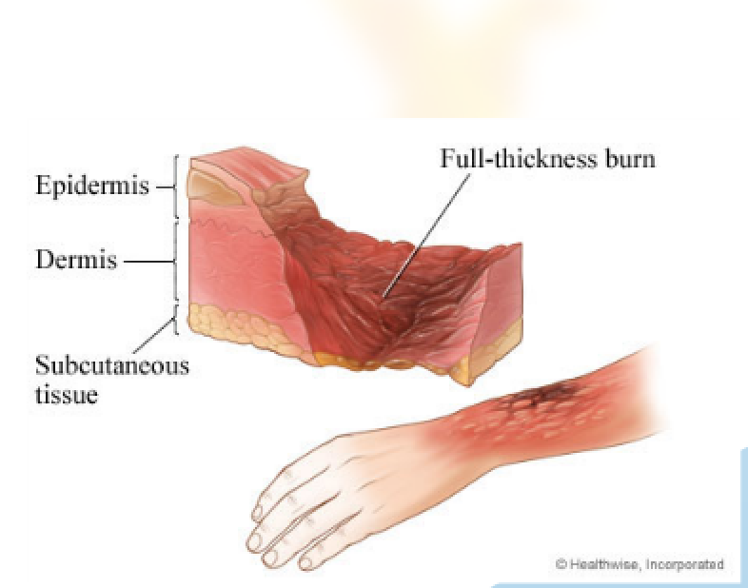
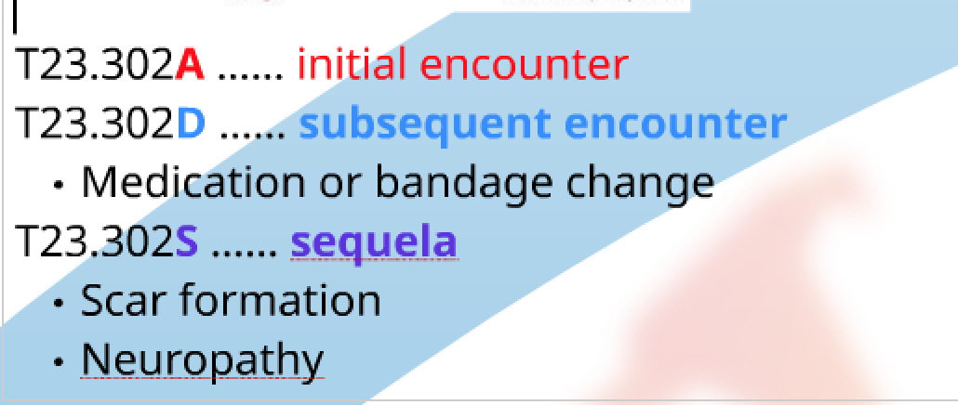
T23.302D
3rd degree Burn to Left Hand, Unspecified site; Subsequent Encounter
Bandage Change –
Wound assessment

Slide 32
Challenges?
Learning Curve
Providers
Staff
Costly
⬆Time Intensive
⬇Productivity
⬇Revenue
Coding Errors
Claim Denials

Slide 33

Overcoming Challenges
Understand the impact in your practice
Consider Template changes
Modify policies & procedures
Documentation modification
Engage with Coders/Billing/Payers
  Relationship is “key”
Internal Testing to Evaluate your Readiness

Slide 34
Capturing similar data
Capturing same data as ICD 9
OTITIS MEDIA
Data: OLDCARTS/PE
Suppurative or Nonsuppurative?
Allergic/non allergic
Associated
Difference is documentation of data
Mucoid
Exudative
With/without effusion
With/without TM Rupture
Related to smoke exposure
Acute, Sub-acute, Chronic, or recurrent
Laterality:
Left/Right Bilateral

Slide 35
Destination… Oct 1, 2015
Flight Plan
ACTION PLAN
TEAM TRAINING
PRIMER
PROCESS UPDATES
-
ENGAGE VENDORS & PAYORS
INTERNAL TESTING
SYSTEMS & PROCESSES
ICD10
ICD-9
(Centers for Medicare and Medicaid, 2015)
Notes:
PLAN: In the beginning stages of your ICD-10 journey -- pinpoint Diagnosis codes. Prepare an ICD-10 transition budget. Set an Action Plan
TEAM TRAINING: Obtain Clinical Documentation Education
Ongoing Practice and Validation
Obtain Coding Education
Obtain ICD-10 Overview Education
UPDATE PROCESSES:
Improve documentation
REVISE templates and paper documents
Obtain ICD 10 Overview
ENGAGE VENDORS/PAYERS
EHR-UPDATES – System updates
Staffing & Billing – Collaborative efforts
Evaluate readiness – Clearinghouse
Evaluate payers and readiness
TEST YOUR SYSTEMS & PROCESSES
Internal
External – Centers for Medicare & Medicaid offer various testing options with feedback

Slide 36

Ready or not…

Slide 37
CMS ICD 10 Testing
Pilot
RESULTS
FAVORABLE
Pilot
Centers for Medicare and Medicaid Services
Approved
Denied Claims
15,000 Claims
19% Denied
81% Accepted
Jan 26, 2015 – Feb 3, 2015
6% due to ICD 10 Mistakes
13% r/t unrelated missteps
(Gruessner, 2015)

Slide 38
Risks of ICD 10 Conversion
5
Lack of Preparation (office & Payers)
Transition
Costs
Insufficient Training
Reduced Productivity
Transition
Issues
Avoid Procrastination: Start training Now

Slide 39
FOR Providers
SPECIFICALLY DOCUMENT SUBJECTIVE & OBJECTIVE FINDINGS
Musculoskeletal Disorders
Diabetes Type II
Hypertensive Disease
FNP Common Codes
Documentation Changes
Pediatric NPs Common Codes
Documentation Changes
Adult/Gero NP Common Codes
Documentation Changes
(Centers for Medicare and Medicaid Services, 2015)

Slide 40
Websites
WHO Training Tool
Road to ICD 10: Training webcasts
CMS ICD 10-CM 2015
CMS ICD 10 Guidelines – 2015
CMS ICD 10 Index - Website Home Page
Pediatric NPs Common Codes
Pediatric Documentation Changes
FNP Common Codes
  Documentation Changes
Adult/Gero NP Common Codes
Documentation Changes
ICD 10 Codes
ICD 10 and Clinical Documentation [video training] (Nichols, 2014)

Slide 41
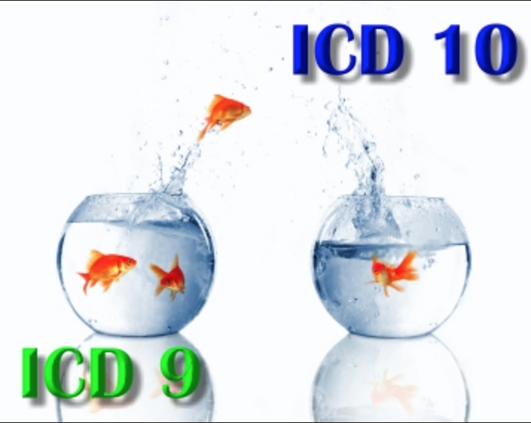

Slide 42

Review

Slide 43
References
Centers of Disease Control (2003). ICD-10 cause of death lists for tabulating Mortality statistics. Retrieved from http://www.cdc.gov/nchs/data/dvs/im9_2002.pdf.pdf
Centers for Medicare and Medicaid Services (2015). Public Health transition to ICD-10-CM/PC. Retrieved from: http://www.cdc.gov/nchs/icd/icd10cm_pcs.htm
Gruessner, V. (2015). CMS finds ICD-10 testing successful. Retrieved from: https:// ehrintelligence.com/2015/02/25/cms-finds- icd-10-testing-successful/
Nichols, J.C. (2014). ICD-10 and clinical documentation [video]. Retrieved from http://www.medscape.org/viewarticle/828929_2
World Health Organization (2010). ICD-10 Training Tool. Retrieved from: http://apps.who.int/ classifications/apps/icd/icd10training/
ICD-10%20training/Start/index.html

Slide 44
When is unspecified, appropriate?
“Coding that does not fully define important parameters of the patient condition…”
But otherwise can be defined with information available to the reader (coder, provider)

