Slide 1
Assessment And Treatment of the Pediatric Client
Teresa Whited, MS, APRN-CNP, CPNP-PC

Slide 2
Objectives
By the end of the learning activity, the student will be able to:
Identify common dermatologic, cardiac, neurologic, infectious disease, and chronic disorders in patients birth to 21 years of age.
Describe common complications in disorders for patients birth to 21 years of age.
Apply pharmacology and pathophysiology to the assessment, diagnosis, and treatment of common acute and chronic disorders in patients birth to 21 years of age

Slide 3
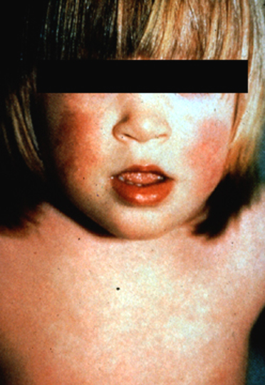
Dermatology
Fifth Disease- Erythema Infectiousum
Notes:
Slapped Cheek Rash—Caused by Parvovirus 19
Benign self limiting with prodrome characterized by low grade fever, headach, and URI symptoms. 3 phases of rash-erythematous facial flushing, then spreads to trunk and proximal extremities as a diffuse macular erythema, finally central clearing of macular lesions-lacy appearance.
Complications: arthritis/arthralgias, Transient aplastic crisis, fetal infection (hydrops and fetal demise), myocarditis, bone marrow suppression in immunocompromised.
Treatments: No routine treatment unless severe complications-then treat with IVIG. No longer contagious after rash presents. Notify contacts. May have recurrence of rash over next 2-4 weeks especially with sun exposure.

Slide 4
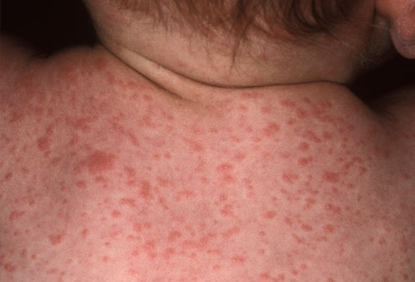
Dermatology
Roseola
Notes:
Caused by human herpesvirus 6 and 7.
95% of cases in children younger than 3. Presents with high temperature (101-106) x 3-5 days, irritability, anorexic
Fever resolves abruptly followed by rash within 12-24 hours.
Rose colored-discrete raised macules on trunk that spreads to neck, face and proximal extremities.
Rash fades in 1-3 days.
Complications: Febrile seizures, encephalitis/menigitis, idiopathic thrombocytopenia
Treatments: No treatment needed unless complications (ganciclovir, cidofovir) Patients who are very uncomfortable or very febrile (history of seizures) Tylenol and Ibuprofen.

Slide 5
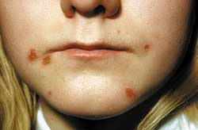
Dermatology
Impetigo
Notes:
Most common form is Non-bullous-70% of cases. Usually caused by Staph Aureus or group A b-hemolytic strep. Starts with skin break usually on the face or extremities. Begins as a tiny vesicle or pustule that progresses to honey colored plaque. Easily spread by contact.
Co mplications: Rare: osteomylitis, septic arthritis, pneumonia, septicemia, acute post-strep glomerulonephritis.
Treatment: Topical treatment with mupirocin TID x 7-10days-minor cases. Oral therapy for areas of larger involvement, areas around mouth, or lymphatic involvement. Erythromycin 40mg/kg/day divided TID to QID x 7-10 days.

Slide 6
Dermatology
Molluscum contagiosum
  Complications
  Treatments:
Notes:
Discrete,pearly, skin-colored smooth, domes-shaped, papules from 1-5mm. Central umbilications from which a plug of cheesy material can be expressed.
Can occur anywhere on the body. Can be isolated or in clusters.
Atopic derm or immunocompromised: can have widespread involvement
Unsightly.
Treatment: usually self limiting but can last 6months to years.
Avoid shared towels and baths. Can be treated with curretage or cantharidin then covered with a bandaid.

Slide 7
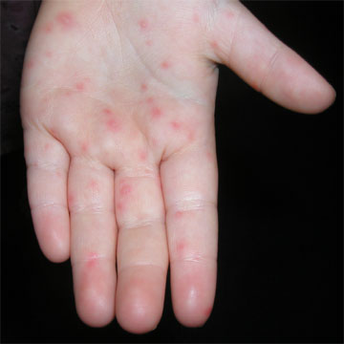
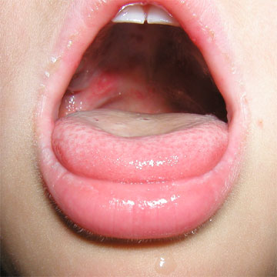
Dermatology
Hand Foot and Mouth
Notes:
Caused by Coxsackie or enterovirus.
Usual presentation: mild fever, oropharynx is inflamed and contains scattered vesicles that can ulcerate on the tongue, buccal mucosa, gingiva and lips.
Maculopapular or vesicular lesions also can occur on hands, feet, growin and buttocks. Resolves in 1 week.
Rare complications: brain stem encephalomyelitis, neurogenic pulmonary edema/hemorrhage, shock, and death
Common complications: Dehydrations and pain
Treatment: Usually self limiting. Will likely require pain management with Tylenol/Motrin. Monitor hydration status.
Magic mouthwash: Mix 1/2 teaspoon antacid solution (such as Maalox or Mylanta) with ½ teaspoon diphenhydramine
solution (liquid Benedryl). Apply some of this solution to the inside of the lips and mouth before feeding, up to six times a day.
Children over age 4 can use 1 teaspoon of this solution to swish and spit out. (lidocaine is controversial secondary to potential systemic side effects)

Slide 8
Dermatology Question:
The nurse practitioner is seeing an 18 month old patient in clinic for a chief complaint of “rash” x 1 day. Family reports the patient had a high fever that resolved abruptly then developed a maculopapular rash on the trunk with spread to the face today. The most likely diagnosis for this child is:
a. Roseola
b. Hand Foot and Mouth
C. Fifth Disease
d. Impetigo

Slide 9
Cardiac Conditions and Treatments
Congenital Heart Defects
  VSD-the most common
  PDA-Premature infants
  AV canal-Down’s Syndrome
  Coarctation-Turner Syndrome
Notes:
1% of population affected by congenital heart defects. Most common birth defect in the US.
VSD and PDA can cause significant left to right shunts leading to heart failure symptoms including tachypnea, poor feedings, diaphoresis, and pulmonary congestion. Surgical repair in the first 6 months if symptomatic or large defect.
Down’s syndrome-~50% will have a heart defect, ~50% will have AV canal. All patients should have screening echocardiogram shortly after birth (prior to 3-6months). Can cause CHF and irreversible pulmonary hypertension if untreated. Surgically repaired in 4-6 months of age.
Turner Syndrome-most common defect is coarctation of the aorta-surgically repaired at birth with prostiglandin therapy prior to repair.
CHF medications: Diuretics, Digoxin, Ace inhibitors.

Slide 10
Congenital defects Complications
Poor growth
Poor energy
Learning disabilities
Developmental delays
Behavioral problems

Slide 11
Additional Cardiac Conditions:
Functional sounds:
  Still’s murmurs
  Venous Hum
  Physiologic split S2
Notes:
Still’s murmurs are the most common finding in 12-school age child. Musical type murmur-grade II or less, usually located at left lower sternal border. Thought to be related to growth and turbulence during high output times (fever, activity).
Complications: none-benign. Treatment: none-resolves typically spontaneously within months to years.
Venous Hum: Benign continuous murmur heard over venous complexes in upper chest-SVC, jugular veins. Turbulence and related to growth of venous structures. Usually noted in school age children. Can be exagerrated or made to disappear by varying position of head or compression of jugular vein in neck. Complications: None-benign. Treatment: Reassurance, usually resolves with growth.
Physiologic split S2-S2 will split with inspiration due to increased introthoracic pressure causing minut delay of pulmonary valve. To verify benign: have patient take deep breath and hold it should split. Have exhale and hold should become single again. No complications or treatment.

Slide 12
Cardiac Question
The nurse practitioner is assessing a child with Down’s Syndrome. The nurse practitioner knows the most common heart defect associated with Down’s Syndrome is:
a. hypoplastic left heart syndrome
b. atrioventricular canal defect
c. tricuspid atresia defect
d. coarctation of the aorta

Slide 13
Neurologic Conditions
Seizures
  Febrile
    Complications
    Treatment
Notes:
Febrile: most common seizure disorder of childhood. Rare before 9 mths or after 5 yrs. Usually associated with high fevers and family history of febrile seizures.
Complications: don’t cause reduction in intellectual performance. Must rule out meningitis or encephalitis .
Treatment: simple short (less than 5 minutes) do not require treatment. For longer seizures (greater than 5 mins), benzodiazepine for acute treatment. Long term treatment not recommended because does not prevent future seizures and may have adverse side effects.

Slide 14
Neurologic Conditions
Cerebral Palsy
  Complications
  Treatments
Notes:
Group of motor syndromes resulting from disorders of early brain development. Caused by: genetics, metabolic, ischemic, infectious, and other acquired etiologies.
CP has multiple complications or associated conditions including: epilepsy, speech, vision, and intellectual delay.
Red flags: handedness prior to 3-4 years of age, poor movement of arms and legs, poor feedings, global developmental delays, persistent primitive reflexs.
Treatment: Multi-disciplinary care including PT/OT/Speech Therapy, orthopedics, adaptive equipment,
Spasticity treatments: benzodiaepines, baclofen pumps, botulinum toxins
Secretion management: scopolomine.

Slide 15
Neurologic Question
The NP is seeing a child in the ER for a seizure. Parents report a fever of 104 with an ear infection. The child had a generalized seizure that last less than a minute. The NP knows the best treatment for this type of initial febrile seizures is:
a. No treatment
b. Long term phenobarbitol therapy
c. Benzodiazepine x 1 stat
d. Referral to neurology

Slide 16
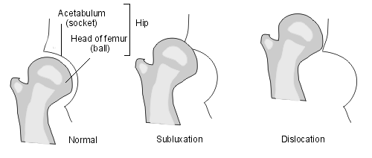
Orthopedic Disorders
Developmental Dysplasia of the Hip
Notes:
Is a spectrum of developmental problems of the acetabulum.
Simple acetabular dysplasia(femoral head retained with inadequate acetabulum)
Acetabular dysplasia with subluxation (femoral head moves slightly away from the acetabular wall)
Dislocation (complete loss of contact between femoral head and acetabulum)
Occurs in 1-1,000 births, more frequently in females and breach presentation.
Ortolani-abduction of the hip with backward down pressure
Barlow-adduction of the hip and posterior pressure-to elicit dislocation of femoral head.
(hip clunk or click). Asymmetric thigh folds. Radiographs: greater than 6 months, ultrasound: younger than 6 months.
Treatment: newborns-pavlik harness for 6 wks. Greater than 6 months: closed reduction with casting, Older than 2 usuall requires open reduction.
Complications: avascular necrosis of Femoral head, hip dislocations or acetabular dysplasia.

Slide 17
Orthopedic Disorders
Osgood-Schlatters
Notes:
Characterized by pain over the tibial tubercle in a growing child with activity. Typically in a very active teenager. Swelling over tubercle.
Patellar tendon pulls on the growth plate of tibial epiphysis. Traction opphysistis of the tibial tubercle growth plate and patellar tendon.
Point tenderness over the tubercle. Radiographs: fragmentary ossification of the tubercle.
Complications: rare but can lead to avulsion of fragment or patellar tendon.
Treatment: rest, restriction of activities and an occasional knee immobilizer is necessary. Key is isometric and flexibility exercise program.
Usually self limited but may take 12-24 month to fully resolve.

Slide 18
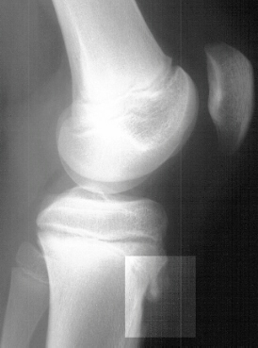
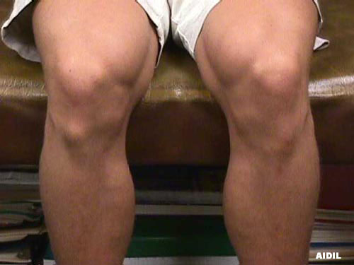
Osgood-Schlatter Disease

Slide 19
Orthopedic Disorders
Slipped Capitol Femoral Epiphysis
  Complications
  Treatment
Notes:
Presentation: pain in groin, hip, or thigh. Usually sudden onset of limp.
Slip of the femoral head at physis. Radiology: AP and lateral views shows widening and irregularity of the physis.
Etiology: obese children more at risk because they have retroverted femoral necks that are directed more posteriorly.
Complications: osteonecrosis or chondrolysis-acute dissolution of articular cartilage in the hip.
Treatment:
Prevent further slippage, reduction of slippage, and salvage procedures. Immediate referral to orthopedic surgeon for surgical management.

Slide 20
SCFE
Male:Female 1.5:1
Typically overweight early adolescent
Bilateral 20-40%
In unilateral disease, contralateral side slips 30-60%
Left>Right
Most common presentation:
  Pain
  Altered gait

Slide 21
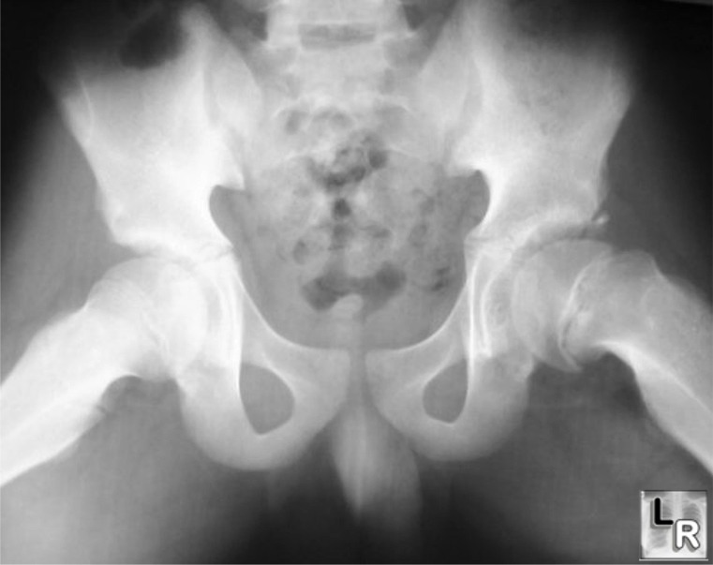
Slipped Capital Femoral Epiphysis

Slide 22
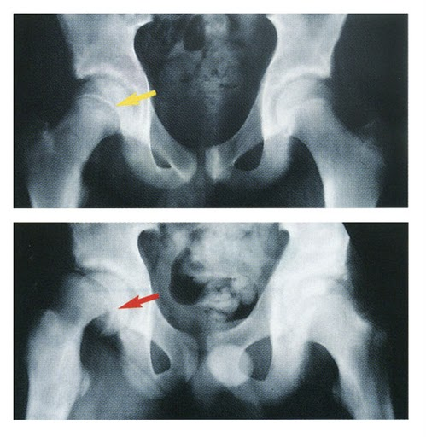



Slide 23
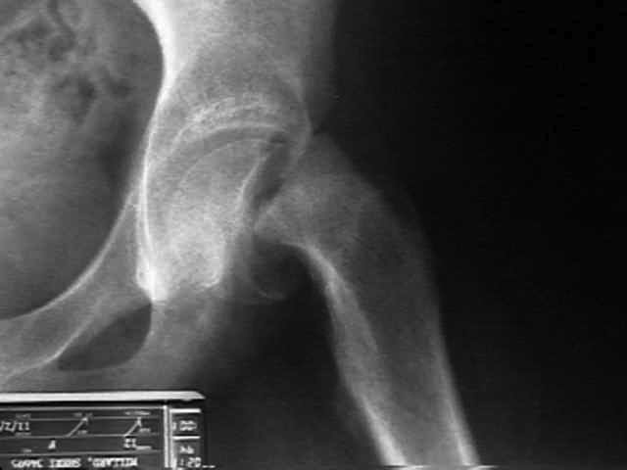
Slipped Capital Femoral Epiphysis

Slide 24
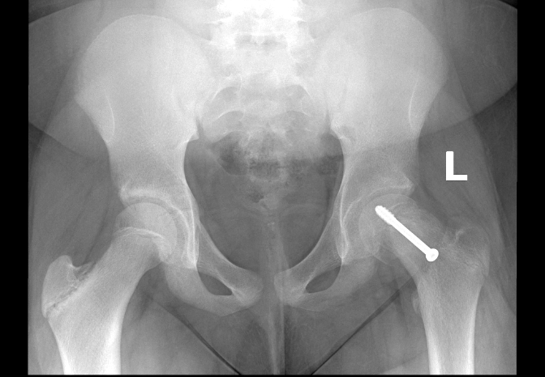

Slide 25
Orthopedic Disorders
Legg-Calve-Perthes Disease
  Complications
  Treatment
Notes:
Unknown etiology: infectious, trauma or transient synovitis. Typical presentation is limp with or without pain to hip, knee or thigh.
Blood supply is temporarily interrupted to the femoral head leading to deformities of the femoral head or acetabulum.
Commonly occurs in children 4-8 years of age.
Complications: deformity of femoral head or hip joint.
Treatment: Activity limitation and PT. Severe pain may require traction and bed rest. Abduction devices to maintain femoral head in acetabulum.
Referral to orthopedics important for long term follow up and potential surgery to correct hip deformities.

Slide 26
LCP Disease
Idiopathic avascular necrosis of femoral head
Affects 3-12 year old (peak 5-7)
Bilateral 10-20%
Male:Female 4:1
Better outcomes in children <8

Slide 27
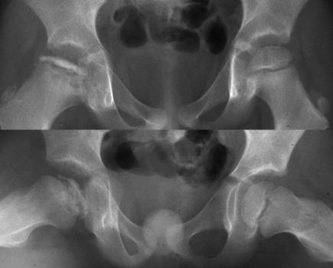

Legg-Calve-Perthes disease

Slide 28
Orthopedic Question
When caring for the child with Osgood-Schlatter Disease, the nurse practitioner would know her treatment has been effective when:
a. The child no longer complains of pain at lower knee at rest
b.The child no longer complains of pain at the ankle at rest.
c.The child no longer complains of pain at the hip during exercise.
d.The child no longer complains of pain at lower knee during exercise.

Slide 29
GU Disorders
UTI
  Complications
  Treatment
Notes:
Occurs in 3-5% of girls and 1% of boys.
Most common bacteria: E.coli, Klebsiella, and Proteus
Complications: renal insufficiency or end stage renal disease.
Presenting symptoms: Fever (infants especially with no other focus), abdominal/flank pain, N/V/D. Infants-poor feedings, irritability and weight loss.
Older than 3 years olds are able to report more classic symptoms-frequency, urgency, pain with urination.
UA (leukocytes) but gold standard is urine culture. Bagged urine insufficient so clean catch or cath specimen.
Treatment:
Trim-sulfa and Nitrofuratoin with 3-10 day course of therapy against most E.coli and Klebsiella. Maintain hydration status.
May need further imaging studies if recurrent or prior to 6 months of age such as a VCUG, renal ultrasound

Slide 30
GU disorders
Enuresis
  Complication
  Treatment
Notes:
Voluntary or involuntary repeated urination after developmental bladder control should be achieved (5 years of age).
2 x a week for at least 3 months. Males more common than females. Familial pattern.
Primary-never been continent (90%)
Regressive-6 months dry and then incontinence.
Complications: psychologic and social implications,
Treatment: First line-behavioral interventions: Reward for dry nights or days, void before sleep, psychotherapy for trauma reasons, limit fluids before bed, regular voiding patterns, conditioning devices.
Pharmacotherapy: 2nd line-DDAVP or Imipramine but high relapse rates and can be associated with adverse side effects such as hyponatremia, water intoxication, seizures, cardiac conduction disturbances.

Slide 31
GU disorders
Encopresis
  Complications
  Treatment
Notes:
Passage of stools in inappropriate places after chronologic age of 4year of age developmentally.
Complications: psychological and social implications. High association with developmental delays and eneuresis. Secondary highly associated with conduct disorder and psychosocial stressors.
Can also be related to constipation and overflow incontinence-highest incidence.
Must evaluate for fecal retention, abnormal anal sphincter function, behavioral issues.
Treatment:
clear fecal impaction and regular laxative use to prevent recurrence and behavioral therapy-regular stooling patterns(postprandial), high fiber diet, Reward compliance behaviors, psychologic treatments.
Usually resolves on its own over time.

Slide 32
GU Question
The nurse practitioner is seeing a 6 year old with a diagnosis of UTI. The nurse practitioner knows the most appropriate pharmacologic treatment for the child with UTI is Bactrim. The reason for the use of this medication over other drugs is:
a. the medication is well absorbed in the liver.
b. the medication is excreted only in the feces.
c. the medication treats mycoplasma pneumonia.
d. the medication treats E. Coli.

Slide 33
Growth and Development
Normal Growth and Development
Handout on growth and nutrition
CDC Developmental Milestone Checklist:
  http://www.cdc.gov/ncbddd/actearly/milestones/index.html
AAP developmental Section
  http://www2.aap.org/sections/dbpeds/screening.asp
Notes:
Review normal growth and development including height and weight at different ages, milestones at well child visits, and normal puberty including Tanner staging.

Slide 34
Growth and Development Disorders
Precocious Puberty
  Complications
  Treatment
Notes:
Boys: development prior to age 9 years-rare and usually related to CNS tumor, CAH, androgen exposure, adrenal tumors.
Girls: development prior to age 7-8 years of age.
Causes: CNS tumors or damage, CNS malformations (cysts, hydrocephalus, septo-optic dysplasia), exposure to exogenous estrogen, ovarian cysts or tumors, severe hypothyroidism or unknown cause.
Complications: premature epiphysal closure, psychosocial distress.
Incomplete forms: premature thelarche (breast development), premature Adrenarche (hair development), true precocious puberty (multiple development)
Hx: family history of endo and pubertal timing, growth patterns in the past. PE: Tanner staging, Skin finding: Café au lait (McCune Albright Syndrome), thyroid, abdominal assessmen, t.
Lab eval: Bone age first: if greater than 2 years advanced then additional assessment. Refer to endocrine for further evaluation.
LH, FSH, DHEAS, and TSH in girls. Test, 17 OH progesterone, LH, and FSH in boys.
If levels normal (prepubertal response) then likely pseudo form. If pubertal response then likely true and needs a MRI/CT scan to rule out brain disease.
Treatment: Depot leuprolide 0.3mg/kg q 28 days IM (GnRH analog-suppress pubertal axis) (if 7-9 years may not require suppression but if sooner should be considered

Slide 35
Growth and Development Disorders
Short Stature
  Constitutional/familial growth delay
  Growth hormone deficiency
Notes:
Linear growth is <4-5cm/year during the years prior to normal age for peak linear growth.
No evidence of peak linear growth by 16 in boy and 14 in girl.
Deceleration below individual est. growth velocity occurs
Height is more than 2SD below calculated midparental height, 3SD below the mean
Most common: familial or constitutional delay
DDs: familial, chronic illness, constitutional delay of puberty, hypothyroidism, GH deficiency, poorly controlled diabetes, Chromosome disorders, skeletal disorders (chondrodysplasia)
Hx: pregnancy issues, birth weight and length (interuterine growth retardation), renal, cardiac, GI, pulmonary, nuero issues. Growth history-growth velocity, family history of growth and puberty
PE: growth charts, U/L body segment ratio, thyroid, tanner staging, neuro.
Lab: CBC, CMP, TSH, Bone age, karyotype, growth factors if indicated.
Treatment: No treatment for familial and constitutional delay. Growth hormone deficiency: GH injections at0.18-0.3mg/kg/wk-prevents lack of achievement of mature height.
Other causes should be addressed with appropriate therapies.

Slide 36
Growth and Development Disorders
Turner Syndrome
  Complications
  Treatment
Notes:
Turner Syndrome: syndrome with complete or partial second X chromosome:
Manifestations: webbed neck, sexual infantilism, short stature, no secondary sexual characteristics, widely spaced nipples, shield chest, edema of hands and feet at birth, low posterior hairline, small mandible, prominent ears, high arched palate.
Complications: Multiple other defects including cardiac, renal, diabetes I, thyroid disease, mental retardation or developmental delay, usually sterile
Usually diagnosed because of phenotype, short stature, or failure to develop (puberty).
Treatment: Growth hormone and estrogen replacement. Treatment focuses on underlying disease or complications.

Slide 37
Growth and Development Question
The NP is seeing a 6 year old patient in clinic. The patient has developed body hair according to the parents. What is the next appropriate step the NP should do?
Get additional history for other signs of puberty and family history of pubertal development
Do a PE to identify additional signs of puberty
Get an LH and FSH to determine hormone levels
Reassure parents this is normal and provide education about normal pubertal development.

Slide 38
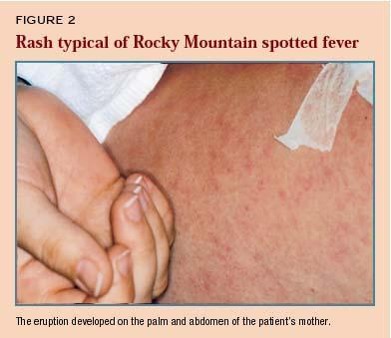
Infectious Diseases
Rocky Mountain Spotted Fever
Notes:
Most common Rickettsial disease in the US. Passed through tick vectors. Incubation is 7-14 days,
Presents as non-specific disease headache, fever, anorexia, myalgias (calf pain common in children), N/V/D. Rash after 2-4 days of illness: discrete, pale, rose-red blanching macules on extremities and then spreads to entire body. After several days rash becomes more petechial or hemorrhagic.
Complications: Meningitis, ataxia, seizures, coma, or auditory deficits. Rarely pulmonary manifestations.
Lab: CBC-low or normal WBC then progressively increases, left shift, anemia, thrombocytopenia, hyponatremia, elevated serum aminotransferase activity.
Treatment: Doxycycline 2.2mg/kg/d PO divided BID

Slide 39
Infectious Diseases
Kawasaki Disease
  Complications
  Treatments
Notes:
Unknown cause but likely infectious in nature. Most common in children under 5 years of age. Infants more likely to have atypical and complications.
Diagnostic criteria: Fever persisting at least 5 days† and the presence of at least 4 of the following 5 principal features:
1. Changes in extremities: Acute: Erythema and edema of hands and feet. Convalescent: Membranous desquamation of fingertips
2. Polymorphous exanthema 3. Bilateral, painless bulbar conjunctival injection without exudate 4. Changes in lips and oral cavity: Erythema and cracking of lips, strawberry tongue, diffuse injection of oral and pharyngeal mucosae. 5. Cervical lymphadenopathy (≥1.5 cm in diameter), usually unilateral
Lab findings: elevated ESR, CRP, normocytic anemia, high platelet count (exceeding 1,000,000), sterile pyuria,
Complications: Coronary artery anerysm-more common after 7-10 days of fever. Echocardiogram-coronary aneurysms or hyperechoic coronaries.
Treatment: IVIG x 1 2g/kg over 12 hours-if fever resolves, repeat if fever within 24 hours. High dose ASA 80-100mg/kg/day x 14 illness day then 5-10mg/kg/day x 6-8 weeks after onset of illness.

Slide 40
Kawasaki Disease
Diagnostic Criteria for Kawasaki Disease:
The child must exhibit fever for 5 days plus 4 of the other 5 criteria or, if fewer than 4 criteria, coronary vessel involvement:
Bilateral conjunctival injection without exudate
Polymorphous rash that may be urticarial or pruritic
Inflammatory changes in the lips and oral cavity
Changes in the extremities, such as peripheral edema, erythema of the palms and soles, or desquamation of the hands and feet (convalescent period)
Cervical lymphadenopathy that is often unilateral, anterior cervical

Slide 41
Kawasaki
Stage 1:
Acute phase that lasts up to 14 days
High fever unresponsive to antipyretics or antibiotics. Fever is first sign.
Significant irritability, bilateral nonpurulent conjunctival injection, erythema or the oropharynx, dryness and fissuring of the lips, “strawberry tongue”, cervical lymphadenopathy, a polymorphous rash, erythema of the urethral meatus, tachycardia, and edema of the extremities
Reddened palms & soles on days 3-5
Edema of hands and feet on days 3-5; painful induration
May be pericardial, myocardial, endocardial, and coronary artery inflammation
Typically is tachycardic and has a hyperdynamic precordium with a gallop rhythm & a flow murmur

Slide 42
Kawasaki
Stage 2:
Subacute phase (2-4 weeks after illness onset)
Desquamation of the fingers, then toes
Transient jaundice, abnormal liver function tests, arthralgia or arthritis, diarrhea, orchitis, facial palsy, and sensorineural hearing loss may occur
Coronary artery aneurysms appear during this period, more so in untreated children

Slide 43
Kawasaki
Stage 3
Convalescent phase
All clinical signs of KD have resolved
Phase is complete when all blood values are normal (6-8 weeks from onset)
Stage 4
Chronic phase is from 40 days to years after illness onset. Coronary complications, if present, can persist into adulthood.

Slide 44
Kawasaki
Diagnostic Studies:
Stage 1: elevated ESR, platelets, CPR, leukocytosis with left shift; slight decrease in hemoglobin; hypoalbuminemia; increased alpha2-globulin; and sterile pyuria. Initially the plt count may be normal but increase after the 7th day of fever.
EKG may show arrhythmias. Baseline CXR may show pleural effusion, atelectasis, and CHF.
Cultures of blood, urine, CSF, and group A beta-hemolytic strep pharyngeal cultures to rule out other sources of fever.
Echocardiograms at acute illness, 2 weeks, and then 6-8 weeks after onset of fever. Other tests may be performed by cardiologist.

Slide 45
Kawasaki Treatment
The specialist’s treatment will include the following:
IV gamma globulin
High dose ASA ( 80-100mg/kg/d divided q6 x febrile phase then decrease to 5mg/kg/d x 6-8 weeks/sometimes warfarin/Lovenox (aneurysms)
Echocardiograms
    If no evidence of coronary or cardiac changes, should be followed by cardiologist for first 6-8 weeks; then PCP may follow patient with no activity restrictions are imposed at that point.
    If coronary or cardiac changes, patient will be followed by cardiologist for years and may have physical activity limitations. With aneurysms, contact sports should be avoided.
Will need influenza vaccine
Live virus vaccines should be delayed until 11 months after administration of IVIG
Follow and counsel all KD patients about atherosclerosis risk factors

Slide 46
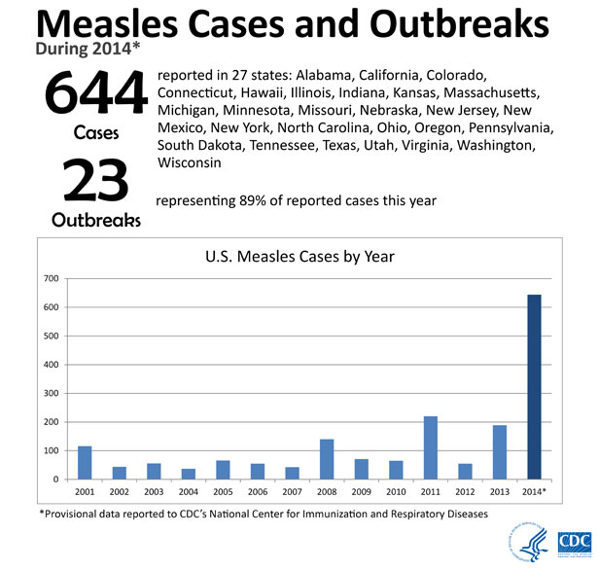
Vaccine Preventable Diseases

Slide 47
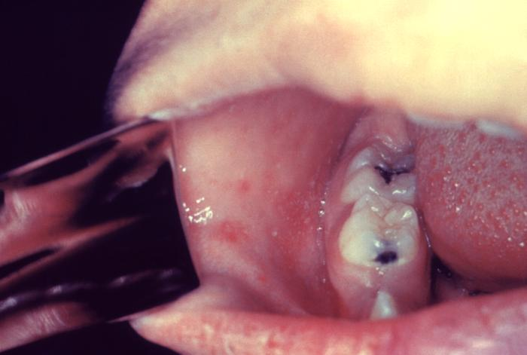
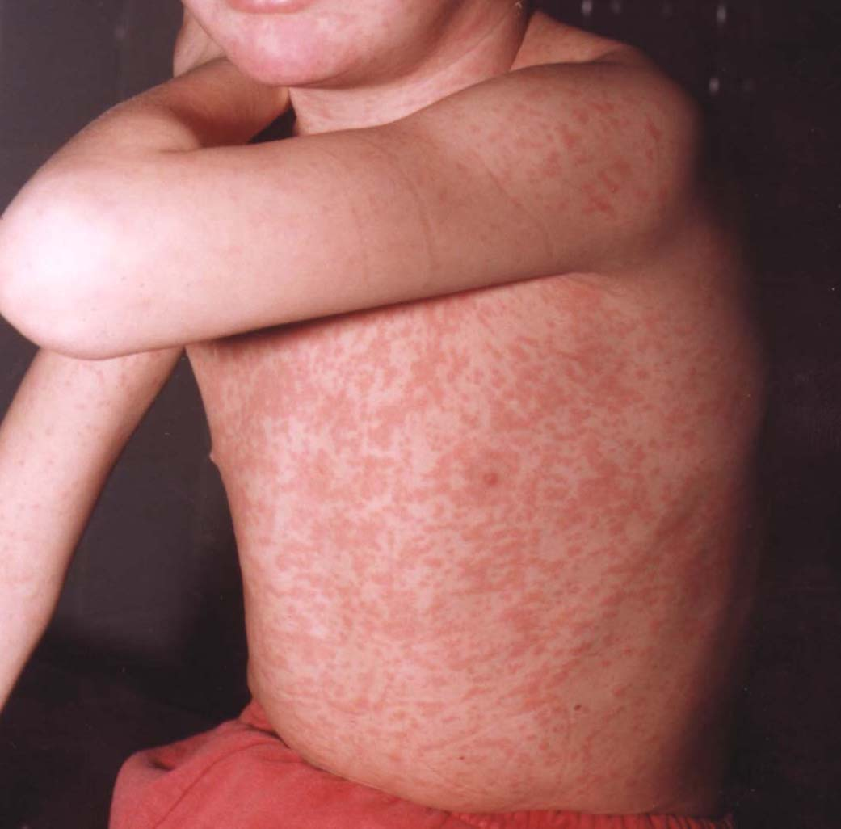
Measles(Rubeola)
Notes:
Measles (thank you anti-vaxxers).
Spread by respiratory droplets, incubation 7-14 days. Contagious 5th day of incubation to first few days of rash.
7 day measles.
Prodrome: 11-12 days of fever, cough, conjunctivitis (photophobia), coryza, lymphadenopathy.
Koplick spots-small irregular, bright red spots with blue-white center point in buccal membranes. (hallmark of disease but not always present)
Rash appears 4th day of fever and is deep red maculopapular rashe begins at hairline and spreads down from face-after several days red fades and becomes brown and does not fade with pressure. Then fades around 5-6 days and desquamation.
Significant complications: Respiratory bacterial superinfections (lung, middle ear, sinus, cervical nodes), encephalitis, myocarditis, thrombocytopenia etc.

Slide 48
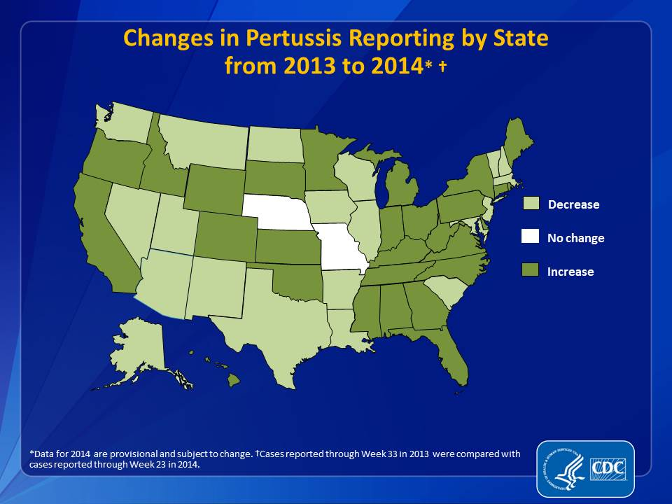
Pertussis
Notes:
Gram negative bacillus-Bordetella Pertussis and toxins causes damage to host.
Key symptom: Whooping cough (inspiratory whoop followed by spasms of coughing) can last up to 6-10 weeks, cough to vomiting. Cough is attempt to dislodge necrotic bronchial epithelial tissue and mucus.
Most common complications occur under 1 year of age including pneumonia, seizures, respiratory failure, and encephalopathy.
Three phases:
Catarrhal: 1-2 weeks like a common cold,
Paroysmal-2-4 weeks-fever gone, coughing fits, vomiting, cyanosis, exhaustion after coughing
Congvalescent-symptoms wane and can take up to 6 months to get over coughing completely.
Diagnostic tests: Culture-considered gold standard but can be neg after 3 weeks ill. So PCR from NP wash or swab.
Treatment: Macrolide Antibiotics. Azyithromycin 10 mg/kg/day x 5 days for infants to 6 months. After 6 months: 10mg/kg/day on day 1 then 5mg/kg/day x 2-5 days.
Does not alter course if in paroxysmal phase but does limit spread of infection.
Supportive treatment up to and including ICU care.

Slide 49
Infectious Diseases Question
Kawasaki diseases primary finding is which of the following?
a. Fever >/= 5 days
b. Strawberry tongue
c. Rash
d. Coronary artery aneurysms

Slide 50
Chronic Diseases
Type 1 Diabetes
  Complications
  Treatments
Notes:
Most common metabolic disorder of childhood-beta cell failure. Causes: unknown but autoimmune disorder-antibiotics detected in many, HLA (human leukocyte antigen) genese, environmental components.
Clinical manifestations: polydipsia, polyuria, polyphagia. Acute onset
Diagnosis: If BG >200-random. Fasting greater than 126mg/dl or 2 hour glucose tolerance test->200. Pancreatic islet cell antibodies or ketoacidosis.
Complications: Ketoacidosis, hypoglycemia, monilial vaginitis, renal failure, eye degeneration, neuropathies, vascular insufficiency and poor wound healing.
Treatment: Insulin dependent long and short acting insulins. Insulin pumps.
Carbohydrate counting, blood sugar monitoring, and insulin therapy mainstay of therapy
Should get all routine immunizations and normal well child examines at least q yearly. Moderate exercise should be encouraged.

Slide 51
Chronic Diseases
Juvenile Rheumatoid Arthritis
  Complications
  Treatments
Notes:
Diagnostic criteria: 1. <16 yrs of age. 2. Arthritis (swelling, effusion or presence of 2 or more signs: limitation of ROM, tenderness or pain in motion, and increased heat in 1 or more joints. 3. duration >6 weeks. 4. Type of onset defined by disease in first 6 months: a. poly-5 or more joints, oligo or pauciartricular-fewer than 5, systemic-arthritis with fever. 5. exclusion of other forms of arthritis.
Typical presentations: limp, joint pain/swelling, unexplained rash or and fever, cyclical fevers.
Complications: Uveitis-inflammation of the iris and ciliary body-glaucoma, cataracts,loss of vision, skeletal or growth abnormalitis-maturation of epiphyseal plates, growth failure-poorly controlled/long term steroid therapy Anemia of chronic disease, hepatosplenomegaly, lymphadenopathy, pericarditis, pleuritis. Sexual maturity may be delayed.
Treatment: NSAIDs, disease modifying antirheumatic drugs (Methotrexate or sulfasalazine), Corticosteroids, Biologic response modifiers (enbrel, humira, remicade, orencia).
Exercise and OT/PT, nutrition education, social support, surgery-synovectomy or repair deformities.
Routine well child and immunizations except when immunosuppressed shouldn’t receive live vaccines. Freq eye exam with fundoscopic exam q 3-12 months.

Slide 52
Chronic Diseases
Congenital Hypothyroidism
  Complications
  Treatment
Notes:
Most cases are not hereditary and result from thyroid dysgenesis. 2 x as common in girls as boys. Clinical manifestations: usually identified through neonatal screen but if missed then head size may be increased, prolonged physiologic jaundice, feeding difficulties, sluggishness, somnolence, choking spells during feedings, large tongue-resp difficulties, constipation, large abdomen, cold mottled extremities, slow heart rate.
Complications: Can be associated with cardiac, CNS and eye anomalies. Retardation of growth and development.
Lab: TSH-high and T4 low.
Treatment: Levothyroxine. Refer to endo for additional studies to look at how much functional thyroid tissue. Neonates 10-15mcg/kg/day, Children 4mcg/kg/day. Will require monthly for first 6 months then q 2-3 months until 24 months then q 6 months.

Slide 53
Chronic Disease Question
The nurse practitioner is planning an education seminar for newly diagnosed Type I diabetic patients. The nurse practitioner should include which of the following in the education of newly diagnosed Type I diabetes patients?
a. Sulfonylureas and exercise management
b. Eye exams and physicals every 5 years
c. Carbohydrates counting and insulin management
d. Avoidance of immunizations and diet management

Slide 54
Conclusion
Key Points:
  Normal Growth and Development
  Reviewed Content on common dermatologic, cardiac, neurologic, orthopedic, GU, growth and development, infectious disease, and chronic issues/disorders in children
  Reviewed complications of these disorders
  Reviewed treatment of these disorders

Slide 55
Questions ?????

Slide 56
References
AAP (2007). Bright Futures: Guidelines for Health Supervision of Infants, Children, and Adolescents. (2007) (3rd ed., rev.) US: American Academy of Pediatrics.
Burns, C. E., Brady, M. A., Dunn, A. M., & Starr, N. B. (2012). Pediatric Primary Care: A Handbook for Nurse Practitoners (5th ed.). Philadelphia: W.B. Saunders.

Slide 57
References
  CDC. (2014). Vaccine Preventable Diseases. http://www.cdc.gov/vaccines/vpd-vac/
  Fisher, M. M., Alderman, E. M., Kreipe, R. E., & Rosenfeld, W. D. (2011). AAP textbook of adolescent health care. US: American Academy of Pediatrics.
  Jackson PJ, Vessey JA. (2009). Primary Care of the Child with a Chronic Condition. (5th ed.) St. Louis: Mosby.

Slide 58
References
Kliegman, R. M., Stanton, B. F., St. Geme, J. W., Schor, N. F. & Behrman, R. E. (2011). Nelson Textbook of Pediatrics (19th ed.). Philadelphia: W. B. Saunders.

