Slide 1
Spirometry in Primary Care
Tiffany J. McCrabb MS, APRN-CNP, AE-C
Nurse Practitioner & Certified Asthma Educator
Pediatric Pulmonary & Cystic Fibrosis Center
OU Children’s Physicians

Slide 2
Session Objectives
At the completion of this educational activity the learner will:
Identify the role of spirometry in assessment and diagnosis of pulmonary disease.
Demonstrate appropriate technique for spirometry procedure.
Interpret spirometry report, distinguishing restrictive pattern vs. obstructive pattern and indicate severity of obstruction.

Slide 3
Common Abbreviations for PFTs
DLCO: Diffusing capacity of the lung; the capacity of the lungs to transfer carbon monoxide (mL/min/mm Hg)
ERV: Expiratory Reserve Volume; the maximum volume of air that can be exhaled from the end-expiratory tidal position.
FET: Forced expiratory time; the amount of time the patient exhales during the FVC maneuver (seconds)
FEV1: Forced expiratory volume in 1 second; volume of air forcibly expired from a maximum inspiratory effort in the first second (L)
FEV1/FVC ratio: Ratio of FEV1 to FVC
FRC: Functional residual capacity; the volume of air in the lungs following a tidal volume exhalation = ERV + RV (L)
FVC: Forced vital capacity; the total volume that can be forcefully expired from a maximal inspiratory effort (L)
IC: Inspiratory capacity; the maximum volume of air that can be inhaled from tidal volume end-expiratory level; the sum of IRV and VT (L)

Slide 4
Common Abbreviations, cont.
IRV: Inspiratory reserve volume; the maximum volume of air that can be inhaled from the end-inspiratory tidal position
LLN: Lower limit of normal; the lowest value expected for a person of the same age, gender and height with normal lung function
PEF: Peak expiratory flow; the highest forced expiratory flow (L/sec)
RV: Residual volume; The volume of air that remains in the lungs after maximal exhalation.
TLC: Total lung capacity; the total volume of air in the lungs at full inhalation; the sum of all volume compartments (IC+FRC or IRV + VT+ERV+RV) (L)
TV or VT: Tidal volume; the volume of air that is inhaled or exhaled with each breath when a person is breathing at rest (L)
VC: Vital capacity; the maximum volume of air that can be exhaled starting from maximum inspiration, TLC (L) can be measured either as slow vital capacity (SVC) or forced vital capacity (FVC)

Slide 5
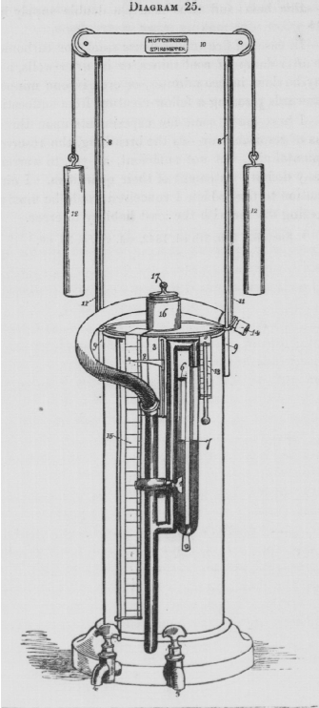
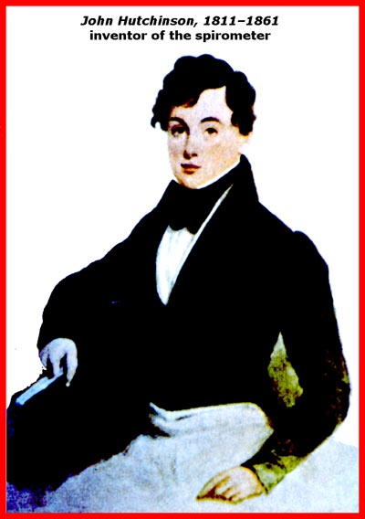
Historical development
In 1846 Hutchinson described a water spirometer, and used it to measure Vital capacity in>2000 people
Tiffeneau and Pinelli introduced the time measurement of forced vital capacity in 1947, a method improved and popularized by Gaensler in America.
In 1955, the mid-maximal expiratory flow( known as FEF25-75 was introduced by Leuallen and Fowler.
In 1979, the recommendations of the Snowbird Workshop were published in ATS, and standards of performance of spirometric systems and details of how to do the test made.

Slide 6
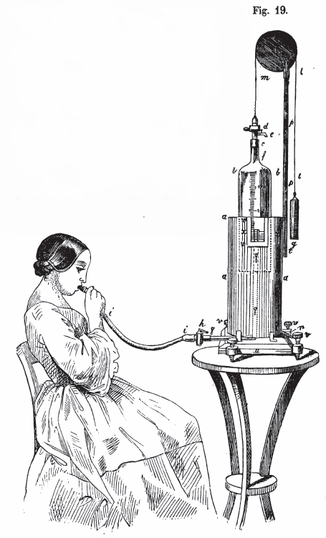
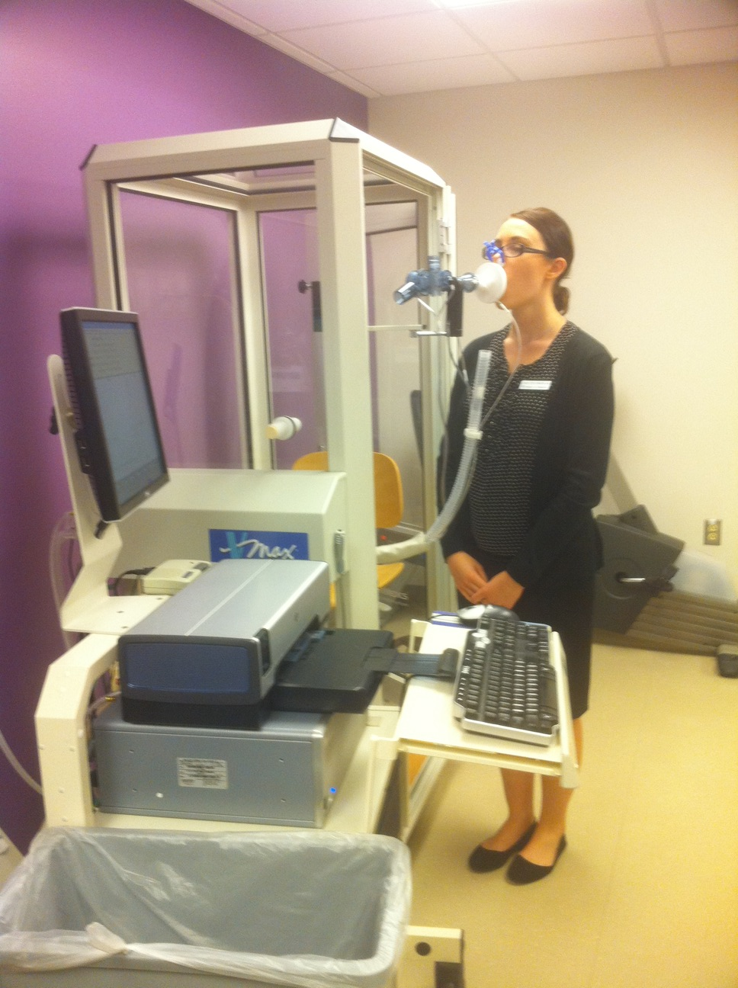
We’ve Come a Long Way
Wintrich Spirometer 1854

Slide 7
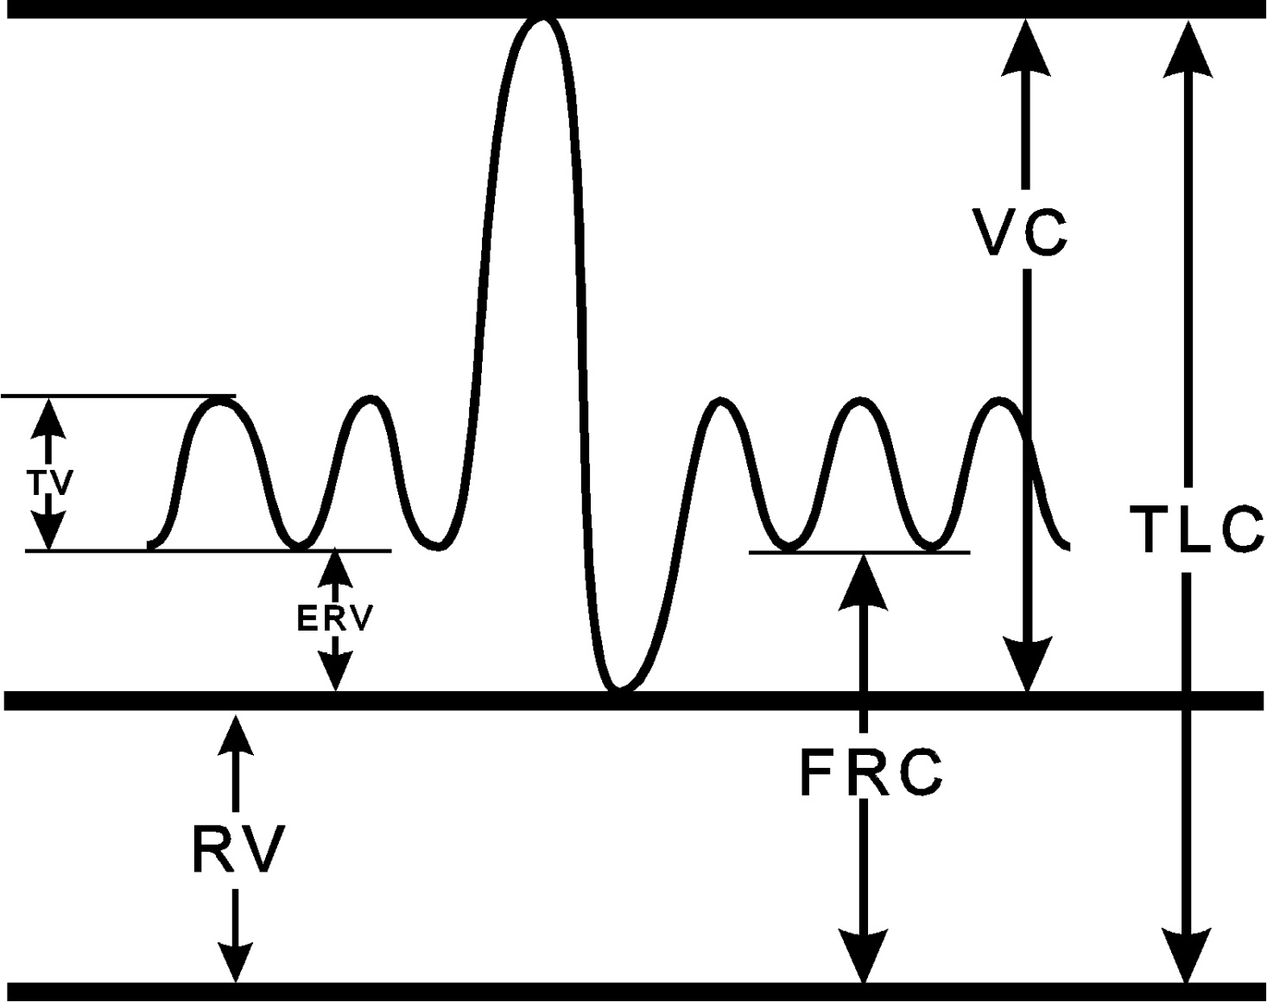

Slide 8
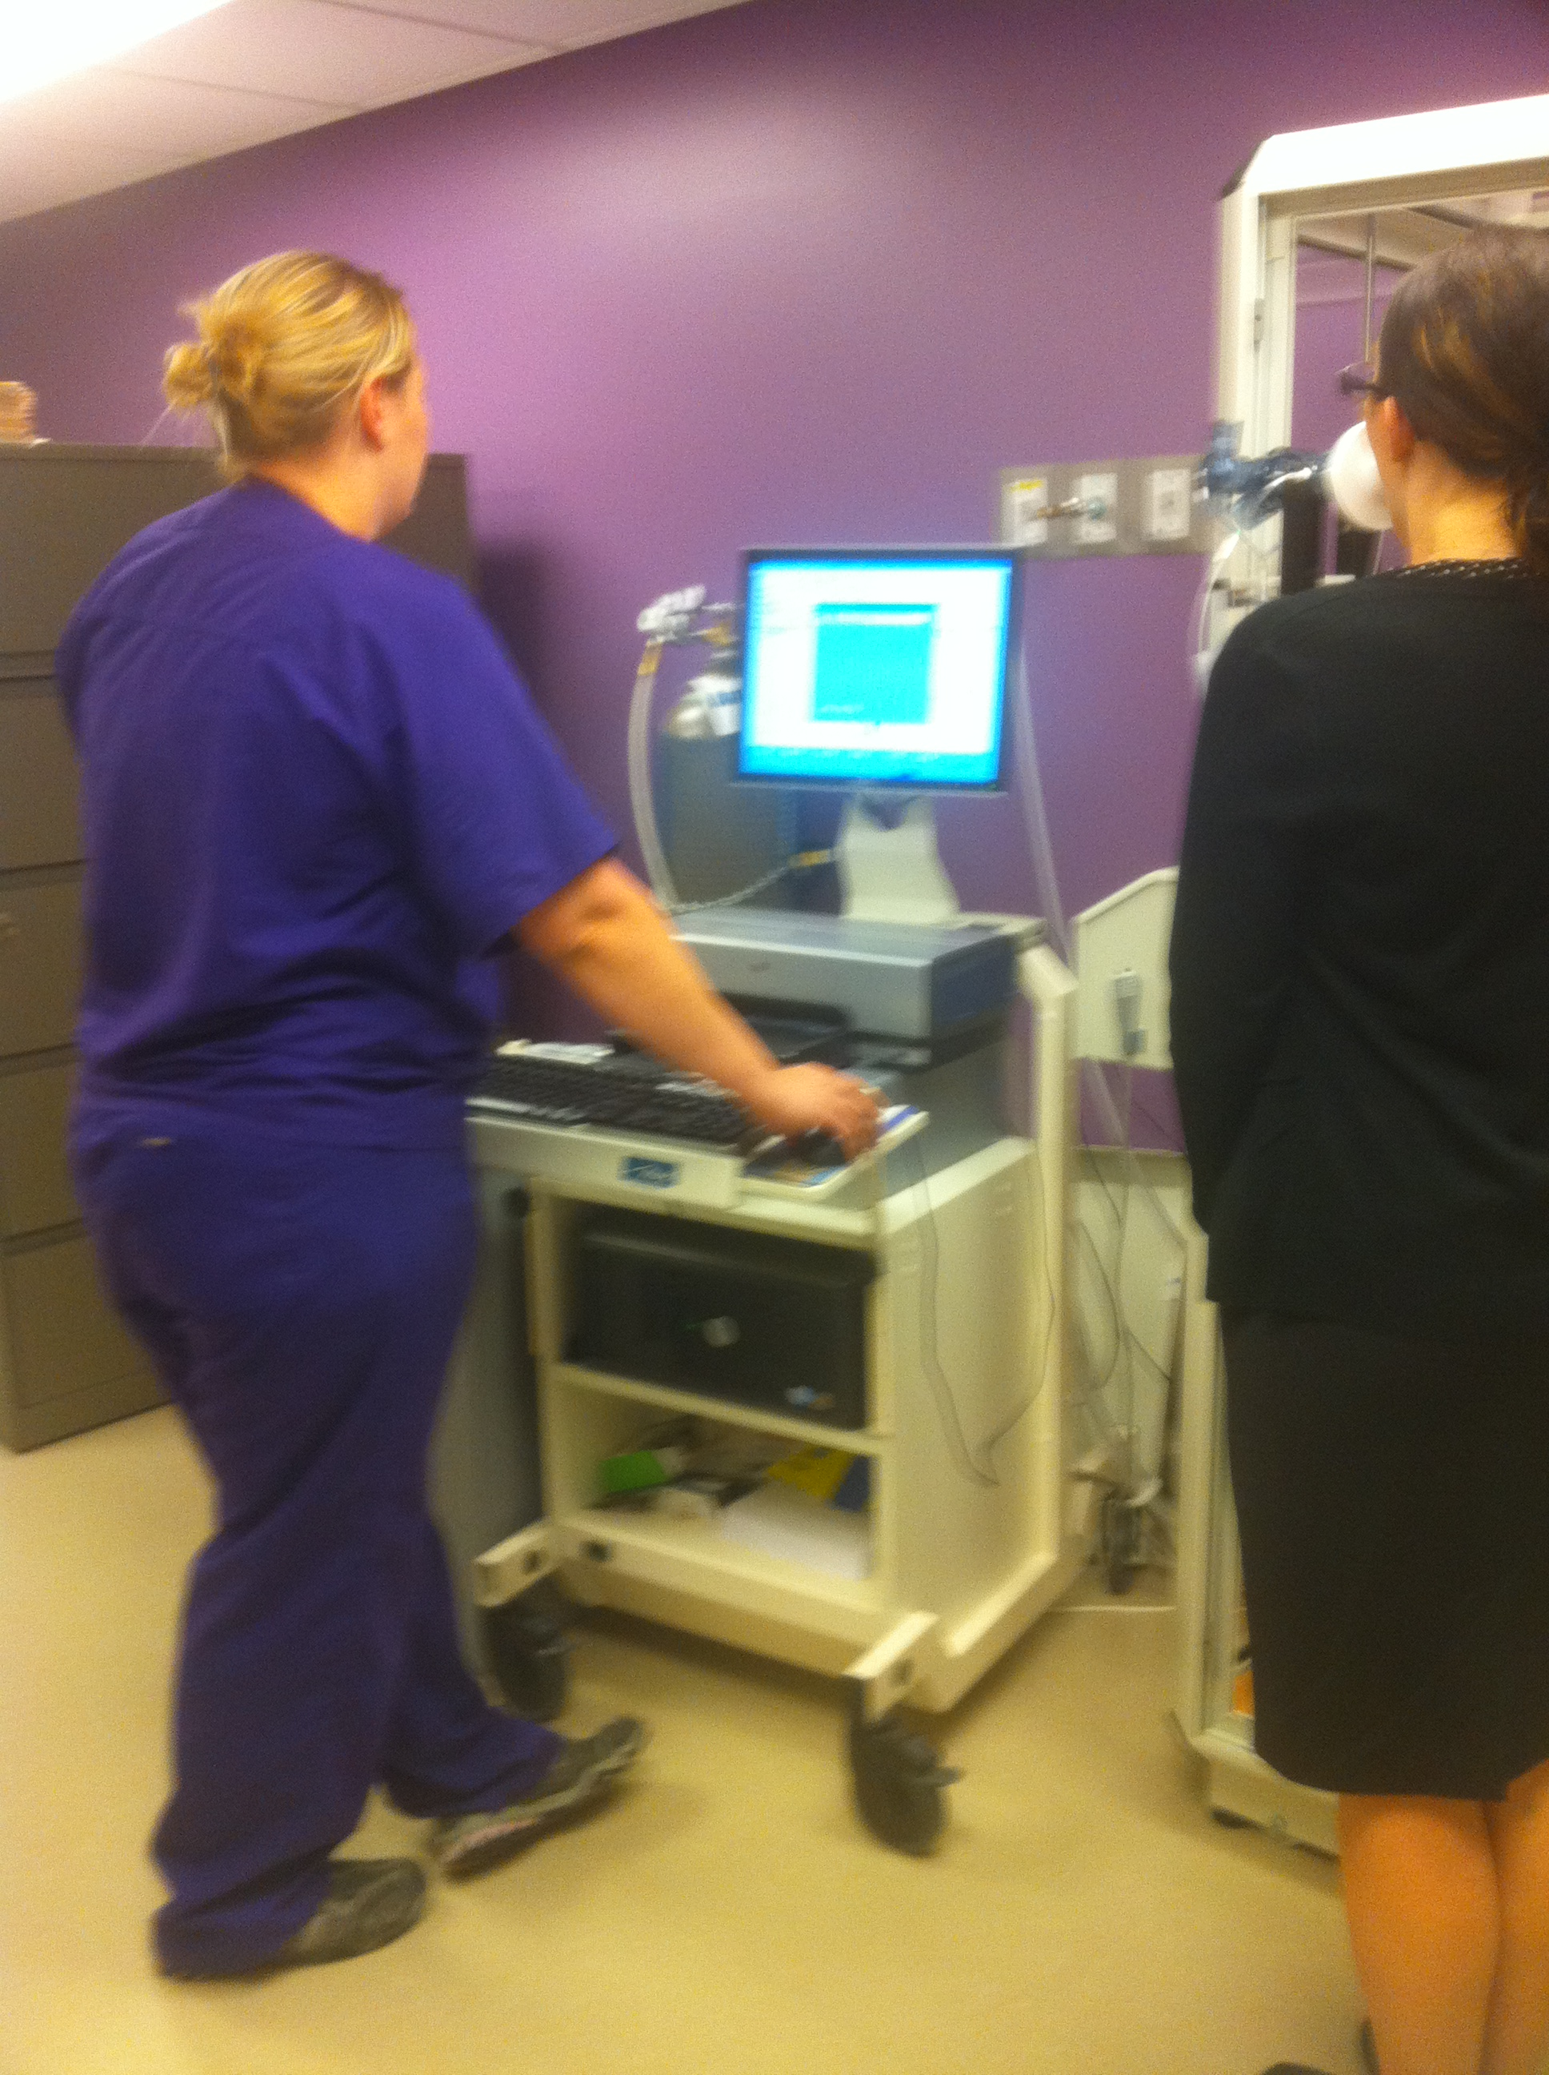
Spirometer
A spirometer is a device that measures the volume of air inspired or expired and records the time over which the volume change occurs.

Slide 9
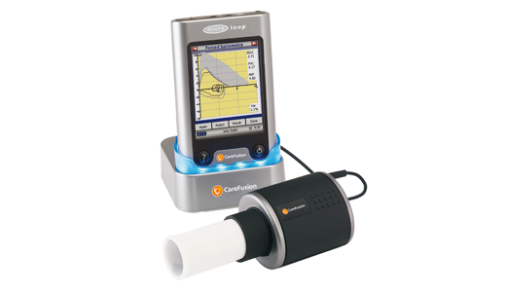
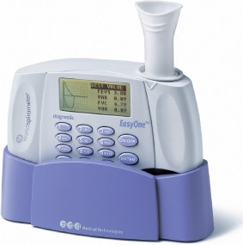
Handheld Spirometers

Slide 10
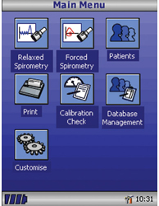
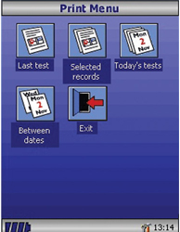
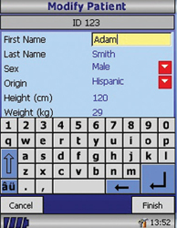

Slide 11
Indications for Spirometry testing
Diagnostic
To evaluate symptoms, signs or abnormal lab tests-detect disease
To measure the effect of disease on pulmonary function
To screen individuals at risk of having a pulmonary disease.
To assess pre-op risk.
To assess prognosis
To assess health status before beginning strenuous physical activity.
Public Health
Epidemiological surveys
Derivation of reference equations
Clinical research
Monitoring
To assess therapeutic intervention
To describe the course of disease that affect lung function
To monitor people exposed to injurious agents
To monitor for adverse reactions to drugs with well known pulmonary toxicity.
Disability /impairment evaluations
To assess patients as part of a rehabilitation program
To assess risks art of an insurance evaluation
To assess individuals for legal reasons
(Miller 2005)

Slide 12
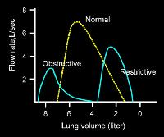
Role of Spirometry in Primary Care
Provides an objective measure of airflow restriction or obstruction
Assesses reversibility of airflow obstruction
Provides objective measures for asthma assessment and monitoring.
Assists with both initial diagnosis of asthma and assessment of asthma control

Slide 13
Establishing Asthma Diagnosis
National Asthma Education & Prevention Program (EPR-3)
Recommended methods to establish the diagnosis:
Detailed medical history to determine episodic symptoms of airflow obstruction or hyper-responsiveness: Cough, wheezing, shortness of breath with exercise.
Physical exam to assess respiratory tract, chest, skin.
Spirometry to demonstrate obstruction and assess reversibility in patients > 5 years of age.
  Reversibility is determined either by an increase in FEV1 of > 12 % from baseline or by an increase of > 10% of predicted FEV1 after inhalation of a short acting bronchodilator.
Additional studies as necessary to exclude alternate diagnosis.

Slide 14
NAEPP Recommends Spirometry
At the time of the initial assessment;
After treatment is initiated and symptoms and peak flow have stabilized to document attainment of (near) “normal” airway function;
During periods of loss of control;
When assessing response to a change in pharmacotherapy; and
At least every 1 to 2 years to assess the maintenance of airway function.
Notes:
Highly recommend that a spirometry be demonstrated in the workshop, with interpretation of results discussed.

Slide 15
Is airflow obstruction present and is it at least partially reversible?
Use spirometry to establish airflow obstruction
FEV₁ < 80% predicted
FEV₁ increases >12% and
FEV₁/FVC below the lower limit of normal, as compared to the individual’s own predicted value
Use spirometry to establish reversibility
> 200 mL after using a short-acting inhaled beta₂-agonist
2- to 3-week trial of oral corticosteroid therapy may be required to demonstrate reversibility
Notes:
>200 mL for adults only.

Slide 16
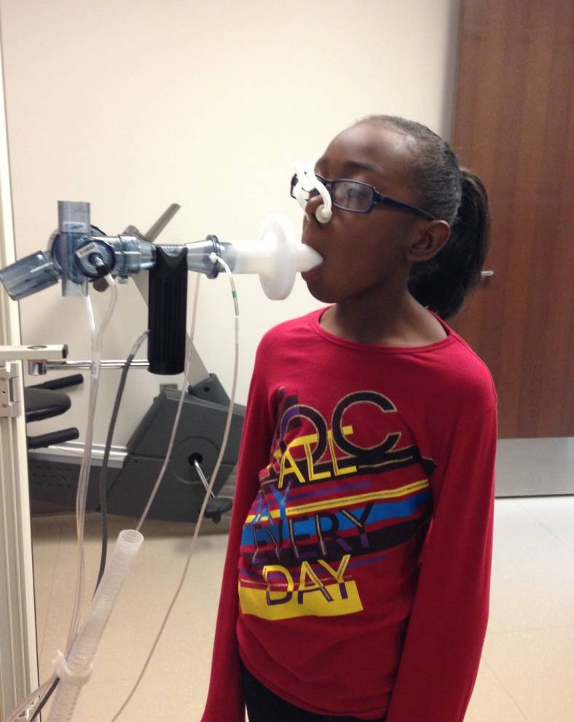
Objective Measures: Spirometry
Gold standard
Useful in determining whether airflow obstruction is at least partially reversible
Generally valuable in children over age 5; however, some children can’t conduct the maneuver adequately before age 7.

Slide 17

Preparing Patients for Spirometry
Painless procedure
Non-invasive
Outpatient
Spirometry measures how much and how quickly air can be expelled following a deep breath.
The patient breathes out forcefully into a device called a spirometer.
May be given a medicine and have repeat testing for reversibility
Notes:
When you send a patient for his or her initial spirometry test, you will want to let the patient know what to expect. You may want to assure the patient that spirometry is a painless procedure that is noninvasive, and that it may be performed on an outpatient basis.

Slide 18
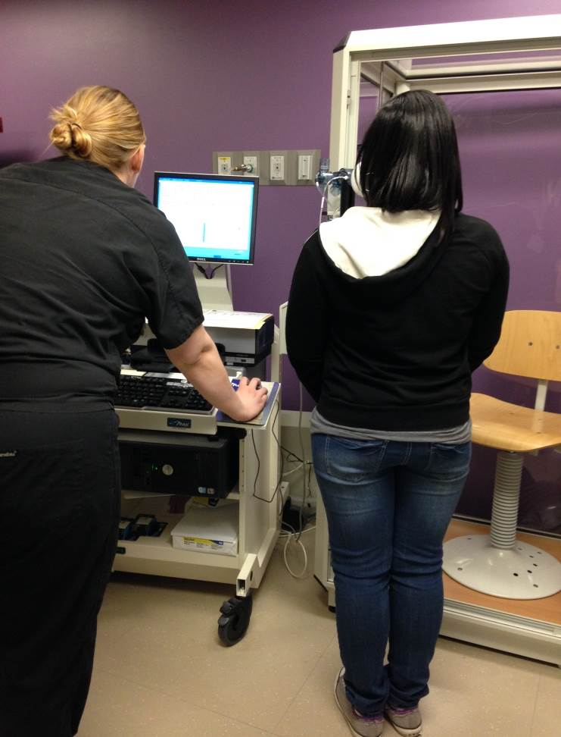
Spirometry Procedure
Spirometry is effort dependent and requires coordination and cooperation of the patient with careful instruction/coaching
Technicians must be trained and maintain proficiency to assure optimal results
Equipment and techniques should meet the ATS standards.

Slide 19
Reliability of Spirometry
Correct technique, calibration methods and maintenance of equipment are necessary to achieve consistently accurate test results.
Maximal patient effort in performing the test is required to avoid important errors in diagnosis and management.
Reproducibility of efforts is essential for accurate assessment.

Slide 20
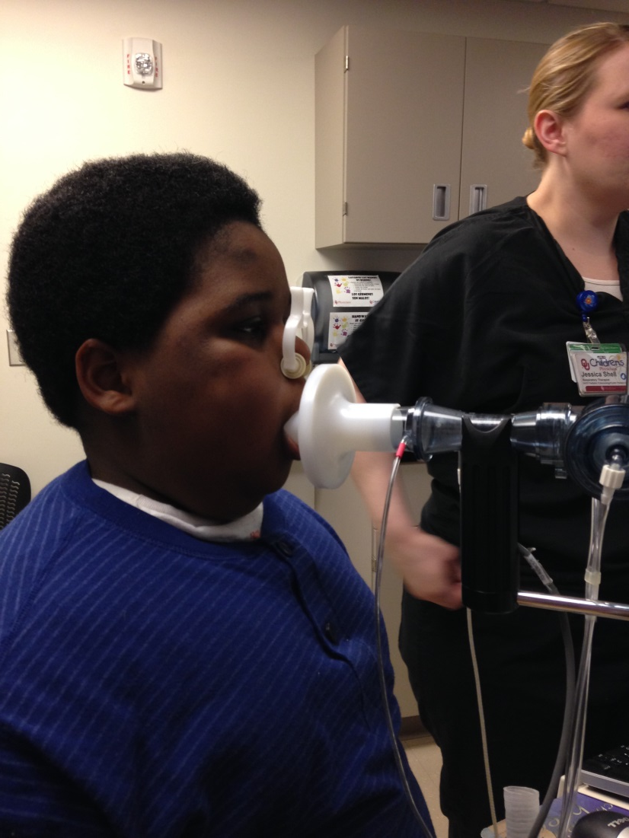
Spirometry Maneuvers
Ideally performed standing with nose clip
Normal breathing prior to effort
Maximum forced exhalation during test
Maneuver repeated until acceptability and reproducibility are achieved.

Slide 21
Coaching for Best Technique
Filling the lungs completely.
Sealing lips around the spirette so that there are no leaks, taking care not to block its opening with teeth or tongue or bite down excessively
Blasting out as hard and fast as possible.
Continue blowing out until the lungs are completely empty

Slide 22
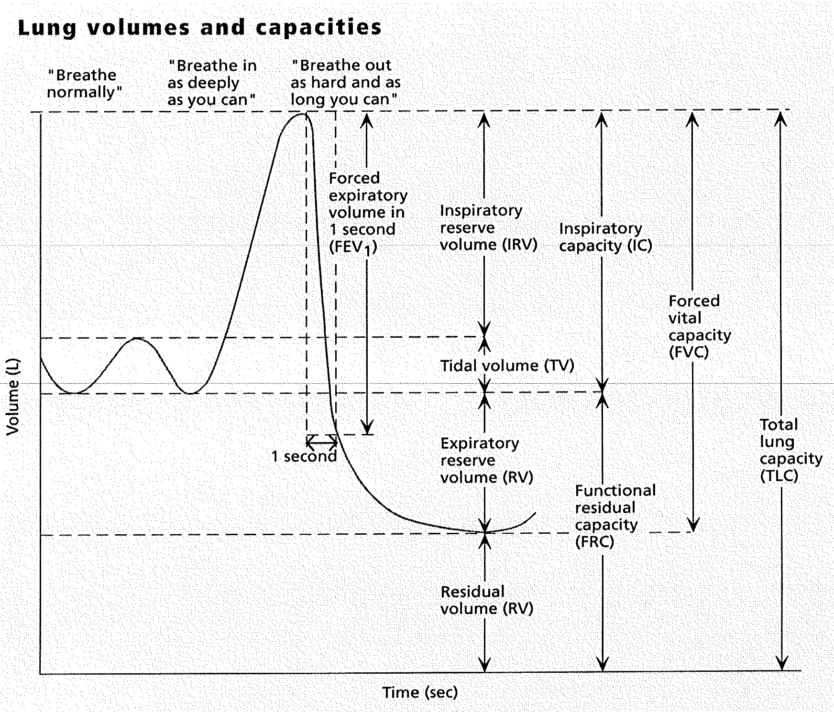

Slide 23
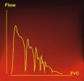
Criteria for Acceptability
Lack of artifact
    Coughing
    glottic closure
    equipment problems
Satisfactory start without hesitation
Satisfactory exhalation with six seconds of smooth, continuous exhalation or a reasonable duration with plateau.
3 acceptable spirograms obtained, 2 largest FVC values within 200mL
COUGH
(Miller, 2005)

Slide 24
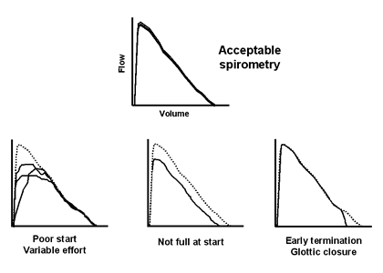
Evaluating Acceptability of Efforts

Slide 25
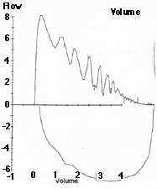
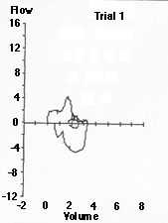
Unacceptable Efforts
Cough
Variable Effort

Slide 26
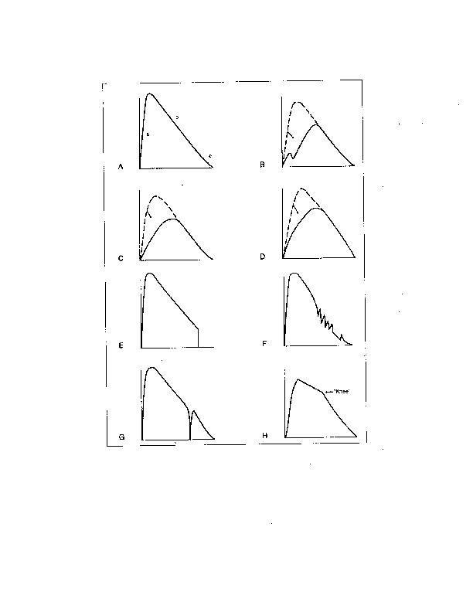
Evaluating Acceptability of Efforts
Excellent effort
Hesitating start makes curve unacceptable.
Subject did not exert maximal effort at start of expiration; tests need to be repeated.
Such a curve almost always indicates failure to exert maximal effort initially, but occasionally it is reproducible and valid, especially in young, nonsmoking females. This is called a “ rainbow curve”
Curve shows good start but subject quit too soon; test needs to be repeated.
Coughing affects the calculation.
Subject stopped exhaling momentarily; test needs to be repeated.
This curve with a “ knee” is a normal variant that often is seen in nonsmokers, especially when young.
Notes:
A. Excellent effort
B. Hesitating start makes curve unacceptable.
C. Subject did not exert maximal effort at start of expiration; tests need to be repeated.
D. Such a curve almost always indicates failure to exert maximal effort initially, but occasionally it is reproducible and valid, especially in young, nonsmoking females. This is called a “ rainbow curve”
E. Curve shows good start but subject quit too soon;test needs to be repeated.
F. Coughing affects the computer.
G. Subject stopped exhaling momentarily; test needs to be repeated.
H. This curve with a “ knee” is a normal variant that often is seen in nonsmokers, especially when young.

Slide 27
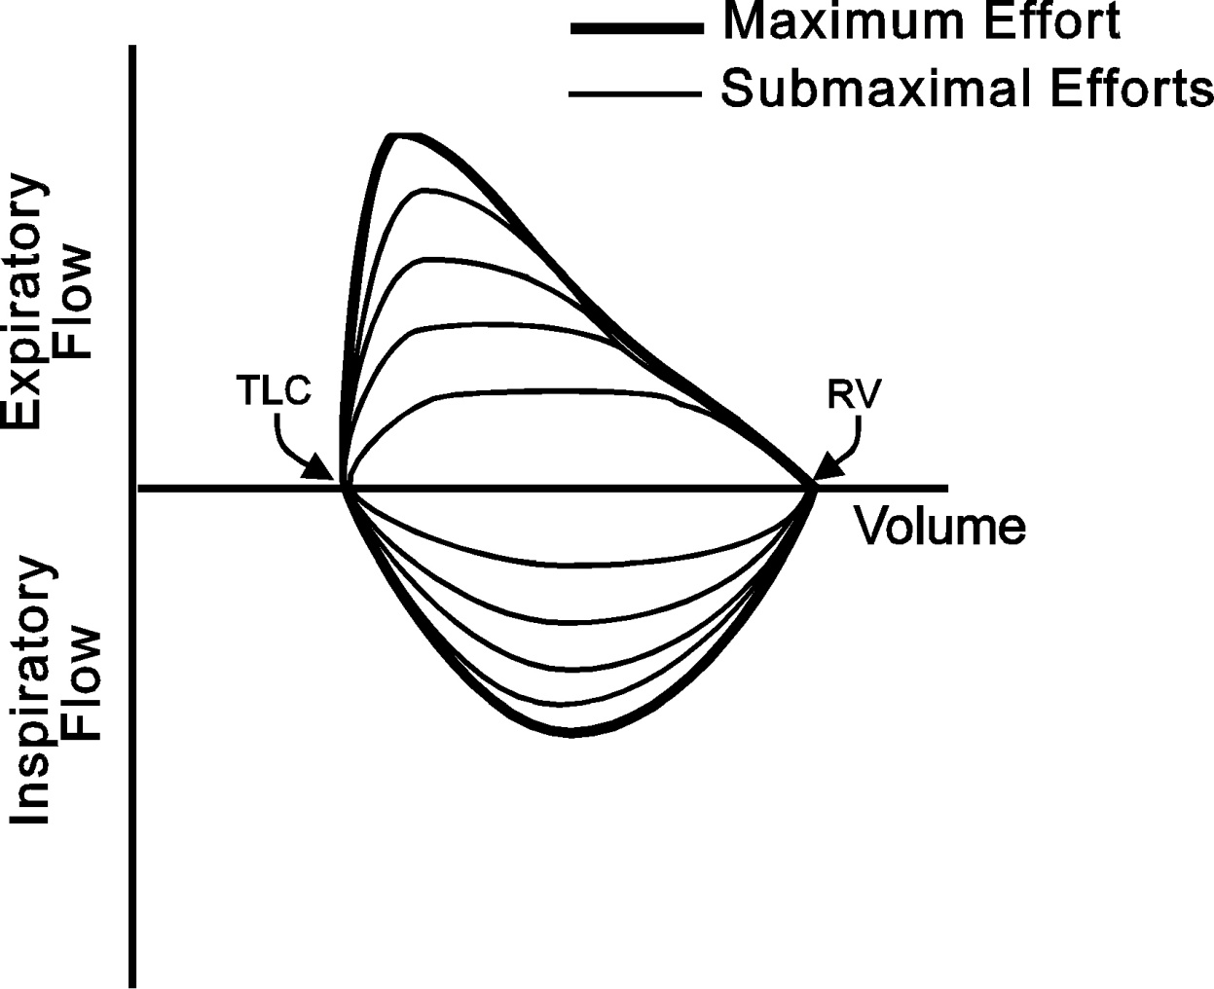

Slide 28
Establishing Reproducibility
After three acceptable spirograms have been obtained, apply the following tests:
The two largest values of FVC must be within 0.150L of each other
The two largest values of FEV1 must be within 0.150L of each other
If both of these criteria are met, the test session may be concluded.
If both of these criteria are not met, continue testing until
  Both criteria are met with analysis of additional acceptable spirograms
Or
  A total of eight tests have been performed or
  Patient/subject cannot or should not continue
  Save as a minimum, the three satisfactory maneuvers
(Miller, 2005)

Slide 29
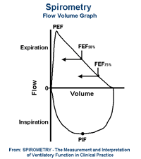
Key Elements of Spirometry
FVC: Forced Vital Capacity is maximal volume of air forcibly exhaled from the point of maximal inhalation
FEV1: Forced Expiratory Volume is volume of air exhaled during the first second of the FVC
FEV1/FVC: ratio of FEV1 to FVC, expressed as a percentage
PEFR: Peak Expiratory Flow Rate is maximum air flow rate during forced exhalation.
FVC

Slide 30
Spirometry Results
Assessment is based on patient’s measured FVC, FEV1 and FEV1 /FVC values relative to reference or predicted values
The predicted values depend on the individual’s age, gender, height and race.
Predicted values are derived from large studies of pulmonary function in greater population.
The numbers are presented as percentages of the average expected in someone of the same age, height, sex and race. This is called percent predicted.

Slide 31
Interpreting Spirometry
Normal values for FEV1 and FVC are expressed in both absolute numbers and percent predicted of normal.
Values for FVC and FEV1 that are above 80% of predicted are defined as within the normal range. (The FEV1/FVC ratio is at least 80% of patient’s vital capacity in one second.)
FEV1/FVC ratio declines as a normal part of aging.

Slide 32
FVC: Forced Vital Capacity
Is the maximum volume of gas that can be expired when the subject exhales as forcefully and rapidly as possible after a maximal inspiration. Often referred as FVC maneuver.
The forced expiratory volume( FEV t) is the volume of air expired over a given time interval(T) from the beginning of FVC maneuver
Reduced value indicates one of 4 possibilities:
  Diseases of the lung- lung resection, area of collapse, obstructive lung disease which limits normal deflation of the lung
  Problems in pleural cavity- enlarged heart, pleural fluid, or tumor
  Chest wall- is restricted
  Inflation and deflation of the system, requires normal functioning of respiratory muscles, primarily the diaphragm, intercostal muscles, and the abdominal muscles

Slide 33
FEV1: Forced Expiratory Volume in 1 Second
It is the volume of air exhaled in the first second of the FVC test.
The FEV1 is the most reproducible.
Most commonly obtained and most powerful measurement.
Normal value depends on subject’s size, age, sex, race, just as does FVC.

Slide 34
FEV1/FVC ratio
The FEV1/FVC ratio is generally expressed as a percentage.
The amount exhaled during the first second is fairly constant fraction of the FVC, irrespective of lung size.
In the normal adult ratio ranges from 75-85%, but it decreases somewhat with aging.
Children have high flows for their size, and thus their ratios are higher, up to 90%.

Slide 35
FEV1/FVC ratio
The significance of this ratio is two-fold.
  It aids in quickly identifying persons with airway obstruction in whom the FVC is reduced.
      Example: If FEV1/FVC is very low at 43%- the low FVC is due to airway obstruction.
  Second- the ratio is valuable for identifying the cause of a low FEV1.
In restrictive disease, the FEV1 and FVC are decreased proportionately, hence the ratio is in the normal range.
In some cases, ratio maybe increased because of elastic recoil of such a lung.

Slide 36
Interpretation of Spirometry
The two terms frequently used in interpretation of PFT’s.
Obstructive defect: implies a process that causes a decrease in maximal expiratory flow so that rapid emptying of the lung is not possible. Examples: emphysema, chronic bronchitis, asthma. Generally an associated decrease in FVC occurs.
Restrictive defect: implies that lung volume, in this case the FVC is reduced by any of the processes, except those causing obstruction.
Caution: To be certain that a Restrictive process is present, the total lung capacity must be less than normal.

Slide 37
Objective Measures: Spirometry
Abnormalities of lung function are categorized as restrictive and obstructive defects.
A reduced ratio of FEV1 / FVC, as compared to the predicted value, indicates obstruction to the flow of air from the lungs.
A reduced FVC with a normal FEV 1 /FVC ratio suggests a restrictive pattern.
Notes:
Abnormalities of lung function are categorized as restrictive and obstructive defects. A reduced ratio of FEV 1 /FVC, as compared to the predicted value, indicates obstruction to the flow of air from the lungs.
A reduced FVC with a normal FEV 1 /FVC ratio suggests a restrictive pattern.
The severity of abnormality of spirometric measurements is evaluated by comparison of the patient's results with reference values based on age, height, sex, and race. (NIH references American Thoracic Society 1991)

Slide 38
Spirometry Values
Obstructive Pattern
Decreased FEV1/FVC Ratio
Decreased FEV1
Normal FVC (usually)
Restrictive Pattern
Both FEV1 and FVC are reduced proportionately
Normal or even elevated FEV1/FVC ratio.

Slide 39
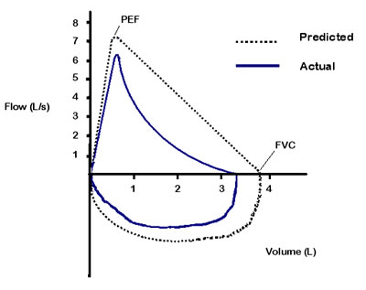
Characteristics of Flow Loops
Classic flow volume loop has a rapid peak and expiratory flow rate with a gradual decline in flow back to zero.
Obstructive pattern loop also has a rapid peak, but the curve descends more quickly than normal taking on a concave shape.
Restrictive pattern retains the shape of a normal cure, but the size of the curve appears smaller.

Slide 40
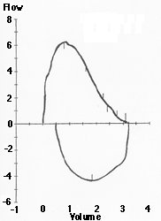
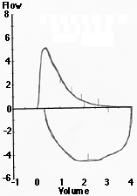
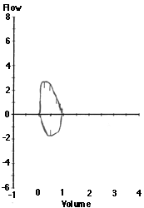
Flow Loops
NORMAL OBSTRUCTIVE RESTRICTIVE

Slide 41
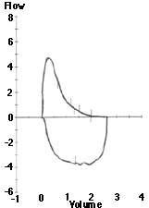
Spirometry Example
Measured
Predicted
Percent (%)
Predicted
FVC
4.09
4.25
96
FEV1
1.95
2.88
68
FEV1/FVC
48
68
PEF
6.27
8.06
78
Restrictive or Obstructive Pattern?

Slide 42
Spirometry Results: Obstruction
 | Measured | Predicted | Percent (%) Predicted
FVC | 4.09 | 4.25 | 96
FEV₁ | 1.95 | 2.88 | 68
FEV₁/FVC | 48 | 68
PEF | 6.27 | 8.06 | 78
Notes:
Reduced FEV1 and ratio indicate obstruction.

Slide 43
Obstructive Pattern
Obstructive lung disease changes the appearance of the flow volume curve.
As with a normal curve, there is a rapid peak expiratory flow, but the curve descends more quickly than normal and takes on a concave shape.

Slide 44
Spirometry Results: Restriction
 | Measured | Predicted | Percent (%) Predicted
FVC | 0.96 | 2.75 | 35
FEV₁ | 0.94 | 1.90 | 49
FEV₁/FVC | 98 | 69
PEF | 2.98 | 5.40 | 55

Slide 45
Restrictive Pattern
Both the FEV₁ and FVC are reduced proportionately.
FEV₁/FVC ratio is normal or even elevated
The shape of the flow volume loop is relatively unaffected in restrictive disease, but the overall size of the curve will appear smaller when compared to normals on the same scale.

Slide 46
Calculating % Predicted
FEV1 Predicted: 4.00L
Patient’s FEV1: 3.00L
What is the percent predicted for this patient?
3.00 = 3 = 75%
4.00 4

Slide 47
Establishing Reversibility
FEV₁ increases > 12% and at least 200mL after a short-acting beta2-agonist.
A short course of oral steroids may be required to demonstrate reversibility.
Degree of reversibility in asthma declines with long-term control therapy.

Slide 48
Calculating Change in FEV1
Post BD FEV1 minus Pre BD FEV1
Pre BD FEV 1
Pre BD FEV1 = 1.50L Post BD FEV1 = 1.80L
What is the % improvement in FEV1?
Example 2: 1.80L – 1.50L= .30 = 1 = 20% improvement
1.50L 1.50 5
Does this meet the NAEPP criteria?

Slide 49
Calculating Change in FEV1
Pre BD FEV 1 = 2.00 L Post BD FEV 1 = 2.40 L
What is the % improvement in FEV1?
Example 1: 2.40 L – 2.00 L= .40 = 20% improvement
2.00L 2.00
Does this meet the NAEPP criteria?
There is > 12% improvement.

Slide 50
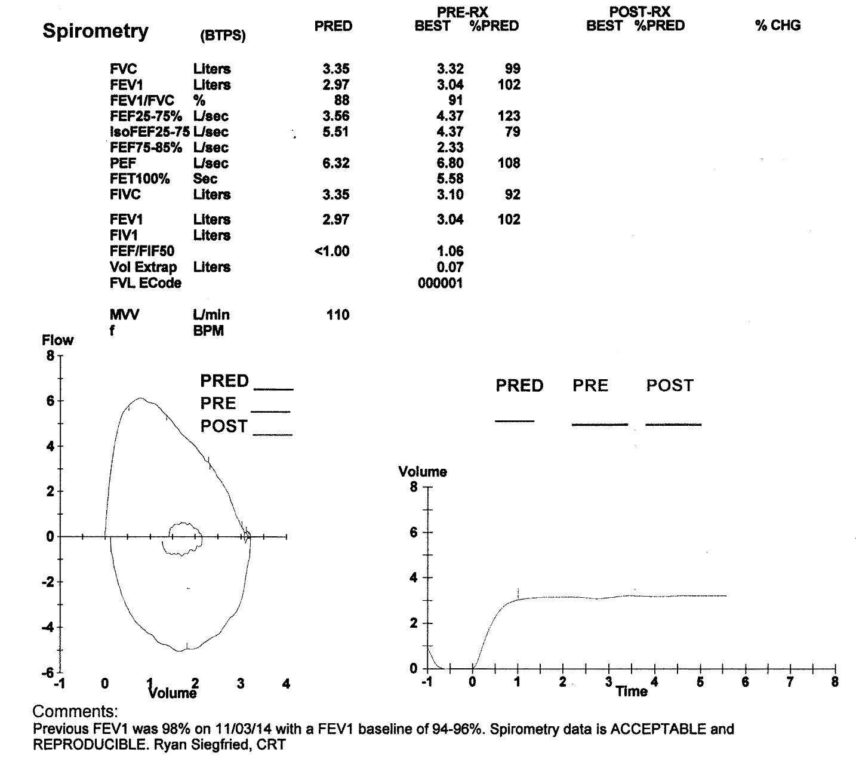
Calculating Change in FEV1
Second requirement is >200ml increase
1.15 L minus 1.00 L is improvement of 0.15 L or 150 ml
Does this meet the NAEPP requirement?
(Post BD minus Pre BD = >200ml)
Notes:
This does not meet ATS criteria for adults but may for a child.

Slide 51
Approach to Interpretation
Organized approach will allow clinician to recognize and quantitate abnormalities.
Confirm demographic data.
Determine whether the test was acceptable and reproducible.
Look at the appearance of the flow/volume curve
Look at FEV1/FVC ratio:
  Low value indicates obstructive pattern
    Quantify obstruction
    Assess for reversibility
  Normal value indicates either restrictive or normal pattern
    If ratio is normal and FVC is low= Restrictive Pattern
    If ratio is normal and FVC is normal= Normal Pattern

Slide 52
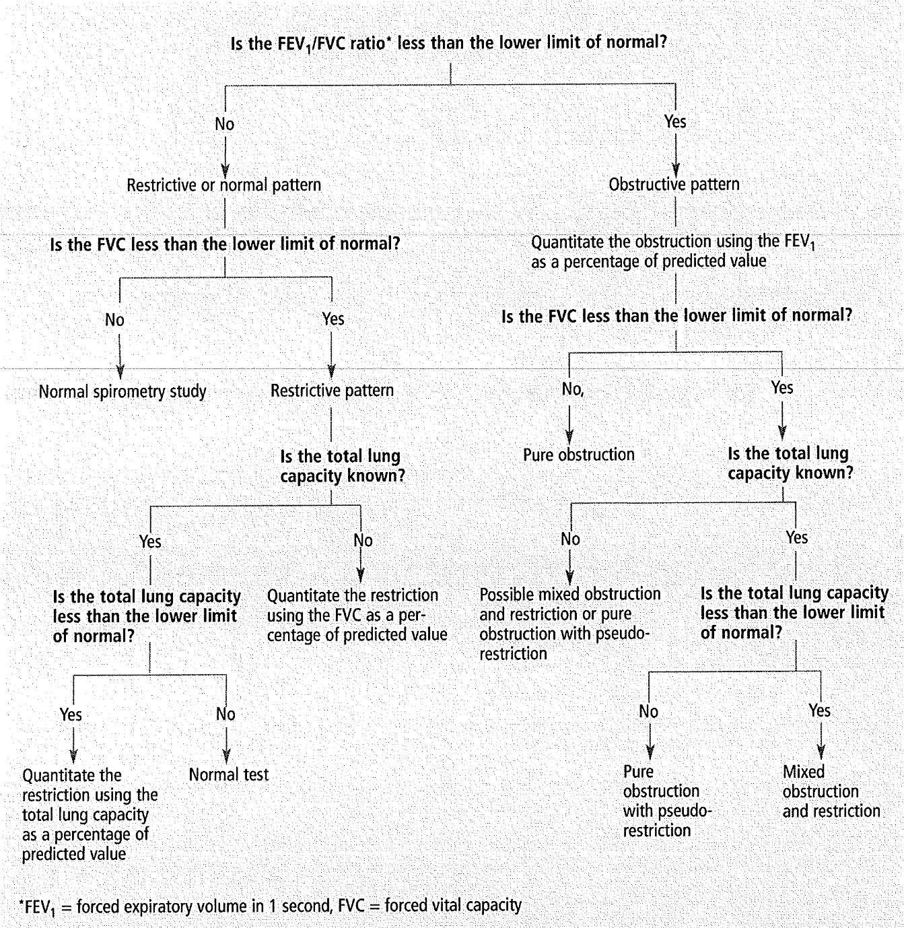

Slide 53
Restrictive & Obstructive Patterns
Measurement | Obstructive Pattern | Restrictive Pattern
FVC | Decreased or Normal | Decreased
FEV1 | Decreased | Decreased or Normal
FEV1/FVC Ratio | Decreased | Normal
Total Lung Capacity | Normal or Increased | Decreased

Slide 54
Quantitate Obstruction
An Obstructive Pattern with:
FEV1 ≥ 60% predicted = Mild airway obstruction
FEV1 ≥ 40% predicted to 60% predicted = Moderate airway obstruction.
FEV1 < 40% predicted= Severe airway obstruction
*Note: This does not directly correlate with mild, moderate and severe asthma categories

Slide 55
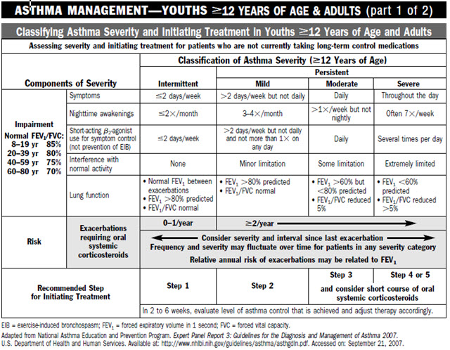

Slide 56
Practice Interpretation
On the following spirometry reports, choose one or more from the following interpretations:
Normal Spirometry
Restrictive pattern, needs lung volumes (TLC) to confirm
Mild obstructive pattern
Moderate obstructive pattern
Severe obstructive pattern
Significant response to bronchodilator (Reversibility)
Uninterpretable, does not meet acceptability criteria

Slide 57
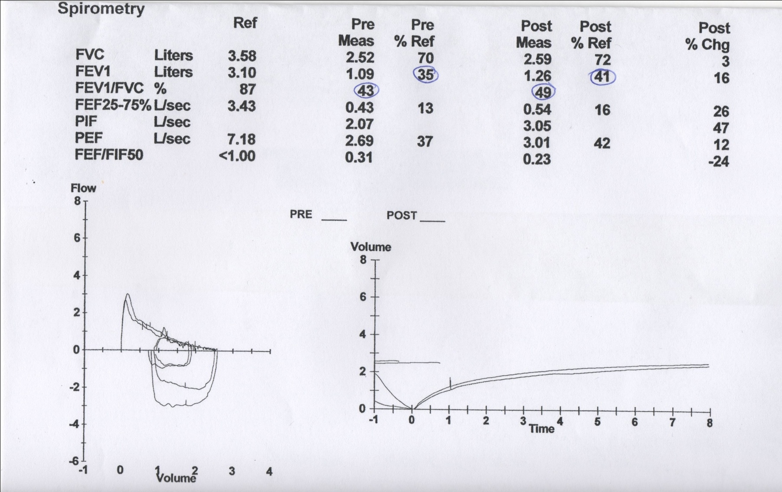

Slide 58


Slide 59
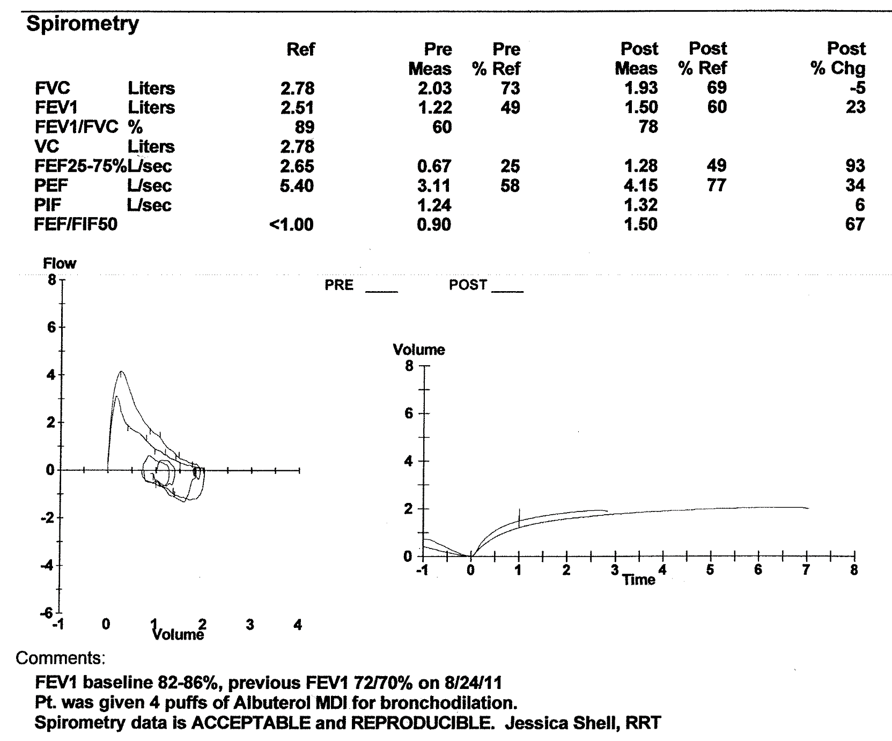

Slide 60
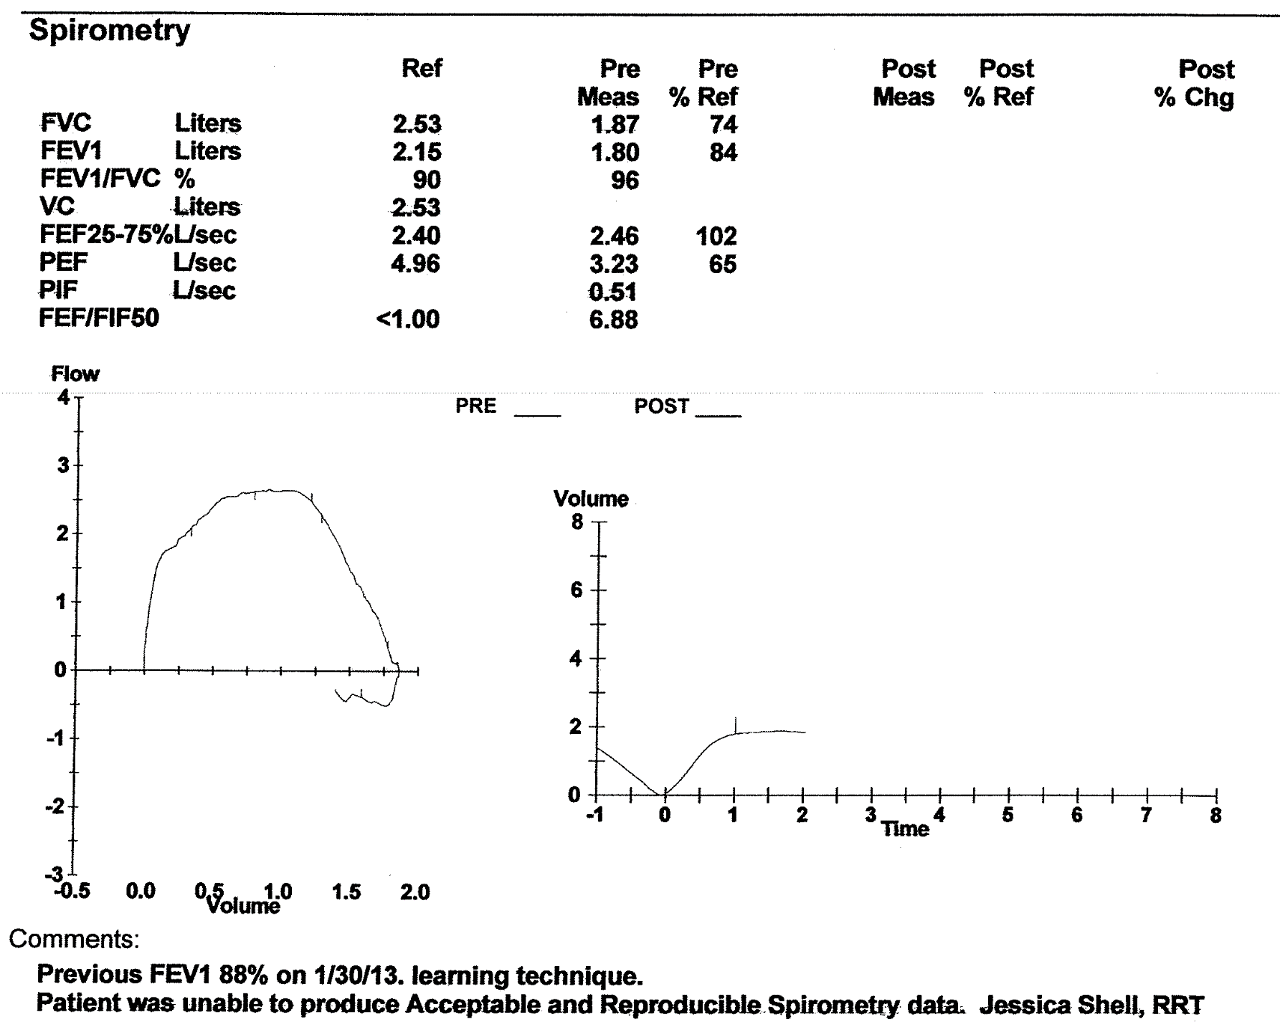

Slide 61
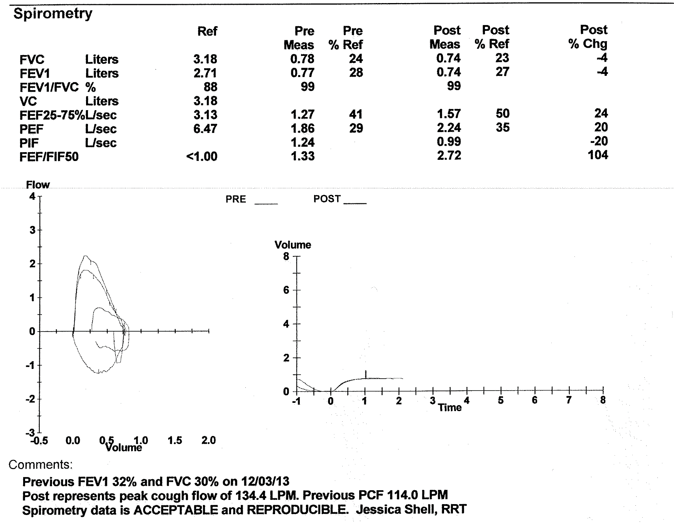

Slide 62
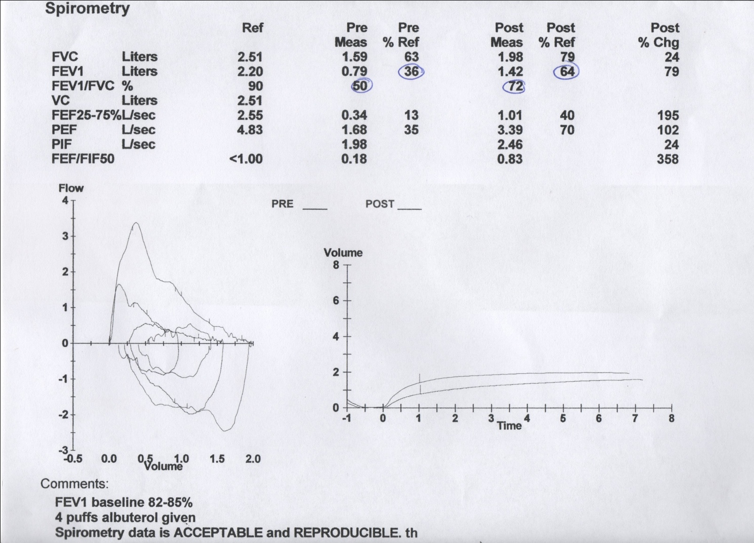

Slide 63
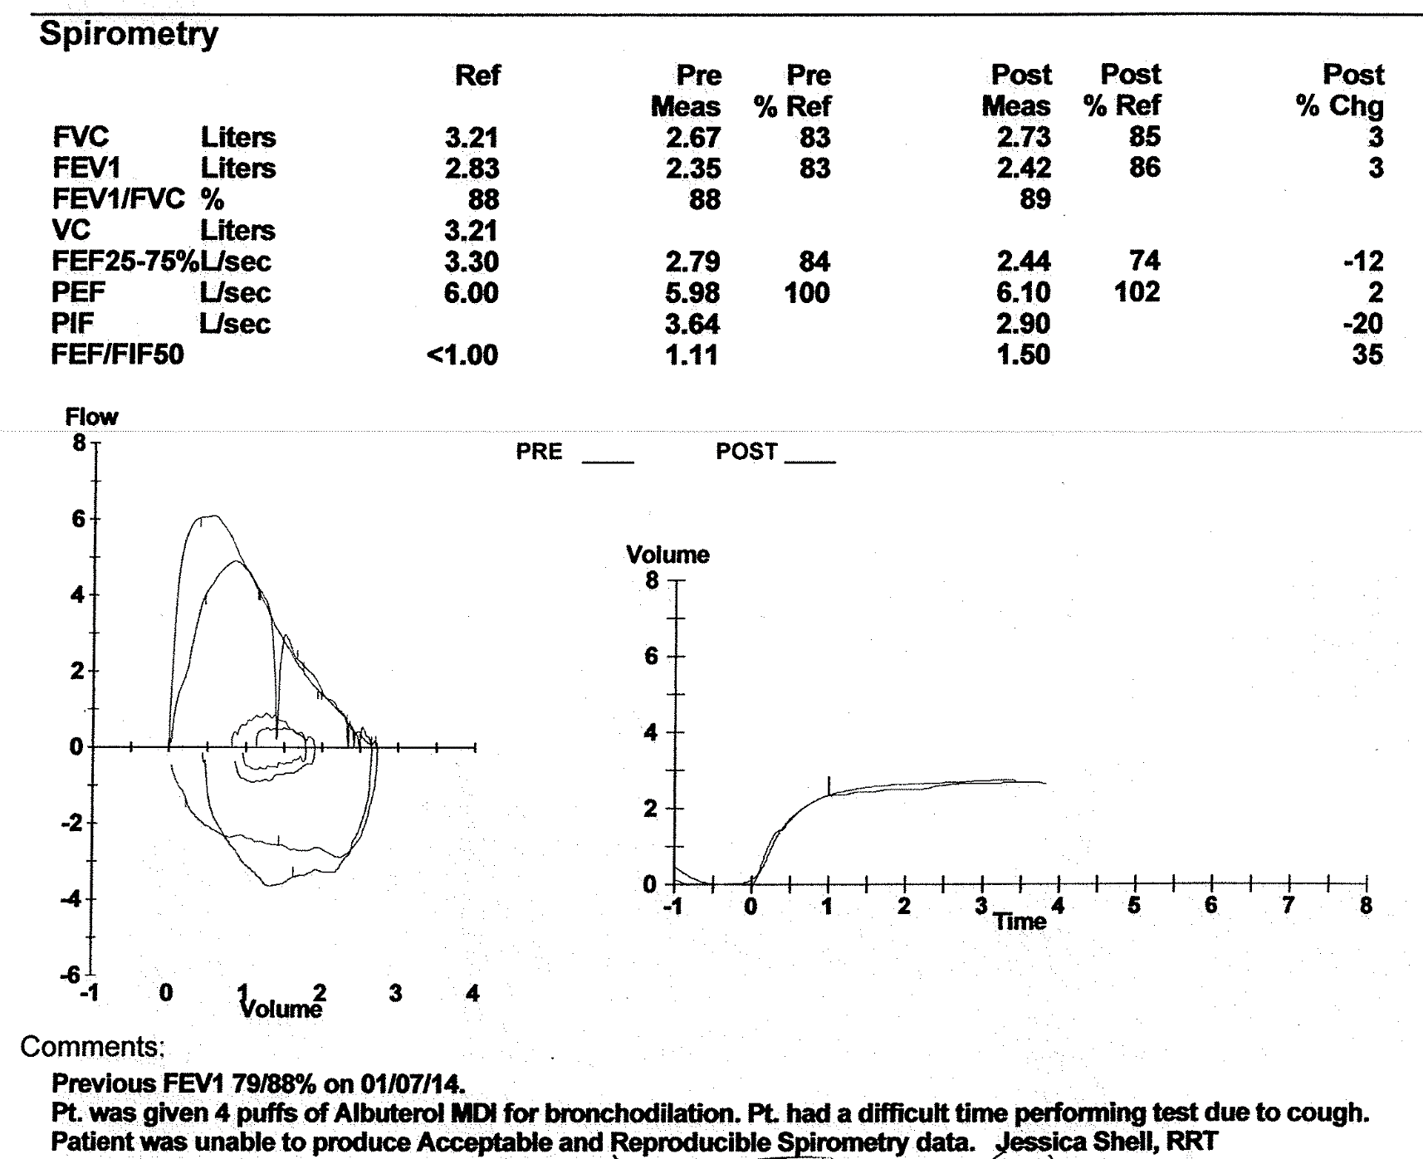

Slide 64
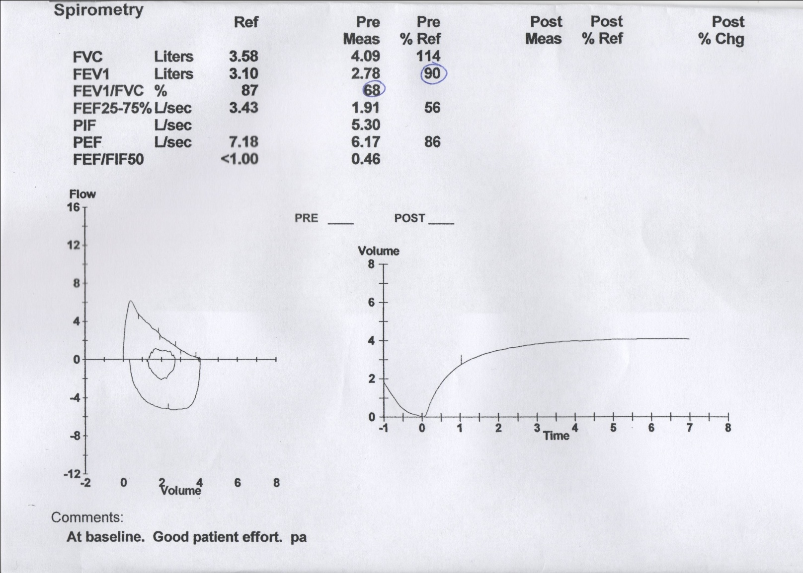

Slide 65
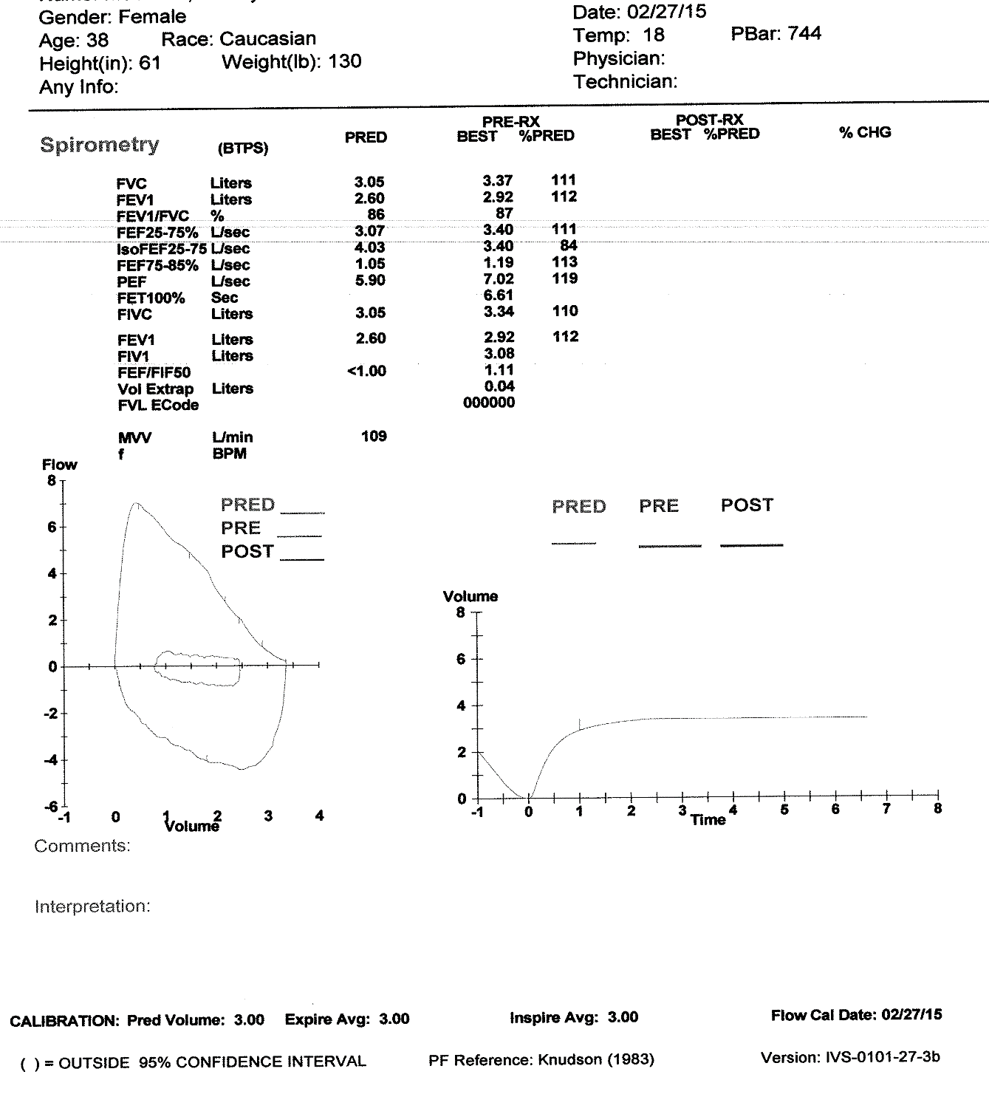

Slide 66
Discussing Results with Patient
Acknowledge that this information is combined with history and physical exam to establish a diagnosis.
Spirometry alone does not make the diagnosis.
After spirometry, additional pulmonary function testing (lung volumes, DLCO) may be necessary for further assessment.

Slide 67
Discussing Spirometry Results with Asthma Patients
Connect spirometry results to the broader picture of the patient’s asthma severity and control.
Explain that spirometry results can improve with effective asthma management.
Stress that effective asthma management can lead to less severe disease.
Notes:
If the spirometry results will lead to any changes in how the patient needs to manage his or her asthma, explain this connection to the patient. You may say, for example, “these results do indicate how important it is for you to get dust covers for your mattress and pillows.” If you will be making any changes in the patient’s medication regimen because of the spirometry results, explain these changes to the patient.
The patient and family members need to know that spirometry results are not like dental records; they are not permanent. Therefore, while a patient may have moderate persistent or severe persistent disease today, with effective asthma management, the patient could have less severe disease over time, and that this would be demonstrated, in part, by improved spirometry results.

Slide 68
References
Al-Ashkar, F., Mehra, R. & Mazzone, P.J. (2003). Interpreting pulmonary function tests: Recognize the pattern, and the diagnosis will follow. Cleveland Clinic Journal of Medicine, 70, 10, 866-881.
Hyatt, R.E., Scanlon, P.D., & Nakamura, M. (1997). Interpretation of Pulmonary Function Tests: A Practical Guide. Lippincott-Raven.
Miller, M.R. et al. (2005). Standardization of Spirometry. European Respiratory Journal, 26, 2, 319-338.
National Heart, Blood & Lung Institute, National Asthma Education and Prevention Program. (2007). Expert Panel Report 3: Guidelines for the Diagnosis and Management of Asthma (NIH Publication No. 08-5846). Bethesda, MD. Retrieved from http://www.nhlbi.nih.gov/guidelines/asthma/asthgdln.htm
Ruppel, G.L. (2008). Manual of Pulmonary Function Testing- 9th edition. CV Mosby.

