Slide 1
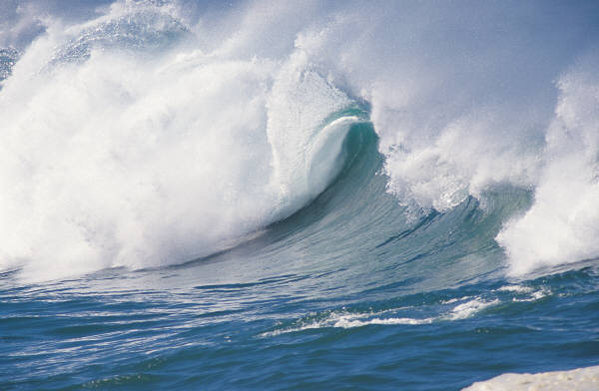
Oceans Review
By:
(put your name here)
Fifth Grade Science

Slide 2
How Much of the Earth is covered with water?

Slide 3
If we made a pie chart of Earth’s water, how much of the pie would be salt water and how much would be fresh?

Slide 4
Ocean Water Variables
1.
2.

Slide 5
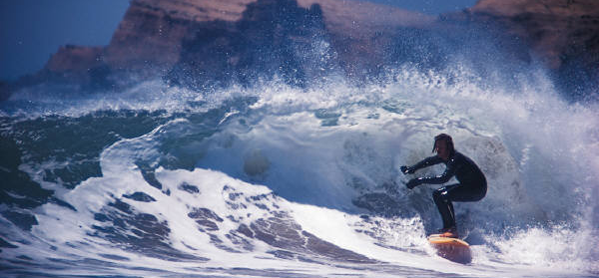
Is All Ocean Water the Same?
Explain!

Slide 6
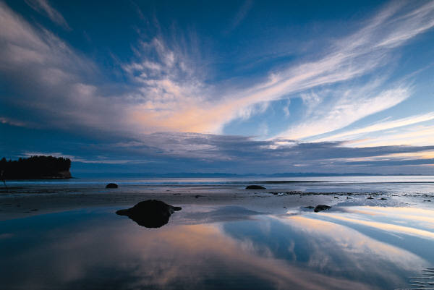
Ways Ocean Water Can Move
(next 5 slides)

Slide 12
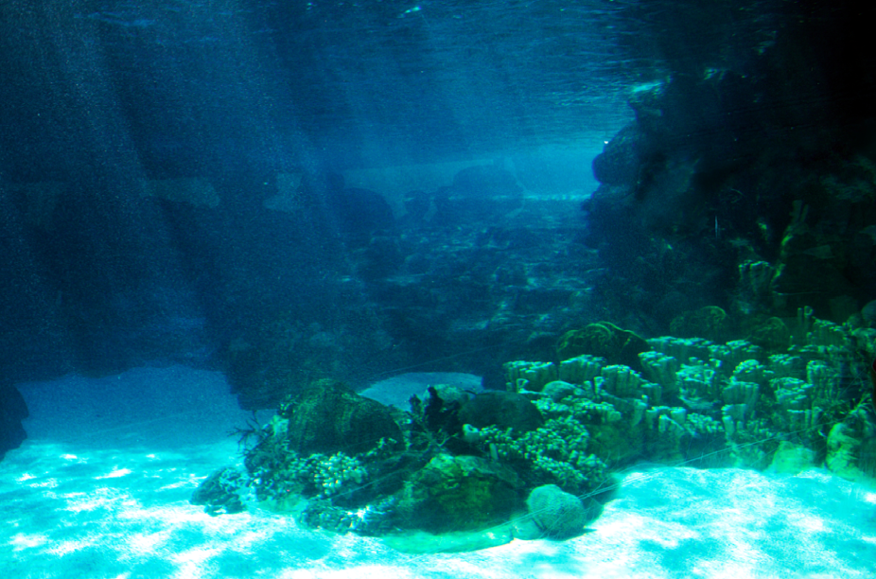
The Ocean Floor

Slide 13
Shoreline & Intertidal Zone

Slide 14
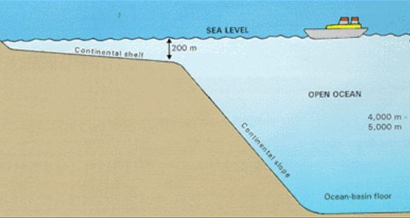
Continental Shelf
&
Continental Slope

Slide 15
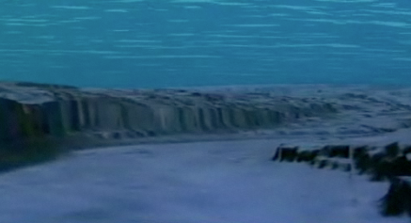
Abyssal Plain & Trench

Slide 16
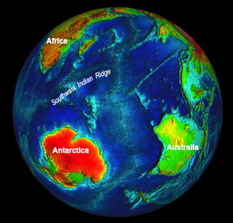
Mid-Ocean Ridge & Rift Valley

Slide 17
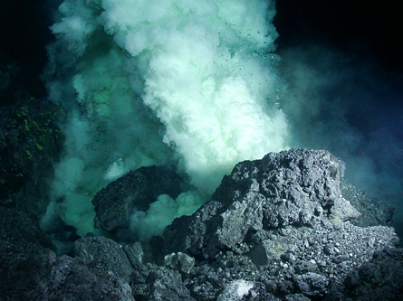
Volcanic Chain

