Slide 1


Slide 2
Double Jeopardy
Periodic Table
Lewis Dot Diagram
Miscellaneous
Hodge Podge
Q1
20
Q5
20
Q9
20
Q13
20
Q2
40
Q6
40
Q10
40
Q14
40
Q3
60
Q7
60
Q11
60
Q15
60
Q4
80
Q8
80
Q12
80
Q16
80
Created by Alma Row (5/02)

Slide 3
What the table organizes
20
Answer #1

Slide 4
What are elements?
20
Back to
Question #1

Slide 5
How it is listed
40
Answer #2

Slide 6
What is the atomic number?
40
Back to
Question #2

Slide 7
Have similar properties
60
Answer #3

Slide 8
What are groups?
60
Back to
Question #3

Slide 9
Located in the narrow stair-step region
80
Answer #4

Slide 10
What are metalloids?
80
Back to
Question #4

Slide 11
20
Located on the right side of
the Periodic Table
Answer #5

Slide 12
What are nonmetals?
20
Back to
Question #5

Slide 13
Protons, neutrons, electrons, quarks, and the nucleus
40
Answer #6

Slide 14
What are the parts of the atom ?
40
Back to
Question #6

Slide 15
60
Symbol in a formula
Answer #7

Slide 16
What represents the element?
60
Back to
Question #7

Slide 17
80
A model that represents valence
electrons in an atom around the
element’s chemical symbol
Answer #8

Slide 18
What is the electron dot diagram?
80
Back to
Question #8

Slide 19

20
Answer #9

Slide 20
What is water?
20
Back to
Question #9

Slide 21
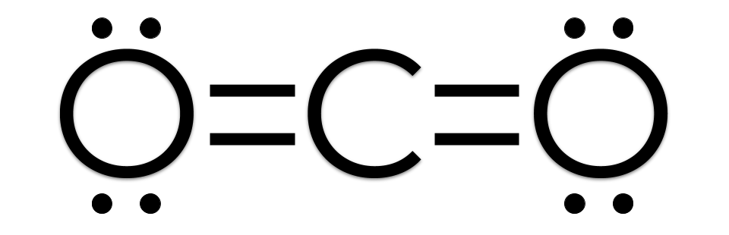
40
Answer #10

Slide 22
40
What is carbon dioxide?
Back to
Question #10

Slide 23
60
This is an example of one:
Answer #11

Slide 24
What is an example of a covalent bond?
60
Back to
Question #11

Slide 25
80
Gilbert Newton Lewis
Answer #12

Slide 26
Who invented the electron dot diagram?
80
Back to
Question #12

Slide 27
Tells how many bonds an atom can form on the diagram
20
Answer #13

Slide 28
What is the number of unpaired dots?
20
Back to
Question #13

Slide 29
40
Furthest from the nucleus
Answer #14

Slide 30
Where, in the atom, the electrons are at their highest energy level.
40
Back to
Question #14

Slide 31
Has a slight positive end and a slight negative end
60
Answer #15

Slide 32
What is a polar molecule?
60
Back to
Question #15

Slide 33
Poor conductors of electricity
80
Answer #16

Slide 34
What are covalent compounds?
80
Back to
Question #16

Slide 35


Daily
Double
Press the arrow

Slide 36

Final Jeopardy

Slide 37
What are the three types of covalent bonds?

Slide 38
Single, Double, and Triple

Slide 39
Daily
Double
Press the arrow

