Slide 1

Approaches to Psychology
“Psychology, I like.” – Yoda
Notes:
Today's psychologists are linked together by their dedication to their specific fields and approaches to the subject matter. They owe a tremendous debt to all of the psychologists who came before them. In this presentation, we will examine the various approaches to the field of psychology and look briefly at the contributions of major psychologists in each of these areas.

Slide 2
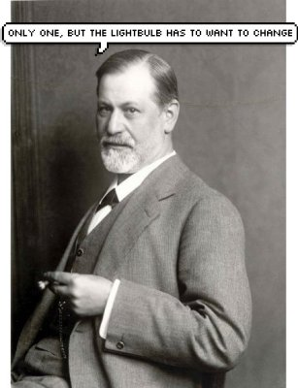
Ch. 1 – The Field of Psychology
Psychology joke.
Notes:
Today's psychologists are linked together by their dedication to their specific fields and approaches to the subject matter. They owe a tremendous debt to all of the psychologists who came before them. In this presentation, we will examine the various approaches to the field of psychology and look briefly at the contributions of major psychologists in each of these areas.

Slide 3
I. The Different Approaches
The problems you wish to investigate are tied to a number of theoretical approaches to psychology
There are six basic approaches to the study of psychology (some psychologists also include a seventh approach)
Notes:
Bullet # 1 Depending on what psychological topic you want to investigate, looking at the variety of approaches presents a good place to begin. If you were studying the causes of schizophrenia, you might first look for a possible biological explanation. If you wanted to find out how infants learn, you might want to investigate the area of cognitive psychology.
Bullet # 2 There are perhaps as many different ways to study psychology as there are psychologists, though it is generally agreed that there are six or seven basic approaches to psychology.

Slide 4
A. Seven Approaches
Evolutionary
Biological
Behavioral
Cognitive
Humanistic
Psychodynamic
Sociocultural
Notes:
Some psychologists choose to adopt one specific approach, while others combine a variety of approaches. Often, it’s not practical to employ just a single approach or to identify a specific psychologist with only one approach. Some of the approaches listed on this slide are more current or are more likely to be employed by contemporary psychologists than others. We will first look at how a psychologist might apply different approaches to specific case studies, then we will examine the advantages, disadvantages, and limitations of each approach.

Slide 5
B. Overview of Each Approach
Biological: Focuses primarily on the activities of the nervous system, the brain, hormones, and genetics
Psychodynamic: Emphasizes internal, unconscious conflicts; the focus is on sexual and aggressive instincts that collide with cultural norms
Notes:
No special notes.

Slide 6
Behavioral: Examines the learning process, focusing in particular on the influence of rewards and punishments
Evolutionary: Investigates how primal survival instincts can influence behavior
Notes:
No special notes.

Slide 7
Cognitive: Focuses on the mechanisms through which people receive, store, and process information
Humanistic: Emphasizes an individual’s potential for growth and the role of perception in guiding mental processes and behavior
Sociocultural: Explores how behavior is shaped by history, society, and culture
Notes:
No special notes.

Slide 8
The Evolutionary Approach
Functionalism
Why we do what we do
The influence of Charles Darwin
Notes:
Bullet # 1 William James (1842–1910) was both a doctor and an early psychologist. James was the founder of the psychological school of thought known as functionalism, which focuses on how behavior helps individuals adapt to the demands placed upon them by their environments.
Bullet # 2 Functionalists examine mental processes in order to find out why we do what we do.
Bullet # 3 William James was dramatically influenced by the work of Charles Darwin. Darwin believed that all forms of life— including humans— had evolved from earlier life forms by adapting over time to the demands of their environments.

Slide 9
Natural Selection
An evolutionary process in which individuals of a species that are best adapted to their environments are the ones most likely to survive; they then pass on these traits to their offspring
Notes:
Bullet # 1 According to the theory of natural selection, some members of a species adapt better to their environments, and thus are more likely to live long enough to reproduce. Their offspring then inherits their parents’ “survival traits.” Eventually, the species becomes dominated by those members that possess the most adaptive traits. When changes do come (environmental or otherwise), those best adapted will survive and the others will die out. Natural selection has also been called “survival of the fittest.”

Slide 10
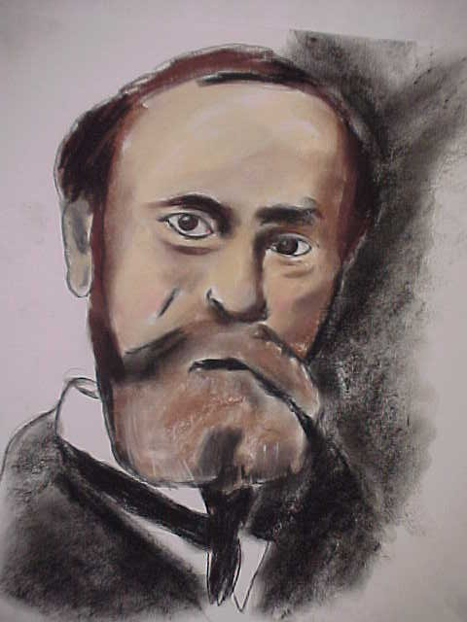
William James’s Adaptation of
Darwin’s Principles
“The most adaptive behaviors in an individual are the ones that grow stronger and become habitual.”
Notes:
Bullet # 1 Scientist William James took Darwin’s ideas and applied them to psychology. He believed that the most adaptive behaviors eventually become habitual. He also believed that less useful behaviors would eventually disappear. Therefore, according to James, the most adaptive behaviors of a species would endure.
Note: Today’s psychologists investigate why some people continue to practice “maladaptive” behaviors (such as smoking, gambling, and excessive drinking) even though they know that these behaviors are extremely harmful.

Slide 11
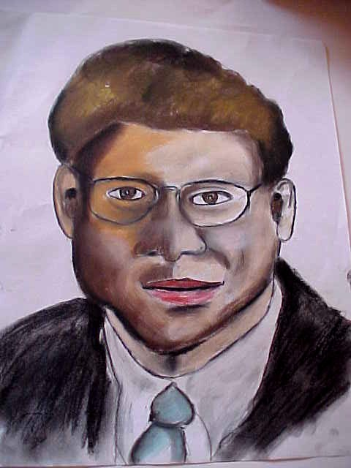
Key Points in the
Evolutionary Approach
The adaptive value of behavior
The biological mechanisms that make it possible
The environmental conditions that either encourage or discourage behavior
Notes:
Bullets # 1–3 The evolutionary approach essentially holds that the behavior of both animals and humans is governed by the laws of natural selection. Evolutionary psychologists examine the world based on the three assumptions shown on this slide. The evolutionary approach has generated a growing body of new research. Psychologists like David Buss (pictured in the slide, Buss is a leading proponent of the evolutionary approach) have focused on a variety of topics, including helping, altruism, mental disorders, temperament, and interpersonal attraction.

Slide 12
The Adaptive Value
Evolutionary psychology examines behaviors in terms of their adaptive value for a species over the course of many generations
Notes:
Bullet # 1 The basic premise of evolutionary psychology is that natural selection favors behaviors that enhance an organism’s reproductive success. This means that they pass their genes on to succeeding generations. For example, if a species is very aggressive, it’s because aggressiveness gives that species a survival advantage. Genes that promote aggression are thus more likely to be passed on to the next generation.

Slide 13
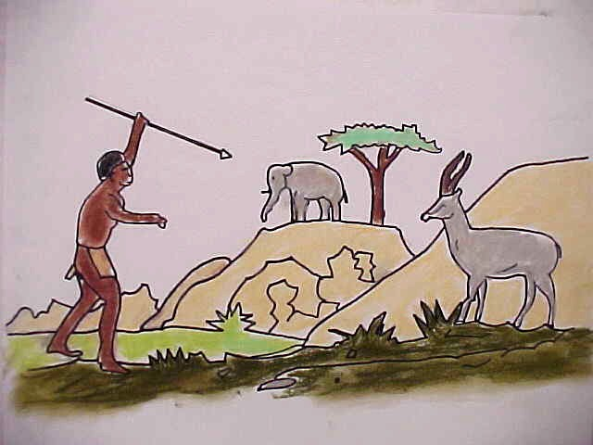
An Example from the Evolutionary Perspective
Male vs. Female: differences in visual-spatial ability
Hunting vs. gathering
Notes:
Bullets #1–2 On the average, males tend to perform a little better than females on visual-spatial tasks that require mentally rotating images, like map reading and working through a maze (Silverman & Eals, 1992). The evolutionary perspective explains this difference by asserting that aspects relating to spatial ability would have facilitated skills like hunting, which has largely been a task historically assumed by males. Following this logic, women should perform better than men on tasks that involve spatial skills similar to those that facilitated gathering—a traditionally female task long ago.

Slide 14
Other Examples
Fear of snakes and spiders
Greater sexual jealousy in males
Preference for foods rich in fats and sugars
Women’s greater emphasis on a potential mate’s economic resources
Notes:
Bullets # 1–3 Evolutionary psychologists often use examples like those listed on this slide as evidence the validity of their approach. These examples show present-day behaviors result from adaptive, life-or-death pressures faced by their ancestors.

Slide 15
Other Evolutionary Notions
Mating preferences, jealousy, aggression, sexual behavior, language, decision making, personality, and development
Critics
Notes:
Bullet # 1 With the work of David Buss (1988) and a number of other psychologists, the evolutionary approach experienced a rebirth in the late 20th century. By the mid-1980s, evolutionary psychology’s stock had risen greatly, and it began to rival the cognitive psychology “revolution” of the 1950s and 1960s.
Bullet # 2 Critics of the evolutionary approach argue that evolutionary theory is impossible to test, and that it has been built on what some have described as “post hoc accounts for obvious behavioral phenomena.”

Slide 16
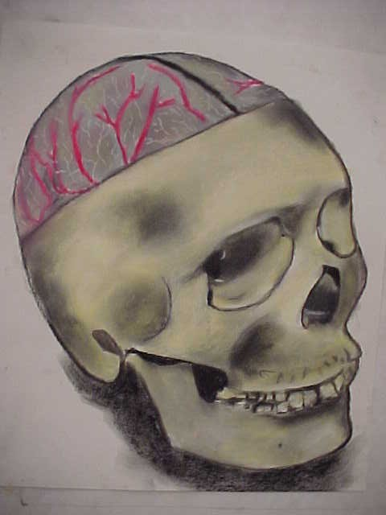
The Biological Approach
Behavior and mental processes are largely shaped by biological processes
It is not identified with any single contributor
Notes:
Bullets # 1–3 The biological approach to psychology investigates the relationships between physiology, behavior, and mental processes. Many neuroscientists have contributed to this field, but it is not usually identified with any single person. The biological approach gained momentum in the 1950s and is still going strong today. Sixty years ago, the psychodynamic approach was in favor. Today, psychologists often look for biological explanations for behavior.

Slide 17
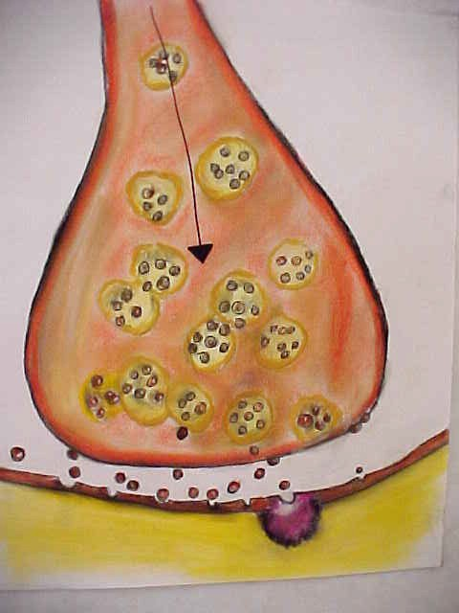
The Biological Focus
The brain and central nervous system
Sensation and perception
Autonomic nervous system
Endocrine system
Heredity and genetics
Notes:
Bullets # 1–5 The biological approach focuses on the central nervous system, the peripheral nervous system, and the autonomic nervous system. It also looks carefully at the significance of brain chemistry, body chemistry, and the endocrine system. Finally, the biological approach considers the influence of genetics and heredity.
Note: The drawing in this slide shows a synapse, the space between the neurons in the brain. The little dots represent neurotransmitters sending messages to the adjacent neuron.

Slide 18
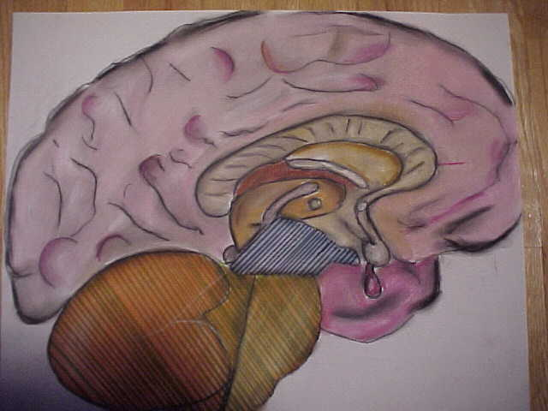
Biological Focus (cont.)
The physiological basis of how we learn and remember
The sleep-wake cycle
Motivation and emotion
Understanding the physical bases of mental illnesses such as depression and schizophrenia
Notes:
Bullet # 1 There is some overlap between the biological and the cognitive approaches to learning and memory. Biological theorists look for physiological and chemical changes in our brains that help us understand, learn, and remember.
Bullet # 2 Biological psychologists also study the wake-sleep cycle, focusing on the neurological sleep centers in the brain and the causes of sleep disorders.
Bullet # 3 The biological approach also involves searching for physiological factors that can influence emotion and motivation.
Bullet # 4 Biological psychologists are also critically interested in the physiological causes of mental illnesses such as bipolar disorder, depression, mania, and schizophrenia.

Slide 19

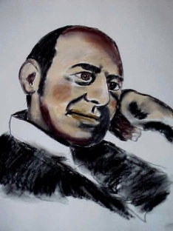

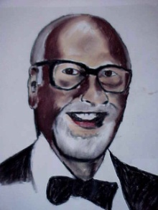
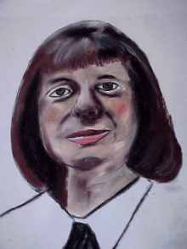
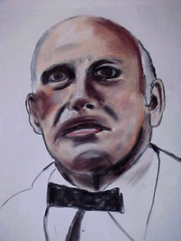
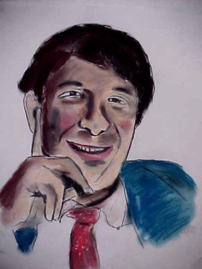
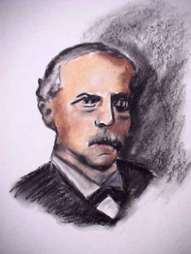
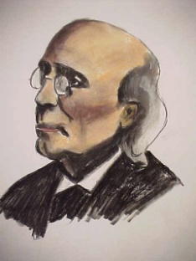
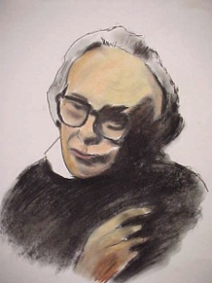
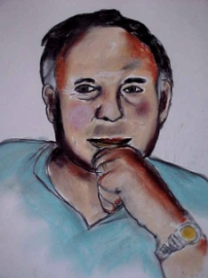
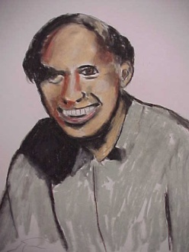
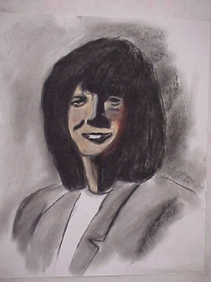
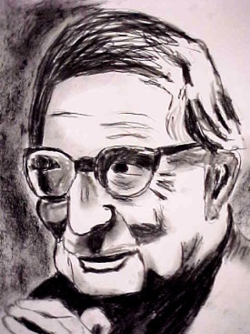
Major Contributors
Notes:
Hundreds of psychologists have made important contributions to the field of biological psychology. This slide contains portraits of those psychologists who have made some of the most prominent contributions. In the following slides, we will examine the ideas and innovations of these psychologists.
Pictured on the slide:
Top Row
William James Bottom Row
Stanley Schachter 1. Elizabeth Loftus
Judith Rodin 2. Hans Eysenck
David McClelland
Virginia Johnson
William Masters
Middle Row
1. Howard Gardner
2. Herman Von Helmholtz
3. Gustav Fechner
4. David Hubel
5. Paul Ekman
6. Erik Kandel

Slide 20

Howard Gardner
Studied brain damage and neurological disorders
Created the theory of multiple intelligences
The different types of intelligence
Notes:
Bullet # 1 Harvard psychologist Howard Gardner observed the behavior of people with brain damage, lesions, and neurological disorders. Gardner’s research led him to believe that different parts of the brain have very different abilities.
Bullet # 2 Gardner postulated that there are many forms of intelligence, most of which couldn’t be measured or quantified using traditional intelligence tests.
Bullet # 3 Originally, Gardner identified seven different intelligences; he later added two more. The nine intelligences are: linguistic, logical/mathematical, musical, spatial, bodily/kinesthetic, interpersonal, intrapersonal, naturalistic, and existential.

Slide 21
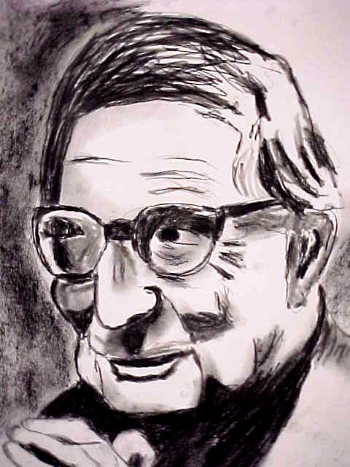
Hans Eysenck
Importance of genetics
Intelligence is inherited
Personality has a biological component
Hierarchy of personality traits
Notes:
Bullets # 1–2 Hans Eysenck was a German psychologist who fled to England when the Nazis came to power. He believed that genetics played a major role in determining both psychological and physical traits. For example, he felt that intelligence was inherited rather than acquired.
Bullets # 3–4 Eysenck also theorized that personality has a biological component and is strongly influenced by genetics; however, he remains best known for his trait theory of personality. Building on Carl Jung’s ideas about introversion and extroversion, he constructed a model of personality using a quadrant system divided into stable vs. unstable and introversion vs. extroversion.

Slide 22
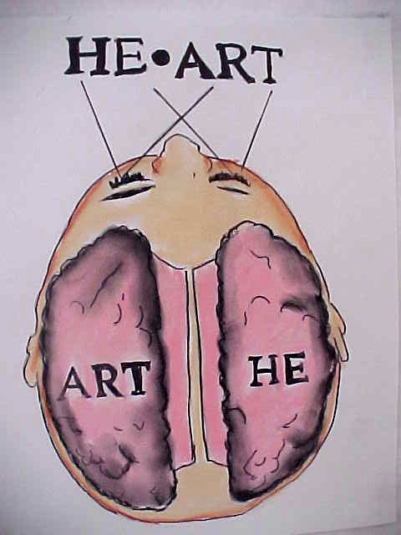
Roger Sperry
Split-brain surgery
Techniques for measuring the different functions of the hemispheres of the brain
Application: epilepsy
Notes:
Bullets # 1–2 Roger Wolcott Sperry (1913–1994) was a developmental neurobiologist who pioneered what became known as split-brain surgery. In the 1950s and 1960s, Sperry devised ways to measure the different functions of the two hemispheres of the brain. He believed that each hemisphere held a separate consciousness. He won a Nobel Prize for his work in 1981.
Bullet # 3 Split-brain operations were first used on humans to control epileptic seizures. An epileptic seizure involves massive, uncontrolled electrical activity that begins in either hemisphere and spreads to the other. In a split-brain operation, neurosurgeons sever the corpus callosum, which is the group of neuronal fibers that connect the two hemispheres of the brain. The procedure is drastic and irreversible, so doctors only use it as a last resort when a patient has severe and frequent seizures.
The picture on this slide depicts a simple experiment Sperry conducted on split-brain patients. Rather than seeing the word “heart” when it was projected on a screen, the subject’s left hemisphere would see the word “art” and the right hemisphere would see the word “he.” Since their two hemispheres couldn’t communicate, the patient couldn’t make the connections to perceive “heart” as a single word.

Slide 23
William James
Humans are motivated by a variety of biological instincts
Instincts are inherited tendencies
The father of American psychology
Notes:
Bullet # 1 William James proposed that all humans shared common instincts such as cleanliness, curiosity, parental love, sociability, sympathy, and jealousy.
Bullet # 2 James believed that our instincts are inherited tendencies or traits. He composed a list of 37 instincts that he believed explained human behavior.
Bullet # 3 James, a professor at Harvard, created the first course in psychology ever offered at an American university. This, along with his landmark psychological theories, have led many to call James the “father of American psychology.”

Slide 24
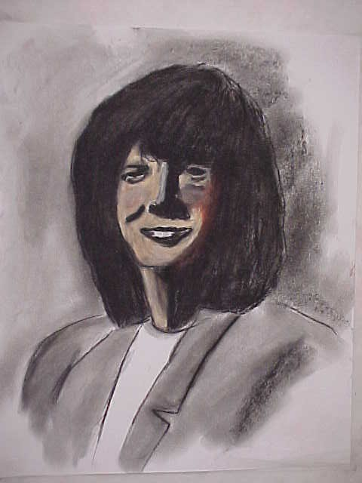
Elizabeth Loftus
Study of memory
Eyewitness testimony
Myth or repressed memories?
Notes:
Bullet # 1 The work and ideas of Elizabeth Loftus cross over into many different areas of psychology. She is best known for her studies on human memory. She theorized that memory does not always work like a camera that records and retrieves snapshots of an event.
Bullet # 2 According to Loftus, sometimes our memory can be flawed. Considered an expert on eyewitness testimony, Loftus’ work has shown that a substantial number of people are wrongly accused and convicted of crimes each year because of faulty eyewitness testimony.
Bullet # 3 Loftus also stands as a major critic of Freud’s theories of the unconscious mind; for example, she has characterized repression of memories as a “myth.”

Slide 25
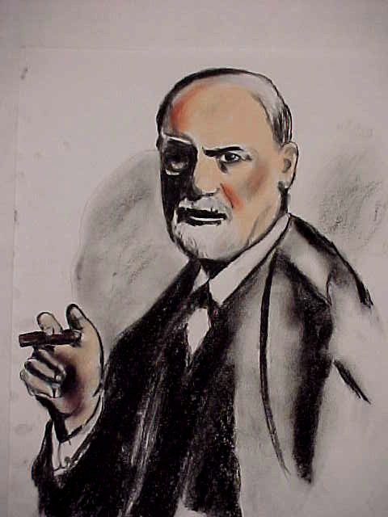
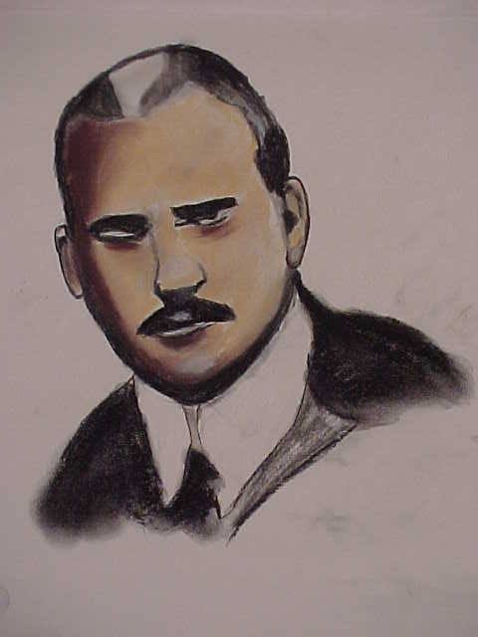
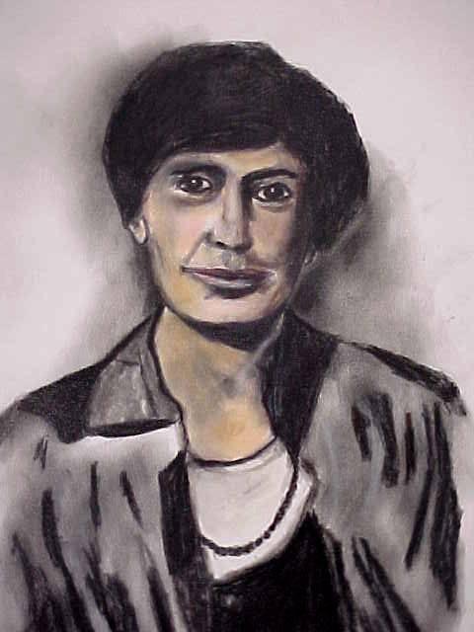
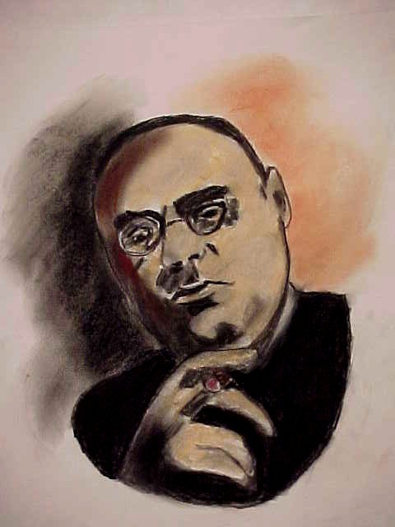
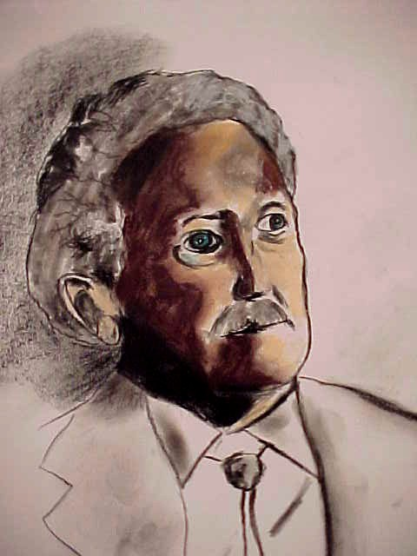
The Psychodynamic Approach
Notes:
When we think of the psychodynamic approach, Sigmund Freud and the theorists he so powerfully influenced in the 1800s and 1900s usually come to mind. In this next section, we will investigate how the psychodynamic approach looks at human behavior. We will also briefly examine the ideas of the major theorists who helped create this school of thought.
Pictured in the slide:
Top row
Sigmund Freud
Carl Jung
Anna Freud
Bottom row
Alfred Adler
Erik Erikson

Slide 26
The Psychodynamic/
Psychoanalytic Approach
Examines unconscious motives influenced by experiences in early childhood and how these motives govern personality and mental disorders
Free association and psychoanalysis
Notes:
Bullet # 1 The psychodynamic approach, which grew out of a search for a new way to treat mental disorders, was largely created by one man—Sigmund Freud, an Austrian physician.
Bullet # 2 Eventually Freud’s “talking cure” (also called “free association”) became the method of choice among therapists; like Freud, some also used hypnosis and dream interpretation.

Slide 27
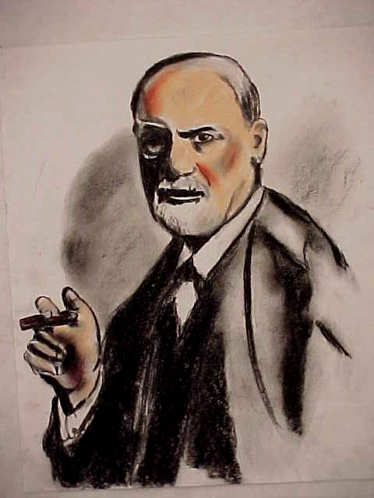
Sigmund Freud
The “Father of psychoanalysis”
The second mind, unconscious
Repression, free association, dream analysis
Theory of personality
Notes:
Bullets # 1–3 Most consider Freud the “father of psychoanalysis.” Freud believed that our “second mind” (also known as the “unconscious”) is filled with sexual and aggressive feelings that our conscious mind has repressed. He believed that unconscious thoughts often cause mental disorders, and that if these thoughts could be brought into a person’s conscious mind through free association (talking about painful memories) or dream analysis, a patient’s life would dramatically improve.
Bullet # 4 Freud also came up with a theory of personality in which he postulated that personality consisted of three components: the id, the ego, and the superego.

Slide 28
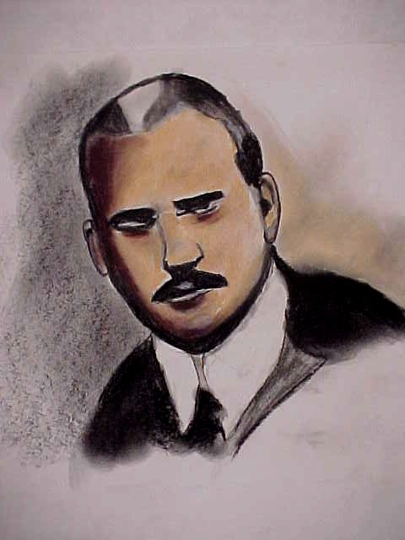
Carl Jung
Analytical psychology
Personal and collective unconscious
Archetypes
Notes:
Bullets # 1–2 Carl Jung was one of Freud’s earliest students and later became his colleague. He developed what came to be known as analytical psychology, as opposed to Freud’s psychoanalytic psychology. Both Freud and Jung agreed upon the existence of the unconscious, but Jung believed that it consisted of two components: a personal one and a collective one. The personal unconscious was much like Freud’s idea of the unconscious, but Jung also believed that humans had a collective, shared unconscious.
Bullet # 3 Jung believed that all cultures had similar “archetypes”: cultural symbols that appear to be nearly universal and that we store in our collective unconscious. For example, Jung believed stallions and bulls were two prominent male archetypes.

Slide 29
Alfred Adler
Individual psychology
Striving for perfection,
compensation, and the inferiority complex
Ordinal position
Notes:
Bullet # 1 Adler, like Jung, was a former disciple of Freud who eventually broke from him, but Adler and Freud still shared many similar ideas. Adler called his brand of thought “individual psychology.”
Bullet # 2 Adler believed that people constantly strive to attain perfection and overcome their weaknesses. Such weaknesses could be physical (e.g. some one born deaf), social (e.g. fear of speaking before a large crowd), or mental (e.g. a learning disability). In addition, weaknesses could either be real or imagined. Adler called the effort to overcome these weaknesses, “compensation.” He saw compensation as a positive thing that led people to grow and played a major role in shaping personality. Focusing on weaknesses, however, leads some people to get so caught up in feelings of inferiority or inadequacy that they can’t take any positive action to change their lives. Adler characterized these people as suffering from what he termed an “inferiority complex.”
Bullet # 3 Adler was also one of the first psychologists to focus on the importance of ordinal position (birth order). According to Adler, firstborn children have an advantage over middle children or younger children. Adler also theorized that the environmental setting for each child within the family is different. Children without siblings are spoiled. Firstborns are often “problem children” because they become upset when a second child is born into the family. Second-born children tend to be competitive because they are trying to catch up with an older sibling.

Slide 30
Erik Erikson
A neo-Freudian
A strong need for social approval
Psychosocial development and crises
Notes:
Bullets # 1–2 Erik Erikson was a neo-Freudian. He subscribed to Freud’s argument about the importance in childhood of issues relating to sexuality and aggression, but he also believed that children have a need for social approval.
Bullet # 3 Erikson also believed that all people go through certain psychosocial crises at different phases of development in our lives, and that each crisis needs to be resolved before a person can progress to the next stage of development. He theorized that personality is shaped by how we manage our psychosocial crisis at each stage.

Slide 31
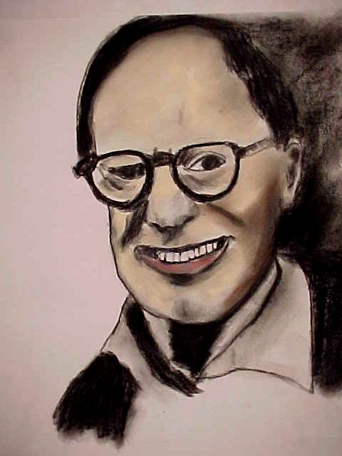
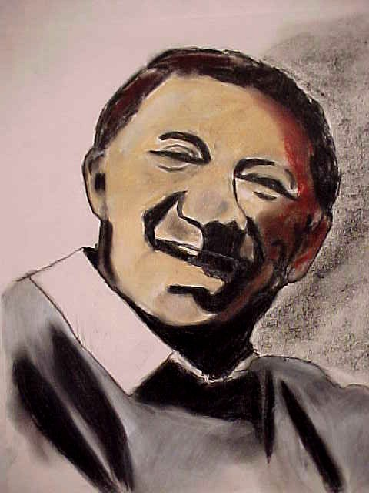
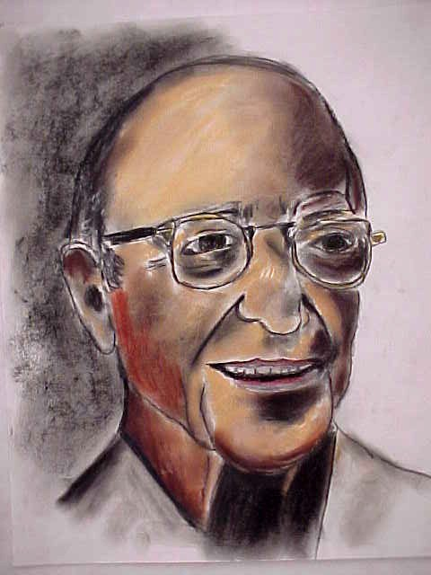
The Humanistic Approach
Notes:
In the 1950s, humanistic psychology arose as a response to perceived shortcomings in the behaviorist and psychodynamic/psychoanalytic approaches.
This slide shows three of the most prominent humanists:
Abraham Maslow
Carl Rogers
Albert Ellis

Slide 32
The “Third Force” in Psychology
Rejected the views of both behaviorism and psychoanalytic thought
Free will and conscious choice
Notes:
Bullet # 1 Sometimes labeled the “third force in psychology,” humanism rejected the two major “forces” that preceded it: behaviorism and psychoanalysis. Behaviorists believed that human behavior was primarily determined by one’s environment; Freudians believed that unconscious forces controlled a person’s motives and thoughts.
Bullet # 2 Humanists believed that each person has free will and is able to make conscious choices about the direction of their lives.

Slide 33
The Humanists Revolt
Humanists felt that both behaviorist and psychoanalytic perspectives were dehumanizing
Humanists believed that behaviorism and psychoanalysis ignored personal growth
An optimistic view of human potential
Notes:
Bullet # 1 Psychoanalysts saw people as dominated by primitive sexual and aggressive urges. Humanists felt that behaviorism was based too much on research with animals: Skinner had used pigeons and rats, Pavlov had worked with dogs, and John Watson had focused on the power environment could exert upon both animals and humans.
Bullet # 2 Humanists believed people were rational and had the potential for conscious growth. They also believed that humans and animals are so different that research on animals had very little relevance to the understanding of human behavior.
Bullet # 3 Unlike behaviorists and psychoanalytic thinkers, humanists take a very optimistic view by focusing on human potential instead of problems or limitations.

Slide 34
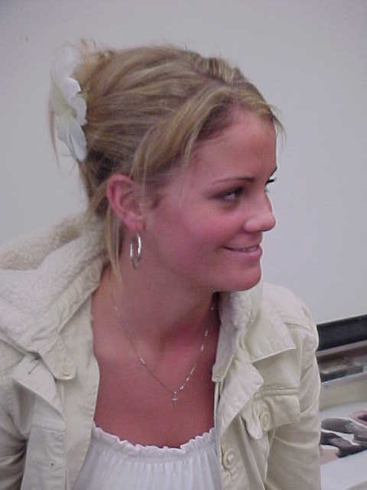
More Differences
Choices are not dictated by instincts, the biological process, or rewards and punishments
The world is a friendly, happy, secure place
Notes:
Bullet # 1 Humanists don’t believe that the life-or-death instincts Freud emphasized control human behavior. They also rejected the behaviorist notion that rewards and punishments play a major role in influencing behavior. Instead, humanists stress each individual’s unique perceptions.
Bullet # 2 Humanists believed that if you perceive the world as a secure and friendly place, your behavior and decisions will reflect this perspective. If you see the world as angry and hostile, you are likely to become anxious or defensive.

Slide 35
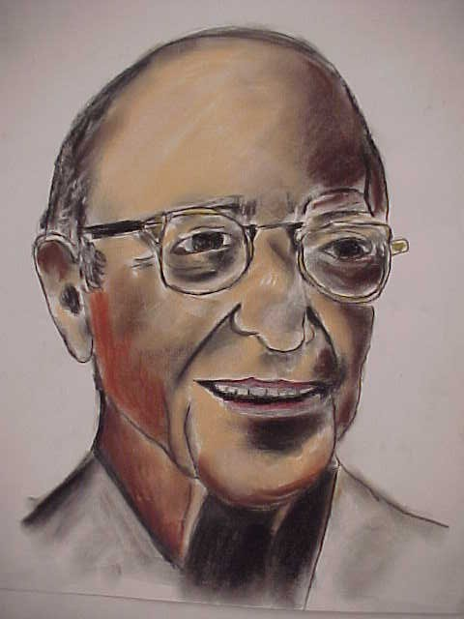
Carl Rogers
In the 1940s, humanism began to receive attention because of Rogers
Human behavior is governed by each individual’s sense of self
The drive for personal growth
Notes:
Bullet # 1 The humanistic approach started to attract attention in the psychological community because of the work of Carl Rogers (1902–1987). Rogers had been trained in the psychodynamic approach, which he eventually rejected.
Bullet # 2 Rogers felt that human behavior was governed by “self concept,” the image a person had of himself or herself. According to Rogers, since animals have no self concept, the results of psychological experiments involving animals couldn’t really apply to humans.
Bullet # 3 Along with Abraham Maslow, Rogers believed that in order for psychologists to truly understand human behavior, they had to take into account the human drive toward personal growth. Humanistic theorists believe that humans continue to evolve and fulfill their potential.

Slide 36
Application of the
Humanistic Approach
Greatest contribution comes in the area of therapy
Client-centered therapy
Notes:
Bullet # 1 Perhaps the greatest contribution to psychology by the humanists has come in their application of their principles to the therapeutic process.
Bullet # 2 Rogers did not call those who came to his therapy sessions “patients;” instead, he referred to them as “clients” because the term implied a kind of equality he felt was lacking the the power-laden “doctor-patient” dynamic. Rogers believed that in therapy, the process is less relevant than the climate. In client-centered therapy (as Rogers’s therapeutic approach came to be known), the therapist tries to created a warm, loving, and comfortable environment so that the client will be less likely to use defense mechanisms during therapy.
A quote from Rogers: “ My experience in therapy and in groups makes it impossible for me to deny the reality and significance of human choice. To me it is not an illusion than man is to some degree the architect of himself.”

Slide 37
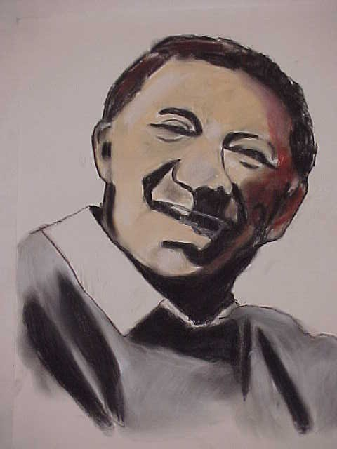
Abraham Maslow
Hierarchy of needs, theory of motivation
Becoming fully self-actualized
Emphasis on uniqueness
Notes:
Bullet # 1 Another extremely influential humanist was Abraham Maslow (1908–1970). Maslow believed that all humans have a “hierarchy of needs” that begins with basics such as food, shelter, comfort, warmth, and security. After those come “higher” needs such as love, self-esteem, knowledge and understanding, and the need for beauty and order.
Bullets # 2–3 In all likelihood, few people have ever reached the top of the hierarchy of needs and truly fulfilled their potential; Maslow called this top level “self-actualization.” He saw Abraham Lincoln and Eleanor Roosevelt as two prime examples of truly self-actualized individuals.

Slide 38
Criticisms of the
Humanistic Approach
Not all people have the same needs or meet them in a hierarchical fashion
The humanistic approach is vague and unscientific
Notes:
Bullet # 1 Critics of the humanistic approach doubt that all people necessarily meet their needs according to some hierarchical structure such as that proposed by Maslow. They also took issue with his concept of self-actualization, viewing it as overly idealistic and unrealistic.
Bullet # 2 Some critics of the humanistic approach also believe that many of its concepts were too vague and would not be able to hold up under scientific scrutiny.

Slide 39
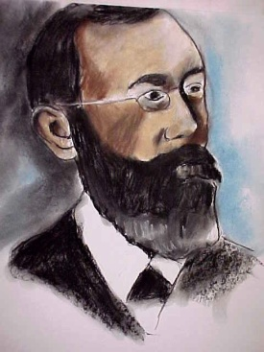
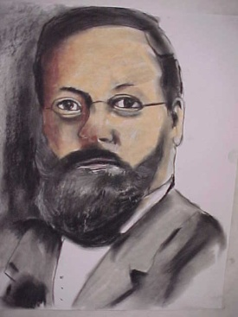
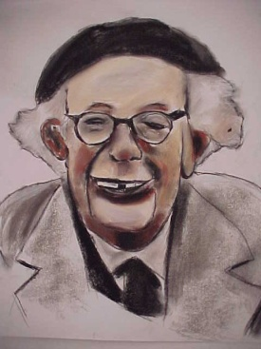
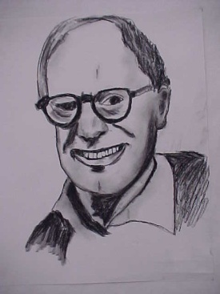
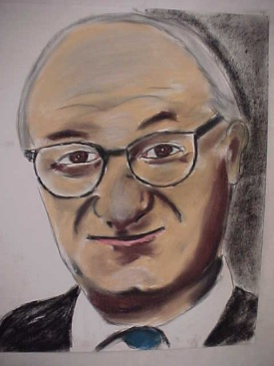


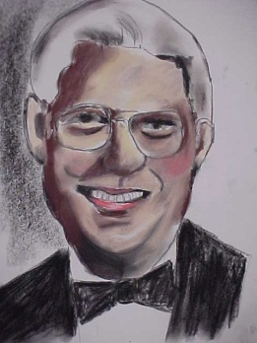
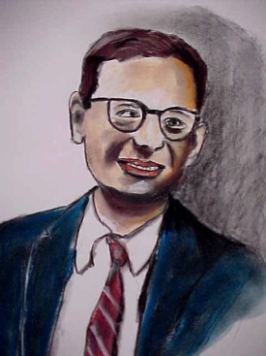
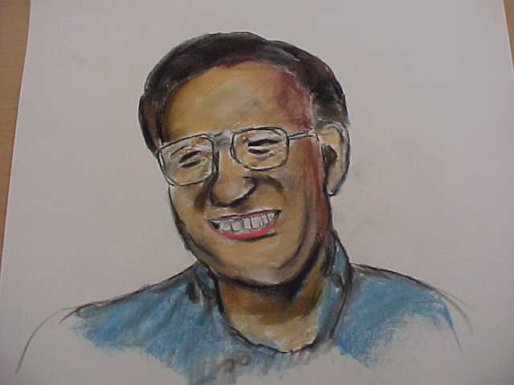
The Cognitive Approach
Notes:
The origins of the cognitive approach go back to two men: Wilhelm Wundt and Edward Titchner, who developed the theory of structuralism. The cognitive approach built upon the main ideas behind structuralism (i.e. defining of the mind by dividing it into its component pieces).
Pictured in the slide:
Top row
Wilhelm Wundt
Edward Titchener
Jean Piaget
Albert Ellis
Albert Bandura

Slide 40
The Cognitive Perspective
Studies people’s mental processes in an effort to understand how humans gain knowledge about the world around them
Cognito = Latin for “knowledge”
How we learn, form concepts, solve problems, make decisions, use language
Notes:
Bullet # 1 Cognitive psychologists study the mental process in order to understand how people gain information and knowledge.
Bullet # 2 The root of the word “cognitive” is cognito, a Latin word that means “knowledge.”
Bullet # 3 The cognitive approach focuses on how we do things such as learn, develop conceptual ideas, solve problems, develop decision-making skills, and use language.

Slide 41
What Is Cognition?
An “unobservable” mental process
The study of consciousness, physiological determinants of behavior
1950s-1960s: new understanding of children’s cognitive development
Notes:
Bullet # 1 Though its roots lie in structuralism, the cognitive approach is relatively new. Historically, any unobservable behavior (such as the “mental process” cognitive psychologists focus on) was thought to be inappropriate for the proper study of psychology.
Bullet # 2 Contemporary psychologists have shown a renewed interest in consciousness (often referred to as “cognition”) and the physiological basis of behavior.
Bullet # 3 The 1950s and 1960s witnessed major strides in our understanding of children’s cognitive development.

Slide 42
Advocates of the
Cognitive Approach
The manipulation of mental images can influence how people behave
The focus is not on “overt” behavior
The cognitive method can be studied objectively and scientifically
Notes:
Bullet # 1 Cognitive theorists believe that how a person creates and manipulates mental images influences not only their behavior but their personality as well.
Bullet # 2 The cognitive approach moves away from overt, observable behavior, which they believe will only yield an incomplete picture of why people behave the way they do.
Bullet # 3 Cognitive psychologists believe that there are ways to study the cognitive process objectively and scientifically.

Slide 43

Wilhelm Wundt
He used “introspection” as a research technique
He set up the first psychology laboratory
Voluntarism
Notes:
Bullet # 1 Wilhelm Wundt was interested in studying people’s mental experiences. He used a method which he called “introspection” which involved having subjects engage in careful self-examination then report their conscious experiences (e.g. thinking, feeling, perceiving).
Bullet # 2 Wundt set up the first psychology lab and did much to establish psychology as a science. Rather than engaging entirely in abstract speculation (like many psychologists of the time), Wundt conducted quantifiable, measurable experiments.
Bullet # 3 Wundt came to the conclusion that a person uses their motives and intentions to direct their attention. He called this theory “voluntarism.”

Slide 44

Jean Piaget
Child psychologist
Educational reforms
Children are not “blank slates”
Notes:
Bullet # 1 Piaget was a Swiss child psychologist. He learned about human behavior by spending a tremendous amount of time watching children. His observations led him to conclude that children think in very different ways than adults do.
Bullet # 2 Piaget championed educational reform. He was one of the first psychologists to take children’s thinking seriously.
Bullet # 3 Piaget felt that children were not merely “blank slates” upon which experience writes. He believed instead that children create their own logic and often acted like miniature scientists. Unlike the behaviorists, Piaget downplayed the role that a child’s environment plays in their mental development; instead, he came to the conclusion that knowledge builds as children grow.

Slide 45

Lawrence Kohlberg
How children develop a sense of right and wrong
He borrowed from Piaget
Moral questions
Notes:
Bullet # 1 Lawrence Kohlberg developed what has become known as “stage theory.” This theory outlines three levels of moral reasoning, preconventional, conventional, and postconventional, each of which can be divided into two stages. Each level also roughly corresponds to a particular age group: preadolescent, adolescent, adult. Stage theory therefore incorporates elements of developmental psychology; it attempts to explain moral development and how children acquire and refine their sense of right and wrong.
Bullet # 2 Kohlberg borrowed heavily from the work of Jean Piaget, who felt that moral development was tied to cognitive development.
Bullet # 3 In one experiment, Kohlberg presented his subjects with a difficult moral question and then asked them what the actor in the dilemma should do. They way in which subjects responded to the question indicated to Kohlberg the specific “stage” each person was in.

Slide 46
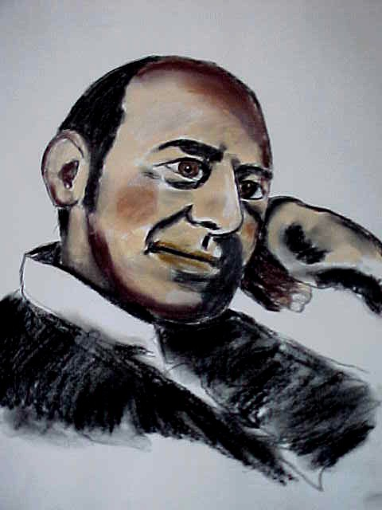
Stanley Schachter
“Misery loves company”
Anxiety and companionship
Notes:
Stanley Schachter, whom we already been discussed when examining the biological approach to psychology, has also made significant contributions to cognitive psychology.
Bullets # 1–2 Schachter performed an experiment based on the notion that “misery loves company.” The experiment showed that people who suffer from a high level of anxiety are more likely to desire companionship.

Slide 47
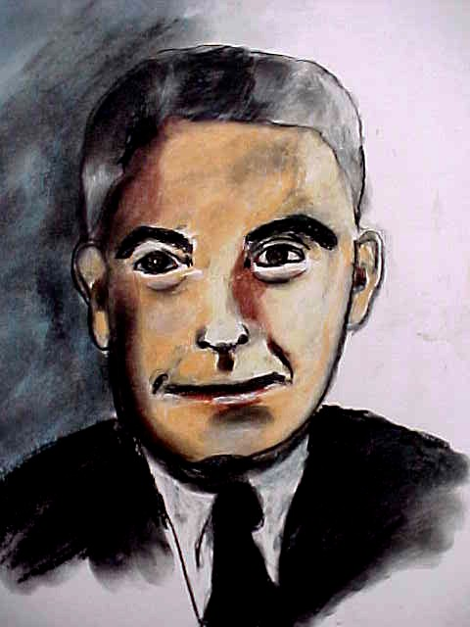
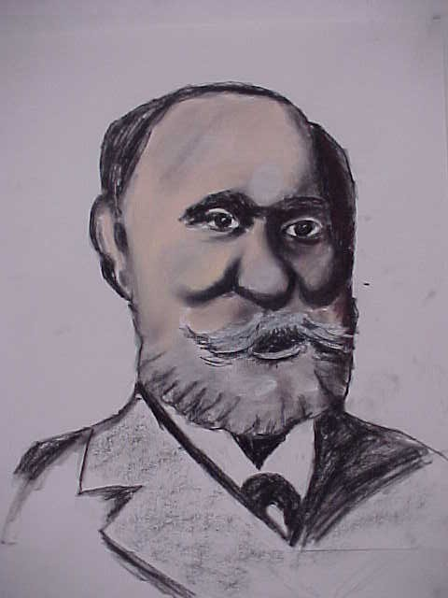
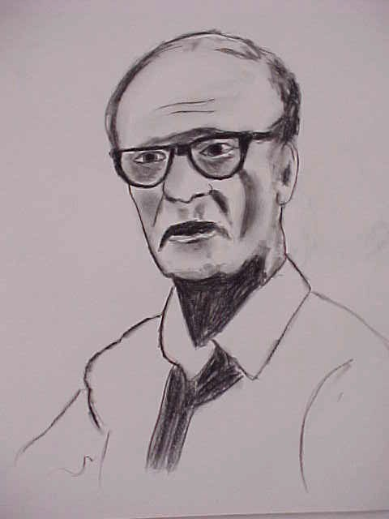
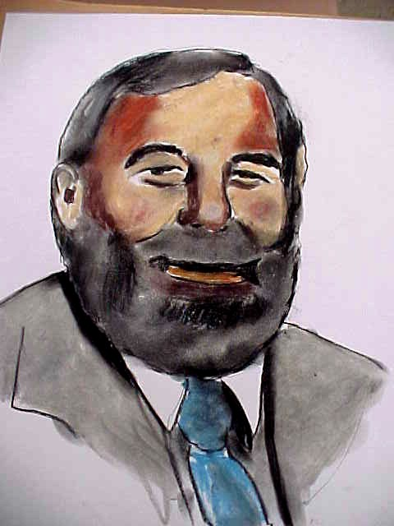
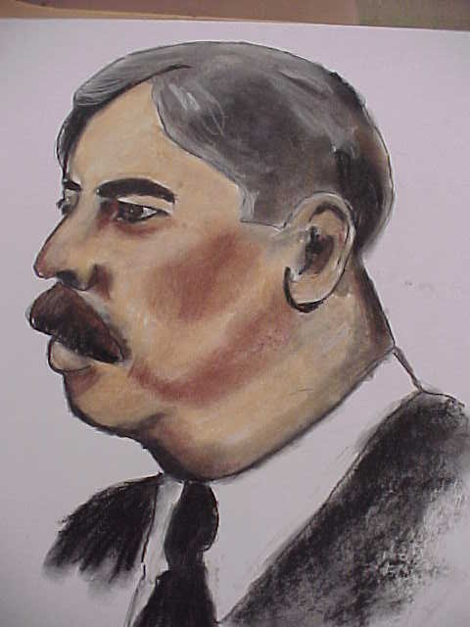
The Behavioral Approach
Notes:
The behavioral approach had its beginnings in the early 1900s and is still used by contemporary psychologists. Behaviorists focus on the effects an individual’s environment has on them, and they also examine the overt behavior of both animals and humans. They believe that only observable stimulus-response relations can be studied scientifically.
Top row
John Watson
Ivan Pavlov
B.F. Skinner
Bottom row
John Garcia
Edward Thorndike

Slide 48
What Is Behaviorism?
Focuses on observable behavior and the role of learning in behavior
Behaviorism continues to influence modern psychology
The role of reward and punishment in learning
Notes:
Bullet # 1 Behaviorism focuses on observable behavior rather than on unobservable thought processes.
Bullet # 2 Though behaviorism reached the height of its popularity in the early 1900s, it still influences modern psychology.
Bullet # 3 Behaviorists believe in and study the importance of rewards and punishments in learning. They also look at the relationship between learning and behavior.

Slide 49
Applications of Behaviorism
Aggression
Drug abuse
Self-confidence issues
Overeating
Criminality
Notes:
The behaviorist approach has applications in many areas, including those listed in the slide. Behaviorists strongly believe that behavior can be changed or altered by manipulating and balancing rewards and punishments. In other words, if we can learn bad behavior patterns, then we can also unlearn and change them.

Slide 50
John Watson
The father of behaviorism
Psychology should become a science of behavior
Environment molds the behavior of us all
Notes:
Bullet # 1 In the early 1900s, John Watson developed what became known as behaviorism. He believed that psychology should only study overt, measurable behavior.
Bullet # 2 Watson felt that psychology needed to study behavior scientifically and needed to break away from concepts like the mind, consciousness, feeling, and thinking.
Bullet # 3 Waston firmly believed in the strength and power a person’s environment could exercise over them. Consequently, he believed that by controlling a healthy child’s environment, it was possible to influence that child to develop in a number of different directions.

Slide 51
Ivan Pavlov
Nobel Prize winner
Psychic reflexes
Classical conditioning
Notes:
Bullet # 1 Ivan Pavlov was a Russian psychologist who won the Nobel Peace Prize for his research on digestion.
Bullet # 2 While he was studying the importance of saliva in digestion, he discovered what later became known as “psychic reflexes.” In his most famous experiment, he conditioned dogs to salivate at the sound of a certain tone. The dogs had come to associate the tone with receiving food.
Bullet # 3 The classical conditioning techniques pioneered by Pavlov have had major application in therapeutic situations. In addition, many of today’s advertisers also use classical conditioning techniques to sell products.

Slide 52
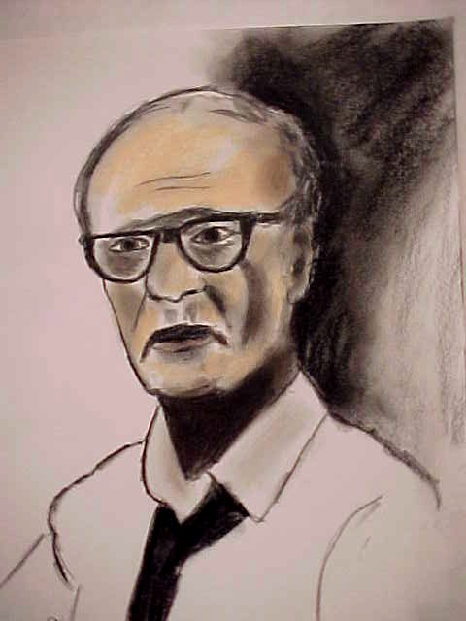
B.F. Skinner
A strict behaviorist
Operant conditioning: rewards and punishments
Notes:
Bullet # 1 Perhaps the most prominent and strict behaviorist, B.F. Skinner spent most of his career at Harvard.
Bullet # 2 Skinner believed that behavior is strongly influenced by rewards and punishments. In much of his work, he used rats and pigeons. Food was the major reward in his experiments and frequent electric shocks were the punishment. This method of experimenting eventually became known as operant conditioning.

Slide 53





The Sociocultural Approach
Notes:
The sociocultural approach to psychology explores how society and culture influence behavior. Throughout the history of psychology, most researchers have believed they could identify general principles of behavior that would apply to all of humanity. For the most part, however, psychology has had a Western/North American/European focus. In addition, the majority of psychological research has been conducted by white, middle, or upper class men. How might cultural biases have affected their theories? How well might their theories play out in non-western societies?
Pictured in the slide:
Top row
Arthur Jensen
Solomon Asch
Stanley Milgram
Bottom row
Albert Bandura
Harry Harlow

Slide 54
Why Has Psychology’s Focus Been So Narrow?
Cross-cultural research is costly, difficult, and time consuming
Psychology has traditionally focused on the individual, not the group
Cultural comparisons may foster stereotypes
Notes:
Bullet # 1 According to sociocultural theorists, time and expense have limited the scope and focus of psychology. Consequently, many researchers have simply studied white, middle-class subjects.
Bullet # 2 Traditionally, psychology has focused more on the individual rather than the group. The study of group phenomena has been left to sociologists.
Bullet # 3 In addition, critics of the sociocultural approach believe that making cultural comparisons merely generates fixed, stereotypical notions of various cultural groups—many of which have already been victims of prejudice and discrimination.

Slide 55

Sociocultural Issues
Ethnicity
Gender issues
Lifestyles
Income
The influence of culture on behavior and the mental process
Notes:
Bullets # 1–5 The sociocultural approach is really a combination of both psychology and sociology. It mixes psychology’s main focus on individual behavior with sociology’s focus on group behavior. The sociocultural approach is incredibly diverse. Sociocultural psychologists study issues ranging from ethnicity to gender to lifestyles; they also look at age, sexual orientation, disabilities, the rise and power of cults, violence, aggression, and obedience to authority.

Slide 56
Stanley Milgram
Classical experiment on obedience to authority
Notes:
Bullet # 1 One of the most elaborate and famous psychological experiments was conducted by Stanley Milgram at Yale in 1960. It involved a white-coated researcher directing a subject to administer increasingly large electric shocks to an unseen “learner.” Before the experiment, Milgram asked many other psychologists how they thought most subjects would behave. The psychologists largely agreed that most of the subjects would obey their conscience and refuse to deliver shocks at high voltages. In Milgram’s experiment, however, 65 percent of the subjects willingly administered shocks at the maximum voltage of 450 volts. In reality, the experiment didn’t involve any electric shocks: Milgram wanted to test how certain factors can influence obedience. The results of his experiment showed that people will change their behavior at the request of—or even in the presence of—someone they perceive to be an authority figure.

Slide 57
Solomon Asch
1950 conformity study showed that people tend to conform to other people’s ideas of truth even when they disagree with those ideas
Notes:
Bullet # 1 Psychologist Solomon Asch devised a study in the 1950s to show how the pressures of conformity can cause attitudes to change. His simple experiment asked subjects to look at one line, then choose which of three other lines most closely approximated the length of the first. He found out that people tend to conform even when they know that it is not right or if they disagree.

