Slide 1
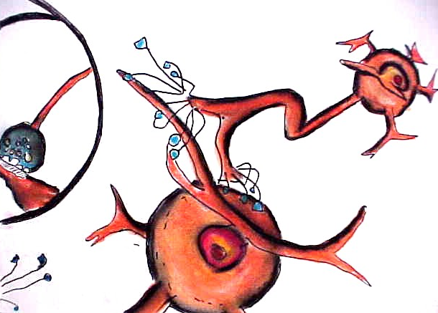
Neurons
Notes:
This drawing presents a simplified version of how of neurons connect. The dendrites appear on the cell body, much like a root. The axons are long, branch-like structures that nearly touch the next neuron. The small blue, bell-like structures are the synaptic knobs, which contain neurotransmitters. At the bottom of the drawing you can see an enlarged image of a synaptic knob nearly touching another neuron.

Slide 2
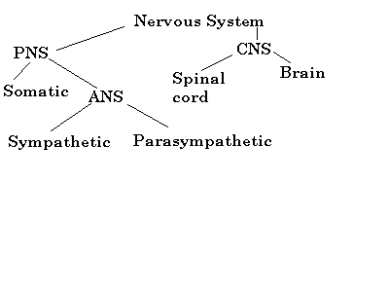
Diagram of the Nervous System
Notes:
This is a diagram of the nervous system. You can see that the main divisions separate the central nervous system (CNS) from the peripheral nervous system (PNS). The central nervous system is composed of the brain and spinal cord; the peripheral nervous system is divided into the somatic nervous system, which controls voluntary body movements, and the autonomic nervous system (ANS), which controls involuntary responses. The ANS is then further divided into the sympathetic and parasympathetic systems.
The nerves of the peripheral nervous system conduct information from the bodily organs to the central nervous system (CNS) and send information back to the organs. These neurons in turn branch out from the spinal cord (they are about the thickness of a pencil). Some nerves are so small that they are invisible.
The sympathetic nervous system kicks into gear when there is an emergency. This is the “fight or flight” part of the nervous system—the “on” switch that makes us react to danger. The parasympathetic nervous system returns our body to a normal, relaxed mode.

Slide 3
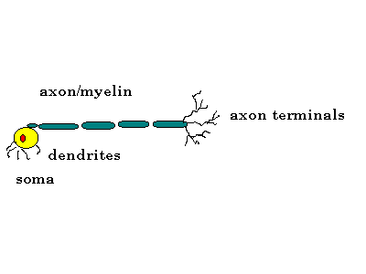
Axons
Thread-like extensions from the cell body
Tube-like fibers that carry impulses away from the soma to the dendrites
Myelin coating
Notes:
Bullet # 1 Axons are thread-like extensions that emanate from the soma/cell body.
Bullet # 2 Axon fibers carry impulses away from the cell body toward the dendrites of another neuron.
Bullet # 3 Most axons, especially those found in the brain, are very short (about 1/25th of an inch long). Axons in other parts of the nervous system can be several feet long. Axons in the PNS (peripheral nervous system) are covered with a white, fatty material called myelin that insulates the nerve fiber and speeds transmission of impulses. Myelin is similar to insulation on an electric wire. Axons with myelin are known as “white matter;” axons without myelin are known as “gray matter.” Axon terminals branch out from the ends of the axon, and are positioned opposite the dendrites of a neuron.

Slide 4

Multiple Sclerosis
MS destroys myelin sheaths of axons
This can cause erratic and uncoordinated behavior
Notes:
Bullets # 1–2 When a person has multiple sclerosis, the disease attacks the myelin coatings of axons. A person’s behavior can consequently become erratic and uncoordinated. Famous people with MS include former child star and Disney Mouseketeer Annette Funicello and talk show host Montel Williams.

Slide 5
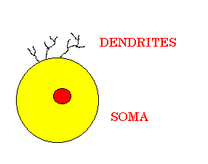
Dendrites
Short, thin fibers that stick out from the cell body
Dendrites receive impulses or messages from other neurons and send them to the cell body
Notes:
Bullets # 1–2 Dendrites are short, thin fibers that protrude from the cell body. Their main task is to receive impulses or messages from other neurons and send them to the cell body. Note: The word “dendrite” is Greek for “tree.”

Slide 6
Characteristics of Neurons
They cannot replace themselves
Damage is permanent
Threshold of excitation
Notes:
Bullets # 1–2 Damage to neurons is permanent and irreversible. They do not have the ability to regenerate themselves.
Bullet # 3 When a neuron transmits a message to a neighboring neuron, the neuron on the receiving end experiences a slight change in its electrical charge. If this change in electrical charge is large enough to exceed what is known as the “threshold of excitation,” the receiving neuron will also fire. Neurons can fire at speeds approaching 250 miles per hour.
Special note: Even though damage to neurons is permanent, other parts of the brain can take over functions that have been lost. Hydrocephalus (water on the brain) can cause irreparable neuronal damage; however, the installation of a valve developed in the 1950s uses the heart as a pump to control the accumulation of cerebrospinal fluid. This device has saved countless lives and enabled some hydrocephalics to lead a relatively normal life.

Slide 7
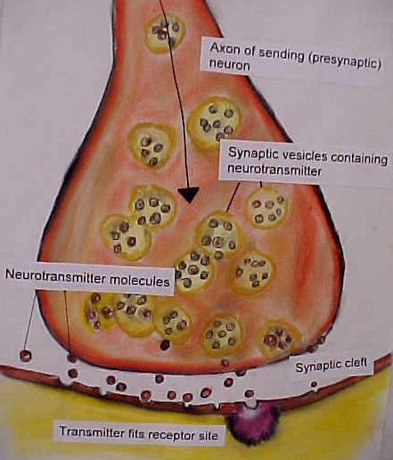
The Neuron Connection
Synapse junction
Neurotransmitters
Open chemical “locks”
Inhibition
Notes:
Bullet # 1 The space between the axon terminal of one neuron and the dendrites of another neuron is called the synapse. It acts as a kind of junction or connection between the neurons. (Note: synapse is a Greek word meaning “junction.”)
Bullet # 2 A neuron transmits its impulse or signal to another neuron across the synapse by releasing chemicals called neurotransmitters.
Bullets # 3–4 Neurotransmitters have specific “receptor sites” on the other side of the synapse. They fit into these receptor sites like a key in the lock of a door. The way that neurotransmitters fit into these “locks” can either excite the next neuron or prevent it from transmitting. This process is known as “inhibition.” Neurotransmitters are similar to traffic cops: they make sure that neural activity is orderly and that it flows in the proper direction.

Slide 8
How a Neuron Fires
Notes:
When a neural impulse triggers the release of a neurotransmitter, the neurotransmitter molecule diffuses across the synaptic cleft (gap) and binds to receptor sites on the postsynaptic (receiving) neuron. A specific neurotransmitter can only bind to receptor sites that its molecular structure will fit into, much like how a key must fit a specific lock.
Special note to the teacher: Click on the blue arrow button to play a Flash movie that illustrates how this process works.

Slide 9
Neurotransmitters
Acetycholine (memory, movement)
Norepinephrine (memory, learning)
Serotonin (sleep, appetite)
Endorphins (inhibits pain)
Dopamine (learning, emotions, movement)
Notes:
Bullet # 1 There are many different neurotransmitters. Acetycholine is related to movement and memory. If there is an undersupply of this neurotransmitter, a person can suffer from Alzheimer’s disease.
Bullet # 2 Norepinephrine affects memory and learning. An undersupply of this neurotransmitter can lead to depression. Norepinephrine also contributes to changes in mood.
Bullet # 3 Serotonin governs sleep patterns, appetite, and body temperature. If serotonin levels fall, a person can become depressed. Abnormal levels of serotonin may also be related to obsessive-compulsive behavior.
Bullet # 4 Endorphins are natural painkillers created by the brain. Morphine and other drugs classified as opiates are quite similar to endorphins and fit into many of the same receptor sites in the brain as endorphins. If a person abuses opiates, they develop a tolerance for them; when they stop, the brain’s natural endorphins aren’t sufficient, and the person goes through withdrawal.
Bullet # 5 Dopamine affects learning, emotions, and movement. An oversupply of dopamine can cause schizophrenia, while an undersupply can cause Parkinson’s disease.

Slide 10
Neurotransmitters
Acetycholine (memory, movement)
Norepinephrine (memory, learning)
Serotonin (sleep, appetite)
Endorphins (inhibits pain)
Dopamine (learning, emotions, movement)
Notes:
Bullet # 1 There are many different neurotransmitters. Acetycholine is related to movement and memory. If there is an undersupply of this neurotransmitter, a person can suffer from Alzheimer’s disease.
Bullet # 2 Norepinephrine affects memory and learning. An undersupply of this neurotransmitter can lead to depression. Norepinephrine also contributes to changes in mood.
Bullet # 3 Serotonin governs sleep patterns, appetite, and body temperature. If serotonin levels fall, a person can become depressed. Abnormal levels of serotonin may also be related to obsessive-compulsive behavior.
Bullet # 4 Endorphins are natural painkillers created by the brain. Morphine and other drugs classified as opiates are quite similar to endorphins and fit into many of the same receptor sites in the brain as endorphins. If a person abuses opiates, they develop a tolerance for them; when they stop, the brain’s natural endorphins aren’t sufficient, and the person goes through withdrawal.
Bullet # 5 Dopamine affects learning, emotions, and movement. An oversupply of dopamine can cause schizophrenia, while an undersupply can cause Parkinson’s disease.

Slide 11
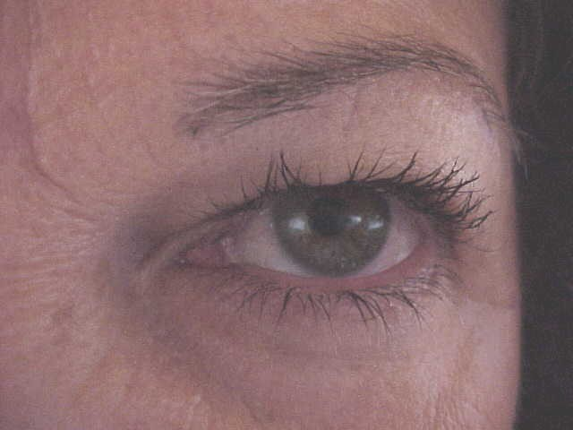
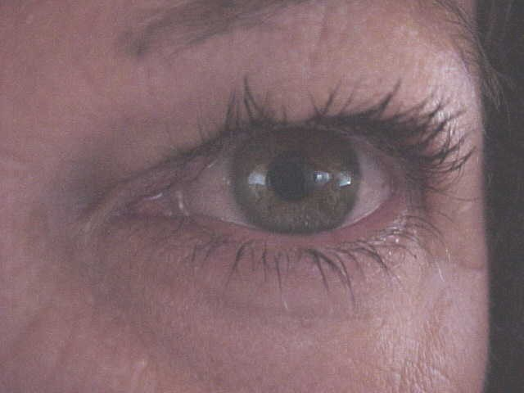
Voluntary vs. Involuntary
Somatic nervous system (voluntary activities)
Autonomic nervous system (involuntary activities)
Notes:
Bullet # 1 The somatic nervous system is the part of the peripheral nervous system that controls voluntary activities. It makes our bodies move.
Bullet # 2 The autonomic nervous system controls all of our involuntary responses, including breathing, heart rate, stomach activity, and many others. We are usually not conscious or aware of these activities.
The two photographs above show the subtle change in the size of the pupil of the eye in response to light. This change is an involuntary activity. The pupils of your eyes get smaller after they are exposed to bright light (the top photo). The bottom photo shows the eye in normal light.

Slide 12
Divisions of the
Autonomic Nervous System
Sympathetic nervous system
1. Fight or flight
2. Speeds up heart rate/O² supply and blood pressure
3. It constricts some arteries, relaxes others
Notes:
Bullet # 1 The sympathetic nervous system prepares our bodies for emergencies or strenuous physical activity.
Bullet # 2 It has been called the “fight or flight” part of our nervous system. When an emergency arises, the SNS speeds up heart rate and respiration. It causes a constriction of some arteries while relaxing others. It sends blood to the muscles, where it is needed most. It also suppresses activities like digestion. In all, the sympathetic nervous system acts like a switch that turns us “on” for emergencies.

Slide 13
Parasympathetic
Nervous System
Works to conserve energy
Helps us recover from strenuous activity
Reduces heart rate and blood pressure
Returns us to a normal resting state
Notes:
Bullets # 1–2 The parasympathetic nervous system is connected to the same muscles and glands as the sympathetic nervous system. The PNS works to help us conserve energy, slow down, and relax after an emergency has ended.
Bullet # 3 The PNS reduces heart rate, respiration, and blood pressure. Digestive activity resumes. Have you ever noticed how hungry you become after a strenuous activity or some traumatic “fight or flight” event?
Bullet # 4 The amazing thing about the PNS is that all of this takes place automatically. If the ANS is our “on” switch, the PNS is our “off” switch.

