Slide 1

Chronic & Age-Related Diseases
Notes:
Image from: sydney.edu.au

Slide 2
“The rise of chronic noncommunicable diseases presents an enormous challenge.
For some countries, it is no exaggeration to describe the situation as an impending disaster;
a disaster for health, for society, and most of all for national economies.”
~Dr. Margaret Chan, WHO Director-General

Slide 3
What are chronic diseases
Diseases that aren’t infectious.
also called non-communicable diseases (NCDs)
These diseases are typically of long duration & slow progression.
Almost half of all Americans have a chronic condition.
Chronic diseases are the leading cause of mortality in the world.

Slide 4
Notes:
Image from: www.who.com

Slide 5
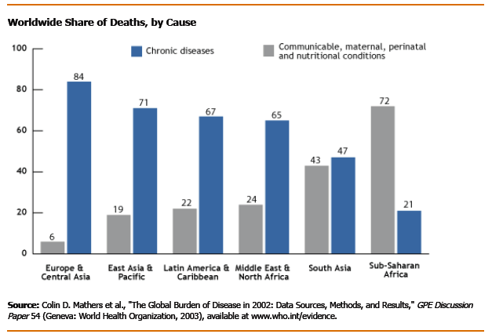
The only continent where infectious diseases outnumber chronic diseases:
Sub-Saharan Africa

Slide 6

CheckPoint©
What is another name for chronic diseases?
How would you define chronic disease?
Approximately how many people in the U.S. have a chronic condition?
What is the only continent in the world where infectious diseases outnumber chronic conditions?

Slide 7
Why is there a shift from infectious diseases?
sanitation & better living conditions
better health practices & improved medical care
worldwide health education

Slide 8
What are some common causes for the increase of chronic diseases?
people living longer
poor eating habits (fast foods, not enough fruit & vegetables)
lack of physical activity
rise in obesity
tobacco use (rising consumption in developing countries)

Slide 9
Common causes for increase of chronic diseases cont.
excessive alcohol consumption
pollution
globalization

Slide 10
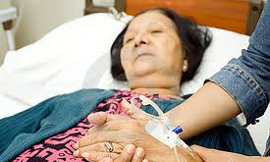
World’s elderly population
more prone to chronic disease
about 80% have one or more chronic diseases
25% are limited in their ability to perform activities of daily living
Notes:
Image from: dreamstime.com

Slide 11
CheckPoint©
Name one reason for the shift from infectious diseases to chronic diseases.
Which of the following is not a cause of chronic disease?
a. rise in obesity
b. increased travel around the world
c. don’t eat enough vegetables & fruit .
What % of world’s elderly have one or more chronic diseases?

Slide 12
The most common NCDs:
Cardiovascular disease
Lung Disease
Diabetes
Cancer

Slide 13
1. Cardiovascular disease
  primarily myocardial infarction & stroke
  also heart valve disease & congenital heart anomalies
  past 2 decades cardiovascular disease decreased in high-income countries; but
  increased in low- & middle-income countries largely due to lifestyle choices ➔

Slide 14


Cardiovascular Disease cont.
  poor diet, lack exercise, smoking, excessive alcohol
  High-income countries have more medical interventions available.
Notes:
Image from: healblog.net

Slide 15
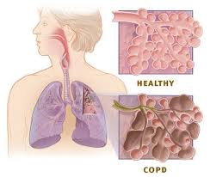
2. Lung disease
  Chronic obstructive pulmonary disease (COPD):
    chronic asthma, chronic bronchitis, emphysema
  incidence of these diseases is increasing throughout world
    smoking & air pollution are major causes
Notes:
Image from: xanthonecorp.com

Slide 16
Notes:
Image from: www.who.com

Slide 17
Notes:
Image from: www.who.com

Slide 18
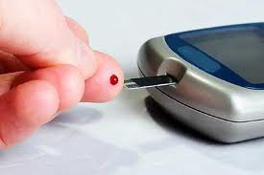
3. Diabetes
  WHO reports: 4.6 million people die each year from diabetes
  most cases are related to diabetes 2
  Diabetes 2 is linked to obesity, poor diet, & lack of exercise.
Notes:
Image from: dallasnaturaldoctor.com

Slide 19
Notes:
Image from: www.who.com

Slide 20
Notes:
Image from: www.who.com

Slide 21
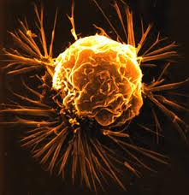
4. Cancer (CA)
  Number of CA deaths worldwide projected to increase 45% by 2030
  Deadly CAs increasing at high rate: lung, stomach, colon, liver, & breast CA
  Only 30% CA cases linked to behavioral or environmental factors
  (tobacco being single largest preventable behavior)

Slide 22
Notes:
Image from: www.who.com

Slide 23
CheckPoint©
In the past 2 decades cardiovascular disease has decreased in: (select any that apply)
a. low-income countries
b. middle-income countries
c. high-income countries
d. sub-Saharan Africa .
Name two lifestyle choices that largely contribute to cardiovascular disease.

Slide 24
CheckPoint cont.
What does COPD stand for?
What are the 2 major causes of COPD around the world?
What type of diabetes is linked to poor diet and obesity?
Diabetes Type I
Diabetes Type 2 .
Name one of the top 11 countries where there is a high prevalence of diabetes.

Slide 25
CheckPoint cont.
Name 2 of the most deadly forms of cancer.
What % of cancer cases are linked to behavioral or environmental factors? .

Slide 26
The burden of chronic diseases
People with chronic conditions account for 83% of all health care spending in US.
It’s projected that by 2020, NCDs will account for almost ¾ all deaths worldwide.
Globally speaking, 60% of burden of chronic diseases will occur in developing countries.
These people are the heaviest users of health care services.
  fill more prescriptions
  visit physicians more

Slide 27
Burden of chronic diseases cont.
  likely to be hospitalized more
  have more home health care visits
People with chronic illness are more likely to have activity limitations.
  interferes with ability to work and be self sufficient

Slide 28
Notes:
Image from: www.who.com

Slide 29
CheckPoint©
Name 2 ways in which people with chronic conditions burden our health care system.

Slide 30
Future cost of chronic diseases
proportion of the burden of NCDs is expected to increase 57% by 2020

Slide 31


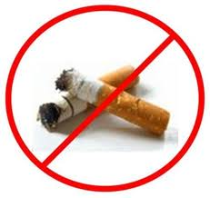

Educate the world & help reverse chronic diseases.
Limit alcohol consumption

