Slide 1
Cell Organelle Campaign

Slide 2
Overview
You will work either by yourself or with a partner to form a campaign for a new president and vice president of the cell.
You will produce a campaign for running mates (2 organelles: one running for president and the other for vice president). The campaign will show the importance of the organelles partnership to the cell and why they should be voted as leaders of the cell.
Each team will need to show knowledge of their organelles by producing a slogan, poster, and bumper sticker for their organelles.

Slide 3
Procedures/Activities:
You will research your group's organelles and become familiar with the function of the organelles and the importance to the cell. To show your knowledge of your organelles your team will produce a "campaign" slogan for the organelles.

Slide 4
Procedures/Activities:
The slogan must tell something about the function of the organelles as they relate to each other.
The bumper sticker tells why the organelles should be head of the cell.
The poster should be able to demonstrate knowledge of your organelles and explain why the organelles are important to the cell and why they should be head of the cell.

Slide 5
Potential Partnerships:
Nucleus and ribosomes
Endoplasmic reticulum and Golgi bodies
Endoplasmic reticulum and ribosomes
Golgi bodies and lysosomes
Nucleus and endoplasmic reticulum and Golgi bodies or vesicles
Endoplasmic reticulum and cell membrane

Slide 6
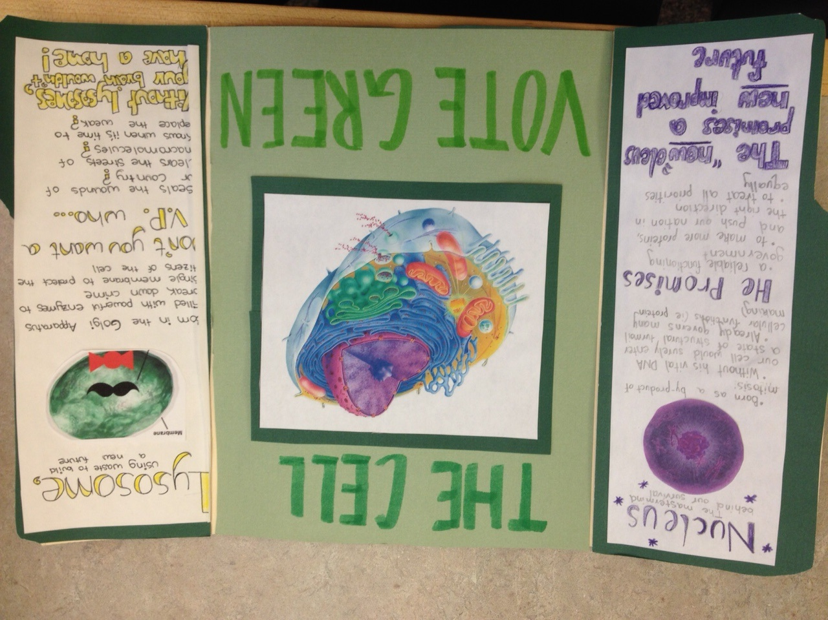

Slide 7
