Slide 1
Viruses & Bacteria

Slide 2
Viruses
Traits
  Neither living or nonliving
  Not made of cells
  Don’t grow or respond to changes in envt.
  Reproduce only in living cells
  Grouped by the type of cell they infect
Host
  Organism that provides food a parasite
Parasite
  Organism that lives in or on another living thing

Slide 3
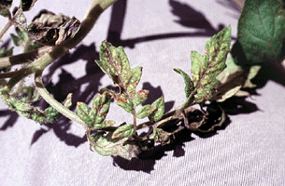
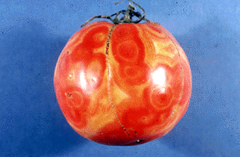
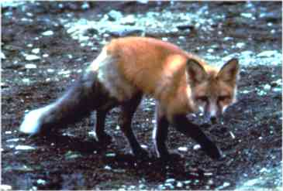
Tomato spotted wilt virus
Rabies

Slide 4
Viral Cycle
http://www.youtube.com/watch?v=gU8XeqI7yts

Slide 5
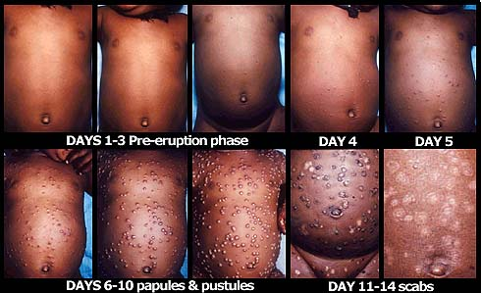
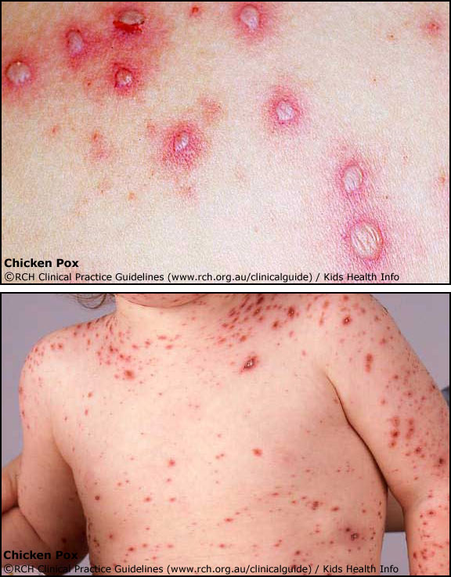
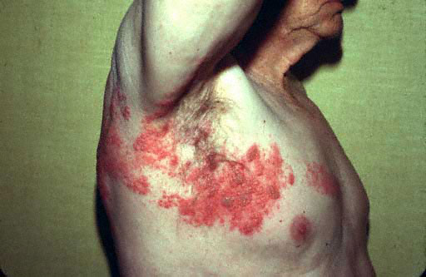
Smallpox
chickenpox
Shingles

Slide 6
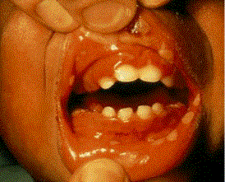
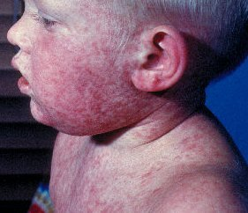
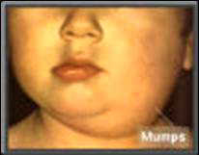
Herpes Simplex I
Measles

Slide 7
Examples of Viral Diseases
HIV Replication and Life Cycle
  http://www.youtube.com/watch?v=rqDkYJn7w9Y

Slide 8
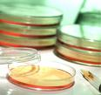
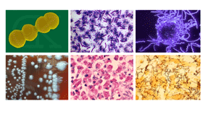
BACTERIA
Microbiology
Bacteriology

Slide 9
Monerans AKA Bacteria
Traits
  Small
  One-celled monerans
  Larger than viruses
  Found almost everywhere
  Live in water, air, soil, food etc.

Slide 10
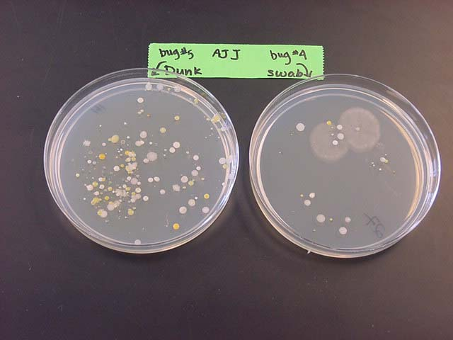

Groups of Bacteria
COLONIES
Example:
  Plaque

Slide 11
Bacteria Reproduction
Binary Fission
  http://www.youtube.com/watch?v=gEwzDydciWc

Slide 12
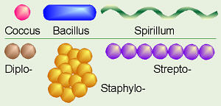
Shapes of Bacteria

Slide 13
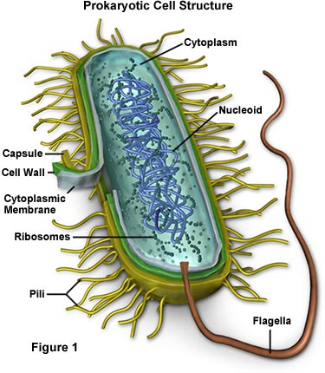
Bacteria Diagram

Slide 14
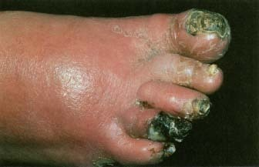
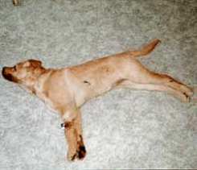
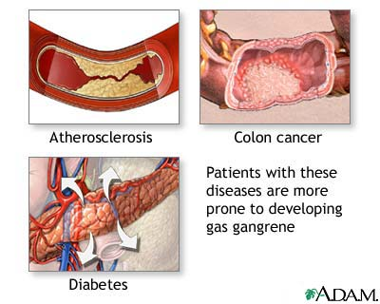

Examples of Bacterial Diseases
Gangrene Gas
Tetanus (Lockjaw)
Rocky Mountain Spotted Fever

Slide 15
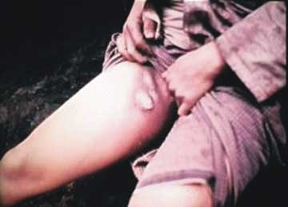
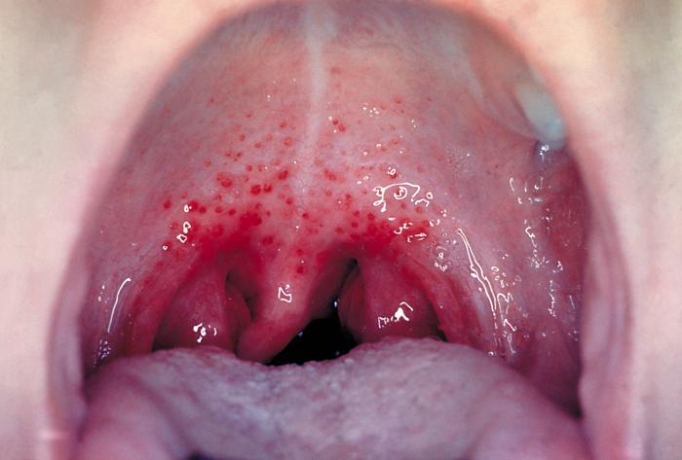
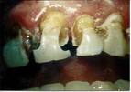
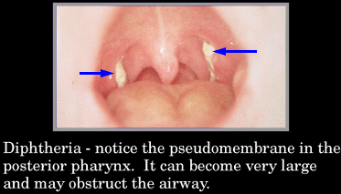
Buboes, or swollen lymph nodes, are classic signs of bubonic plague. Buboes appear in the lymph nodes closest to where a flea bit a person. Photograph is courtesy of CDC.
Strep Throat

Slide 16
