Slide 1
Los Olímpicos
Pretérito Vs Imperfecto

Slide 2
Game Play
On each round, you will answer 4 or 6 questions.
The teacher will keep the time. You may have 10 seconds, or you may have 30 seconds.
When the bell rings, drop your pencil and trade papers with the partner you are assigned.
We will switch partners each round so you aren’t always against the same person.

Slide 3
Scoring Explanation
Check the first answer.
  If you both got it right, you both get 1 point.
  If you got it right and your partner did not,
  you get 2 points, they get 0.
  If you got it wrong and your partner did not,
  you get 0 points, they get 2.
  If you both got it wrong, you both get 0.
Repeat for each question in that round.
Record your score total for each round.

Slide 4
Ronda 1
Write “P” if it requires Preterite or
Write “I” if it requires Imperfect
Used to _ 4. Was _ ing
One time event 5. Isolated action
Would _ in the past 6. Did _ once

Slide 5
Ronda 1
Write “P” if it requires Preterite or
Write “I” if it requires Imperfect
Imperfect 4. Imperfect
Preterite 5. Preterite
Imperfect 6. Preterite

Slide 6
Ronda 2
Write “P” if it requires Preterite or
Write “I” if it requires Imperfect
Weather 4. Describing people
Feelings 5. Chain of events
Setting the scene 6. Telling Time

Slide 7
Ronda 2
Write “P” if it requires Preterite or
Write “I” if it requires Imperfect
Imperfect 4. Imperfect
Imperfect 5. Preterite
Imperfect 6. Imperfect

Slide 8
Ronda 3
Write “P” if it requires Preterite or
Write “I” if it requires Imperfect
Age 4. Emotions and Beliefs
“yesterday I…” 5. “as a kid I…”
An on-going action 6. An action that
interrupts another

Slide 9
Ronda 3
Write “P” if it requires Preterite or
Write “I” if it requires Imperfect
Imperfect 4. Imperfect
Preterite 5. Imperfect
Imperfect 6. Preterite

Slide 10
Ronda 4
Conjugate these past tense verbs:
  Tener / yo / pret
  Decir / tú / imp
  Dormir / usted / pret
  Leer / nosotros / imp

Slide 11
Ronda 4
Conjugation:
  Tener / yo / pret TUVE
  Decir / tú / imp DECÍAS
  Dormir / usted / pret DURMIÓ
  Leer / nosotros / imp LEÍAMOS

Slide 12
Ronda 5
Conjugate these past tense verbs:
  Ser/ yo / pret
  Venir/ tú / imp
  Escuchar/ usted / pret
  Dar / nosotros / imp

Slide 13
Ronda 5
Conjugate these past tense verbs:
  Ser/ yo / pret FUI
  Venir/ tú / imp VENÍAS
  Escuchar/ usted / pret ESCUCHÓ
  Dar / nosotros / imp DÁBAMOS

Slide 14
Ronda 6
Translate these past tense phrases:
  (Yesterday) I went…
  (As a kid) I used to swim…
  (Last week) we received…
  (Normally) they would run…

Slide 15
Ronda 6
Translate these past tense phrases:
  (Yesterday) I went… FUI
  (As a kid) I used to swim… NADABA
  (Last week) we received… RECIBIMOS
  (Normally) they would run… CORRÍAN

Slide 16
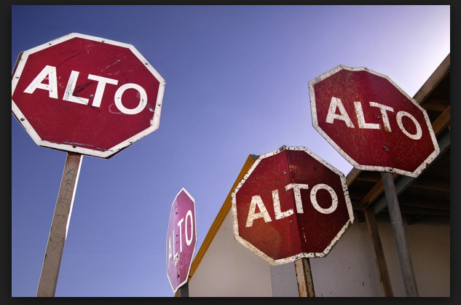
Matemáticas
Stop and add up your points so far.
(If you had gotten every question right and your partners had too, your total would be 30 points.)

Slide 17
Ronda 7
Translate these past tense phrases:
  (On Saturdays) I used to sleep…
  (This morning) I ate…
  (And then) she left…
  We were talking…

Slide 18
Ronda 7
Traducción:
  (On Saturdays) I used to sleep… DORMÍA
  (This morning) I ate… COMÍ
  (And then) she left… SALIÓ
  We were talking… HABLABA

Slide 19
Ronda 8
Choose which verb would complete each:
  Ayer yo (miraba/miré) el programa.
  Los domingos ellos (jugaban/jugaron) al fútbol.
  Como niña, yo (era/fui) muy atlética.
  Mi gato (lloraba/lloró) por horas y horas.

Slide 20
Ronda 8
Contexto:
  MIRÉ
  JUGABAN
  ERA
  LLORABA

Slide 21
Ronda 9
Choose which verb would complete each:
  (Hacía/hizo) sol esta tarde.
  Ella (se llamaba/se llamó) Cecilia.
  (Eran/fueron) las dos cuando yo llegué.
  Mis amigos (llegaban/llegaron) depués de mí.

Slide 22
Ronda 9
Contexto:
  HACÍA
  SE LLAMABA
  ERAN
  LLEGARON

Slide 23
Ronda 10
Translate these past tense sentences:
  I used to read.
  She left at 9.
  We were sad.
  They died.

Slide 24
Ronda 10
Translate these past tense sentences:
  YO LEÍA.
  ELLA SALIÓ A LAS NUEVE.
  ESTÁBAMOS TRISTES.
  ELLOS MURIERON.

Slide 25
Ronda 11
Translate these past tense sentences:
  It was 1:00.
  They were tall.
  I was talking.
  He called me.

Slide 26
Ronda 11
Translate these past tense sentences:
  ERA LA UNA.
  ELLOS ERAN ALTOS.
  YO HABLABA.
  ÉL ME LLAMÓ.

Slide 27
Ronda 12
Translate these past tense verbs:
  I was swimming.
  You saw me.
  They were running.
  We were friends.

Slide 28
Ronda 12
Translate these past tense verbs:
  YO NADABA.
  TÚ ME VISTE.
  ELLOS CORRÍAN.
  ÉRAMOS AMIGOS.

Slide 29
Matemáticas
Stop and add up your points.
(If you had gotten every question right and your partners had too, your total would be 24 since our last checkpoint.)

Slide 30
Prizes
Add up your total points for rounds 1-12.
If there is no evidence of foul play, these prizes MAY be awarded:
  1st place: Doesn’t have to take the quiz. You’ve clearly mastered this verb tense.
  2nd place: You have to take the test, but you will get 2 extra credit points.
  3rd place: You have to take the test, but you will get 1 extra credit point.

