Slide 1
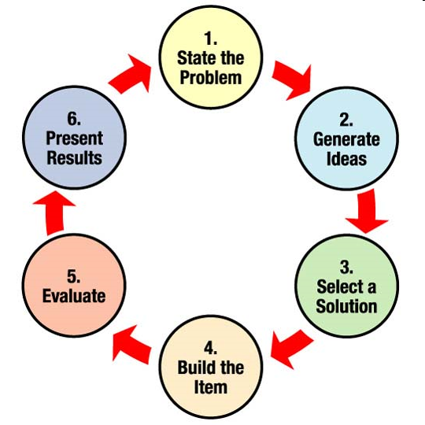

Slide 2
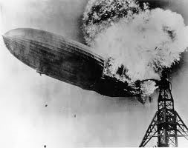
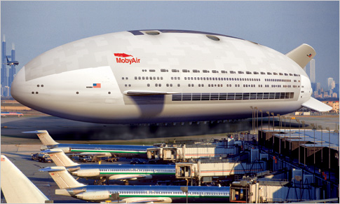
There is No Perfect Design

Slide 3
Stating A Problem
Find a situation or product that can be improved.
Evaluate Design
Ways to improve:
  Performance
  Features
  Durability
  Cost

Slide 4
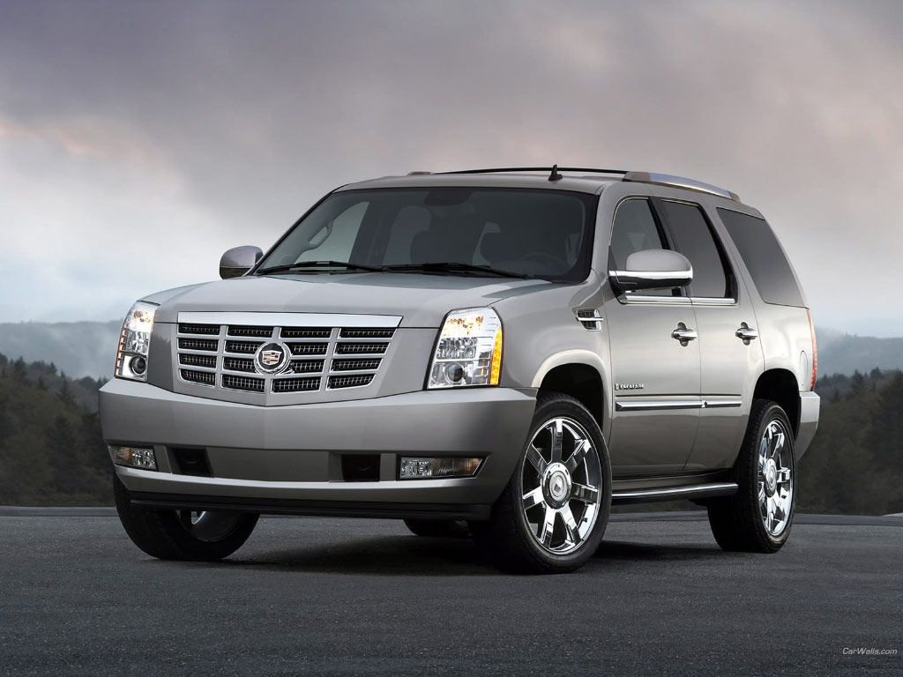
Need More Fuel Efficient Car
Good:
Can transport 8 people and pull 8,300 lbs.
Bad:
With a 10 mpg fuel rating it will cost you about $27 to 100 mpg

Slide 5
Generate Ideas
Create representations of possible prototypes:
Evaluate these representations with the following criteria:
  Cost
  Feasibility
  Durability
  Materials
  Ethics

Slide 6
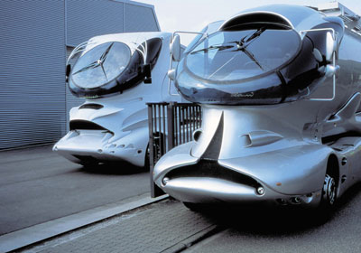
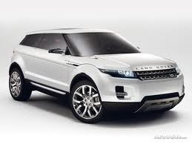
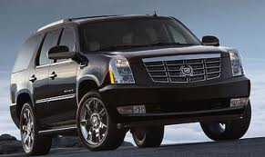
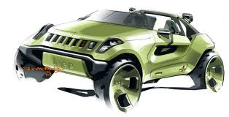

Slide 7
Pick a Prototype
Choose a prototype based on your evaluation

Slide 9
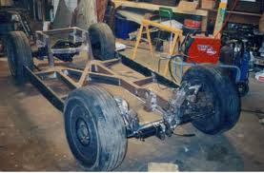
Build Your Prototype

Slide 10
Evaluate:
Look at:
  Durability
  Cost
  Fuel Economy
  Need

Slide 11
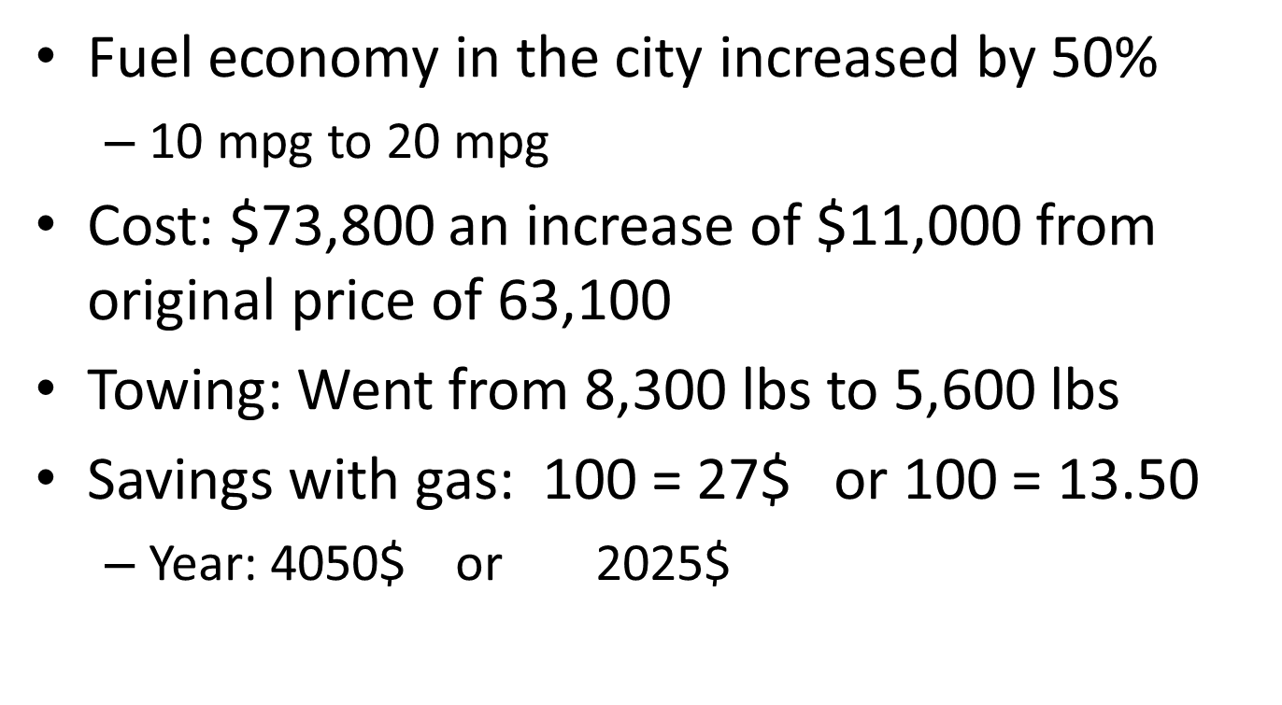
Present Results

Slide 12
What do you think?
Why would this be a good buy?

