Slide 1
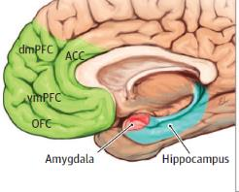
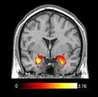
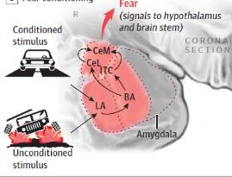
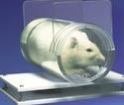
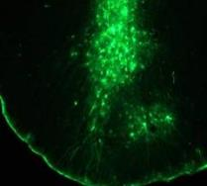
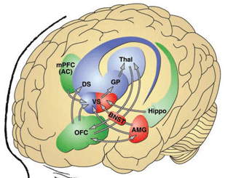
Neurobiology of PTSD and its Treatment
Lowell General Hospital
Grand Rounds
April 24, 2024
Kerry J. Ressler, MD, PhD
Chief Scientific Officer
McLean Hospital, Mass General Brigham
Professor of Psychiatry, Harvard Medical School

Slide 2
Disclosure Summary of Relevant Financial Relationships
Kerry J. Ressler, MD, PhD
Potential Conflicts of Interest
Sci Advisory Board: Boehringer Ingelheim
Sci Advisory Board: Senseye Inc.
Sci Advisory Board: Brain Research Foundation
Consultant: Bionomics
Sci Advisory Board: Sage
Consultant: Jazz Pharma
Learning Objectives
1) The learner will be able to describe new research across Patient populations and animal models into the neurobiology of PTSD.
2) The learner will be able to discuss brain regions, neural circuits, and genetics thought to underlie PTSD.
3) The learner will be able to educate others on potential new treatment methods, as well as further understanding current approaches to treating PTSD.

Slide 3
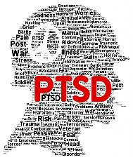
Posttraumatic Stress Disorder
DSM-5 Criteria
A ‘Pathological’ Fear Reaction
Clinically important (5% to 10% population, 15% to 25%
veterans and at-risk populations);
1st month – Acute Stress Disorder; 1 mon – PTSD, > 3 mon chronic PTSD
Able to study – we know when it starts;
DSM-5 (‘ERANDS’ - Event,Re-experience,Aviodance,Negative/Decreased,Sympathetic)
Criterion A: Event: The person was exposed to: death, threatened death, actual or threatened serious injury, or actual or threatened sexual violence; Note that the response often involves intense fear and helplessness
Characteristic symptoms include persistent:
Criterion B: Intrusion Symptoms: Re-experiencing of the traumatic event (nightmares, flashbacks)
Criterion C: Avoidance Symptoms: Avoidance of stimuli associated with the trauma
Criterion D: Negative alterations in cognition and mood related to trauma; Decreased interest / anhedonia; alienation; numbing
Criterion E: Increased arousal (Sympathetic Hyperactivation) (decreased sleep, startle, hypervigilance, irritable/aggressive and self-destructive behavior) and decreased concentration
Maketheconnection.com videos

Slide 4
Post-Traumatic Stress Disorder: History
Herodotus
In writing of the battle of Marathon in 490 B.C., Herodotus cites an Athenian warrior who went permanently blind when the soldier standing next to him was killed, although the blinded soldier “was wounded in no part of his body.”
Samuel Pepys
Writing of the Great Fire of London in 1666, Pepys recounts people’s terror and frustration at being unable to protect their property or stop the fire. Pepys writes: “A most horrid, malicious, blood fire. . . . So great was our fear. . . . It was enough to put us out of our wits.”
Although his own home was untouched, Pepys was unable to sleep for days after the fire. He scrawls: “Both sleeping and waking, and such fear of fire in my heart, that I took little rest.”
American Civil War & Jacob Mendes da Costa
Describes “Soldier’s Heart” aka “Da Costa’s Syndrome” consisting of tachypnea, palpitations, and tachycardia at rest in combat veterans of the American civil war.
WW I – “Shell Shock”, “Effort Syndrome”, “Neurocirculatory Asthenia”
WW II – “Acute Combat Stress Reaction”, “Battle Fatigue”, “Operational Fatigue”, and “Combat Neurosis”

Slide 5
Post-Traumatic Stress Disorder: History
Korean War
Acuity of treatment following clinical presentation with traumatic stress reaction in close proximity to location of traumatic event is emphasized.
Vietnam War
Continuation of treatment principles of: “immediacy, proximity, and expectancy”.
Rapidly growing appreciation of the lack of adequate treatment resources relative to affected individuals.
Rape Trauma Syndrome
Burgess & Holmstrom in 1974 published a seminal paper describing three reactions to rape and specialized treatments based on qualitative interview data from N=92 female rape survivors.
Rape now seen as a violent, rather than sexual, act which was for the time a major paradigm shift.
PTSD enters DSM-III as formal diagnosis in 1980
Development and growth of genomic and translational research into the etiology of PTSD along with research and development of evidence-based psychological and medical treatments for PTSD that continues today.

Slide 6
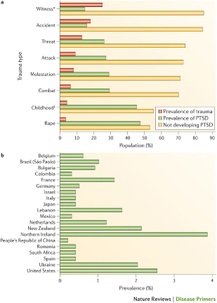
Post-Traumatic Stress Disorder: Epidemiology I
Prevalence of Trauma Exposure
  Globally, > 70% of adults are exposed to trauma at some point during their lifetime and 31% of adults are exposed to ≥ 4 traumatic events across their life (Benjet et al., 2016).
  Most common trauma exposures in United States are physical/sexual assaults (52%) and accidents/fires (50%) (Benjet et al., 2016).
Prevalence of Post-Traumatic Stress Disorder
  Lifetime prevalence of PTSD is 1.3 – 12.2% and varies by social background and country of residence (Kessler et al., 1995; Karam et al., 2014).
  One-Year Prevalence of PTSD is 0.2 – 3.8% (Karam et al., 2014).
  Higher rates of PTSD occur in military personnel with combat exposure, socially-disadvantaged people, police officers & firefighters, first responders to accidents and mass casualty events (Hoge et al., 2004; Alim et al., 2006; Gillespie et al., 2009; Hoge et al., 2014; Karam et al., 2014).
  Conditional risk of PTSD varies by sex and trauma type with greater risk for female sex and exposure to trauma of human design such as physical/sexual assault or torture (Kessler et al., 1995).
Yehuda et al., 2015

Slide 7
Post-Traumatic Stress Disorder: Epidemiology II
Comorbidity & Mortality
  Greater than 50% of cases of PTSD involve comorbidity with anxiety, mood, or substance use disorders (Pietrzak et al., 2011).
  PTSD is associated with a variety of medical disorders including type 2 diabetes, metabolic syndrome, cardiovascular disease, sleep disorders, premature senescence, significant disability, and early mortality (Hoge et al., 2007; Nazarian et al. 2012; Lohr et al., 2015; Rosenbaum et al., 2015; Schlenger et al., 2015; Khazaie et al., 2016; Vancampfort et al., 2016; Koenen et al., 2017; Wolf et al., 2018).
PTSD & Suicidality
  Relationship between PTSD and suicide is not straightforward with relative risk (2.0) comparable to generalized anxiety disorder (2.3) but lower than major depressive disorder (4.8.) (Bernal et al., 2007).
  Recent studies with active military personnel did not demonstrate an association between suicide and war-zone deployment or combat exposure. Other factors such as protracted/repeated deployment may be drivers of elevated rates of suicide in the military (Schoenbaum et al., 2014; Reger et al., 2015).

Slide 8
Post-Traumatic Stress Disorder: Epidemiology II
Course and Risk Factors
  Most individuals exposed to trauma will experience transient symptoms of PTSD but most individuals exposed to trauma will not develop PTSD (Marmar et al., 2015).
  Meta-analytic data indicate that female sex, childhood abuse and/or trauma exposure, fewer years of education, prior mental health history, exposure to ≥ four traumatic events, and history of interpersonal violence exposure all predict increased risk for PTSD (Ozer et al., 2003).
  Intensity of the traumatic event(s) also elevates subsequent risk for PTSD with greatest risk seen with exposure to death, severe injury, torture, body disfigurement, peri-traumatic dissociation, and trauma exposure that is unexpected, inescapable, or uncontrollable (Ozer et al., 2003). Traumatic brain injury also is associated with elevated risk for PTSD (Yurgil et al., 2014).
  Physiological and neuroendocrine predictors of PTSD include elevated heart and respiratory rate and low plasma cortisol (Delahanty et al., 2005).

Slide 9
Expert Consensus Guidelines Intervention & Prevention
Early Intervention and Prevention
Immediately after exposure:
  Normalize distress
  Educate patient, family and significant others
  Repeated retelling of the event
  Provide emotional support
  Relieve irrational guilt
  Refer to peer support group or trauma counseling
  Consider short-term sleep medication for insomnia
Foa, Davidson, Frances, 1999

Slide 10
Psychotherapy for PTSD: Trauma-Focused CBTs for PTSD
Cognitive Behavioral Treatment (CBT)
Prolonged Exposure (PE)
STAIR – Skills training in affect / Interpersonal regulation
Cognitive Processing Therapy (CPT)
Stress Inoculation Therapy (SIT)
Eye Movement Desensitization and Reprocessing (EMDR)
DBT-PTSD
Prolonged Exposure (Gold Standard)
  Often 12-16 sessions; 60-90 min each
Interventions
  In vivo (“in real life”) exposure
    successive approaching of feared places & situations until anxiety subsides
  Imaginal exposure
    repeated retelling of traumatic event until distress subsides
Impediments to Exposure include:
Avoidance
Emotional Numbing
Unhelpful thoughts
Exposure (habituation) components of PTSD therapies can be understood as Pavlovian Extinction over time
Anxiety
Time

Slide 11
Pharmacological Treatments for PTSD
1) Antidepressants SSRIs/SNRIs
  Only FDA approved for PTSD are Sertraline/Paroxetine
Serotonergic agents – increase serotonin functioning – increased tolerance to aversion, decreased stress/fear response, trophic action, e.g. fluoxetine, (es-)citalopram, sertraline, paroxetine
Noradrenergic and mixed SSRI/SNRI agents – correct dysregulated NE system, with similar changes as above, e.g. reboxetine, duloxetine, venlafaxine
2) What about benzodiazepines?
3) Other medications used off label:
  Mood Stabilizers (Lamotrigine, Valproate, Carbamazapine)
  Antipsychotics (Olanzapine, Quetiapine, Risperdal)
  Adrenergic Blockers (Prazosin,Propranolol)
11

Slide 12
Low Remission Rates in PTSD:
Antidepressants are effective options but low remission
50
Remission Rates
in PTSD (%)^{1, 2}
25
0
Sertraline
Placebo
Venlafaxine¹
Paroxetine²
Placebo
¹ Venlafaxine study: CAPS-SX ≤20; Davidson JR. et al. J Clin Psychopharmacology. 2006
² Paroxetine study: CAPS-2 <20; Tucker et al. J Clin Psychiatry. 2001
This information concerns a use that has not been approved by the US FDA.
Notes:
12

Slide 13
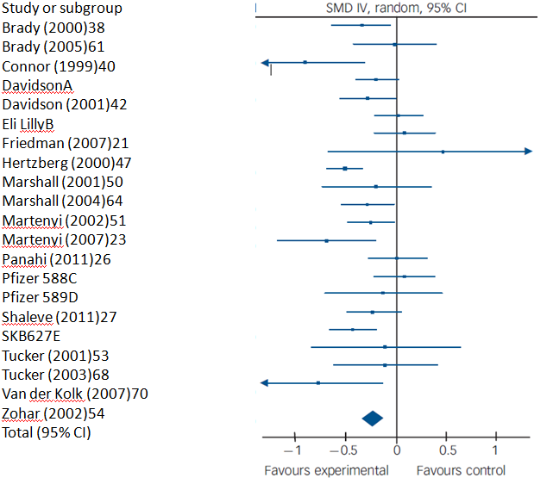
Positive but relatively small effect sizes in SSRI Meta-analysis:
Possibly greater signal for paroxetine, fluoxetine and venlafaxine
Hoskins et al. 2015
Notes:
Results
Selective serotonin reuptake inhibitors were found to be
statistically superior to placebo in reduction of PTSD
symptoms but the effect size was small (standardised mean
difference 70.23, 95% CI 70.33 to 70.12). For individual
pharmacological agents compared with placebo in two or
more trials, we found small statistically significant evidence
of efficacy for fluoxetine, paroxetine and venlafaxine.
Conclusions
Some drugs have a small positive impact on PTSD symptoms
and are acceptable. Fluoxetine, paroxetine and venlafaxine
may be considered as potential treatments for the disorder.
For most drugs there is inadequate evidence regarding
efficacy for PTSD, pointing to the need for more research in
this area
This systematic review found statistically significant evidence on
meta-analysis for three pharmacological agents v. placebo in the
treatment of PTSD (fluoxetine, paroxetine and venlafaxine) but
no evidence for brofaromine, olanzapine, sertraline or topiramate.
Four drugs – amitriptyline, GR205171 (a neurokinin-1 antagonist),
mirtazapine and phenelzine – showed superiority over placebo in
single RCTs, whereas eleven did not: alprazolam, citalopram,
desipramine, escitalopram, imipramine, lamotrigine, nefazadone,
risperidone, tiagabine and valproate semisodium. When metaanalyses
were undertaken by class of drug rather than individual
drug, SSRIs were found to perform better than placebo. The
absence of sufficient data precluded meta-analyses of other drug
classes. The absence of difference in numbers of individuals
leaving the study early for any reason suggests that the drugs
included were well tolerated overall

Slide 14
What about Benzodiazepines and PTSD?
Consistent concerns
APA 2004 Guidelines: Benzodiazepines cannot be recommended as monotherapy for PTSD
IOM report 2014: Benzodiazepines and atypical antipsychotics for combat-related PTSD is contraindicated and strongly discouraged
VA DOD 2017 Guidelines: Strong recommend against
pre-clinical evidence suggests that benzodiazepines may actually interfere with the extinction of fear conditioning and/or potentiate the acquisition of fear responses and worsen recovery from trauma
Risk substance abuse and interference with extinction learning. Not first line for sleep either.
Clearly NOT recommended monotherapy
Possible cautious adjunctive or brief use associated symptoms (e.g. panic, insomnia) but not first line and not early
Notes:
14

Slide 15
The PTSD Coach
Free app created by the VA’s National Center for PTSD and the DOD’s National Center for Telehealth and Technology
Provides:
  Information about PTSD and treatment
  Self-assessment tools
  Links to urgent services
The PTSD Coach, 2012, JAMA

Slide 16
PTSD Clinical Overview
Conclusions
Evidence based trauma focused therapies strongly recommended
Effective pharmacologic therapies exist for PTSD but best data for SSRI/SNRI and effects not universal
Significant unmet need for more efficacious prevention, initial and next step refractory treatment
More research needed on who responds to what treatment, how to personalize the interventions

Slide 17

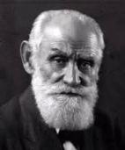
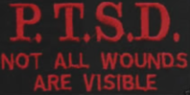
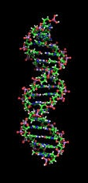
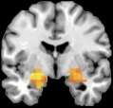
Neurobiology:
From Pavlov to PTSD
1) PTSD is Tractable
Shared Fear Neurocircuitry
- We know when it starts
Learning and Memory processes
2) A Molecular Neurobiology of PTSD
Predictive biomarkers
- Novel interventions to prevent PTSD
- Novel interventions to treat PTSD

Slide 18

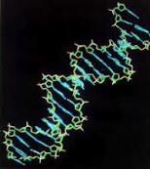

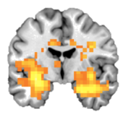


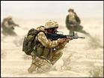
Genes + Environment Increase Risk of
Fear Disorders and Posttraumatic Stress
GENES
Fear-Related Disorders
PTSD
Development
ENVIRONMENT
TRAUMA
Notes:
Summarize so far – risk for Fear-related disorders and PTSD.
How does this burgeoning increase in our understanding of Fear and PTSD provide new approaches to treat or prevent PTSD?

Slide 19
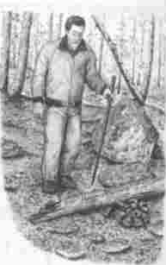
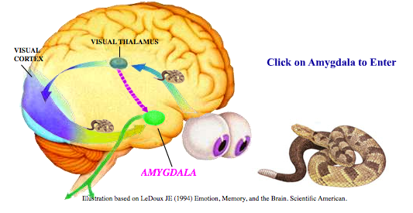
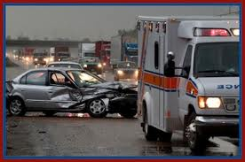
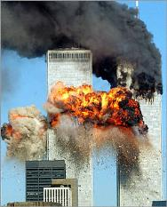

Fear is evolutionarily useful
LeDoux, 1996
but… Dysregulated Fear leads to Phobia, Panic, and PTSD
Single or repeated exposure to extremely traumatic situations
- Characteristic symptoms of PTSD
  Increased anxiety / hypervigilance
  Declarative memory alterations
  Problems in sleep and concentration
  Flashbacks
  Inability to inhibit fear

Slide 20
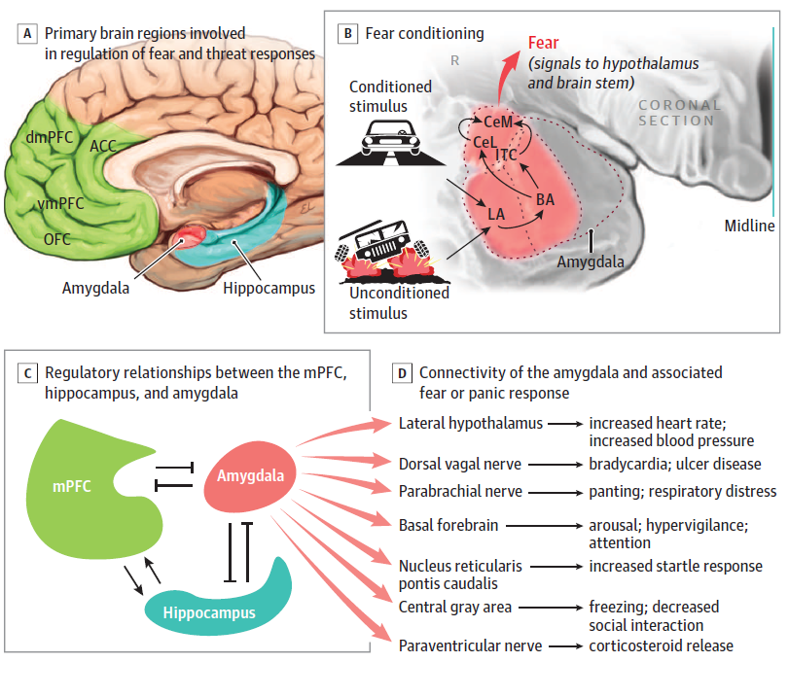
nuc.
Ross et al., JAMA Psychiatry, 2017

Slide 21
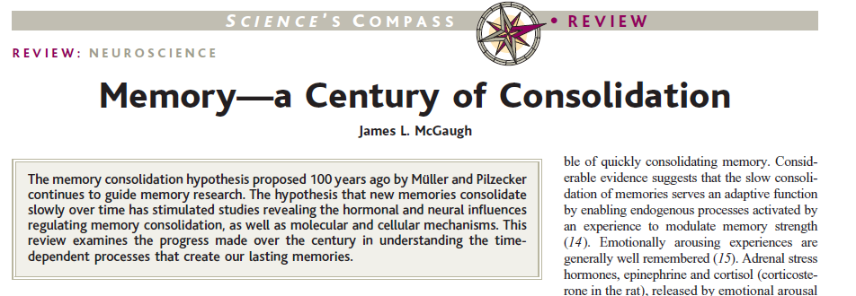
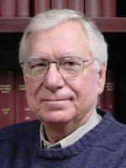

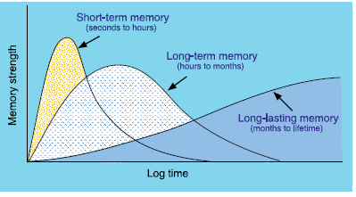
Jim McGaugh
Short-Term Memory
Long-Term Memory
TIME

Slide 22

Synaptic Plasticity and Fear Memory Consolidation
Michael Davis
Seizure
Control
Fear consolid.
Ressler et al., J Neurosci, 2002

Slide 23
Maddox et al., Neuron, 2019

Slide 24
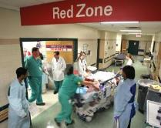
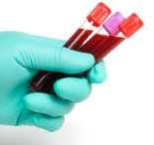
Emory – Miami
Predictive Biomarkers Study
Criterion A trauma exposure
STAT pack blood for ED clinical care
N>500 with full consent
(avg time from ED entry 2-3 hours)
Collecting physio, phenotypes, and biomarkers
during consolidation period
Whole blood EDTA (10ml)
Serum (6ml)
Tempus (RNA)
Longitudinal Assessment of PTSD Syndromes
PI: Sam McLean, MD
University of North Carolina
Karestan Koenen, Ron Kessler
Harvard Medical School
>25 ED sites enrolling nationally
Goal of 8000 participants
Approx >100 new participants each month
Multisite study of Posttraumatic predictors
U01 MH110925
McLean et al., Molecular Psychiatry, 2020

Slide 25



Slide 26
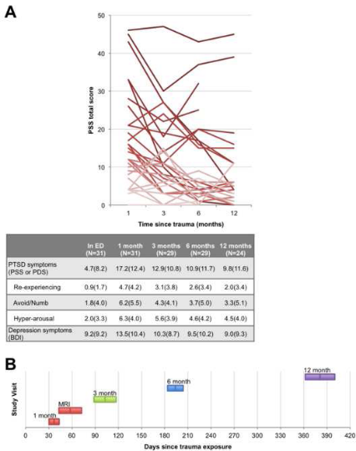
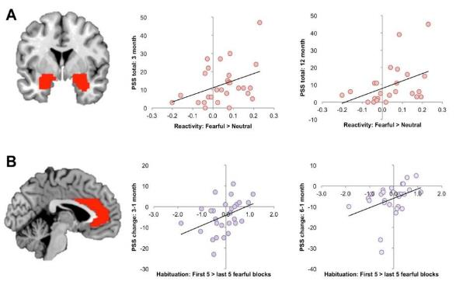

Human Trauma Consolidation: Neuroimaging
Early Increased Amygdala reactivity and Anterior Cingulate habituation predict PTSD symptoms at 3-6 months
Measures of fMRI reactivity and habituation
that were predictive of later PTSD symptoms
Stevens et al., Biol Psychiatry, 2017
Notes:
Figure 1. PTSD symptom trajectories. A: Line graph shows each participant’s PTSD symptom
severity scores (PSS total scores), across the four follow-up visits. Line shading (darker to
lighter) indicates more severe to less severe symptoms at the 1-month visit. Corresponding group
summary statistics for each visit [M(SD)] are shown in the table below. B: Timeline of study
visits. Colored bars show M ± SD in the visit delay, relative to study enrollment in the
Emergency Department.

Slide 27

Human Trauma Consolidation: Neuroimaging
Early Hippocampal decreased activation predicts PTSD
Decreased response inhibition in hipp predicts increased later PTSD symptoms
Pre
Defining predictors using elastic net regression
van Rooij et al 2017 Biol Psychiatry

Slide 28
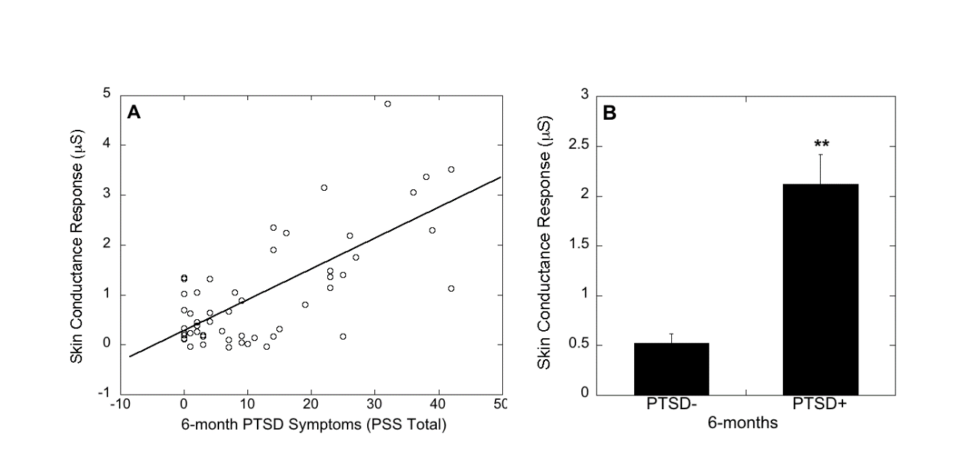


Human Trauma Consolidation: Physiology
Skin conductance (SCR – measure of sympathetic arousal)
Immediately Post-Trauma Correlates to PTSD development.
Scatter plot of SCR to trauma description in the Emergency Department and PTSD symptoms 6 months following trauma (PSS total score) (r=0.49 p<0.001).
Mean ± SEM skin conductance response to trauma description in the emergency department (SCR, microSiemens, 𝜇S) broken down by PTSD diagnosis **P < .001
.
Hinrichs et al., 2019, Chronic Stress
Hinrichs et al., 2017, Dep & Anxiety

Slide 29


Comorbidity between AUD/SUD & PTSD
Is common and replicated, but how does it work?
PTSD increases risk for AUD / addiction
AUD/SUD increases risk for PTSD
Shared Neural Circuitry
Shared deficits in extinction
Habitual vs. goal directed behavior
Shared genetic risks or unique genetics/circuits for comorbid AUD/SUD and PTSD

Slide 30
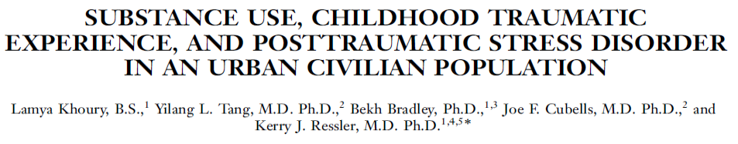
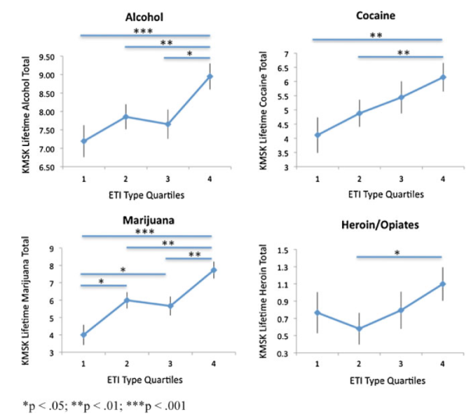
High rates of lifetime dependence:
39% alcohol
34.1% cocaine
6.2% heroin/opiates
44.8% marijuana
N=587
61% Female
91% African American
Depression & Anxiety, 2010

Slide 31
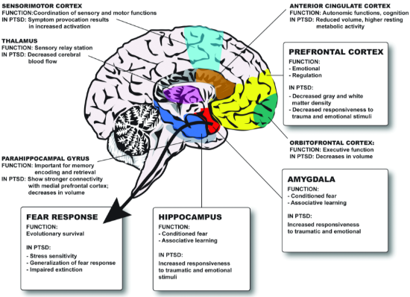
The same brain regions involved in fear are involved in excitement and addiction
Koob
Binge/Intoxication
Withdrawal/Negative Emotion
Preoccupation/Craving

Slide 32
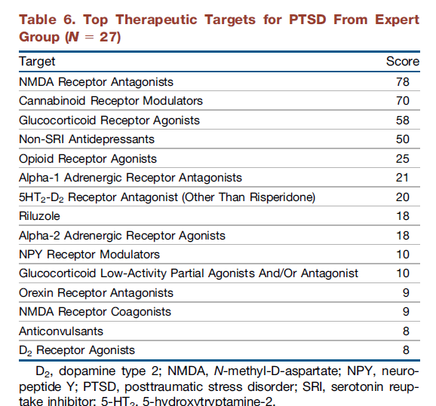
It Is Time to Address the Crisis in the Pharmacotherapy of Posttraumatic Stress Disorder: A Consensus Statement of the PTSD Psychopharmacology Working Group.
Krystal JH, Davis LL, Neylan TC, A Raskind M, Schnurr PP, Stein MB, Vessicchio J, Shiner B, Gleason TD, Huang GD. Biol Psychiatry. 2017 Oct 1;82(7):e51-e59.
To generate the preliminary data in this table, we sent surveys to 45 PTSD investigators around the world, chosen on basis of their involvement in previous VA, DoD, NIMH, and industry-sponsored PTSD clinical trials, and the PTSD Psychopharmacology Working Group, asking them to rank the top five potential new therapeutic targets for PTSD. The data were analyzed in a weighted fashion (eight points for top rank, five points for second, four points for third, three points for fourth, two points for fifth).
Implicated in Fear / Trauma Memory Consolidation
Beta-2 Adrenergic Antagonists

Slide 33
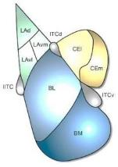
Fear Consolidation: Identifying Novel Molecular-Cellular Mechanisms
Tac2 (NKB-expressing cells) are associated with Fear Consolidation in CeA
Andero et al., Neuron 2014

Slide 34
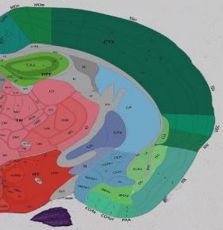
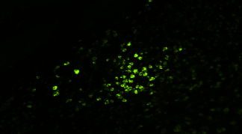
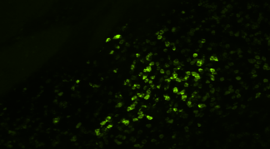
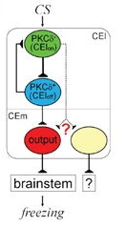
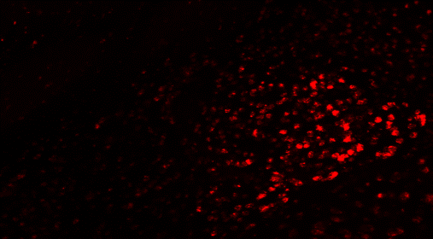
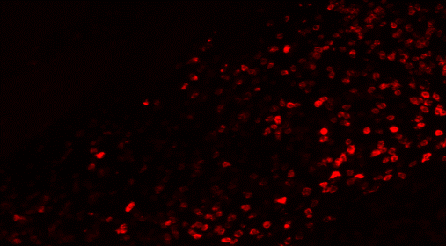
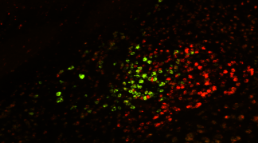
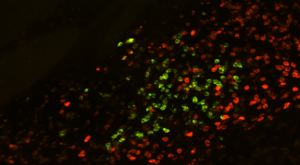
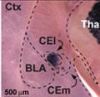
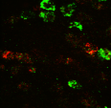
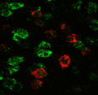
Tac2 expression
Tac2 cellular expression is limited to the CeM within Amygdala
CeM
CeL
CeM
CeL
CeA
CeA
Tac2
BLA
Tac2
BLA
CeC
CeC
CeM
CeL
CeM
CeL
CeA
CeA
PKCd
BLA
EnK
BLA
CeC
CeC
CeM
CeL
CeM
CeL
Tac2/PKCd
BLA
Tac2/EnK
BLA
Haubensak et al., 2011
CeC
CeC
Andero et al., Neuron 2014

Slide 35
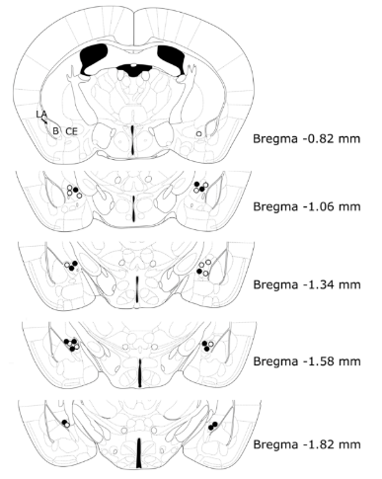
Mouse Fear Consolidation: Cellular Mechanisms
Tac2R (NKB) antagonist, osanetant impairs fear memory consolidation
CeA Cannulation
osanetant 30nmol/side
Veh/Osa (Immediately after)
Fear conditioning
24hrs later
Fear Expression (15CS)
5 cs 1ma
Andero et al., Neuron 2014

Slide 36
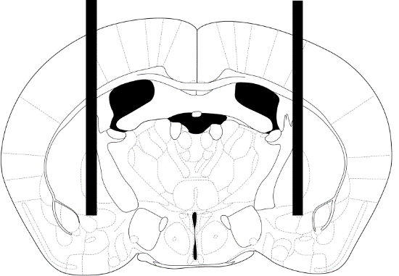
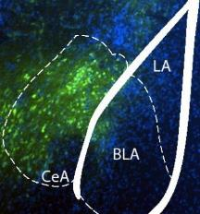
Tac2 viral overexpression enhances fear consolidation
LV-Tac2 or LV-GFP
LV-Tac2 or LV-GFP
LV-Tac2
LV-GFP
14 days later
Andero et al., Neuron 2014

Slide 37


Understanding Cell-Type Specificity of Amygdala Function and Fear Processing – Towards a Cell-Type Specific Pharmacology of Fear?
FEAR
Marker Function
LA
GRP ?
CS
CeL
? Fear On
CeM
Thy1 Extinction
Parv Inhibitory
SST Inhibitory
ITC
FoxP2 ITC-Extinction
MOR ITC-Extinction
BL
Drd2 Fear On
PKCd Fear Off
US
Tac2 Fear On
VP Excitatory
BM

Slide 38
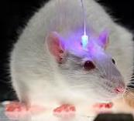
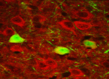




Optogenetically (ChR2) Activating the Thy-1 Neurons in Vivo
Inhibits fear consolidation
Enhances fear extinction
B
B
*
*
*
*
*
*
*
*
*
*
*
B
Extinction
Ext. Retention
Training
Test Blocks of 2
Jasnow et al., 2013, J Neurosci

Slide 39









Identifying Cell-Type Specific
Markers for the ‘Fear Off’ Neurons
Proof of Concept – Targeting a Novel Pathway:
Activation of NTS2 Receptor, specific to the ‘fear off’ Amygdala neuron population
blocks fear expression
RSPO2
s100b
slit1
DKK3
hapln4
DCN
Kenneth McCullough et al
Nature Communications, 2016

Slide 40



Hydrocortisone
(support Hipp consolidation)
(CRH cell pathways)
NTSR2 agonist
(activate ‘Fear-off’ BLA neurons)
(Thy1 – NTSR2 BLA cell pathways)
Adora2 antagonist
(inhibit ‘Fear On’ Neurons in CeA)
(Inhibit CeA Fear+ Cells)
Tac2/ NKb antagonist
(Inhibit Fear output in CeA)
(Tac2 CeA cells)
Trauma Exposure
Inhibit Fear / Threat Memory Consolidation via Rational Neurobiology
Seal & Stein, 2013
(Review of Andero et al)

Slide 41
Summary 1: PTSD and Trauma Related Disorders
DSM-5 DX (‘ERANDS’ - Event,Reexperience,Aviodance,Negative/Decreased,Sympathetic)
Current Treatments:
Pharmacological:
Benzodiazepines – good short-term, poor long-term, likely due to worsening extinction, e.g. clonazepam, alprazolam, lorazepam
Serotonergic agents – increase serotonin functioning – increased tolerance to aversion, decreased stress/fear response, trophic action, e.g. fluoxetine, (es-)citalopram, sertraline, paroxetine
Noradrenergic and mixed SSRI/SNRI agents – correct dysregulated NE system, with similar changes as above, e.g. reboxetine, duloxetine, venlafaxine
Adrenergic antagonists: Prazosin, Propranolol
Dopaminergic antagonists: (Antipsychotic) augmentation
CBTs / Exposure Therapy:
These disorders all share resistance to extinction. Significantly complicated by avoidance phenomena
Principles of exposure therapy are affective regulation (relaxation training, coping with stress techniques), while being progressively exposed to the fearful stimulus (phobic stimulus, PTSD memories, agoraphobic situations)

Slide 42




Summary 2 : Fear & Trauma Consolidation
Short-Term Memory
Long-Term Memory
TIME
Systems Consolidation
Implications for Post-trauma Intervention
Molecular Consolidation
HPA axis (e.g. CRF / cort)
Adrenergic / Angiotensin systems
BDNF / TrkB pathways
Bcatenin / Wnt / Notch pathways
miRNA / epigenetic pathways
Cellular / Circuit
Targeted pharm - inactivate specific cells
(e.g. CRF, Thy1, and Tac2 cells)
Systems Consolidation
Neurotherapeutics
ECT or targeted TMS post-trauma
Early prolonged exposure
Xenon / broad neural approaches
FEAR
CS
LA
CeL
CeM
Circuit Consolidation
BL
ITC
US
BM

Slide 43





The Grady Trauma Project
Tanja Jovanovic
Bekh Bradley
Rickey Gillespie
Jennifer Stevens
Negar Fani
Abigail Powers
Genetics of PTSD
Elisabeth Binder
Kristie Mercer
Alicia Smith
Lynn Almli
Adriana Lori
Caroline Nievergelt
Nikos Daskalakis
Collaborators
Barbara Rothbaum
Charles Nemeroff
Michael Davis
Nadine Kaslow
Bill Carlezon
Milissa Kaufman
Diego Pizzagalli
Isabelle Rosso
Scott Rauch
Donald Rainnie
Shannon Gourley
NIMH/NIAAA/NICHD: P50MH115874, U01MH110925, R01MH108665, R01MH117292, R01MH106595, BBRF, HHMI
McLean / MRC
Torsten Klengel
Jakob Hartmann
Teniel Ramikie
Junghyup Suh
Claudia Klengel
Steph Maddox
Kenneth McCullough
Robbie Fenster
Cameron Pernia
Erin Hisey
Olga Ponomareva
Emily Newman
McLean / Biobank
Lucie Duffy
Savannah Layfield
Samantha Wong
Kim Cramer
McLean / Oaks
Lauren Lebois
Nate Harnett
Antonia Seligowski
Many Students
& Interns!
Yerkes / Emory
Raul Andero
Brian Dias
Nina Banerjee
Dennis Choi
Georgette Gafford
Orion Keifer
Kelsey Zimmerman
Amy Mahan
Ryan Parsons
Aliza Wingo
Kimberly Kerley
Vas Michopoulos
Notes:
43
43

