Slide 1
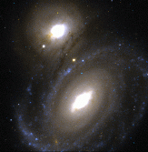
Stars and Galaxies
Chapter 28

Slide 2
Section 28.1: A Closer Look at Light
Objectives:
Describe the characteristics of electromagnetic radiation.
Explain techniques for analyzing light to obtain information about stars.
Explain the Doppler effect and how it gives information about star motions.
Key Vocabulary:
Electromagnetic radiation
Continuous spectrum
Electromagnetic spectrum
Emission spectrum
Absorption spectrum

Slide 3
A Closer Look at Light
Light is more than what we get when we turn on a lamp.
Light also refers to a form of radiation that stars and other celestial objects emit.
Most of what we know about the universe we have learned from analyzing the light that reaches us from distant stars and galaxies.

Slide 4
What Is Light?
Light is a form of electromagnetic radiation, which is energy that travels in waves.
Examples of electromagnetic radiation:
Music is broadcast using radio waves,
In hospitals, x-rays are used to produce images of your bones,
As you read, visible light gathered in by your eyes helps you to see.

Slide 5
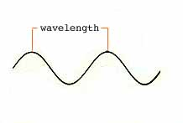
What Is Light?
All types of electromagnetic radiation travel in the form of waves, at a speed of about 300,000 km per second (the speed of light).
The lengths of the waves determine the characteristics of each form of electromagnetic radiation.
The distance from one wave crest to the next is called the wavelength.
Radio waves have the longest wavelength (longer than a soccer field), and gamma rays have the shortest.**

Slide 6
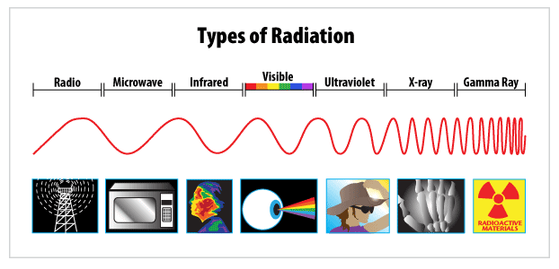
Draw diagram of waves in packet – make note of short waves v. long waves - REQUIRED
***

Slide 7
What Is Light?
The various types of electromagnetic radiation can be arranged in a continuum, with the longest wavelengths at one end and the shortest at the other end.
This continuum is called the electromagnetic spectrum. Stars such as the sun emit a wide range of wavelengths.
Electromagnetic waves can travel through empty space.
Electromagnetic waves emitted by an object provide information about the elements present in the object and about the object’s motion.

Slide 8
The Spectroscope
Visible white light is actually made up of light of various colors, each with a different wavelength. These are the colors you see in a rainbow ** or in the spectrum produced by light passing through a prism.
Red light has the longest wavelength, and violet has the shortest.
Astronomy Tutorial: Electromagnetic radiation (approx. 10 min)

Slide 9
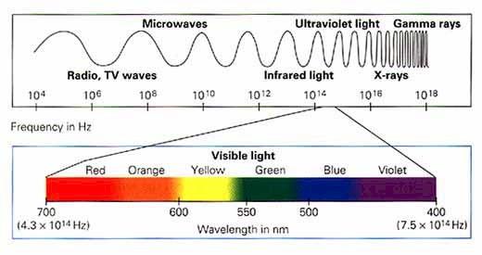
note short color waves v. long color waves
Electromagnetic spectrum

Slide 10
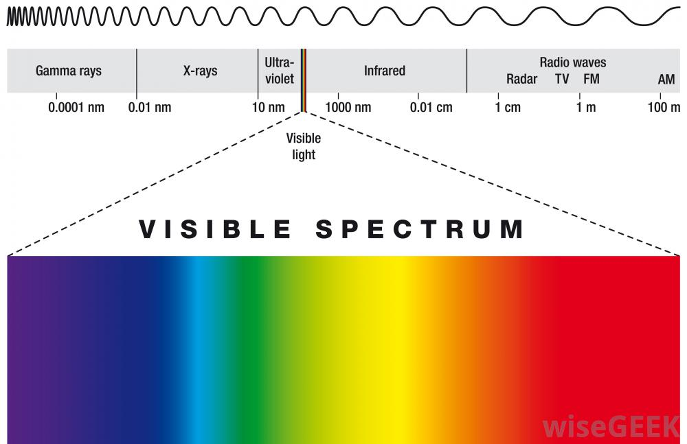
The Spectroscope
The band of colors we can see is called the visible spectrum.
To separate starlight into its colors, astronomers use a tool called a spectroscope, which uses a prism to split the light gathered by a telescope into a spectrum.**

Slide 11
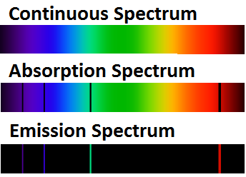
Types of Visible Spectra
Spectroscopes break light into three different types of spectra (the plural form of spectrum):
1. A continuous spectrum,
2. an emission spectrum, and
3. an absorption spectrum.

Slide 12
Types of Visible Spectra
A continuous spectrum is an unbroken band of colors, which shows that its source is emitting light of all visible wavelengths. Continuous spectra are emitted by:
Glowing solids (such as the filament of an electric light),
Glowing liquids (such as molten iron),
The hot, compressed gases inside stars.

Slide 13
Types of Visible Spectra
An emission spectrum is a series of unevenly spaced lines of different colors and brightnesses.
The bright lines show that the source is emitting light of only certain wavelengths. Glowing thin gases produce emission spectra.
Since every element has a unique emission spectrum, scientists are able to identify the elements in objects by analyzing the spectra of light emitted.

Slide 14
Types of Visible Spectra
An absorption spectrum is a continuous spectrum crossed by dark lines. These lines form when light from a glowing object passes through a cooler gas, which absorbs some of the wavelengths.
The elements in the gas absorb exactly the same wavelengths they would emit if they were in the form of glowing gases.
By comparing emission and absorption spectra, scientists can determine what elements are present in the cooler gas that is absorbing some of the light.

Slide 15
Types of Visible Spectra
A star’s absorption spectrum indicates the composition of the star’s outer layer.***
Our sun provides a good example. Scientists know that the photosphere and chromosphere absorb some of the sun’s electromagnetic waves. By studying the absorption spectrum of the sun and comparing these with the emission spectra of gases tested in a laboratory, scientists have identified more than 67 elements in the sun’s outer layer.

Slide 16
Types of Visible Spectra
Absorption spectra can also be used to determine the composition of a planet’s atmosphere (since a planet shines by reflecting sunlight).
If the spectrum of a planet contains dark lines that are not found in the sun’s spectrum, then these lines must be caused by substances in the planet’s atmosphere.

Slide 17
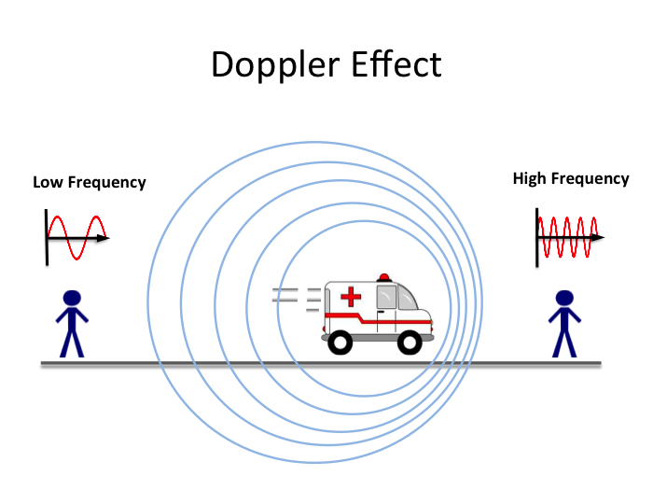
The Doppler Effect
The Doppler Effect is the apparent change in the wavelength of radiation in which there is relative motion between the source (another star or planet) and the receiver (our Earth).
While examining the spectra of stars we can see that the dark lines of the stars’ spectra may be shifted to the left or the right. The shift tells us the star is moving relative to Earth.

Slide 18
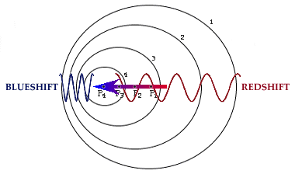
The Doppler Effect
If the star is moving toward the Earth, the wavelength of light emitted becomes shorter. The light waves “shift” toward the blue end of the spectrum. This is called blueshift.
If the star is moving away from Earth, the wavelength of light increases. The dark lines “shift” toward the red end of the spectrum. This is called redshift.

Slide 19
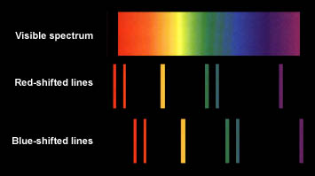
The Doppler Effect
The blueshift or redshift can also tell us how fast a star is moving toward or away from Earth.
Moving away from Earth
Moving toward Earth

Slide 20
Ticket out the door
1. What part of the electromagnetic spectrum can be divided into rainbow like colors?
2. The Continuous spectrum is emitted by what 3 things:
3. When a star’s spectral lines are shifted towards the red end of the spectrum, the star is moving towards Earth OR moving away from Earth?

Slide 21
Section 28.1: review
What do radio waves, visible light, and gamma rays all have in common?
What does a spectroscope do?
How do scientists use different spectra to figure out the composition of a star’s outer layer?
Why is the light reaching us from some celestial objects shifted toward the red or blue end of the spectrum?
Every star has a unique spectrum. What does this suggest about stars?

Slide 22
Section 28.2: Stars and Their Characteristics
Objectives:
Explain why the positions of constellations in the sky change with the seasons.
List three units astronomers use to measure distances to stars.
Describe the characteristics of stars, including mass, size, temperature, color, and luminosity.
Describe variable stars.

Slide 23
Section 28.2: Stars and Their Characteristics
Key Vocabulary
Constellation
Apparent magnitude
Astronomical unit
Light-year
Parsec
Luminosity
Absolute magnitude
Cepheid variable

Slide 24
Stars and Their Characteristics
Our sun is just one star among many. The light from other stars have traveled great distances to get to Earth.
The light from Proxima Centauri (the star nearest the sun) left that star more than four years ago.
Light from other stars and celestial objects may have taken thousands, millions, or even billions of years to get here.

Slide 25
Constellations
Constellations are a group of stars that appear to form a pattern in the sky.
Officially, we recognize eighty-eight (88) constellations that can be viewed from Earth’s northern and southern hemispheres.
Ancient peoples named constellations for mythical heroes (Hercules), animals (Leo the lion, Taurus the bull), monsters (Draco the dragon, Centaurus the centaur), and familiar objects (Lyra the lyre or harp).

Slide 26
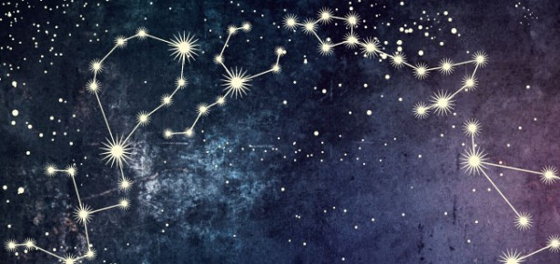
Constellations
The stars that make up a constellation actually are located at varying distances from Earth and are moving in relation to one another.
However, because the stars are so far from Earth, it takes thousands of years before we notice any movement.

Slide 27
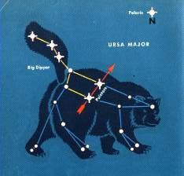
Constellations
A small star grouping, or sub-grouping of a constellation is called an asterism. We are familiar with the constellation known as Ursa Major (the Great Bear). Within Ursa Major is the Big Dipper. The Big Dipper is an asterism in the shape of a dipper and handle.
The two stars farthest from the Big Dipper’s (Ursa Major) handle “point” toward the North Star (Polaris).** Polaris is found in the handle of the Little Dipper, an asterism of the Ursa Minor (the Little Bear) constellation.

Slide 28
Constellations
The apparent movement of the constellations across our sky is caused by Earth’s motions – its rotation and revolution.
Because Earth moves from west to east, the whole sky appears to turn, or move, from the east to the west.
Sections of the sky directly above Earth’s poles seem stationary as the Earth turns on its axis. Polaris (the North Star) seems fixed in the sky while the nearby stars move counterclockwise around it. These are called circumpolar stars (stars that circle the poles).

Slide 29
CHECKING FOR UNDERSTANDING
WHY DO CONSTELLATIONS APPEAR TO MOVE?

Slide 30
Constellations
Circumpolar stars will never set below the horizon and can be seen all year long (Ursa Major, Ursa Minor, and Cassiopeia).
Some constellations can be seen only in certain seasons. For example, in the Northern Hemisphere, Lyra can best be seen in the summer time. Orion can best be seen in the winter.***
Seasonal differences in the constellations is due to Earth’s movement around the sun.***

Slide 31
CHECKING FOR UNDERSTANDING
WHAT CAUSES SEASONAL DIFFERENCES IN CONSTELLATIONS, I.E., WHY ARE WE ONLY ABLE TO SEE SOME CONSTELLATIONS DURING CERTAIN TIMES OF THE YEAR?

Slide 32
Apparent Magnitude
The apparent magnitude of a star is a measure of how bright a star appears to be to an observer on Earth.
The lower the apparent magnitude number, the brighter the star is. Some of the brightest stars in the sky are classified as first-magnitude stars. The faintest stars that can be seen with our unaided eye are called sixth-magnitude stars. Each magnitude differs from the next by a factor of about 2.5.
Some stars are so bright that they have a negative apparent magnitude.

Slide 33
CHECKING FOR UNDERSTANDING
HOW IS APPARENT MAGNITUDE RELATED TO A STAR’S BRIGHTNESS? WHY IS IT COUNTER-INTUITIVE?

Slide 34
Distances to Stars
Because of the large distances in space, we have defined the average distance between the Earth and our sun as one Astronomical Unit. This is written as 1 AU.
1 AU = about 150,000,000 kilometers
The next nearest star past our sun is called Proxima Centauri. Proxima Centauri is more than 260,000 AU from Earth.
1 AU

Slide 35
Distances to Stars
Scientists use two other units that cover large distances in space.
Light-year = a light year is the distance that a ray of light will travel in one year.*** This is equal to about 9.5 trillion kilometers.
Proxima Centauri is about 4.2 light-years away from Earth.

Slide 36
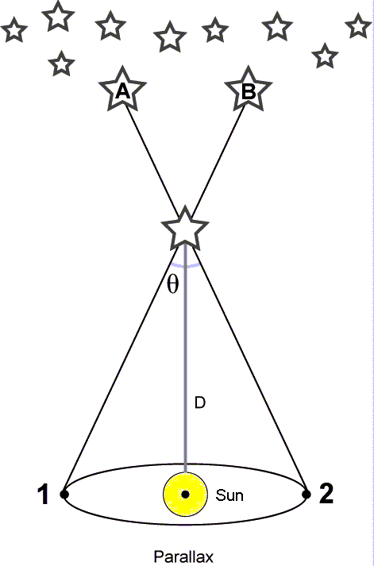
Distances to Stars
Parallax is a change in an object’s direction due to a change in the observer’s position.
Because Earth orbits the sun, astronomers experience parallax when they observe the stars. Astronomers can use parallax to calculate the distance to a star, by knowing the angle between two observed positions and the distance between the observation points.

Slide 37
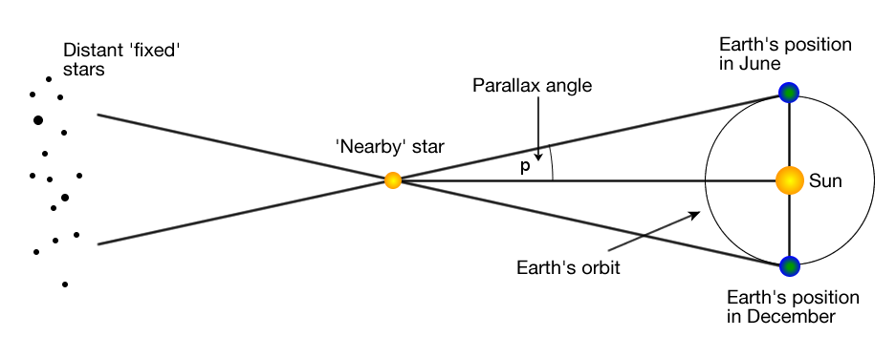
Distance to stars
Astronomy Tutorial: Distances and Parallax (approx. 11 min)

Slide 38
Distances to Stars
To express these measurements, astronomers use a special unit of distance called a parsec. A parsec is a “parallax second”, and is equal to 3.258 light-years.

Slide 39
Elements in Stars
A star is a sphere of super-hot gases, mostly hydrogen and helium, *** although one or two percent of a star’s mass may consist of heavier elements (oxygen, carbon, nitrogen, sodium).
At its surface, our sun is about 69% hydrogen, 29% helium, and about 2% of heavier elements.
Although all stars consist mostly of hydrogen and helium, no two stars contain exactly the same elements in the same proportion. Astronomers use spectral analysis to determine a star’s makeup.

Slide 40
Mass, Size, and Temperature of Stars
Stars vary greatly in their masses, size, and densities.
We cannot observe a star’s mass directly. We can only calculate it based on other observations. It can be determined either by the inertial properties of the body or by its gravitational influence on other bodies.***
The larger the mass, the stronger the gravitational effect on the bodies around it.
Stellar masses are expressed as multiples of the mass of our sun, which is called one solar mass.

Slide 41
Mass, Size, and Temperature of Stars
Stars vary more in size than they do in mass. The smallest stars are smaller than Earth. The largest star known has a diameter more than 2000 times that of our sun.
Stars differ even more in density. Betelgeuse is about one ten-millionth as dense as our sun. However, one star near Sirius is so dense that one teaspoon of it would weigh more than a ton on Earth.

Slide 42





Temperature and Color of Stars
Stars also vary in temperature. The range of colors a star emits depends on its surface temperature.
Cooler surface temperatures (below 3900° C) results in a red coloring (for example, Betelgeuse). Hotter temperatures change the color to orange, then yellow (our sun, at about 5500° C), and then white. The hottest stars (such as Sirius) have a bluish white color (above 9500° C).

Slide 43
Luminosity and Absolute Magnitude
Luminosity is the actual brightness of a star. Luminosity depends only on the star’s size and temperature. Distance from Earth is not a factor.
If two stars have the same surface temperature, the larger star would be more luminous.***
If two stars have the same size, the hotter star would be more luminous.

Slide 44
Luminosity and Absolute Magnitude
Absolute magnitude is a measure of how bright a star would be if all stars were at the same distance (ten parsecs) from Earth.
Thus, distance from Earth no longer becomes a factor in how bright a star is. Remember, very bright stars that are very far from Earth may appear to be very faint to us.
For example:
Since our sun is so close to Earth, it has an apparent magnitude of –26.7. However, the sun has an absolute magnitude of only +4.8.

Slide 45
Variable Stars
Most stars shine with a steady brightness. Variable stars show a regular variation in brightness over cycles that last from days to years. There are several different kinds of variable stars.
1. Pulsating stars change in brightness as they expand and contract.
Contracting (hotter) = brighter,
expanding (cooler) = dimmer.

Slide 46
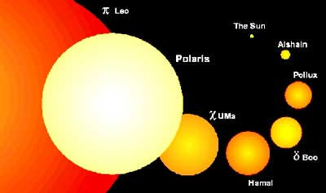
Variable Stars
2. An important class of pulsating stars are called Cepheid variables. These are yellow supergiants whose cycles of brightness range from about 1 day to 50 days (5 is average).
Notes:
Polaris is a Cepheid variable star.

Slide 47
Variable Stars
The absolute magnitude of a Cepheid is related to the length of time between its periods of maximum brightness. The slower the cycle, the greater the luminosity of the star.
By comparing a Cepheid’s apparent and absolute magnitudes, astronomers can determine the distance from Earth to the star. This helps astronomers to calculate the distance to galaxies that contain Cepheid’s.***

Slide 48
Variable Stars
3. A nonpulsating “star” may change brightness because it actually is two or more stars. Most stars are parts of systems in which two or more stars revolve around each other. These star systems are called eclipsing binaries.
From Earth, it appears that one star eclipses (passes in front of) another star. This causes the “star” system to dim at regular intervals.
Algol is a bright star that is eclipsed by a dim companion. Algol’s brightness appears to decrease by about 1/3 every 2.9 days.

Slide 49
Telescopes
Telescopes help astronomers in two ways:
They collect far more light than an unaided eye can.
They magnify images so you can see more detail and to visually separate distant objects from one another.
Notes:
The area of a circle equals pi X radius squared.

Slide 50
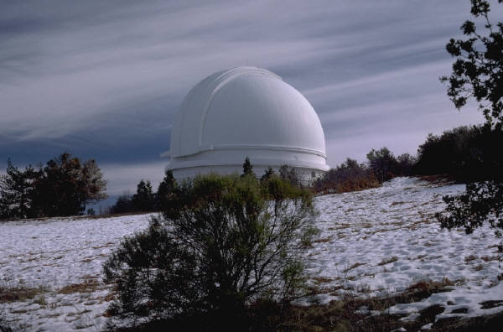
Telescopes
Optical telescopes use lenses or mirrors to gather and focus starlight. Most lenses or mirrors are round, so doubling the radius of the lens or mirror increases its light-gathering power four times. The best locations for optical telescopes are on mountain peaks in dry climates. These telescopes can only work after the sky becomes dark.

Slide 51
Telescopes
Refracting telescopes use lenses both to focus light and to magnify an image for viewers. These are the original type of telescope.
Reflecting telescopes use one mirror to focus light and a second mirror to reflect the light to the eyepiece. If the telescope uses an array of smaller mirrors (in place of one larger objective mirror) it is called a multiple-mirror telescope or MMT.
Both refracting and reflecting telescopes have a lens in the eyepiece.
Notes:
The picture shows the MMT at Mount Hopkins, Arizona.

Slide 52
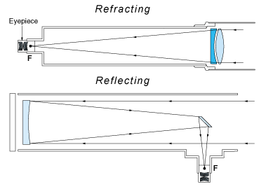
Telescopes
Uses lenses
Uses a mirror

Slide 53
Telescopes
Astronomers observe not only the visible light emitted by a celestial object (using optical telescopes), but they also detect emissions throughout the electromagnetic spectrum.
Radio telescopes gather information from radio waves. Clouds don’t disrupt the collection of radio wave data, but electrical storms do. These telescopes can collect data during the day or night. Radio telescopes look like large dishes that are used to receive television signals from satellites. They are large because radio waves have longer wavelengths than visible light.
Notes:
The radio telescope on the left is located in West Virginia. On the right is the Arecibo radio telescope (Puerto Rico).

Slide 54
Telescopes
Radio telescopes are often used in arrays (arrangements of multiple telescopes so they can act like one large telescope).
In addition to radio waves, astronomers also gather data from ultraviolet light, X rays, gamma rays, and infrared wavelengths when studying celestial objects.

Slide 55
Telescopes
Much of these wavelengths are absorbed by our atmosphere, so to collect data on these wavelengths, we use high flying aircraft, balloons, rockets, and satellites.
Several infrared telescopes are found on Earth, however, they are usually built high up on mountain tops. They must be kept very cool if they are to detect weak infrared sources in space.

Slide 56
Ticket out the door
1. Why can certain constellations only be seen during certain seasons?
2. What does a light-year measure?
3. What are Cepheid variable stars used to determine?

Slide 57
Section 28.2: review
How do constellations differ from other groupings of stars, such as galaxies?
What is a light-year? A parsec?
Copy and complete the concept map.
What is the connection between a star’s surface temperature and its color?
Would the sun be more luminous if it were the same size but hotter? If it had the same surface temperature but were more massive. Explain.

Slide 58
Section 28.3: Life Cycles of Stars
Objectives:
Describe the birth of a star
Compare and contrast the life cycle of a star like the sun and a star more massive than the sun.
Describe the remnants of supernovae.

Slide 59
Section 28.3: Life Cycles of Stars
Key Vocabulary:
Main sequence
Giant star
Supergiants
White dwarfs
Planetary nebula
Supernova
Neutron star
Pulsar
Black hole
Nebula

Slide 60
Life Cycles of Stars
Stars are born from great clouds of gas and dust. They will mature, grow old, and die. When they die, they may produce new clouds of dust, from which new stars and planets may be formed.
The more massive a star is, the shorter its life will be.

Slide 61
The Hertzsprung-Russell Diagram
The stars in the universe are at different stages in their life cycles.
Some stars are young and hot; others are older and colder.
The Hertzsprung-Russell Diagram (or H-R Diagram) gives us a picture of a star’s life.
Named for astronomers Ejnar Hertzsprung (of Denmark) and Henry Norris Russell (of the United States).

Slide 62
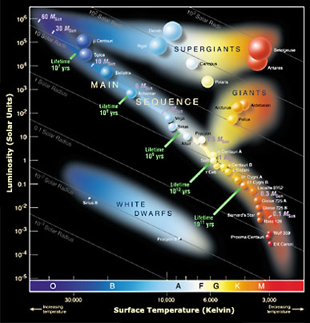
The Hertzsprung-Russell Diagram

Slide 63
The Hertzsprung-Russell Diagram
The H-R diagram plots the luminosity (brightness) of stars against their surface temperatures.
Most stars fall into distinct groups in the H-R diagram, because the groups represent stages in the life cycles of the stars.
About 90% of all stars seem to fit in a band that runs from the upper left of the diagram to the lower right. This band is called the main sequence. The stars in this band are called main-sequence stars.

Slide 64
The Hertzsprung-Russell Diagram
Main-sequence stars vary in surface temperature and absolute magnitudes. However, all main-sequence stars are actively fusing hydrogen into helium.
Above the main-sequence stars are giant stars. Giant stars are more luminous and have diameters from 10-100 times greater than our sun.
Super giants are giant stars that have diameters more than 100 times greater than our sun. These giant stars (but relatively cool) are very luminous.

Slide 65
The Hertzsprung-Russell Diagram
Also included on the H-R diagram are white dwarfs. These are stars that are near the end of their lives. These were once red giant stars that have lost their outer atmosphere and are now only a glowing stellar core.
Red giant → loses outer atmosphere = white dwarf

Slide 66
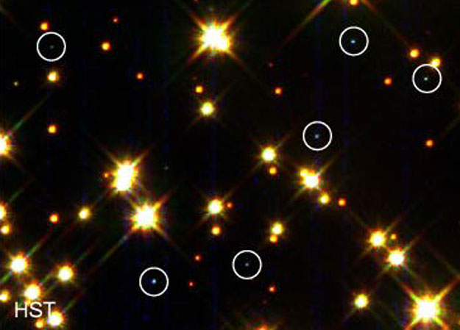
White Dwarfs

Slide 67
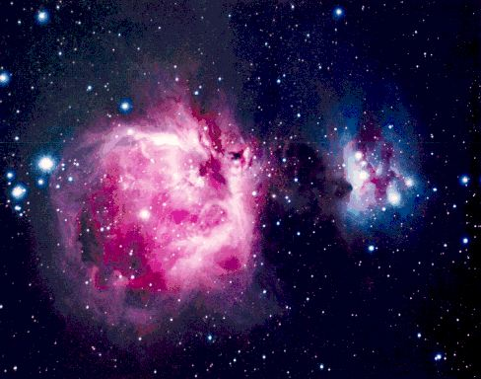
Birth of a Star
A star begins its life as a cloud of gas and dust called a nebula.
About 99% of a nebula consists of gas (mostly hydrogen) and the remaining 1% is a kind of dust made of very tiny grains.
Orion Nebula

Slide 68
Birth of a Star
The nebula starts to compress when pushed by an outside force (such as a shock wave)
Gas and dust move closer together (because of gravity)
Regions become denser, and temperatures start to go up
In large nebulas, parts of it will start to glow
Glowing areas are called protostars

Slide 69
Birth of a Star
Gravity continues to cause contraction
Protostars get hotter and hotter
When the protostar’s center gets hot enough, a fusion reaction begins
A new star is born!
Astronomy Tutorial: Stars Approx. 10 min

Slide 70
CHECKING FOR UNDERSTANDING
SUMMARIZE IN YOUR OWN WORDS HOW A STAR IS BORN, I.E., THE VARIOUS STEPS INVOLVED, ETC.
THIS IS REQUIRED FOR YOUR CLASS NOTES GRADE

Slide 71
Death of a Star Like the Sun
Main-sequence stars like the sun remain about the same size for millions or even billions of years.
Hydrogen in the core of the star continues to fuse into helium. The energy being produced balances the force of gravity.
Eventually, the hydrogen core shrinks, producing additional heat, which triggers hydrogen fusion outside the core. The entire star begins to expand.

Slide 72
Death of a Star Like the Sun
Core temperature rises and helium fuses into heavier elements (carbon and oxygen). The star begins to die.
A carbon-oxygen core forms, while hydrogen and helium fusion continues in the layers surrounding the core.
Surface gases begin to blow away in abrupt bursts.
Eventually all the gases are gone, and only the carbon-oxygen core remains. This is what we call a white dwarf.

Slide 73
Death of a Star Like the Sun
Ultraviolet emissions from the white dwarf are absorbed by the nearby gases. This gives off visible light (glowing).
This glowing halo of gases is called a planetary nebula. (early astronomers thought they looked like the disks of planets)
After 25,000 years, the planetary nebula will dissipate into space, leaving only the white dwarf.

Slide 74
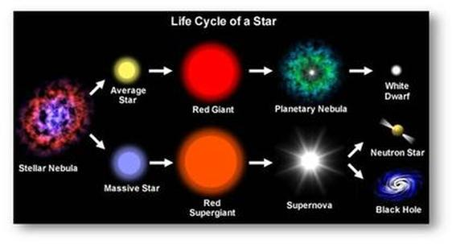
Death of a Star Like the Sun v. massive star

Slide 75
Death of a Massive Star
Stars eight or more times massive than our sun have a different life cycle.
In massive stars, as hydrogen runs out, fusion continues until iron nuclei are formed. The star then swells to more than 100 times the diameter of the sun, becoming a super giant.
The iron nuclei don’t release energy (like hydrogen), instead they absorb energy.
This causes the iron core to quickly and suddenly collapse.

Slide 76
Death of a Massive Star
The collapse produces a shock wave that blasts the star’s outer layers into space at thousands of miles per second, and produces a brilliant burst of light.
The explosion is called a supernova. This nova is 10-100 times as bright as our sun.
The explosion produces many elements, including copper, uranium, silver, and lead. These elements are blown away into space as a huge cloud of gas and dust, mixing with what was already there.

Slide 77
Remnants of Massive Stars
After a star goes supernova, it leaves behind its core. Sometimes this is a neutron star. This star is named this way because the gravitational force is so great that each atom’s electrons are crushed into the nucleus.
A neutron star is for the most part a dense mass of neutrons. While neutron stars are typically about 20 km in diameter, they are trillions of times more dense than the sun.

Slide 78
Remnants of Massive Stars
When they are first formed, neutron stars spin rapidly, giving off bursts of radio waves. Beams of radiation sweep through space like a searchlight.
Astronomers call these rapidly spinning neutron stars a pulsar (because of the pulses of energy).

Slide 79
Remnants of Massive Stars
A black hole is the remnant of a star at least 15 times as massive as the sun. Inside a black hole, the mass of 10 suns may be condensed inside an area 30 kilometers wide.
How do we identify black holes?
Black holes are a source of strong x-rays. Astronomers believe that atoms are emitting x-rays as they are ripped apart by the force of gravity within the black hole.
A black hole is thought to be at the center of our Milky Way galaxy.

Slide 80
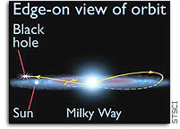
Remnants of Massive Stars
The rogue black hole is devouring a small companion star as the pair travels in an eccentric orbit looping to the outer reaches of our Milky Way galaxy.

Slide 81
Death of an average star v. Massive Star

Slide 82
CHECKING FOR UNDERSTANDING
COMPARE AND CONTRAST THE LIFE CYCLE AND DEATH OF A REGULAR STAR SUCH AS THE SUN TO A MASSIVE STAR. THIS IS REQUIRED FOR YOUR CLASS NOTES GRADE.

Slide 83
Ticket out the door
1. How is the mass of a star measured?
2. Most stars are composed of what two elements?
3. What do astronomers use Cepheid variable stars to determine?

Slide 84
Section 28.3: REVIEW
What does the Hertzprung-Russell diagram depict?
What forces balance each other in a main-sequence star?
Describe the end of a massive star’s life.

Slide 85
Section 28.4: Galaxies and the Universe
Objectives:
Tell what a galaxy is and describe the various types of galaxies.
Explain the origin of the universe according to the big bang model.
Key Vocabulary:
Galaxies
Quasar
Big bang model

Slide 86
Galaxies and the Universe
The universe is everything that exists.
The observable universe is everything we can observe.
Astronomers are not sure how old the universe is, but current estimates range from 10-20 billion years.

Slide 87
What are Galaxies?
Galaxies are systems that contain millions or even billions of stars.
Most estimates place the number of galaxies in the observable universe at 50-100 billion.
Space is so vast that most galaxies are light-years apart.

Slide 88
What are Galaxies?
We are part of the Milky Way galaxy. Our star is only one among hundreds of billions. The Milky Way galaxy is a spiral galaxy that is shaped like a thin disk with a central bulge.***
The diameter of the Milky Way is about 100,000 light-years. Its greatest thickness is about 10,000 light-years. The sun is about 26,000 light-years from the Milky Way’s center.
The “milky” haze in the night sky is the large number of stars that are in this region of the sky.

Slide 89
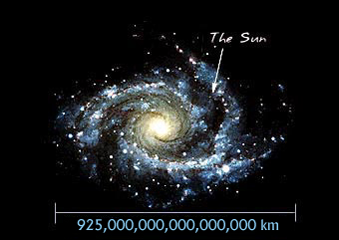
What are Galaxies?
Milky Way

Slide 90
What are Galaxies?
The Milky Way belongs to a group of more than 30 galaxies called the Local Group. The Milky Way’s nearest neighbors in the Local Group are the two Magellanic Clouds, which can be seen without a telescope in the Southern Hemisphere.
The Andromeda Galaxy is faintly visible in the Northern Hemisphere with the unaided eye.

Slide 91
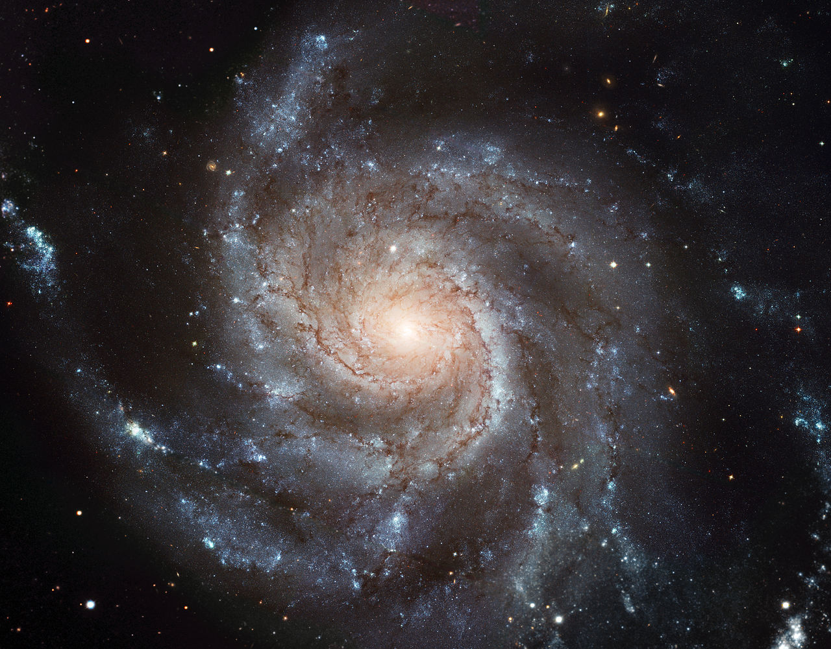
Types of Galaxies
No two galaxies are exactly alike. Most galaxies can be classified by shape.
Spiral galaxies (like the Milky Way) come in a range of types – from ones with large, bright nuclei of stars and tightly wound spiral arms, to ones with very small, dim nuclei and open sprawling arms.
The Andromeda Galaxy is also a spiral galaxy.

Slide 92
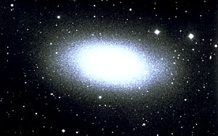
Types of Galaxies
Elliptical galaxies range from nearly spherical to lens-shaped. Their stars are concentrated in their centers, and they have no arms. Elliptical galaxies contain far less interstellar gas and dust (than spiral galaxies), and contain few, if any, young stars. The galaxy called M87 is an elliptical galaxy.

Slide 93
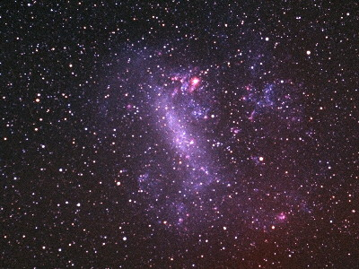
Types of Galaxies
Irregular galaxies have irregular shapes and are much smaller and fainter than both spiral and elliptical galaxies. Stars in irregular galaxies are spread out unevenly. The two Magellanic Clouds are irregular galaxies.

Slide 94
Active Galaxies
The Milky Way is a normal galaxy. A normal galaxy is one where the total energy emitted by the galaxy equals the energy emitted by all the galaxies component stars.***
Active galaxies are those where far more energy is emitted than could be given off by the stars within the galaxy. *** Some emit large amounts of radiation while others change in brightness considerably over short periods of time. Super massive black holes located at the center of these galaxies may be the reason for large amounts of radiation.

Slide 95
Active Galaxies
Quasars are extremely distant objects, some as far away as 12 billion light-years, that are perhaps a hundred to even a thousand times brighter than a normal galaxy. Quasars may be highly active galactic nuclei.
A blazar is believed to be an active galaxy that has one of its jets of hot gas pointed directly at Earth, so we are looking directly into the jet of escaping energy.
Lower-luminosity active galaxies are thought to be weaker versions of quasars.

Slide 96
Origin of the Universe
Scientists cannot say where or how the universe originated. However, through observations and experiments they have put together a model about how the universe has developed.
This model is called the big bang model. The big bang model explains the history of the universe from a tiny fraction of a second after it came into being up to the present time.
Astronomy Tutorial: Big Bang Model Approx. 13 min

Slide 97
A Model of the Beginning
According to the big bang model, 10-20 billion years ago all matter existing in an incredibly hot and dense state.
Matter expanded and cooled, slowly condensing into stars and galaxies.
The first stars consisted mostly of hydrogen with a small amount of helium.
No planets orbited yet, heavier elements did not yet exist.

Slide 98
A Model of the Beginning
More and more stars formed, matured, and died, making more and more heavier elements.
Supernovas and dying red giants released the heavier elements into space.
Eventually our sun and its nine planets were formed from interstellar gas and dust.

Slide 99
Checking for understanding
Write a paragraph explaining in your own words the big bang model. (Required for your class notes grade).

Slide 100
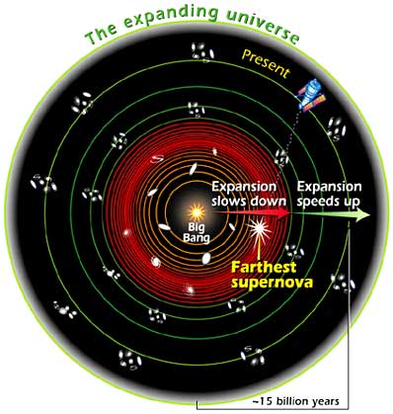
Evidence for the Big Bang Model
The distance between galaxies and groups of galaxies seems to have increased with time (Edwin Hubble found redshifts in galaxies he studied).***
Cosmic background radiation has been discovered (radiation left over from the universe’s beginning).***

Slide 101
Ticket out the door: 28.4
1. What type of galaxy is the Milky Way Galaxy? (Extra Credit – the Milky Way Galaxy belongs to a group of 30 galaxies called the ______________?
2. What is the MAIN difference between normal galaxies and active galaxies?
3. What are the two sources of evidence for the Big Bang Model?

Slide 102
Section 28.4: review
What is the difference between the universe and the observable universe?
Into what basic shapes can most normal galaxies be classified?
How do active galaxies differ from normal galaxies?
Copy and complete the concept map concerning what we know about the universe.
Observations of very distant galaxies show that they are at an earlier stage of development than nearby galaxies. How do these observations support the big bang model?

