Slide 1
Earth’s Structure & Motion

Slide 2
Earth’s Formation
OBJECTIVES
NGSS STANDARDS
Explain how most scientists explain the formation of the solar system
Describe Earth’s size and shape and the arrangement of its layers
List three sources of Earth’s internal heat
Describe the Earth’s magnetic field
HS-ESS1-6
Apply scientific reasoning and evidence from ancient Earth materials, meteorites, and other planetary surfaces to construct an account of Earth’s formation and early history
HS-ESS1-2
Construct an explanation of the Big Bang theory based on astronomical evidence of light spectra, motion of distant galaxies, and composition of matter in the universe

Slide 3
Earth’s Formation
Key Idea
  Earth formed from a whirling cloud of gas and debris into a multilayered sphere, which has since been losing heat.
  Key Vocabulary
  geology lithosphere
  inner core asthenosphere
  outer core magnetic field
  mantle
  crust

Slide 4
Origin of the Solar System
The most widely accepted model of the formation of our solar system is called the nebular hypothesis.
It suggests that about 4.6 billion years ago a great cloud of gas and dust was rotating slowly in space.
The cloud was at least 10 billion kilometers in diameter.
As time passed, the cloud shrank under the pull of its own gravity. As it shrank, its rate of rotation increased.

Slide 5
Origin of the Solar System
Most of the material in the rotating cloud gathered around its center.
Compression of this material made its interior so hot that a powerful reaction called hydrogen fusion occurred. At this time, the star we now know as our sun was born. nebular hypothesis animation
About 10% of the material in the cloud formed a great plane-like disk surrounding the sun and extending far into space.

Slide 6
Origin of the Solar System
Frictional, electromagnetic, and gravitational forces within the disk caused most of its mass to condense, forming solid particles of ice and rock.
The condensed particles in the spinning cloud eventually combined into larger bodies called planetesimals.
The planetesimals continued to compress and spin, sometimes colliding with each other and other objects in space. Eventually these planetesimals developed into planets and moons.

Slide 7
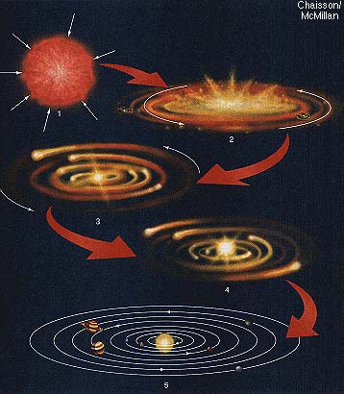
Origin of the Solar System
  nebular hypothesis animation

Slide 8
Checking for Understanding
Think.Pair.Share re: How the earth formed.
THEN, In your journal,
Write a paragraph describing how the earth formed based on the information in your text and our discussions in class.

Slide 9
Earth’ Size and Shape
The spinning motion resulted in Earth developing into a sphere with a bulge in the middle (oblate spheroid).
Total surface area is about 510 million km
  29% land
  71% water (ocean)

Slide 10
Earth’s Size and Shape
How did we learn that the Earth was not a perfect sphere?
Scientists measured the weight of an object in several places on Earth’s surface, and the weight was not the same.
The farther an object is located from the center of the Earth, the lighter it is. The closer an object is located to the center of the Earth, the heavier it is.
It turns out that an object will weigh more at the North and South Pole than it will at the Equator.
Notes:
Remember that an object at sea level will weigh more than the same object located on top of Mount Everest.

Slide 11
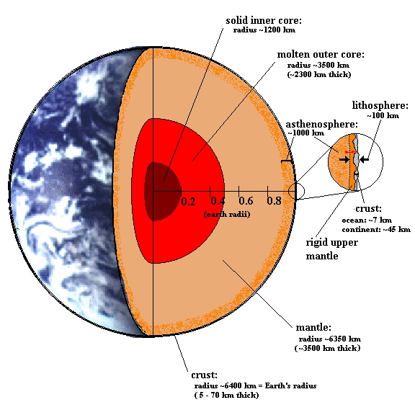
Earth’s Interior
Earth's interior
At earth’s center is an inner core composed of iron and nickel.
Surrounding the inner core is an outer core composed of iron and nickel in a liquid state.
Around the core is the thickest of Earth’s layers the mantle.
Surrounding the mantle is the crust, a thin, rigid layer of lighter rocks that includes Earth’s surface

Slide 12
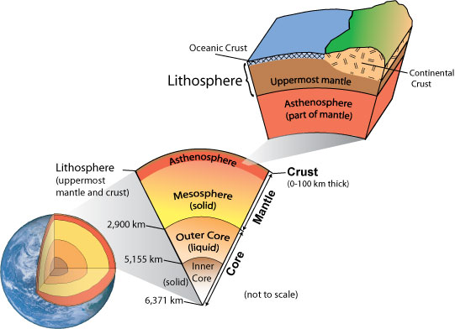
Earth’s interior
Earth’s near surface layers are classified by the material properties. The crust and the uppermost portion of the mantle make up the lithosphere.
The more rigid material of the lithosphere floats upon a thin, slushlike layer of the mantle called the asthenosphere.

Slide 13
Crust
Solid
A thin, rigid layer of lighter rocks
Extends to a depth of 65 km
Temperature is less than 1000 K, however it increases by 10-30 K for every kilometer of depth
The part of the geosphere that humans have direct contact with, and the only place where life has been found
Note K = Kelvin K = °C + 273

Slide 14
Mantle
Solid with liquid properties
Thickest of Earth’s layers
Composed mostly of compounds rich in iron, silicon, and magnesium
High temperatures and pressures cause it to behave as a liquid in some ways
Extends to a depth of 2890 km (from the surface)
Temperature is between 1500-3200K, and increases with depth

Slide 15
Outer Core
Liquid
Composed of iron and nickel
Extends to a depth of 5150 km (from the surface)
Temperature is between 3700-5500 K, and increases with depth

Slide 16
Inner Core
Solid
Composed of iron and nickel
Extends to a depth of 6371 km (from the surface)
Temperature is approximately 6000 K

Slide 17
Earth’s Heat
Earth’s heat was generated by:
1. meteorite impacts
2. weight of overlying materials causing compressional heat
3. decay of radioactive isotopes, elements that release heat as they disintegrate into more stable forms.

Slide 18
Earth’s Heat
Earth has been slowly losing heat:
Some rocks lose heat more quickly than others
The thickness of the crustal rock varies from place to place
The percentage of radioactive materials in rocks varies

Slide 19
Earth’s Magnetic Field
Earth's magnetic field

Slide 20
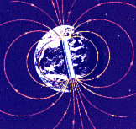
Earth’s Magnetic Field
A compass needle always points north. In fact, the compass needle aligns itself along the lines of force that makes up Earth’s magnetic field.
The magnetic north pole is the equivalent of the attracting or positive end of a bar magnet, so it attracts your compass needle. The magnetic south pole is like the repelling or negative end of a bar magnet.

Slide 21
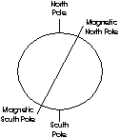
Earth’s Magnetic Field
Earth’s magnetic field is actually tilted about 11° away from the poles. The 11° tilt explains why the magnetic north pole and the geographic north pole are not in exactly the same place.
Scientists do not fully understand the origin of our magnetic field. However, many support a hypothesis that credits Earth’s magnetic field to the movement of fluid in the outer core.

Slide 22
Earth’s Magnetic Field
An electric current is generated when liquid iron moves across an already existing, but weak, magnetic field. The electric current produces a magnetic field that, with fluid motion, produces yet another magnetic field. Together, these fields create Earth’s strong magnetic field.

Slide 23
Checking for Understanding
Based on what we have learned about the Earth’s magnetic field, what would happen if we did not have one?

Slide 24
Review Section 4.1

Slide 25
Earth’s Rotation
Objectives
Standards
Give evidence for Earth’s rotation
Relate Earth’s rotation to the day-night cycle and the time zones
ESS1.B: Earth and the Solar System

Slide 26
Earth’s Rotation
Key Idea
Earth rotates on its axis once approximately every 24 hours, resulting in a day and night and providing the basis for time zones.
Vocabulary
Rotation international date line
Standard time zone prime meridian
Time meridian

Slide 27
Rate of Rotation
The Earth rotates one complete turn approximately every 24 hours. Because of Earth’s spheroidal shape, the speed of rotation varies from point to point.
Since the Earth is largest at its equator, it must rotate fastest at the equator to “keep up” with the rest of the planet. At the equator, the Earth rotates at 1670 km per hour. As you move north or south, the speed of rotation drops. At Boston, the rate of rotation drops to about 1300 km per hour. Near the poles, the speed of rotation is almost 0 km per hour, because the poles are on the axis of rotation.

Slide 28
Evidence for Rotation
The spinning of Earth around its axis is called rotation.
Foucault’s pendulum. He observed the direction of swing shifted 11° in a clockwise direction every hour. After 8 hours the pendulum was swinging at a right angle to its starting direction. Conclusion: shift was caused by Earth’s turning beneath the pendulum.
Earth’s winds. If Earth did NOT rotate, winds would blow in straight paths from areas of high pressure to low pressure. Because of Earth’s rotation, winds are deflected. In the Northern Hemisphere winds are deflected to the right and in the Southern Hemisphere winds are deflected to the left - i.e., the Coriolis Effect.

Slide 29
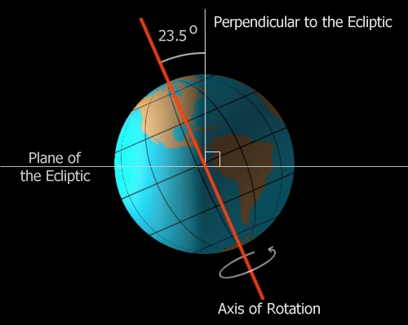
Axis and Rate of Rotation
Earth’s axis of rotation is an imaginary straight line that passes through the Earth between the North Pole and the South Pole. When Earth rotates, it turns around this axis.
The orbital path of the Earth is an imaginary flat surface around the sun. The axis of Earth is tilted 23.5° from this imaginary flat surface.
At present, Earth’s axis always points toward Polaris (the North Star). The tilt of our axis stays the same throughout the year. The consistency in Earth’s tilt is called parallelism.

Slide 30
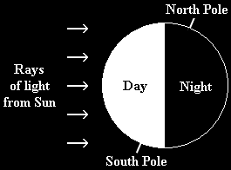
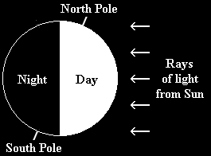
Effects of Rotation
An effect of Earth’s rotation is the daily change from day to night. The Earth rotates counterclockwise (from the standpoint of the North Pole). Thus, our sun appears to rise in the east and set in the west.
Only half of the Earth receives sunlight at any given time. If the Earth did not rotate, the half facing the sun would have constant light, while the other half would have perpetual dark.

Slide 31
Measuring Time
One day (24 hours) is the approximate time it takes Earth to rotate once on its axis. For centuries, people figured the time of day by the sun’s position in the sky. Each day, the sun rises on the eastern horizon, seems to move in an arc across the sky, and sets below the western horizon.
Solar noon occurs when the sun is in its highest position in the sky. This causes a problem; because of Earth’s rotation, solar noon does not occur at the same time everywhere.

Slide 32
Standard Time Zones
The problem of having different solar times in nearby communities was solved through the development of time zones. The Earth was divided into 24 standard time zones, each 15° of longitude wide.
The basis for time zones is the rate at which the sun appears to move across the sky. Each standard time zone is roughly centered on a line of longitude exactly divisible by 15°, called a time meridian. All areas within a time zone keep the same clock time. Clock time is the average solar time at that zone’s time meridian.

Slide 33
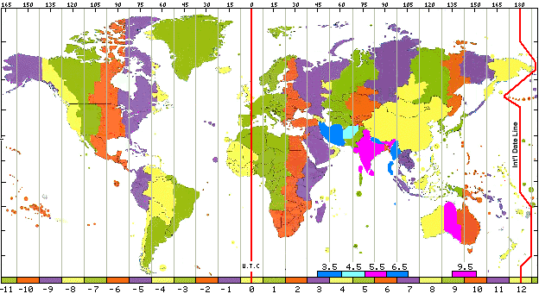
Standard Time Zones

Slide 34
Standard Time Zones
The starting point for the standard time zones is the prime meridian, located in Greenwich, England. Travelers moving westward from Greenwich move their clocks back to earlier times, while those moving eastward change to a later time.
In theory, each standard time zone should be exactly 15° wide. However, time zone boundaries on land are seldom straight lines, shifting east or west to meet the needs of the people living there.

Slide 35

U.S. Time Zones
Eastern Standard, Central Standard, Mountain Standard, and Pacific Standard time zones were created in the U.S. in 1883, in order to standardize train schedules. Congress made the time zones official under federal law in 1918.
Since then, Alaska Standard and Hawaii-Aleutian Standard time zones have been added.

Slide 36
The International Date Line
Travelers going completely around the world gain or lose time at each time zone until they have gained or lost an entire day.
An imaginary line called the International Date Line (located along the 180th meridian) represents the longitude at which the date changes.
Upon crossing the date line, travelers change their calendars, not their watches. For travelers moving westward, the date is changed to one day later; for eastward travelers, the date is changed to one day earlier.

Slide 37
Review Section 4.2 p. 78

Slide 38
Earth’s Revolution
Objectives
Standards
Give evidence for Earth’s revolution around the Sun
Describe Earth’s path and rate of revolution
Explain why seasons occur
ESS1.B: Earth and the Solar System

Slide 39
Earth’s Revolution
Key Idea
Earth revolves around the sun in an elliptical orbit, causing seasonal variations
Vocabulary
Revolution winter solstice
Parallax vernal equinox
Summer solstice autumnal equinox

Slide 40
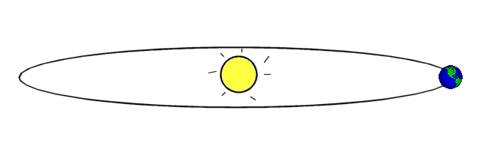
Earth’s Revolution
Revolution is the movement of Earth in its orbit around the sun.
What evidence do we have that we revolve around the sun?
Constellations change their position in the sky, and some are not even visible for a period of time.
Nearby stars seem to shift position when compared to distant stars. This apparent shift is called parallax.

Slide 41
Path and Rate of Revolution
Like our rotation, the direction of Earth’s revolution is also counterclockwise. Earth’s orbit is an ellipse with the sun located at one focus.
The average distance from the Earth to the sun is 150 million km.
At perihelion (Earth’s closest point to the sun in our orbit), we are about 147.6 million km from the sun. Perihelion occurs on or about January 2.
At aphelion, (Earth’s farthest point from the sun in our orbit), we are about 152.4 million km from the sun. Aphelion occurs on or about July 4.

Slide 42
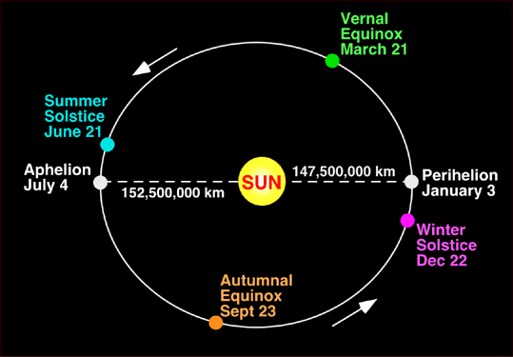
Path and Rate of Revolution

Slide 43
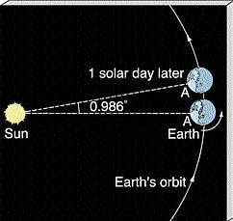
Path and Rate of Revolution
Earth makes one revolution around the sun every 365.24 days. Since one orbit represents a journey of 360°, Earth’s rate of revolution is approximately one degree per day.
Earth’s revolution around the sun causes the sun’s apparent path across the sky to change throughout the year.

Slide 44
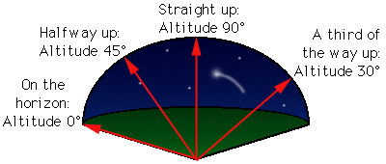
Path and Rate of Revolution
When describing the sun’s position in the sky, we refer to the point directly above an observer as the zenith. The angular distance between the horizon and the sun’s position is called its altitude. When the sun is at the zenith, its altitude is 90° . For locations in the U.S. (except Hawaii), the sun is always below the zenith.
When the sun is on the horizon, the altitude is 0°

Slide 45
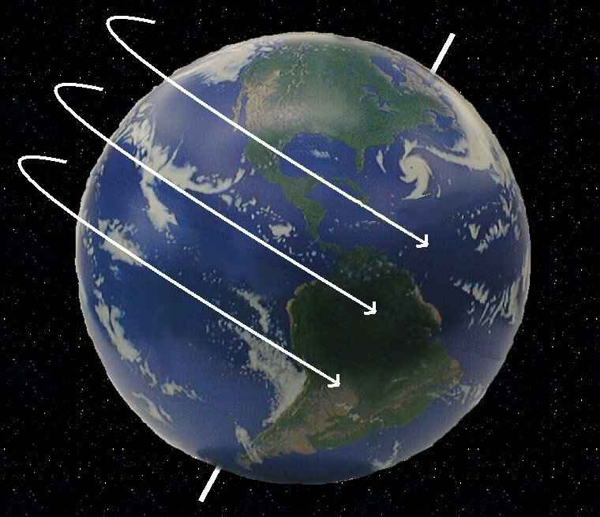
Effects of Revolution and Tilt
Effects of Earth’s revolution include the seasons and variation in the length of days and nights. In addition, the tilt of the axis has a profound effect on Earth.
At almost any given time, one hemisphere is tilted toward the sun, as the other is tilted away. The hemisphere tilted toward the sun receives more direct sunlight and thus has warmer temperatures and longer days. The hemisphere tilted away from the sun receives indirect sunlight. This results in cooler temperatures and shorter days.

Slide 46
Effects of Revolution and Tilt
The changes in the hours of daylight and in temperature caused by the revolution and tilt lead to the yearly change in seasons at middle latitudes.
If the Earth had no tilt, then seasons would not occur. Every place on Earth would experience 12 hours of daylight and 12 hours of night.
If the Earth had a tilt greater than 23.5°, then each hemisphere would experience hotter summers and colder winters.

Slide 47
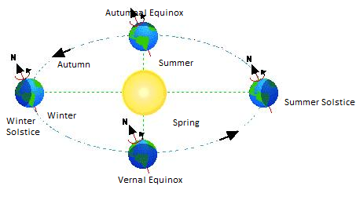
Effects of Revolution and Tilt
Solstices and Equinoxes explained
Why seasons occur
Why we have seasons

Slide 48
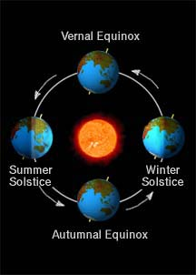
Seasons
Notice how the tilt of our axis is always pointing the same direction in space (toward Polaris).

Slide 49
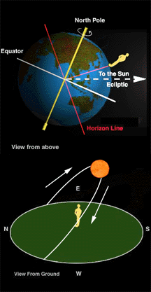
Seasons
The first day of summer in the Northern Hemisphere occurs on or about June 21 every year. This day has the longest daylight period and is known as the Summer Solstice.
At the Summer Solstice, the Northern Hemisphere is at its maximum tilt, causing the sun to be directly above the Tropic of Cancer (located at 23.5° North latitude).
On the Summer Solstice, every point that is located within 23.5° of the North Pole (the Arctic Circle) will experience 24 hours of daylight.

Slide 50
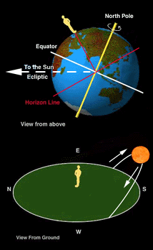
Seasons
The first day of winter in the Northern Hemisphere occurs on or about December 21. This day has the shortest daylight period and is known as the Winter Solstice.
At the Winter Solstice, the Northern Hemisphere is at its maximum tilt away from the sun, causing the sun to be directly above the Tropic of Capricorn (located at 23.5° South latitude).
On the Winter Solstice, every point that is located within 23.5° of the South Pole (the Antarctic Circle) will experience 24 hours of daylight.

Slide 51
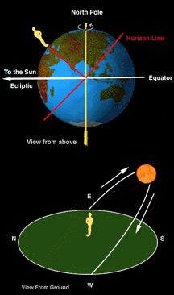
Seasons
There are two days each year, midway between the solstices, when neither hemisphere tilts toward the sun. On these days, daytime and nighttime are equal in length all over the world. Each of these days is known as an equinox.
The vernal (or spring) equinox occurs on or around March 21. The autumnal (or fall) equinox occurs on or around September 22.
On the equinox, the sun is overhead the equator at noon. They also mark periods of long twilight at the poles. Depending on the pole, the sun is either rising and visible for the next six months, or setting and not visible for the next six months.

Slide 52
Seasons
Because of the tilt of the Earth, the seasons are opposite in the Northern and Southern Hemispheres.
When it is Summer in the Northern Hemisphere, it is Winter in the Southern Hemisphere, and vise versa.
When it is Spring in the Northern Hemisphere, it is Fall in the Southern Hemisphere, and vise versa.

Slide 53
Section Review 4.3

Slide 54

Ticket out the Door – Day 1
How is the earth’s interior structure organized? i.e., what are the layers of the Earth composed of from the center outward?

Slide 55
Ticket Out the Door – Day 2
What causes the Earth to have day and night?

Slide 56
Ticket out the Door – Day 3
What causes Earth’s seasons?

