Slide 1
Passing this class
This is OUR class. We have to learn Natural Science, but how we get through the journey is up to us.

Slide 2
Believe in yourselves, I do.
I do not care who said what, when, why or to whom, but in this class you are ALL smart, good kids destined to do their best. I believe that. You may not all make the best choices or you may exhibit bad behavior (even my son Gabriel and even I do that), but THAT does not define YOU. YES, I have done bad behavior.
YOU define YOU.
If YOU believe you can pass this class, then YOU can. AND, I am here to help you.
I will study with you. I will quiz you. I will listen to you. I will make flashcards with you. I am willing to do what it takes to help you pass the class, you just have to put in the effort.
Believe it or not, if the only time you can study is afterschool, I would even fight traffic to stay later with you. (Most of you know I live about an hour away).

Slide 3

YOU CAN DO IT!
Yes, this is really how I see each and one of you in my mind’s eye!

Slide 4
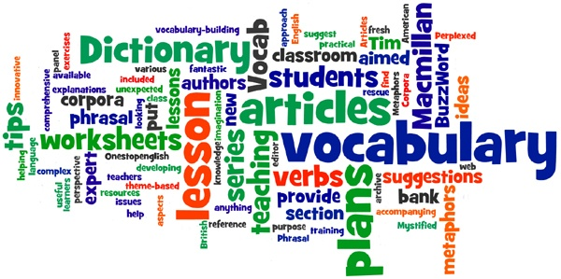
vocabulary
Ewwww…. Vocabulary. It’s soooo boring.
Yup, it sure can be.
But… vocabulary is one of the MAIN keys to success in any class.
Let’s think about it for a minute:
  ? There is a vocabulary quiz - hands down if you know the vocabulary you are gonna ace it
  ? There is a concept test / multiple choice. Get’s a little trickier, but if you know the vocabulary used in the questions you can knock out some of the obvious wrong answers improving your chances of getting the question right.
  ? Doesn’t it take a lot of work to memorize vocabulary? – Not really, just a few minutes with some flashcards here and there, and before you know it . . . You know it!

Slide 5
Taking notes
Here we go again . . . Boring! But, hey Mrs. Muñoz only makes us fill in the blanks, so we don’t even really need to pay attention, right?
NOPE. Sorry Charlie. It does not work that way.
First . . . You need to think about what you are writing to see if it makes sense. – Otherwise, how you gonna ask questions?
Second . . . You need to review the information, just like studying flashcards so the ideas coalesce (make sense) together in your mind. Otherwise, how you gonna answer questions?
Third . . . By having time to only write in the blanks, you have extra time to annotate your notes . . . You know – highlight important concepts, underline vocabulary words, put stars next to questions I mention might be important on the test.
Fourth . . . This is a no brainer – each section of the notes packet is worth 5 points – that is usually 60 points for notes (vocabulary, notes and review questions) that is equal to an exam grade! Why throw away free points?

Slide 6
homework
Hate to say it guys, this one is kind of on you. You know I grade mostly for effort so as long as you did the work, you get the points. Then, we correct the answers and you get to use the information/notes on the test.
It only makes sense to do the best you can, correct the answers and use them to ace the tests.

Slide 7
Projects/labs
This is a big one guys! These projects are equal to a test grade, if not more.
I absolutely LOVE projects. The chapter information can be bland and textual, but projects give you a way to shine, to make what we are learning about your own, put your own spin on it.
Sometimes, the projects flop – I was a little disappointed in how few volcanoes were made, but next year things will go better.
The Rock Cycle project was awesome. Some of you guys turned in some truly amazing powerpoints and posters!
We have two different earthquake projects come up that promise for some fun.
AND, I am already designing a solar system trading card game for our next unit.
IT IS IMPERATIVE THAT YOU DO THESE PROJECTS, PUT IN AS MUCH EFFORT AS YOU CAN MUSTER, ASK ME FOR HELP, WHATEVER IT TAKES, BUT YOU MUST DO THEM OR PUT YOUR GRADE INTO JEOPARDY!

Slide 8
Tests / final exam
There are chapter vocabulary quizzes. I will help you study prior to taking the quiz, which seems to help the scores improve significantly since I started doing that. However, it is really up to you to study a little every day so you can ace the quizzes.
I am considering more frequent quizzes/concept, etc., but it is still under consideration.
I am undecided as to whether I will resume chapter tests or save the concept test for the comprehensive final, which is mandatory. I will probably skip the chapter tests so we have more time for projects and study time. It is fluid. Thoughts? Put them in the suggestion box.

Slide 9
SUGGESTION BOX – WHAT’S LEFT?
Give me ideas.
What do you think will help you be successful?
We will read these suggestions and comments together as a group. Please be respectful and only put in useful, productive comments or suggestions.

Slide 10
Golden rule
I had a great conversation with my 14 year old son, Gabriel the other day.
During that conversation it became clear that there are often erroneous assumptions made, by teachers and students.
First of all . . . Teachers are people! When students are nice to us, we feel warm and fuzzy and it makes us feel happy inside.
Second of all . . . Students are people! When teachers are nice to them, I like to believe they feel warm and fuzzy and it makes them happy inside too.
Third of all . . . It is NEVER my intent to ever make any of you feel badly, even if you make a poor choice or engage in bad behavior. I will make every effort to remain calm and respectful, firm and decisive. Should I fail in this regard, please respectfully remind me that I may need a time out myself.

