Slide 1
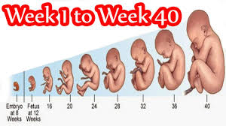
CHAPTER 3
Fetal Development

Slide 2
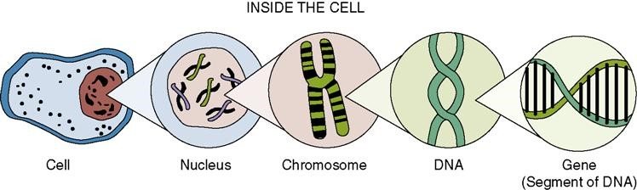
Body Cell
DNA and nucleus control cell function
  The genes and chromosomes in the DNA determine individual traits
Each contains 46 chromosomes
  22 pairs of autosomes
  1 pair of sex chromosomes
Biological development influenced by
  External environment (teratogens)
  Drug use
  Undernutrition
Smoking

Slide 3
Cell Division and Gametogenesis
Mitosis
  Continuous process
  Body grows, develops, and dead cells are replaced
  Each daughter cell contains same number of chromosomes as parent cell—called diploid
  Process of mitosis for sperm is spermatogenesis
  Process of mitosis for ovum is oogenesis
Notes:
Mitosis refers to the division and multiplication of body cells.

Slide 4
Cell Division and Gametogenesis
Meiosis
  Reproductive cells undergo two sequential divisions
  Number of chromosomes is 23 per cell with only one sex chromosome—called haploid
  At fertilization, the new cell contains 23 chromosomes from the sperm and 23 chromosomes from the ova
  Formation of gametes by this type of cell division is gametogenesis
Notes:
Meiosis refers to the same process when taking place in sex cells.

Slide 5
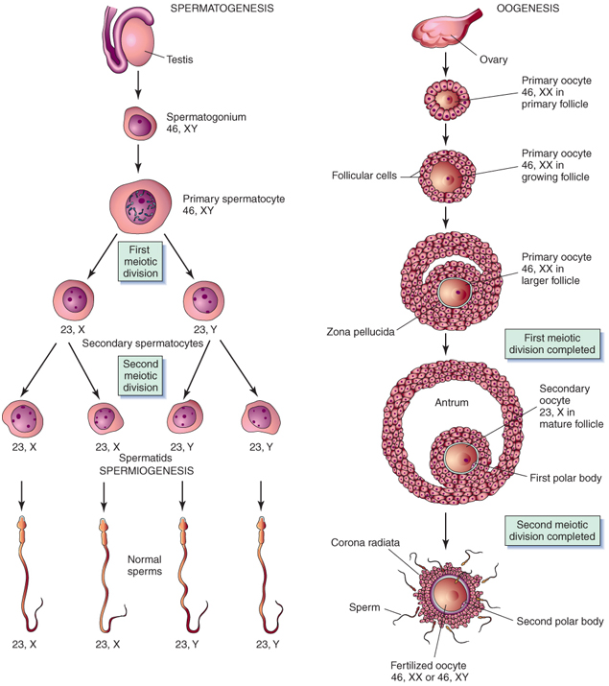
Cell Division and Gametogenesis ( (p. 31)

Slide 6
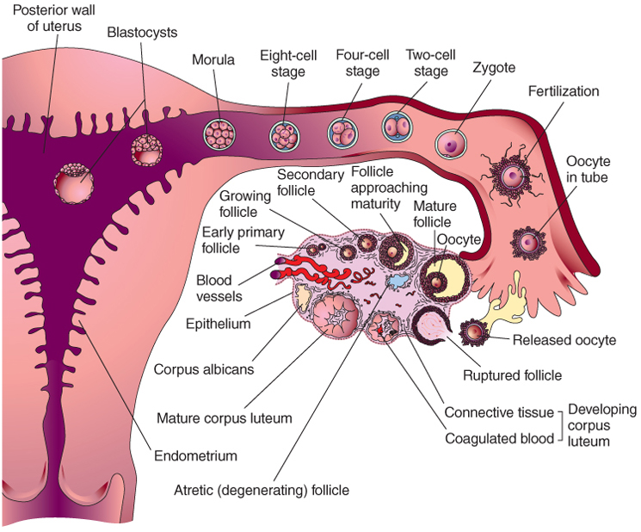
Fertilization
Occurs when a sperm penetrates an ovum and they unite
Takes place in the outer third of the fallopian tube, near the ovary
As soon as it occurs, a chemical change in the membrane around the fertilized ovum prevents further sperm from penetrating the ovum
Notes:
Only a single sperm can penetrate a single egg.

Slide 7
Nursing Tip
During sexual counseling, the nurse should emphasize that the survival time of sperm ejaculated into the area of the cervix may be up to 5 days and that pregnancy can occur with intercourse as long as 5 days before ovulation
Notes:
The timing of intercourse to facilitate pregnancy can be a source of confusion to couples.
The sperm can be present in the woman’s body prior to ovulation and survive until ovulation.
Are there any days during the woman’s monthly cycle in which she cannot become pregnant?

Slide 8
Sex Determination
Sperm can carry either an X or a Y chromosome
Male determines the gender of the fetus
pH of female reproductive tract influences survival rate of the X- and Y-bearing sperm, including speed of motility
XX results in female
XY results in male
Notes:
Many theories exist involving interventions to increase the likelihood of a woman conceiving a child of the desired sex.
What are the ethical implications of attempting to control the sex of the baby?

Slide 9
Sex Determination
The gender of a baby is determined by the father’s sperm.
The conception and birth of a child of a certain sex is a source of concern to some families

Slide 10
Inheritance
Each gene is coded for inheritance
  Genes carry instruction for dominant and recessive traits
  Dominant usually overpower recessive
  Passed on to offspring

Slide 11
Tubal Transport of the Zygote
Zygote is formed by union of sperm and ovum
Transported through fallopian tube into uterus
During transport, zygote undergoes rapid mitotic division (known as cleavage)
Size of zygote does not increase, individual cells become smaller as they divide, then form a solid ball (known as a morula)
Notes:
After fertilization, the zygote travels to the uterus for implantation.
What action allows the zygote to travel?
During this time, does the mother recognize she is pregnant? No
What are the implications if the tubal structure is not “normal”?

Slide 12
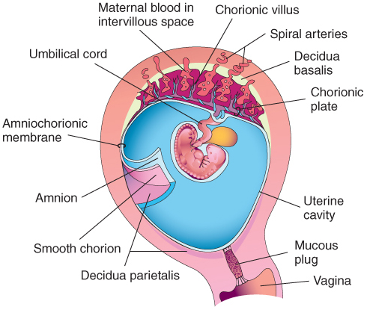
Maternal-Fetal Circulation

Slide 13
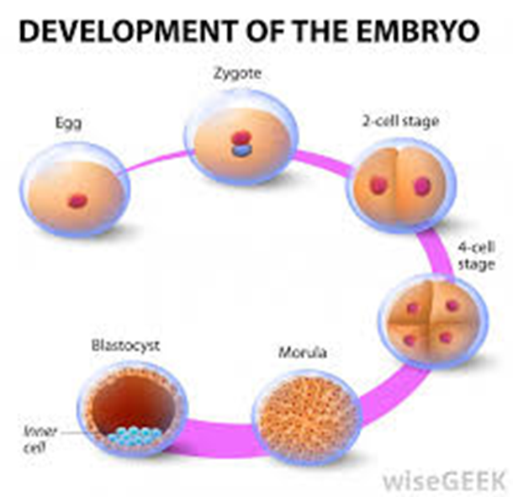
Morula
Enters uterus on third day
  Floats for another 2 to 4 days
  Cells form a cavity
  Two distinct layers evolve
    Inner layer is a solid mass of cells called blastocyst
    Develops into embryo and embryonic membranes
  Outer layer—trophoblast
  Develops into embryonic membrane—chorion
Notes:
Refer to Figure 3-2: Ovulation and Fertilization and discuss how the oocyte progresses to a morula.

Slide 14
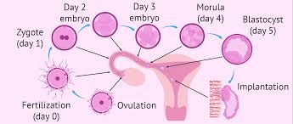
Implantation of the Zygote
Usually in upper section of posterior uterine wall
  Cells burrow into prepared lining—endometrium
  Endometrium now called decidua
  Area under blastocyst is decidua basalis
    Becomes maternal part of the placenta

Slide 15
Development
Cell differentiation
  Occurs after implantation
  Special functions
    Chorion
    Amnion
    Yolk sac
    Primary germ layers
Notes:
At the time of implantation, the cells are identical.
What is the importance of differentiation?

Slide 16
Chorion
Develops from trophoblast
Envelops amnion, embryo, and yolk sac
Thick membrane has projections called villi
Villi extend into decidua basalis on uterine wall
Form the embryonic/fetal portion of placenta

Slide 17
Amnion
Second membrane
Thin structure that envelops and protects embryo
Together, chorion and amnion form an amniotic sac filled with fluid (bag of waters)
Amniotic fluid is clear, mild odor, may contain bits of vernix or lanugo
Volume of fluid steadily increases from ~30 mL at 10 weeks to 350 mL at 20 weeks; at 37 weeks, fluid is ~1000 mL
Notes:
To allow students to conceptualize the volumes being discussed, provide them with examples.
30 mL is similar in size to a small medication cup.
1000 mL is the amount of volume in a large IV bag.
What terms indicate an excess or lack of adequate amniotic fluid?
Review diagnostic mechanisms that can be used to assess amniotic fluid volume.
Identify the source of amniotic fluid.

Slide 18
Functions of Amniotic Fluid
Maintains an even temperature
Prevents the amniotic sac from adhering to the fetal skin
Allows symmetrical growth of fetus
Allows buoyancy and fetal movement
Acts as a cushion to protect the fetus and umbilical cord from injury

Slide 19
Yolk Sac
A cavity develops on the ninth day after fertilization
Functions only during embryonic life
Initiates production of red blood cells
Continues until fetal liver takes over around 6 weeks
Umbilical cord encompasses yolk sac which then degenerates

Slide 20
Germ Layers
Zygote in blastocyst stage transforms into three primary germ layers
  Ectoderm
  Mesoderm
  Endoderm

Slide 21
Ectoderm
Outer layer of skin
Oil glands and hair follicles of skin
Nails and hair
External sense organs
Mucous membrane of mouth and anus

Slide 22
Mesoderm
True skin
Skeleton
Bone and cartilage
Connective tissue
Muscles
Blood and blood vessels
Kidneys and gonads

Slide 23
Endoderm
Lining of trachea, pharynx, and bronchi
Lining of digestive tract
Lining of bladder and urethra

Slide 24
Three Stages of Prenatal Development
Zygote: cell formed by union of sperm and ovum
Embryo: second to eighth week of development
By third week heart will pump blood
Fetus: ninth week until birth
Age of viability: 20 weeks of gestation but requires NICU care to survive
Notes:
Discuss the definition of viability.
What is the size of an infant born at 20 weeks?

Slide 25
Nutritional Consideration
Folic Acid Supplements can help prevent most neural tube defects..which can help with prevention of spina bifada
It is important that mother start with supplements in the first days of the embryo.

Slide 26
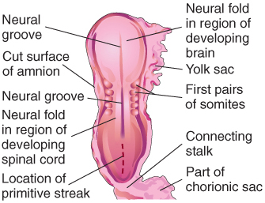
Prenatal Development
Embryo at 3, 4, 6, and 8 weeks and by 9th week able to see sex organs on Ultra sound
Notes:
Point out the changing size and shape of the embryo.
Initially the embryo is straight, and later it appears curved.

Slide 27
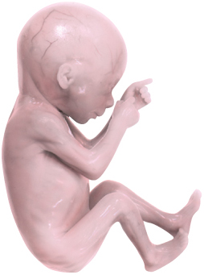
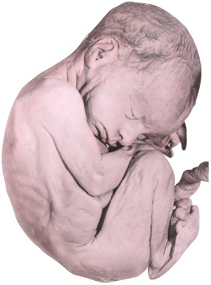
Prenatal Development
Embryo at 17- leg movement and 25 weeks, bones ossified; eye movement occurs
Embryo at 25 - eyes are open, now viable, vernix caseosa and lanugo on skin, brown fat formed, lungs begin to secrete surfactant

Slide 28
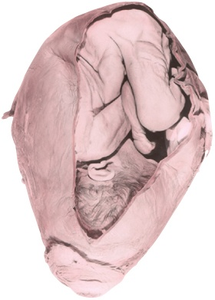
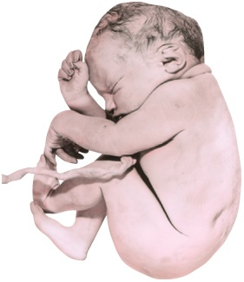
Prenatal Development
Embryo at 29 and 36 weeks

Slide 29
Accessory Structures of Pregnancy
Placenta
Umbilical cord
Fetal circulation
  Supports fetus
Notes:
What is the function of each structure?

Slide 30
Placenta
Organ for fetal respiration, nutrition, and excretion
Produces four hormones
  Progesterone
  Estrogen
  Human chorionic gonadotropin (hCG)
  Human placental lactogen (hPL)
Notes:
The placenta produces four hormones.
Which, if any, of the hormones are produced by a woman’s body when not pregnant? Progesterone and estrogen
Review the primary functions of each of the hormones listed.

Slide 31
Placental Transfer
Fetal deoxygenated blood and waste products leave the fetus through two umbilical arteries
Fetal and maternal blood do not normally mix
Oxygenated, nutrient-rich blood from mother spurts into intervillous space from spiral arteries in the decidua
Fetal blood releases carbon dioxide and waste products

Slide 32
Placental Transfer
Fetal blood takes oxygen and nutrients before returning to fetus through umbilical vein
Many harmful substances can be transferred to fetus
  Drugs, nicotine, viral infectious agents
  May cause fetal drug addiction, congenital anomalies, and fetal infection
Notes:
When should patient education concerning toxic substances begin?

Slide 33
Placental Hormones
Progesterone
Functions during pregnancy
  Maintains uterine lining for implantation of the zygote
  Reduces uterine contractions to prevent spontaneous abortion
  Prepares the glands of the breasts for lactation
  Stimulates testes to produce testosterone, which aids the male fetus in developing the reproductive tract

Slide 34
Placental Hormones
Estrogen
Stimulates uterine growth
  Increases the blood flow to uterine vessels
  Stimulates development of the breast ducts to prepare for lactation
Effects of estrogen, not related to pregnancy
  Increased skin pigmentation
  Vascular changes in the skin and mucous membranes of nose and mouth
  Increased salivation

Slide 35
Human Chorionic
Gonadotropin (hCG)
Causes the corpus luteum to persist and continue production of estrogen and progesterone to sustain pregnancy
hCG is detectable in maternal blood as soon as implantation occurs (usually 7 to 9 days after fertilization)
Notes:
hCG is the hormone detected in early pregnancy for a positive pregnancy test.
hCG is a test obtained by serum or urine.
Which of the tests is most accurate? Serum
Review the time of day in which a pregnant woman’s hCG levels are highest.

Slide 36
Human Placental Lactogen
(hPL)
Also known as human chorionic somatomammotropin (hCS)
hPL causes decreased insulin sensitivity and utilization of glucose by mother
  Helps to make more glucose available to fetus to meet growth needs
Notes:
Review the phenomena created by the actions of hPL.

Slide 37
Umbilical Cord
Lifeline between mother and fetus
Two arteries carry blood away from fetus
One vein returns blood to the fetus
Wharton’s jelly covers and cushions cord vessels
Normal length is 55 cm (22 inches)
The umbilical cord usually protrudes near the center of the placenta
Notes:
A normal placenta has three vessels.
It is the responsibility of the nurse at the time of delivery to note the number of vessels in an umbilical cord.
What are the implications of a two-vessel cord?

Slide 38
Memory Jogger
An easy way to remember the number and type of umbilical cord vessels is the woman’s name “AVA,” which stands for “Artery-Vein-Artery”

Slide 39
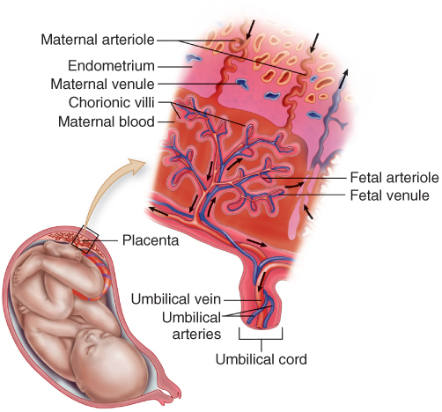
Maternal-Fetal Circulation

Slide 40
Fetal Circulatory Shunts
Foramen ovale-diverts most blood from right atrium to left atrium
Ductus arteriosus-diverts most blood from the pulmonary artery into the aorta
Ductus venosus-diverts some blood away from the liver as it returns from the placenta
Notes:
Outline the location and role of each of the identified structures.

Slide 41

Circulation Before Birth
Blood enters fetal body through umbilical vein
About half goes to the liver, remainder enters inferior vena cava through the ductus venosus, then goes through foramen ovale, then ductus arteriosus
Blood containing waste products is returned to placenta through umbilical arteries
Notes:
Fetal circulation sends a limited amount of blood through the lungs.
Discuss the physiological reasoning for this.

Slide 42
Circulation After Birth
Foramen ovale closes within 2 hours after birth (permanently by age 3 months)
Ductus arteriosus closes within 15 hours (permanently in about 3 weeks)
Ductus venosus closes functionally when cord is cut (permanently in about 1 week)
If newborn has untreated respiratory distress it can cause the foramen ovale to reopen the increased resistance to blood flow
After permanent closure, the ductus arteriosus and ductus venosus become ligaments

Slide 43
Impaired Prenatal Development
Undernutrition
  Can result in permanent changes in fetal structure, physiology, and metabolism
  Can influence development of conditions such as heart disease and stroke in adulthood
  Exposure to toxins in utero
  Can also influence health in later life
Notes:
Healthy intake during pregnancy will influence the development of the fetus.
Which mothers are at an increased risk for undernutrition?

Slide 44
Impaired Prenatal Development
Intrauterine growth restriction may reduce number of cells in organs
  Can predispose to the development of specific diseases later in life
Fetal growth best assessed when weight, length of gestation, placental size, and newborn head and abdominal circumference are considered
Fetal growth limited by nutrients and oxygen received from mother-for instance monozygotic twins
A healthy mother can produce a healthy child who is less prone to illness

Slide 45
Impaired Prenatal Development and Subsequent Illness
Undernutrition in utero can result in:
  Permanent changes in fetal structure, physiology, metabolism
  Development of chronic conditions later in life
To prevent illness of the next generation, this generation must focus on their own health practices

Slide 46
Multifetal Pregnancy
Twins occur once in every 90 pregnancies
When hormones are used to assist with ovulation, twinning and other multifetal pregnancies occur
Monozygotic twins are from a single fertilized ovum (identical)
Dizygotic twins are from two separate fertilized ovum (fraternal) so will have separate chorions
  Usually a familial tendancy
Notes:
Twins are increasing in numbers.
Which mothers have an increased likelihood of becoming pregnant with twins?

Slide 47
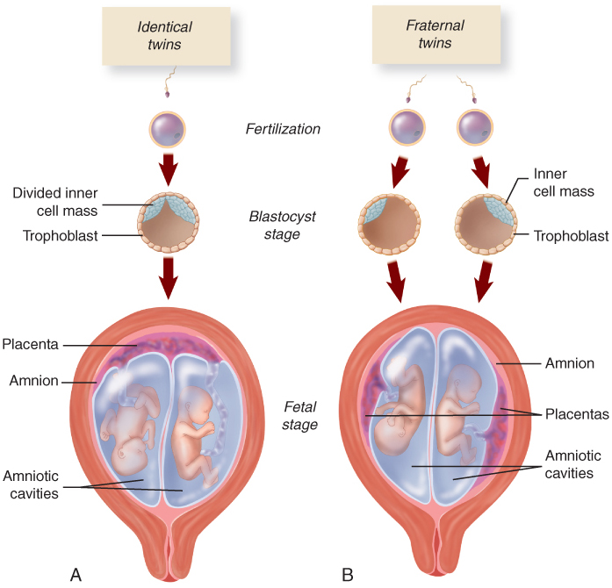
Multifetal Pregnancy
Notes:
Identical twins might or might not share a placenta and amniotic sac.
What factors determine this?

