Slide 1
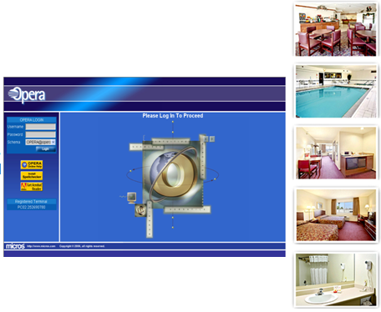
CHAPTER 1
GETTING TO KNOW MICROS OPERA

Slide 2
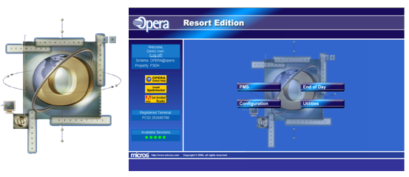
Chapter 1: an Overview
LEARNING OBJECTIVES
EXPECTED DEMONSTRATED SKILLS
Basic Hotel Software Defaults
Log-in and log-out of Micros Opera
Secure and change Passwords
Navigate through the different Micros Opera Windows
Use keyboard Shortcuts and quick keys
Enumerate the benefits of a PMS in a hotel or related institution
Perform the log-in and log-out of Micros Opera
Change Passwords
Identify the different screens and the locations of the different Hotel Functional Modules in Micros Opera PMS
Use keyboard shortcuts and Quick keys

Slide 3
Every Hotel has its own configuration
Opera is extremely customizable.
There are a number of functions to customize in the Property Management System (PMS), depending on the operational decisions of each hotel.
Screens may display information in a different order or may not display some of the functionality if the management decision is not to activate it.

Slide 4
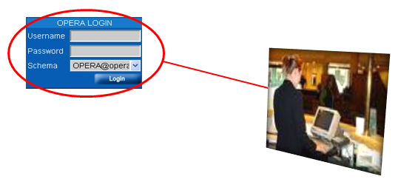
LOG-IN
Login Screen provides access to the main screen of the Property Management System

Slide 5
Steps to Log In
Choose the OPERA user profile
Launch Internet Explorer (You’ll be directed to the URL linking to the Micros Opera Operation)
At the Micros Opera Main Screen, you will be prompted to enter your username and password
Select Login to initiate the login process verifying your username, password, and property login.

Slide 6
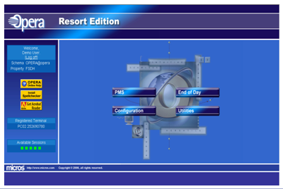
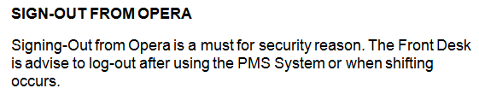
Steps to Log Out
On the Tool Bar, click the Exit Button
On the Opera Main Screen, click Log-off
OR
Quick Logout by pressing the F8 function key

Slide 7
Using OPERA Windows
Once in the Opera Application, it is easy to navigate through the screens.
Depending on access level, the first screen that will welcome you to opera will contain the modules that are allowed for your log-in rights.
Whether you see a lot of modules on the opening screen or not, the most important is the access icon to the Property Management System (PMS as this will be the focus of our course.

Slide 8
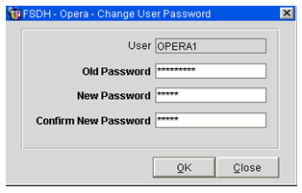
CHANGING OF PASSWORD
For security reason, it is important for learners to know how they can change their passwords:
Select Miscellaneous from the Drop Down Menu, then choose Change Password
Enter the old Password
Enter the new Password
Enter the confirm new password (Retype the password)
Click OK to process changes.

Slide 9
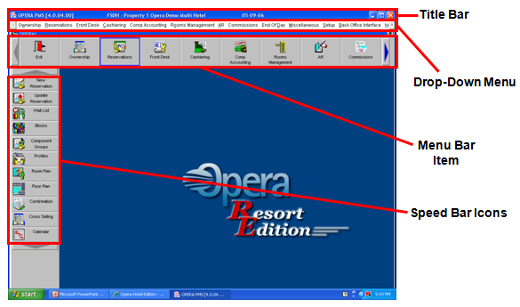
BASIC PARTS OF THE OPERA MAIN SCREEN

Slide 10
BASIC PARTS OF THE OPERA MAIN SCREEN
Title Bar – contains the Micros Opera Version installed in the machine that you are using and the name of the Hotel or institution to whom the license is granted.
Drop Down Menu – contains the different modules in the PMS. By clicking each option in the menu bar, a sub-menu of functionalities under each module will roll-down. Clicking on the sub-menu will activate a command or open a window.

Slide 11
Menu Bar – contains the visual representations of the different modules in the PMS that are also found on the Drop Down menu. Clicking an option will show different sub-menus at the left panel of the screen called the Speed Bar.
Speed Bar – contains the clickable shortcuts for functionalities of each PMS

Slide 12
KEYBOARD SHORTCUTS
Keyboard commands variations:
Alt keys
Shift Keys
Control Keys
Function Keys

Slide 13
Alt-Key
Shortcut | Modules
Alt + R | Reservations
Alt + F | Front Desk
Alt + C | Cashiering
Alt + O | Rooms Management
Alt + D | End of Day
Alt + S | Set-Up
Alt + H | Help
Alt + E | Exit
Every option in the menu bar has a letter underlined. Such command can be activated through Alt key + the underlined letter.

Slide 14
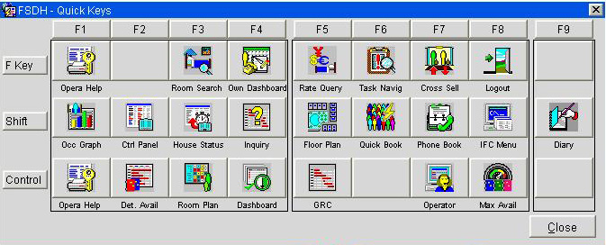
Quick Keys

Slide 15
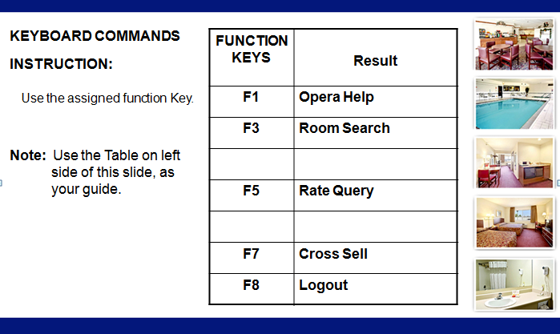
Function Keys

Slide 16
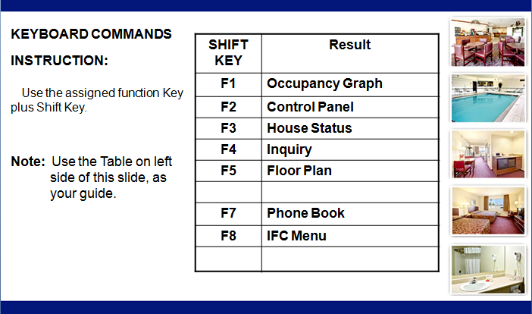
SHIFT KEY

Slide 17
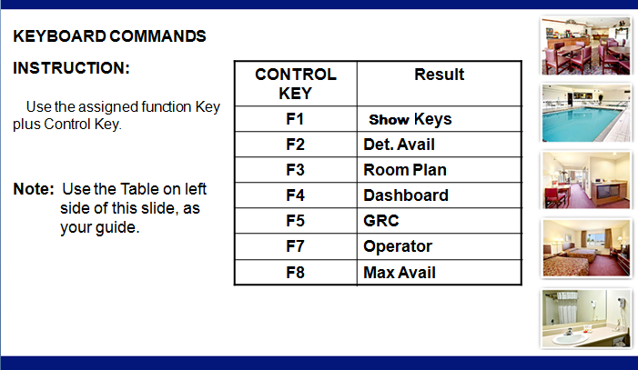
Control key

