Slide 2
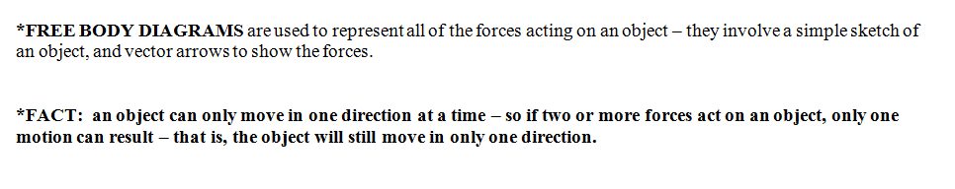
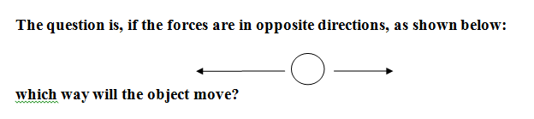

Slide 3
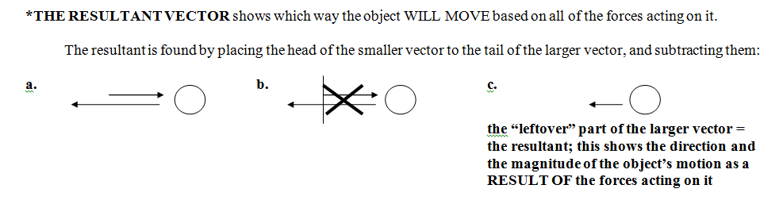

Slide 5
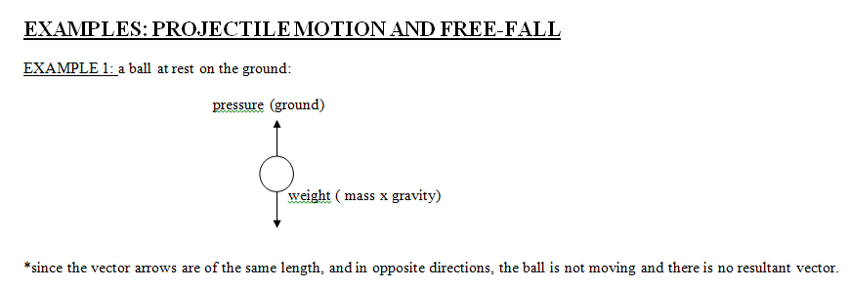

Slide 6
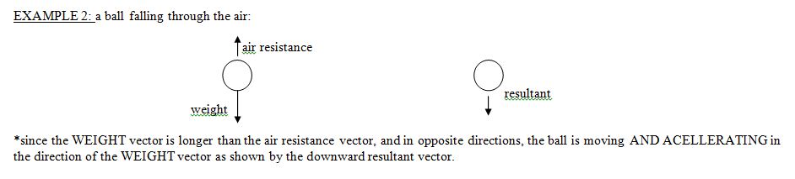

Slide 7
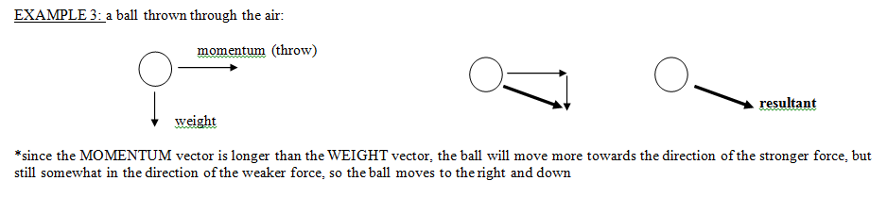

Slide 8
EXAMPLES: FLIGHT AND MOVING VEHICLES
Unlike objects in free fall, or objects that are simply thrown or have no power to maintain their motion, flying objects (such as birds and airplanes) and powered vehicles (such as cars) exert a force known as THRUST:
Thrust is used to either a) maintain a constant speed/velocity, b) accelerate, which means to “speed up”, or c) decelerate which means to “slow down”.
DRAG is the force of the air that WORKS IN THE OPPOSITE DIRECTION OF THRUST.
Increasing thrust tends to increase an object’s velocity; increasing drag tends to decrease its velocity, or slow it down.

Slide 9
HOW DO THESE FORCES INTERACT WITH EACH OTHER?
1. If thrust is GREATER THAN drag, the object will ACCELERATE (speed up)
2. If thrust is LESS THAN drag, the object will DECELERATE (slow down)
3. If thrust is EQUAL TO drag, the object will NOT ACCELERATE – IT WILL MAINTAIN A CONSTANT VELOCITY (no speeding up/slowing down)

Slide 10
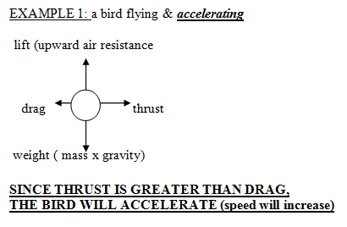

Slide 11
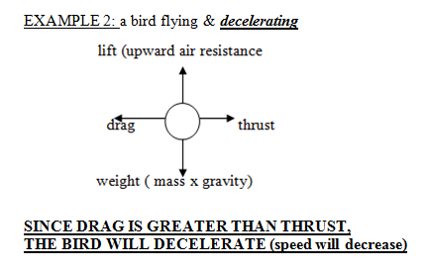

Slide 12
So, do moving objects move forever?
***AN OBJECT STOPS MOVING WHEN THE DRAG EXCEEDS THRUST FOR LONG ENOUGH TO BRING ITS VELOCITY TO ZERO.***

Slide 13
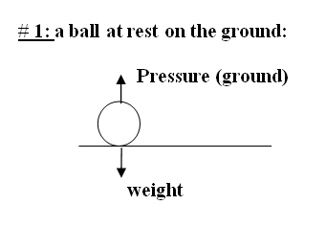
VECTORS EXERCISES WORKSHEET

Slide 14
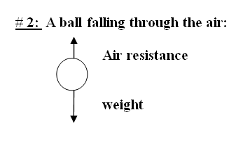

Slide 15
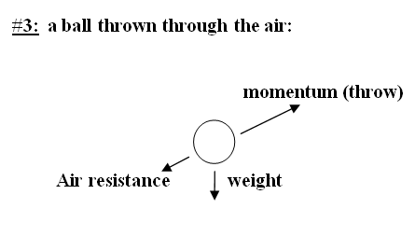

Slide 16
In the spaces below, draw free body diagrams for the following objects, and be sure to indicate a resultant:
4. a feather floating in the air

Slide 17
5. a flying bird:
REMEMBER – THIS IS FLIGHT – USE THE APPROPRIATE FORCES (thrust, drag, lift, weight) and IDEAS (balanced and unbalanced forces, acceleration/deceleration/constant speed)!

Slide 18
6. a moving car (HINT – VERY SIMILAR TO FLIGHT!)

