Slide 1
CHEMICAL FORMULAS AND EQUATIONS

Slide 2
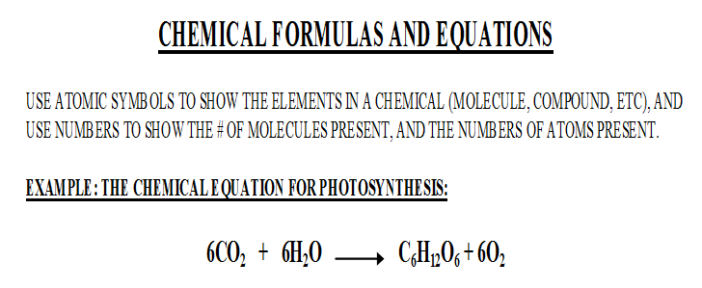

Slide 3
CHEMICAL FORMULAS

Slide 4
“THE RULE”
MULTIPLE THE “BIG #” BY THE “SMALL #” FOR EVERY CAPITAL LETTER IN A FORMULA
Ex. 6CaCO₃= 6 x Ca = 6 Ca atoms;
6 x C = 6 C atoms; 6 x 3 O’s = 18 O atoms;

Slide 5
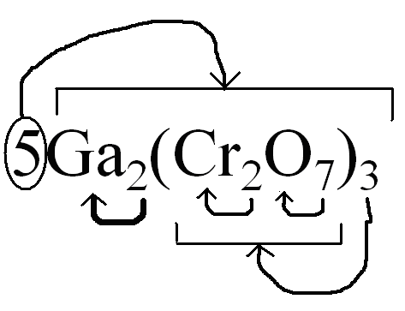
Coefficients and Subscripts : 5Ga₂(Cr₂O₇)₃
Subscripts apply to the element directly to the left. If the subscript is
outside parentheses it applies to everything inside the parentheses only.
Coefficients multiply everything to the right of them, or inside parentheses.
Ga = (2 x 5) = 10 Cr = (2 x 3) x 5 = 30 O = (7 x 3) x 5 = 105

Slide 6
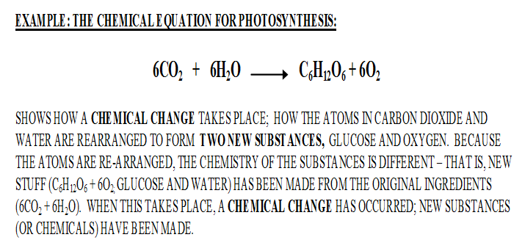
CHEMICAL EQUATIONS

Slide 8
