Slide 4
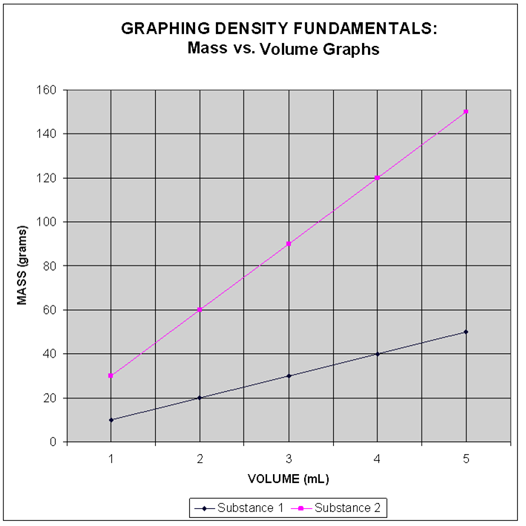
ANALYSIS QUESTIONS: Use the graph provided to answer the following.
1a.Which SUBSTANCE has a greater density?
1b. what type of slope did you look for to determine your answer?
1c. using the fact that Density = slope = y ÷ x (for a straight line), calculate the density of this substance:
2a.Which SUBSTANCE has the lower density?
2b. what type of slope did you look for to determine your answer?
2c. using the fact that Density = slope = y ÷ x (for a straight line), calculate the density of this substance:

Slide 5
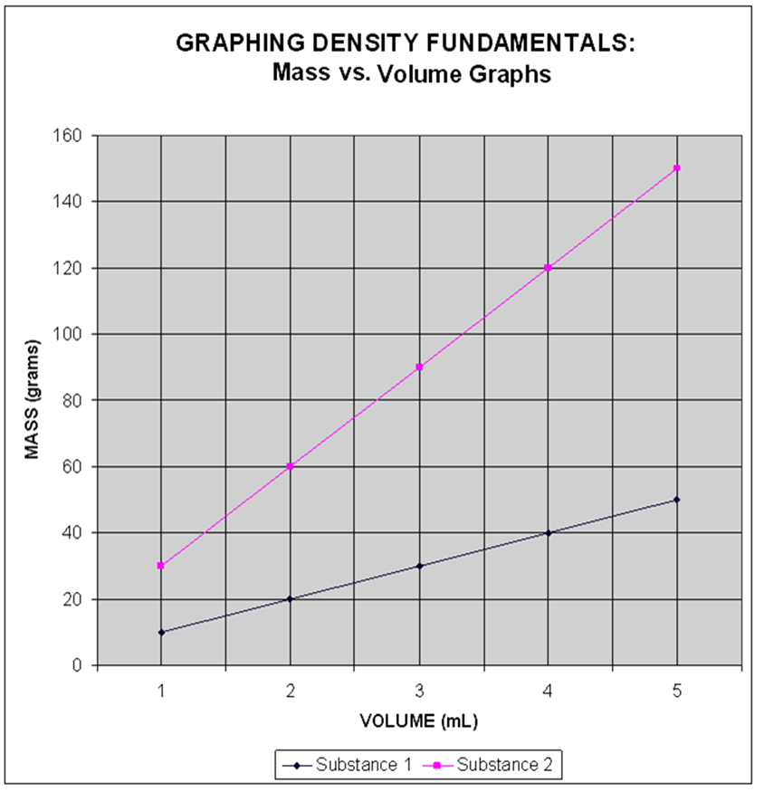
INTERPOLATING DATA USE THE LINES FOR EACH SUBSTANCE AND THE INFORMATION PROVIDED TO ANSWER THE FOLLOWING QUESTIONS:
3. ___ is the mass of 5 mL of substance 1
4. is the volume of 60 grams of substance 2
5. is the mass of 4 mL of substance 2
6. is the volume of 40 grams of substance 1

