Slide 1
MENISCUS PRACTICE

Slide 2
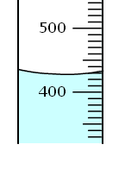
A: value of graduates:_________
B: volume of liquid:_________

Slide 3
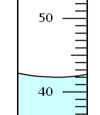
A: value of graduates:_________
B: volume of liquid:_________

Slide 4
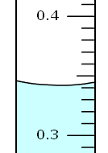
A: value of graduates:_________
B: volume of liquid:_________

Slide 5
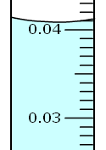
A: value of graduates:_________
B: volume of liquid:_________

